Slide 1
3D Computer Vision
Dr. Hassan Foroosh
School of EECS
UCF

Slide 2
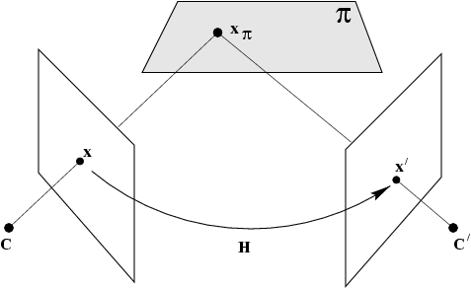
Scene planes and homographies
plane induces homography between two views

Slide 3


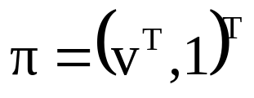

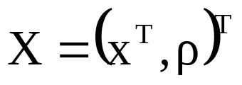
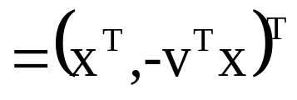
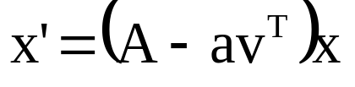


Homography given plane
point on plane
project in second view

Slide 4

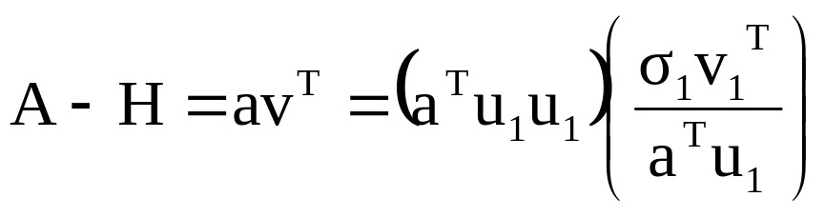
Homography given plane
and vice-versa

Slide 5


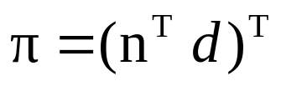

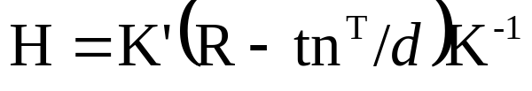
Calibrated stereo rig

Slide 6
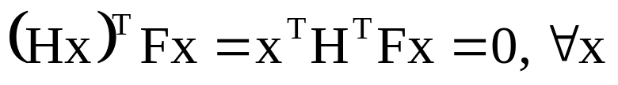


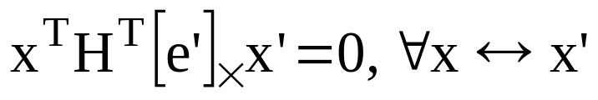
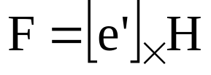
Homographies and epipolar geometry
points on plane also have to satisfy epipolar geometry!
H^{T}F has to be skew-symmetric

Slide 7









Homographies and epipolar geometry
(pick l_{π} =e’, since e’^{T}e’≠0)

Slide 8
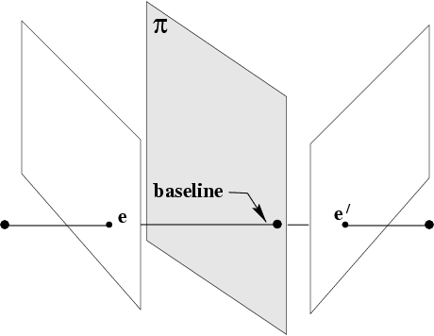
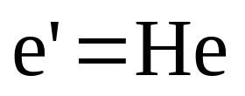
Homography also maps epipole

Slide 9
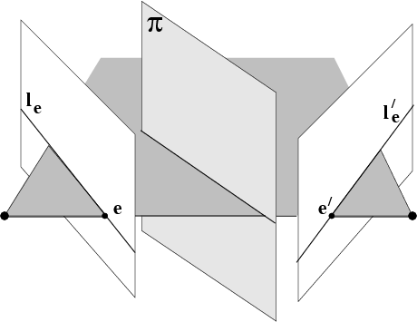
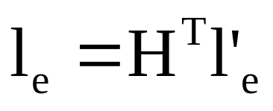
Homography also maps epipolar lines

Slide 10
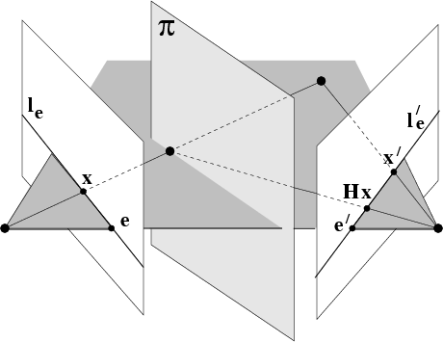
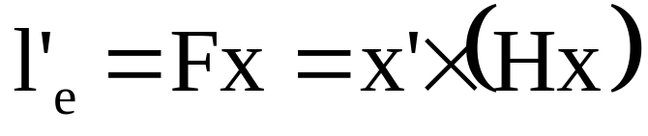
Compatibility constraint

Slide 11
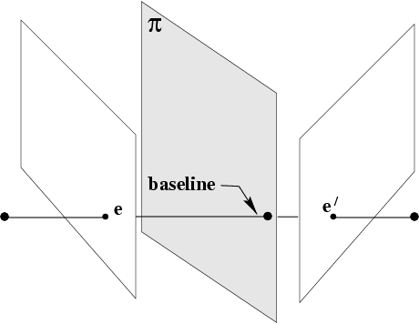
Plane homography given F
and 3 points correspondences
Method 1: reconstruct explicitly,
compute plane through 3 points
derive homography
Method 2: use epipoles as 4th correspondence
to compute homography

Slide 12
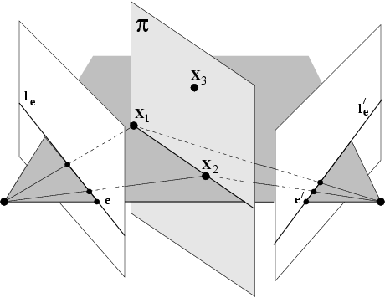
Degenerate geometry for an implicit computation of the homography

Slide 13
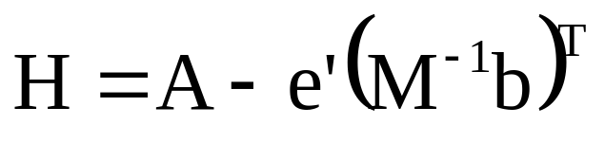
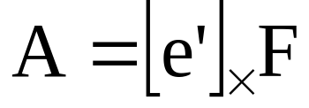
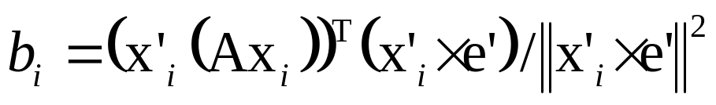
Estimastion from 3 noisy points (+F)
Consistency constraint:
points have to be in exact epipolar correspodence
Determine MLE points given F and x↔x’
Use implicit 3D approach (no derivation here)

Slide 14
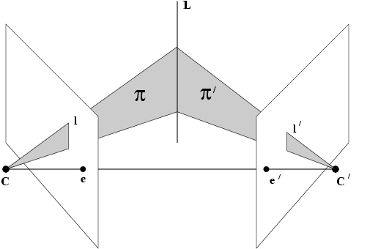
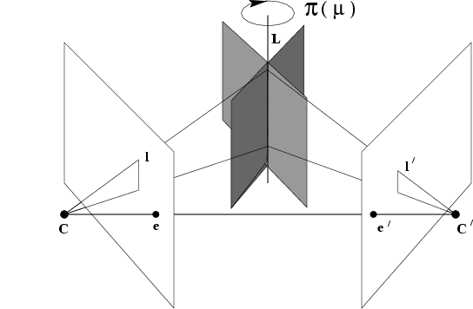
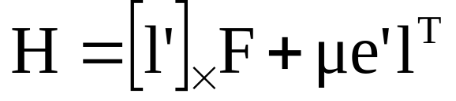
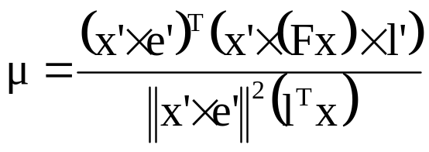
Plane homography
given F, a point and a line

Slide 15
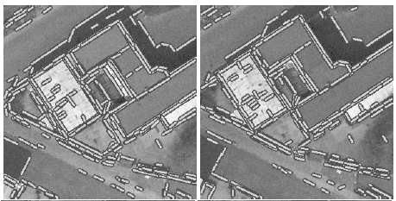
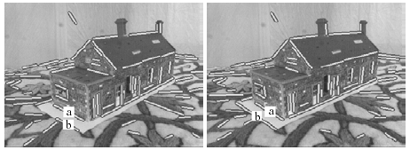
application: matching lines
(Schmid and Zisserman, CVPR’97)

Slide 16
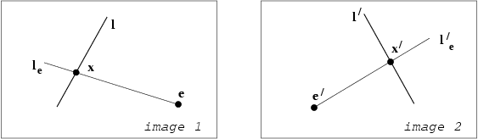
Epipolar geometry induces
point homography on lines

Slide 17
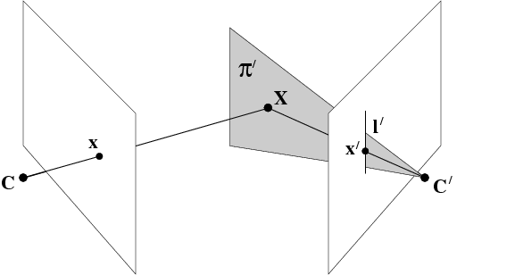

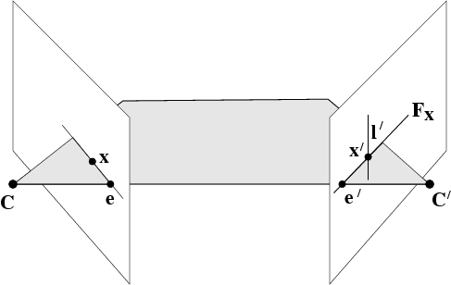
Degenerate homographies

Slide 18
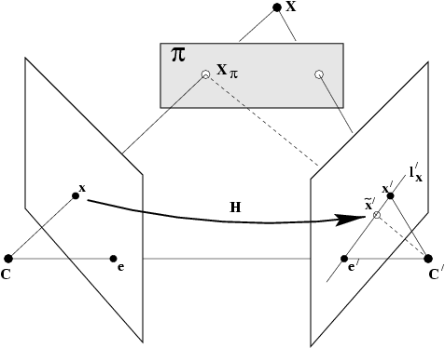



Plane induced parallax

Slide 19


Slide 20
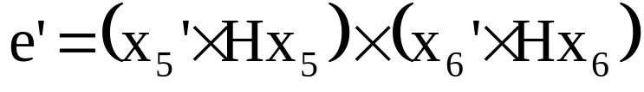
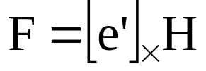
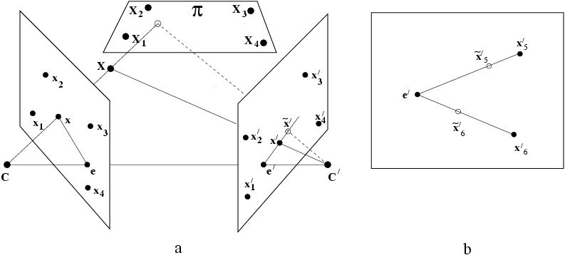
6-point algorithm
x₁,x₂,x₃,x₄ in plane, x₅,x₆ out of plane
Compute H from x₁,x₂,x₃,x₄

Slide 21
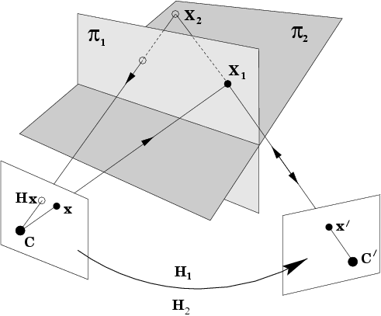
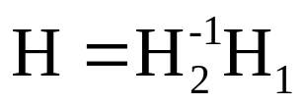

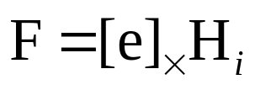
Two planes
H has fixed point and fixed line

