Slide 1
CAP 6411
Aug 18, 2025

Slide 2
Attendance

Slide 3
Syllabus etc.
Go through syllabus
For assignments, ensure you save all your checkpoints, datasets
Class format
Assignment 0 – form project team

Slide 4
Residual Network (ResNet)
Before ResNet:
Adding more layer to deep CNN results in degradation of performance
Is this degradation due to overfitting?
No …
Because training error went up – if it has been overfitting, training error would have gone down
If not overfitting, should adding more layers cause degradation by itself?
No …
Imagine a shallow network, you can add more layers that are identity mappings, so the resulting deeper network should minimally have the same performance!!

Slide 5



What does this tell us?
Trying to learn even an identity mapping as network gets deeper is not trivial
So, what's the solution?
Say is the desired mapping
We learn instead
The original desired mapping is now
This means that if we want to learn identity mappings, we just need to learn x = 0, which is easier than learning an identity mapping as mentioned

Slide 6
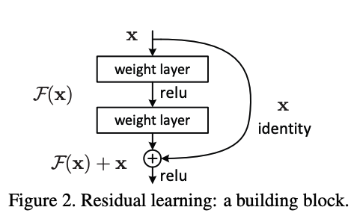


Residual Block
Shortcut connections
Element-wise addition
2-3 layers work best per block

Slide 7
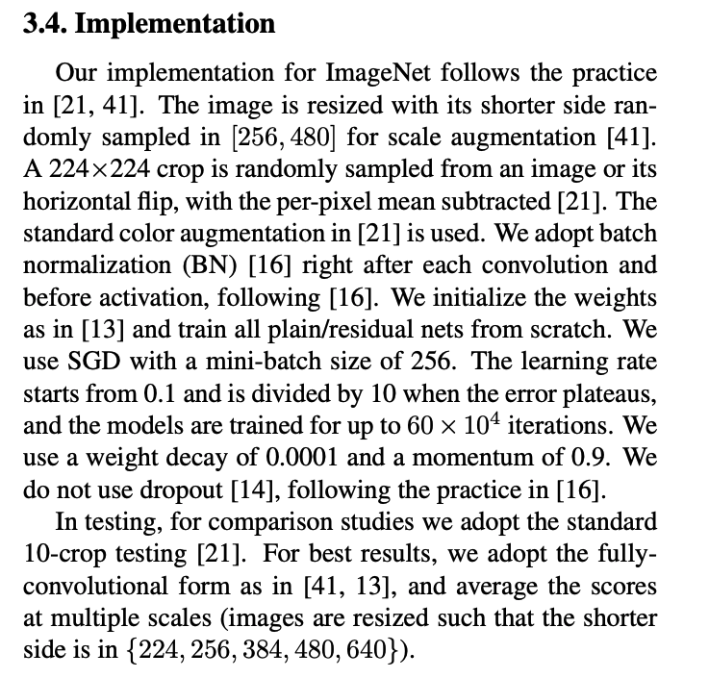
Implementations

Slide 8

Transformer vs CNN
Transformer:
Originated from language research
Sentences are broken into tokens
Tokens are run through self-attention processor:
Intuitively, and this is MY interpretation, this is like "self-selection" to figure out what tokens are important
Convolutional layers are also trying to achieve similar purpose – selecting the neurons/pixels that matters, but done through a "completely" different mechanism (like abstracting an image)

Slide 9
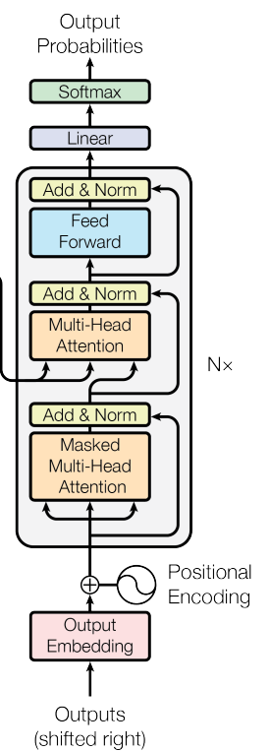
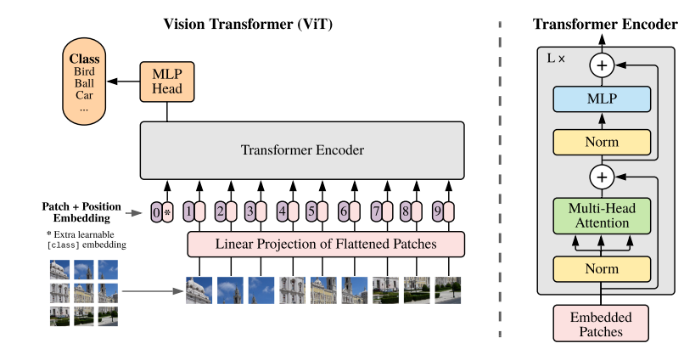
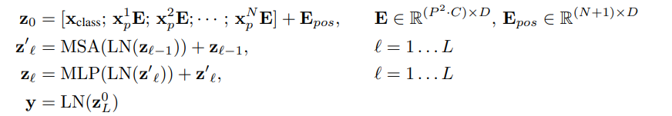
ViT Architecture
WHY?

Slide 10
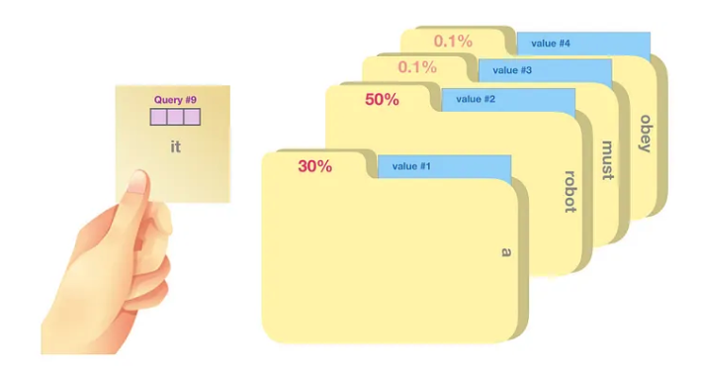
QKV
Example on using LLaVA for Classification

Slide 11
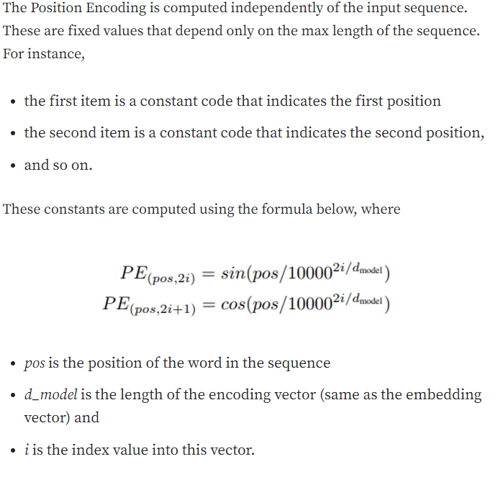
Positional Encoding

Slide 12
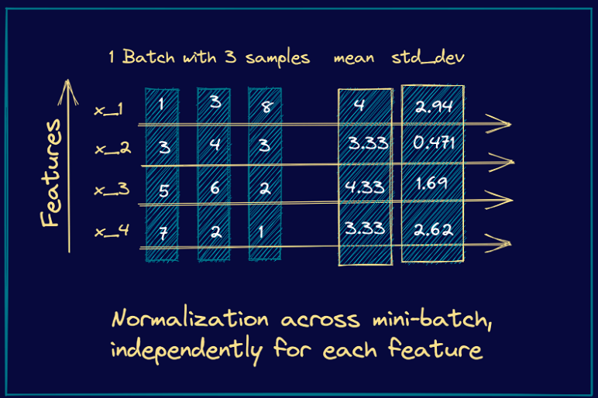
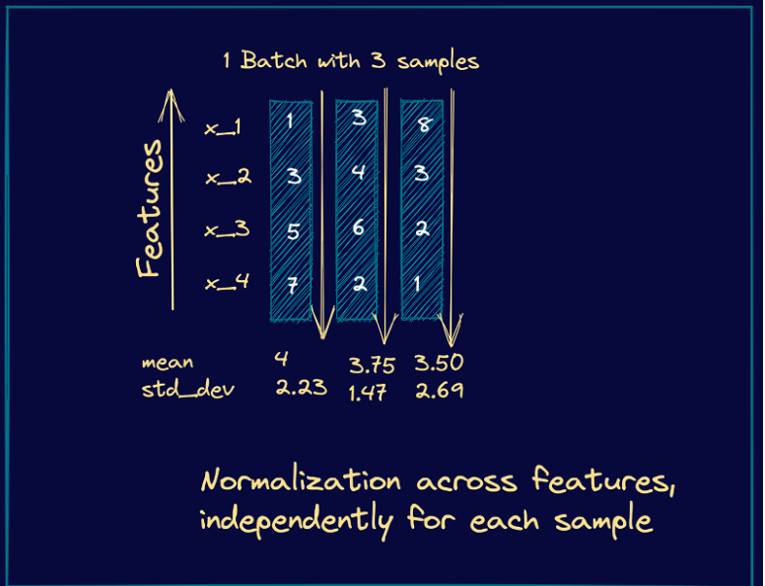
LN (Layer Norm) vs BN (Batch Norm)
BN
LN – good for sequence model, removes dependence on batches of samples

Slide 13
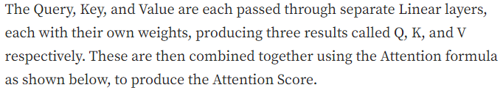
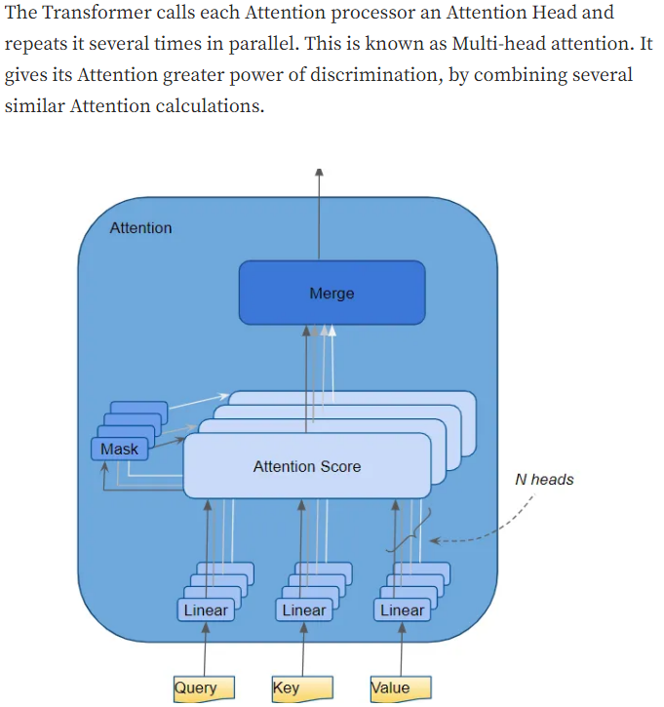
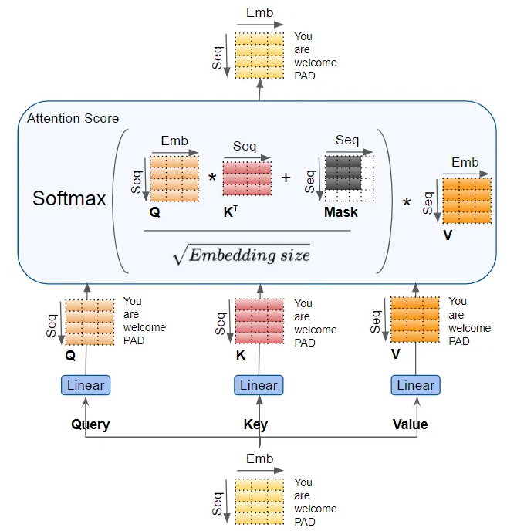
MSA (Multi-head Self Attention)

Slide 14
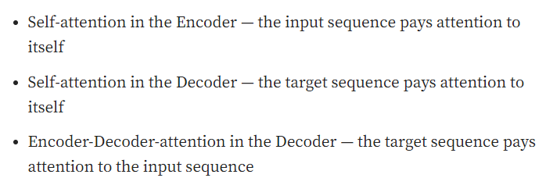
Who Attend Who?

Slide 15
Assignments (due 8/28)
Train on Human Action Recognition (40%) https://www.kaggle.com/datasets/shashankrapolu/human-action-recognition-dataset/data
Evaluation on test set human-action-recognition
15 classes, 218 MB, 12600 images, train/test split available
ResNet 18 vs ViT
Report and code zip (10%)
Errors and obstacles faced running the model
Must have conda requirement.txt, cli commands to generate the evaluation results above (random checks will be perform to verify)
Training log
Video of live demo (20%)
The video should comprise of visual outputs (e.g., a text "cat" overlay on the image being classified that has a cat in it)
Insights (30%)
ResNet vs ViT
Computational comparisons
Why one is better ...

