Slide 1
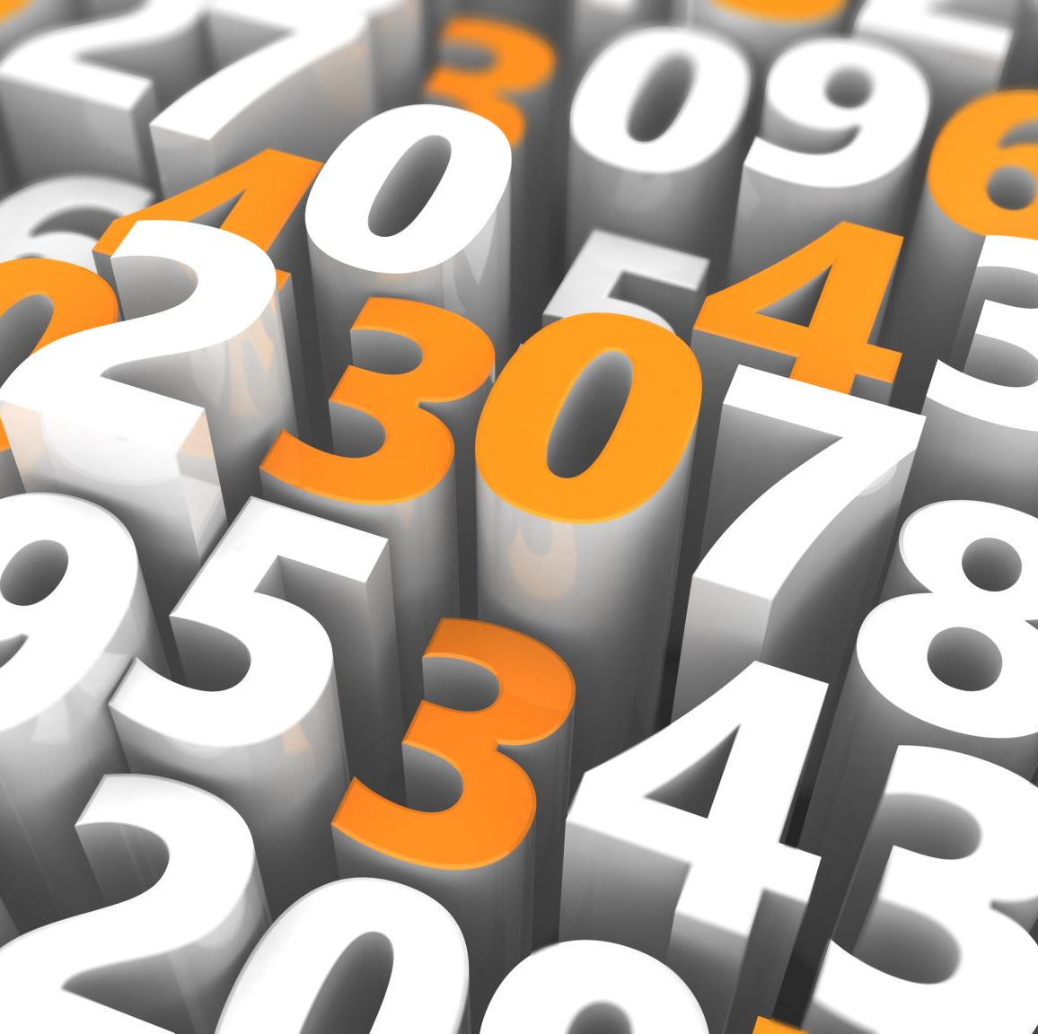
CAP6411
8/26/2025

Slide 2
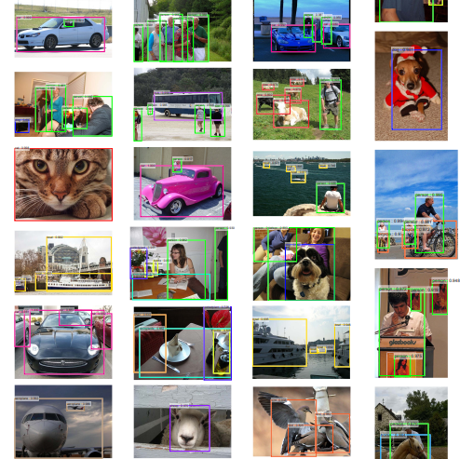
Object Detection
Goal: given an image, put bounding boxes (tight) around objects in the image, and predict what type of object it is
Multiple approaches have been proposed in the past but the most popular class is the Region-CNN (R-CNN)
Two steps in R-CNN:
Propose potential bounding boxes
Throw or keep the true positives
Classify the class of the object in each box

Slide 3

Three Main Evolutions of R-CNN
R-CNN
Lay down a lot of bbox
"Cut out each box as an image"
Warp the resulting image to fit the input dimensions
Run SVM classification on each box
Fast R-CNN
Given an image and a set of bboxes
Share the convolutional map between boxes
Predict both bbox regression and cls
Above two steps done in unified training - such unification speeds things up a lot
Faster R-CNN
Do away with input includes a set of bboxes
Integrated Region Proposal Network that produces bboxes together with Fast R-CNN
This eliminates the slowdown of computing a separate set of bboxes

Slide 4
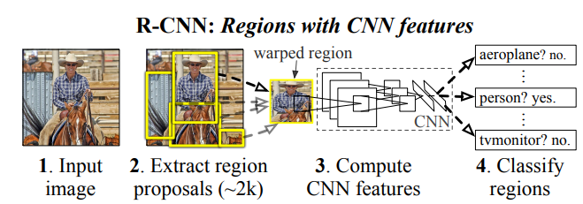
R-CNN
Quite simple approach
Use selective search to lay down boxes
Greedy merging of superpixels
Each region: extract fixed-length feature vector (4096)
Run SVM
Non-maximum suppression
SVMs per class!!
Some consideration:
Why not a sliding window?
Too coarse grained as the receptive fields in the later layers are fairly large and strides size is large as well
R-CNN generate ~2k regions

Slide 5
Two Stage R-CNN Training
Stage 1 – Train CNN:
5 conv layers and 2 FC layers
Mean subtracted input image 227x227
Image level training on ILSVRC2012
Stage 2 – Fine Tune for Object Detection:
Take each bbox, cut it out and warp it to 227x227
Add 1 background class to the classification layer
Ground Truthing:
Positive: IOU >= 0.5 with ground truth bbox
Hard negative mining

Slide 6

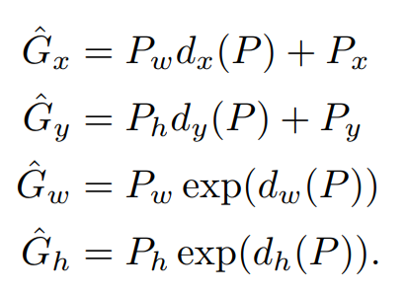
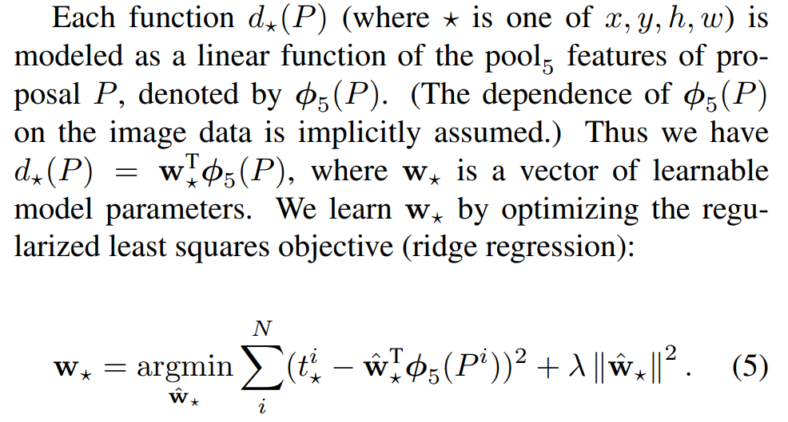
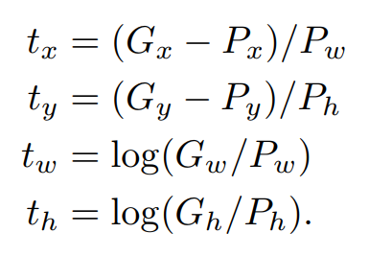
R-CNN BBox Regression

Slide 7
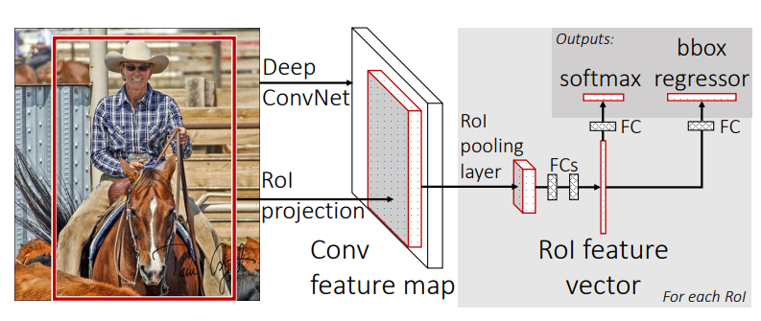
Fast R-CNN
The separate steps in R-CNN really make it slow …
Each bbox results in a CNN forward pass, without sharing computation
Fast R-CNN combines all into one training flow
Assume input is the image and a set of bboxes is given

Slide 8
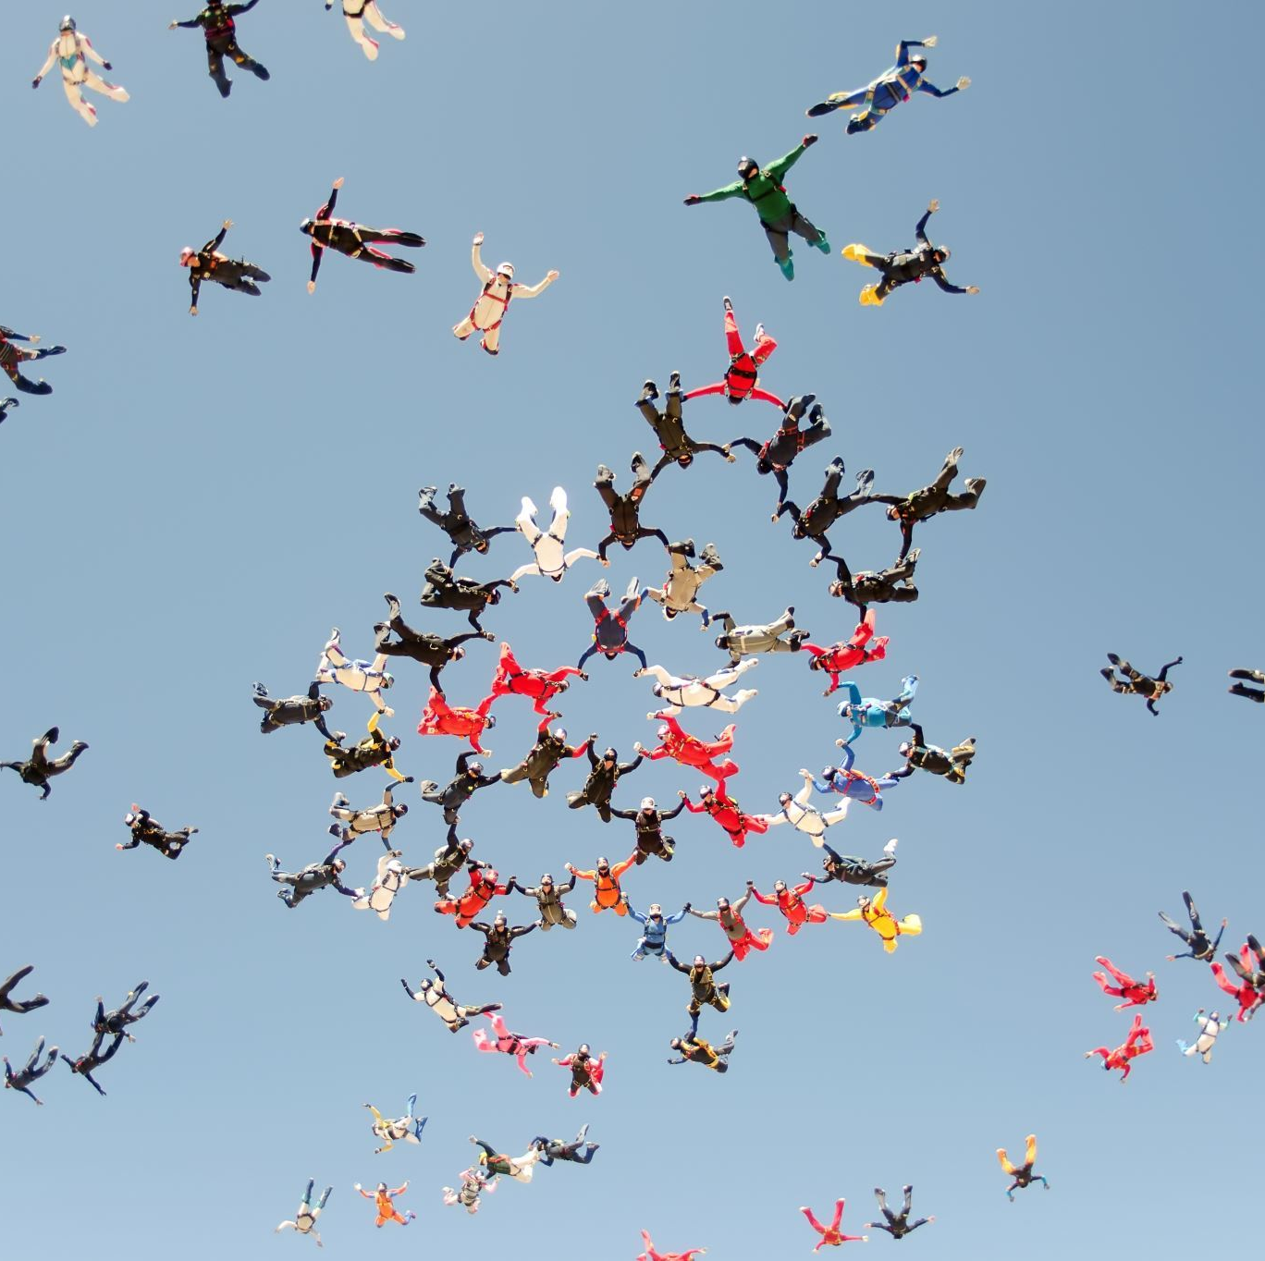
Combining Stages
Run the conv layers/maxpool first
For each bbox, run max pooling to get a fixed-length feature vector
Predict (fc layers):
Softmax prob on classes (has a background class)
BBox regression

Slide 9

RoI Pooling
h x w RoI window
h/H x w/W - H x W grid
Max pooling in each sub window

Slide 10
Pretrained Networks
Pretrained ImageNet networks, 5 max pooling layers, 5-13 conv layers
Last max pool layer replaced by RoI pooling
Replace last FC with classification and bbox regression layers
Modified to take image and set of bboxes

Slide 11
On Batch Size
Use less images (N)
Use more RoIs (R) because they can share the feature map!!
N = 2, R= 128

Slide 12



Accelerating Large FC layers
Simply use SVD
So truncate t to top singular values

Slide 13
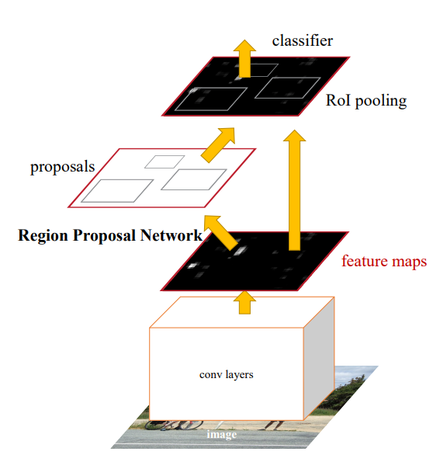

Faster R-CNN
Fast R-CNN still needs as input a set of bboxes separately computed!!

Slide 14
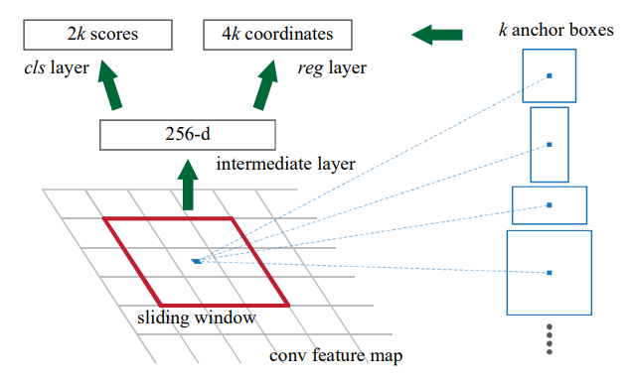
Generate Region Proposals
Slide a 3x3, grab the feature from the shared feature map
At each sliding window position, generate k bbox anchors at different scales and positions (from the center of the sliding window)

Slide 15
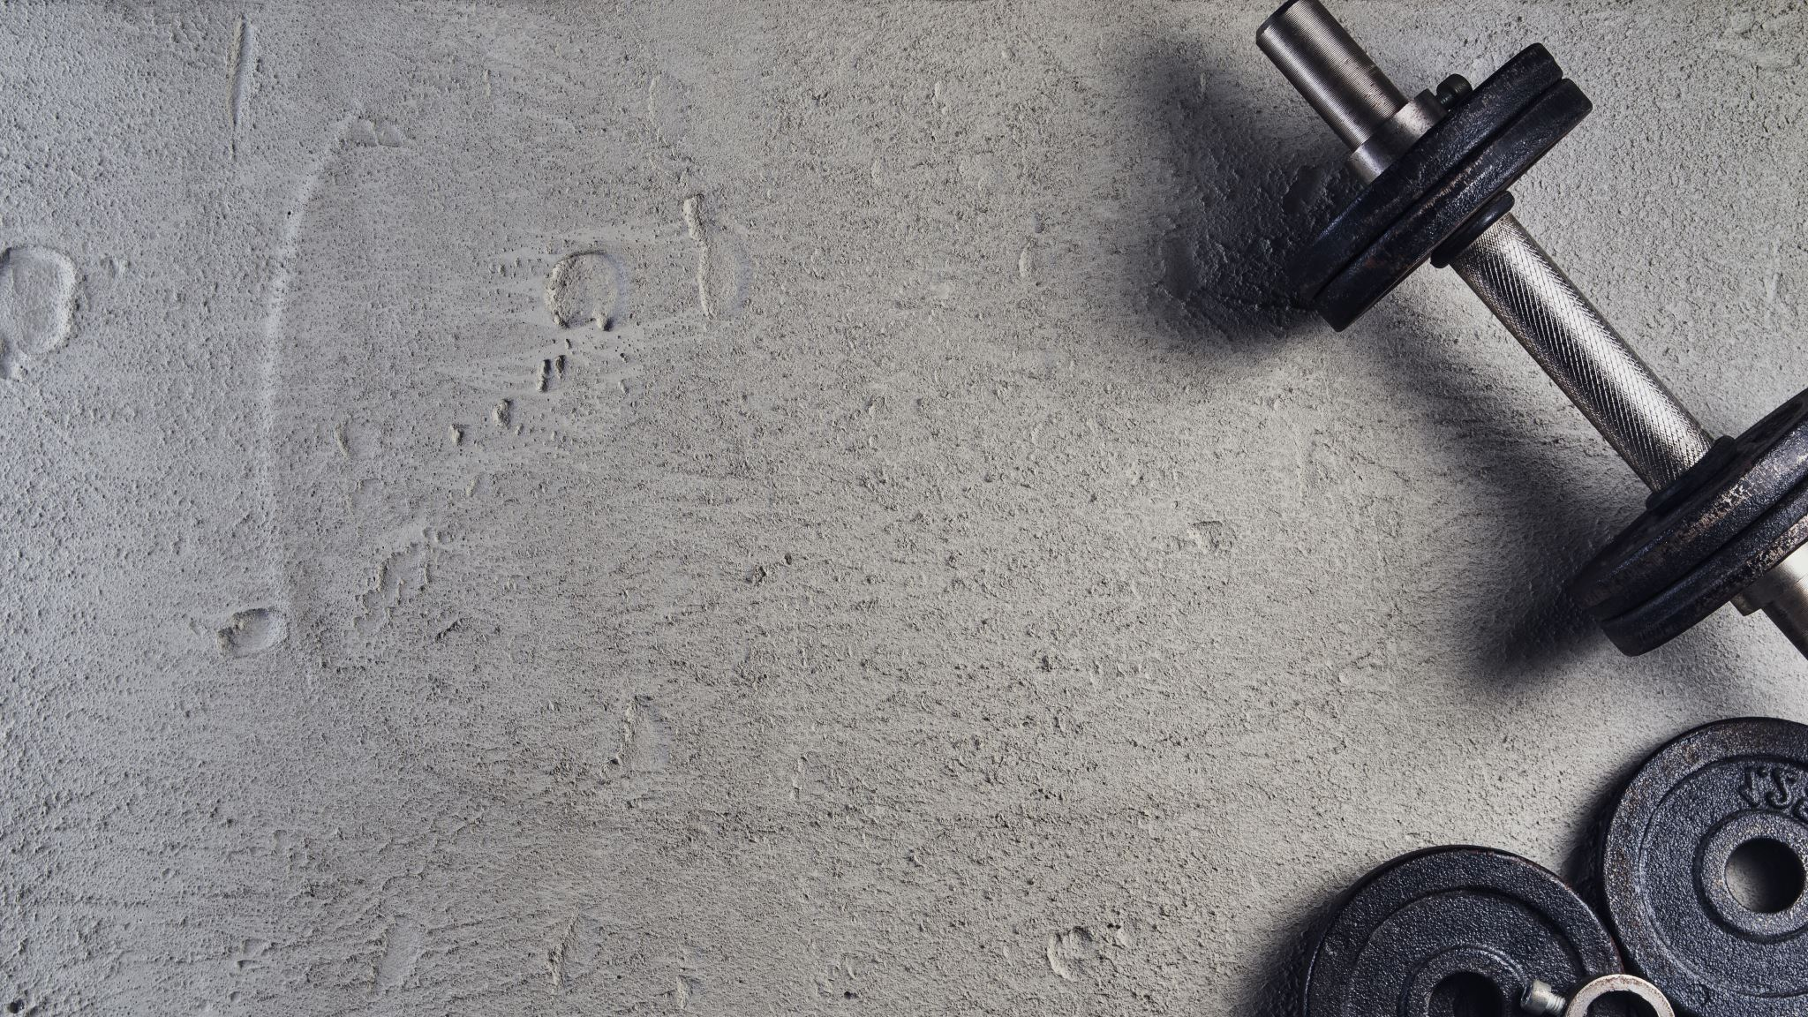
Training Scheme Options
Alternating
Do RPN first then Fast R-CNN
Approximate Joint Training
Backprop to the share layers of RPN and R-CNN
Will not update RoI Pooling
Non-Approximate Joint Training
Need differentiable RoI Pooling

Slide 16

Final 4-Steps Training Scheme
Train RPN with a pretrained ImageNet backbone
Train a separate Fast R-CNN using proposals from step 1
Use model trained in step 2 to start training RPN (approximate Joint)
Fine tune Fast R-CNN unique layers

Slide 17
DETR (Detection Transformer)
Recall:
Faster R-CNN tried to "merge" RPN as part of one network (sliding window based)
Each sliding window: k anchor boxes
DETR main principles:
One-shot detection – do away with surrogate predictions, postprocessing (NMS)
Transformer (attention, attention, attention)
Direct set prediction (set of bboxes)
Predict bbox regression and classification

Slide 18
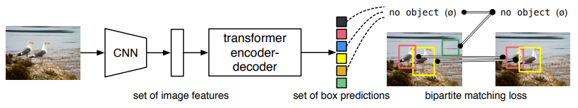

Key Ingredients
Set prediction loss that enforce unique matches
Recall in Faster R-CNN, there often are multiple overlapping bboxes
An architecture that predicts (in a single pass) a set of objects and models their relation.

Slide 19


Details
N is a large number such that an image will not contain more than N objects
Step 1 – Hungarian Matching:

Slide 20


Details
Step 2 – Hungarian Loss:

Slide 21
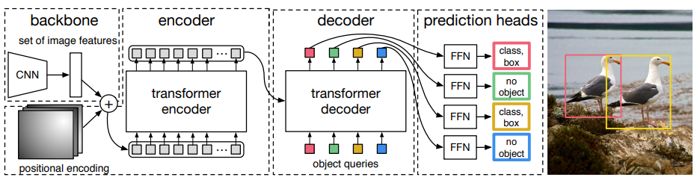




DETR Architecture

Slide 22

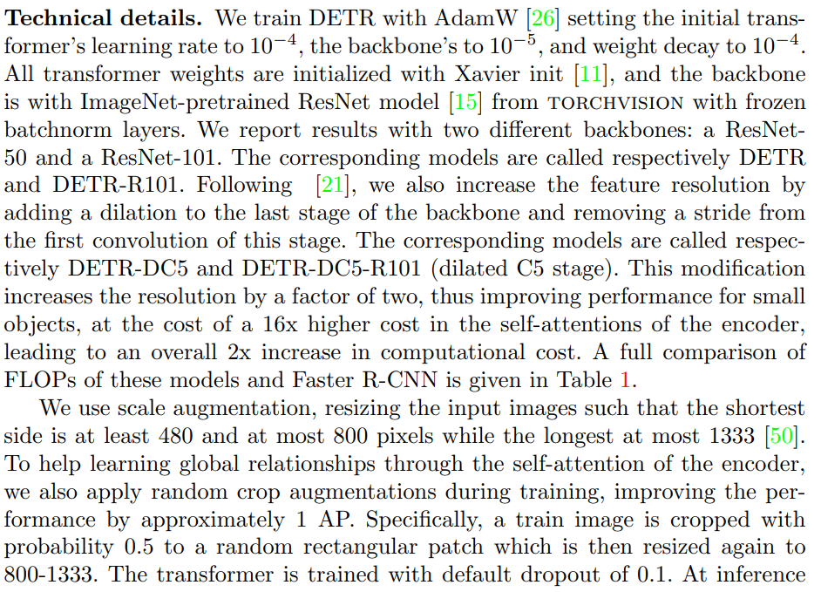
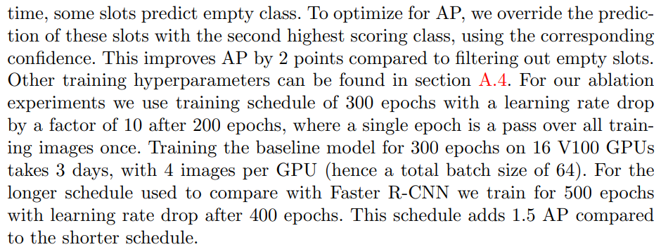
Training Details

Slide 23
DINO - DETR with Improved deNoising anchOr boxes
Denoising training
Mixed query selection for anchor initialization
Look forward twice scheme for box predictions

Slide 24
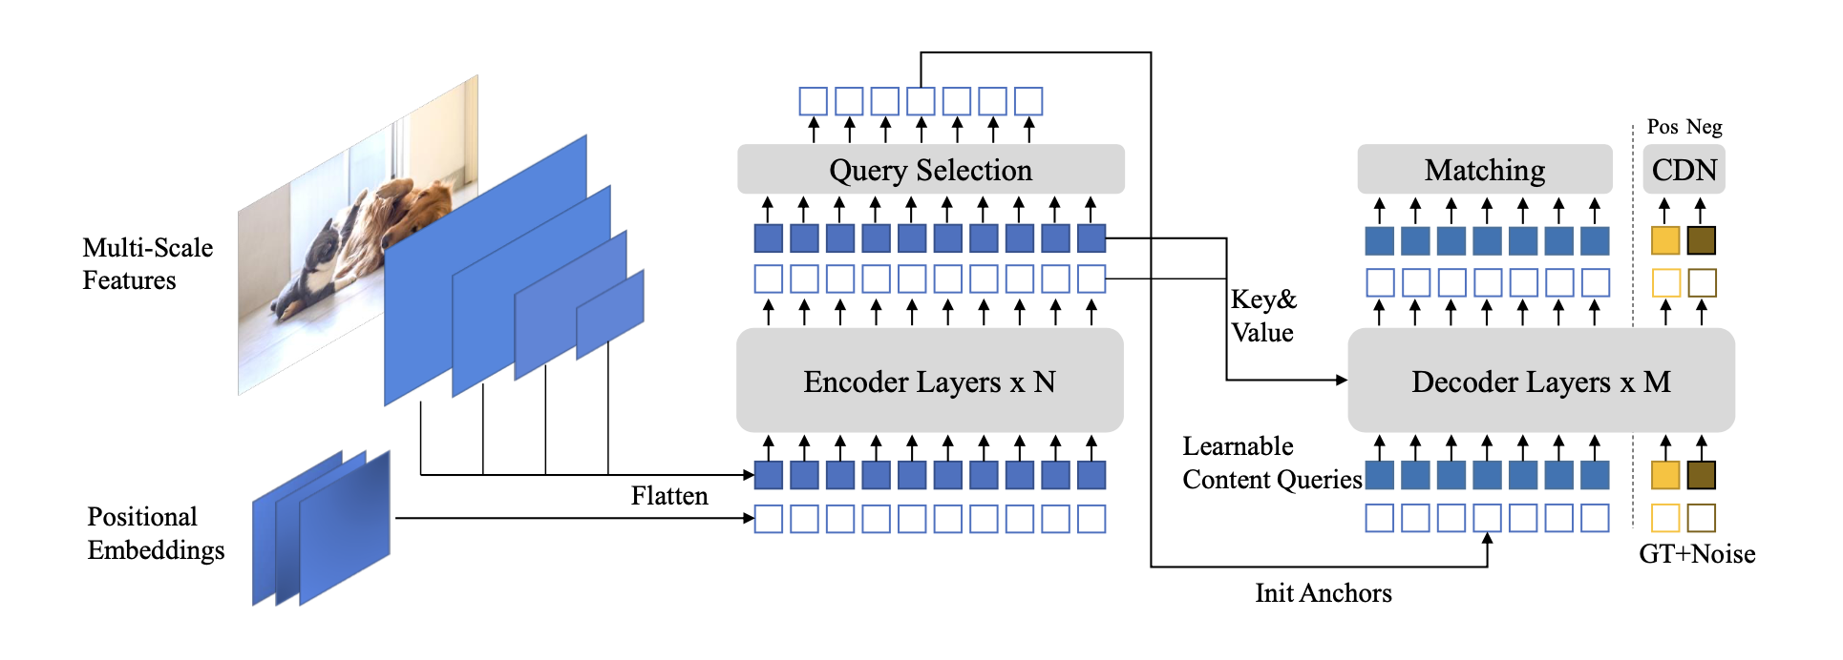




Slide 25




Contrastive Denoising Training
Denoising was added to SOTA like DN-DETR
Adds noise to ground truth labels and boxes into the Transformer decoder layers to help stabilize bipartite matching during training
DN-DETR
Can't really detect as "no objects" for anchors with no nearby objects
Hyperparam
Controls noise scale
DINO introduces
Noise scale: < , between , >
GT
"no object"
Hard negatives, small value to ensure hard negatives

Slide 26
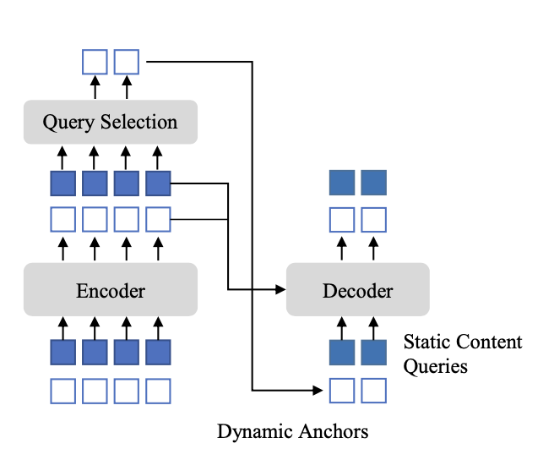
Mixed Query Selection
Select top K encoder features from the last encoder layer
as priors to enhance decoder queries

Slide 27
Look forward twice scheme for box predictions
Basically, box backprogate to the layer that predicts the box and the next layer as well
"Twice"

Slide 28
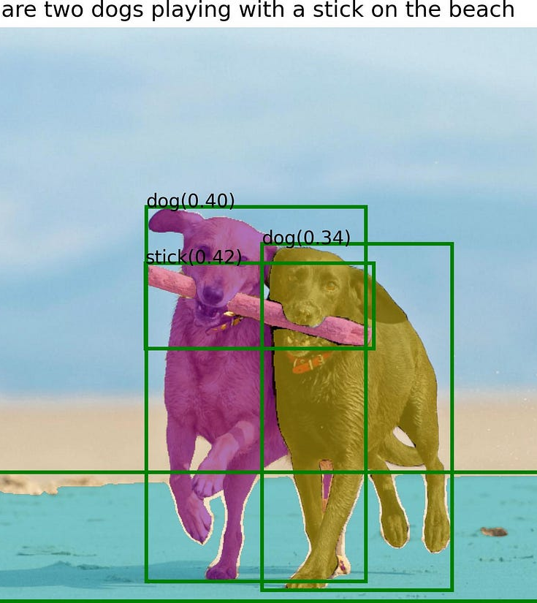
Grounding DINO
Referring Expression Comprehension (REC)
Outputs multiple pairs of object boxes and noun phrases for a given (Image, Text) pair
Grounding DINO aims to detect objects from an image specified by an input text

Slide 29
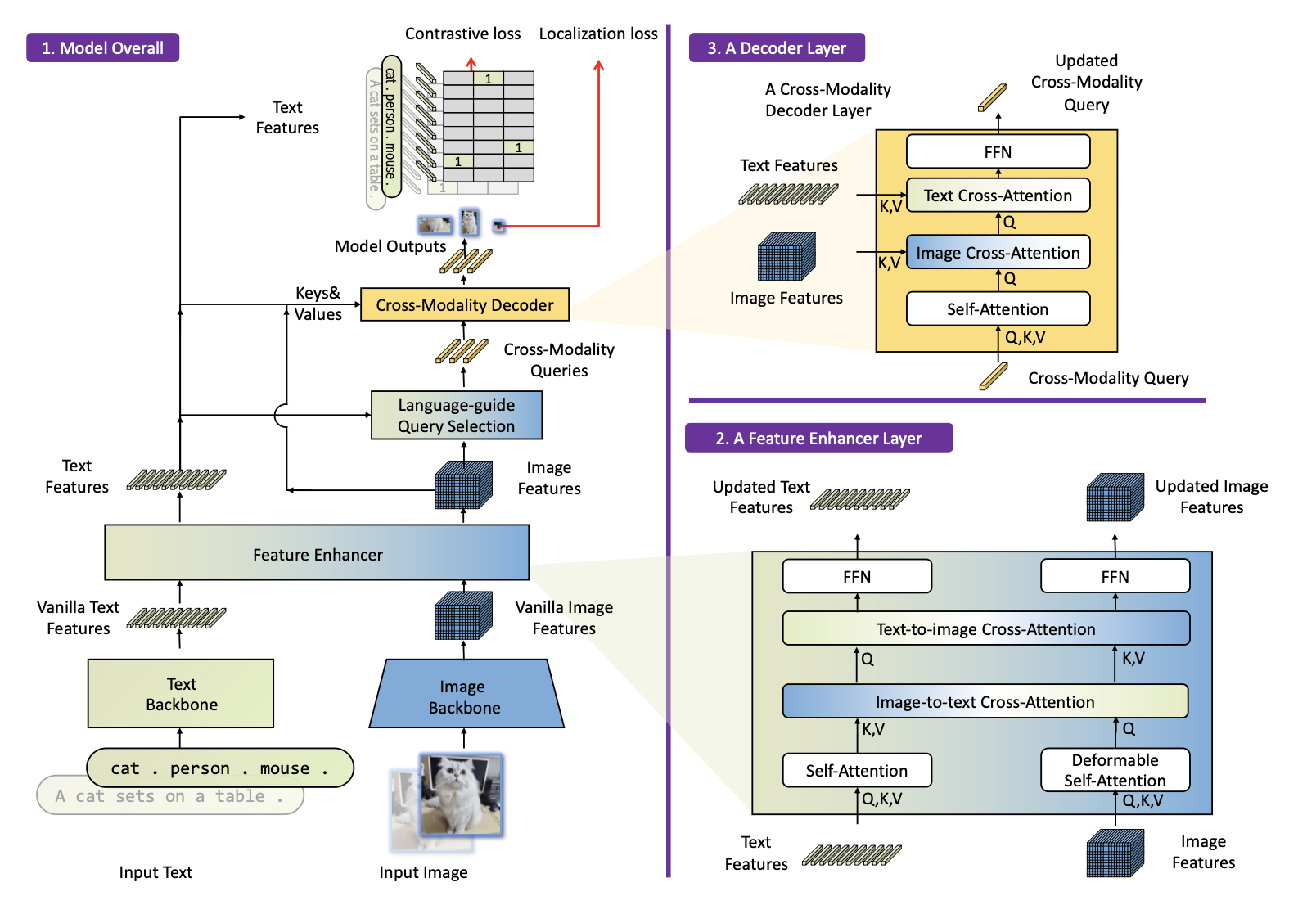





Slide 30

Details
Deformable attention
L1 focal loss for cls and GIOU loss for box regression
Contrastive loss between predicted objects and language tokens
Language guided query selection
Bipartite matching as usual

Slide 31
Assignment Due 9/4
Object detection – refer to slides 8/26/2025 class
https://www.kaggle.com/datasets/awsaf49/coco-2017-dataset
Run detection performance comparing (inference only):
Faster R-CNN
DETR
DINO
Grounding DINO (used text prompt at your discretion)
Same grading criteria:
Report
Code
Video
Insight

