Slide 1
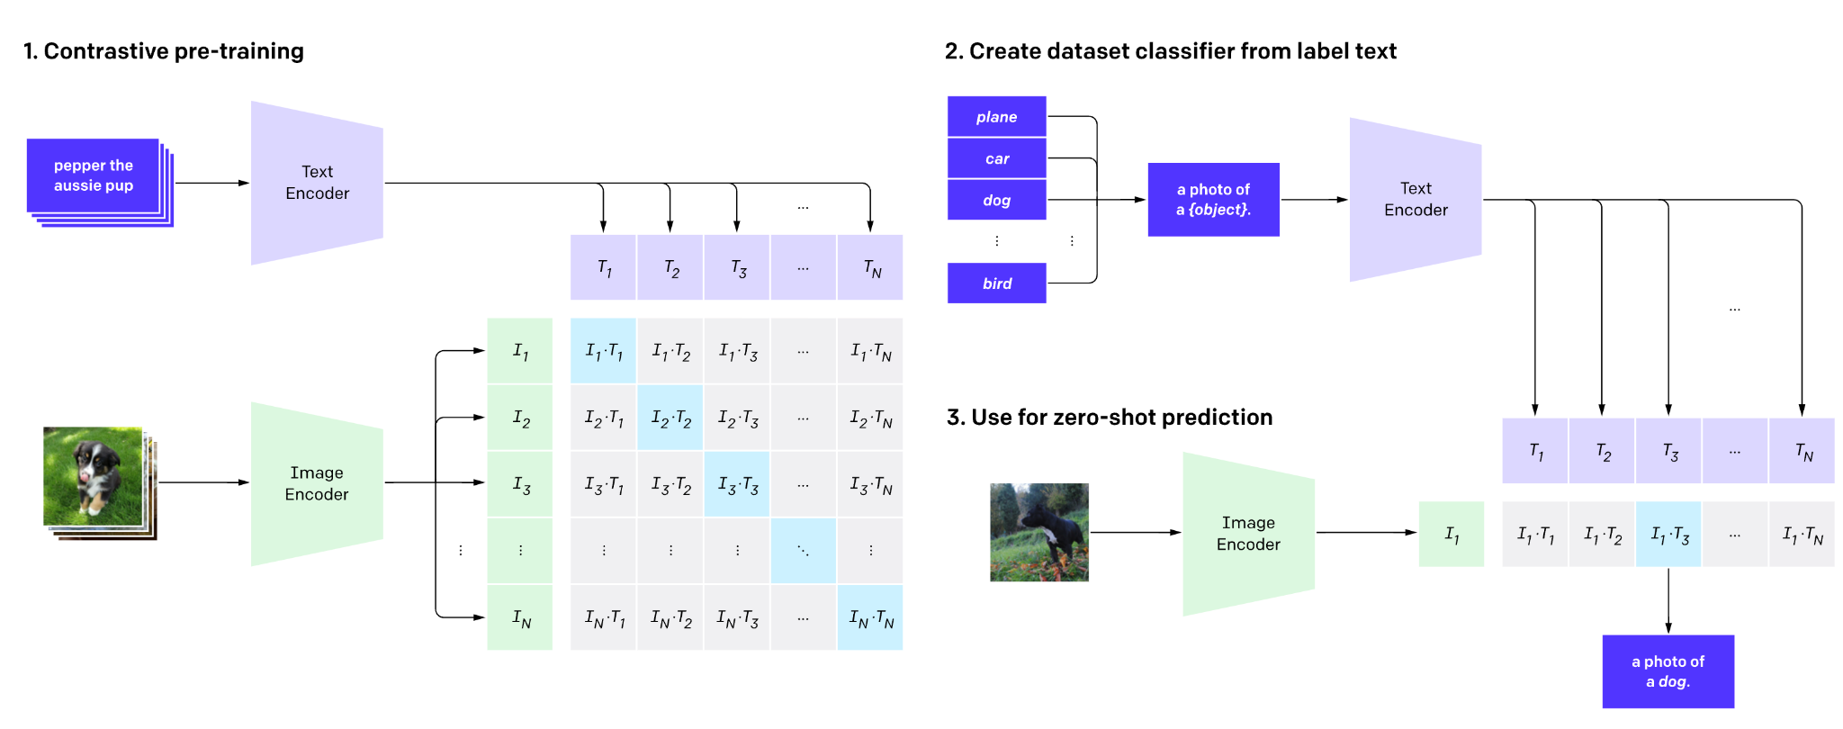
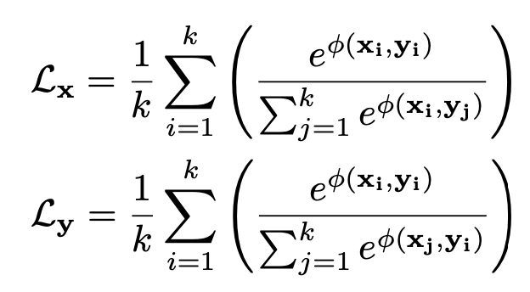


Open World Image Semantic Segmentation
Introduction to CLIP (Contrastive Language-Image Pre-training)
Aligns the CLS token of image and text encoder via InfoNCE
Zero-shot image classification

Slide 2
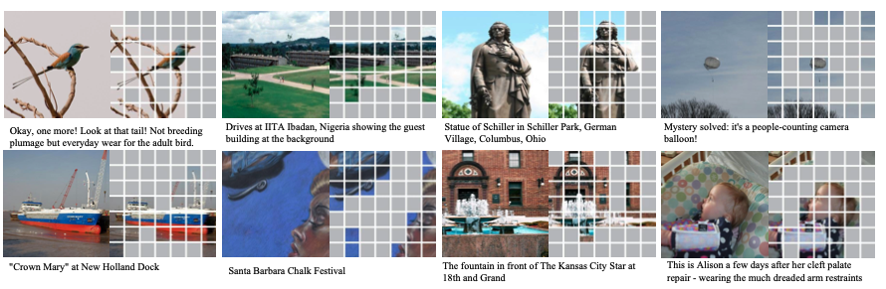
Attentive Mask CLIP
Main idea:
Drop irrelevant tokens!!
Drop almost >= 50%
Random dropping degrades performance though
Masked Image Modeling (MIM) works with random dropping but not CLIP, why?
A-CLIP

Slide 3
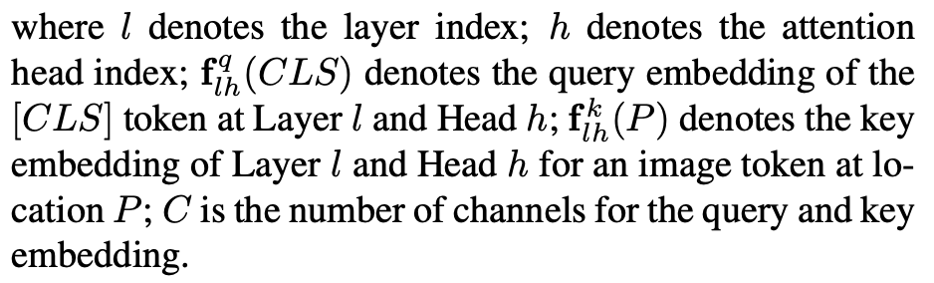

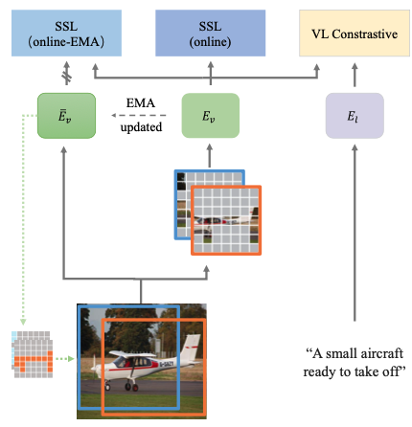






Attentive Mask
Low strategy – discard low s_p score, high strategy: discord high s_p scores, mixture strategy
EMA for attention score computation
A-CLIP-eff: half-res for speed as it does not need to be very accurate
Shared EMA scored map for multiple views, efficiency
Multiple masked views
Auxiliary contrastive learning
Between a masked view and EMA feature (BYOL)
Between masked views (SIMCLR)

Slide 4
Sigmoid Loss based CLIP
Recall:
SGLIP
Inefficient and prevents large batch size (usually 32768, N positive pairs, NxN – N negative pairs)

Slide 5
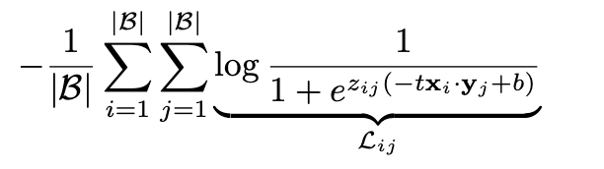
SGLIP
Instead of global normalization as in CLIP, separate pair processing
A lot of negative pairs causing a lot of imbalance during optimization
Massive over-correction in the training results
Added a bias term and temperature
Z_{ij} is the label (1 for positive pair and –1 otherwise)
Batch size can go up to a million, but typically 32k
Allows for chunking

Slide 6
Attendance

Slide 7
Assignment Due 9/18
Dataset: Human Action Recognition (HAR)
Same train/test split
Fine tune on HAR and compare CLIP, A-CLIP and SGLIP
Report performance, speed and memory consumption
SGLIP is able to load very large batch size, use 32k
For CLIP, A-CLIP (4096)
Report, code, video to be submitted

