Slide 1
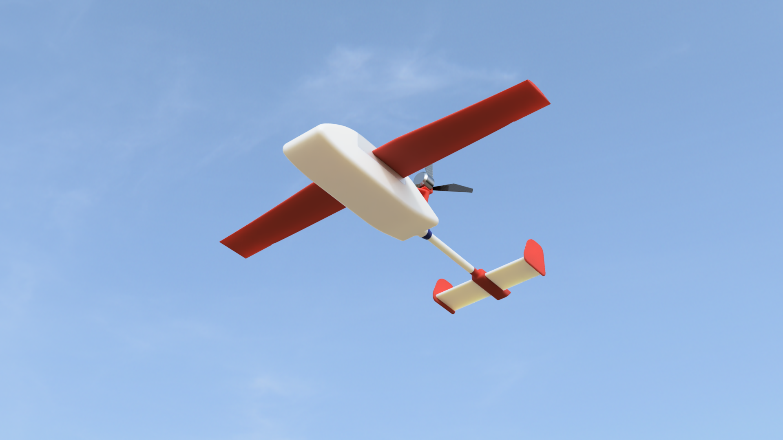
CAP6411- Course Project Autonomous Fixed Wing UAV
Team:
Lam Nguyen

Slide 2
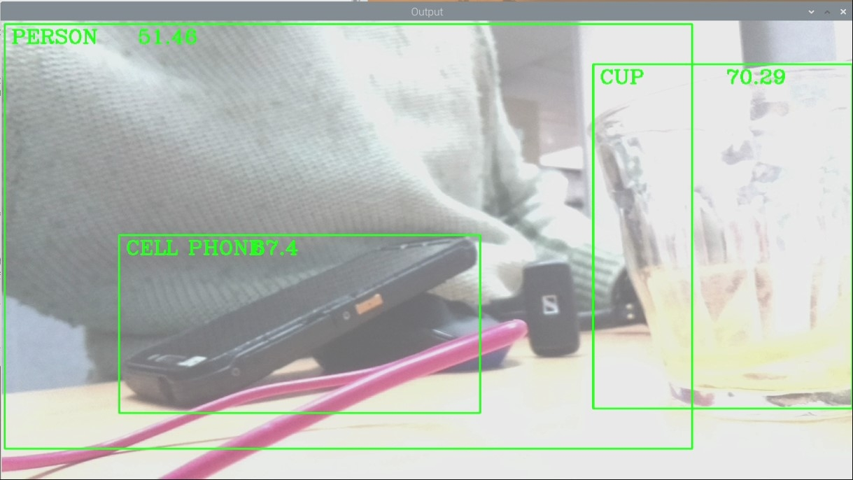
Project Overview
Create a fixed wing aircraft that can use vision and other navigation systems to move along a selected path
Automatically identify objects using object detection and send to Goggles
First Person View Camera
Create a project as cheaply as possibly with consumer items.

Slide 3
Questions?
Any suggestions?

