Slide 1
Sample Solutions CENTRAL EUROPE REGIONAL CONTEST 2011 Czech Technical University in Prague

Slide 2
PRACTICE: ANTS

Slide 3
Ants
Ants are “interchangeable”
=> Meeting and “turning around” can be ignored
=> Solution is trivial

Slide 4

PRACTICE: ELECTRICIAN

Slide 5
Electrician
for (;;)
{
scanf("%d", &x);
if (x == 0) break;
printf((x == 2) ? "Bad luck!\n“ : "Electrician needs 1 trips.\n");
}

Slide 6
Sample Solutions
Cards
Vigenere
Unique
Trail
Program
Regulate
Analyse
Grille
Unchange
Execute

Slide 7
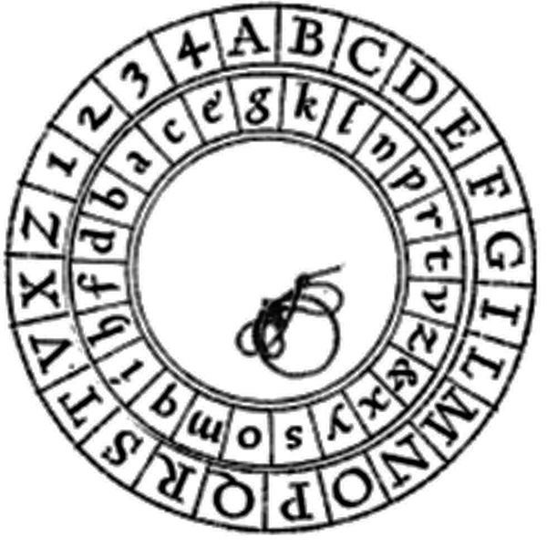
VIGENERE GRILLE

Slide 8
Vigenere Grille
Pretty easy, wasn’t it?

Slide 9
EXECUTE

Slide 10
Stack Machine Executor
Straightforward simulation
Beware of
Integer overflow (MUL)

Slide 11

PROGRAM

Slide 12
Stack Machine Programmer
The machine language is limited
Several ways to solve the problem
Polynomial
Linear combination of some values
Implement EQ
Implement IF/THEN ☺

Slide 13
Polynomial way
1→ 3, 2 → 10, 3 → 20
Polynomial: A.x² + B.x + C
A.1² + B.1 + C = 3
A.2² + B.2 + C = 10
A.3² + B.3 + C = 20

Slide 14
“Equals” implementation
Sort inputs: 2 3 5 8 11
Q = (((X mod 11) mod 8) div 5)
Q=1 iff X=5
Q=0 otherwise
Q mul R (R – desired output for 5)
Sum for all inputs:
Q₁.R₁ + Q₂.R₂ + Q₃.R₃ + Q₄.R₄ + Q₅.R₅

Slide 15
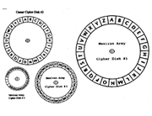
ANALYSE

Slide 16
Vigenere Analyse
We try the cribs in all positions
B | A | N | K
A | C | E | W | S | U | Y | A | V | D | C | E
Y | B | Q | L

Slide 17
Vigenere Analyse
We try the cribs in all positions
Y | B | Q | L
B | A | N | K
A | C | E | W | S | U | Y | A | V | D | C | E
A | D | I | H

Slide 18
Vigenere Analyse
We try the cribs in all positions
Y | B | Q | L
A | D | I | H
B | A | N | K
A | C | E | W | S | U | Y | A | V | D | C | E
C | V | G | J

Slide 19
Vigenere Analyse
We try the cribs in all positions
Y | B | Q | L
A | D | I | H
M | O | N | E | Y
C | V | G | J
A | C | E | W | S | U | Y | A | V | D | C | E
N | N | Q | R | T

Slide 20
Analyse
All placements of the first crib
O(n.k)
All placements of the second crib
Test by hash map
O(n.k . H)

Slide 21
Analyse
Beware of
Key length and repetitions
ABCAB → possible keys are ABC, ABCA
Overlapping words
There should be “two words” in the text
Sample input/output had an example

Slide 22

REGULATE

Slide 23
Strange Regulations
For each company, the cables form linear paths only
We keep the disjoint-set information
find
union
split

Slide 24
Regulate – Disjoint Sets

Slide 25
Regulate – Disjoint Sets

Slide 26
Strange Regulations
We need all operations quickly
Tree-based structures
Balancing!!
One query
O(log n)
O(sqrt(n)) – amortized (rebuild)

Slide 27
UNIQUE

Slide 28
Unique Encryption Keys
Trivial solution: O(n) for each query
Prepare a data structure
Perform the lookups faster

Slide 29
Unique – possible solution
One possibility:
Remember the “last previous” duplicity
2 | 6 | 12 | 5 | 6 | 4 | 7 | 6 | 7 | 14 | 2 | 14
0 | 1 | 2 | 3 | 4 | 5 | 6 | 7 | 8 | 9 | 10 | 11
X | X | X | X | 1 | 1 | 1 | 4 | 6 | 6 | 6 | 9

Slide 30
Unique Keys
Query is resolved in O(1)
2 | 6 | 12 | 5 | 6 | 4 | 7 | 6 | 7 | 14 | 2 | 14
0 | 1 | 2 | 3 | 4 | 5 | 6 | 7 | 8 | 9 | 10 | 11
X | X | X | X | 1 | 1 | 1 | 4 | 6 | 6 | 6 | 9
6 ≥ 3

Slide 31
Unique Keys
Query is resolved in O(1)
OK
2 | 6 | 12 | 5 | 6 | 4 | 7 | 6 | 7 | 14 | 2 | 14
0 | 1 | 2 | 3 | 4 | 5 | 6 | 7 | 8 | 9 | 10 | 11
X | X | X | X | 1 | 1 | 1 | 4 | 6 | 6 | 6 | 9
1 < 2

Slide 32
Unique – time complexity
Lookup array prepared: O(n . log n)
Using a map
One query: O(1)

Slide 33
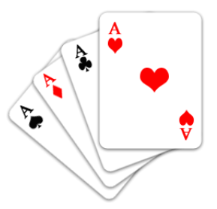
CARDS

Slide 34
Card Game
One game = permutation
Follow the position of all cards
Each card “travels” in some cycle
Periodically repeating occurrences

Slide 35
Card Game
Each card “travels” in some cycle
Periodically repeating occurrences
1 | 2 | 3 | 4 | 5 | 6 | 7 | 8 | 9 | 10

Slide 36
Card Game
When is the card “3” at position 6?
In the game #3 and then every 7th game
7.i + 3
1 | 2 | 3 | 4 | 5 | 6 | 7 | 8 | 9 | 10

Slide 37
Card Game
Track all of the cards at all positions
Card C is at the position P in the deck
F_{CP} + i_{CP}.R_{CP}
never

Slide 38
Card Game
All winning combinations (120 x N)
1,2,3,4,5,x,x,x,x,x
1,2,3,5,4,x,x,x,x,x
1,2,4,3,5,x,x,x,x,x
1,2,4,5,3,x,x,x,x,x
1,2,5,3,4,x,x,x,x,x
… etc.

Slide 39
Card Game
For each winning combination
Do the cards ever occur at those places? When?
F_{1P} + i_{1P}.R_{1P}
F_{2Q} + i_{2Q}.R_{2Q}
F_{3S} + i_{3S}.R_{3S}
F_{4T} + i_{4T}.R_{4T}
F_{5U} + i_{5U}.R_{5U}

Slide 40
Card Game
Find the common occurrence
Solving the Bezout’s identity A.i + B.j = C
Extended Euclidean algorithm
gcd(A,B) divisible by C

Slide 41
TRAIL

Slide 42
Racing Car Trail
What we cannot use:
Backtracking
Dynamic programming
What to use?
Graph theory

Slide 43
Trail – the graph
Each position is a node
Edge if the move is possible

Slide 44
Trail – key observation
We find the maximum matching

Slide 45
Trail – key observation
Maximum matching
Start from an unmatched node => lose

Slide 46
Trail – key observation
How to find answer to some node?
Find maximum matching without it
Try to find an augmenting path from it

Slide 47
Trail – key observation
Does the augmenting path exist?
YES => Alice can win
NO => Alice will lose

Slide 48
Trail – time complexity
Turn a matching (without one node) into another by 1 augmenting path
O(n²) – the initial matching
O(n) for each node
TOTAL: O(n²)

Slide 49
UNCHANGE

Slide 50
Unchanged Picture
Picture “normalization”
Join overlapping and continuing lines
Compare two pictures
Try to map one line in Picture 1 to all lines in Picture 2
Check if it maps everything

Slide 51
Unchange – time complexity
Comparing lines – hashing
O(n^2 . H)
O(n^3) is too much!

Slide 52
Unchange – faster solution
Find the “center of mass” X
Points in the longest distance from X map to each other
“Tie-breakers”
Not required in this contest (1000 lines max)

Slide 53
Authors
Josef Cibulka
Jakub Černý
Zdeněk Dvořák
Martin Kačer
Jan Stoklasa
Jan Katrenic
Radek Pelánek

