Slide 1
Rehla.com
Lamees basher

Slide 2
My projects
The login progect.
Sales page project.
Rehla tourist project.

Slide 3
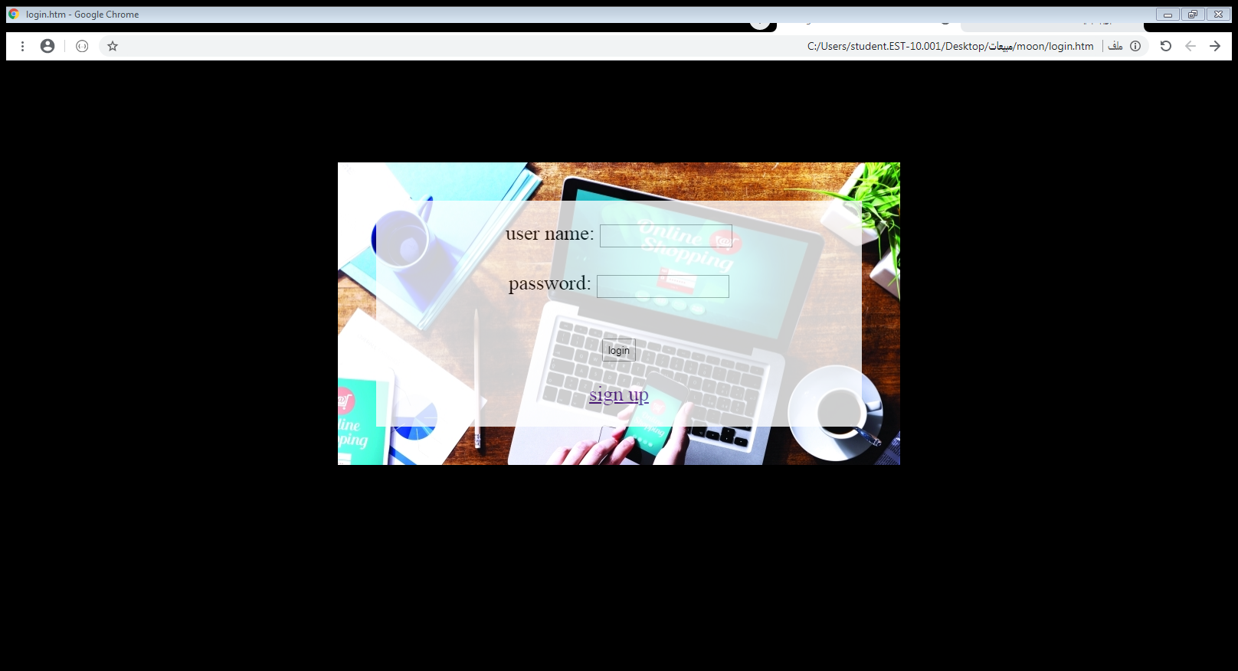
The login project

Slide 4
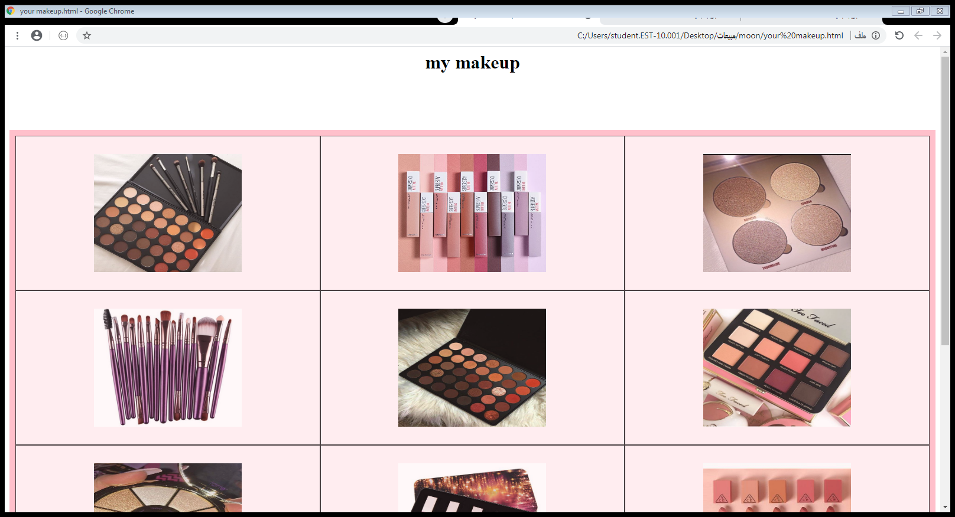
Salse page project

Slide 5
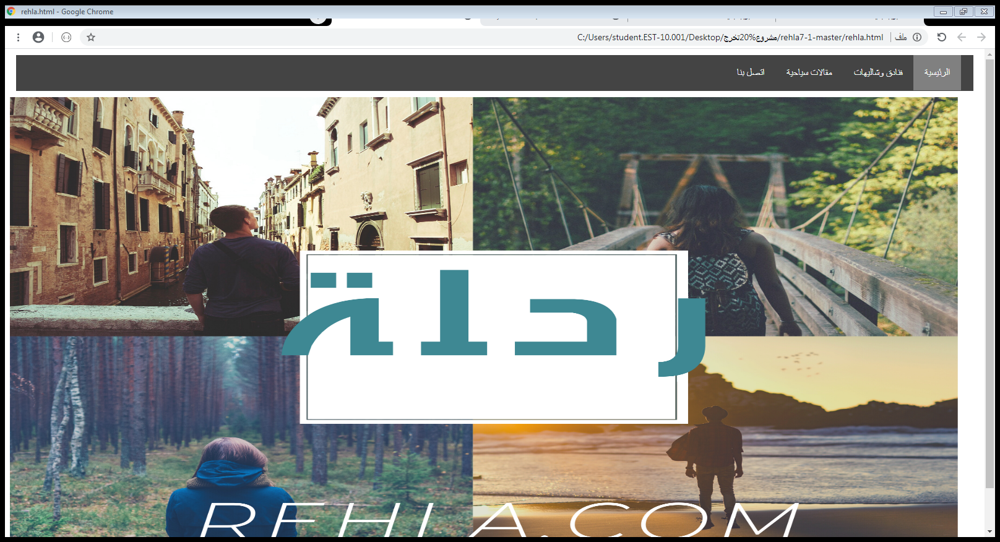
rehla tourist project

Slide 6
Introdution thay started I signed in to sign back end as for the rehla progect ,it is asimple project that gives the visitor an easy idea of tourism in jordan.

Slide 8
The goal of this project it is asmall idea for some hotels and articles

