Slide 1
Multicriteria Decision Aid: the Outranking Approach
Multicriteria decision aid
PROMETHEE & GAIA methods
Decision Lab software
Bertrand Mareschal
ULB – SMG & Solvay Business School
bmaresc@ulb.ac.be
http://homepages.ulb.ac.be/~bmaresc
March 2008

Slide 2
Course summary
Unicriterion vs. multicriteria models.
Multicriteria modeling: Basic concepts.
Multi-attribute utility theory (aggregation – “US school”).
Outranking methods (“French school”).
PROMETHEE & GAIA methods.
Decision Lab software – iVision project.
March 2008

Slide 3

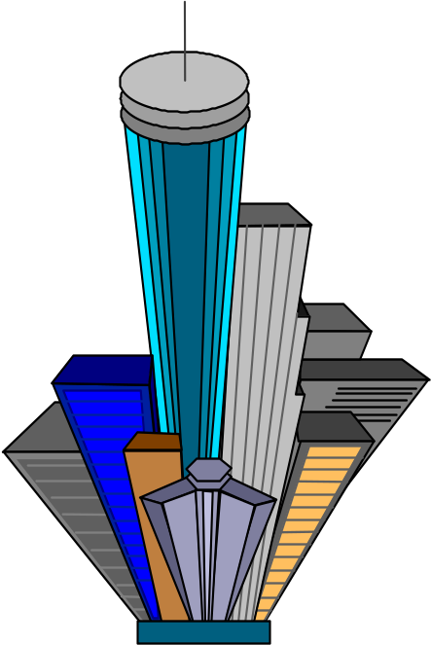

Decision making
Real world
  Social
  Political
  Economical
  Industrial
  Environmental
  Military
Describe,
Understand,
Manage.
2 Approaches :
Qualitative approach,
Quantitative approach.
March 2008

Slide 4

Decision aid
Réalité
  Sociale
  Politique
  Economique
  Industrielle
  Environnementale
  Militaire
Real world
  Social
  Political
  Economical
  Industrial
  Environmental
  Military
Quantitative model
Possible decisions?
How to compare them?
Preferences, Objectives?
March 2008

Slide 5
Decision aid
Réalité
  Sociale
  Politique
  Economique
  Industrielle
  Environnementale
  Militaire
Real world
  Social
  Political
  Economical
  Industrial
  Environmental
  Military
Quantitative model
Approximation to real world!
Decision aid.
March 2008

Slide 6
Some Decision or Evaluation Problems
Locating a new plant, a new shop, ...
Human resources management.
Purchasing equipment.
Assessing the quality of suppliers.
Evaluating projects.
Selecting an investment strategy.
March 2008

Slide 7

Unicriterion vs multicriteria model
Unicriterion model:
  Mathematically well-stated:
    Optimal solution,
    Complete ranking of the actions.
  Socio-economically ill-stated:
    Single criterion? Not realistic.
    Notion of criterion: perception thresholds, …
March 2008

Slide 8
Unicriterion vs multicriteria model
Multicriteria model:
  Mathematically ill-stated:
    No optimal solution,
    No mathematical meaning.
  Socio-economically well-stated:
    Closer to real world decision problem,
    Search for a compromise solution.
March 2008

Slide 9
Chronology of multicriteria decision aid
1968 : ELECTRE I method (B. Roy)
1972 : 1st international conference in the USA
1973 : 1st ULB thesis on MCDA
1975 : European working group
1977 : Charnes & Cooper:
The main impetus for the burst of new applications seems to be associated with the evolution of public management science and its very natural orientation towards multiobjective formulation.
1980-85 : ± 12% of papers in European conferences.
1992 : international journal JMCDA
March 2008

Slide 10
Multicriteria table
Actions:
  Possible decisions,
  items to evaluate.
Criteria:
  quantitative,
  qualitative.
March 2008

Slide 11
Multicriteria table
 | Crit. 1 (/20) | Crit. 2 (rating) | Crit. 3 (qual.) | Crit. 4 (Y/N) | …
Action 1 | 18 | 135 | G | Yes | …
Action 2 | 9 | 147 | B | Yes | …
Action 3 | 15 | 129 | VG | No | …
Action 4 | 12 | 146 | VB | ? | …
Action 5 | 7 | 121 | G | Yes | …
… | … | … | … | … | …
March 2008

Slide 12
Plant location
 | Investment (BEF) | Costs (BEF) | Environm. (impact) | …
Site 1 | 18 | 135 | G | …
Site 2 | 9 | 147 | B | …
Site 3 | 15 | 129 | VG | …
Site 4 | 12 | 146 | VB | …
Site 5 | 7 | 121 | G | …
… | … | … | … | …
March 2008

Slide 13
Purchase options
 | Price (BEF) | Reliability (days) | Maintenance (estimate) | …
Product A | 18 | 135 | G | …
Product B | 9 | 147 | B | …
Product C | 15 | 129 | VG | …
Product D | 12 | 146 | VB | …
Product E | 7 | 121 | G | …
… | … | … | … | …
March 2008

Slide 14
A simple example
Purchase of a car
Objectives :
Economy (price),
Usage (fuel consumption),
Performance (power),
Space,
Comfort.
March 2008

Slide 15
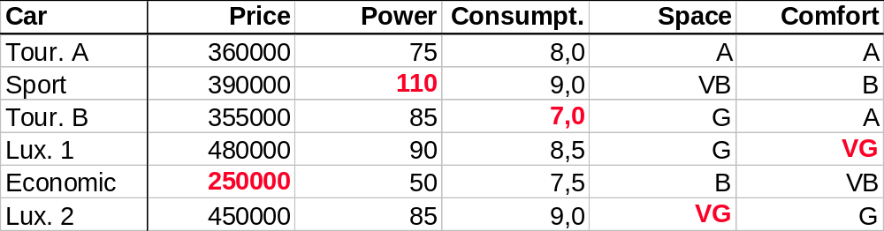

Multicriteria table
Best buy?
Best compromise?
Priorities of buyer?
March 2008

Slide 16
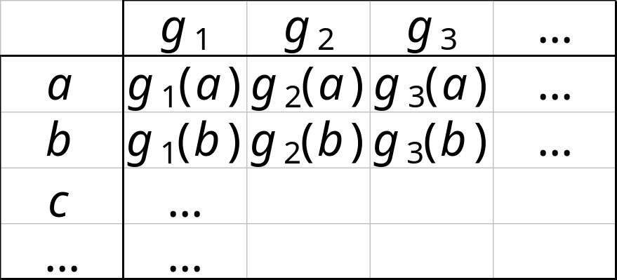
Modeling… 1… 2… 3…
2.
Define the criteria
1.
Define the actions
3.
Model the preferences
March 2008

Slide 17
Defining the actions
Definition : Let A the set of actions. A can be defined:
  by extension:
  by enumeration of its elements.
  ➔ relatively small number of actions.
  by comprehension:
  by constraints on a set of decision variables.
  (Cf. linear programming)
  ➔ large number or infinity of actions.
March 2008

Slide 18
Some properties of the set of actions
A can be:
stable: a priori defined, doesn’t evolve.
evolutive: can evolve during the procedure.
globalised: mutually exclusive elements.
fragmented: combinations of actions are considered.
March 2008

Slide 19
Defining the criteria
Definition:
function g defined on A, taking its values in a totally ordered set, and representing an objective of the decision-maker.
Consistent family of criteria:
  Include all aspects of the decision problem, all the objectives of the decision-maker,
  Avoid redundancies.
March 2008

Slide 20
Qualitative criteria
Qualitative scales:
  Maximum 9 levels (7 ± 2) to ensure a consistent evaluation.
  Presence of a neutral level?
  Examples:
    Very good, Good, Average, Bad, Very bad
    Yes, No
    ++, +, 0, -, --
    ++, +, -, --
Underlying numerical scale (coding).
March 2008

Slide 21
Modeling preferences
Problem:
How to compare two actions
a and b to each other?
A first model: 3 possible results:
  Preference: aPb or bPa
  Indifference: aIb
  Incomparability: aRb
March 2008

Slide 22
Preference structures
Properties (logical):
P, I and R define a preference structure if, for all a,b in A, one and only one of the following statements holds:
aPb or bPa or aIb or aRb
aPb ⇒ not bPa | P is asymetrical
aIa | I is reflexive
aIb ⇒ bIa | I is symetrical
Not aRa | R is non-reflexive
aRb ⇒ bRa | R is symetrical
March 2008

Slide 23
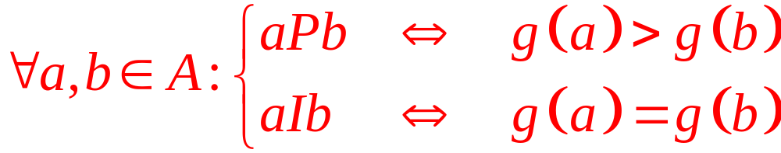
Traditional preference structure (unicriterion)
Optimisation of a function g on A
Consequences:
Complete ranking.
R is empty
P is transitive
I is transitive
March 2008

Slide 24
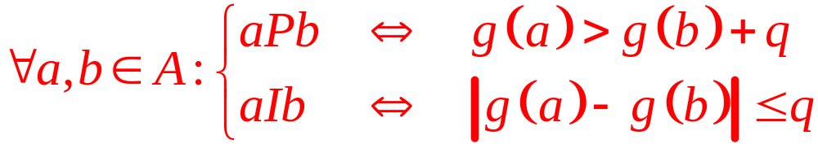
The notion of indifference threshold
Problem: Indifference can be intransitive.
Cf. Coffee cup paradox (Luce, 1956)
Introduction of an indifference threshold:
Quasi-order : P is transitive, but not I.
March 2008

Slide 25
Other preference structures
Variable indifference threshold
⇒ Interval order.
Preference + indifference thresholds
⇒ Pseudo-order.
Models including incomparability
⇒ Partial orders.
Valued preference structures.
March 2008

Slide 26
Social choice theory
Problem:
  A group of voters have to select a candidate among a group of candidates (election).
  Each voter has a personal ranking of the candidates according to his/her preferences.
  Which candidate must be elected?
What is the « best » voting procedure?
Analogy with multicriteria decision aid:
  Candidates ↔ actions,
  Voters ↔ criteria.
March 2008

Slide 27
5 procedures…
… among many others…
Relative majority.
Condorcet.
Second ballot (French presidential).
Borda.
Successive eliminations.
March 2008

Slide 28
Procedure 1 : Relative majority
3 candidates: Albert, Bruno, Claire
30 voters:
11 voters | 10 voters | 9 voters
A | B | C
B | C | B
C | A | A
A | 11
B | 10
C | 9
Albert is elected
March 2008

Slide 29
Procedure 1 : Relative majority
3 candidates: Albert, Bruno, Claire
30 voters:
11 voters | 10 voters | 9 voters
A | B | C
B | C | B
C | A | A
A | 11
B | 10
C | 9
Problem: B and C preferred to A by a majority of voters!
Albert is elected
March 2008

Slide 30
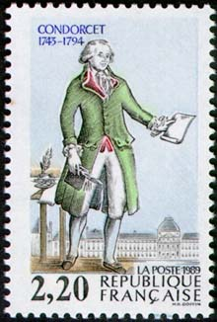
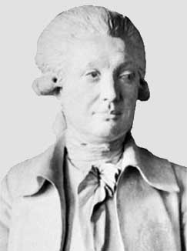
Marie Jean Antoine Nicolas de Caritat
Marquis de Condorcet
1743 - 1794
March 2008

Slide 31
Procedure 2 : Condorcet
3 candidates: Albert, Bruno, Claire
30 voters:
11 voters | 10 voters | 9 voters
A | B | C
B | C | B
C | A | A
B preferred to A | 19 votes
B preferred to C | 21 votes
C preferred to A | 19 votes
Bruno is elected
March 2008

Slide 32
Procedure 2 :
Condorcet paradox
3 candidates: Albert, Bruno, Claire
9 voters:
4 voters | 3 voters | 2 voters
A | B | C
B | C | A
C | A | B
A preferred to B | 6 votes
B preferred to C | 7 votes
C preferred to A | 5 votes
March 2008
Nobody is elected!

Slide 33
Procedure 3 : second ballot
(French presidential election)
4 candidates: Albert, Bruno, Claire, Diane
63 voters:
22 voters | 21 voters | 20 voters
B | C | D
A | A | A
C | D | C
D | B | B
1st tour: | B and C
2nd tour: | C beats B (41 vs 22)
Claire is elected
March 2008

Slide 34
Procedure 3 : second ballot
(French presidential election)
4 candidates: Albert, Bruno, Claire, Diane
63 voters:
22 voters | 21 voters | 20 voters
B | C | D
A | A | A
C | D | C
D | B | B
Claire is elected !!!
...but
A preferred to C | 42 votes
A preferred to B | 41 votes
A preferred to D | 43 votes
March 2008

Slide 35
Procedure 3 : second ballot
(French presidential election)
3 candidates: Albert, Bruno, Claire
17 voters:
1st tour: | A and B
5 voters | 6 voters | 4 voters | 2 voters
C | A | B | B
A | B | C | A
B | C | A | C
2nd tour: | A beats B (11 vs 6)
Albert is elected
March 2008

Slide 36
Procedure 3 : second ballot
(French presidential election)
3 candidates: Albert, Bruno, Claire
17 voters:
Albert was elected
5 voters | 6 voters | 4 voters | 2 voters
C | A | B | B
A | B | C | A
B | C | A | C
1st tour: | A and C
A
B
2nd tour: | C bat A (9 contre 8)
Claire is elected !
Problem: non-monotonicity!
March 2008

Slide 37
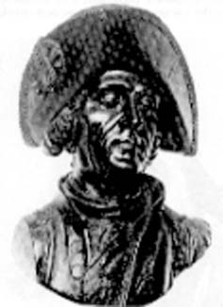
Jean Charles de Borda
1733 - 1799
March 2008

Slide 38
Procedure 4 : Borda
31 x 2 + 39 x 1
3 candidates: Albert, Bruno, Claire
11 x 2 + 11 x 1
81 voters:
30 voters | 29 voters | 10 voters | 10 voters | 1 voter | 1 voter
A | C | C | B | A | B
C | A | B | A | B | C
B | B | A | C | C | A
Points
2
1
0
Scores
A | 101
B | 33
C | 109
Claire is elected!
39 x 2 + 31 x 1
March 2008

Slide 39
Procedure 4 : Borda
3 candidates: Albert, Bruno, Claire
81 voters:
30 voters | 29 voters | 10 voters | 10 voters | 1 voter | 1 voter
A | C | C | B | A | B
C | A | B | A | B | C
B | B | A | C | C | A
Points
2
1
0
Scores
A | 101
B | 33
C | 109
A preferred to C : 41 on 81
March 2008

Slide 40
Procedure 4 : Borda
4 candidates: Albert, Bruno, Claire, Diane
7 voters:
Scores
A | 13
B | 12
C | 11
D | 6
Ranking
A
B
C
D
3 voters | 2 voters | 2 voters
C | B | A
B | A | D
A | D | C
D | C | B
Points
3
2
1
0
March 2008
Albert is elected

Slide 41
Procedure 4 : Borda
4 candidates: Albert, Bruno, Claire, Diane
7 voters:
Scores
A | 6
B | 7
C | 8
Ranking
C
B
A
3 voters | 2 voters | 2 voters
C | B | A
B | A | C
A | C | B
Points
2
1
0
Claire is elected
March 2008

Slide 42
Borda
(manipulation)
3 candidates: Albert, Bruno, Claire
34 voters:
Bruno’s partisans generate the candidacy of x (« fake candidate »)
Scores
A | 46
B | 36
C | 20
Ranking
A
B
C
12 voters | 12 voters | 10 voters
A | B | C
B | A | A
C | C | B
Points
2
1
0
Albert is elected
March 2008

Slide 43
Borda
(manipulation)
4 candidates: Albert, Bruno, Claire, x
34 voters:
Scores
A | 68
B | 70
C | 42
x | 24
Ranking
B
A
C
x
12 voters | 12 voters | 10 voters
A | B | C
B | x | A
C | A | B
x | C | x
Points
3
2
1
0
Bruno is elected!
March 2008

Slide 44
Borda
(manipulation)
4 candidates: Albert, Bruno, Claire, x
34 voters:
Scores
A | 58
B | 48
C | 30
x | 68
Ranking
x
A
B
C
12 voters | 12 voters | 10 voters
A | B | C
x | x | x
B | A | A
C | C | B
Points
3
2
1
0
The fake candidate is elected!
March 2008

Slide 45
Procedure 5 :
Eliminations successives
Tour-wise procedure.
Principle:
Eliminate progressively the worst candidates, one by one, until only one is left.
March 2008

Slide 46
Conclusion?
5 candidates: Albert, Bruno, Claire, Diane, Eric
25 voters:
Relative majority
8 voters | 7 voters | 4 voters | 4 voters | 2 voters
A | B | E | D | C
C | D | C | E | E
D | C | D | B | D
B | E | B | C | B
E | A | A | A | A
Albert elected
Second ballot:
Bruno elected
Condorcet:
Claire elected
Borda:
Diane elected
Successive eliminations:
Eric elected
March 2008

Slide 47
Kenneth Arrow
(Nobel prize in economy, 1972)
Impossibility theorem (1952):
With at least 2 voters and 3 candidates, it is impossible to build a voting procedure that simultaneously satisfies the 5 following properties:
  Non-dictatorship.
  Universality.
  Independence with respect to third parties.
  Monotonicity.
  Non-imposition.
March 2008

Slide 48
Problematics
Evaluations
n actions
k criteria
- choice: determine a subset of actions
(the « best ones »).
β - sorting: sort actions in predefined categories.
γ - ranking: rank from the best to the worst action.
δ - description: describe actions and their consequences.
March 2008

Slide 49
Dominance and efficiency
« Objective ».
Based on a unanimity principle:
Efficiency: a is efficient if it is not dominated by any other action.
Problems:
  Dominance is poor (few dominances),
  Many actions are efficient.
March 2008

Slide 50
Objections to dominance
I | g₁ | g₂
a | 100 | 100
b | 20 | 30
II | g₁ | g₂
a | 100 | 30
b | 20 | 100
III | g₁ | g₂
a | 100 | 99
b | 20 | 100
a efficient
a preferred to b
a and b efficient
a and b incomp.
a and b efficient
a preferred to b
IV | g₁ | g₂
a | 100 | 99
b | 99 | 100
V | g₁ | g₂
a | 100 | 100
b | 99 | 99
a and b efficient
a and b indiffer.
a efficient
a and b indiffer.
March 2008

Slide 51
Some characteristics for a good multicriteria method
Take into account deviations between evaluations.
Take scale effects into account.
Build either a partial (P,I,R) or a complete (P,I) ranking of the actions.
Stay sufficiently simple:
  no black box,
  no technical parameters.
March 2008

Slide 52
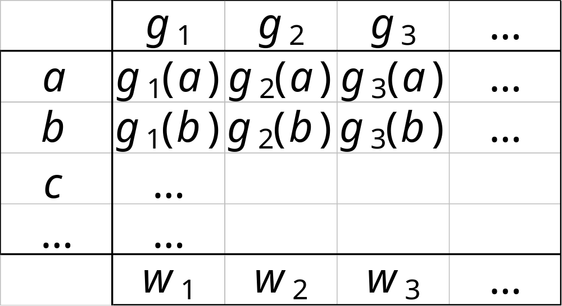
A common approach:
The weighted sum
Criteria
Actions
or
Decisions
Weights of
the criteria
March 2008

Slide 53
A common approach:
The weighted sum
Global value for a :
V(a) = w₁ g₁(a) + w₂ g₂(a) + …
a is preferred to b if:
V(a) > V(b)
(if all criteria are to maximise)
March 2008

Slide 54
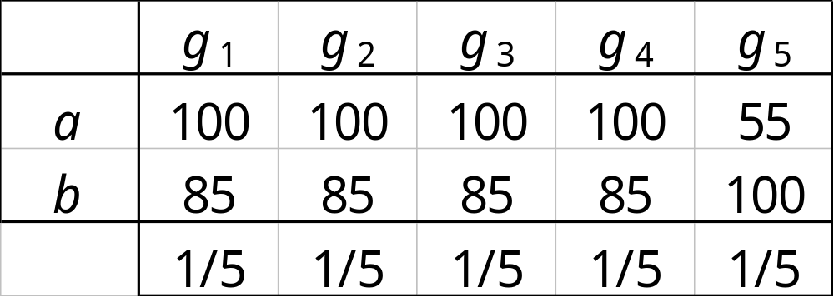
Weighted sum:
Example 1
V(a) = 91 V(b) = 88
Total and uncontrolled compensation of weaknesses by strengthes.
March 2008

Slide 55
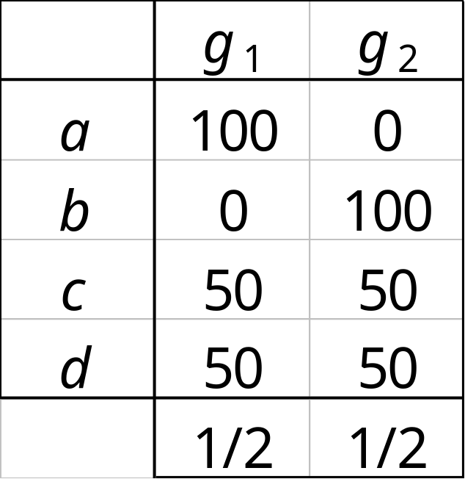
Weighted sum:
Example 2
V(a) = V(b) = V(c) = V(d) = 50
Elimination of conflicts – Loss of information.
March 2008

Slide 56
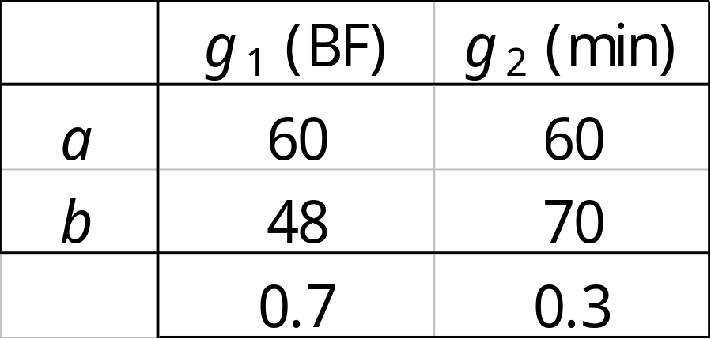
Weighted sum:
Example 3
“Profit is approximately 2 times more important
than time savings;
0.7 for profit and 0.3 for time savings.“
V(a) = 60
V(b) = 54.6
a is ranked 1st.
March 2008

Slide 57
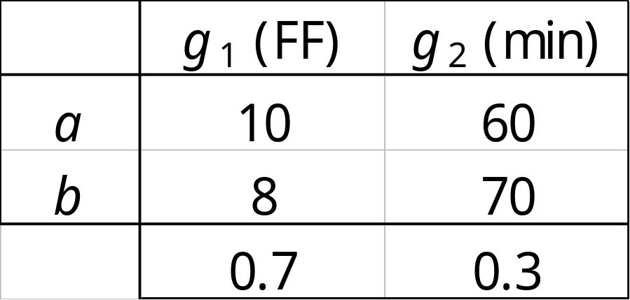
Weighted sum:
Example 3
“Profit is approximately 2 times more important
than time savings;
0.7 for profit and 0.3 for time savings.“
V(a) = 25
V(b) = 26.6
b is ranked 1st!
March 2008

Slide 58


Weighted sum:
Example 3
V(a) = 60
V(b) = 54.6
a is ranked 1st.
V(a) = 25
V(b) = 26.6
b is ranked 1st.
→ Significance of “weights” ! ←
March 2008

Slide 59
Multicriteria decision aid
Multiattribute utility theory (“US school”).
Outranking methods (“French school”).
Interactive methods.
Multiobjective programming.
…
Since 1970, numerous developments: conferences, papers, books, applications, software...
March 2008

Slide 60
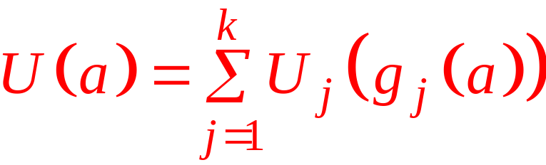
Multiattribute utility (MAUT)
Single synthesis criterion (aggregation).
Existence?
Construction?
Mathematical form?
➔ additive?
March 2008

Slide 61
Multiattribute utility (MAUT)
Mode of construction :
  direct,
  indirect.
Information intensive for the decision maker.
(quantity of information vs reliability?).
Not flexible (sensitivity analyses).
Far away from the original decision problem structure:
multicriteria → unicriterion
March 2008

Slide 62
Outranking methods
Majority principle
(vs unanimity for dominance).
Pairwise comparison of actions.
Closer to the decision problem.
ELECTRE methods (1968-).
PROMETHEE & GAIA methods (1983-).
March 2008

Slide 63
Different approaches
Outranking
 | Unicriterion approach | Weighted sum | Pairwise comparisons
Foundation | Mathematical | Economical | Economical
Compensation between criteria | - | Total | Limited
Scales | - | Linked to weigths of criteria | Taken into account
Conflict detection | - | No | Yes
March 2008

Slide 64

Decision aid methods
Supplementary information:
Perception of scales
Weighing of criteria
Analysis Procedure:
Prescriptive approach: PROMETHEE
Descriptive approach: GAIA
March 2008

Slide 65
Comparison of 2 actions
 | Crit. 1 (/20) | Crit. 2 (rating) | Crit. 3 (qual.) | Crit. 4 (Y/N) | …
Action 1 | 18 | 135 | B | Oui | …
Action 2 | 9 | 147 | M | Oui | …
Action 3 | 15 | 129 | TB | Non | …
Action 4 | 12 | 146 | TM | ? | …
Action 5 | 7 | 121 | B | Oui | …
… | … | … | … | … | …
Difference = 6
March 2008

Slide 66
Preference function
Preference degree
1
Difference
0
Q
6
P
Indifference threshold
Linear
Preference threshold
March 2008

Slide 67
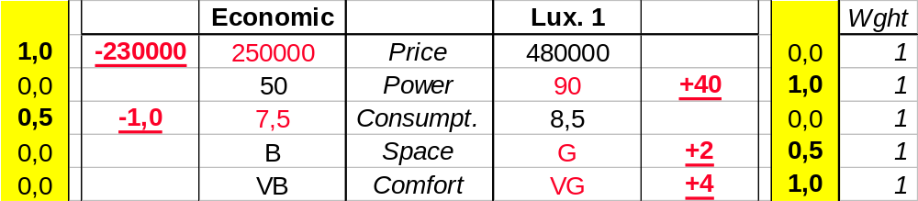
PROMETHEE
Pref (Eco.,Lux.)
Pref (Lux.,Eco.)
Preference
Pref (Eco.,Lux.) = 0,3
= (1 + 0 + 0,5 + 0 + 0 ) / 5
Pref (Lux.,Eco.) = 0,5
= (0 + 1 + 0 + 0,5 + 1 ) / 5
Deviation
March 2008

Slide 68

PROMETHEE
Pref (Eco.,Lux.)
Pref (Lux.,Eco.)
Preference
Pref (Eco.,Lux.) = 0,43
= (2 x 1 + 0 + 2 x 0,5 + 0 + 0 ) / 7
Pref (Lux.,Eco.) = 0,36
= (0 + 1 + 0 + 0,5 + 1 ) / 7
Deviation
March 2008

Slide 69
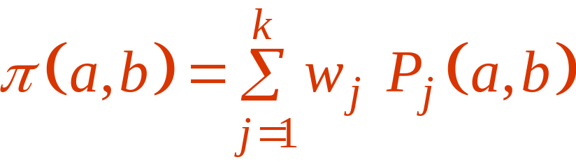
Pairwise comparisons
For each criterion g_{j} :
  Preference function P_{j}
  Weight w_{j}
Multicriteria preference degree
of a over b :
March 2008

Slide 70
Preference functions
(as in Decision Lab software)
Q
P
Usual
« U » shape
« V » shape
Q
P
Q
P
S
Level
Linear
Gaussian
March 2008

Slide 71
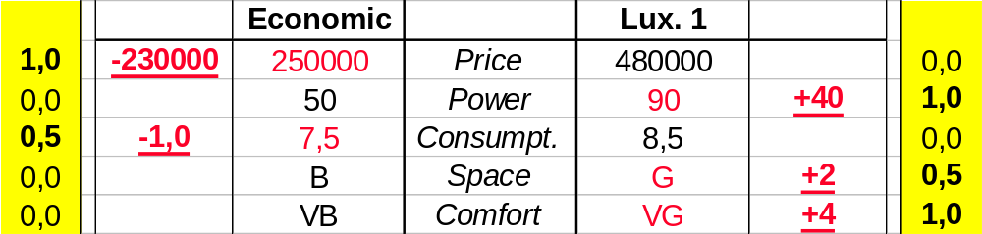
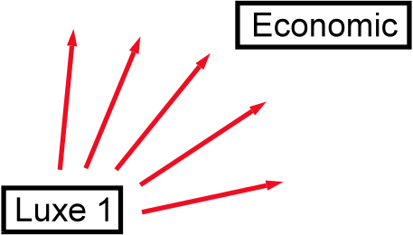
PROMETHEE
Pref (Eco.,Lux.)
Pref (Lux.,Eco.)
Preference
Pairwise comparisons
Deviation
March 2008

Slide 72
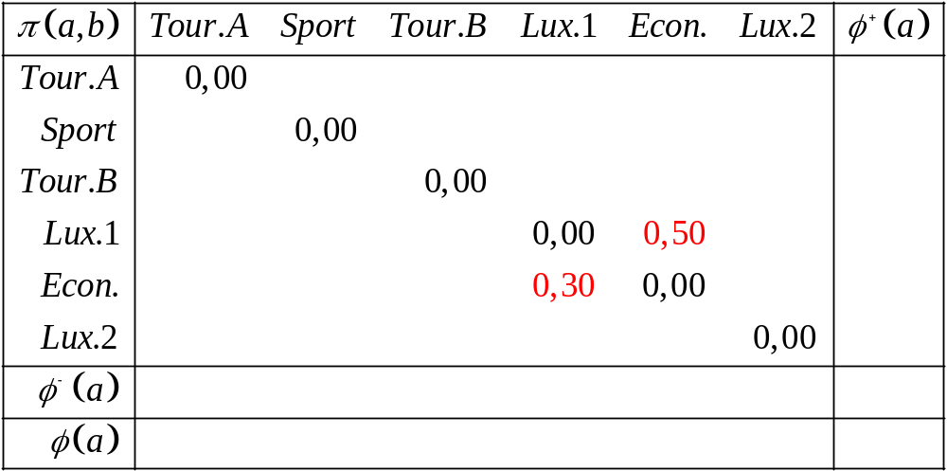
Pairwise preference matrix π (a,b)
March 2008

Slide 73
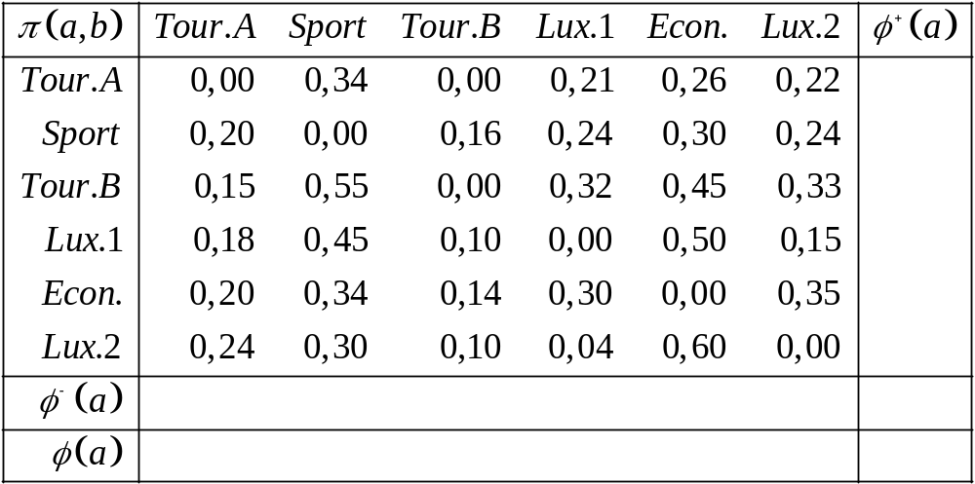
Pairwise preference matrix π (a,b)
March 2008

Slide 74
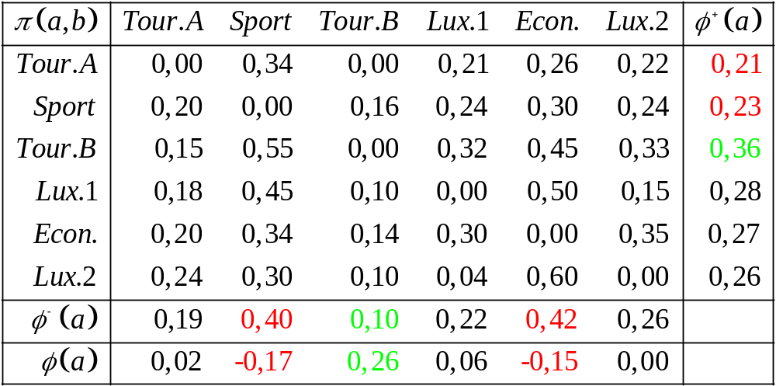
Computation of preference flows
March 2008

Slide 75
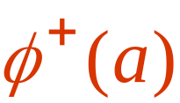
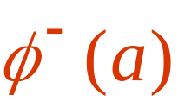
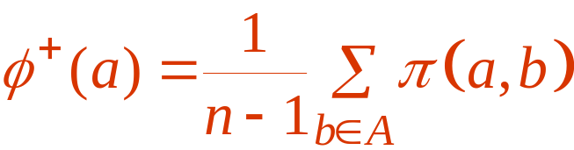
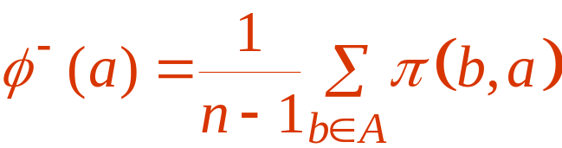

Preference flows
b
b
a
a
Leaving flow:
(strength)
Entering flow:
(weakness)
Net flow:
March 2008

Slide 76
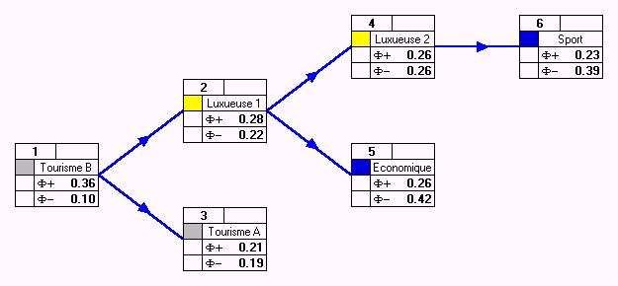

PROMETHEE
Rank decisions from the best to the worst ones.
Identify best compromise solutions.
March 2008

Slide 77
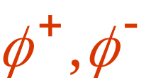

PROMETHEE
PROMETHEE I : partial ranking
PROMETHEE II : complete ranking
March 2008

Slide 78
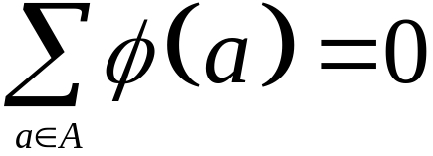
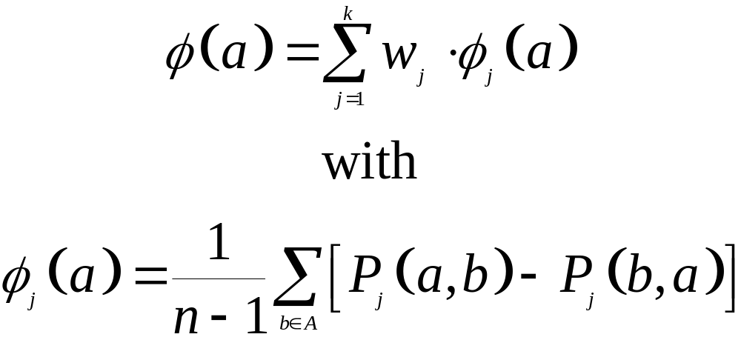
Properties of the net flow
Net flow is centered:
Unicriterion net flows:
March 2008

Slide 79
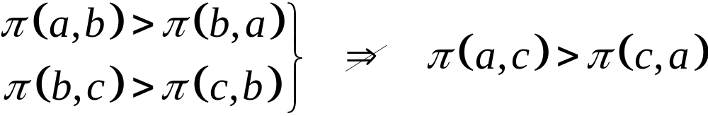
Outranking and rank reversal
Pairwise comparisons (outranking) not transitive due to the multicriteria nature of the decision problems:
Rank reversals unavoidable to obtain a transitive ranking (preorder).
March 2008

Slide 80
Rank reversals in PROMETHEE
Limited:
  Net flow is the least squares optimal score with respect to rank reversal.
  Centered score s(a) that minimizes:
March 2008

Slide 81
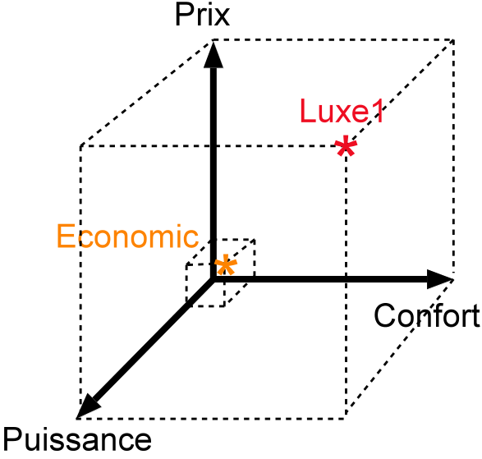
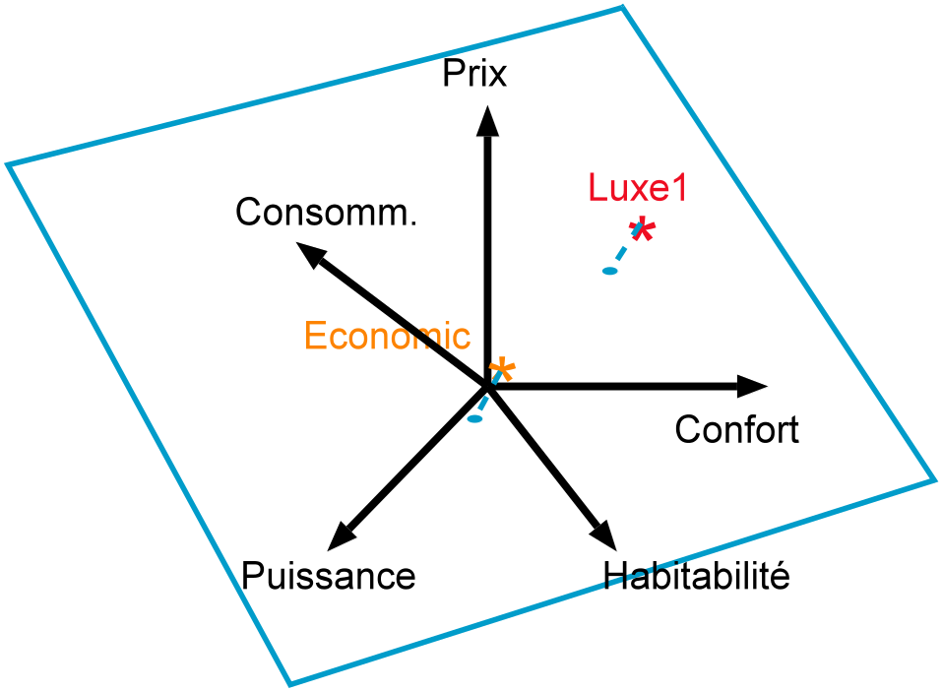
GAIA
Computation of unicriterion net flows (normalization)
Projection on a plane:
Graphical representation.
5 dimensions!
March 2008

Slide 82
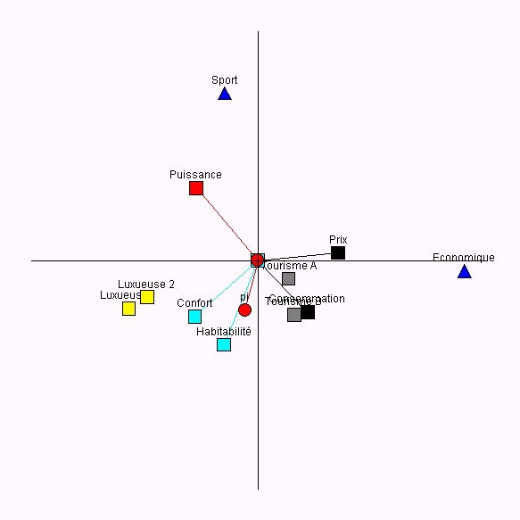
GAIA
Discover conflicts among criteria.
Identify potential compromises.
Help to fix priorities.
March 2008

Slide 83
GAIA
Actions:
points
Criteria:
axes
March 2008
Δ = 90%

Slide 84
GAIA
Price
Economic: 15 k€
Tourism: 25,5-26 k€
Sport: 29 k€
Luxury: 35-38 k€
March 2008
Δ = 90%

Slide 85
GAIA
Power
Sport: 110 kW
Luxury: 85-90 kW
Tourism: 75-85 kW
Economic: 50 kW
March 2008
Δ = 90%

Slide 86
GAIA
Actions:
points
Criteria:
axes
Decision
axis
PROMETHEE II !
Tour.B : 0,26
Lux.1 : 0,06
Tour.A : 0,02
Lux.2 : 0,00
Econ. : -0,15
Sport : -0,17
March 2008
Δ = 90%

Slide 87
GAIA
Actions:
points
Criteria:
axes
Decision
axis
!! only Δ % information !!
March 2008
Δ = 90%

Slide 88
PROMETHEE & GAIA methods
PROMETHEE : prescriptive approach
  Partial ranking (prudent)
  - PROMETHEE I
  Complete ranking (rating)
  - PROMETHEE II
GAIA : descriptive approach
  Identification of conflicts among criteria.
  Profiles of actions.
  Fix priorities, sensitivity analysis (decision axis).
March 2008

Slide 89
Home assignment
Set up a decision problem (up to 60 cells): min. 5 actions and 5 criteria.
Model the problem in Decision Lab.
Analyze the problem, including weight sensitivity analysis.
Produce a written report including:
  Problem description,
  Preference modeling choices (scales, preference functions, weights),
  Complete PROMETHEE & GAIA analysis results,
  Conclusion.
  Max. 20 pages including figures.
March 2008

Slide 90
Example 2 :
Plant location
Actions: 5 potential sites
Criteria:
  g₁ : Cost (investment)
  g₂ : Cost (operations)
  g₃ : Employment
  g₄ : Transportation
  g₅ : Environmental impact
  g₆ : Social impact
March 2008

Slide 91
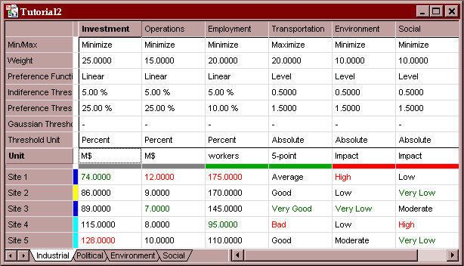
Evaluation table
Criteria to minimize or maximize.
Different scales.
Quantitative or qualitative criteria.
March 2008

Slide 92
Mono- and Multi-decision maker decision problems
Mono-decision maker :
  Single stakeholder (decision maker).
  Single evaluation table and preference structure.
Multi-decision maker:
  Multiple stakeholders (including decision maker(s)).
  Multiple evaluation tables and preference structures.
  Looking for a consensus solution.
March 2008

Slide 93
Example 2
Four stakeholders (“decision makers”):
  Industrial (actual decision maker),
  Political authorities (regional),
  Environmental protection groups,
  Workers unions (social).
Four multicriteria tables.
March 2008

Slide 94
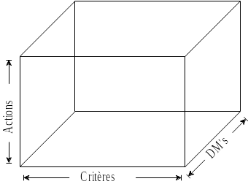
Multicriteria matrix
Adapt multicriteria methods to multi-decision maker problems.
Analyze conflicts among decision makers.
Help to achieve consensus solution.
March 2008

Slide 95
Multi-scenarios model
Scenarios:
  Points of view,
  Hypotheses, …
Evaluations:
  ‘Objective’ criteria: common evaluations.
  ‘Subjective’ criteria: specific evaluations for each scenario.
Specific preference structures :
  Weights, preference thresholds.
March 2008

Slide 96
Multi-scenarios model
Adaptation of PROMETHEE:
  Individual rankings.
  Global (group) rankings taking into account a possible weighing of the scenarios.
Adaptation of GAIA:
  Two distinct analyses.
March 2008

Slide 97
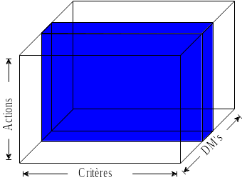
Individual views
Single scenario:
(fixed decision maker)
PROMETHEE rankings
“Classical” mono-decision maker GAIA plane:
  Axes = criteria
  Points = actions
March 2008

Slide 98
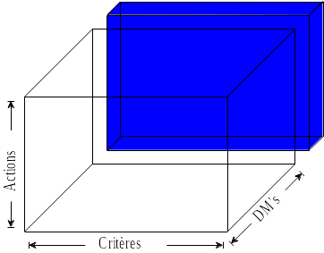
Multi-scenarios synthesis
Aggregating all scenarios (group).
PROMETHEE group rankings.
“Classical” GAIA-Criteria
plane:
  Axes = criteria
  Points = actions
March 2008

Slide 99
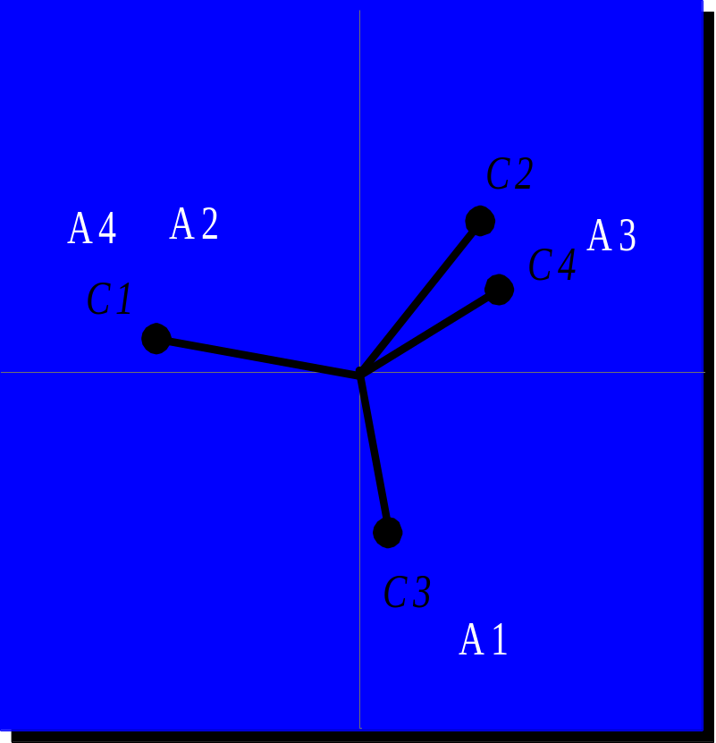
GAIA-Criteria plane
Information:
  Conflicts among criteria.
Pertinence:
  For mostly objective criteria.
March 2008

Slide 100
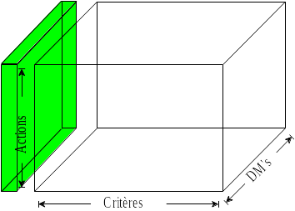
Multicriteria synthesis
Aggregating all criteria.
(group)
Global PROMETHEE rankings.
GAIA-scenarios plane:
  Axes = decision makers
  Points = actions
March 2008

Slide 101
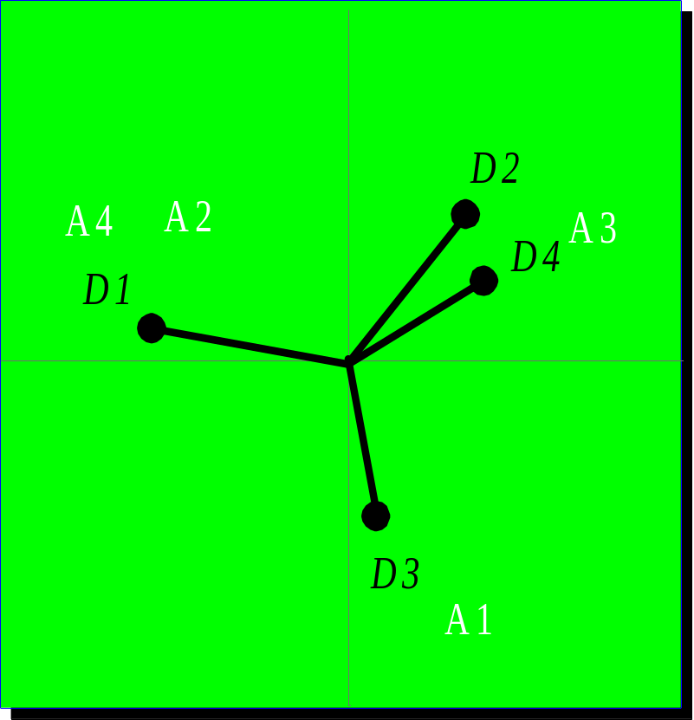
GAIA-Scenarios plane
Information:
  Global view of conflicts among scenarios (decision makers).
Origin of conflicts?
  Definition of criteria,
  Subjective criteria,
  Definition of actions,
  Individual priorities.
March 2008

Slide 102
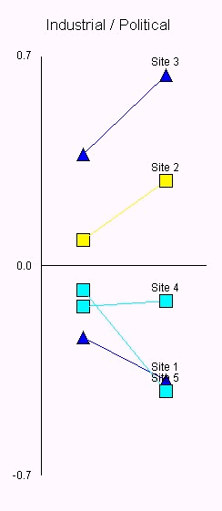
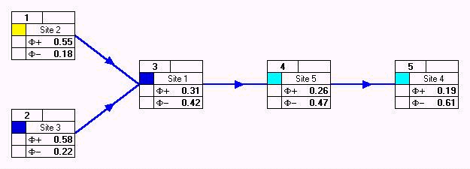
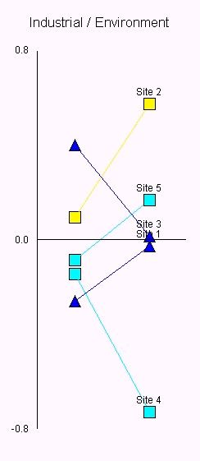
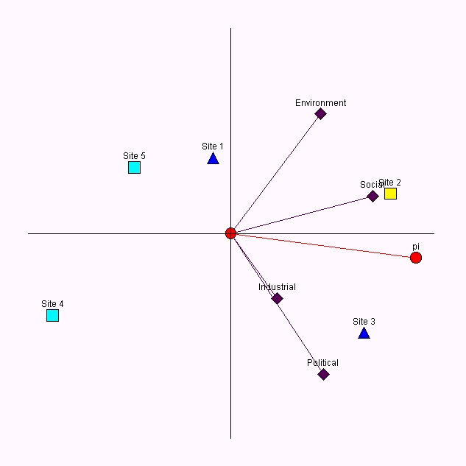
March 2008

Slide 103
Group decision making
Up to 80% of upper management and executives working time spent in meetings.
  Time consuming (meetings, travel),
  High cost.
Limited efficiency of classical meetings:
  Limited time allocated to each participant,
  Psychological restraints,
  Limited memory, …
Important stakes for organisations.
March 2008

Slide 104
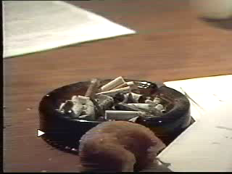
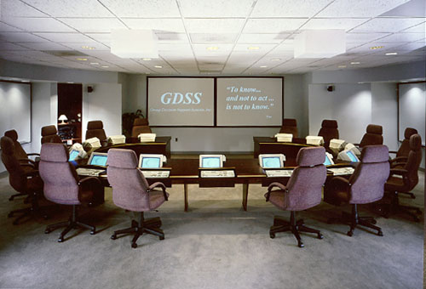
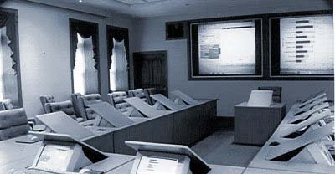
GDSS Rooms
March 2008

Slide 105
Group Decision Support System
Use IT to improve the efficiency of meetings.
  Electronic brainstorming.
    Working in parallel.
    Possible anonymity.
    Automated report generation.
  Decision Aid.
  Voting procedures.
GDSS rooms or Internet.
Time savings and costs reduction.
March 2008

Slide 106
Some applications at SMG
Financial evaluation of companies.
Quality assesment of suppliers.
Electricity production planning at Electrabel.
Regional planning.
Evaluation of urban waste management systems.
Environmental applications.
Therapeutical choice.
...
March 2008

Slide 107
Decision Lab 2000
PROMETHEE & GAIA software
http://homepages.ulb.ac.be/~bmaresc/disk1.htm
Data management:
  Qualitative scales,
  Categories of actions or criteria.
PROMETHEE I et II
GAIA
Sensitivity analysis tools:
  Walking weights,
  Stability intervals.
Multiple scenarios (GDSS)
March 2008

Slide 108
iVision project
New software.
New visual tools:
  Visual interactive preference modeling.
  Representation of PROMETHEE rankings.
  GAIA extensions:
    GAIA-stick
    GAIA-criterion
March 2008

