Slide 1
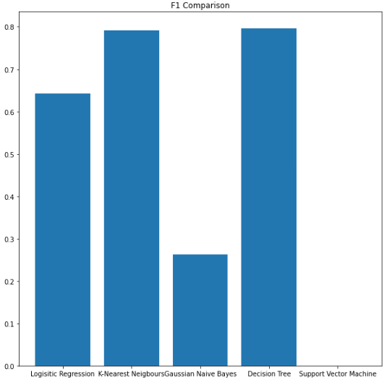
The Performance of Various Machine Learning
Algorithms on Credit Card Fraud Detection
Calvin Tse and Mohammad Uzair Bawany, Simon Fraser University
Introduction
As more of the banking industry becomes digitized, electronic fraud becomes a larger topic of interest. It is important that credit card companies can distinguish fake and real activities. For this project we will be on conducting various classification techniques on a set of data for detecting credit card fraud.
Results
Conclusions
As seen from the F1 Comparison graph, the Decision Tree has the best performance out of the five classification models tested.
Materials and methods
Dataset:
30 Features
284808 Samples
Trained and tested classification models on dataset using 80% of the data to train and 20% to test.
Classification Models Tested:
Logistic Regression
K-Nearest Neighbor
Gaussian Naïve Bayes
Decision Tree
Support Vector Machine
Literature cited
https://www.kaggle.com/datasets/mlg-ulb/creditcardfraud
Acknowledgments
Dr. Mohammad Narimani
Further information
Please see submission for Final Project for the course MSE 491 in Simon Fraser University for Group 14
Notes:
Hello, welcome to the presentation of the Final project for Group 14 in MSE 491 at Simon Fraser University
My name is Calvin Tse and today I will be presenting to you the findings of our final project
For the final project, we are evaluating the performance of various machine learning algorithms on credit card detection fraud
As more of the banking industry becomes digitized, electronic fraud becomes a larger topic of interest. It is important that credit card companies can distinguish fake and real activities. For this project we will be on conducting various classification techniques on a set of data for detecting credit card fraud.
The dataset we used has 30 features and 284808 Samples
To evaluate the performance of each model, 80% of the dataset was used for training the models and 20% was used for testing
For this project, we evaluated 5 different classification models which were logistic regression, k-nearest neighbor, gaussian naïve bayes, decision trees, and support vector machine
As seen in the bar chart, the best performing model was the decision tree which have a F1 score of 0.796, a close second was K-Nearest Neighbor which had an F1 score of 0.792.
For this dataset, we have chosen to use the F1 score as our primary means of evaluating performance instead of accuracy because the model is heavily skewed towards non fraudulent transactions
Therefore, F1 Score is the best method of evaluating performance when the dataset is heavily skewed
In the end decision tree has the best F1 score out of the 5 classification models tested.
I would like to acknowledge Professor Dr. Narimani for teaching us this material and how to apply it to our dataset
And we would like to mention Kaggle for providing access to this dataset
If you would like a more in-depth analysis of the findings of this project, please see the submission for the final project for the course MSE 491 in Simon Fraser University for Group 14
Thank you for your time

