Slide 1

marketing campaign
For Marketing/Finance team

Slide 2
Outline
Business and data questions
Data pre-processing
Feature selection with forward feature selection
Business application
Supervised learning with logistics regression model

Slide 3

Strategy for upcoming marketing campaign
Business Questions
Data Questions
Which channel should we focus on?
Which products should we focus on?
Which customer segments should we target?
How to reduce cost to improve profitability?
Do we have enough data points from historical records?
Do we have the relevant features?
Is our model accurate?

Slide 4

Data pre-processing
Data cleaning (2240 rows)
Fill missing income values using average income based on education level
Feature engineering: Numerical
Create new feature, being customer’s period of membership (in days relative to the first enrolment), based on no of days between the earliest and the customer’s date of enrolment
Feature engineering: Categorical
Represent marital status with 0 being single and 1 being married
Rank education on a scale of 1 to 5 for Basic, Graduation, 2n Cycle, Master and PhD
Predictors and Target
For predictors (X): remove cost, revenue, target and non-numerical columns, e.g., customer ID, date of enrolment and marital status
For target (y): response to the last campaign
Split train/test dataset
Stratify to preserve proportion of incidence in train vs test dataset – due to low incidence rate of 14% in the target response
70% Train dataset vs 30% Test dataset

Slide 5

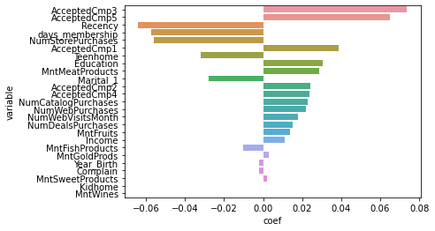
Feature Selection
Coefficients of features derived from 10-fold cross-validated Lasso Regression using normalised features (standard scaler) at optimal regularization parameter (alpha = 0.002) resulting in R2 score of 0.33
Based on findings, we retain all features except MntWines, being the amount spent on wine products in the last 2 years.
R2 score of Lasso Regression is low at 0.33. We apply Logistic Regression instead to predict the response which are discrete rather than continuous variables.
Logistic regression will perform better as a classification algorithm.

Slide 6
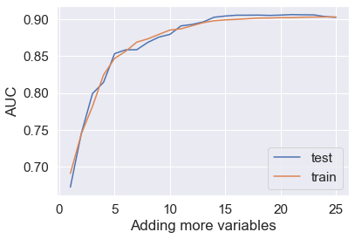
Forward Feature Selection
No. of variables to be set at 15 considering no significant increase in AUC afterwards.
Higher AUC represents better model with higher TPR (True Positive Rate) relative to FPR (False Positive Rate)
No | Features selected
1 | No. purchases using catalogue
2 | No. of days since last purchase
3 | No. of days since first member
4 | Accepted offer in 5th campaign
5 | Accepted offer in 3rd campaign
6 | Accepted offer in 1st campaign
7 | Married/ Single
8 | Education level
9 | No. of teenagers in household
10 | No. of purchases using web
11 | Amount spent on meat last 2 years
12 | No. of purchases made in stores
13 | Accepted offer in 4th campaign
14 | No. of purchases with discount
15 | Accepted offer in 2nd campaign

Slide 7
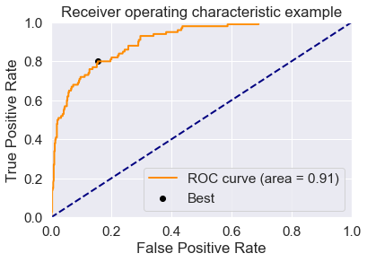

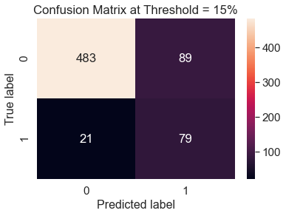
Evaluating result of Logistic Regression
AUC of 0.91 indicates a high probability that the model ranks a random positive example more highly than a negative example
At the best threshold, the model resulted in TPR of ~0.8 and FPR of ~0.15
Out of 672 test population, the model predicts 79 responses out of 100 responses (i.e. TPR 0.8)
TPR = 79 / (21+79) = 0.8
(correctly predicted positives/true positives)
FPR = 89 / (483+89) = 0.15
(incorrectly predicted positives/true negatives)

Slide 8

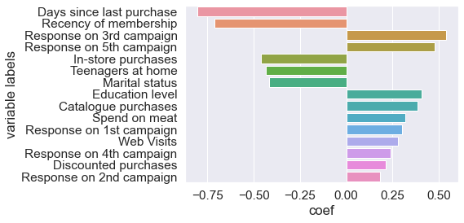
Business Applications: predictive strength of selected features
CHANNEL
PRODUCTS
CUSTOMER SEGMENTS
Website
Meat
Recent Purchase
Recent Membership
Higher Education
Not married

Slide 9
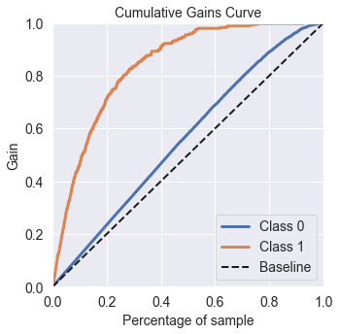
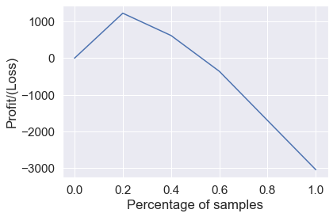
Business Applications: Cumulative gain
SAMPLE SIZE
GAIN
PROFITS
2240
% of targets gained
Cost = $11 per customer
Revenue = $3 per target
Maximise profit at 20% of sample size which results in 70% of target responses
Percentage of target achieved at each sample size
Samples selected = 440
(0.2 x population size of 2240)
Targets achieved = 234
(0.7 x total positive responses of 334)
Cost = 440 x 3 = 1,320
Revenue = 234 x 11 = 2,574
Profit = 2,574 – 1,320 = 1,254

Slide 10
Conclusion
Logistics regression model provides high accuracy classification which allows business to identify response-driving features and optimize scale for profitability
However, the strategic decisions may consider more forward-looking elements such as increase in market shares, customer acquisitions, market penetrations, etc.

