Slide 1
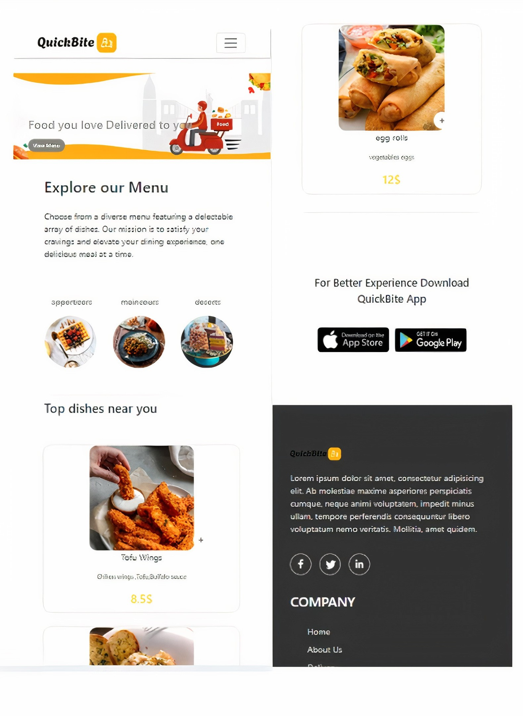
QuickBite: A Node.js and React.js Powered Restauration Website
QuickBite is a modern, user-friendly website that brings the convenience of restaurant dining directly to your doorstep. Built with the robust Node.js and React.js frameworks, QuickBite provides a seamless and engaging experience for both restaurants and customers.

Slide 2
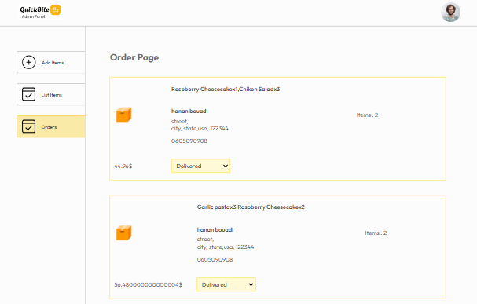
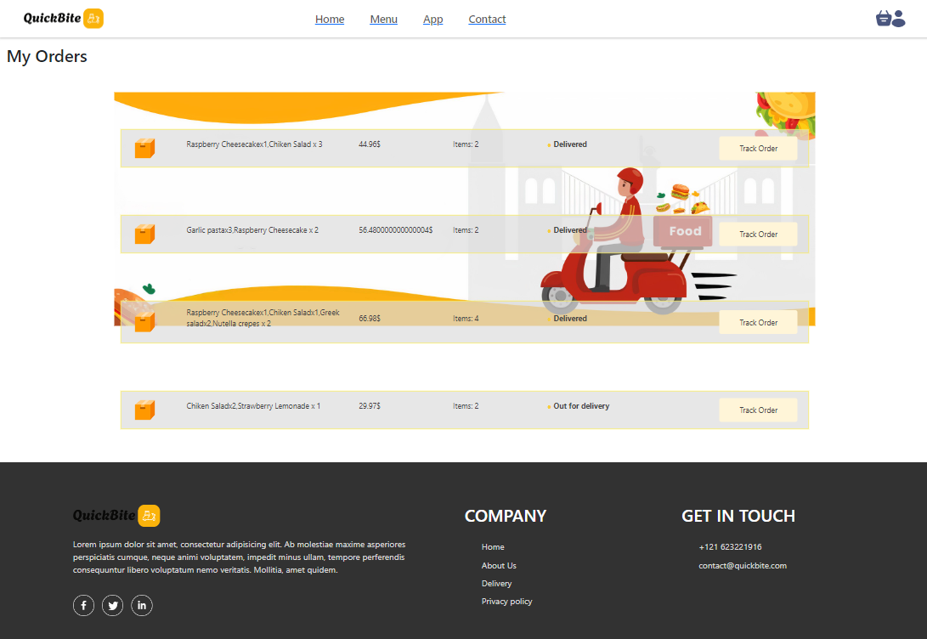
Delivery Functionality
Order Status
Real-time Order Tracking
Customers can track the progress of their orders in real-time, from placement to delivery, through the user-friendly interface.
Admin can change the order status from food processing to delivered and the user can track this order by clicking on track my order button

Slide 3
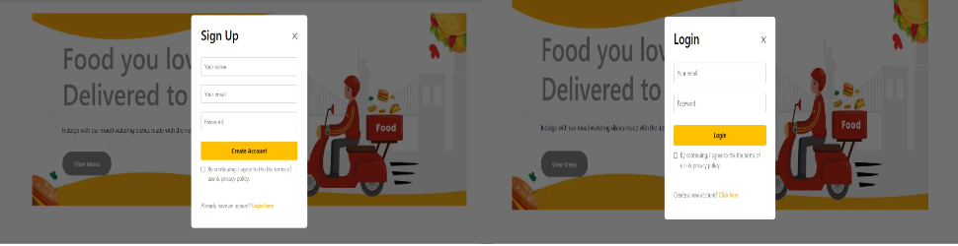
Login and Sign Up
Secure Authentication
Personalized Experience
Users can create accounts with strong passwords and unique usernames for secure access to their order history, saved addresses, and preferences.
Upon logging in, users can personalize their experience with saved preferences, order history, and customized recommendations based on their past interactions.

Slide 4
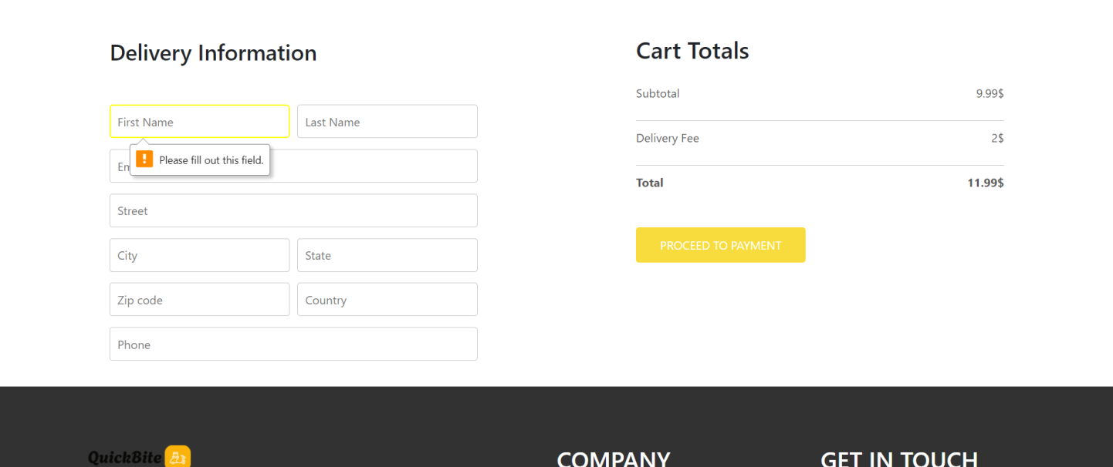
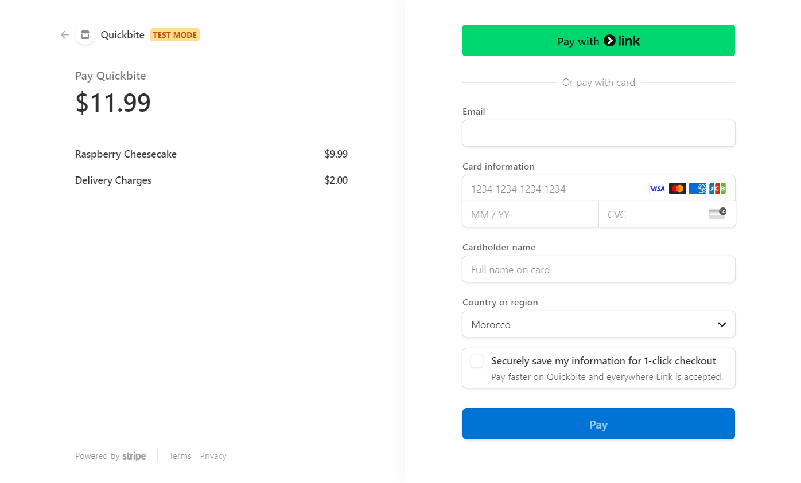
Stripe Library for Checkout Payment
QuickBite leverages the Stripe library to facilitate seamless and secure online payments.
Stripe handles all aspects of payment processing, including credit card validation, fraud prevention, and payment gateway integration, streamlining the checkout experience for users.

Slide 5
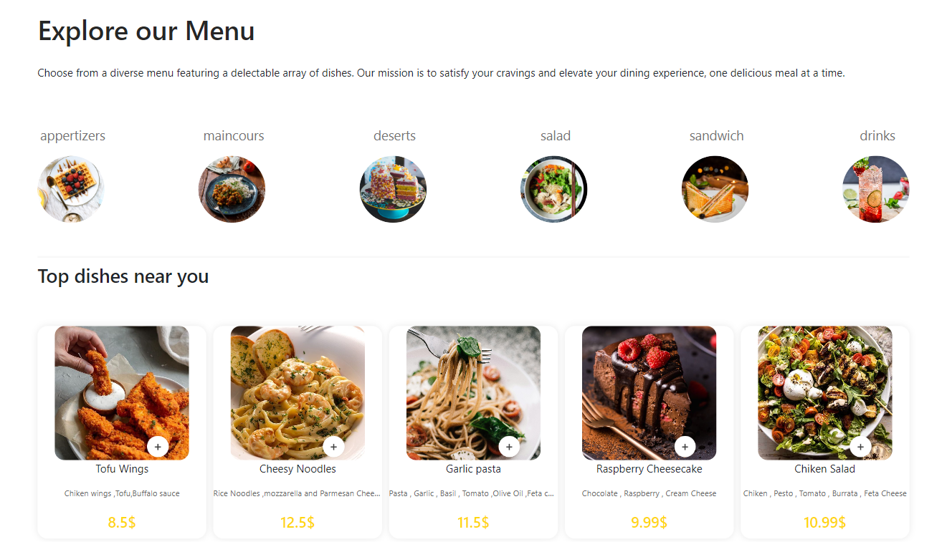
User-Friendly Interface
QuickBite prioritizes a user-friendly interface for a seamless ordering experience. Users can easily navigate the menu, browse various cuisines, and place orders with a few simple clicks.
The interface is designed to be intuitive and responsive, adapting to different screen sizes and devices.

Slide 6
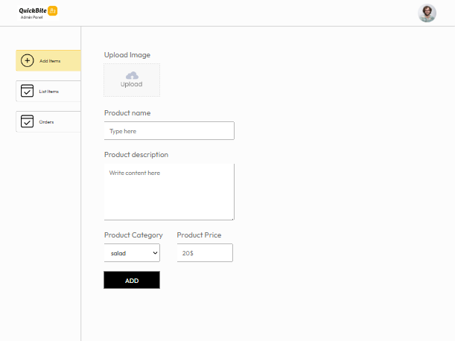
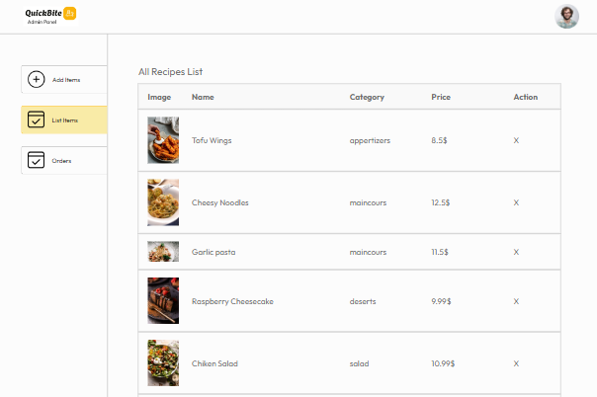
API Integration for Recipe Data
Functionality of adding new recipes by the admin
and removing them,plus fetching the list of recipes

Slide 7
Responsive Front-end with React.js
Adaptive Design
Intuitive Navigation
The QuickBite website is designed to adapt seamlessly to various devices, ensuring a consistent and enjoyable user experience across desktops, tablets, and smartphones.
React.js allows for a dynamic and user-friendly interface, enabling effortless browsing, menu selection, and order placement.
Dynamic Content
Enhanced Performance
React.js powers the dynamic loading of recipes, menus, and other content, ensuring a smooth and engaging browsing experience.
React.js's virtual DOM and efficient rendering contribute to a fast and responsive front-end, enhancing the overall user experience.

Slide 8
Efficient Backend with Node.js
Node.js Power
Database Integration
API Management
Node.js provides a robust and efficient backend for QuickBite. It enables real-time functionality and efficient handling of numerous requests.
Node.js seamlessly integrates with MongoDB for storing and retrieving user data, order information, and restaurant menus.
Node.js powers QuickBite's APIs, enabling communication between the frontend and backend for data exchange and seamless functionality.

Slide 9



Seamless Order Placement and Tracking
Order Confirmation
1
Real-time confirmation
Order Tracking
2
Live updates on order status
Easy Payment
3
Secure and convenient checkout
Users can effortlessly place orders with just a few clicks. The platform provides real-time order confirmation. Order tracking is integrated, allowing users to monitor the progress of their orders in real-time. The checkout process is designed for a seamless experience, ensuring a secure and convenient transaction.

