Slide 1
BIOBANK &
BIOSPECIMEN
MANAGEMENT SYSTEM
DB
Database design, SQL operations & connected Python GUI
Prepared by
Lamia Shady
241002351
Database Management System • MySQL • 2026
01

Slide 2
01
PROJECT OVERVIEW
Problem, objective and practical solution
!
Problem
◎
Objective
✓
Solution
Biobank information
becomes difficult to manage when donors
, samples and laboratory activities are
stored without a structured
relational design.
The project organizes these records
so they can be stored, related,
queried and maintained consistently.
Design and implement a MySQL relational
database for biobank and biospecimen
management. The system demonstrates
entities, relationships, keys, constraints,
normalization, SQL operations, views,
a trigger and testing.
MySQL stores the structured data,
while Python Tkinter provides
a connected desktop interface.
The GUI can display donor records,
search for a donor and
add new donor information
directly to the database.
BIOBANK & BIOSPECIMEN MANAGEMENT SYSTEM • MySQL
02

Slide 3
02
SYSTEM SCOPE & ENTITIES
What the database is responsible for
10
3NF
2
1
GUI
MAIN TABLES
NORMALIZATION
DATABASE VIEWS
TRIGGER
BONUS FEATURE
The implemented relational
schema contains ten main tables.
The design was normalized
to Third Normal Form.
Donor Sample View and
Research Test View.
Validates sample usage
quantity before insertion.
Python Tk inter
connected directly to MySQL.
D
Donor & Consent
S
Samples & Storage
R
Research & Testing
Donors stores personal donor information.
Consent stores consent date,
type and status linked to the donor.
Sample Types defines sample categories.
Collection Events records collection activity.
Samples stores collected samples.
Storage Locations records freezer and
temperature information.
Researchers manage researcher information.
Test Requests records requested tests.
Test Request Samples resolves
the many-to-many relationship.
Sample Usage tracks researcher use of samples.
BIOBANK & BIOSPECIMEN MANAGEMENT SYSTEM • MySQL
03

Slide 4
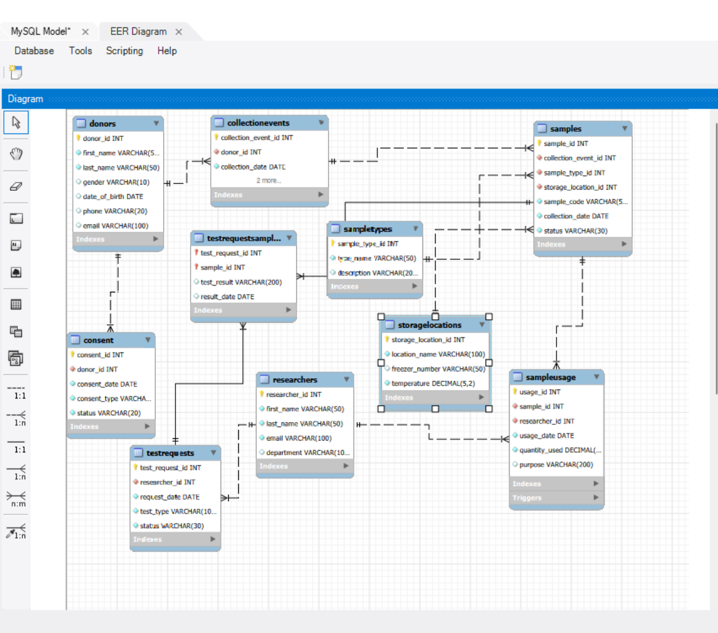
03
CONCEPTUAL DESIGN — ER DIAGRAM
Entities, relationships and cardinality
KEY RELATIONSHIPS
• Donor 1 : Many Consent
• Donor 1 : Many CollectionEvents
• CollectionEvent 1 : Many Samples
• SampleType 1 : Many Samples
• StorageLocation 1 : Many Samples
• Researcher 1 : Many TestRequests
• TestRequest Many : Many Sample → TestRequestSamples
• Researcher Many : Many Sample → SampleUsage
Associative tables preserve many-to-many relationships.
Use the complete ERD with table names, PK/FK fields and relationship lines.
BIOBANK & BIOSPECIMEN MANAGEMENT SYSTEM • MySQL
04

Slide 5
04
RELATIONAL SCHEMA & NORMALIZATION
How the ER model was converted into MySQL tables
RELATIONAL SCHEMA
WHY 3NF?
Donors(donor_id PK, first_name, last_name, gender, date_of_birth, phone, email UNIQUE)
Consent(consent_id PK, donor_id FK, consent_date, consent_type, status)
Sample Types(sample_type_id PK, type_name UNIQUE, description)
Storage Locations(storage_location_id PK, location_name, freezer_number, temperature)
Collection Events(collection event_id PK, donor_id FK, collection_date, collection_method, collector_name)
Samples(sample_id PK, collection_event_id FK, sample_type_id FK, storage_location_id FK, sample_code UNIQUE, collection_date, status)
Researchers(researcher_id PK, first_name, last_name, email UNIQUE, department)
Test Requests(test_request_id PK, researcher_id FK, request_date, test_type, status)
Test Request Samples(test_request_id PK/FK, sample_id PK/FK, test_result, result_date)
Sample Usage(usage_id PK, sample_id FK, researcher_id FK, usage_date, quantity_used, purpose)
1
1NF — Atomic values
Each field stores one value and
there are no repeating groups.
2
2NF — Full dependency
Non-key attributes depend on the complete primary key;
this is important for the composite key in
Test Request Samples.
3
3NF — No transitive dependency
Related information is separated into appropriate tables so
non-key attributes do not depend on other non-key attributes.
BIOBANK & BIOSPECIMEN MANAGEMENT SYSTEM • MySQL
05

Slide 6
05
MYSQL IMPLEMENTATION
Database creation, table creation and organized SQL scripts
DATABASE CREATION
PROJECT EXECUTION ORDER
CREATE DATABASE IF NOT EXISTS BiobankDB; USE BiobankDB; CREATE TABLE Donors ( donor_id INT AUTO_INCREMENT PRIMARY KEY, first_name VARCHAR(50) NOT NULL, last_name VARCHAR(50) NOT NULL, gender VARCHAR(10), date_of_birth DATE, phone VARCHAR(20), email VARCHAR(100) UNIQUE );
01
create_tables.sql
Creates the database tables and constraints.
02
load_data.sql
Inserts the test data into the implemented tables.
03
views.sql
Creates the two required database views.
04
Triggers procedures.sql
Implements the sample-usage validation trigger.
05
queries.sql
Runs retrieval, joins, aggregation, subqueries and
data modification.
Primary keys + foreign keys + NOT NULL + UNIQUE
BIOBANK & BIOSPECIMEN MANAGEMENT SYSTEM • MySQL
06

Slide 7
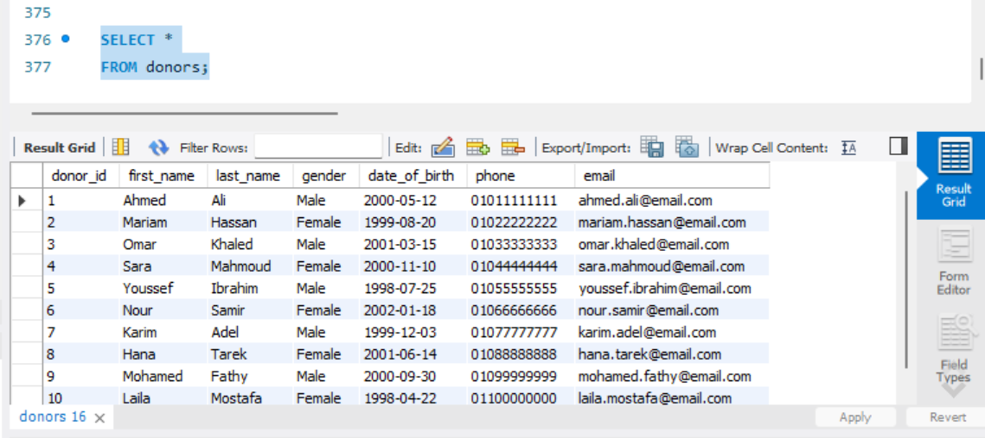
06
SAMPLE DATA & SUCCESSFUL EXECUTION
Evidence that the database contains meaningful test records
DONORS TABLE
The Donors table stores:
• donor_id — unique identifier
• first_name / last_name — donor name
• gender — donor gender
• date_of_birth — birth date
• phone — contact number
• email — unique contact email
10 meaningful donor records were loaded for testing.
Recommended: show the 10 donor records clearly in the result grid.
Keep this slide evidence-focused: the screenshot is the proof; the text explains what the examiner should notice.
BIOBANK & BIOSPECIMEN MANAGEMENT SYSTEM • MySQL
07

Slide 8
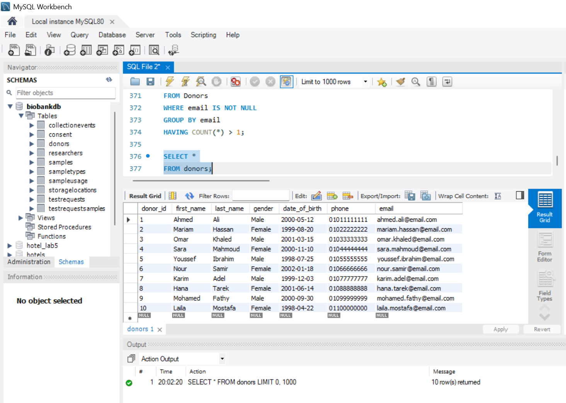
07
SQL OPERATIONS
Retrieval, joins, aggregation, subqueries and data modification
SELECT + JOIN + AGGREGATION + SUBQUERY
-- Filtering SELECT * FROM Donors WHERE gender = 'Female'; -- Join SELECT d.first_name, d.last_name, ce.collection_date FROM Donors d JOIN CollectionEvents ce ON d.donor_id = ce.donor_id; -- Aggregation SELECT st.type_name, COUNT(s.sample_id) AS number_of_samples FROM SampleTypes st LEFT JOIN Samples s ON st.sample_type_id = s.sample_type_id GROUP BY st.type_name; -- Subquery SELECT first_name, last_name FROM Donors WHERE donor_id IN ( SELECT donor_id FROM CollectionEvents );
Choose a result that clearly demonstrates a JOIN or aggregation.
↕
Data modification was also tested
INSERT, UPDATE and DELETE statements
were executed to demonstrate that records
can be added, changed and
removed while respecting the database constraints.
BIOBANK & BIOSPECIMEN MANAGEMENT SYSTEM • MySQL
08

Slide 9
08
VIEWS, TRIGGER & BUSINESS RULES
Advanced database objects used to simplify reporting and protect data integrity
V1
View 1 — Donor Sample View
V2
View 2 — Research Test View
TR
Trigger — Sample Usage
Combines donor, sample, sample type and
storage information.
It returns the donor name, sample code,
sample type, storage location, temperature and
sample status.
Combines researcher and test-request information.
It returns the researcher name, department,
request date, test type and request status.
Before inserting into Sample Usage,
the trigger checks quantity_used.
If the value is less than or equal to zero,
the insert is rejected with an error message.
Business rule enforced: quantity_used must be greater than zero.
BIOBANK & BIOSPECIMEN MANAGEMENT SYSTEM • MySQL
09

Slide 10
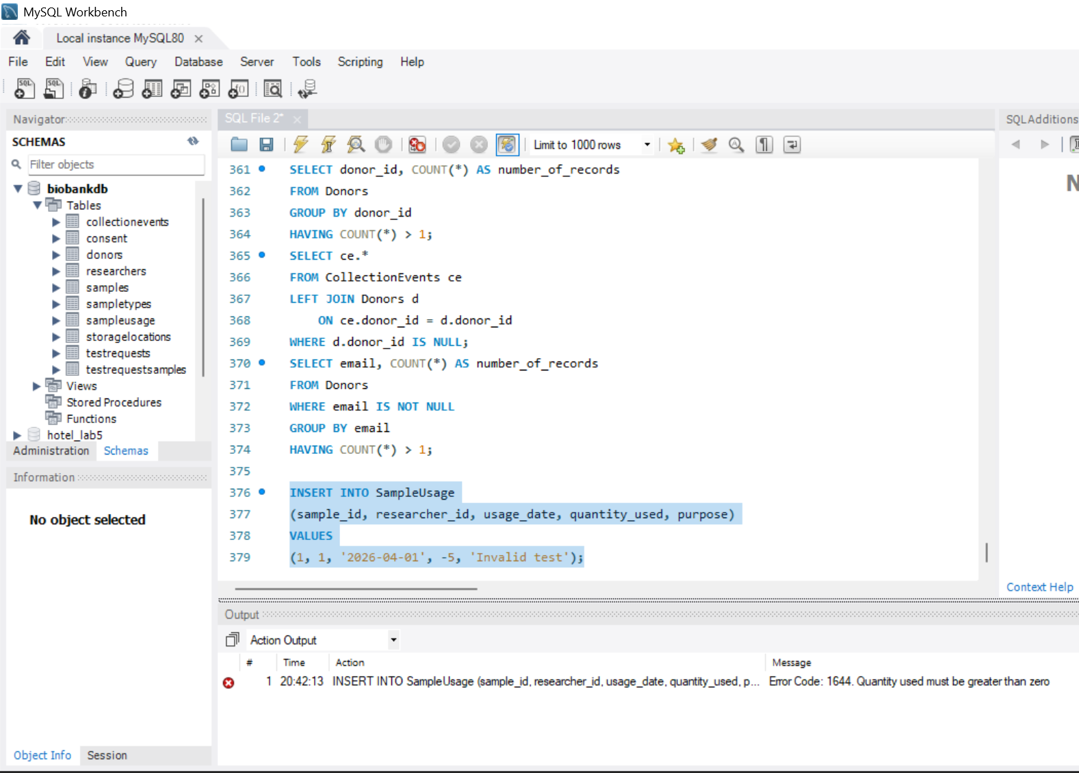
09
TESTING & VALIDATION
Evidence that constraints, views, joins and business rules behave correctly
TEST CASE
EXPECTED RESULT
STATUS
Valid data insertion
Record is inserted successfully
PASSED
Duplicate primary key
Duplicate record is rejected
PASSED
Invalid foreign key
Invalid relationship is rejected
PASSED
Show the error produced when quantity_used is invalid.
Duplicate UNIQUE value
Duplicate email/sample code is rejected
PASSED
✓
What the tests prove
Negative sample quantity
Trigger rejects the record
PASSED
Valid records can be inserted and retrieved.
Invalid keys and duplicate UNIQUE values are prevented.
The trigger enforces the sample-usage rule,
while views and JOIN queries return
the expected related information.
View execution
Expected combined data is returned
PASSED
JOIN query
Related records are displayed correctly
PASSED
BIOBANK & BIOSPECIMEN MANAGEMENT SYSTEM • MySQL
10

Slide 11
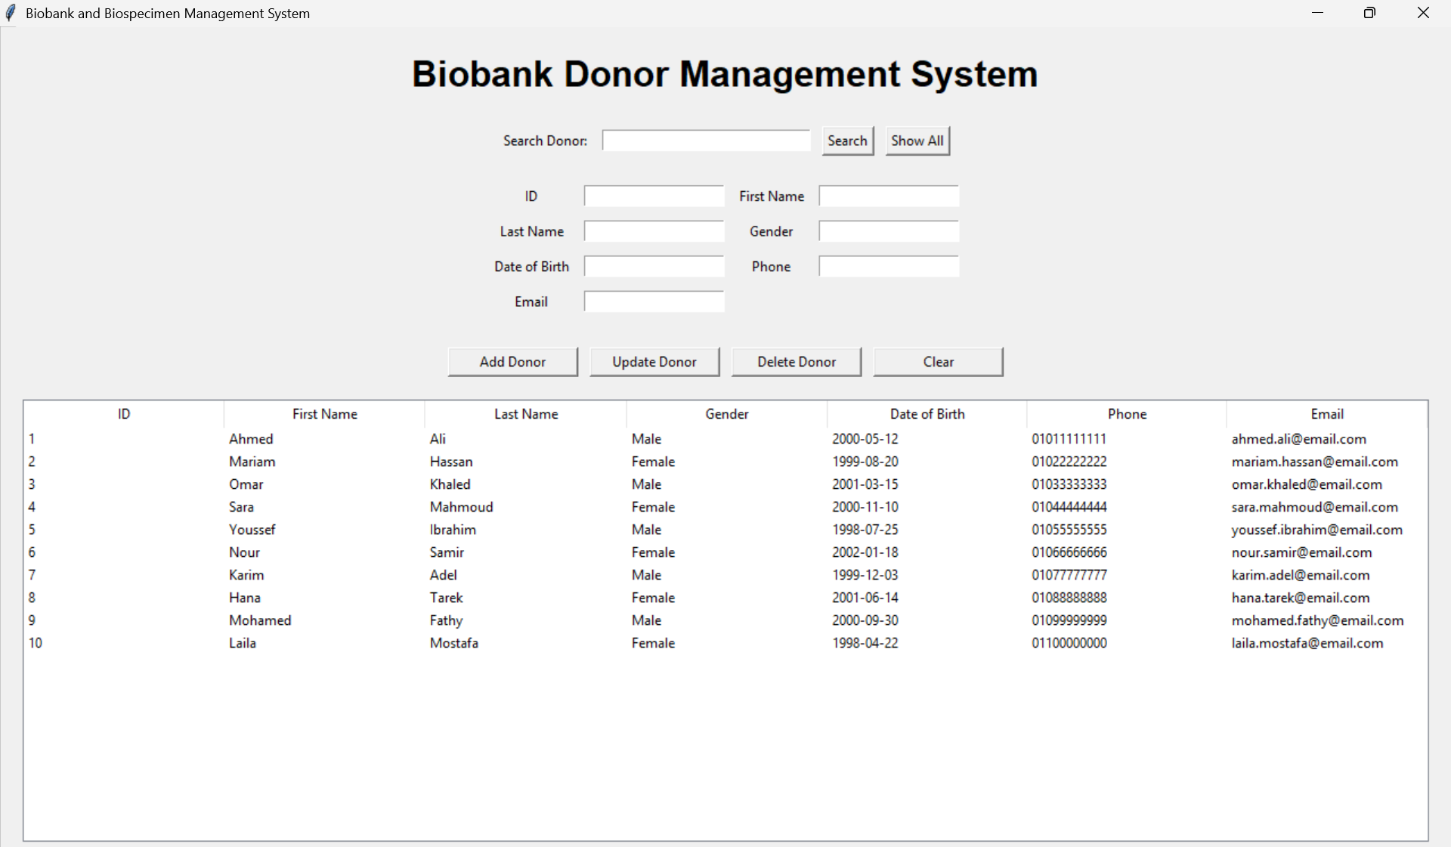
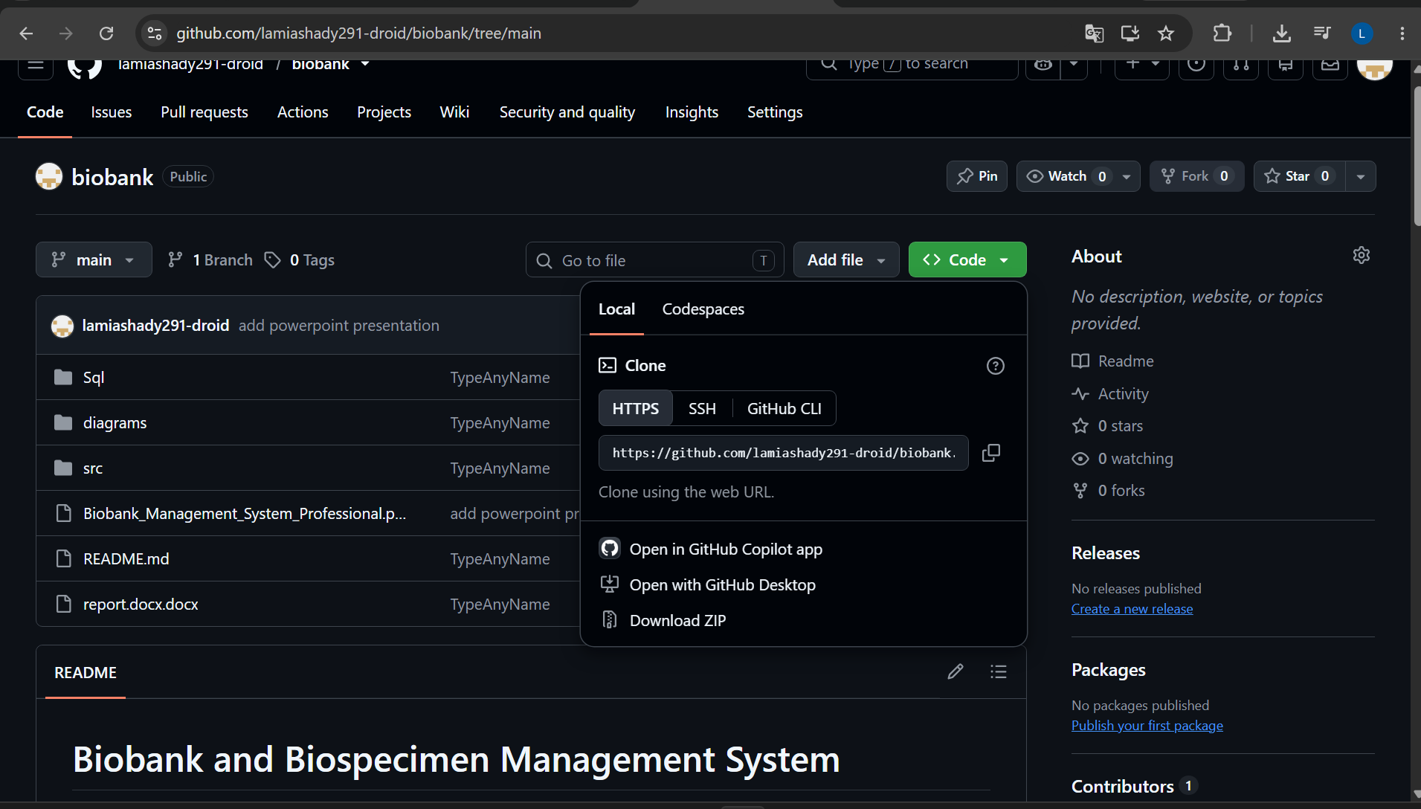
10
BONUS — CONNECTED TKINTER GUI + GITHUB
The working application and the project repository
Best choice: Show All donors, Search result, or Add Data result.
Show the repository name, project files and README.
GUI
GUI bonus
GH
GitHub submission
Python Tkinter connects directly to MySQL and
demonstrates viewing, searching and adding donor records through a real interface.
The public repository keeps the SQL scripts, source code, README,
report and presentation together for reproducible submission.
BIOBANK & BIOSPECIMEN MANAGEMENT SYSTEM • MySQL
11

Slide 12
11
SYSTEM WORKFLOW & KEY ACHIEVEMENTS
From relational design to a usable database application
01
02
03
04
05
06
REQUIREMENTS
→
ER DESIGN
→
3NF SCHEMA
→
MYSQL
→
SQL OBJECTS
→
GUI
Define entities, attributes
and
business rules.
Model relationships
and
cardinalities.
Map entities
into
normalized tables.
Create tables, keys,
constraints and data.
Run queries,
views and trigger.
Connect Tkinter to
the live database.
WHAT THE PROJECT DEMONSTRATES
1
Structured data management
2
Integrity & validation
3
Practical application
Ten related tables organize donors, samples,
researchers, tests, storage and
usage information with PK/FK constraints.
UNIQUE and NOT NULL rules,
referential integrity, views and
the sample-usage trigger protect the database.
The connected Tkinter interface turns
the database into a usable
application for viewing, searching and
adding donor data.
BIOBANK & BIOSPECIMEN MANAGEMENT SYSTEM • MySQL
12

Slide 13
CONCLUSION
A structured database
with integrity, advanced SQL features, and a working user interface.
• The MySQL database was designed around a normalized relational model for biobank and biospecimen management.
• SQL queries, joins, aggregation, subqueries, two views and a trigger were implemented and tested.
• The Tkinter GUI provides a practical connection between the database and the user.
• Future development can add more biospecimen workflows, stronger validation and richer reporting screens.
DB
THANK YOU!
Any questions?
Lamia Shady • Biobank & Biospecimen Management System • MySQL + Python Tkinter

