Slide 1
UMRAH GUIDE
Knowledge Base
Artificial Intelligence & Expert Systems Lab | CSE404
University of Asia Pacific
Lamia Tabassum Orpa | Student ID: 22101184
Submitted to: Nahida Marzan, Lecturer, Dept. of CSE

Slide 2
Problem Statement
Umrah is one of the most significant acts of worship in Islam. Many pilgrims — especially first-timers — face challenges:
❓ Ritual Sequence
📋 Ihram Rules
Difficult to remember all 8 steps in correct order
Unclear what is allowed or forbidden during Ihram
🤲 Duas
👤 Personal Guidance
Hard to recall the correct dua for each occasion
Lack of tailored advice for elderly, pregnant, or disabled pilgrims
✅ Solution: A Prolog-based Knowledge Base that stores and reasons over structured Islamic knowledge — interactive and queryable.

Slide 3
Tools & Technologies
🔷 SWI-Prolog v10.0.2
Primary language for knowledge representation, fact storage, rule definition and interactive querying.
💻 SWI-Prolog IDE
Development environment — interactive console for loading, testing, and debugging the knowledge base.
📝 Notepad (Windows)
Text editor used to write and edit the Prolog source code file (.pl).
🖥️ Windows 11
Operating system used for the entire development process.
🐙 GitHub
Version control — repository available at https://github.com/lamiatabassumorpa/AI-lab

Slide 4
Knowledge Base Structure
01
Places
02
Rituals in Sequence
03
Ihram Rules Engine
8 sacred Umrah locations with descriptions and categories (Masjid al-Haram, Kaaba, Hateem, Zamzam Well, Safa, Marwa, Meeqat, Masjid Aisha)
8 steps of Umrah stored in order Query next/previous ritual, first & last ritual
8 allowed + 9 forbidden actions check_action() returns ALLOWED / FORBIDDEN with reason
04
Dua Knowledge Base
05
Pilgrim Advisor
7 duas with Arabic text and English meaning (Talbiyah, Tawaf, Hateem, Zamzam, Saee, Safa, Marwa)
5 pilgrims with different genders & conditions Personalized guidance + gender-specific Ihram clothing rules

Slide 5
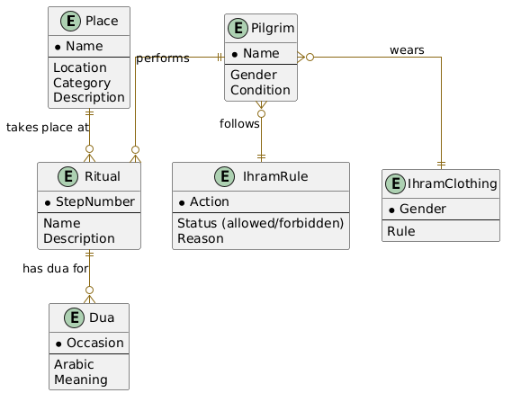
ERD Diagram
Place
Ritual
IhramRule
Name (PK) Location Category Description
StepNumber (PK) Name Description
Action (PK) Status Reason
Pilgrim
IhramClothing
Dua
Name (PK) Gender Condition
Gender (PK) Rule
Occasion (PK) Arabic Meaning
Relationships
→ Pilgrim performs Ritual
→ Pilgrim follows IhramRule
→ Pilgrim wears IhramClothing
→ Ritual takes place at Place
→ Ritual has dua for Dua

Slide 6
Key Prolog Concepts
📌 Facts
⚙️ Rules
Unconditionally true statements stored directly in the KB.
Logical conditions that derive new facts from existing ones.
Example:
Example:
place(kaaba, inside_masjid_al_haram, structure, 'Qibla of all Muslims').
inside_haram(X) :- place(X, inside_masjid_al_haram, _, _).
More examples:
More examples:
• ritual(1, enter_ihram, '...')
next_ritual(X,Y) :- ritual(N,X,_),
• forbidden_in_ihram(use_perfume, '...')
N1 is N+1, ritual(N1,Y,_).
• pilgrim(maryam, female, pregnant)
is_forbidden(X) :- forbidden_in_ihram(X,_).
holy_place(X) :- place(X,_,_,_).

Slide 7
Sample Queries & Outputs
Q1 — List all holy places
Q2 — Next ritual after Tawaf
Q3 — Check action (forbidden)
?- holy_place(X).
?- next_ritual(tawaf, X).
?- check_action(cut_nails).
X = masjid_al_haram ; X = kaaba ; ... X = masjid_aisha.
X = two_rakah_prayer.
FORBIDDEN: Trimming nails is forbidden in state of Ihram
Q4 — Check action (allowed)
Q5 — Show dua
Q6 — Guidance for pregnant pilgrim
?- check_action(recite_quran).
?- show_dua(drinking_zamzam).
?- show_guidance(maryam).
ALLOWED: Recitation of Quran is encouraged in Ihram
Arabic: Allahumma inni asaluka ilman nafia Meaning: O Allah I ask You for beneficial knowledge
Condition: pregnant Guidance: Consult a doctor. Tawaf at outer areas.

Slide 8
Challenges Faced
Learning Prolog from Scratch
Understanding Backtracking
01
First exposure to logic programming — a completely different paradigm from Python or Java.
02
Learning that pressing ; triggers backtracking to find the next solution was essential.
Writing Rules with Variables
Handling Unknown Actions
03
Using X, D, N, N1 as variables and _ as a wildcard required careful understanding.
04
Using the \+ negation operator in check_action for unrecognized actions was tricky.
Structuring the Knowledge Base
05
Organizing 5 sections cleanly in one .pl file required multiple planning revisions.

Slide 9
Conclusion
✅ Successfully built a Prolog-based Umrah Guide Knowledge Base covering 5 key areas.
✅ The system reasons over Islamic knowledge — not just stores it — using logical inference.
✅ Users can query rituals in order, check Ihram rules, retrieve duas, and get personalized guidance.
✅ Unlike traditional databases, Prolog's backtracking delivers intelligent, rule-based responses.
✅ The project holds personal significance — inspired by a real Umrah visit, ensuring authenticity.
Course: CSE404 — AI & Expert Systems Lab | University of Asia Pacific

Slide 10
Resources & Links
Lab Report
📄
https://docs.google.com/document/d/1oxk7hY2zl-T206oxTrWrCSX9BWnLz_YEdOrH2ELYiUA/edit?usp=sharing
Source Code
💾
https://drive.google.com/file/d/1FOEmS8lGpaNwGcenjKQb-6Rj9itKgFVy/view?usp=sharing
GitHub Repository
🐙
https://github.com/lamiatabassumorpa/AI-lab

