Slide 1
SQL Observer
UI concept deck
Important information, within easy reach
Seven screen concepts for passive SQL Server monitoring and diagnosis
Fleet overview / Server summary / Live activity / Query performance
Deadlock investigation / Operational health / Alert triage
September 2026 UI proposals with illustrative data
Notes:
Based on the current local SqlObserver repository, inspected September 9, 2026. These images are generated UI concepts, not screenshots of implemented product behavior or real telemetry. Source: README.md, web/src/App.tsx, web/src/dashboardModel.ts, and feature files cited on individual slides. Product remains pre-release. The concepts preserve passive SQL Server diagnostics and authorized evidence access.

Slide 2
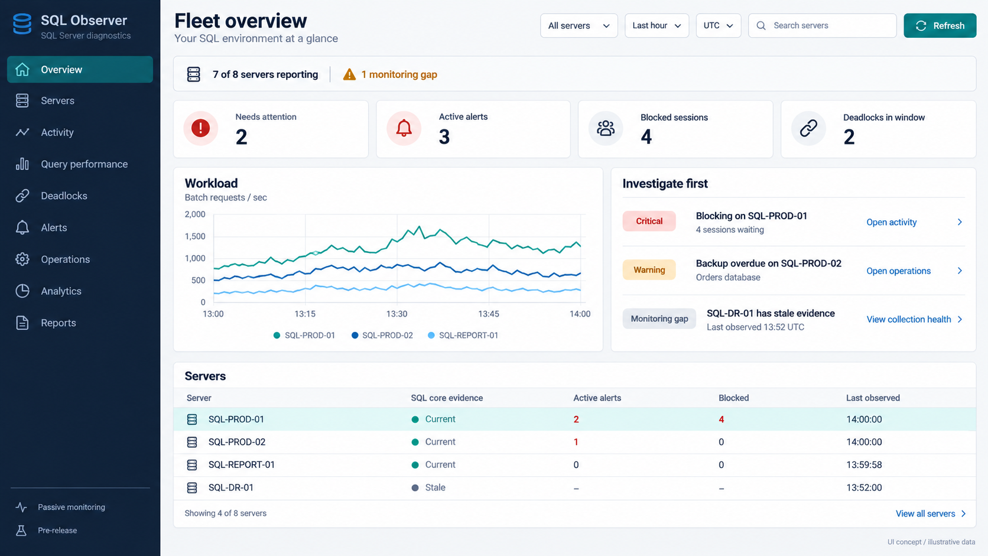
01 / Fleet overview
Exceptions lead the page. Collection gaps remain visible beside the evidence.
Notes:
Existing fleet overview already supplies ranked issues, workload, resources, explicit gaps and scoped time windows. Proposed visual hierarchy makes the investigation list prominent and adds a compact searchable server entry point. Counts and names are illustrative. 7/8 reporting refers to SQL core evidence, not every source.
Repository sources:
G:/Adams SQL Diagnostic Manager/web/src/features/overview/OverviewPage.tsx
G:/Adams SQL Diagnostic Manager/web/src/features/overview/overviewTypes.ts
Image generated with the built-in imagegen tool. Proposed UI. All measurements, names and timestamps are illustrative. Prompt recorded in image-prompts.md.

Slide 3
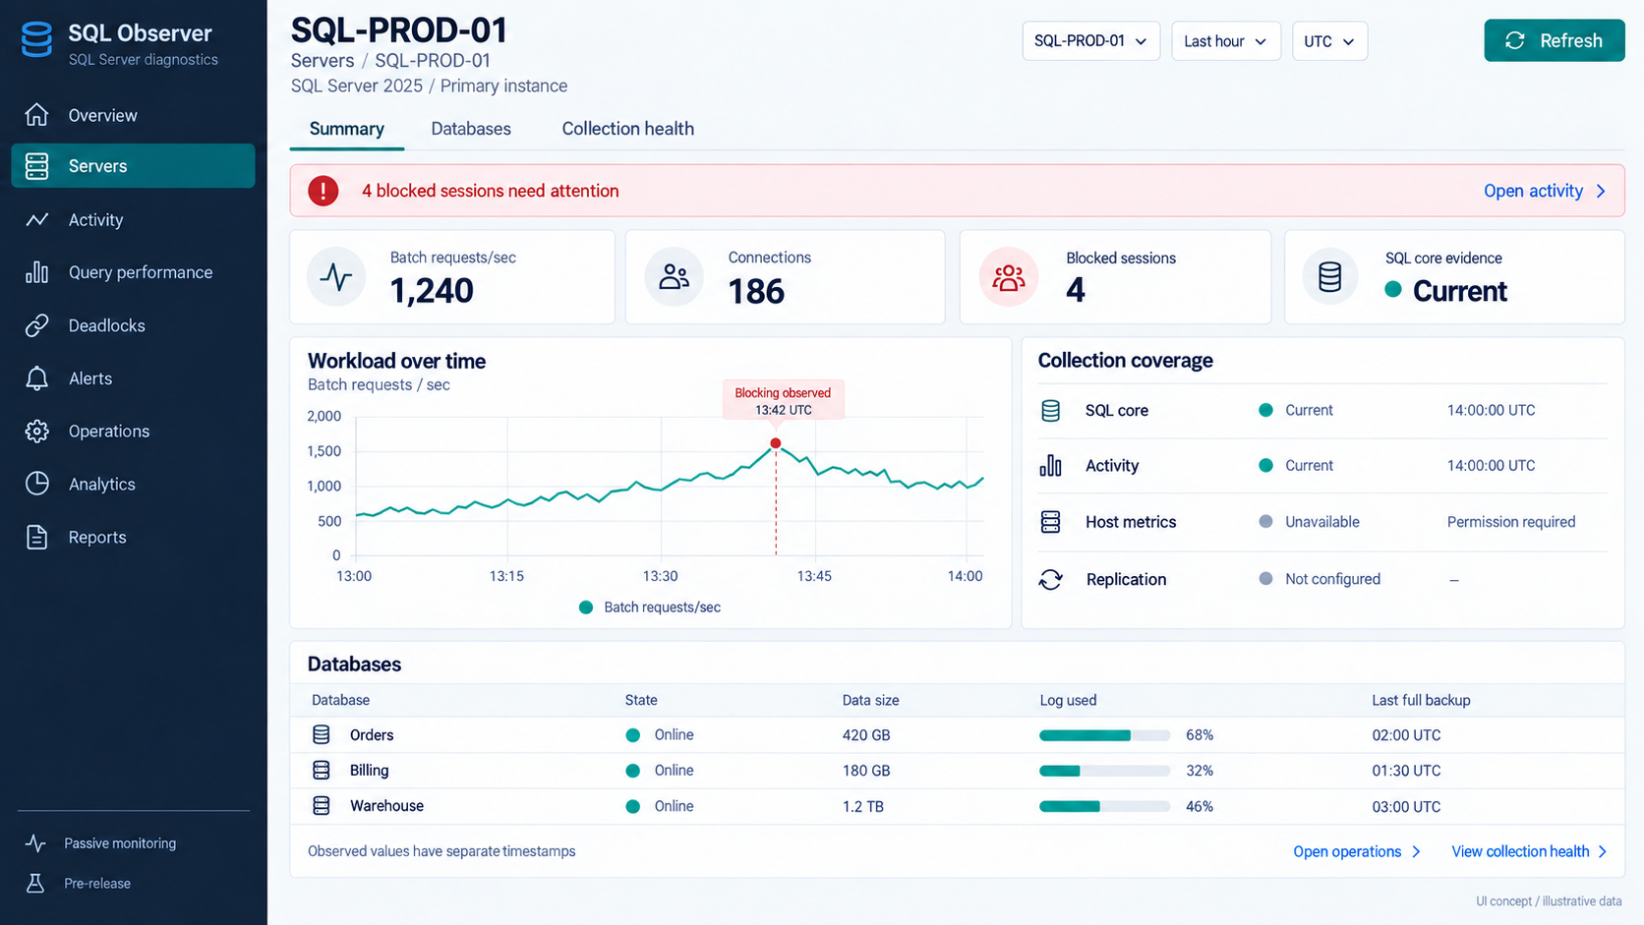
02 / Server summary
Server context, workload and database health stay together throughout the investigation.
Notes:
Proposes consolidating the current Health destination into the selected server workspace. The summary combines existing health, inventory, activity, and operational projections. Host permissions and replication configuration remain separate from SQL-core freshness. Cross-source event markers and common selectors require UI wiring.
Repository sources:
G:/Adams SQL Diagnostic Manager/web/src/features/health/TargetHealthPanel.tsx
G:/Adams SQL Diagnostic Manager/web/src/features/health/healthTypes.ts
G:/Adams SQL Diagnostic Manager/web/src/App.tsx
Image generated with the built-in imagegen tool. Proposed UI. All measurements, names and timestamps are illustrative. Prompt recorded in image-prompts.md.

Slide 4
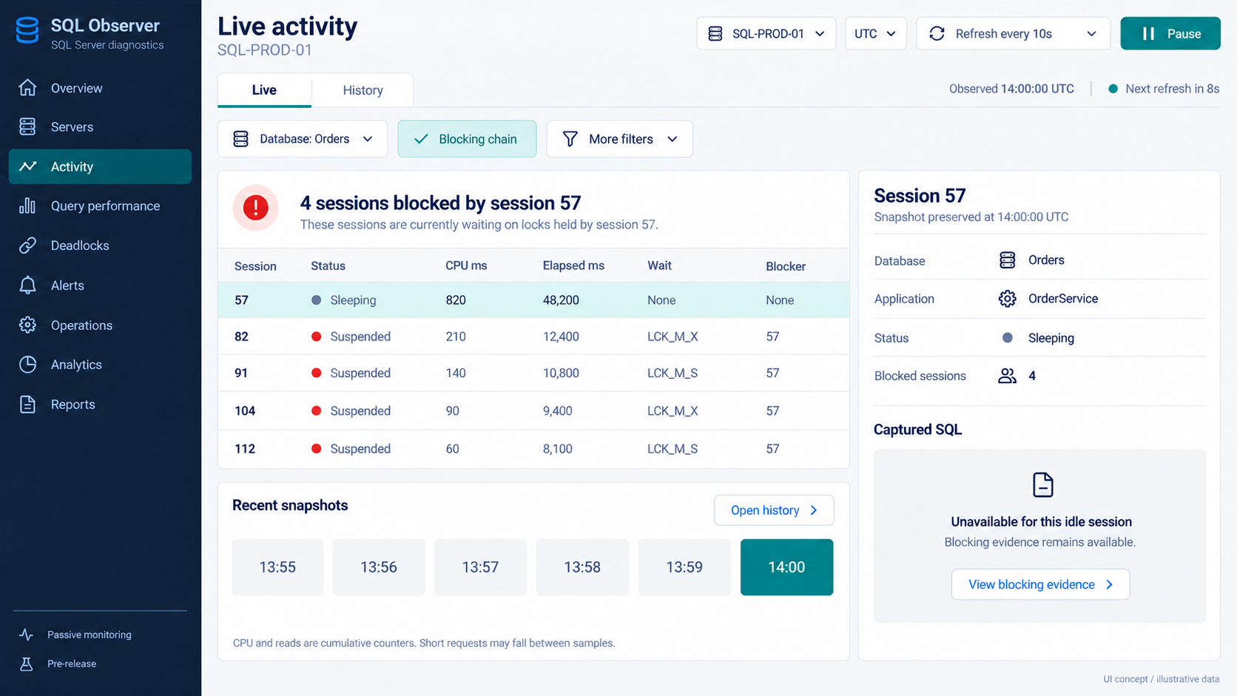
03 / Live activity
A focused blocking chain and a preserved snapshot keep fast-changing sessions understandable.
Notes:
Current code implements 10-second refresh, pause/history, snapshot pagination, filters, session inspection and protected query text. The concept adds a blocking-chain filter including the blocker as context and a simpler snapshot picker. This example uses an idle blocker with unavailable SQL text. Do not equate cumulative CPU milliseconds with CPU percentage. The idle row's duration should be presented as session age rather than request elapsed time in implementation.
Repository sources:
G:/Adams SQL Diagnostic Manager/web/src/features/activity/LiveSessionsPanel.tsx
G:/Adams SQL Diagnostic Manager/web/src/features/activity/liveActivityApi.ts
G:/Adams SQL Diagnostic Manager/web/src/features/activity/liveRefresh.ts
Image generated with the built-in imagegen tool. Proposed UI. All measurements, names and timestamps are illustrative. Prompt recorded in image-prompts.md.

Slide 5
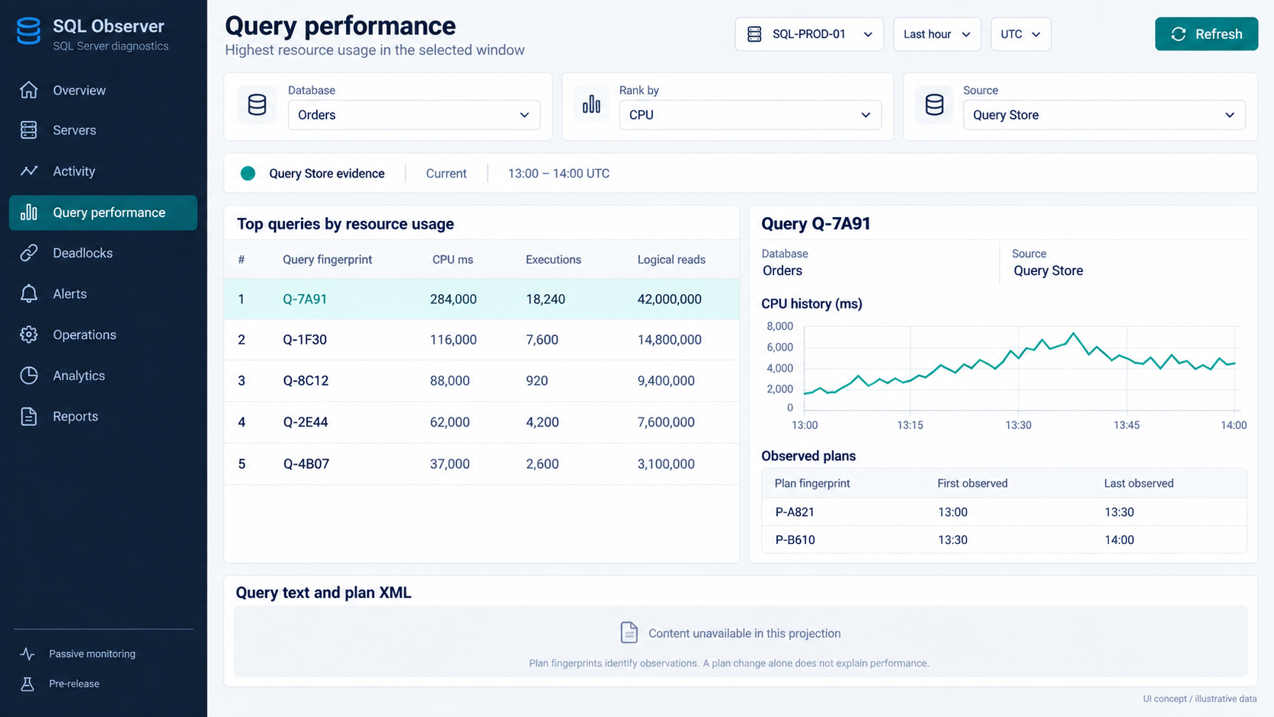
04 / Query performance
Ranked queries open beside their history, with the source and content limits kept explicit.
Notes:
Existing ranking supports CPU, duration, executions, logical reads, writes and rows, with Query Store / plan-cache provenance. Query and plan contentAvailable is false in this projection. Fingerprints shown are shortened illustrative identifiers. Proposed master/detail layout combines ranks, query history and observed plan fingerprints. Time-series points need clearly defined interval aggregation when implemented. No causal claim follows from a plan fingerprint change.
Repository sources:
G:/Adams SQL Diagnostic Manager/web/src/features/queries/TargetQueryPerformancePanel.tsx
G:/Adams SQL Diagnostic Manager/web/src/features/queries/queryPerformanceTypes.ts
Image generated with the built-in imagegen tool. Proposed UI. All measurements, names and timestamps are illustrative. Prompt recorded in image-prompts.md.

Slide 6
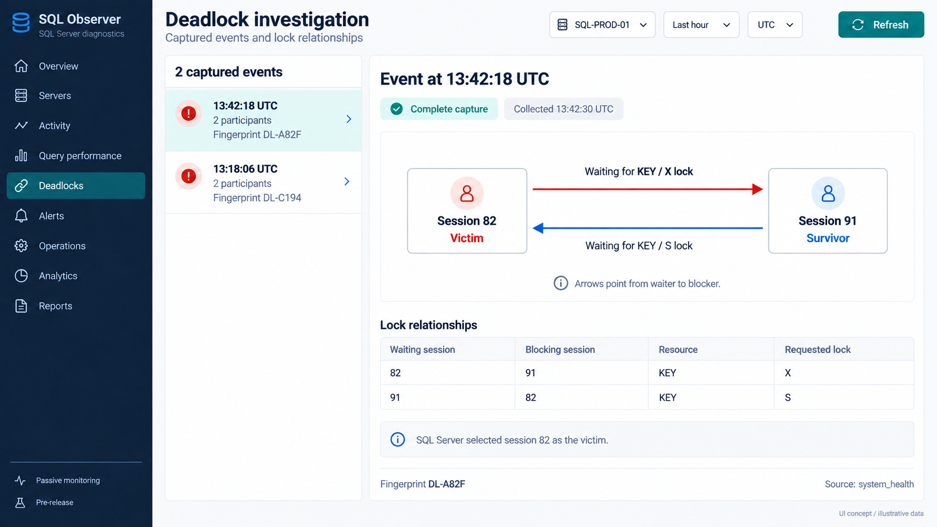
05 / Deadlock investigation
The victim and lock cycle are visible immediately, with the underlying relationships below.
Notes:
Current detail provides participant session IDs, victim flags and blocker/waiter relationships with resource category and lock mode. The proposed diagram maps these existing fields. Arrows point from waiter to blocker. The two-event list and event fingerprints are illustrative. Complete capture denotes capture completeness, not server health.
Repository sources:
G:/Adams SQL Diagnostic Manager/web/src/features/deadlocks/TargetDeadlockPanel.tsx
G:/Adams SQL Diagnostic Manager/web/src/features/deadlocks/deadlockTypes.ts
Image generated with the built-in imagegen tool. Proposed UI. All measurements, names and timestamps are illustrative. Prompt recorded in image-prompts.md.

Slide 7
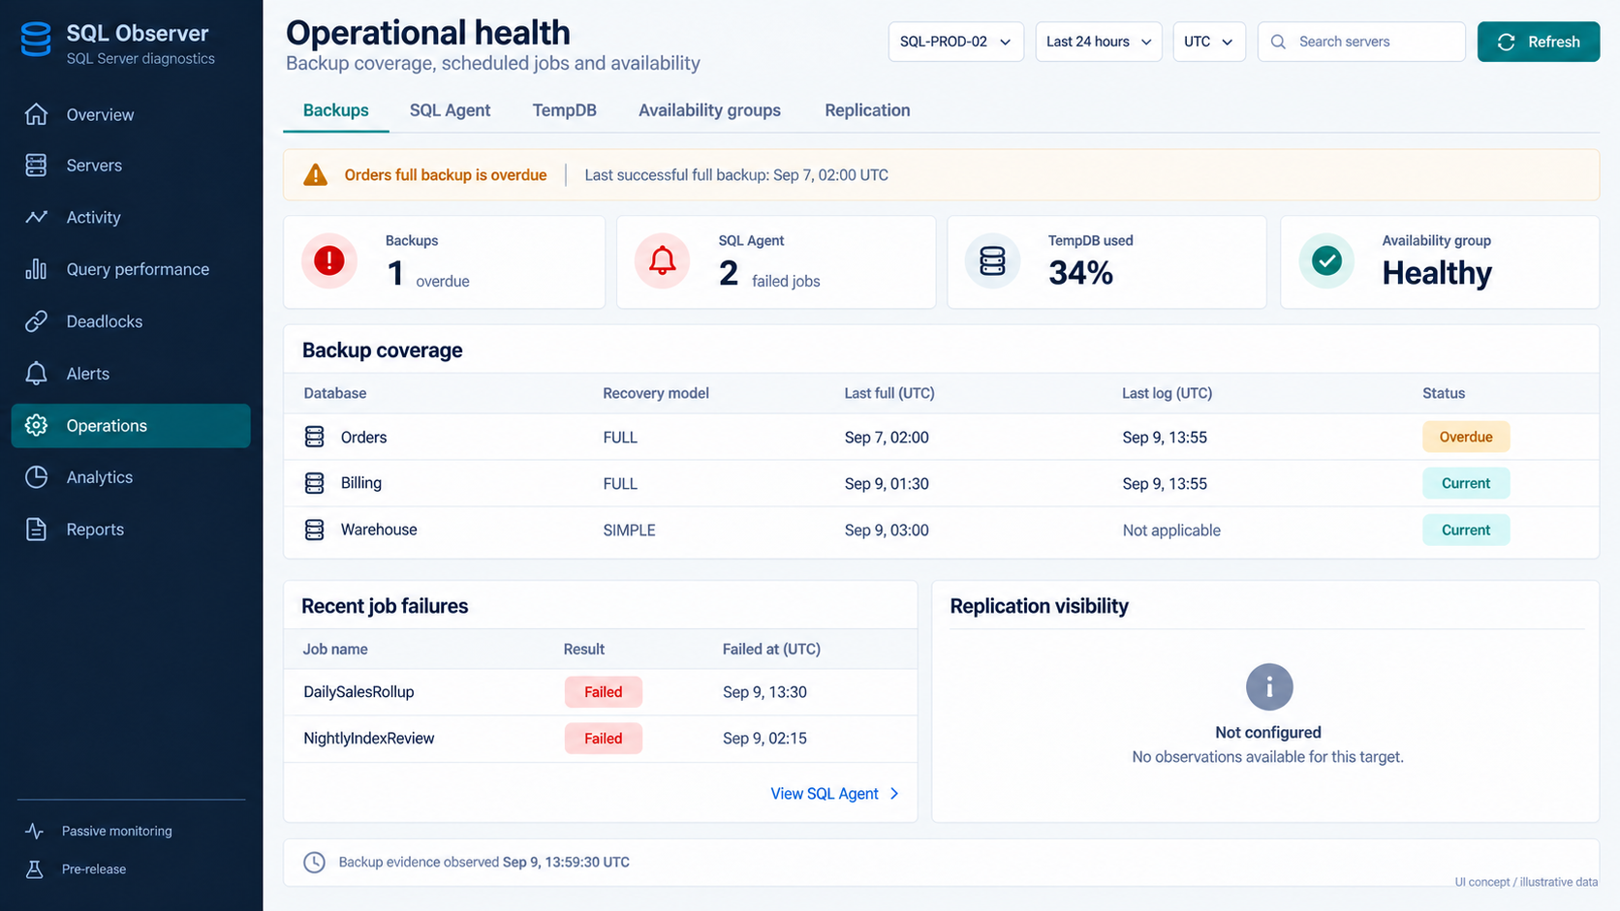
06 / Operational health
Daily checks share one workspace, with overdue work and unavailable monitoring clearly labeled.
Notes:
Backups, SQL Agent failures, TempDB, availability groups, and replication evidence exist. The concept groups these under Operations and summarizes exceptions at the top. Replication currently lives under Analytics. Each metric needs its own observation time and coverage. Overdue backup status must use an explicit policy, not a hard-coded universal age. Job labels are synthetic and need an authorized display-name field or a safe identifier. This is a read-only diagnostics workflow.
Repository sources:
G:/Adams SQL Diagnostic Manager/web/src/features/operations/OperationsPanel.tsx
G:/Adams SQL Diagnostic Manager/web/src/features/operations/operationsTypes.ts
G:/Adams SQL Diagnostic Manager/web/src/features/analytics/AnalyticsSurfacePanel.tsx
Image generated with the built-in imagegen tool. Proposed UI. All measurements, names and timestamps are illustrative. Prompt recorded in image-prompts.md.

Slide 8
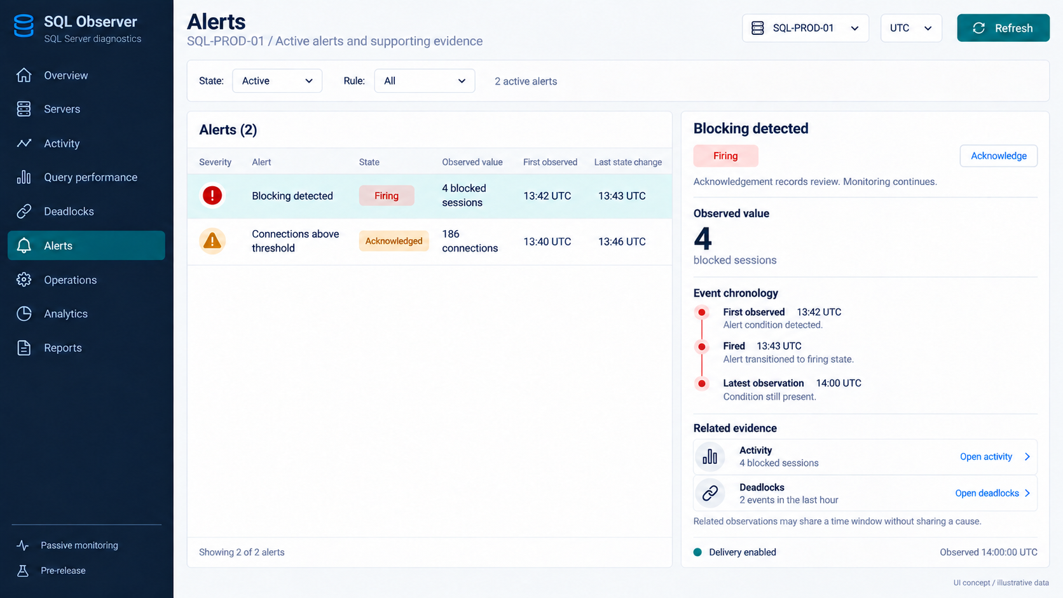
07 / Alert triage
Alert state, review history and links to supporting evidence appear in one place.
Notes:
Existing active alerts are target-scoped and support acknowledgement, state timestamps and delivery-suppression evidence. Friendly rule names, explicit severity and related-evidence links are proposed UI enrichments requiring metadata joins. Acknowledge records review and does not resolve the condition. Delivery enabled is the illustrative case without suppression. Related observations do not prove a shared cause.
Repository sources:
G:/Adams SQL Diagnostic Manager/web/src/features/alerts/TargetAlertsPanel.tsx
G:/Adams SQL Diagnostic Manager/web/src/features/alerts/alertTypes.ts
G:/Adams SQL Diagnostic Manager/web/src/features/alerts/alertApi.ts
Image generated with the built-in imagegen tool. Proposed UI. All measurements, names and timestamps are illustrative. Prompt recorded in image-prompts.md.

Slide 9
Design priorities
Problems before detail
Rank exceptions on the overview and link each one to the next useful diagnostic view.
Context follows the user
Keep the selected server, database and time window through navigation. Preserve inspected snapshots.
Evidence stays honest
Show current, stale, unavailable and incomplete states with text and observation times.
Dense data stays readable
Use aligned tables, concise defaults and a detail pane for the selected item.
Additional capabilities in the project
Analytics includes history, baselines, forecasts and incident evidence. Reports expose HTML and CSV exports. MCP provides read-only diagnostic access. Release certification remains in progress.
Notes:
The seven images prioritize common monitoring and investigation workflows; they are not an exhaustive screen inventory. Additional source capabilities: web/src/features/analytics/analyticsTypes.ts; web/src/features/analytics/AnalyticsPanel.tsx; web/src/features/reports/ReportsPanel.tsx; README.md. Current ReportsPanel exposes instance health, performance window, incident evidence and capacity/readiness reports with printable HTML and section CSV. This source implementation is more recent than some README roadmap wording; support/release certification is not established by this design review. Proposed navigation combines Health under Servers and replication under Operations. These are information-architecture changes, not implemented behavior. Global search, shared scope, master/detail panes, linked events and friendly rule labels require frontend wiring and may require small API enrichments.

