Slide 1
MOVIELOD / SEMANTIC WEB / ONTOLOGY 3.0.0
MovieLOD
DBpedia reuse · OWL reasoning · linked movie knowledge
From movie data
to a knowledge graph
30
real films
37
named classes
Ontology · RDF · Linked Open Data · SPARQL
La Minh Trung (20251319M)
Nguyen Thu Uyen (20252279M)
Nguyen Thi Nha Linh (20261262M)
Nguyen Khac Thai Binh (20251324M)
1,727
external links
Data checked: 09 Oct 2026 • Sources: project code and evidence/
01 / 24
Notes:
We present the final local ontology, version 3.0.0. It contains 30 films, 37 named classes and 1,727 identity links. We distinguish the verified ontology from the web application, which now uses the same canonical vocabulary. Our examples use real Inception and Christopher Nolan records.

Slide 2
MOVIELOD / SEMANTIC WEB / ONTOLOGY 3.0.0
Objectives and synchronized evidence
Ontology, data, publication, linking and SPARQL access
ID
Requirement
Deliverable / evidence
R1
DBpedia-based ontology
37 named classes; HermiT consistency
R2
Source-supported data
76 retained responses and provenance
R3
RDF publication
Canonical RDF / OWL 3.0.0
R4
Identity alignment
1,699 Wikidata + 28 DBpedia links
R5
SPARQL access
27 questions; source / inferred / named graph modes
Report: 15 pages · main slides: 24 · MP4 excluded by request. Examples: Inception and Nolan.
Data checked: 09 Oct 2026 • Sources: project code and evidence/
02 / 24
Notes:
The five core requirements share ontology version 3.0.0. The source graph, inferred graph and named before/after dataset are available in the browser and local endpoint. The report, slides and query results describe the same model. MP4 files were removed at the user’s request; no video was regenerated.

Slide 3
MOVIELOD / SEMANTIC WEB / ONTOLOGY 3.0.0
Architecture and knowledge layers
One reproducible pipeline across every interface
01
02
03
04
SOURCE FACTS
BUILD 3.0.0
REASON / CHECK
QUERY MODES
76 retained responses
+ provenance
Canonical RDF / OWL
+ resource pages
HermiT + OWL RL
27 query checks
Source / inference
Before / after
NEW MODEL: asserted.ttl + schema.ttl + inferred.ttl; query 27 uses before_after.trig.
APPLICATION: Flask / RDFLib / Comunica share the canonical version-3 graph exports.
Data checked: 09 Oct 2026 • Sources: project code and evidence/
03 / 24
Notes:
The source collector feeds a native version-3 build. HermiT classifies the canonical OWL, and OWL RL materializes inverse, subproperty and chain relations. Validation executes all 27 competency questions. Source facts, inferred knowledge and named-graph comparisons are shared by the browser, endpoint and terminal.

Slide 4
MOVIELOD / SEMANTIC WEB / ONTOLOGY 3.0.0
Dataset: units and counting scope
Final OWL: 19,025 triples including schema and asserted facts
30
851
1,010
films
people
credit records
45
672
76
companies
award entities
source responses
37 named classes · 19 object + 5 datatype properties · 4 controlled role individuals
Data checked: 09 Oct 2026 • Sources: project code and evidence/
04 / 24
Notes:
The selected sample has 30 films, 851 people, 1,010 credit records, 45 companies and 672 award entities. The final OWL contains 19,025 triples including schema and asserted data, not a complete reasoning closure. There are 75 genres, 11 countries, 15 languages and 76 source responses. Counts refer to local resource identifiers; the four role individuals use the ontology namespace.

Slide 5
MOVIELOD / SEMANTIC WEB / ONTOLOGY 3.0.0
Ontology inventory: reuse before extension
17 DBpedia classes + 1 VoID class + 19 local classes
17 classes
DBpedia classes and hierarchy
ẢNH PROTÉGÉ CẦN BỔ SUNG · P00
1 class
void:Dataset
IRI và phiên bản 3.0.0
3 classes
Contribution / Role / SourceSnapshot
2 classes
ActionGenre / DramaGenre
P00_ontology_header.png
4 classes
Role-defined credit subclasses
1. Mở ontology/Movie_Knowledge_Graph.owl.
2. Chọn Active Ontology / Ontology Header.
10 classes
Domain inferred subsets
3. Giữ IRI và versionInfo 3.0.0 trong ảnh.
37 named classes: 17 dbo: + 1 void: + 19 ex:
10 inferred subsets + 4 supporting credit types.
Thay khung bằng ảnh thật; chi tiết thêm trong Speaker Notes.
Data checked: 09 Oct 2026 • Sources: project code and evidence/
05 / 24
Notes:
The module has 37 named classes: 17 DBpedia classes, one VoID Dataset and 19 local classes. The local classes comprise source records, the contribution model, two label-based genre buckets and ten domain inferred classes. Four additional inferred credit subclasses support the reasoning chains. No local clone of Actor, Genre, Award or Company remains.
ẢNH PROTÉGÉ CẦN BỔ SUNG P00 — P00_ontology_header.png
Mở ontology/Movie_Knowledge_Graph.owl
1. Mở ontology/Movie_Knowledge_Graph.owl.
2. Chọn Active Ontology / Ontology Header.
3. Giữ IRI và versionInfo 3.0.0 trong ảnh.
Cần thấy: 37 lớp có tên; không đếm biểu thức anonymous như lớp có tên.

Slide 6
MOVIELOD / SEMANTIC WEB / ONTOLOGY 3.0.0
Work and Film: meaningful inferred subsets
No unsupported feature, animation or documentary declarations
dbo:Work
ẢNH PROTÉGÉ CẦN BỔ SUNG · P01
dbo:Film · 30
ActionFilm · 12
Cây Work / Film
AwardWinningFilm · 26
AwardWinningActionFilm · 10
GenreCrossingFilm · 8
P01_film_hierarchy.png
1. Mở Classes → dbo:Work → dbo:Film.
2. Hiện ActionFilm, AwardWinningFilm và các lớp giao.
3. Giữ IRI DBpedia của Film trong Description.
Thay khung bằng ảnh thật; chi tiết thêm trong Speaker Notes.
Membership is inferred from source-supported facts; genre buckets are explicit author mappings.
Data checked: 09 Oct 2026 • Sources: project code and evidence/
06 / 24
Notes:
Film reuses DBpedia and is a Work. ActionFilm and AwardWinningFilm follow genre and award facts. AwardWinningActionFilm combines those memberships. GenreCrossingFilm requires action and drama membership but does not prove two distinct genre fillers. Unsupported release-kind assertions and empty documentary classes were removed.
ẢNH PROTÉGÉ CẦN BỔ SUNG P01 — P01_film_hierarchy.png
Mở ontology/Movie_Knowledge_Graph.owl
1. Mở Classes → dbo:Work → dbo:Film.
2. Hiện ActionFilm, AwardWinningFilm và các lớp giao.
3. Giữ IRI DBpedia của Film trong Description.
Cần thấy: Không có FeatureFilm/AnimatedFilm/DocumentaryFilm trong module cuối.

Slide 7
MOVIELOD / SEMANTIC WEB / ONTOLOGY 3.0.0
People and companies: reuse DBpedia hierarchy
Actor and Filmmaker may overlap; roles remain individuals
dbo:Agent
ẢNH PROTÉGÉ CẦN BỔ SUNG · P02
dbo:Person · 851
dbo:Artist → dbo:Actor · 769
Cây chủ thể DBpedia
dbo:MovieDirector · 17
dbo:Writer → ScreenWriter · 34
dbo:Producer · 57
P02_agent_hierarchy.png
Filmmaker · 89; WriterDirector · 10
1. Mở dbo:Agent → dbo:Person và dbo:Organisation.
dbo:Organisation
2. Hiện Artist → Actor; Organisation → Company.
dbo:Company · 45
3. Mở MovieDirector / Writer → ScreenWriter.
Thay khung bằng ảnh thật; chi tiết thêm trong Speaker Notes.
No ex:Actor / Organization / ProductionCompany clones; four role values describe credit records.
Data checked: 09 Oct 2026 • Sources: project code and evidence/
07 / 24
Notes:
Actor is inferred using the range of starring and remains the DBpedia class. The module also reuses MovieDirector, Writer, ScreenWriter and Producer. Contribution restrictions support one-way occupation inferences without redefining these global classes. Company is a subclass of Organisation. A person may satisfy several occupations and local subsets.
ẢNH PROTÉGÉ CẦN BỔ SUNG P02 — P02_agent_hierarchy.png
Mở ontology/Movie_Knowledge_Graph.owl
1. Mở dbo:Agent → dbo:Person và dbo:Organisation.
2. Hiện Artist → Actor; Organisation → Company.
3. Mở MovieDirector / Writer → ScreenWriter.
Cần thấy: Reuse lớp DBpedia; không tạo ex:Actor hoặc ex:Organization.

Slide 8
MOVIELOD / SEMANTIC WEB / ONTOLOGY 3.0.0
Genre, awards and provenance
Explicit label mappings are distinguished from logical entailment
dbo:Genre
ẢNH PROTÉGÉ CẦN BỔ SUNG · P03
dbo:MovieGenre
ex:ActionGenre · 3 genre entities
MovieGenre và Award
ex:DramaGenre · 9 genre entities
dbo:Award · 672 entities
P03_genre_award_hierarchy.png
Film and person award facts
No guessed award subclasses
1. Mở dbo:Genre → dbo:MovieGenre.
2. Hiện ActionGenre / DramaGenre; chọn dbo:Award.
3. Giữ Description để đọc IRI và lớp cha.
Thay khung bằng ảnh thật; chi tiết thêm trong Speaker Notes.
Supporting vocabulary: dbo:Country / Language · ex:SourceSnapshot · void:Dataset
Data checked: 09 Oct 2026 • Sources: project code and evidence/
08 / 24
Notes:
Genre and MovieGenre are reused. The two local buckets ActionGenre and DramaGenre use crawled English genre labels. No fiction hierarchy is guessed, and unrecognized awards are not automatically called FilmAward. Award remains a reused entity class. SourceSnapshot records retrieval provenance, while void:Dataset describes the collection.
ẢNH PROTÉGÉ CẦN BỔ SUNG P03 — P03_genre_award_hierarchy.png
Mở ontology/Movie_Knowledge_Graph.owl
1. Mở dbo:Genre → dbo:MovieGenre.
2. Hiện ActionGenre / DramaGenre; chọn dbo:Award.
3. Giữ Description để đọc IRI và lớp cha.
Cần thấy: Không có FictionGenre hoặc các nhóm award suy đoán theo nhãn.

Slide 9
MOVIELOD / SEMANTIC WEB / ONTOLOGY 3.0.0
Contribution: person, film and role
Exactly one endpoint of each kind per credit record
Nolan
→
Contribution
ẢNH PROTÉGÉ CẦN BỔ SUNG · P04
hasContribution
Ràng buộc Contribution
Contribution
→
Inception · Film
contributionTo
P04_contribution_restrictions.png
Contribution
→
DirectorRole
1. Chọn ex:Contribution.
hasRole
2. Hiện exactly 1 cho contributionBy, contributionTo, hasRole.
3. Chọn hasRole để thấy Functional và role individual.
Each role has its own record
Director / Actor / Writer / Producer. Nolan has 3 roles in
Inception.
Thay khung bằng ảnh thật; chi tiết thêm trong Speaker Notes.
Data checked: 09 Oct 2026 • Sources: project code and evidence/
09 / 24
Notes:
Each Contribution relates one person, one film and one role, with functional endpoints and qualified exactly-one restrictions. Nolan has directing, writing and producing credits for Inception. Role-specific credit subclasses are inferred using hasRole value restrictions. Missing fields still require structural validation under open-world semantics.
ẢNH PROTÉGÉ CẦN BỔ SUNG P04 — P04_contribution_restrictions.png
Mở ontology/Movie_Knowledge_Graph.owl
1. Chọn ex:Contribution.
2. Hiện exactly 1 cho contributionBy, contributionTo, hasRole.
3. Chọn hasRole để thấy Functional và role individual.
Cần thấy: Ba endpoint đúng 1; dữ liệu thiếu cần structural validation riêng.

Slide 10
MOVIELOD / SEMANTIC WEB / ONTOLOGY 3.0.0
Properties: reuse, inverse and chain
19 object properties; custom relations describe credit context
Property
Domain → range
Inverse
ẢNH PROTÉGÉ CẦN BỔ SUNG · P05
contributionBy
Credit → Person
hasContribution
contributionTo
Credit → Film
contributionOf
Domain / range / inverse
hasRole
Credit → Role
functional
dbo:director
Film → Person
ex:directed
P05_object_property.png
dbo:starring
Work → Actor
ex:actedIn
1. Chọn contributionBy: Contribution → dbo:Person.
contributedTo
Person → Film
property chain
2. Hiện Functional và inverse hasContribution.
3. Có thể chụp contributedTo với property chain.
Thay khung bằng ảnh thật; chi tiết thêm trong Speaker Notes.
contributionBy / contributionTo / hasRole: functional. Domain/range can infer types; inverse reverses a relation.
Data checked: 09 Oct 2026 • Sources: project code and evidence/
10 / 24
Notes:
Direct film relations reuse DBpedia. The inverse of contributionBy supports hasContribution. contributedTo is entailed through the hasContribution/contributionTo property chain. Directed and actedIn are narrower subproperties. The chain property is non-simple, so the cardinality model uses the simple hasContribution relation.
ẢNH PROTÉGÉ CẦN BỔ SUNG P05 — P05_object_property.png
Mở ontology/Movie_Knowledge_Graph.owl
1. Chọn contributionBy: Contribution → dbo:Person.
2. Hiện Functional và inverse hasContribution.
3. Có thể chụp contributedTo với property chain.
Cần thấy: Chain hasContribution rồi contributionTo; không đặt cardinality trên contributedTo.
Reference: all 19 object properties (not intended to be read aloud in full):
| Property | Domain | Range | Inverse / characteristics |
|:--|:--|:--|:--|
| dbo:award | — | dbo:Award | — |
| dbo:country | — | dbo:Country | — |
| dbo:director | dbo:Film | dbo:Person | ex:directed |
| dbo:genre | — | dbo:Genre | — |
| dbo:language | — | dbo:Language | — |
| dbo:producer | dbo:Work | dbo:Agent | — |
| dbo:productionCompany | dbo:Work | dbo:Company | ex:productionOf |
| dbo:starring | dbo:Work | dbo:Actor | ex:actedIn |
| dbo:writer | dbo:Work | dbo:Person | — |
| ex:actedIn | dbo:Actor | dbo:Film | dbo:starring |
| ex:contributedTo | dbo:Person | dbo:Film | — |
| ex:contributionBy | ex:Contribution | dbo:Person | ex:hasContribution · functional |
| ex:contributionOf | dbo:Film | ex:Contribution | ex:contributionTo |
| ex:contributionTo | ex:Contribution | dbo:Film | ex:contributionOf · functional |
| ex:directed | dbo:Person | dbo:Film | dbo:director |
| ex:hasContribution | dbo:Person | ex:Contribution | ex:contributionBy |
| ex:hasRole | ex:Contribution | ex:ContributionRole | — · functional |
| ex:productionOf | dbo:Company | dbo:Work | dbo:productionCompany |
| ex:sourceSnapshot | — | ex:SourceSnapshot | — |

Slide 11
MOVIELOD / SEMANTIC WEB / ONTOLOGY 3.0.0
OWL axioms: what each statement means
Model semantics and structural data validation answer different questions
Class definitions
Exactly one endpoint
AND / OR / SOME / VALUE
Conditions produce types not asserted in source
facts.
Contribution: one person, film and role.
Missing-field checks are separate.
Inverse and property chain
Open world and identity
hasContribution o contributionTo → contributedTo
965 local person–film pairs.
Missing facts do not imply falsehood.
Different IRIs do not establish inequality.
Data checked: 09 Oct 2026 • Sources: project code and evidence/
11 / 24
Notes:
Equivalent classes express necessary and sufficient conditions; subclass axioms have one direction. Existential and value restrictions classify credits and people. Functional properties can force equality, while different role values provide distinctness witnesses. Missing facts do not imply negation, and different IRIs alone do not prove different individuals.

Slide 12
MOVIELOD / SEMANTIC WEB / ONTOLOGY 3.0.0
Verified domain classes after HermiT
All listed types have zero assertions in the input data
Class
Condition in plain language
Count
Method
Filmmaker
Directing, writing or producing credit
89
HermiT
ActionFilm
Action genre membership
12
HermiT
AwardWinningFilm
Film with an award
26
HermiT
MultiCreditContributor
At least 2 provably distinct credits
17
HermiT
ThreeCreditContributor
At least 3 provably distinct credits
7
HermiT
WriterDirector
MovieDirector AND ScreenWriter
10
HermiT
ActorFilmmaker
Actor AND Filmmaker
7
HermiT
AwardWinningFilmmaker
Filmmaker with an award
65
HermiT
AwardWinningActionFilm
ActionFilm AND AwardWinningFilm
10
HermiT
GenreCrossingFilm
Action AND drama genre membership
8
HermiT
Supporting credit types: Acting 855 · Directing 31 · Writing 51 · Producing 73; dbo:Actor 769.
Data checked: 09 Oct 2026 • Sources: project code and evidence/
12 / 24
Notes:
Ten domain subsets have genuine HermiT members, including seven additional subsets beyond Filmmaker, ActionFilm and AwardWinningFilm. The four credit subclasses are supporting definitions. Actor uses DBpedia range reasoning. Counts are local identifiers only. No COUNT DISTINCT aggregate is used to produce these domain class memberships.

Slide 13
MOVIELOD / SEMANTIC WEB / ONTOLOGY 3.0.0
Nolan: facts → credit type → Filmmaker
A multi-step explanation grounded in real records
SOURCE FACTS
ẢNH PROTÉGÉ CẦN BỔ SUNG · P06
Nolan a dbo:Person; credit hasRole DirectorRole.
Định nghĩa Filmmaker
↓
CREDIT CLASS
P06_filmmaker_equivalent_class.png
credit a DirectingContribution; inverse yields
hasContribution.
1. Chọn ex:Filmmaker.
↓
2. Hiện Equivalent To với Person AND các nhánh SOME.
PERSON CLASS
3. Đọc các nhánh Directing / Writing / ProducingContribution.
Nolan a Filmmaker; directing + writing also yield
WriterDirector.
Thay khung bằng ảnh thật; chi tiết thêm trong Speaker Notes.
Nolan: 8 directed films, 22 credit IRIs in the sample; three roles on Inception.
Data checked: 09 Oct 2026 • Sources: project code and evidence/
13 / 24
Notes:
A directing record with DirectorRole becomes DirectingContribution. The inverse property supplies hasContribution for Nolan. The existential and union definition yields Filmmaker. Writing credits additionally support ScreenWriter; directing credits support MovieDirector, and their intersection yields WriterDirector. These types are not manually asserted.
ẢNH PROTÉGÉ CẦN BỔ SUNG P06 — P06_filmmaker_equivalent_class.png
Mở ontology/Movie_Knowledge_Graph.owl
1. Chọn ex:Filmmaker.
2. Hiện Equivalent To với Person AND các nhánh SOME.
3. Đọc các nhánh Directing / Writing / ProducingContribution.
Cần thấy: Công thức không tự chứng minh reasoner đã chạy.

Slide 14
MOVIELOD / SEMANTIC WEB / ONTOLOGY 3.0.0
Genuine minimum-cardinality reasoning
Functional hasRole + different roles prove distinct credits
MultiCreditContributor · 17
ẢNH PROTÉGÉ CẦN BỔ SUNG · P07
Person and hasContribution min 2 Contribution.
Distinctness needs semantic evidence.
Cardinality trên Contribution
P07_three_credit_cardinality.png
ThreeCreditContributor · 7
1. Chọn ex:ThreeCreditContributor; hiện min 3 hasContribution
Contribution.
Person and hasContribution min 3 Contribution.
Nolan supplies three different-role witnesses.
2. Chạy HermiT; chọn Nolan ở inferred view.
3. Chụp thêm Functional hasRole và AllDifferent của bốn role.
Distinct IRIs ≠ provably different OWL individuals.
Thay khung bằng ảnh thật; chi tiết thêm trong Speaker Notes.
Negative test: min 2 genres gives 0 DL members; SQL/SPARQL counting is a different claim.
Data checked: 09 Oct 2026 • Sources: project code and evidence/
14 / 24
Notes:
Nolan has directing, writing and producing credits with different controlled role values. Because hasRole is functional and the roles are AllDifferent, these records cannot be the same individual. HermiT entails at least three distinct Contributions. Seven people satisfy min three and seventeen min two. Genre cardinality still lacks inequality witnesses; MultiGenreFilm is not retained as a populated inferred class.
ẢNH PROTÉGÉ CẦN BỔ SUNG P07 — P07_three_credit_cardinality.png
Mở ontology/Movie_Knowledge_Graph.owl
1. Chọn ex:ThreeCreditContributor; hiện min 3 hasContribution Contribution.
2. Chạy HermiT; chọn Nolan ở inferred view.
3. Chụp thêm Functional hasRole và AllDifferent của bốn role.
Cần thấy: 7 người đạt min 3; 17 người đạt min 2; không phải COUNT DISTINCT.

Slide 15
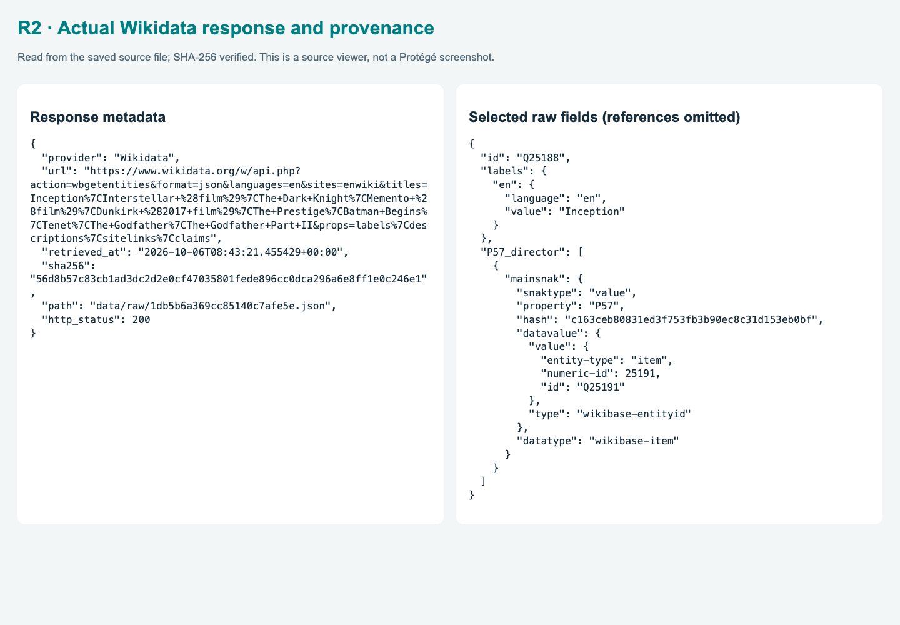
MOVIELOD / SEMANTIC WEB / ONTOLOGY 3.0.0
Source claims and reproducibility
Real crawl fields; no fabricated budget, ratings or awards
Source-supported relations
P57 / P161 / P58 / P162: credits.
P136 / P166 / P272: genre, award, company.
Normalized values
P2047 duration → seconds.
P577 → earliest Gregorian release-year summary.
Traceability
76 responses; retrieval URL / time / SHA-256.
Identity links and provenance have different meanings.
Right: actual Wikidata metadata and response excerpt. Hashes verify integrity, not real-world truth.
Data checked: 09 Oct 2026 • Sources: project code and evidence/
15 / 24
Notes:
The collector contains credit claims, genres, awards, companies, countries, languages, dates and durations. We exclude fields that were not collected. Seventy-six saved responses provide retrieval URLs, timestamps and checksums. Label-based genre normalization is an author policy, not a source-provided OWL taxonomy. Hashes establish byte integrity, not factual truth.

Slide 16
MOVIELOD / SEMANTIC WEB / ONTOLOGY 3.0.0
RDF literals and DBpedia units
runtime is seconds; labels are annotations
res:film-Q25188 a dbo:Film ;
rdfs:label "Inception"@en ;
ex:releaseYear 2010 ;
dbo:runtime "8880.0"^^xsd:double ;
dbo:director res:person-Q25191 .
ẢNH PROTÉGÉ CẦN BỔ SUNG · P08
Thời lượng theo DBpedia
P08_runtime_datatype.png
Data property
xsd: type
dbo:runtime
double · seconds
1. Chọn dbo:runtime trong Data properties.
ex:releaseYear
integer
2. Hiện domain dbo:Work và range xsd:double.
ex:sourceUrl
anyURI
3. Chọn Inception: runtime = 8880 giây.
ex:retrievedAt
dateTime
ex:sha256
string
Thay khung bằng ảnh thật; chi tiết thêm trong Speaker Notes.
Data checked: 09 Oct 2026 • Sources: project code and evidence/
16 / 24
Notes:
Inception has label Inception, release-year summary 2010 and runtime 8880 seconds. Runtime reuses DBpedia with xsd:double. The model has five datatype properties; rdfs:label is an annotation property, not an extra custom title datatype. We preserve the source precision rather than inventing a full release date.
ẢNH PROTÉGÉ CẦN BỔ SUNG P08 — P08_runtime_datatype.png
Mở ontology/Movie_Knowledge_Graph.owl
1. Chọn dbo:runtime trong Data properties.
2. Hiện domain dbo:Work và range xsd:double.
3. Chọn Inception: runtime = 8880 giây.
Cần thấy: 8880 giây = 148 phút; rdfs:label là annotation property.

Slide 17
MOVIELOD / SEMANTIC WEB / ONTOLOGY 3.0.0
Linked data: identity and publication
Canonical identifiers, graph exports and external identity links
1★
Open license
CC BY-SA 4.0
2★
Structured source descriptions
Claims, identifiers, values
3★
Open RDF serializations
RDF/XML, Turtle, JSON-LD
4★
HTTP identifiers and RDF
Canonical version 3.0.0
5★
External identity links
1,699 Wikidata + 28 DBpedia
Public graphs and local canonical exports are checked for semantic equality.
Data checked: 09 Oct 2026 • Sources: project code and evidence/
17 / 24
Notes:
The website distributes the version-3 RDF, schema, full OWL and inference exports. HTTP identifiers and CC BY-SA support reuse. Identity alignment retains 1699 Wikidata and 28 DBpedia links. Reusing dbo:Film, identity sameAs and source provenance are three distinct semantic operations.

Slide 18
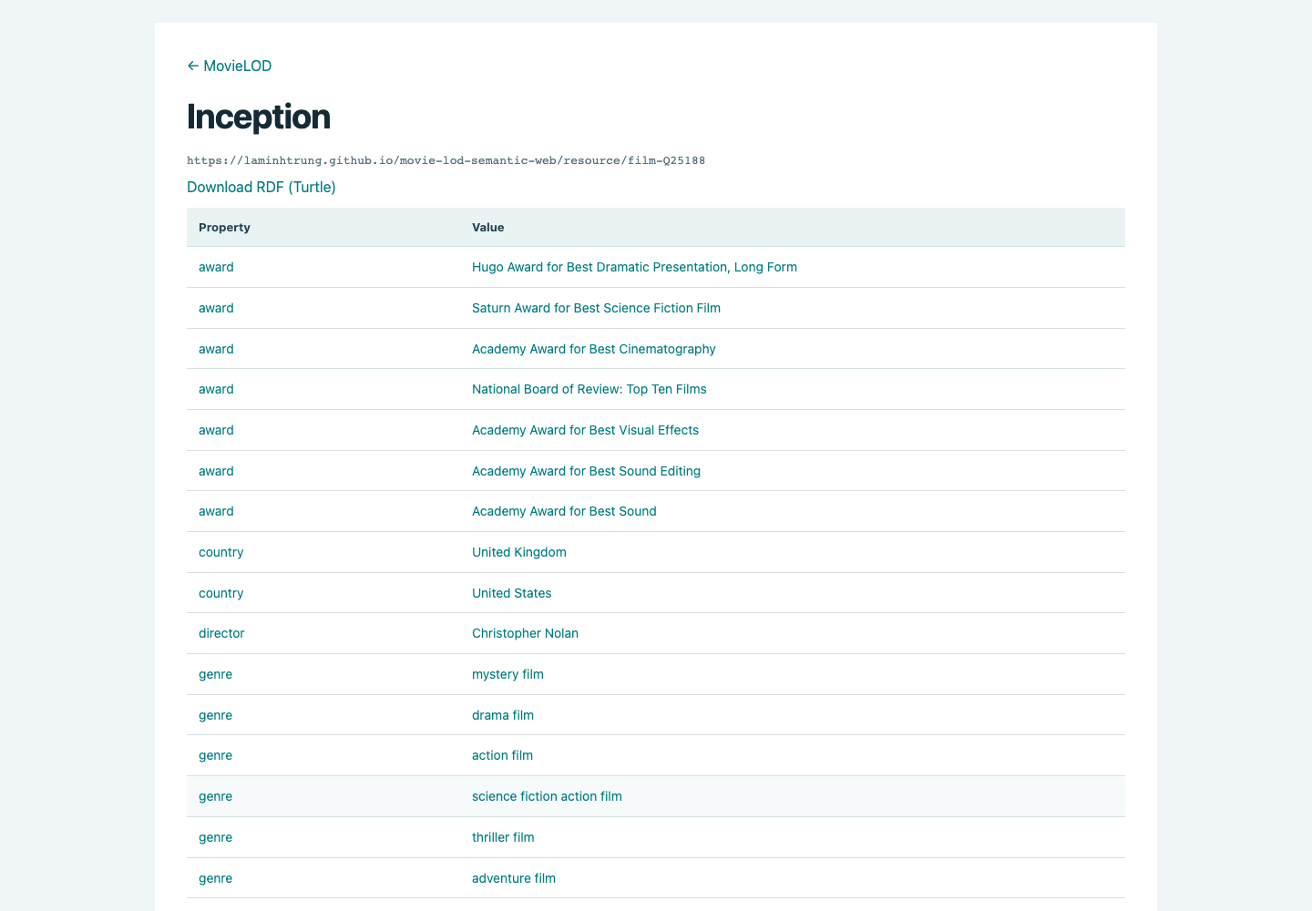
MOVIELOD / SEMANTIC WEB / ONTOLOGY 3.0.0
Inception: RDF resource and OWL
The web description and final OWL share the same source facts
ẢNH PROTÉGÉ CẦN BỔ SUNG · P09
Cá thể Inception bản mới
P09_inception_individual.png
1. Mở Movie_Knowledge_Graph.owl 3.0.0.
2. Chọn film-Q25188; hiện label, releaseYear 2010, runtime
8880.
3. Hiện dbo:director, genre, productionCompany và award.
Thay khung bằng ảnh thật; chi tiết thêm trong Speaker Notes.
Left: current version-3 web description. Right: capture the same individual in Protégé.
Data checked: 09 Oct 2026 • Sources: project code and evidence/
18 / 24
Notes:
The resource page displays the canonical description of Inception: DBpedia properties, its release-year summary, duration in seconds, identities and provenance. The photo slot requests the same individual in Protégé. It distinguishes a live resource description from a genuine ontology screenshot.
ẢNH PROTÉGÉ CẦN BỔ SUNG P09 — P09_inception_individual.png
Mở ontology/Movie_Knowledge_Graph.owl
1. Mở Movie_Knowledge_Graph.owl 3.0.0.
2. Chọn film-Q25188; hiện label, releaseYear 2010, runtime 8880.
3. Hiện dbo:director, genre, productionCompany và award.
Cần thấy: Cá thể trong OWL khớp trang resource 3.0.0; runtime là 8880 giây.

Slide 19
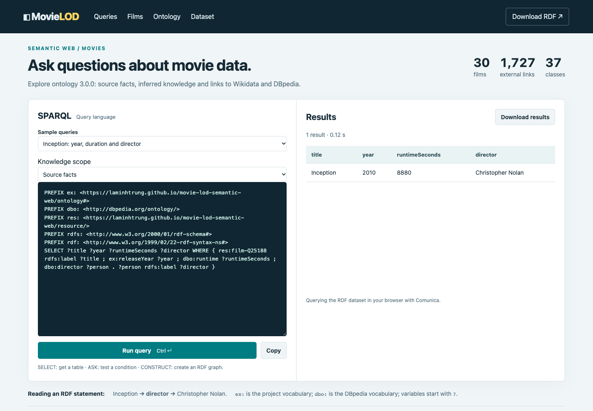
MOVIELOD / SEMANTIC WEB / ONTOLOGY 3.0.0
SPARQL: choose the knowledge scope
Source facts, OWL inference or before/after named graphs
SELECT ?year ?seconds ?director WHERE {
res:film-Q25188 ex:releaseYear ?year ;
dbo:runtime ?seconds ; dbo:director ?person .
?person rdfs:label ?director .
}
2010 · 8,880 seconds · Nolan
SELECT chooses columns; WHERE matches; OPTIONAL
preserves rows.
The sample chooses its required scope automatically; change scope to compare before and after.
Data checked: 09 Oct 2026 • Sources: project code and evidence/
19 / 24
Notes:
The default Inception query returns 2010, 8880 seconds and Nolan. The knowledge-scope selector chooses source facts, the precomputed inference graph or the named before/after dataset. The browser uses Comunica; the local endpoint uses RDFLib. Both modes query the same exports rather than executing a reasoner for every request.

Slide 20
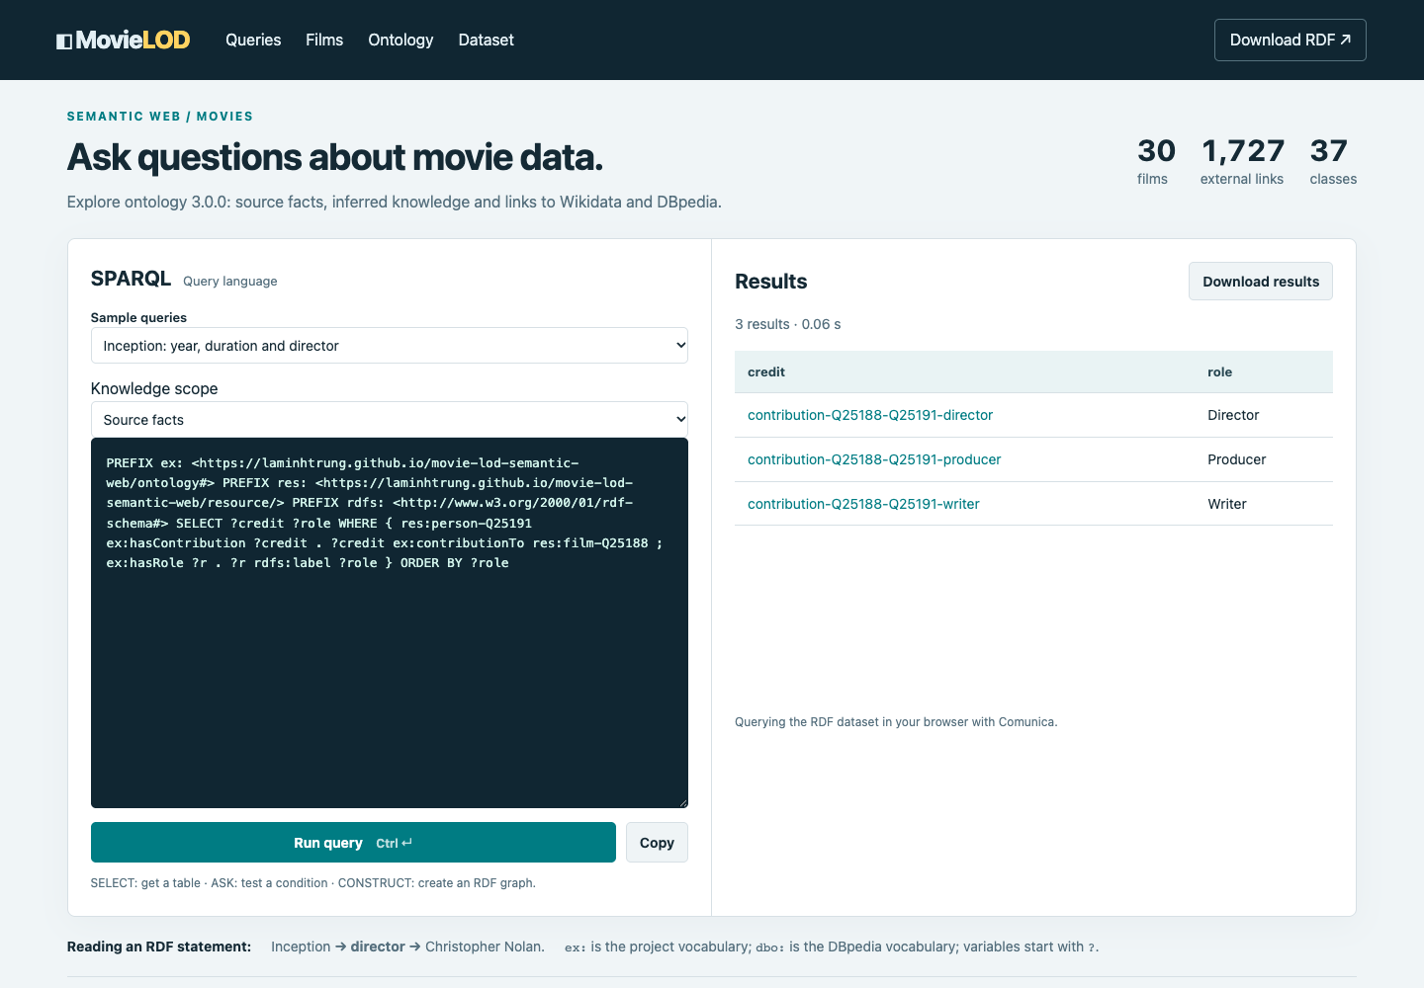
MOVIELOD / SEMANTIC WEB / ONTOLOGY 3.0.0
Credit records and competency questions
27 design queries; counts use local identities
25 Inception credits
21 acting + 1 directing + 1 writing + 2
producing.
8 / 4 / 7
Nolan films / Inception companies /
Godfather awards.
27 design queries
Direct facts / hierarchy / inferred
knowledge.
Data checked: 09 Oct 2026 • Sources: project code and evidence/
20 / 24
Notes:
Inception has 25 credit records: 21 acting, one directing, one writing and two producing. The current application image shows Nolan’s three roles, not all 25 records. The new competency suite contains 27 queries and tests before/after reasoning, including WriterDirector and property-chain results.

Slide 21
MOVIELOD / SEMANTIC WEB / ONTOLOGY 3.0.0
Before / after: Nolan and WriterDirector
The same result is available in web, local endpoint and terminal
.venv/bin/python src/query.py queries/20.rq
.venv/bin/python src/query.py queries/20.rq --reasoned
.venv/bin/python src/query.py queries/27.rq --mode dataset
ẢNH PROTÉGÉ CẦN BỔ SUNG · P10
Các type suy luận của Nolan
P10_nolan_inferred_types.png
1. Chọn HermiT → Start reasoner, chờ hoàn tất.
Mode
Nolan types returned
2. Chọn person-Q25191; mở inferred types.
3. Giữ WriterDirector, Filmmaker, ThreeCreditContributor trong
ảnh.
Asserted
WriterDirector 0; Nolan min 3: false
Reasoned
WriterDirector 10; Nolan min 3: true
Thay khung bằng ảnh thật; chi tiết thêm trong Speaker Notes.
All query interfaces read the same canonical graph exports; inference is computed before serving.
Data checked: 09 Oct 2026 • Sources: project code and evidence/
21 / 24
Notes:
WriterDirector has zero asserted members and ten inferred local members. The scope selector lets readers compare the same query before and after reasoning. Query 27 uses explicit named graphs. The terminal supports --mode asserted, reasoned or dataset; no distinct-term count is used to classify the cardinality subsets.
ẢNH PROTÉGÉ CẦN BỔ SUNG P10 — P10_nolan_inferred_types.png
Mở ontology/Movie_Knowledge_Graph.owl
1. Chọn HermiT → Start reasoner, chờ hoàn tất.
2. Chọn person-Q25191; mở inferred types.
3. Giữ WriterDirector, Filmmaker, ThreeCreditContributor trong ảnh.
Cần thấy: Type mới không được gán trực tiếp trong asserted graph; giữ trạng thái reasoner.
Reference: 27 design queries, asserted versus reasoned results:
1. List films: 30 → 30
2. Inception: year, duration and director: 1 → 1
3. Directors of Inception: 1 → 1
4. Inception credits and roles: 25 → 25
5. Films directed by Nolan: 8 → 8
6. Companies credited on Inception: 4 → 4
7. Awards of Inception: 7 → 7
8. Runtime in seconds: 1 → 1
9. Film genres through the parent class: 0 → 75
10. Persons through Agent hierarchy: 0 → 851
11. Production companies: 45 → 45
12. Film subclasses: 0 → 4
13. Actors through Artist hierarchy: 0 → 769
14. Inferred Actors: 0 → 769
15. Inferred Filmmakers: 0 → 89
16. Inferred Action films: 0 → 12
17. Award-winning films: 0 → 26
18. People with at least two provably distinct credits: 0 → 17
19. People with at least three provably distinct credits: 0 → 7
20. Writer-directors: 0 → 10
21. Actor-filmmakers: 0 → 7
22. Award-winning filmmakers: 0 → 65
23. Award-winning action films: 0 → 10
24. Action/drama crossing films: 0 → 8
25. Nolan contributions through property chain: 0 → 8
26. Nolan films through inverse director: 0 → 8
27. Types present only after reasoning: 0 → 1261

Slide 22
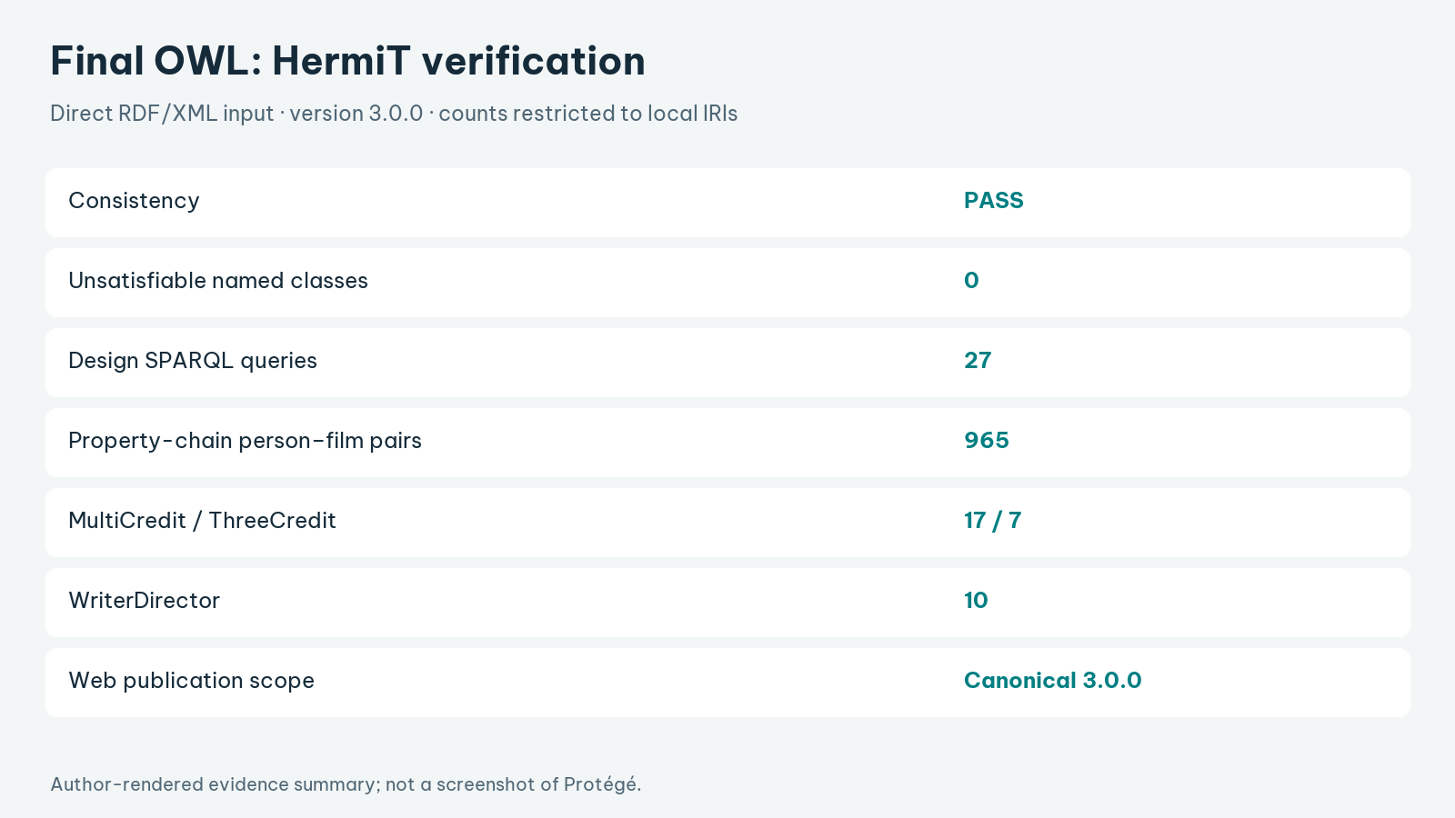
MOVIELOD / SEMANTIC WEB / ONTOLOGY 3.0.0
Verification of the final OWL
Direct HermiT run; evidence bound to the file hash
PASS
HermiT consistency
0
unsatisfiable named classes
27
design queries executed
965
chain pairs verified
Canonical OWL verified by HermiT; browser queries use matching source, reasoned and named graphs.
Data checked: 09 Oct 2026 • Sources: project code and evidence/
22 / 24
Notes:
HermiT checked the canonical RDF/XML OWL: consistent, no unsatisfiable named classes. All 27 competency questions execute against explicit graph scopes; 965 chain pairs are materialized separately. Sixteen tests verify the model and endpoint. Browser checks exercise SELECT, ASK, CONSTRUCT, DESCRIBE and recovery from malformed queries.

Slide 23
MOVIELOD / SEMANTIC WEB / ONTOLOGY 3.0.0
Coverage and limitations
Verified functional requirements; evidence scope remains explicit
Req.
Evidence
Status
Inference scope
R1
Canonical OWL + HermiT
Verified
Consistency does not prove completeness or factual
accuracy.
R2
Source facts + provenance
Verified
R3
Public RDF / OWL
Aligned
Source and identity
R4
Retained identity links
Verified
No blanket inequality for QIDs; genre buckets are
author mappings.
R5
Three query scopes
Verified
Deliverables
Slides, report and guides are current. No MP4 files are
included.
Canonical model and application are aligned.
Data checked: 09 Oct 2026 • Sources: project code and evidence/
23 / 24
Notes:
The ontology, dataset, query interfaces and document exports share version 3.0.0. Consistency, source integrity and before/after query behavior are checked independently. Selection bias, label mappings and unannotated identity matching still limit generalization. MP4 files are excluded as requested; an official assignment grade is not inferred from technical checks.

Slide 24
MOVIELOD / SEMANTIC WEB / ONTOLOGY 3.0.0
Evidence capture and submission checklist
Report: 15 pages · main deck: 24 slides · no MP4 included
Image
Slide
Evidence to capture
Before submission
P00
5
Ontology 3.0.0 header
P01
6
Work and Film hierarchy
1. Verify ontology version 3.0.0.
2. Insert the requested genuine
screenshots.
3. Save them in evidence/protege/ for
automatic replacement.
4. Rehearse the script and demonstrate
the current query modes.
P02
7
DBpedia agent hierarchy
P03
8
MovieGenre and Award
P04
9
Contribution restrictions
P05
10
Inverse and functional properties
P06
13
Filmmaker equivalent class
P07
14
Three-credit cardinality
P08
16
DBpedia runtime in seconds
P09
18
Inception in the final OWL
P10
21
Nolan inferred types
Use the canonical OWL for Protégé evidence; source facts and inferred knowledge have separate scopes.
Data checked: 09 Oct 2026 • Sources: project code and evidence/
24 / 24
Notes:
The remaining slots request genuine Protégé screenshots of the final ontology. The Vietnamese speaker script matches the English deck. The report keeps its fifteen-page academic format. Current web captures and reasoner logs support the presentation; MP4 files have been removed without editing or generating video content.

