Slide 1
MOVIELOD / SEMANTIC WEB / ONTOLOGY 3.0.0
MovieLOD
DBpedia reuse · OWL reasoning · linked movie knowledge
From movie data
to a knowledge graph
30
real films
37
named classes
Ontology · RDF · Linked Open Data · SPARQL
La Minh Trung (20251319M)
Nguyen Thu Uyen (20252279M)
Nguyen Thi Nha Linh (20261262M)
Nguyen Khac Thai Binh (20251324M)
1,727
external links
Data checked: 09 Oct 2026 • Sources: project code and evidence/
01 / 13
Notes:
We present the final local ontology, version 3.0.0. It contains 30 films, 37 named classes and 1,727 identity links. We distinguish the verified ontology from the web application, which now uses the same canonical vocabulary. Our examples use real Inception and Christopher Nolan records.

Slide 2
MOVIELOD / SEMANTIC WEB / ONTOLOGY 3.0.0
Objectives and synchronized evidence
Ontology, data, publication, linking and SPARQL access
ID
Requirement
Deliverable / evidence
R1
DBpedia-based ontology
37 named classes; HermiT consistency
R2
Source-supported data
76 retained responses and provenance
R3
RDF publication
Canonical RDF / OWL 3.0.0
R4
Identity alignment
1,699 Wikidata + 28 DBpedia links
R5
SPARQL access
27 questions; source / inferred / named graph modes
Report: 15 pages · main slides: 24 · MP4 excluded by request. Examples: Inception and Nolan.
Data checked: 09 Oct 2026 • Sources: project code and evidence/
02 / 13
Notes:
The five core requirements share ontology version 3.0.0. The source graph, inferred graph and named before/after dataset are available in the browser and local endpoint. The report, slides and query results describe the same model. MP4 files were removed at the user’s request; no video was regenerated.

Slide 3
MOVIELOD / SEMANTIC WEB / ONTOLOGY 3.0.0
Architecture and knowledge layers
One reproducible pipeline across every interface
01
02
03
04
SOURCE FACTS
BUILD 3.0.0
REASON / CHECK
QUERY MODES
76 retained responses
+ provenance
Canonical RDF / OWL
+ resource pages
HermiT + OWL RL
27 query checks
Source / inference
Before / after
NEW MODEL: asserted.ttl + schema.ttl + inferred.ttl; query 27 uses before_after.trig.
APPLICATION: Flask / RDFLib / Comunica share the canonical version-3 graph exports.
Data checked: 09 Oct 2026 • Sources: project code and evidence/
03 / 13
Notes:
The source collector feeds a native version-3 build. HermiT classifies the canonical OWL, and OWL RL materializes inverse, subproperty and chain relations. Validation executes all 27 competency questions. Source facts, inferred knowledge and named-graph comparisons are shared by the browser, endpoint and terminal.

Slide 4
MOVIELOD / SEMANTIC WEB / ONTOLOGY 3.0.0
Dataset: units and counting scope
Final OWL: 19,025 triples including schema and asserted facts
30
851
1,010
films
people
credit records
45
672
76
companies
award entities
source responses
37 named classes · 19 object + 5 datatype properties · 4 controlled role individuals
Data checked: 09 Oct 2026 • Sources: project code and evidence/
04 / 13
Notes:
The selected sample has 30 films, 851 people, 1,010 credit records, 45 companies and 672 award entities. The final OWL contains 19,025 triples including schema and asserted data, not a complete reasoning closure. There are 75 genres, 11 countries, 15 languages and 76 source responses. Counts refer to local resource identifiers; the four role individuals use the ontology namespace.

Slide 5
MOVIELOD / SEMANTIC WEB / ONTOLOGY 3.0.0
Ontology inventory: reuse before extension
17 DBpedia classes + 1 VoID class + 19 local classes
17 classes
DBpedia classes and hierarchy
ẢNH PROTÉGÉ CẦN BỔ SUNG · P00
1 class
void:Dataset
IRI và phiên bản 3.0.0
3 classes
Contribution / Role / SourceSnapshot
2 classes
ActionGenre / DramaGenre
P00_ontology_header.png
4 classes
Role-defined credit subclasses
1. Mở ontology/Movie_Knowledge_Graph.owl.
2. Chọn Active Ontology / Ontology Header.
10 classes
Domain inferred subsets
3. Giữ IRI và versionInfo 3.0.0 trong ảnh.
37 named classes: 17 dbo: + 1 void: + 19 ex:
10 inferred subsets + 4 supporting credit types.
Thay khung bằng ảnh thật; chi tiết thêm trong Speaker Notes.
Data checked: 09 Oct 2026 • Sources: project code and evidence/
05 / 13
Notes:
The module has 37 named classes: 17 DBpedia classes, one VoID Dataset and 19 local classes. The local classes comprise source records, the contribution model, two label-based genre buckets and ten domain inferred classes. Four additional inferred credit subclasses support the reasoning chains. No local clone of Actor, Genre, Award or Company remains.
ẢNH PROTÉGÉ CẦN BỔ SUNG
Mở ontology/Movie_Knowledge_Graph.owl.
Chọn Active Ontology / Ontology Header.
Giữ IRI và versionInfo 3.0.0 trong ảnh.
37 lớp có tên; không đếm biểu thức anonymous như lớp có tên.

Slide 6
MOVIELOD / SEMANTIC WEB / ONTOLOGY 3.0.0
Contribution: person, film and role
Exactly one endpoint of each kind per credit record
Nolan
→
Contribution
ẢNH PROTÉGÉ CẦN BỔ SUNG · P04
hasContribution
Ràng buộc Contribution
Contribution
→
Inception · Film
contributionTo
P04_contribution_restrictions.png
Contribution
→
DirectorRole
1. Chọn ex:Contribution.
hasRole
2. Hiện exactly 1 cho contributionBy, contributionTo, hasRole.
3. Chọn hasRole để thấy Functional và role individual.
Each role has its own record
Director / Actor / Writer / Producer. Nolan has 3 roles in
Inception.
Thay khung bằng ảnh thật; chi tiết thêm trong Speaker Notes.
Data checked: 09 Oct 2026 • Sources: project code and evidence/
06 / 13
Notes:
Each Contribution relates one person, one film and one role, with functional endpoints and qualified exactly-one restrictions. Nolan has directing, writing and producing credits for Inception. Role-specific credit subclasses are inferred using hasRole value restrictions. Missing fields still require structural validation under open-world semantics.
ẢNH PROTÉGÉ CẦN BỔ SUNG
Chọn ex:Contribution.
Hiện exactly 1 cho contributionBy, contributionTo, hasRole.
Chọn hasRole để thấy Functional và role individual.
Ba endpoint đúng 1; dữ liệu thiếu cần structural validation riêng.

Slide 7
MOVIELOD / SEMANTIC WEB / ONTOLOGY 3.0.0
Properties: reuse, inverse and chain
19 object properties; custom relations describe credit context
Property
Domain → range
Inverse
ẢNH PROTÉGÉ CẦN BỔ SUNG · P05
contributionBy
Credit → Person
hasContribution
contributionTo
Credit → Film
contributionOf
Domain / range / inverse
hasRole
Credit → Role
functional
dbo:director
Film → Person
ex:directed
P05_object_property.png
dbo:starring
Work → Actor
ex:actedIn
1. Chọn contributionBy: Contribution → dbo:Person.
contributedTo
Person → Film
property chain
2. Hiện Functional và inverse hasContribution.
3. Có thể chụp contributedTo với property chain.
Thay khung bằng ảnh thật; chi tiết thêm trong Speaker Notes.
contributionBy / contributionTo / hasRole: functional. Domain/range can infer types; inverse reverses a relation.
Data checked: 09 Oct 2026 • Sources: project code and evidence/
07 / 13
Notes:
Direct film relations reuse DBpedia. The inverse of contributionBy supports hasContribution. contributedTo is entailed through the hasContribution/contributionTo property chain. Directed and actedIn are narrower subproperties. The chain property is non-simple, so the cardinality model uses the simple hasContribution relation.
ẢNH PROTÉGÉ CẦN BỔ SUNG
Chọn contributionBy: Contribution → dbo:Person.
Hiện Functional và inverse hasContribution.
Có thể chụp contributedTo với property chain.
Chain hasContribution rồi contributionTo; không đặt cardinality trên contributedTo.

Slide 8
MOVIELOD / SEMANTIC WEB / ONTOLOGY 3.0.0
Verified domain classes after HermiT
All listed types have zero assertions in the input data
Class
Condition in plain language
Count
Method
Filmmaker
Directing, writing or producing credit
89
HermiT
ActionFilm
Action genre membership
12
HermiT
AwardWinningFilm
Film with an award
26
HermiT
MultiCreditContributor
At least 2 provably distinct credits
17
HermiT
ThreeCreditContributor
At least 3 provably distinct credits
7
HermiT
WriterDirector
MovieDirector AND ScreenWriter
10
HermiT
ActorFilmmaker
Actor AND Filmmaker
7
HermiT
AwardWinningFilmmaker
Filmmaker with an award
65
HermiT
AwardWinningActionFilm
ActionFilm AND AwardWinningFilm
10
HermiT
GenreCrossingFilm
Action AND drama genre membership
8
HermiT
Supporting credit types: Acting 855 · Directing 31 · Writing 51 · Producing 73; dbo:Actor 769.
Data checked: 09 Oct 2026 • Sources: project code and evidence/
08 / 13
Notes:
Ten domain subsets have genuine HermiT members, including seven additional subsets beyond Filmmaker, ActionFilm and AwardWinningFilm. The four credit subclasses are supporting definitions. Actor uses DBpedia range reasoning. Counts are local identifiers only. No COUNT DISTINCT aggregate is used to produce these domain class memberships.

Slide 9
MOVIELOD / SEMANTIC WEB / ONTOLOGY 3.0.0
Nolan: facts → credit type → Filmmaker
A multi-step explanation grounded in real records
SOURCE FACTS
ẢNH PROTÉGÉ CẦN BỔ SUNG · P06
Nolan a dbo:Person; credit hasRole DirectorRole.
Định nghĩa Filmmaker
↓
CREDIT CLASS
P06_filmmaker_equivalent_class.png
credit a DirectingContribution; inverse yields
hasContribution.
1. Chọn ex:Filmmaker.
↓
2. Hiện Equivalent To với Person AND các nhánh SOME.
PERSON CLASS
3. Đọc các nhánh Directing / Writing / ProducingContribution.
Nolan a Filmmaker; directing + writing also yield
WriterDirector.
Thay khung bằng ảnh thật; chi tiết thêm trong Speaker Notes.
Nolan: 8 directed films, 22 credit IRIs in the sample; three roles on Inception.
Data checked: 09 Oct 2026 • Sources: project code and evidence/
09 / 13
Notes:
A directing record with DirectorRole becomes DirectingContribution. The inverse property supplies hasContribution for Nolan. The existential and union definition yields Filmmaker. Writing credits additionally support ScreenWriter; directing credits support MovieDirector, and their intersection yields WriterDirector. These types are not manually asserted.
ẢNH PROTÉGÉ CẦN BỔ SUNG
Chọn ex:Filmmaker.
Hiện Equivalent To với Person AND các nhánh SOME.
Đọc các nhánh Directing / Writing / ProducingContribution.
Công thức không tự chứng minh reasoner đã chạy.

Slide 10
MOVIELOD / SEMANTIC WEB / ONTOLOGY 3.0.0
Genuine minimum-cardinality reasoning
Functional hasRole + different roles prove distinct credits
MultiCreditContributor · 17
ẢNH PROTÉGÉ CẦN BỔ SUNG · P07
Person and hasContribution min 2 Contribution.
Distinctness needs semantic evidence.
Cardinality trên Contribution
P07_three_credit_cardinality.png
ThreeCreditContributor · 7
1. Chọn ex:ThreeCreditContributor; hiện min 3 hasContribution
Contribution.
Person and hasContribution min 3 Contribution.
Nolan supplies three different-role witnesses.
2. Chạy HermiT; chọn Nolan ở inferred view.
3. Chụp thêm Functional hasRole và AllDifferent của bốn role.
Distinct IRIs ≠ provably different OWL individuals.
Thay khung bằng ảnh thật; chi tiết thêm trong Speaker Notes.
Negative test: min 2 genres gives 0 DL members; SQL/SPARQL counting is a different claim.
Data checked: 09 Oct 2026 • Sources: project code and evidence/
10 / 13
Notes:
Nolan has directing, writing and producing credits with different controlled role values. Because hasRole is functional and the roles are AllDifferent, these records cannot be the same individual. HermiT entails at least three distinct Contributions. Seven people satisfy min three and seventeen min two. Genre cardinality still lacks inequality witnesses; MultiGenreFilm is not retained as a populated inferred class.
ẢNH PROTÉGÉ CẦN BỔ SUNG
Chọn ex:ThreeCreditContributor; hiện min 3 hasContribution Contribution.
Chạy HermiT; chọn Nolan ở inferred view.
Chụp thêm Functional hasRole và AllDifferent của bốn role.
7 người đạt min 3; 17 người đạt min 2; không phải COUNT DISTINCT.

Slide 11
MOVIELOD / SEMANTIC WEB / ONTOLOGY 3.0.0
Linked data: identity and publication
Canonical identifiers, graph exports and external identity links
1★
Open license
CC BY-SA 4.0
2★
Structured source descriptions
Claims, identifiers, values
3★
Open RDF serializations
RDF/XML, Turtle, JSON-LD
4★
HTTP identifiers and RDF
Canonical version 3.0.0
5★
External identity links
1,699 Wikidata + 28 DBpedia
Public graphs and local canonical exports are checked for semantic equality.
Data checked: 09 Oct 2026 • Sources: project code and evidence/
11 / 13
Notes:
The website distributes the version-3 RDF, schema, full OWL and inference exports. HTTP identifiers and CC BY-SA support reuse. Identity alignment retains 1699 Wikidata and 28 DBpedia links. Reusing dbo:Film, identity sameAs and source provenance are three distinct semantic operations.

Slide 12
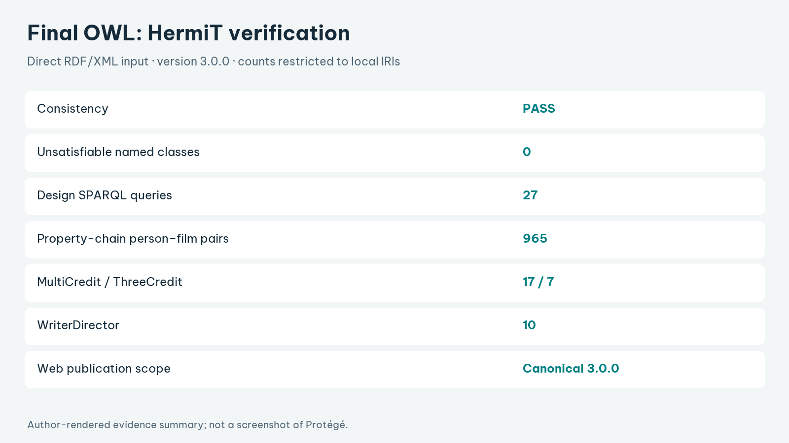
MOVIELOD / SEMANTIC WEB / ONTOLOGY 3.0.0
Verification of the final OWL
Direct HermiT run; evidence bound to the file hash
PASS
HermiT consistency
0
unsatisfiable named classes
27
design queries executed
965
chain pairs verified
Canonical OWL verified by HermiT; browser queries use matching source, reasoned and named graphs.
Data checked: 09 Oct 2026 • Sources: project code and evidence/
12 / 13
Notes:
HermiT checked the canonical RDF/XML OWL: consistent, no unsatisfiable named classes. All 27 competency questions execute against explicit graph scopes; 965 chain pairs are materialized separately. Sixteen tests verify the model and endpoint. Browser checks exercise SELECT, ASK, CONSTRUCT, DESCRIBE and recovery from malformed queries.

Slide 13
MOVIELOD / SEMANTIC WEB / ONTOLOGY 3.0.0
Evidence capture and submission checklist
Report: 15 pages · main deck: 24 slides · no MP4 included
Image
Slide
Evidence to capture
Before submission
P00
5
Ontology 3.0.0 header
P04
6
Contribution restrictions
1. Verify ontology version 3.0.0.
2. Insert the requested genuine
screenshots.
3. Save them in evidence/protege/ for
automatic replacement.
4. Rehearse the script and demonstrate
the current query modes.
P05
7
Inverse and functional properties
P06
9
Filmmaker equivalent class
P07
10
Three-credit cardinality
Use the canonical OWL for Protégé evidence; source facts and inferred knowledge have separate scopes.
Data checked: 09 Oct 2026 • Sources: project code and evidence/
13 / 13
Notes:
The remaining slots request genuine Protégé screenshots of the final ontology. The Vietnamese speaker script matches the English deck. The report keeps its fifteen-page academic format. Current web captures and reasoner logs support the presentation; MP4 files have been removed without editing or generating video content.

