Slide 1
PRiMeFlow
Code implementation (2)
Source: https://github.com/lamiro3/PRiMeFlow
Ko Taehyeon

Slide 2
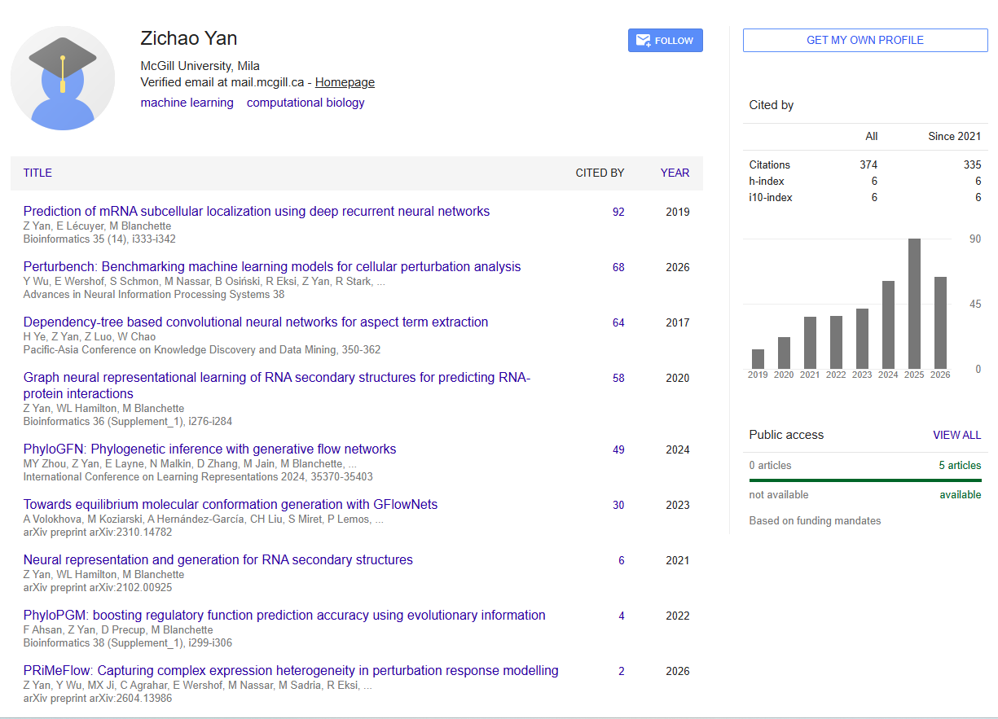
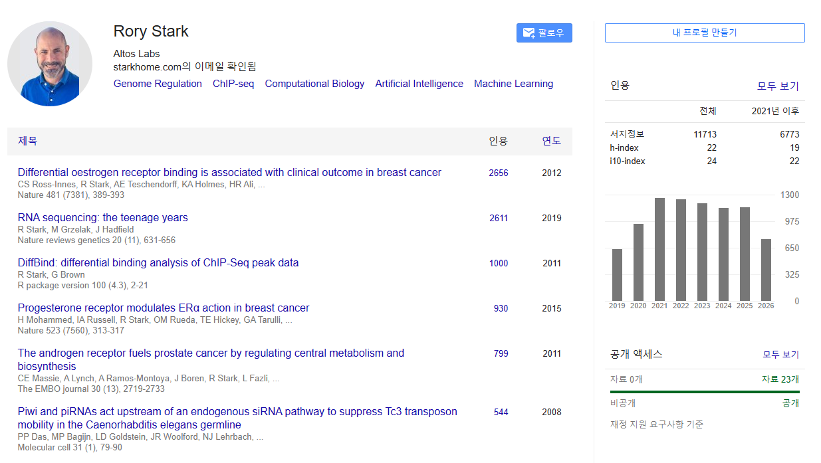
Author
Zichao Yan, Rory Stark

Slide 3
Implementation scope
Models compared (10, on Norman19)
Source: https://github.com/altoslabs/perturbench
6 baselines
Linear_additive · Latent_additive · Decoder_only · CPA · SAMS_VAE · Biolord
4 PRiMeFlow variants (my implementation)
U-Net, CFG=1.0 — no gene embedding (ablation)
U-Net + gene embedding, CFG = 1.0 / 3.0 / 5.0 (CFG sweep)
→ all evaluated on the same Norman19 split & metric set

Slide 4
Implementation goals & environment
Training environment
Setup
Hydra config + PyTorch Lightning, single-node multi-GPU
fp16 mixed precision diverged to NaN → precision = 32
PRiMeFlow(U-Net+gemb): 4-GPU DDP, effective batch 512
Training time
1~2h per run (fill in wall-clock before the talk)
Server
정보문화관-P rack A5000

Slide 5
Implementation goals & environment
Dataset — Norman19
Paper: Srivatsan20 / Jiang24 / Norman19 (three datasets)
This work: Norman19 — one of the paper's own three datasets
→ a reproduction on a shared benchmark (not the earlier "different datasets" framing)
Norman19 (Norman et al., 2019, Science)
Perturb-seq — CRISPRa (gene activation) in K562 cells
~105 single + ~131 two-gene (combinatorial) perturbations
double perturbations test generalization to unseen combinations
perturbench's standard norman19 recipe & split used as-is

Slide 6
Implementation scope
Model input — genes in, expression out
How many genes & how extracted
raw count matrix → perturbench datamodule selects HVG (highly variable genes)
not all ~58k genes — only the HVG subset;
No PCA — direct expression space
the HVG values go straight into the model — no PCA / autoencoder
MLP: [expr n_genes ‖ cond ‖ time-emb] → n_genes
U-Net: Conv1d over the gene axis → n_genes
output is the same n_genes expression vector (no reduction)
contrast: Latent / Linear-additive act in a latent space; PrimeFlow works in gene space directly

Slide 7
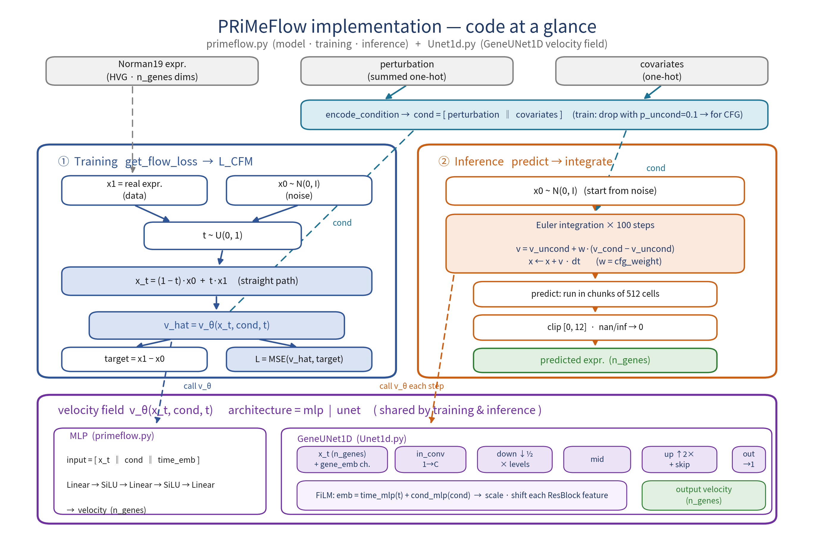
Implementation process
Code overview — the whole picture
primeflow.py = model · training · inference · Unet1d.py = velocity field (GeneUNet1D) · training & inference share v_θ

Slide 8
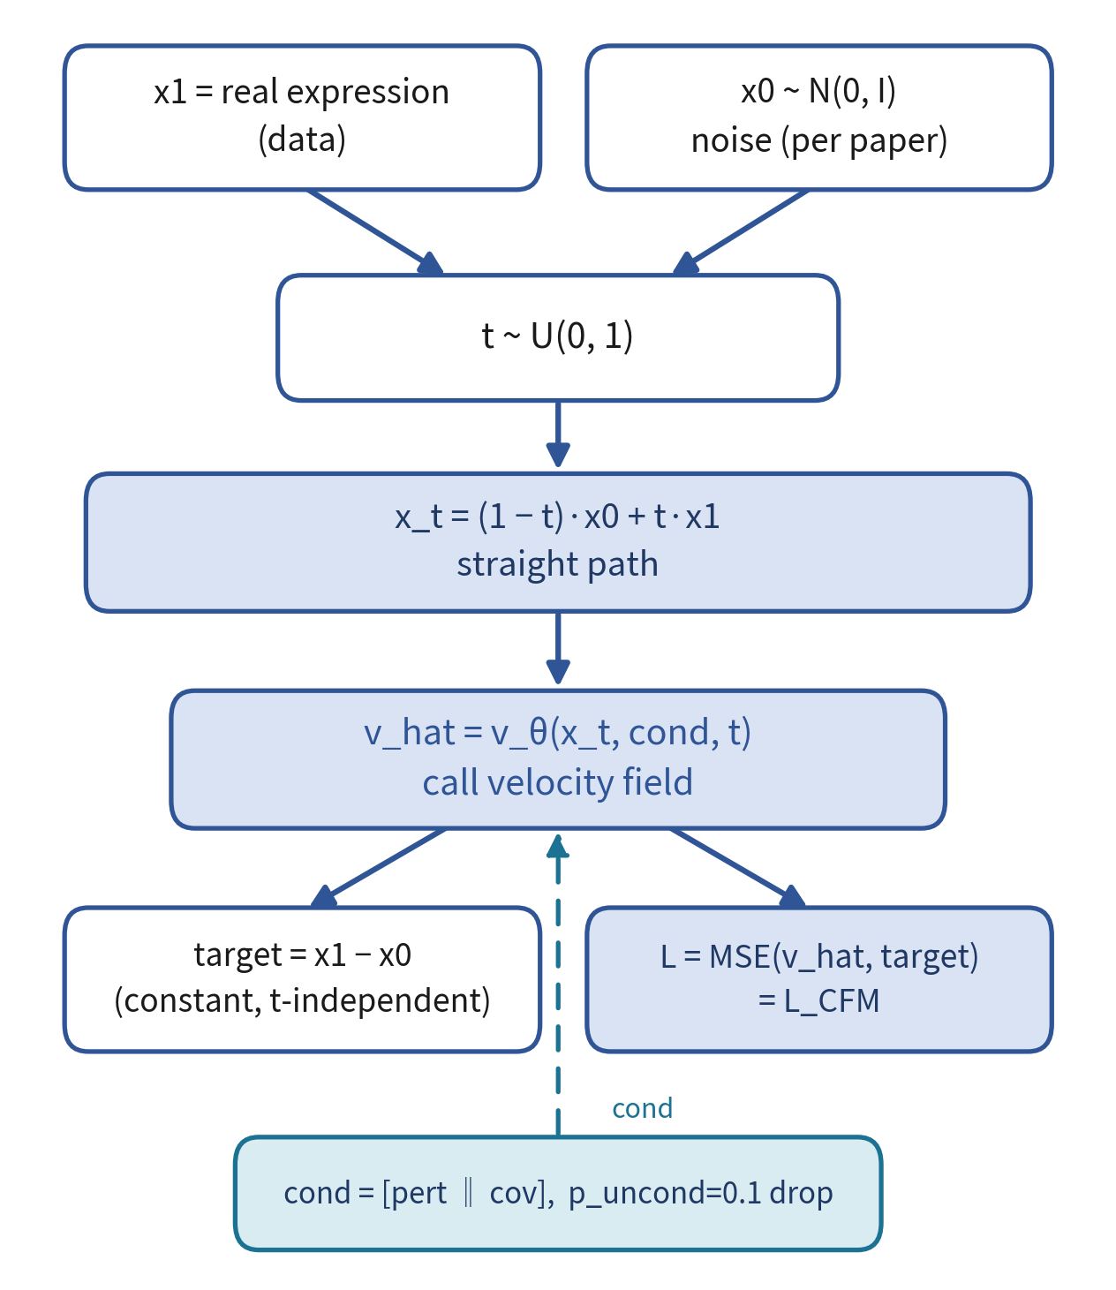
Implementation process
Training — get_flow_loss → L_CFM
x0 starts from noise N(0, I) (paper's way)
straight path x_t = (1−t)·x0 + t·x1
target = x1 − x0 → constant, independent of t
L = MSE(v_hat, target) = L_CFM
condition drop with p_uncond=0.1 → learns CFG

Slide 9
Background — Classifier-Free Guidance
CFG: from diffusion to flow matching
CFG originated in diffusion models (Ho & Salimans, 2022)
In diffusion
train: with prob. p_uncond drop the condition (null) → one model learns both conditional & unconditional score
sample: mix the two — ε̃ = ε_uncond + w·(ε_cond − ε_uncond)
w > 1 → more faithful to the condition (fidelity ↑ / diversity ↓); no separate classifier = "classifier-free"
In PrimeFlow (flow matching) — same idea on the velocity field v
train: p_uncond = 0.1 condition drop in get_flow_loss
infer: v = v_uncond + w·(v_cond − v_uncond) (w = cfg_weight)
w is inference-only → sweep it without retraining

Slide 10
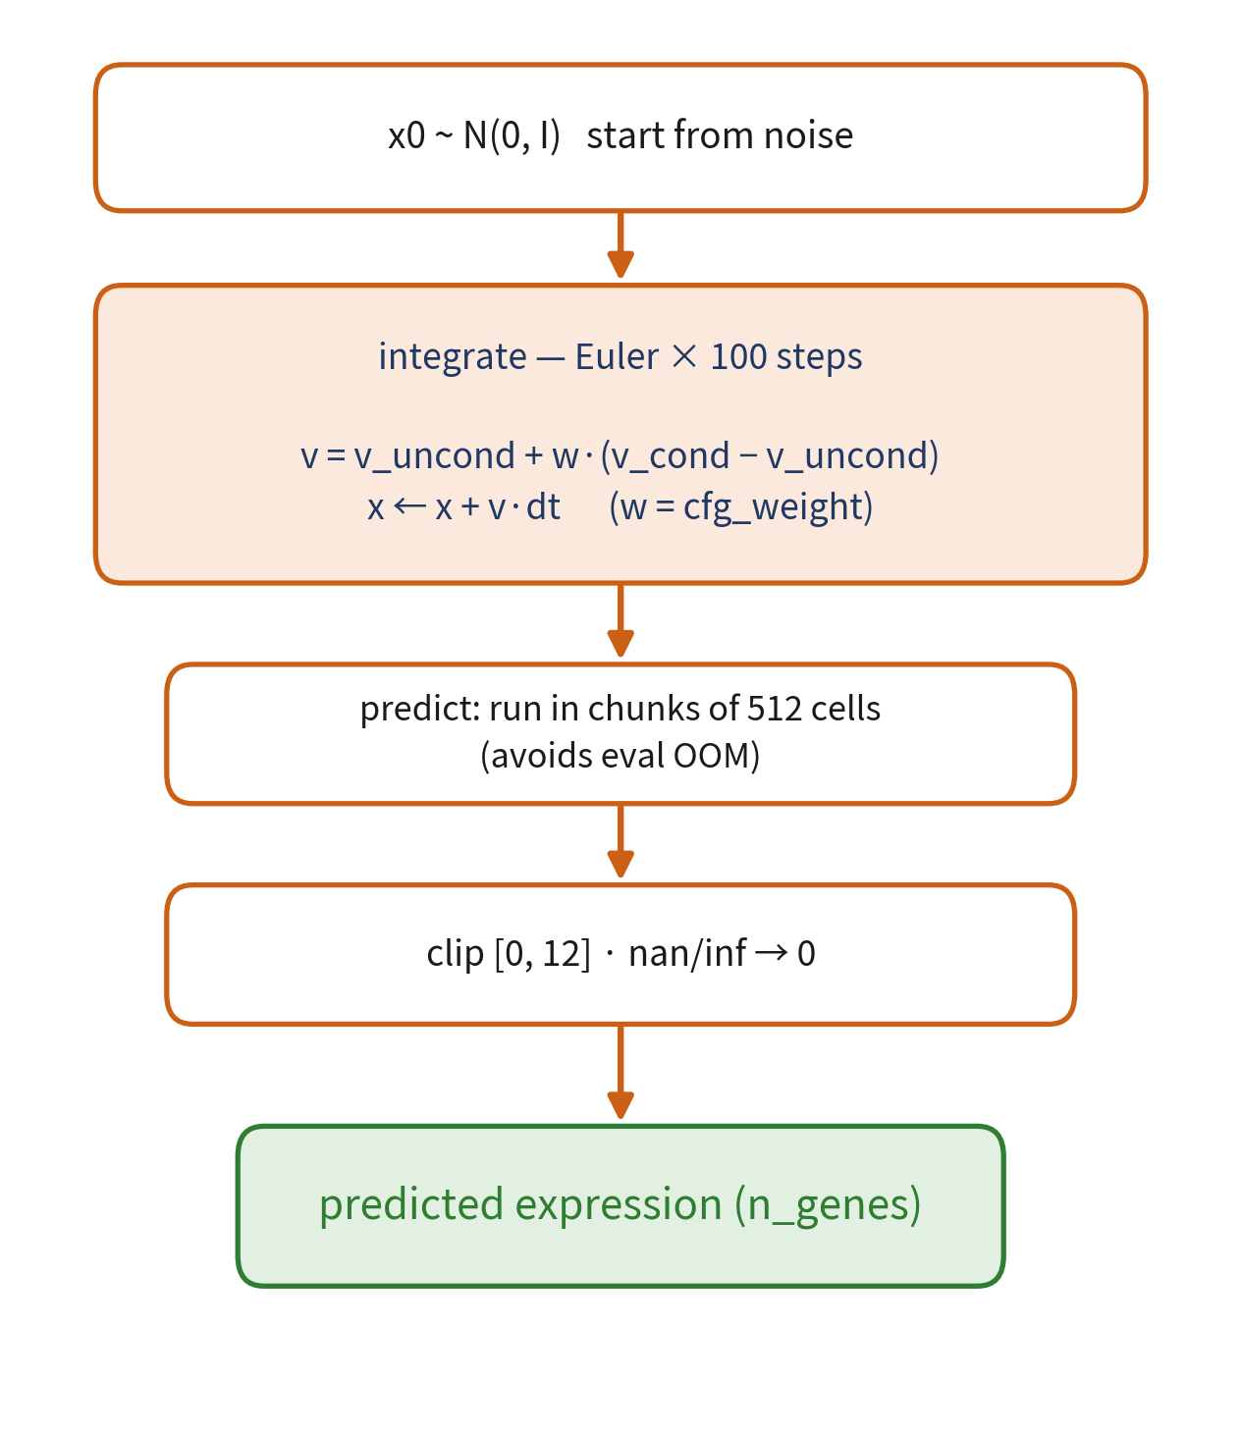
Implementation process
Inference — predict → integrate
Euler integration for 100 steps from noise x0
CFG: v = v_uncond + w·(v_cond − v_uncond)
eval: up to 20k cells → run in chunks of 512
→ fixes mid-attention OOM
clip [0,12] · nan/inf→0 → predicted expression

Slide 11
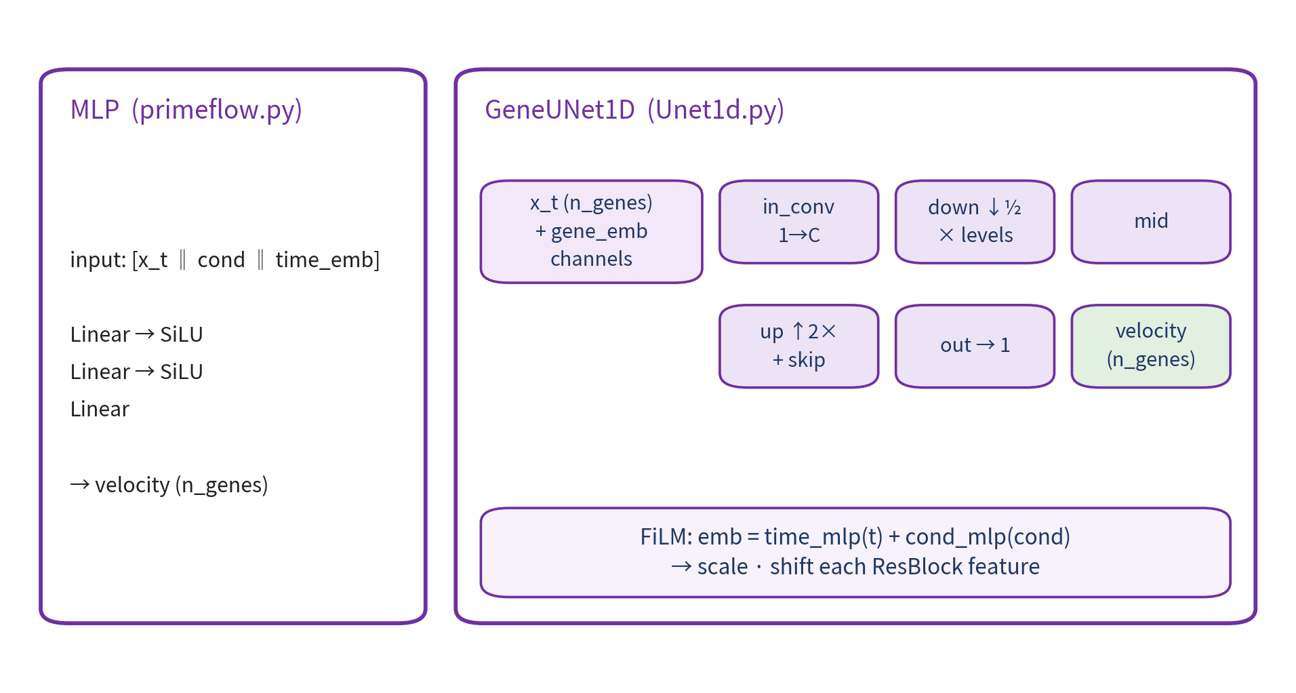
Implementation process
Velocity field v_θ — MLP / GeneUNet1D
v_θ called by both training & inference (architecture = mlp | unet, same interface)
gene embedding channel + FiLM(time+cond) conditioning → the key to the gains

Slide 12
Evaluation metrics
10 metrics → 6 groups → one overall score
10 metrics grouped into 6
RMSE (raw/rank) ↓ — mean expression error
cos PCA (raw/rank) — direction in PCA space
cos logFC (raw/rank) — fold-change vs control
R² ↑ — variance explained
top-k recall ↑ — top DEG (diff-expr genes) recovered
MMD PCA (raw/rank) ↓ — distribution distance
Turning them into one score
scale: unbounded metrics use robust (median/MAD) scaling → one outlier can't dominate the scale
direction: lower-is-better (↓) metrics are flipped so higher = better everywhere
overall = mean of the 6 group-means
(so raw/rank pairs aren't triple-counted, and single metrics R² / top-k count equally)

Slide 13
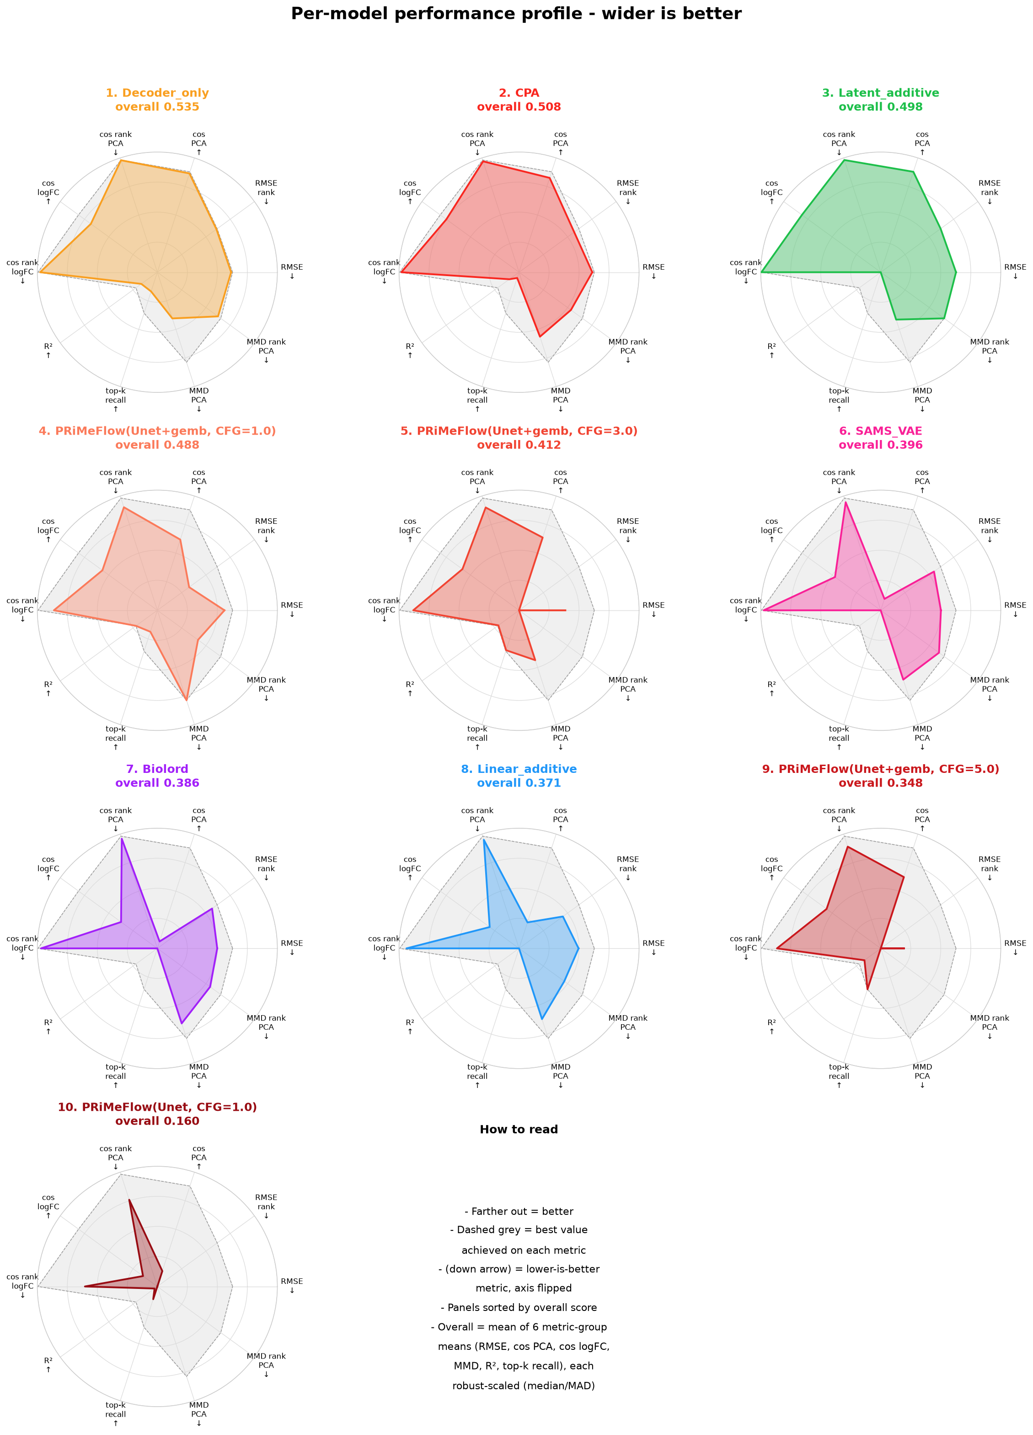
Result
Per-model performance profile
Decoder_only best 0.535; CPA 0.508; Latent_additive 0.498
PRiMeFlow(U-Net+gemb, CFG=1.0) 4th, 0.488 — spiky: strong on MMD / R² / top-k
CFG sweep 1→3→5: spikier top-k but weaker overall (next slide)
PRiMeFlow(U-Net, no gemb) last, 0.160 — gene embedding decisive
dashed grey = per-metric best; wider = better

Slide 14
Result
PRiMeFlow (gemb) tops the distribution-level metrics
PRiMeFlow (U-Net + gene embedding) — the family tops all 3 distribution-level metrics among 10 models:
0.867
0.22
0.358
MMD PCA ↓
best · CFG=1.0 (base 1.67–3.22)
R² ↑
best · CFG=1.0
top-k recall ↑
best · CFG=5.0
→ reproduces the paper's claim (flow matching strong at distribution-level prediction). Each metric peaks at a different CFG → trade-off next slide.

Slide 15
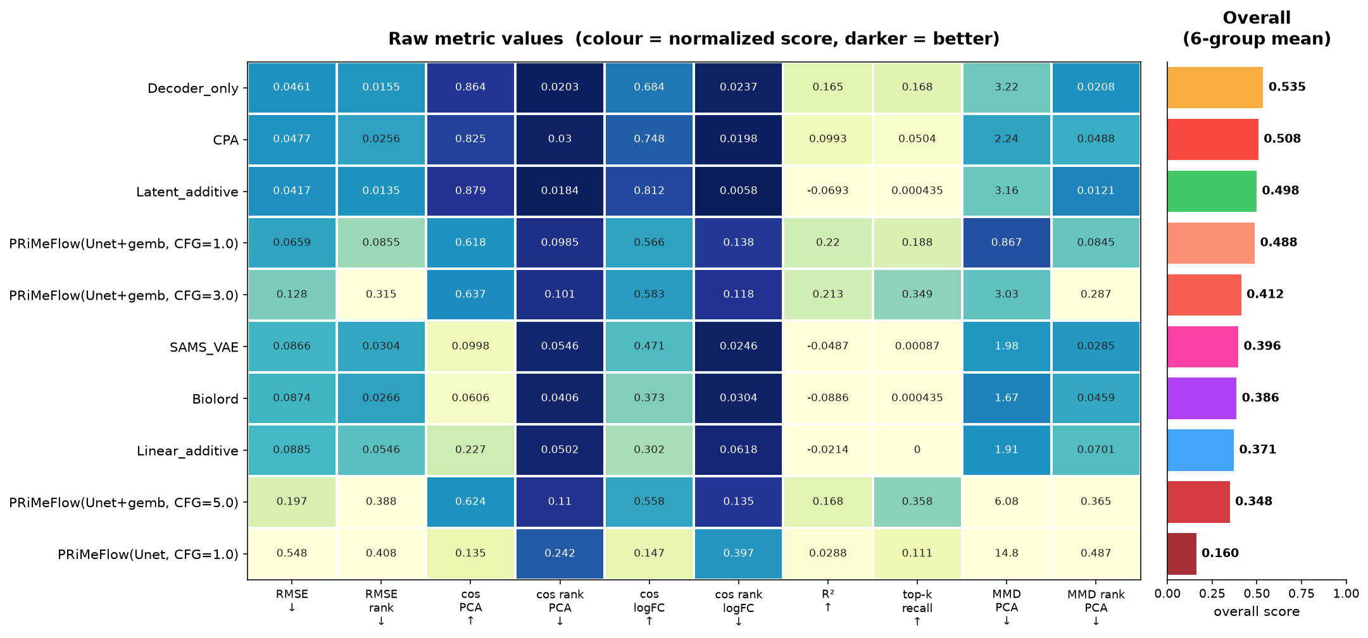
Result
Metric heatmap
rows = models (by overall), cols = metrics, darker = better; right bar = overall (6-group mean).
PRiMeFlow(gemb, CFG=1.0): darkest MMD PCA / R² cells; higher-CFG rows trade MMD away for top-k.

Slide 16
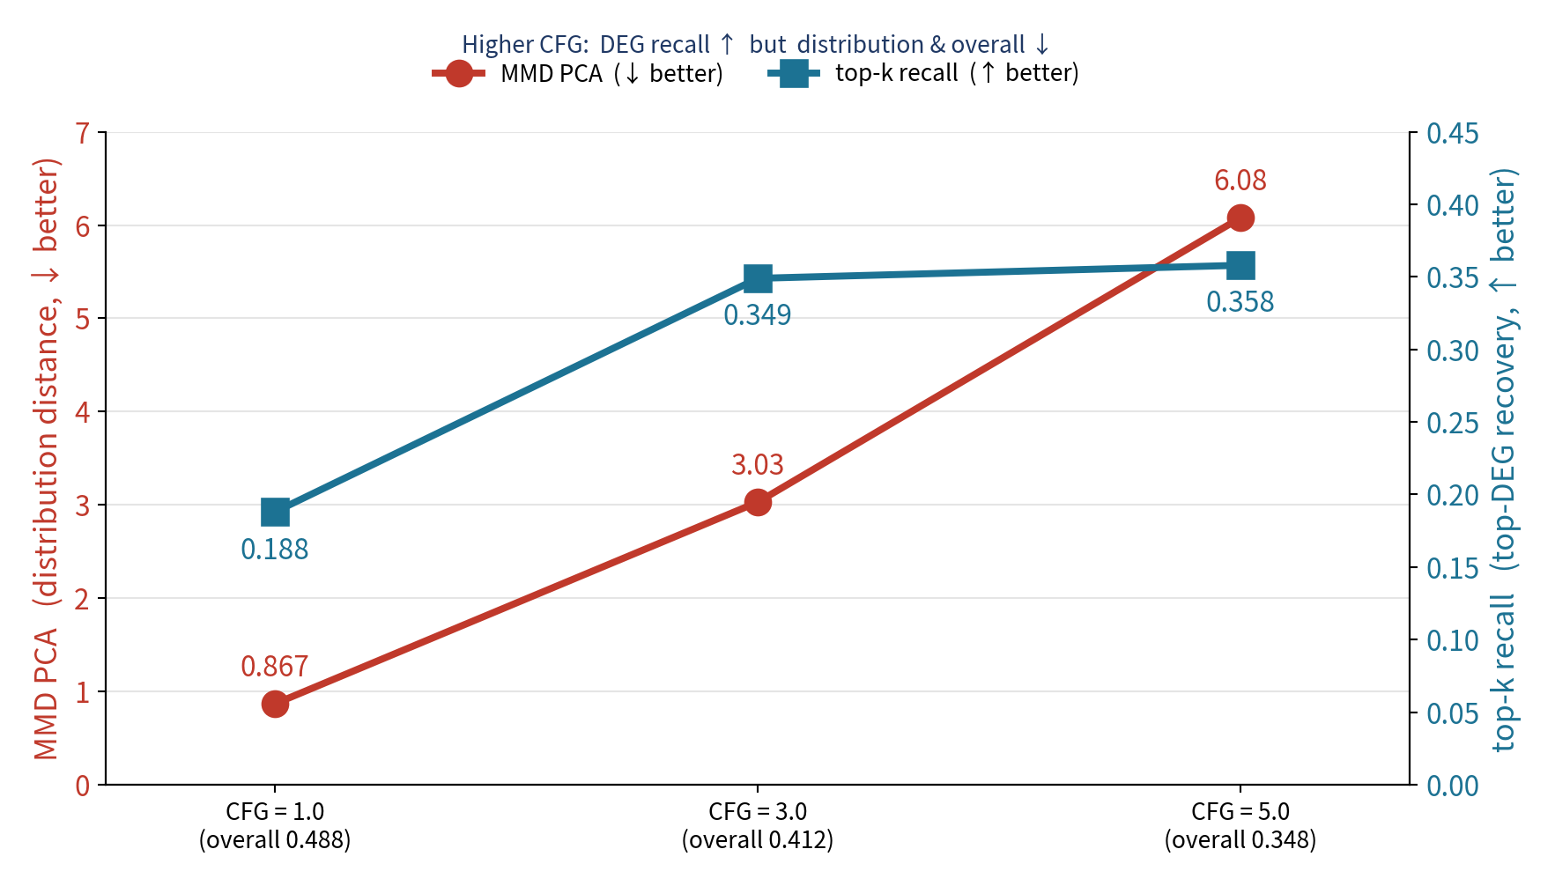
Result
CFG sweep — fidelity vs distribution trade-off
CFG weight 1→3→5 controls guidance strength (inference only, no retraining)
CFG↑ → top-k recall 0.188 → 0.358 (better top-DEG recovery)
but MMD PCA 0.867 → 6.08, RMSE also worsens → overall 0.488 → 0.348
classic CFG fidelity↑ / diversity↓ trade-off — guidance exaggerates the condition, saving key DEGs but narrowing the distribution
conclusion: for overall & distribution, CFG=1.0 is best; use high CFG only when you just need top-DEG recovery

Slide 17
Limit and the next step
MMD_PCA outlier → solved by a gene embedding
Earlier PRiMeFlow collapsed on MMD_PCA (predicted distribution far off).
Cause: Conv1d shares weights across positions → from noise alone it can't tell which gene a position is (pred per-gene mean std 0.13 vs real 0.57).
Fix: add a learnable per-gene embedding (gene_emb_dim = 16) as an input channel — the paper's Emb(G) in Eq. 3.
U-Net (no gene emb)
MMD PCA 14.8
overall 0.160
U-Net + gene emb
MMD PCA 0.867
overall 0.488

Slide 18
Limit and the next step
Indicator moves in opposite directions depending on the source (noise vs. control) setting
Setup — FlowMatching-U-Net, source=noise vs source=control
(early dev logs, not the final benchmark)
source=noise — RMSE 0.545 / MMD_PCA 16.3
source=control — RMSE improves to 0.112, but R² collapses to −0.999
Takeaway — No clear winner; metrics move in opposite directions — still not fully understood

Slide 19
Limit and the next step
Next step
✓ Done: gene embedding Emb(G) → MMD_PCA fixed
✓ Done: CFG sweep (1/3/5) → fidelity vs distribution trade-off quantified
Remaining
Add the rest of Eq. 3's input encoding — sinusoidal Enc(x_t) (currently a raw-scalar Conv1d lift)
Analyze the weak correlation metrics (cos-PCA rank, RMSE) behind the 4th-place overall
Extend to Srivatsan20 & Jiang24 (the paper's other two datasets)

