Slide 1
RENTIT
Group-5
Farhat Lamisa (1910539)
Utsav Dhar(1911108)
Sadnan Haque (1920370)
Niloy Sinha (1930331)
Joyeta Roy(2021241)
Md. Istiaq Ahmed(2030096)

Slide 2
INTRODUCTION
Rent IT is a rental management system designed to make the rental process easier for both property owners and renters. It is intended to simplify the rental and management of properties, including property listings, the renter applications, rental agreements, and rent collection. Rent IT provides a wide variety of features and tools to assist owners in efficiently managing their properties, such as a centralized dashboard for managing multiple properties, the renter screening tools, and online rent payment options. Property owners can use Rent IT to save time, reduce administrative tasks, and provide a better rental experience for their residents.

Slide 3
History leading to project request:
We created RENT IT with the aim of assisting individuals in finding suitable rental properties and ensuring that they secure their desired house. Furthermore, we strive to promote the development of various affordable, accessible, and high-quality rental housing options within the community. Our ultimate goal is to provide financial planning for homeownership, enabling low and moderate-income families to achieve success. Many of our acquaintances are currently pursuing their studies in Dhaka. As managing a rental property for bachelors can be a challenging task, they faced several difficulties in finding an appropriate apartment. This issue is not unique to them, as bachelors living outside of the city often encounter similar problems. Therefore, we are determined to establish RENT IT that can provide people with a quick and effective long-term solution in less than a minute.

Slide 4
Problem Statement and Solution:
Problem | Solution
The rental application process needs to be handled manually. | RENT IT can simplify the rental application process by providing an online application form that potential renters can access from anywhere at any time.
Property owners may find it difficult to keep track of all of their properties, which can lead to missed rental payments, tenant complaints, and inefficient property management. | RENT IT provides a central hub for all property management tasks, such as listing properties, managing leases, and communicating with renters.
Manually collecting rent payments can be time-consuming. | RENT IT has an automated rent collection system that allows renters to pay rent online.
Property owners may struggle to communicate effectively with renters, and important messages or requests may be missed. | This system includes messaging, alerts, and notifications to help property owners stay on top of renters' requests and concerns.

Slide 5
Project goal and objectives:
The purpose of RENT IT is to provide a comprehensive and efficient property management system that streamlines the rental application process, improves communication between owners and renters, and improves overall property management operations. The system aims to improve efficiency, reduce errors, and improve the renter's experience by providing a centralized platform for managing all rental-related activities. Ultimately, the goal is to increase property management companies' profits while providing tenants with a better experience.

Slide 6
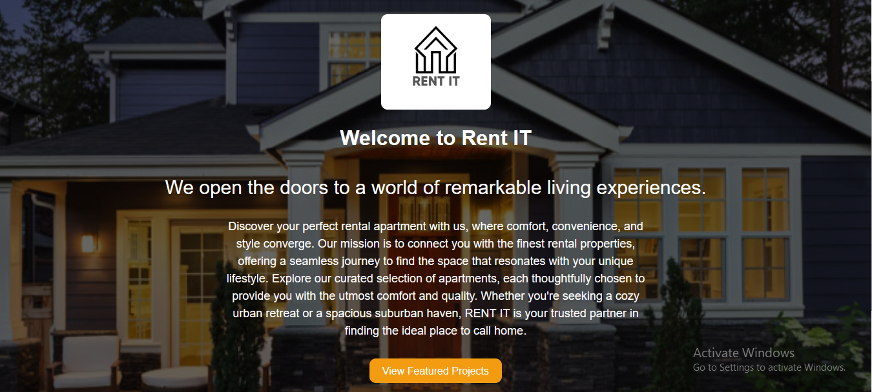
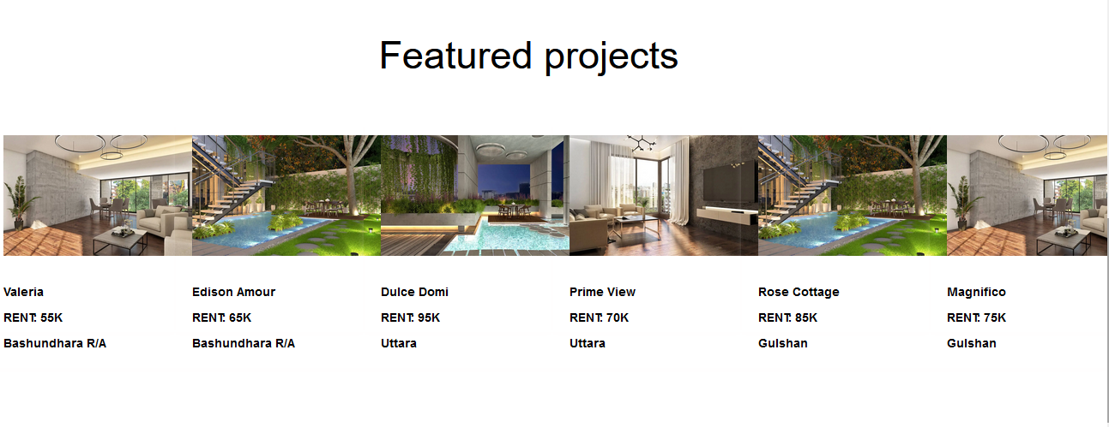
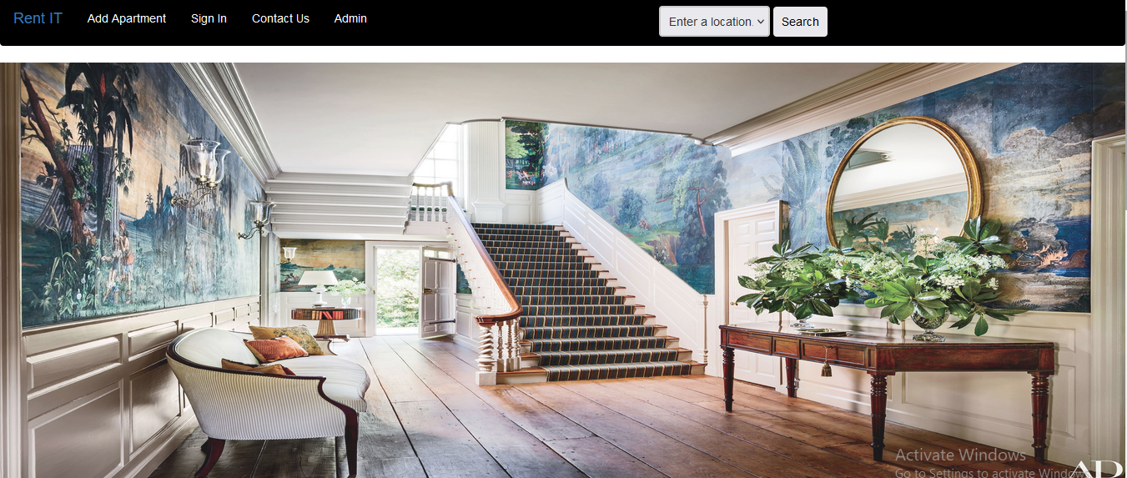
Prototype the user interface:

Slide 7
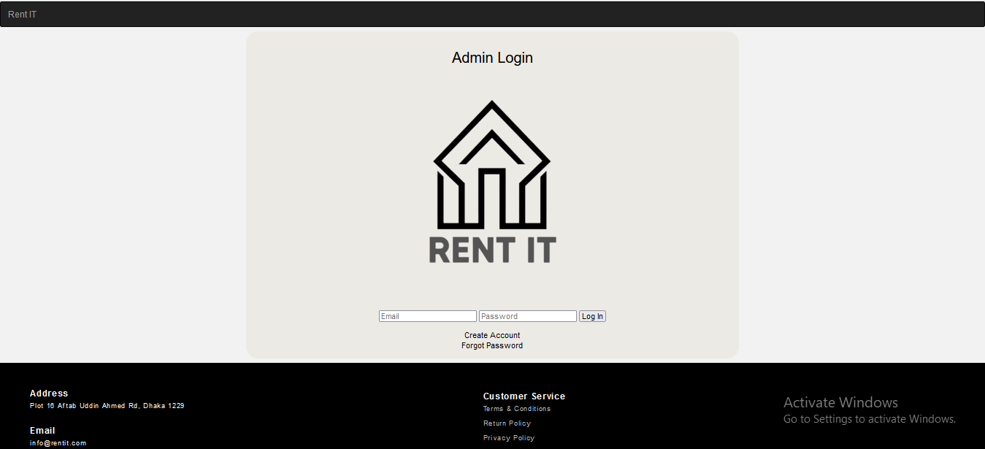
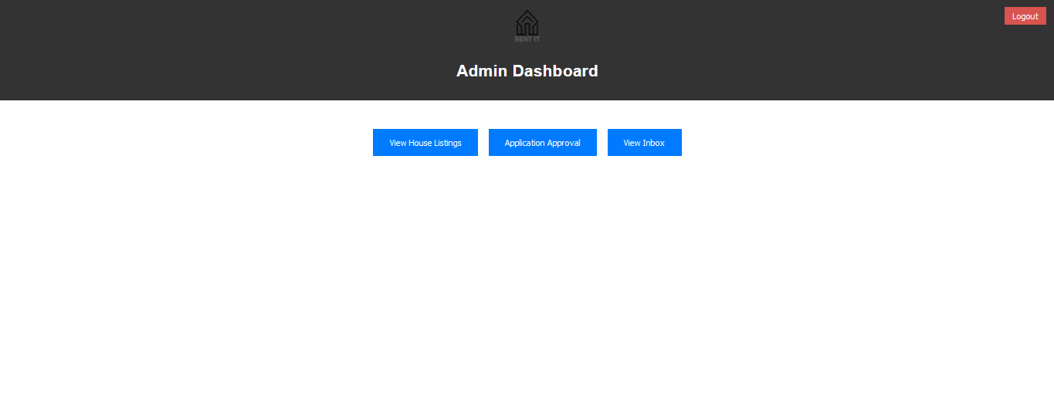

Slide 8
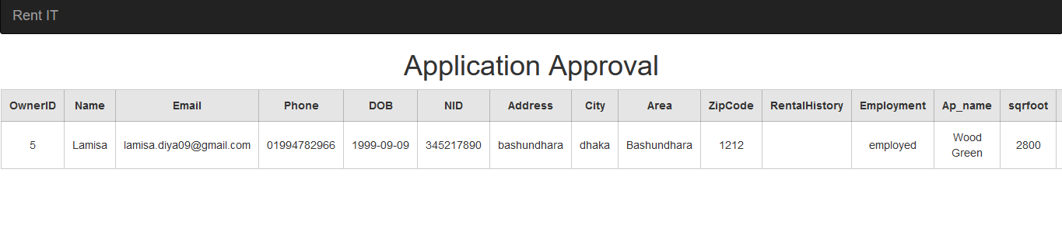
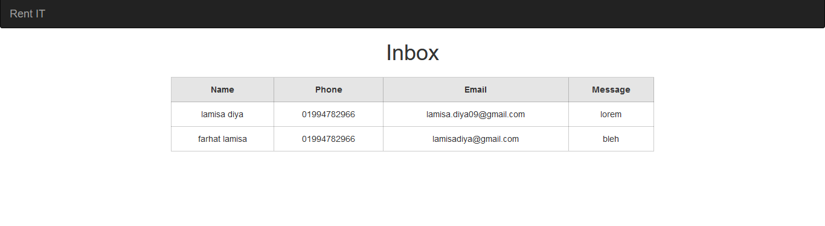

Slide 9
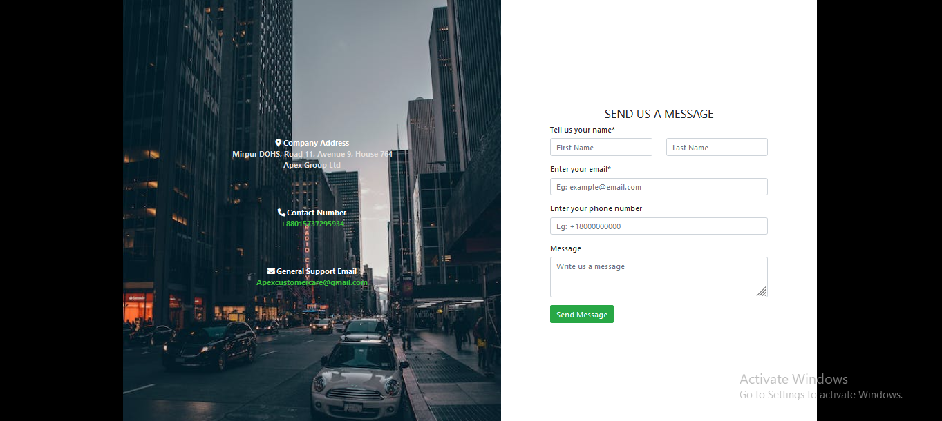

Slide 10
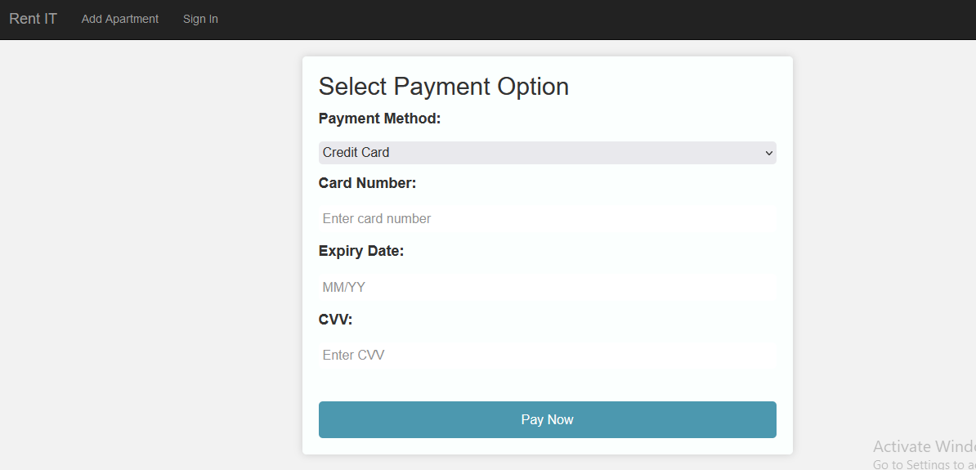
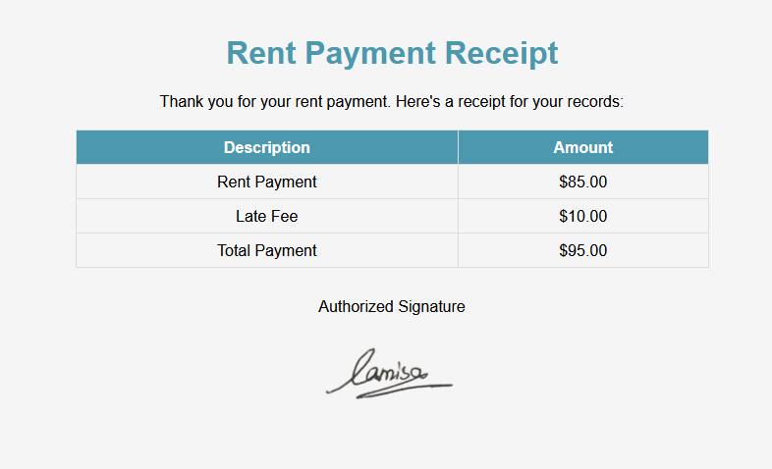
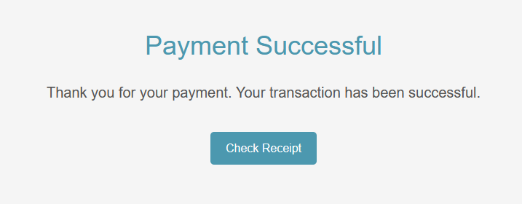

Slide 11
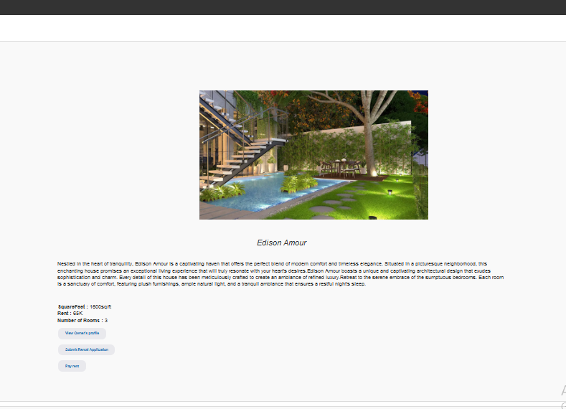
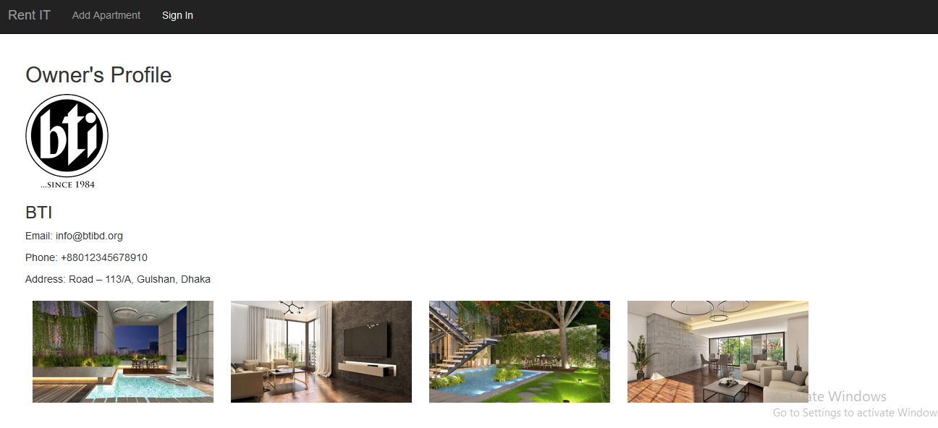
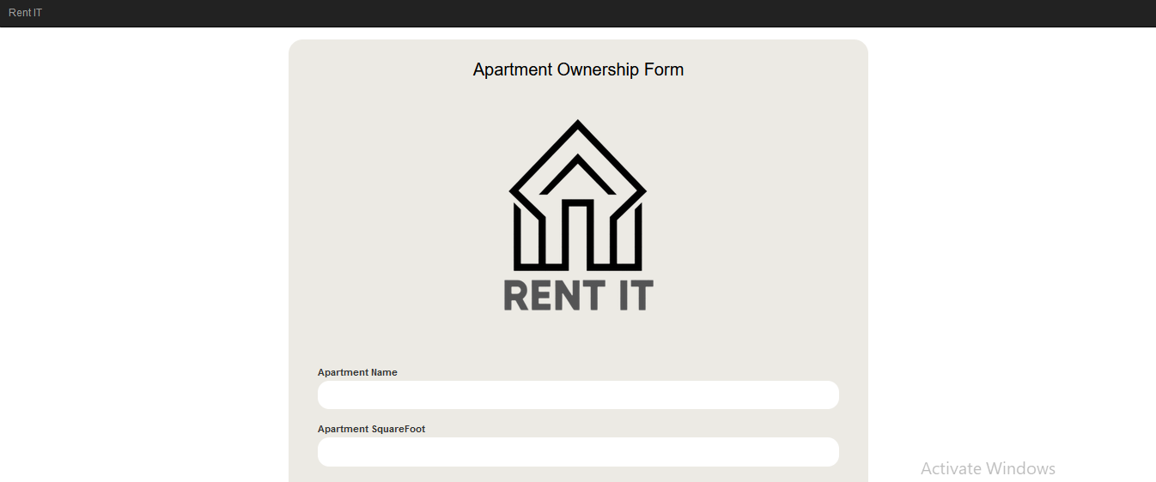

Slide 12
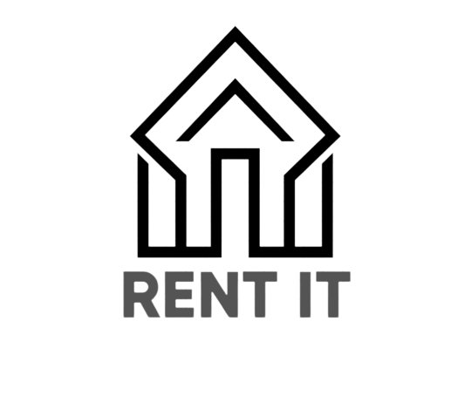
THANK YOU

