Slide 1

Data Analyst Professional Practical Exam
Presentation
Office Products Sales

Slide 2
Business Goals
The objective is to determine the most effective sales method to maximize revenue and improve sales strategies for office products. By analyzing sales data, we aim to optimize decision-making and enhance profitability.
To achieve this, we seek to explore the following key areas:
Number of customers using each sales method
Overall revenue distribution and trends
Revenue variations across different sales methods
Revenue patterns and fluctuations over time
The most effective sales approach for future optimization

Slide 3
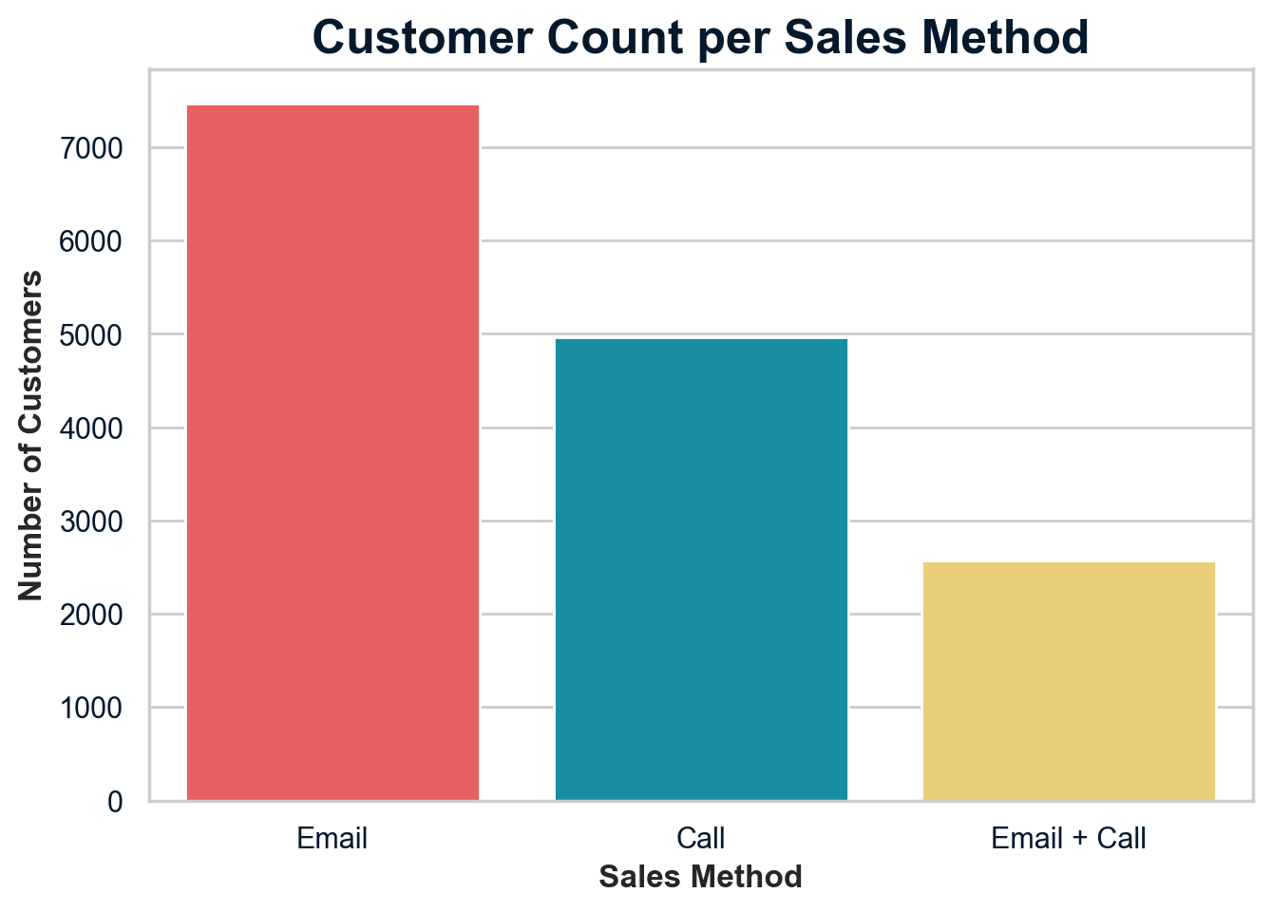
Outcomes
1. Number of customers using each sales method
As we can see from the countplot, Email had the highest number of customers, with approximately 7500 transactions, nearly 1.5 times more than Call and three times more than Email + Call .
While Email attracts the most customers, it does not necessarily generate the highest revenue per transaction.

Slide 4
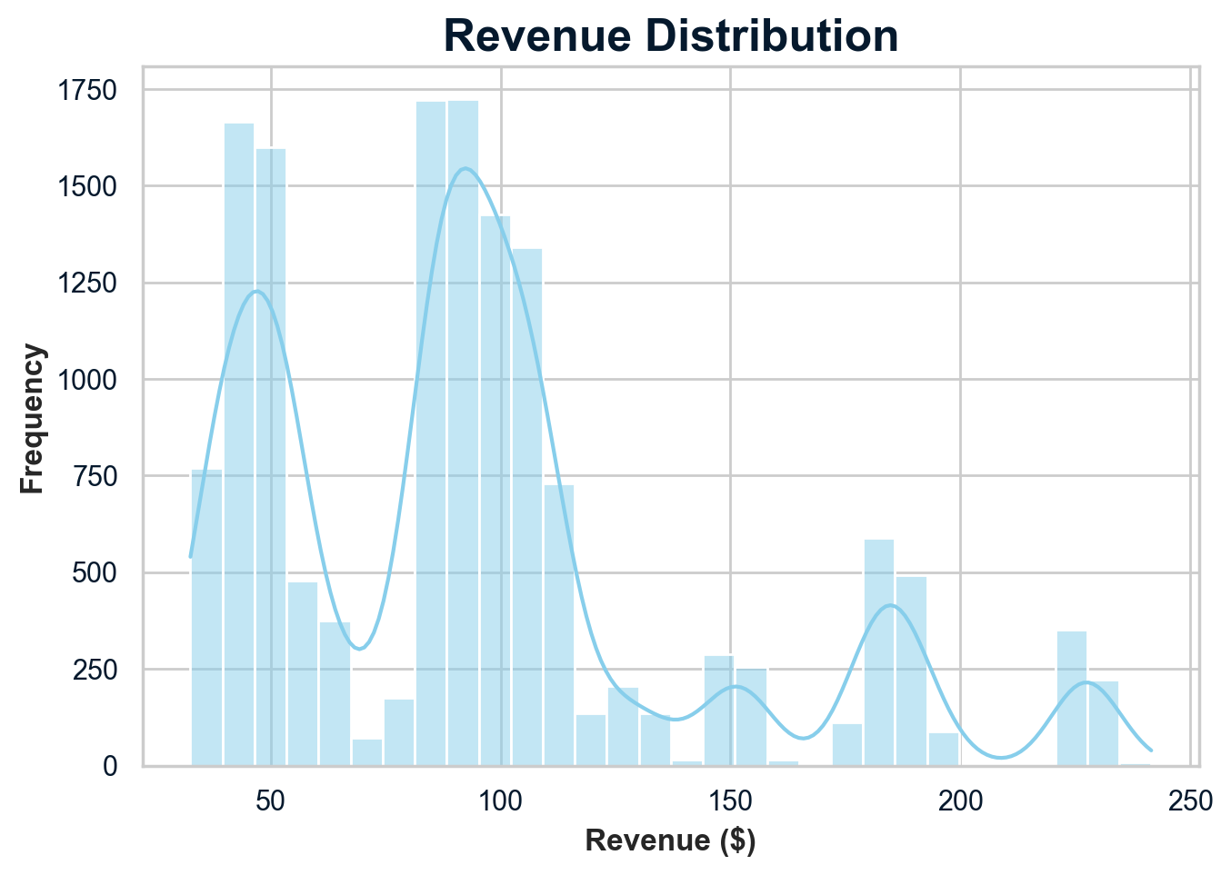
Outcomes
2. Overall revenue distribution and trends
The histogram reveals that most transactions generate revenue between $50 and $120, while fewer transactions exceed $230. The revenue distribution is slightly right-skewed, meaning a small number of transactions contribute significantly more revenue than the majority.
Understanding these high-revenue transactions is crucial for maximizing profitability.

Slide 5
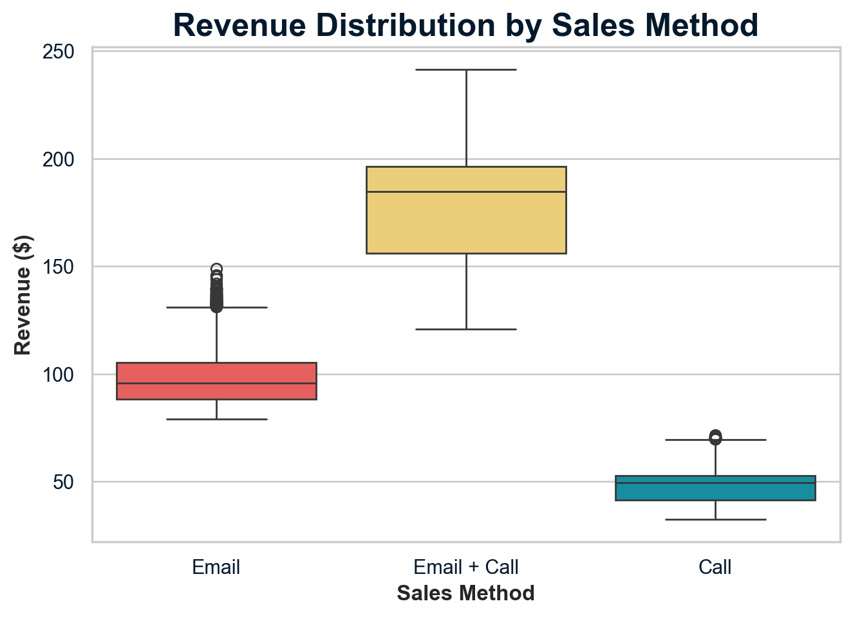
Outcomes
3. Revenue variations across different sales methods
As shown in the box plot, Email + Call has the highest median revenue per transaction at approximately $185 and the widest revenue range, indicating a large variation in revenue per sale. This makes it almost twice as profitable as Email and nearly four times higher than Call.
This confirms that Email + Call delivers the most value per sale, while also showing opportunities to optimize high-revenue transactions.

Slide 6
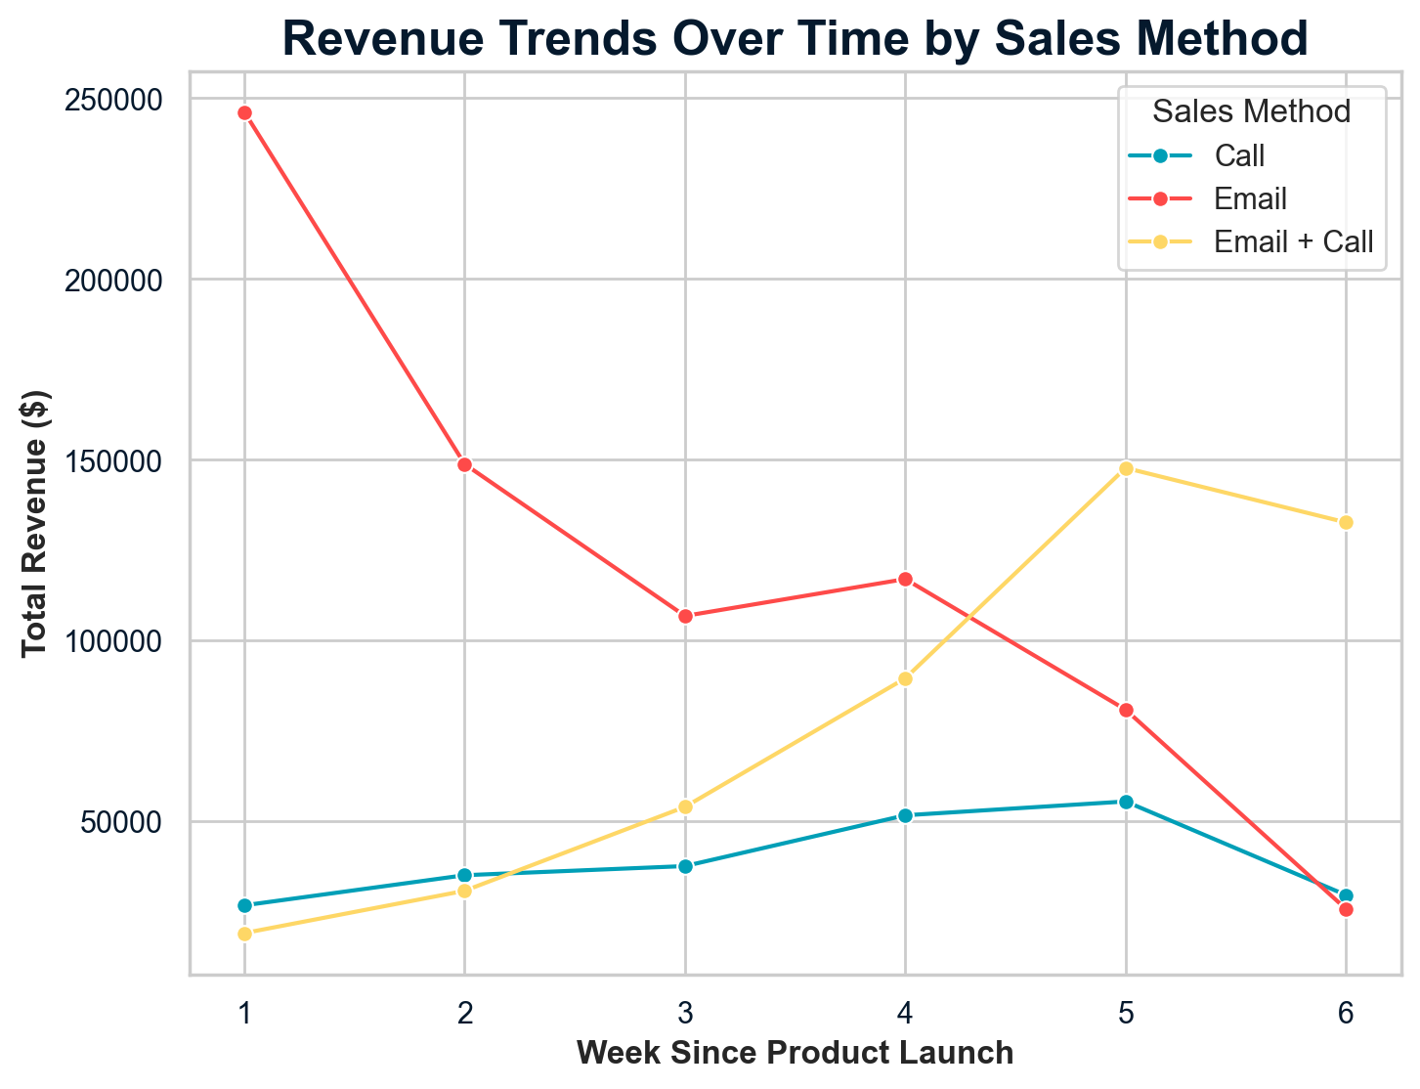
Outcomes
4. Revenue patterns and fluctuations over time
The line chart demonstrates how Email starts strong in Week 1 but declines steadily and does not recover. Call grows gradually, reaching its peak in Week 5, but drops afterward. Email + Call also peaks in Week 5 but maintains higher revenue after its peak, making it the most stable and profitable method long-term.

Slide 7
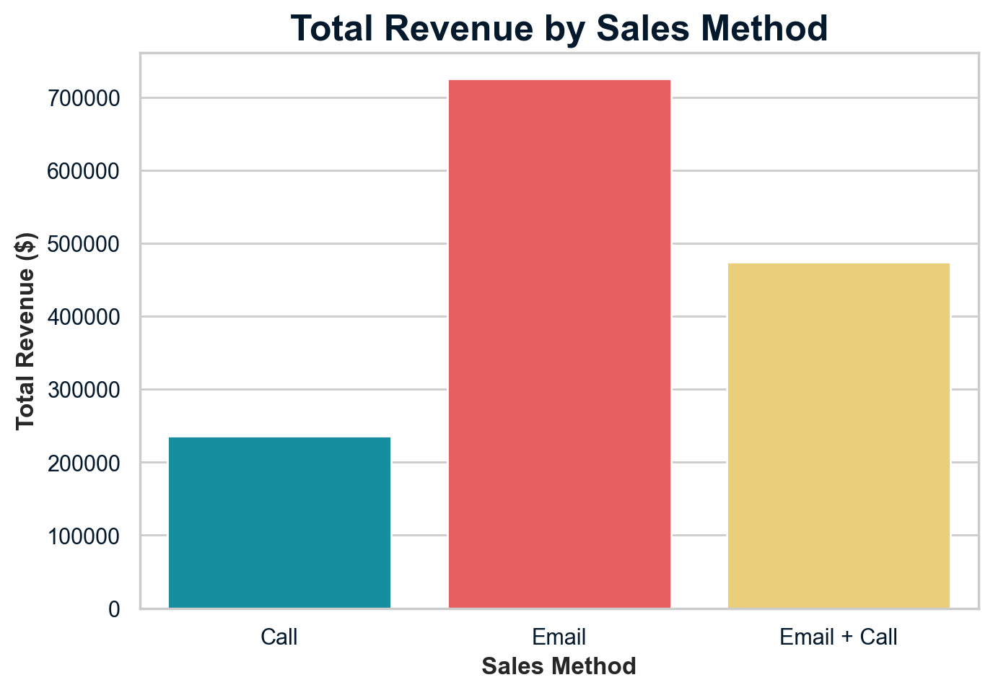
Outcomes
5.1. The most effective sales approach for future optimization - total revenue
As we can see from the bar chart, Email generated the highest total revenue, over $700K, which is approximately three times that of Call. Meanwhile, Email + Call, despite having fewer customers, still contributed over $450K, proving its efficiency in generating high-value transactions. Call has the lowest total revenue, reinforcing its lower effectiveness.
However, total revenue alone does not determine the best method, as revenue efficiency per customer is equally important.

Slide 8
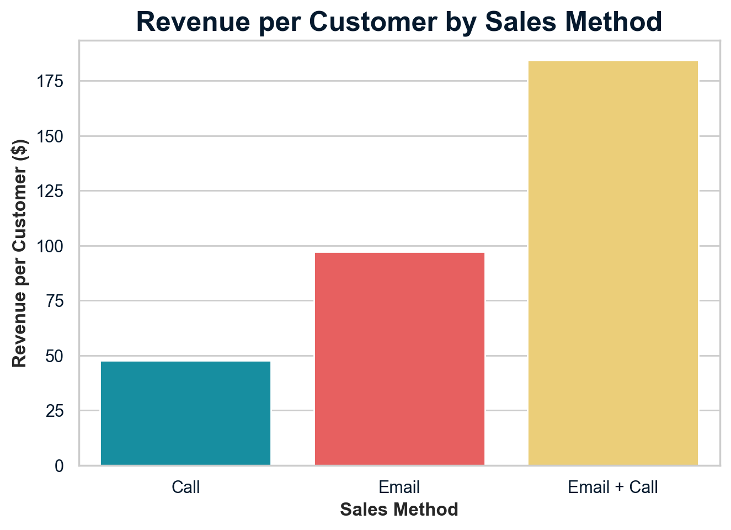
Outcomes
5.2. The most effective sales approach for future optimization - revenue per customer
The bar chart confirms that Email + Call generates the highest revenue per customer at over $180, making it almost double that of Email (around $95 per customer) and nearly four times higher than Call (around $45 per customer).
This confirms that Email + Call ensures maximum revenue efficiency per transaction.
This comparison highlights that while Email brings in more total revenue, Email + Call ensures the highest revenue efficiency per transaction, making it the strongest option moving forward.

Slide 9
Business Metrics
To ensure long-term profitability, the company should focus on Revenue per Customer per Sales Method as our metric rather than just total sales volume. This metric provides a clearer understanding of revenue efficiency by showing how much each customer contributes to overall sales. By tracking this metric, the company can identify the most valuable sales approach and optimize its strategy accordingly.
The initial estimates suggest that Email + Call generates the highest revenue per customer, making it the most effective method. Monitoring this metric will allow the company to refine its sales strategy and focus on high-value transactions.

Slide 10
Recommendations
To maximize revenue and sales efficiency, the company should implement the following strategies:
Prioritize the Most Profitable Sales Method:
Expand the use of Email + Call, as it consistently delivers the highest revenue per customer.
Invest in sales training to refine this method and enhance customer interactions.
Enhance Email-Only Sales Performance:
Test pricing or bundling strategies to increase revenue per transaction.
Segment customers and personalize offers to drive higher-value sales.
Optimize Call-Based Sales:
Identify high-value leads and prioritize outreach to improve efficiency.
Introduce automated follow-ups to enhance conversion rates.
Leverage Data for Continuous Improvement:
Monitor Revenue per Customer per Sales Method to adjust strategies dynamically.
A/B test sales strategies to determine the most effective approaches.
Encourage website engagement as data suggests site visitors tend to spend more.

