Slide 1
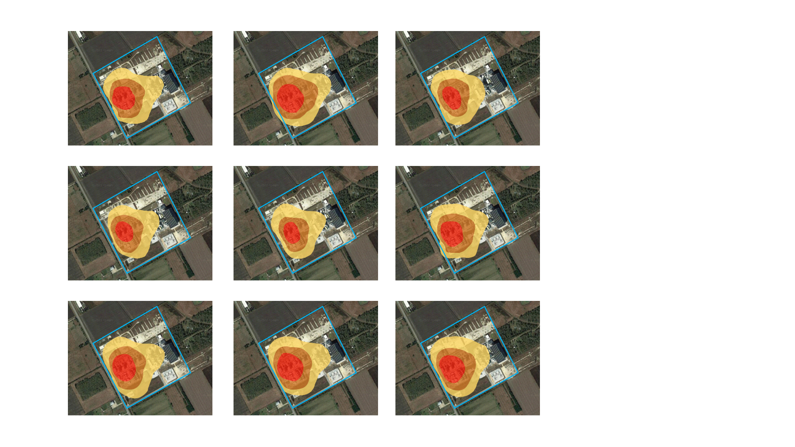
Sensor
Legal Boundary
Low Concentration
Medium Concentration
High Concentration

