Slide 1
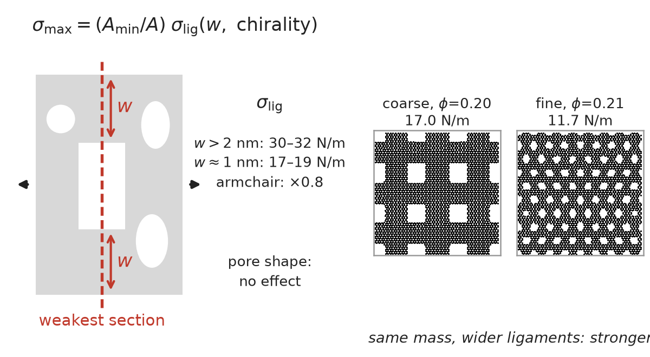
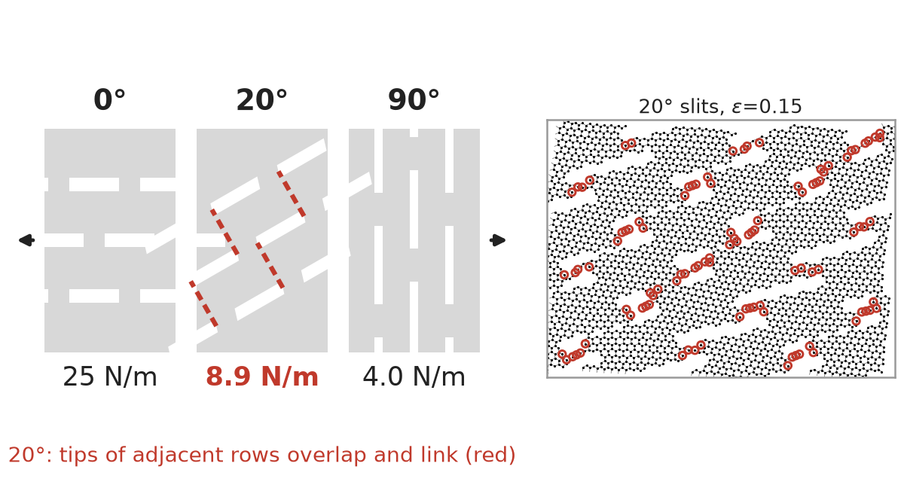
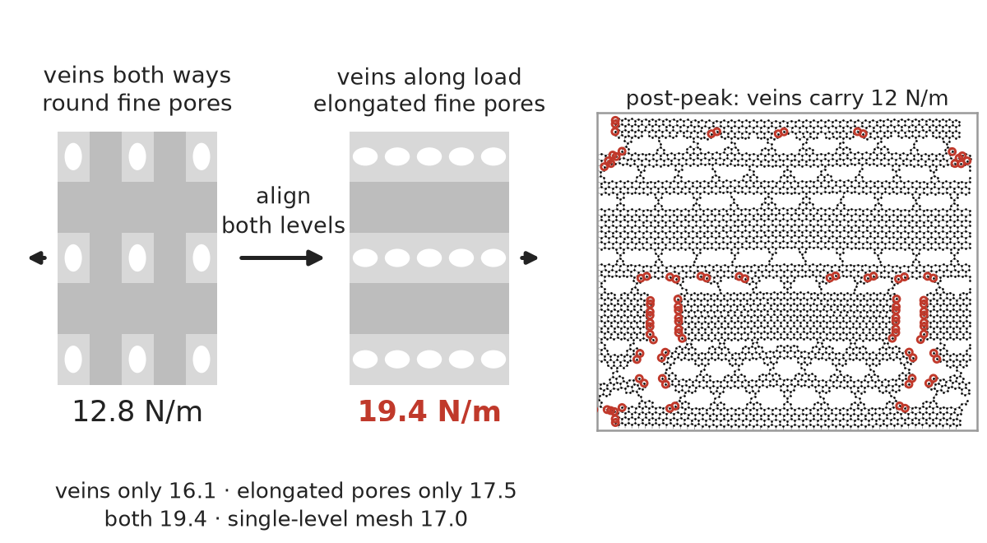
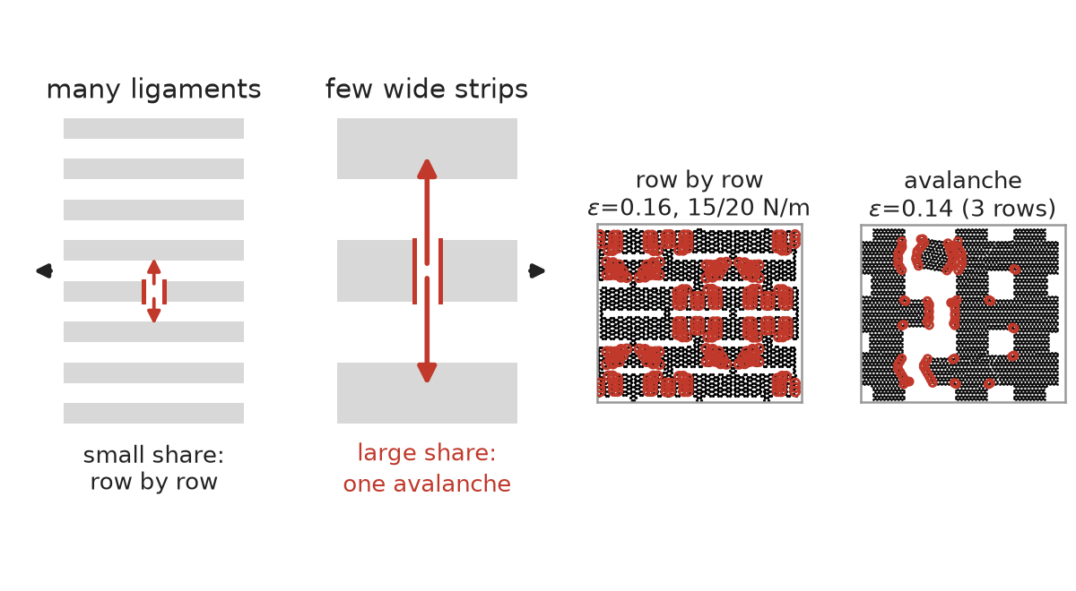
Four mechanisms set the strength and fracture mode of architected graphene
96 architectures, ten families, one validated model, matched porosity — what actually moves strength
1
Weakest section × ligament strength
2
Alignment has a cliff, not a slope
What is new
Strength is not a rule of mixtures; modulus nearly is. At equal mass, specific strength spans a factor of 6 across families; specific modulus stays within 110–275 N/m.
Load paths, not mass, separate the families. Only load-parallel slit arrays keep >80% of the pristine specific strength.
Alignment fails abruptly once slit tips overlap (en-echelon coalescence), a mechanism absent from all training data.
Hierarchy is not a free lunch: aligned levels add, unaligned levels only cost mass.
Disorder, gradients and pore halos are costs; apparent optima vanished under seed replication.
Pre-registered holdouts: median strength error 14%, mode right in 10/12; the misses were exactly the new mechanisms.
Pore shape is irrelevant at the coarse scale; ligament width and lattice orientation set σ_lig (armchair ligaments −20%).
Parallel slits 25 N/m, perpendicular 4 N/m; a 20° rotation already collapses to 9 N/m, below the 45° array (18.5).
3
Hierarchy pays only when aligned
4
Fracture mode = load-transfer property
Nested meshes at matched mass never beat the single-level mesh unless a level is aligned with the load; aligning both levels adds the two effects (19.4 N/m, best nested design).
8–10 parallel ligaments fail row by row and keep 20–60% of peak load; three wide strips cascade even with 15% dispersion.
Model results only: screened REBO2 (validated against the Atomistica reference), athermal quasi-static uniaxial tension, 2D stress in N/m; work to failure is a proxy, not a fracture toughness. Red circles in snapshots: atoms that lost a bond.
Notes:
Mechanism slide: each tile pairs a schematic of the idea with a real simulation snapshot from the database. Numbers are 2D strengths in N/m for the screened REBO2 model under quasi-static tension.

