Slide 1
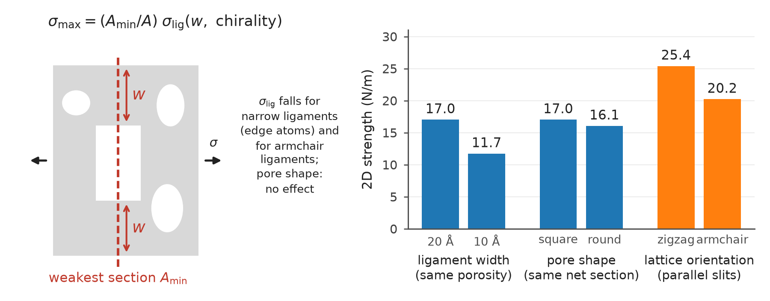
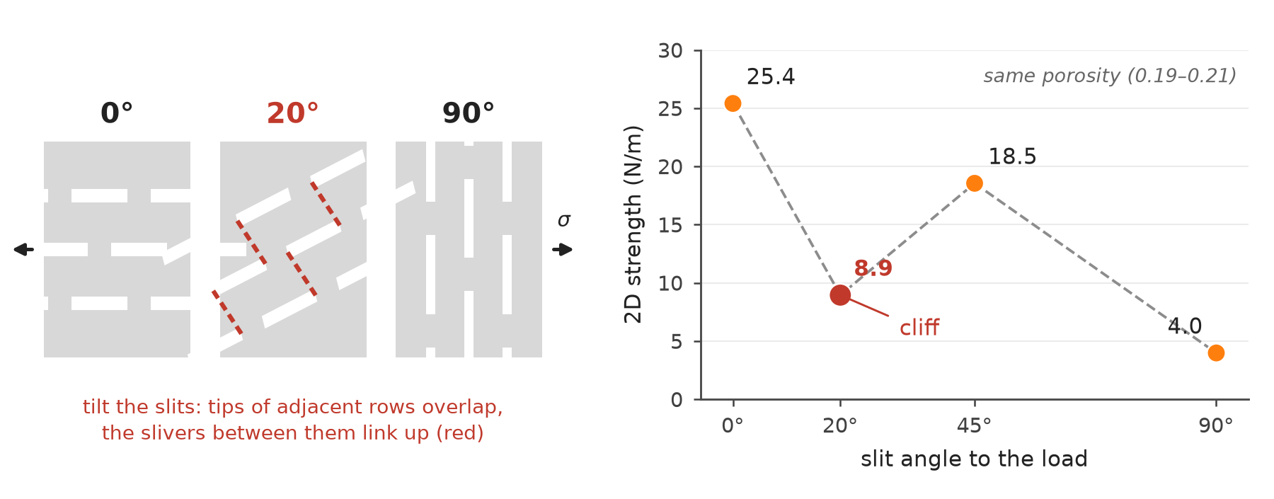
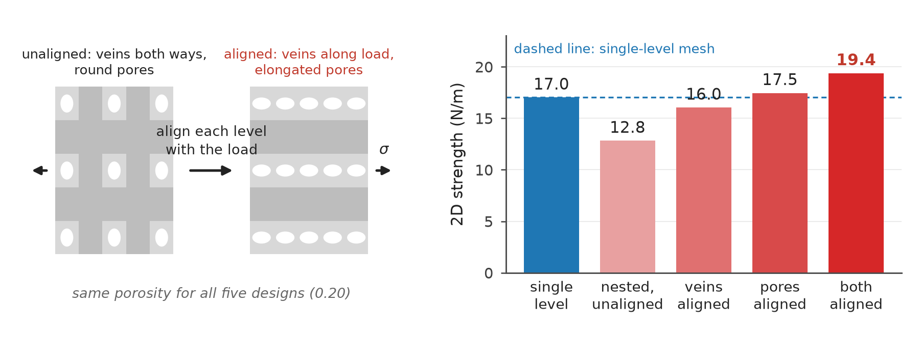
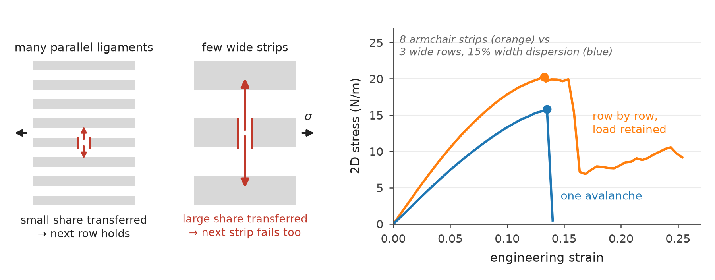
The four mechanisms: sketch on the left, one measurement on the right
Every number is one simulation from the campaign database (screened REBO2, athermal quasi-static tension, 2D strength in N/m); designs compared at the same porosity.
1
Strength = weakest section × ligament strength
KNOWN, SHARPENED
2
Alignment has a cliff, not a slope
NEW
Halving the ligament width at the same porosity costs a third of the strength; changing the pore shape at the same net section costs nothing; armchair ligaments are 20% weaker than zigzag.
Strength is not monotonic in the slit angle: a 20° tilt is worse than 45° because the slit tips of neighbouring rows overlap and link en echelon.
3
Hierarchy pays only when aligned, and adds up
NEW
4
Fracture mode = load transfer between paths
KNOWN, SHARPENED
At matched mass the nested mesh is weaker than the single-level one until a level is aligned with the load; aligning both levels adds the two gains.
Many ligaments hand over a small share when one breaks and fail row by row; three wide strips hand over a large share and fail in one avalanche, dispersion or not.
Tiles 2 and 3 are findings we could not locate in the prior literature; tiles 1 and 4 are established principles (net-section scaling, fibre-bundle load sharing) confirmed and refined at the atomic scale. Work to failure is a proxy, not a fracture toughness.
Notes:
Schematic + data slide: each tile is a sketch of the mechanism and one simple chart of real campaign data (bar charts of 2D strength, strength versus slit angle, and two stress-strain curves).

