Slide 1
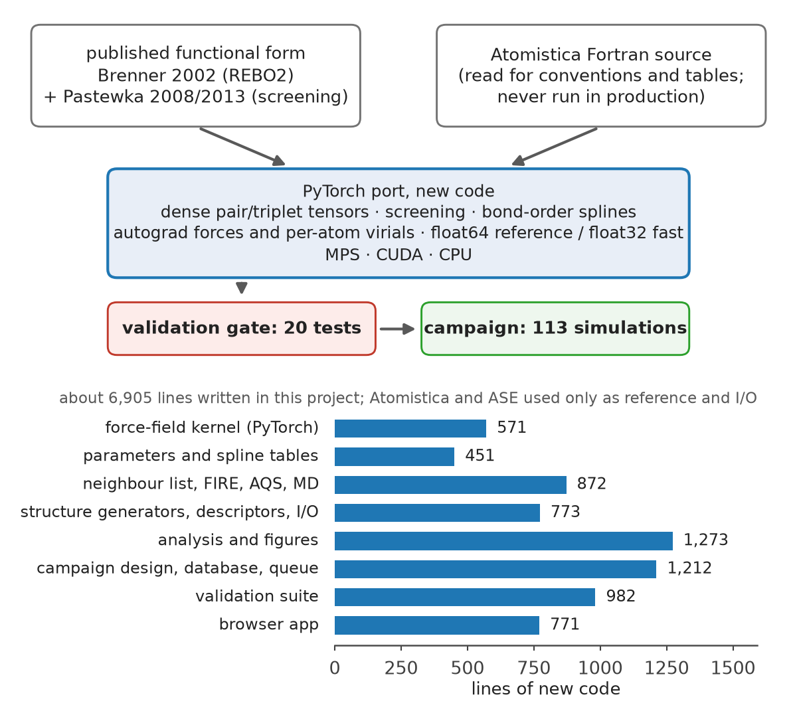
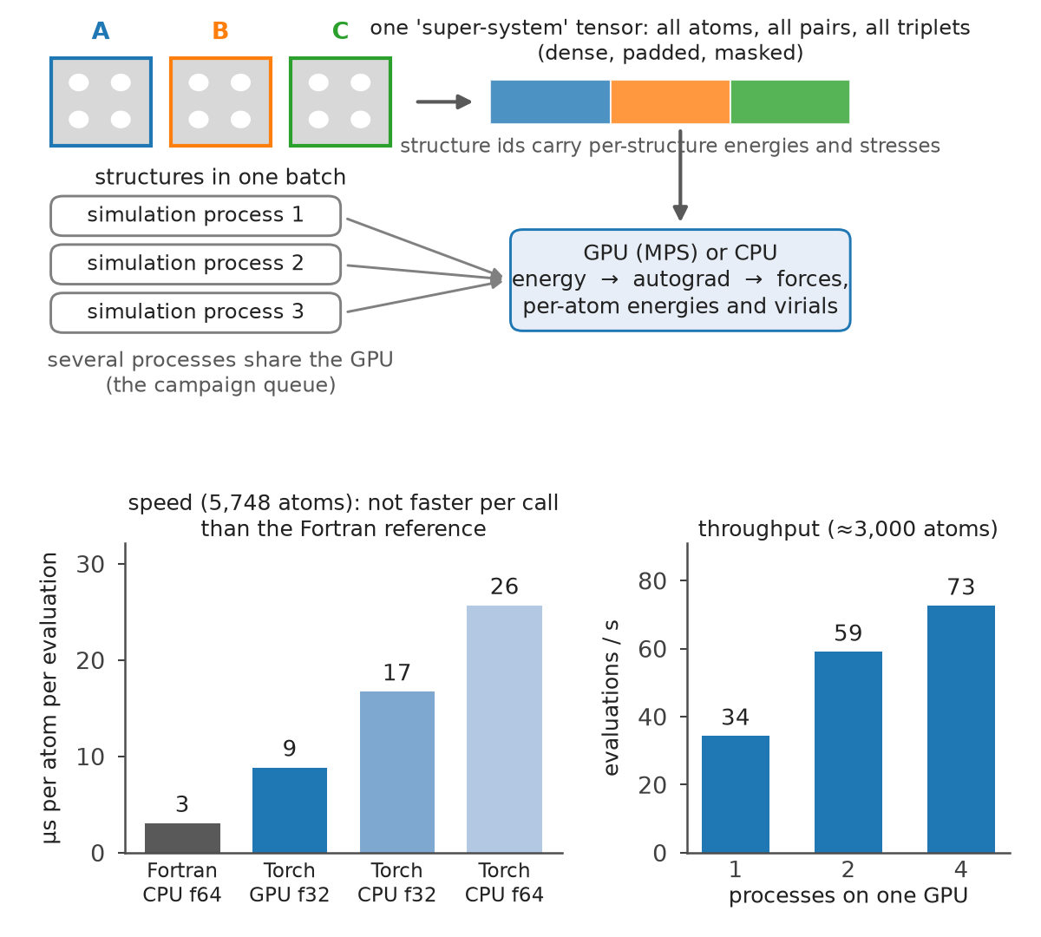
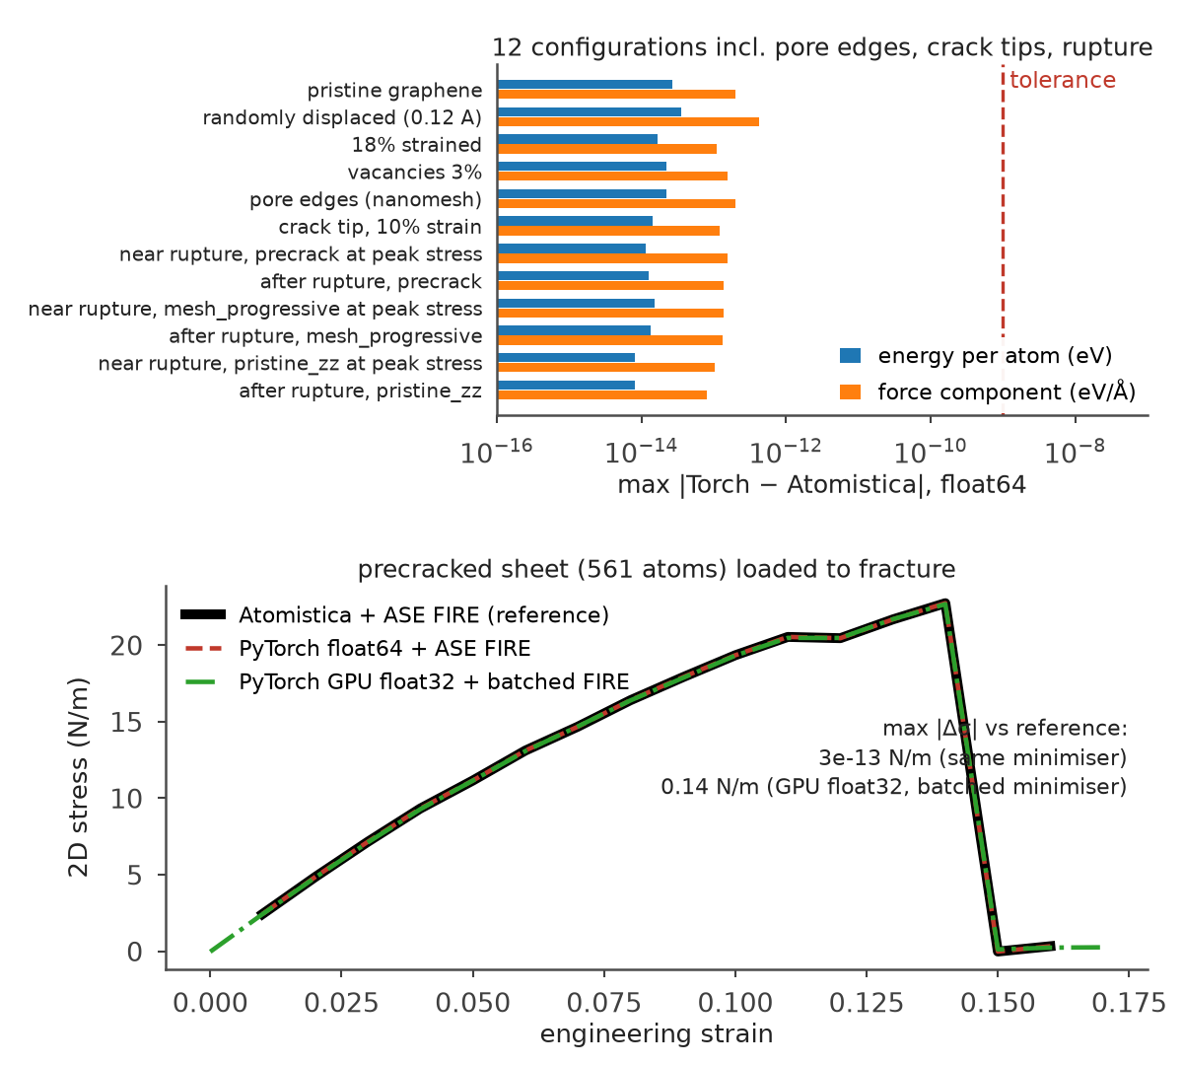
The force engine: written from scratch, validated to machine precision
New PyTorch implementation of the published screened REBO2 potential, batched for the GPU, checked against the Atomistica reference before any result was produced.
A
Written from scratch, not adapted
B
Vectorised and batched for the GPU; honest speed
C
Validated against the reference, through fracture
The functional form and parameter tables were transcribed from the papers and the reference source; the code itself (potential, neighbour list, minimiser, loading driver, MD, analysis, app) is new. Parameters unchanged; their checksum is stored in every run record.
All atoms, pairs and triplets of several structures are one padded tensor; forces and per-atom virials come from autograd. Per call the port is 3× slower than the Fortran reference; the gains are batching, exact per-atom stresses and several processes sharing the GPU.
Energies agree to 6×10⁻¹⁴ eV/atom and forces to 4×10⁻¹³ eV/Å on ordinary and difficult configurations; a complete loading curve to fracture is identical when the same minimiser is used, and within 0.14 N/m with the GPU float32 fast mode and the batched minimiser.
20 validation tests, all passed (validation/results/validation_table.json: expected, observed, error, tolerance)
Exactness vs reference (T1, T2, T19)
energies 6×10⁻¹⁴ eV/atom · forces 4×10⁻¹³ eV/Å · bond rupture E(r), F(r) to 10⁻¹¹ eV/Å (dimer, in-lattice bond, crack tip, affine stretch)
Internal consistency (T3, T9–T12, T17)
finite-difference forces and stress · neighbour list identical to brute force · translation and periodic-image invariance · force balance 10⁻¹⁴ · repeatability on the GPU
Fast mode, physics, protocol (T4–T8, T13–T16, T18, T20)
float32 GPU within 7×10⁻⁶ eV/atom, 1.5×10⁻⁴ eV/Å, 4×10⁻⁵ N/m · lattice constant, cohesive energy, elastic constants, chirality · FIRE-tolerance, strain-step and cell-size convergence · full curve through fracture · export round-trips
The last 10⁻⁸ eV/atom. The port first agreed with the reference only to 10⁻⁸. The residual was traced to the Fortran source storing the bond-order spline knots as single-precision literals; reproducing that rounding closed the gap to 10⁻¹³.
Reference: Atomistica 1.2.7 Rebo2Scr (Pastewka et al.), used only for validation; production runs use the PyTorch port on the Apple GPU in float32 with the float64 CPU mode as the precision reference. No machine-learned surrogate anywhere in the mechanics.
Notes:
Engine slide: what was written (pipeline and lines of code), how it runs on the GPU (batched super-system tensor, autograd, multi-process concurrency) with honest speed numbers, and how it was validated (per-configuration agreement with the reference, full stress-strain overlay, the 20-test suite).

