Slide 1

Text Analytics and Stylometrics to Build Analyses
Leslie A. McFarlin, Principal UX Architect at Wheels

Slide 2
About Me
Principal UX Architect at Wheels.
Develop UX data analytics discipline within the Digital Engagements Team.
Design generative AI supported experiences.
Create proofs of concept for internal machine learning tools that support the Digital Engagements Team.

Slide 3
Presentation Overview
A Brief Introduction to Text Analytics and Stylometrics
Example Walkthrough
Project Ideas

Slide 4

A Brief Introduction to Text Analytics and Stylometrics

Slide 5
Text Analytics
Extract metrics and qualitative insights from text processing.
Also known as text mining, in the context of the presentation, it will refer to metrics not related to unique linguistic features.
Useful for:
Analyzing feedback
Content analysis
Social media monitoring

Slide 6
Stylometrics
Insights based on the analysis of linguistic style and patterns within texts.
Used for:
Authorship attribution and verification
Profiling

Slide 7
Why Use Stylometrics?
Combining stylometrics with text analytics provides researchers with a deeper understanding of texts, particularly when studying nuances or developing profiles.
Discover unique stylistic patterns.
Reveal linguistic preferences or habits of authors.
Provide additional context to content analysis around sentiment, topics, or named entities.
Offer insights into biases.
Notes:
One additional point to make here before moving on: Just because something is a metric, doesn’t mean that it can’t be used in the context of a stylometric analysis. Some of the metrics I will show you do double duty in that the do measure some aspect of a text, but that measure also tells you something about the author’s style.

Slide 8

Example Walkthrough

Slide 9
What Are We Analyzing?
Fake and Real News Dataset, formerly found at Kaggle, curated by Clement Bisaillon. View his project on Github.
 | True.csv | Fake.csv
Composition | 21,417 articles | 23,481 articles
Source | http://reuters.com | A variety of sites flagged as unreliable by Politifact.
Processing | HTML tags removed, punctuation preserved. | HTML tags removed, spelling errors and punctuation preserved.
Fields | Title, Text, Subject, Date

Slide 10
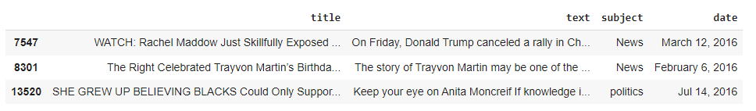
Fake.csv Sample

Slide 11
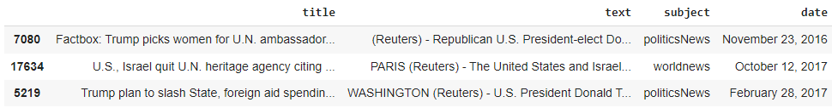
True.csv Sample
Notes:
At this point I want to mention that this presentation will not cover anything specific to the date and subject fields. Dates are not relevant for what we’re talking about. The subject field is relevant, but the subject categories are not the same between the True and Fake CSV files, in that there are 7 categories in the Fake CSV file, but only 2 in the True CSV file. Given that, in the Project Ideas section I will talk briefly about topic modeling as that can be an interesting replacement for subject.

Slide 12
What Are We Doing?
Processing texts.
Calculate text metrics.
Discuss why you should calculate certain metrics.

Slide 13
Processing Texts
Processing texts encompasses multiple activities:
Removing texts according to specific criteria:
Under a specific alphanumeric character length.
No text other than URLs
Removing news desk information: ‘{City Name} (News Outlet) - ’
Build and apply a text processing pipeline in spaCy.
Notes:
I’m using spaCy because if you’re new to natural language processing and text mining, it will do a lot of core work for you.
It offers 3 pre-trained pipelines.
Covers most of the major languages in the world.
Integrates well with HuggingFace and LLMs.

Slide 14
Tip: Let Domain and Hypotheses Guide Text Cleaning
Whether you remove punctuation, stopwords, expand contractions, and correct misspellings depends partly on your data’s domain.
All of these elements maintain authenticity and provide important context, but it can build to a point where there is a lot of noise in the data.
Ask yourself: “If I remove this one aspect of my text data, am I possibly removing a feature that will help me perform my analysis?”
Think back to any hypotheses you might have. Are they dependent upon features that might be removed by how you clean your text?
Notes:
In my own work I make decisions about when to do a more thorough text cleaning process.
For any reviews of our products or services, I apply a full text cleaning pipeline. It makes it easier to determine sentiment.
When looking at social media, I preserve the raw text as much as possible. There are a lot of unique features that can help me create profiles for the types of people engaging around our brand on social media.

Slide 15
Build a Text Processing Pipeline
# Installations
!pip install spacy
!python -m spacy download en_core_web_sm ### PRE-TRAINED PIPELINE
# Imports
import spacy
### GLOBAL ###
nlp = spacy.load("en_core_web_sm") ### THIS IS YOUR PIPELINE OBJECT
STOPWORDS = nlp.Defaults.stop_words

Slide 16
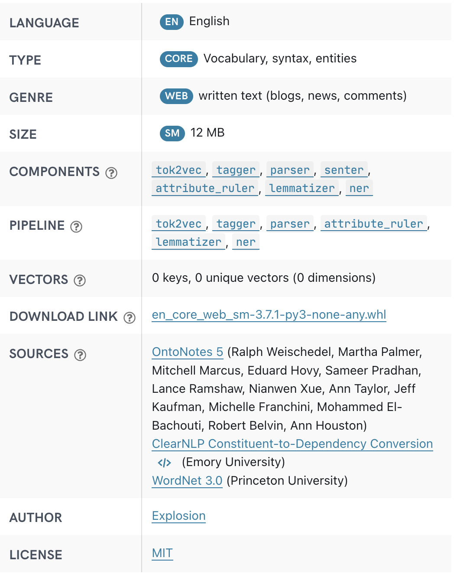
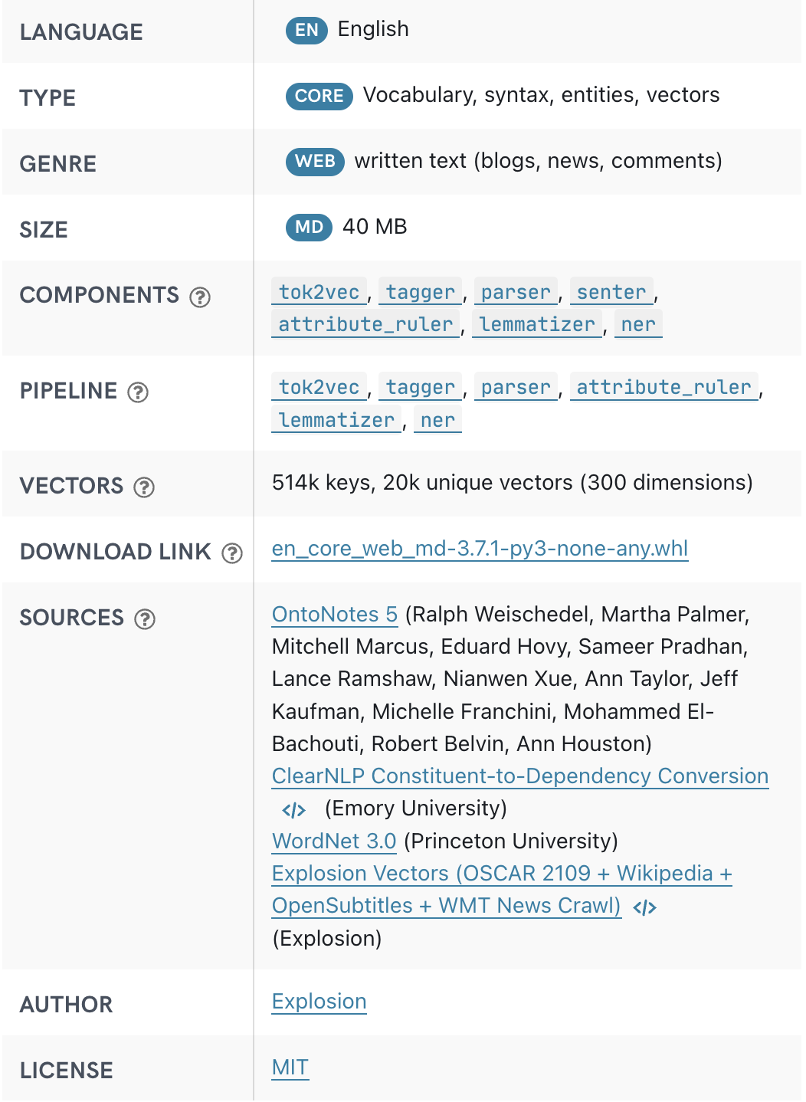
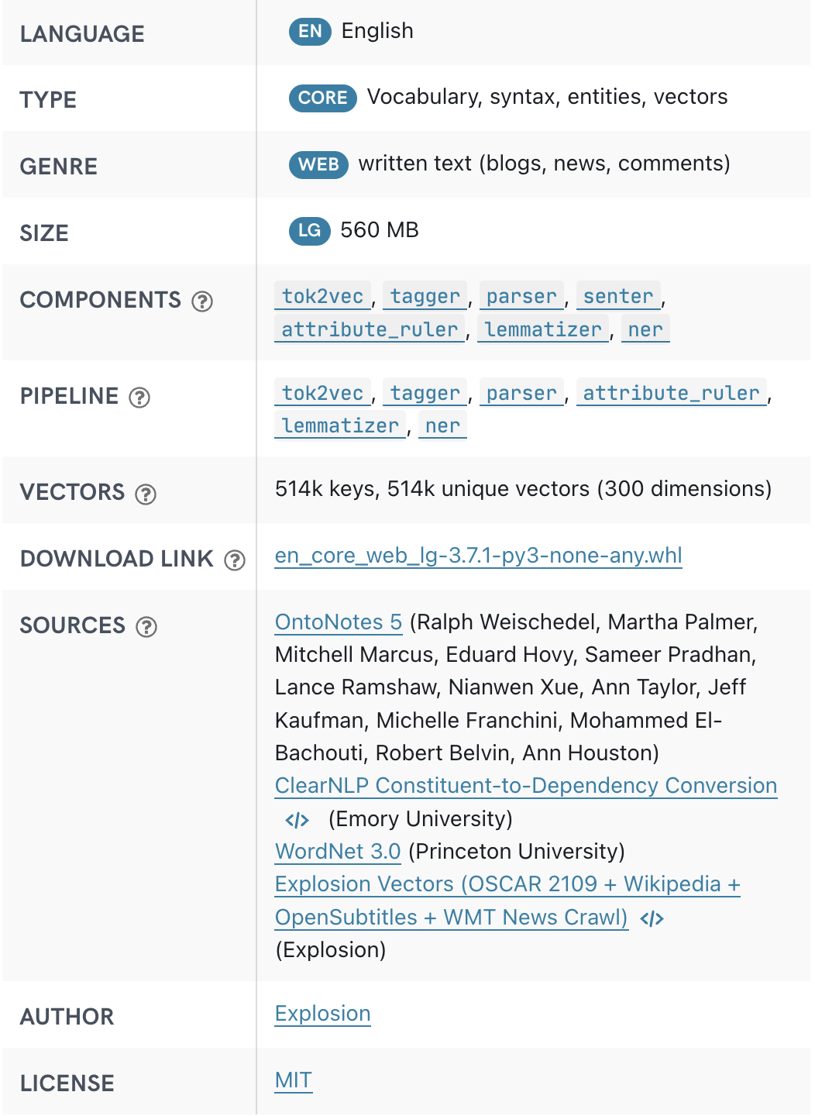
Tip: Be Mindful of Your Pre-Trained Pipeline Selection
en_core_web_sm
en_core_web_md
en_core_web_lg
Notes:
Choice of model is important if you plan to export your pipeline and re-use it later, as some activities require word vectors to run.
Example: BERTopic, which I will show you some code for in the Project Ideas section.

Slide 17
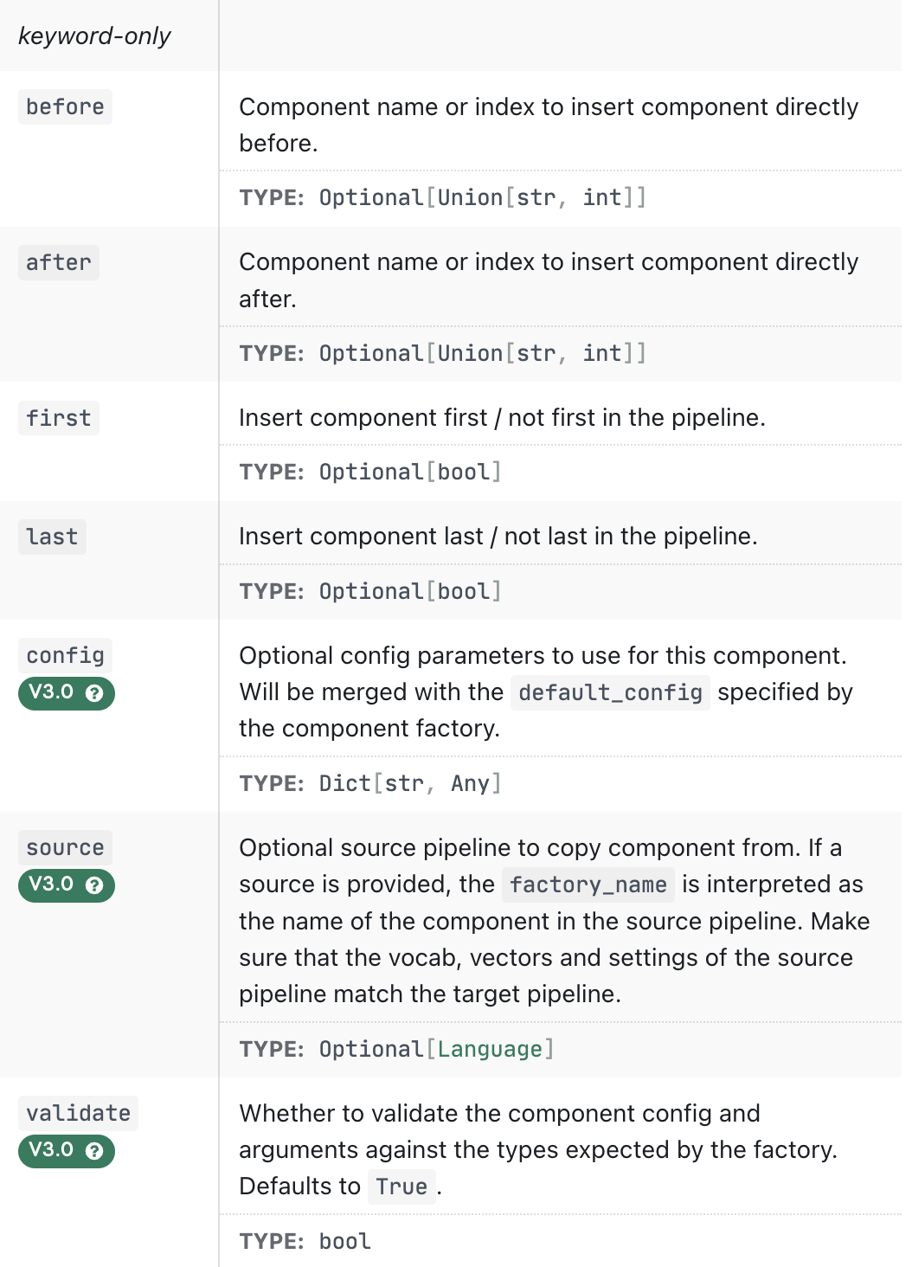
Build a Text Processing Pipeline
# Include sentence tokenizer
nlp.add_pipe('sentencizer', after='parser')
Learn more about nlp.add_pipe()

Slide 18
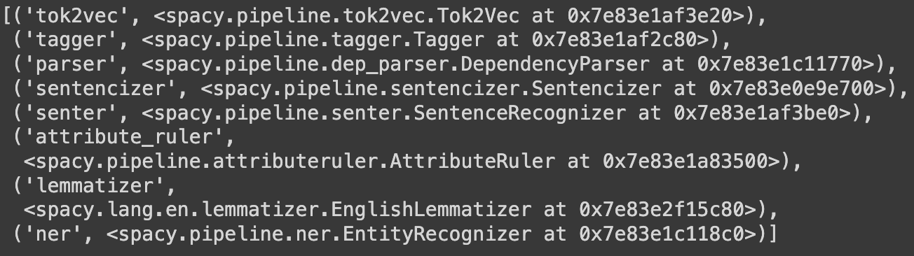
Build a Text Processing Pipeline
# View the pipeline components
nlp.components

Slide 19
Tip: Watch the Ordering of Pipeline Components
Order pipeline elements in such a way that the output of an earlier component can be used by components later in the pipeline.
# Include sentence tokenizer
nlp.add_pipe('sentencizer', after='parser')
Parser
Identifies relationships between words
Sentencizer
Uses punctuation to tokenize sentences.
Senter
Detects sentence boundaries
Offers improved processing time and additional context for better sentence tokenizing.
Tokenizing sentences based on punctuation produces a more accurate starting point for boundary detection.
Improved boundary detection creates better starting points for NER tagging and other processing tasks.

Slide 20
Build a Text Processing Pipeline
After creating a pipeline, it can be saved and exported for use elsewhere.
# For future use, export this pipeline
nlp.to_disk('/content/drive/MyDrive/Python/MSCAPP/utils/pipeline/')
# FYI - Imported for use
nlp = English().from_disk(‘/content/drive/MyDrive/Python/MSCAPP/utils/pipeline/’)

Slide 21
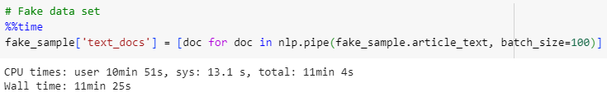
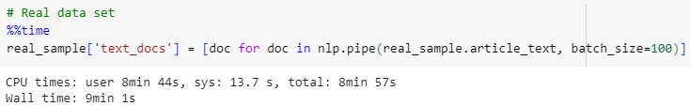
Apply a Text Processing Pipeline
Use pipe() to apply a text processing pipeline.
Notes:
Using batching vs. streaming processing depends on any resource constraints you might have, as well as how quickly you need access to processed data.
Batching can help manage resources and take advantage of parallel processing.
Streaming processing is good if you need the processed data in real-time/near-to real-time.

Slide 22
Apply a Text Processing Pipeline
Doc
A processed document yielded by a generator created by a pipeline.
Token
Smallest unit of processed text. Contain context information and linguistic details.
Span
Contiguous sequence of tokens within a Doc.
text
token.text
lemma_
text.lemma_
pos_
token.pos_
sents
doc.sents
ents
doc.ents
text
ent.text
label_
ent.label
Notes:
For lemma_ and pos_ there are also elements with the same name minus the underscore at the end. Think of them as pointers to the actual objects called out here.

Slide 23
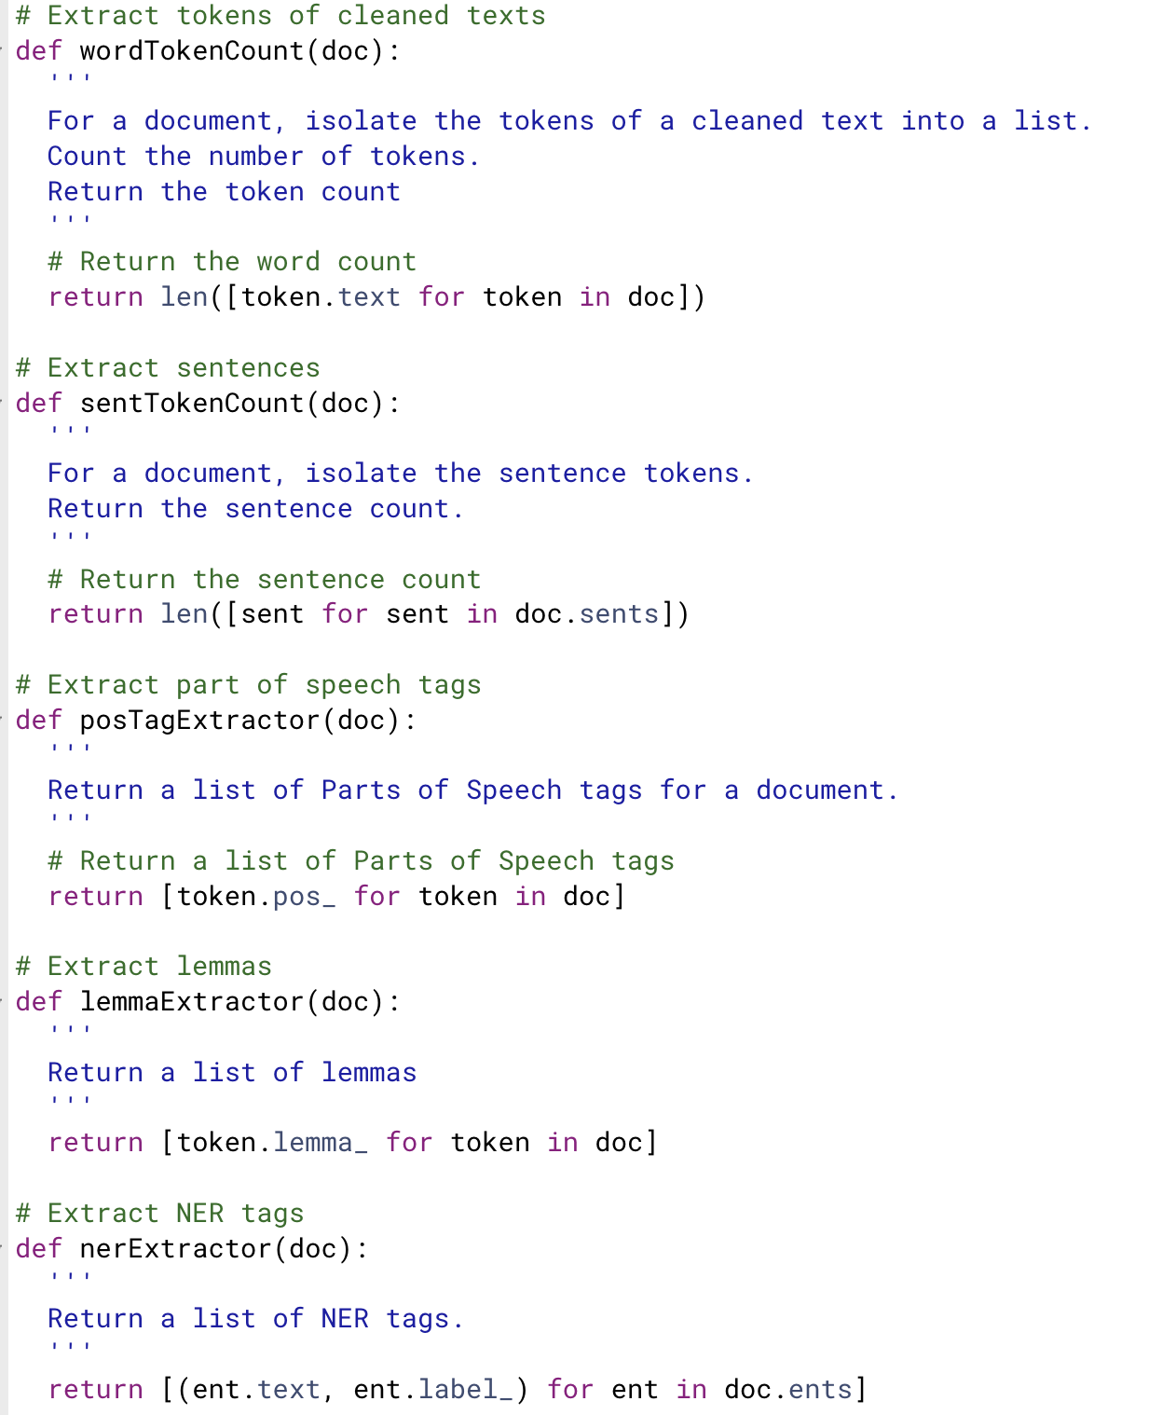
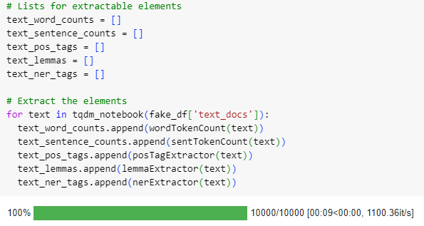
Calculate Text Metrics

Slide 24
Calculate Text Metrics
Element | Information | Use
Characters, Words, Sentences | Counts | Mean or median lengths of words and sentences; measures of readability, vocabulary richness, and lexical diversity.
Parts of Speech tags | Counts | Functional-Content Word Ratio
Named Entity Recognition tags | Counts | Entity diversity, entity co-occurrence.
Emotions | Association scores (weights) | Determine dominant sentiments; feature vector creation

Slide 25
Calculate Text Metrics
Readability index values, vocabulary richness, and lexical diversity have demonstrated some reliable patterns in research.
Multiple studies have shown that fake news and conspiracy theory-based texts have lower readability index scores, meaning they should be easier to read and more accessible to a wider variety audience.
Some studies have found vocabulary richness and lexical diversity measures to be higher for fake news than real news.
Such measures can help you develop important indicators for categories of texts you analyze.

Slide 26
Calculate Text Metrics: Automated Readability Index
Automated Readability Index (ARI) produces a score indicating the grade level required to understand a text. Accessible via textstat.
# Calculate ARI
data['ARI'] = data['original_text'].apply(lambda x: textstat.automated_readability_index(x))

Slide 27
Calculate Text Metrics
Vocabulary richness and lexical diversity both look at the variety of words in a text, but their focus is slightly different.
Vocabulary Richness | Lexical Diversity
Total number of unique words in a text. | Distribution of unique words within a text.
Uses the total count. | Ratio of unique words to total count of words.
The higher the vocabulary richness score, the wider the variety of words used in a text. | The higher the lexical diversity score, the more variation of word types within a text.
Indicates range of vocabulary. | Indicates range and variety of vocabulary.

Slide 28

Calculate Text Metrics: Type-Token Ratio
Type-Token Ratio (TTR) creates a ratio of unique words to total words in a text that serves as a measure of vocabulary richness. Available via lexicalrichness.

Slide 29
Calculate Text Metrics: TTR in Code
# TTR
def ttrCalc(text):
'''
Uses lexicalrichness package to calculate the Type-Token Ratio.
Returns the TTR value.
'''
assert len(text) > 1, "Text is too small. Check text lengths and try again."
# New text object
lex = LexicalRichness(text)
# Return TTR
return lex.ttr
# Calculate TTR
data['TTR'] = data['original_text'].apply(lambda x: ttrCalc(x))

Slide 30
Calculate Text Metrics: Measure of Textual Lexical Diversity
Measure of Textual Lexical Diversity (MTLD) assesses lexical diversity by measuring the number of words someone would need to see for a text to be considered lexically diverse. Also available via lexicalrichness.
Measures TTR after every word of a sample until it reaches some threshold.
Repeat until the last token of the sample has been included in calculations.
Divide the text length by the total number of TTR values at the threshold.
Perform the previous steps in reverse.
Take the average of the forward and backward MTLD scores to get the final index.

Slide 31
Calculate Text Metrics: MTLD in Code
# MTLD
def mtldCalc(text):
'''
Uses lexicalrichness package to calculate the Measure of Textual Lexical Diversity.
Returns the MTLD value.
'''
# New text object
lex = LexicalRichness(text)
# Return MTLD
return lex.mtld(0.72)
# Calculate MTLD
data['MTLD'] = data['original_text'].apply(lambda x: mtldCalc(x))

Slide 32
Tip: Be Aware of Metric Limitations
Some metrics are better suited to for analyses when texts are similar on certain features. Example: text length.
TTR can become artificially low in longer texts because at some point terms start to be reused.
Either use a different metric that is insensitive to that feature, or include additional measures that look at text aspects such as lexical redundancy.
Entropy is one way to calculate redundancy in a text.

Slide 33
Calculate Text Metrics: Hapax
Hapaxes are words appearing only once within a text or corpus. They are representative of vocabulary richness and lexical diversity.
Start with counts, and then evaluate hapaxes with respect to parts of speech and named entity tags.
A hapax might also hold domain- or context-relevant information (example: technical jargon).
Warning: Sometimes a hapax can be indicative of typographic errors, so you may need to take additional steps to verify a hapax is a legitimate word.

Slide 34
Calculate Text Metrics: Hapax and Counts in Code
def hapaxCalc(text):
'''
Determine hapaxes per text.
Use word tokenization to create a Counter object.
Filter counter object to a list of words that appear only once.
Return a list of hapaxes.
'''
# Get the word tokens counter
word_token_counter = Counter([t for t in text.split() if t.isalnum()])
# Filter the Counter to values of only 1
hapaxes = [key for key, value in word_token_counter.items() if value == 1]
# Return the list
return hapaxes
# Find hapaxes
data['hapaxes'] = data['original_text'].apply(lambda x: hapaxCalc(x))
# Get the count of hapaxes
data['hapaxes_count'] = data['hapaxes'].apply(lambda x: len(x))

Slide 35
Calculate Text Metrics: Part of Speech Tags
Part of Speech (POS) tags indicate the types of words (noun, adverb, conjunction) appearing in a text.
Important for understanding syntactic structure.
Offer insights into distribution of word types in a text.
Reduce ambiguity for words with multiple meanings.
Enables other activities, such as named entity recognition.
See the full list of spaCy POS tags.

Slide 36
Calculate Text Metrics: Functional-Content Word Ratio
The Functional-Content Word Ratio (FCR) is the balance of function words to content words within a text. It relies on POS tags.
Function words serve grammatical or structural functions within a sentence: Conjunctions, determiners, prepositions, pronouns, auxiliary verbs.
Content words carry semantic meaning: Nouns, verbs, adjectives, adverbs, numerals, interjections.

Slide 37
Calculate Text Metrics: FCR in Code I
# Make a list
all_pos_tags = []
# Iterate
for i in tqdm_notebook(range(data.shape[0])):
# Iterate each tag per text
for pos in data.text_pos_tags[i]:
# Append
all_pos_tags.append(pos)
# Create a set
all_pos_tags_set = set(all_pos_tags)

Slide 38
Calculate Text Metrics: FCR in Code II
# Create new columns in data per unique pos tag
for tag in all_pos_tags_set:
data[tag] = 0
# Add counts of tags per text
for i in tqdm_notebook(range(data.shape[0])):
# Counter per text
text_pos_counter = Counter(data.text_pos_tags[i])
# Get the intersection in all_pos_tags_set and counter keys
intersecting_keys = all_pos_tags_set.intersection(text_pos_counter.keys())
# Iterate the intersecting keys
for key in intersecting_keys:
# Add the count to the corresponding column
data.loc[i, key] = text_pos_counter[key]

Slide 39
Calculate Text Metrics: FCR in Code III
# Define POS tags for function words - https://github.com/explosion/spaCy/blob/master/spacy/glossary.py
function_pos_tags = ['ADP', 'AUX', 'DET', 'INTJ', 'SCONJ']
# Content POS tags
content_pos_tags = ['ADJ', 'ADV','NOUN', 'NUM', 'PROPN', 'VERB']
# Calculate FCR
data['function_word_ratio'] = data[function_pos_tags].sum(axis=1) / data[content_pos_tags].sum(axis=1)

Slide 40
Calculate Text Metrics: Named Entity Recognition Tags
Named Entity Recognition (NER) tags are labels assigned to words and phrases in a text that identify real world entities. They cover things like people, organizations, dates, and quantities.
Count tags per text and overall for a collection, which can be used to explore entity diversity.
Use a context window to find entity co-occurrences within a text.
See the full list of spaCy NER tags.

Slide 41
Calculate Text Metrics: Counting NER Tags in Code I
# Make a list
all_ner_tags = []
# Iterate
for i in tqdm_notebook(range(data.shape[0])):
# Iterate each tag per text
for ner in data.text_ner_tags[i]:
# Append
all_ner_tags.append(ner[1])
# Create a set
all_ner_tags_set = set(all_ner_tags)

Slide 42
Calculate Text Metrics: Counting NER Tags in Code II
# Create new columns in data per unique ner tag
for tag in all_ner_tags_set:
data[tag] = 0
# Add counts of tags per text
for i in tqdm_notebook(range(data.shape[0])):
# NER tags per text
this_text_ner_tags = [record[1] for record in data.text_ner_tags[i]]
# Counter per text
text_ner_counter = Counter(this_text_ner_tags)
# Get the intersection in all_pos_tags_set and counter keys
ner_intersecting_keys = all_ner_tags_set.intersection(text_ner_counter.keys())
# Iterate the intersecting keys
for key in ner_intersecting_keys:
# Add the count to the corresponding column
data.loc[i, key] = text_ner_counter[key]

Slide 43
Calculate Text Metrics: Emotions
Assessing emotions in texts provides deeper insights into communication patterns that can be used to create more detailed profiles of texts or create features for use in machine learning models.
Uncover attitudes toward trends, famous figures, current events.
Detect psychological states.
Find emotional manipulation tactics.

Slide 44
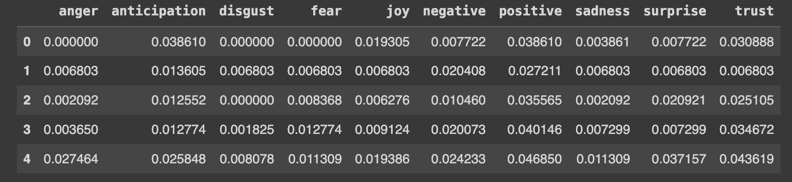
Calculate Text Metrics: Emotions
Emotions can be assessed via the LeXmo package, which is based on the NRC Word-Emotion Association Lexicon (EmoLex).
8 emotions: Anger, anticipation, disgust, fear, joy, sadness, surprise, trust.
2 sentiments: Negative, positive.

Slide 45
Calculate Text Metrics: Emotions
# Iterate through the DataFrame in batches
for start in range(0, fake_sample.shape[0], batch_size):
# Initialize tqdm with the total number of iterations
progress_bar = tqdm_notebook(total=batch_size, desc="Processing")
# Create the dictionary
this_dict = defaultdict(dict)
end = min(start + batch_size, fake_sample.shape[0])
# Get the batch using iloc
batch = fake_sample.iloc[start:end]
# Process the batch using iterrows
for index, row in batch.iterrows():
# Process for emotions
emotions = LeXmo.LeXmo(row.article_text)
emotions.pop('text', None)
this_dict[index] = emotions
# Update progress bar
progress_bar.update(1)
# Close progress bar
progress_bar.close()
# Write to pickle
with open(f"/content/drive/MyDrive/Python/MSCAPP/data/fake_emotions_{start}_{end-1}.pkl", "wb") as file:
pickle.dump(this_dict, file)

Slide 46
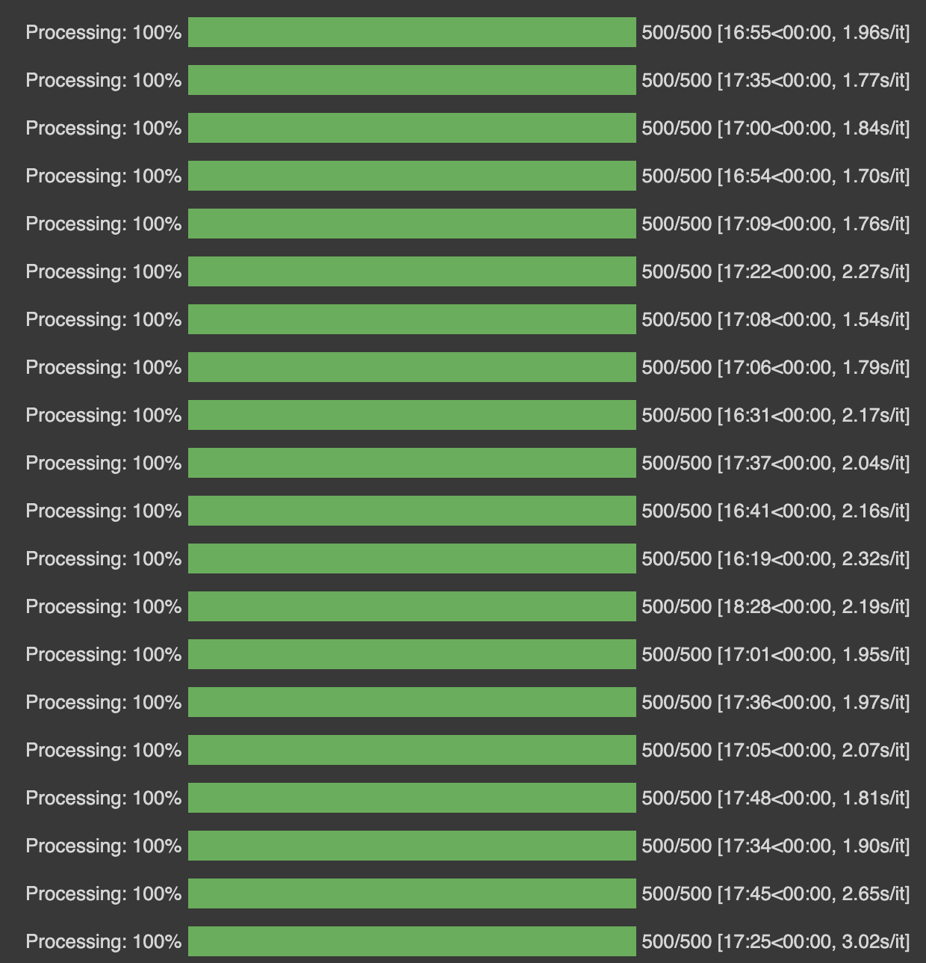
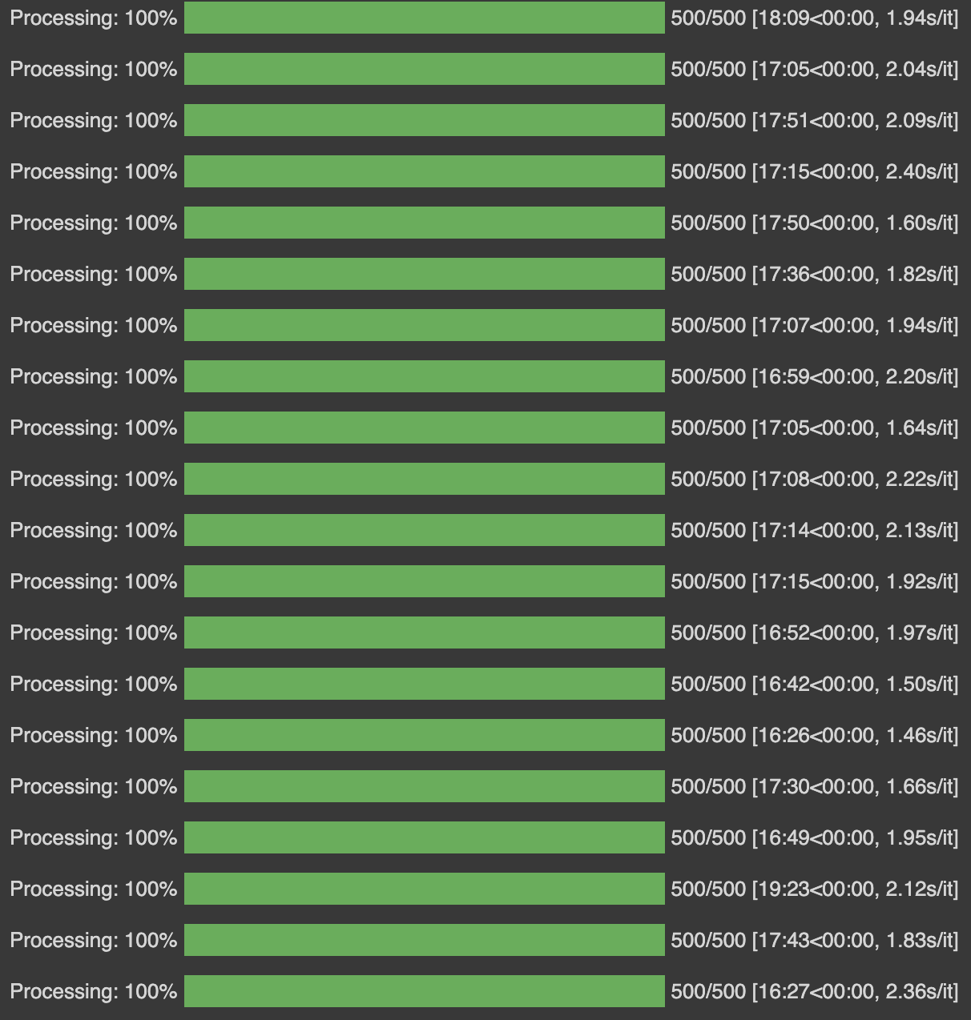
Calculate Text Metrics: Emotions
Fake News
Real News

Slide 47

Project Ideas

Slide 48
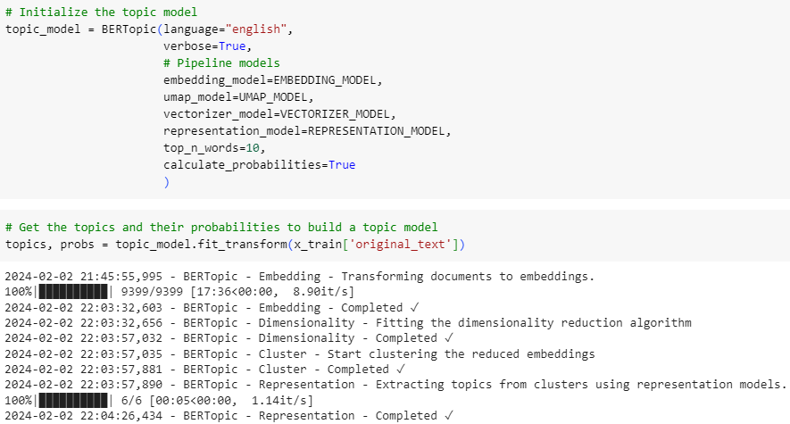
Topic Modeling with BERTopic
Notes:
spaCy’s website depicts a simpler code set up than what I show here, and that’s fine for getting acquainted with BERTopic. However, if you follow what I show here, you get the following:
Umap_model enables better topic visualization
Representation_model allows you to bring in KeyBERT for better keyword identification, and ChatGPT to help you write summaries and other generative tasks you think might be relevant.
Also, always leave verbose as True while you’re getting used to BERTopic. Any issues with your model, particularly if you’re using an LLM, will become very clear and easy to resolve if you do.

Slide 49
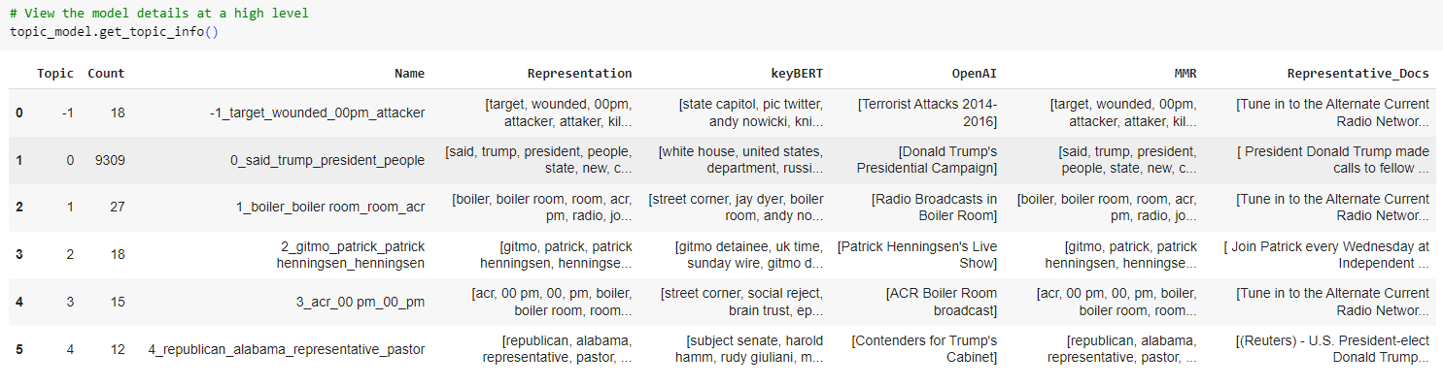
Topic Modeling with BERTopic

Slide 50
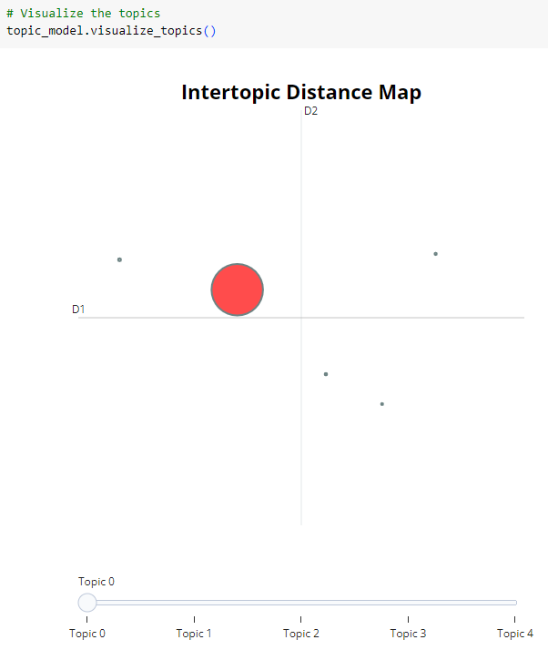
Topic Modeling with BERTopic

Slide 51
Clustering
How well does our data perform using the KMeans clustering algorithm?
We have real and fake news articles, so set k=2.
Subset data set to ARI, TTR, function_word_ratio, median_word_length, median_sentence_length.
Standardize the data.
Run the clustering, and check clusters with silhouette scores and Davies-Bouldin Index.

Slide 52
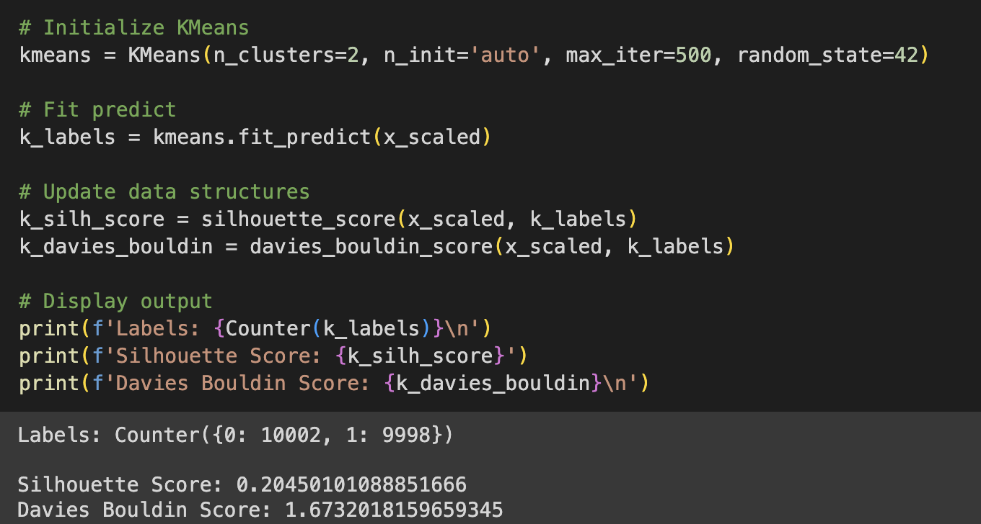
Clustering
Notes:
Silhouette scores range from -1 to 1.
Closer to 1 is good, closer to -1 is not so good.
Near 0 means that you have a sizable chunk of data points right on the decision line for determining cluster membership, so go back and look at your variables and start tweaking those.
Davies Bouldin should be closer to 0 to indicate better clustering.
1 or higher can mean your cluster composition could be improved.

Slide 53
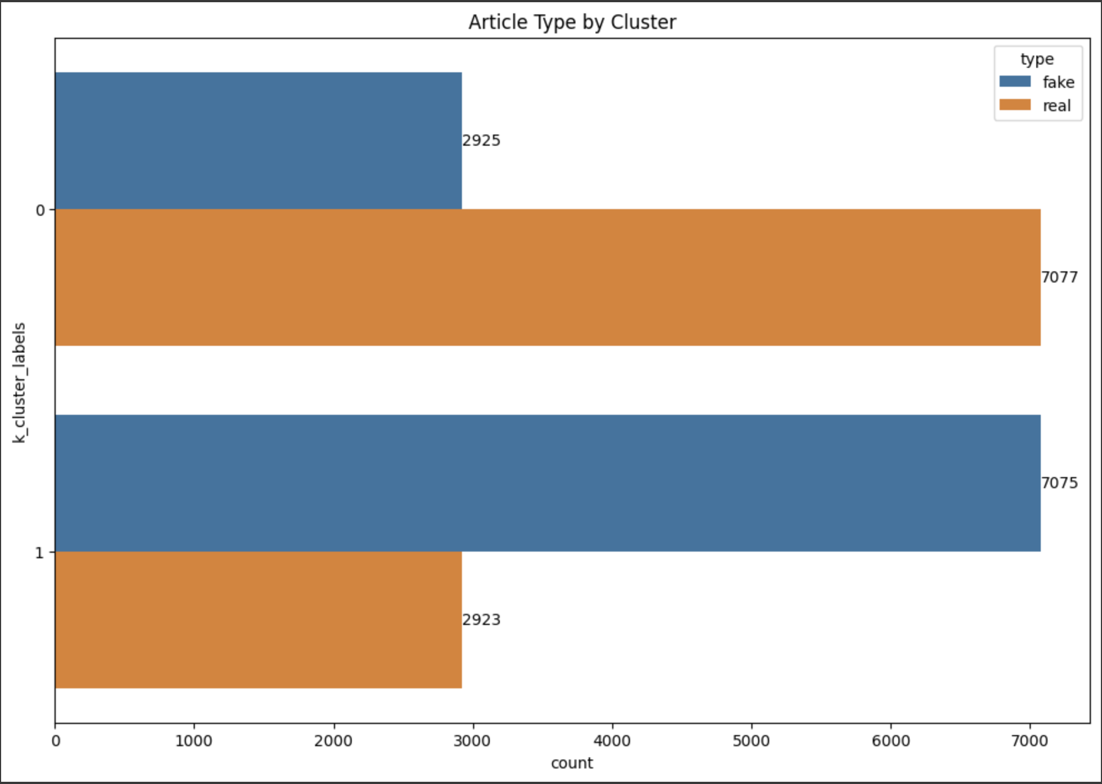
Clustering

Slide 54
Predictive Modeling
Predictive models can be as simple as a logistic regression, or as complex as deep learning models.
Logistic regression model using the data set in today’s presentation.
3HAN, a 3-level DNN for fake news detection.
Stylometric fake news detection model with NER tags.
SLMs and LLMs can also be used in fake news detection through well-structured prompt chains.

Slide 55
Thank You!
Leslie A. McFarlin | leslie.mcfarlin@wheels.com | https://www.linkedin.com/in/lesliemcfarlin/

