Slide 1
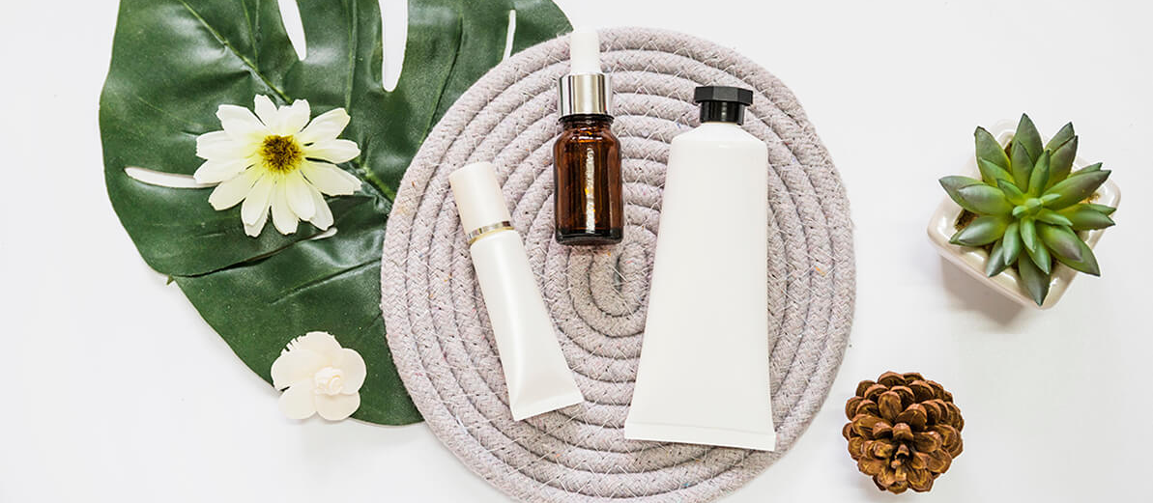
Similar cosmetic recommendation system
Lâm Mỹ Quỳnh - CH2004013

Slide 2
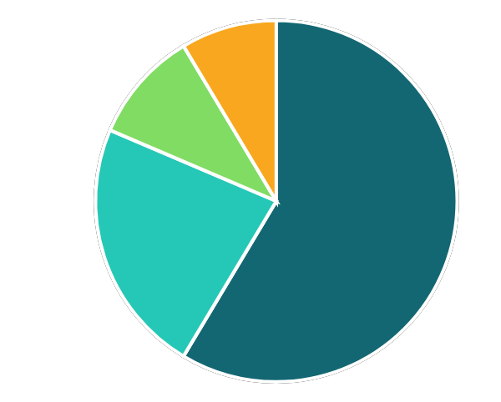
Overview
1
Objectives and scope of the topic
2
Implementation Detail
Scraping - Preprocessing - Modeling - Visualization
3
Demo
4
References

Slide 3
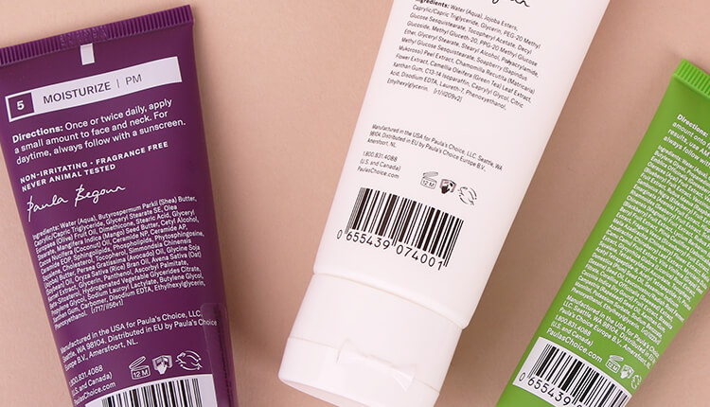
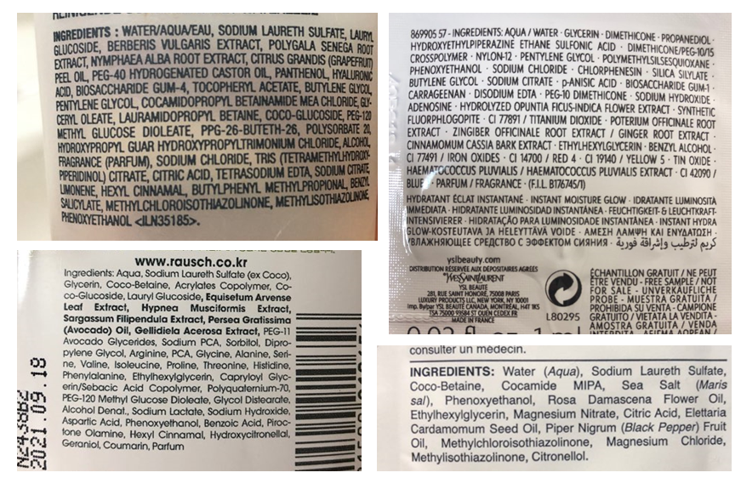
Overview
Make recommendations on cosmetic items based on their ingredient similarities
Make recommendations based on skin type and cosmetic type

Slide 4
Implementation Detail
Scraping
2. preprocessing
cosmetic
recommendation
3. modeling
4. Visualization

Slide 5
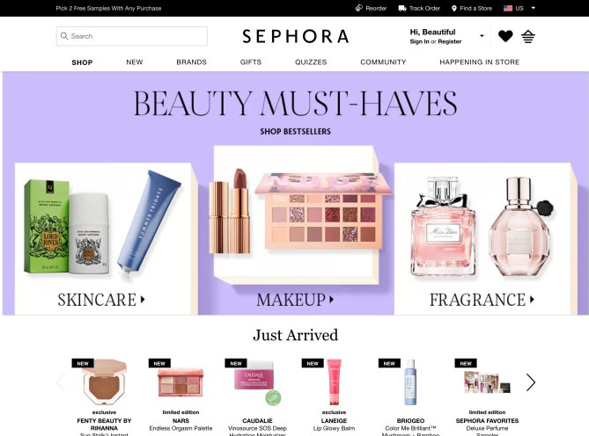
scraping
Library: Selenium
Source: https://www.sephora.com/
6 different categories:
Moisturizing cream
Facial treatments
Cleanser
Facial mask
Eye treatment
Sun protection
Notes:
Lý do chọn Sephora là nguồn để thu thập dữ liệu vì đây là cửa hàng nổi tiếng thế giới với số lượng sản phẩm khủng lồ và có website có thông chi tiết đầy đủ với cấu trúc trang đồng nhất dễ dàng để thu thập dữ liệu
Với bài toán đề xuất sp dựa trên thành phần thì chỉ tập trung thu thập dữ liệu dưỡng da thuộc 6 cat

Slide 6
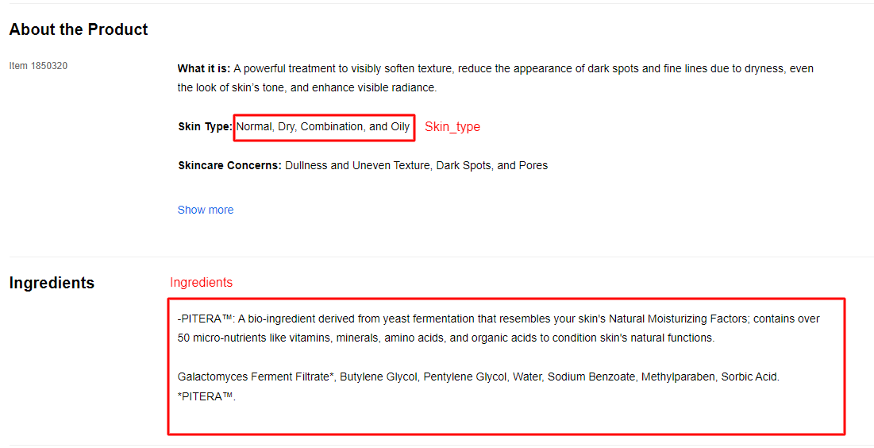
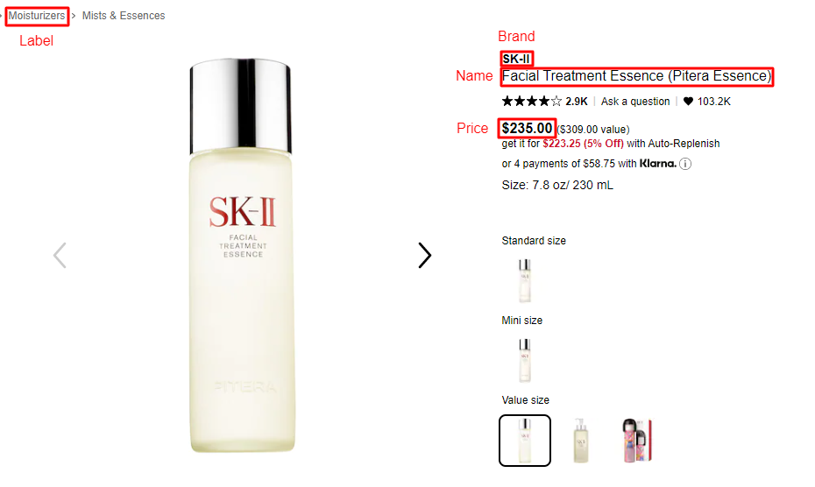
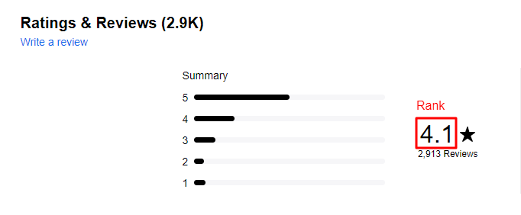
scraping
Library: Selenium
Source: https://www.sephora.com/
Notes:
Những thông tin cần thu thập sẽ gồm:

Slide 7
scraping
Output: 1472 items
Label | URL | brand | name | price | rank | skin_type | ingredients
moisturizing-cream-oils-mists | https://www.sephora.com/product/creme-de-la-mer-moisturizing-cream-P416341?icid2=products%20grid:p416341:product | LA MER | Crème de la Mer | $175.00 | 4.1 | ['✔ Normal\n', '✔ Oily\n', '✔ Combination\n', '✔ Dry\n', '✔ Sensitive\n'] | Algae (Seaweed) Extract, Mineral Oil, Petrolatum, Glycerin, Isohexadecane, Microcrystalline Wax, Lanolin Alcohol, Citrus Aurantifolia (Lime) Extract, Sesamum Indicum (Sesame) Seed Oil, Eucalyptus Globulus (Eucalyptus) Leaf Oil, Sesamum Indicum (Sesame) Seed Powder, Medicago Sativa (Alfalfa) Seed Powder, Helianthus Annuus (Sunflower) Seedcake, Prunus Amygdalus Dulcis (Sweet Almond) Seed Meal, Sodium Gluconate, Copper Gluconate, Calcium Gluconate, Magnesium Gluconate, Zinc Gluconate, Magnesium Sulfate, Paraffin, Tocopheryl Succinate, Niacin, Water, Beta-Carotene, Decyl Oleate, Aluminum Distearate, Octyldodecanol, Citric Acid, Cyanocobalamin, Magnesium Stearate, Panthenol, Limonene, Geraniol, Linalool, Hydroxycitronellal, Citronellol, Benzyl Salicylate, Citral, Sodium Benzoate, Alcohol Denat., Fragrance. Please be aware that ingredient lists may change or vary from time to time. Please refer to the ingredient list on the product package you receive for the most up to date list of ingredients.
moisturizing-cream-oils-mists | https://www.sephora.com/product/protini-tm-polypeptide-cream-P427421?icid2=products%20grid:p427421:product | DRUNK ELEPHANT | Protini™ Polypeptide Cream | $68.00 ($90 value) | 4.4 | ['✔ Normal\n', '✔ Oily\n', '✔ Combination\n', '✔ Dry\n'] | -9 Signal Peptide Complex -Pygmy Waterlily Stem Cell Extract -Soybean Folic Acid Ferment Extract Water, Dicaprylyl Carbonate, Glycerin, Cetearyl Alcohol, Cetearyl Olivate, Sorbitan Olivate, Sclerocarya Birrea Seed Oil, Bacillus/Soybean/ Folic Acid Ferment Extract, Nymphaea Alba Root Extract, sh-Oligopeptide-1, sh-Oligopeptide-2, sh-Polypeptide-1, sh-Polypeptide-9, sh-Polypeptide-11, Copper Palmitoyl Heptapeptide-14, Heptapeptide-15 Palmitate, Palmitoyl Tetrapeptide-7, Palmitoyl Tripeptide-1, Alanine, Arginine, Glycine, Histidine, Isoleucine, Phenylalanine, Proline, Serine, Threonine, Valine, Acetyl Glutamine, Coconut Alkanes , Coco-Caprylate/Caprate, Sodium Hyaluronate, Aspartic Acid, Linoleic Acid, Linolenic Acid, Lecithin, Butylene Glycol, Polyvinyl Alcohol, Sodium Lactate, Sodium PCA, PCA, Sorbitan Isostearate, Carbomer, Polysorbate 20, Polysorbate 60, Lactic Acid/Glycolic Acid Copolymer, Hydroxyethyl Acrylate/Sodium Acryloyldimethyl Taurate Copolymer, Xanthan Gum, Isomalt, 1,2-Hexanediol, Caprylyl Glycol, Chlorphenesin, Phenoxyethanol, Tocopherol, Sodium Benzoate, Phenylpropanol, Glyceryl Caprylate, Symphytum Officinale Callus Culture Extract.
Notes:
Sau khi thu thập sẽ trả về file CSV với 1472 item với format như sau

Slide 8
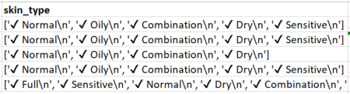
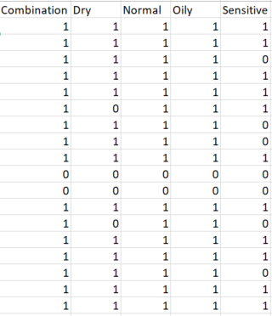
2. preprocessing
Remove items without ingredients
Remove duplicate item
Remove "$" characters and promotional price
Fill 0 in the blank values in "rank"
Split skin_type value into columns
Fill 0 or 1 for skin_type columns
Notes:
Từ các dữ liệu thô sau khi tt thì e bắt đầu qt P cho dữ liệu: bắt đầu bằng việc

Slide 9
2. preprocessing
Output: 1472 items
Label | brand | name | price | rank | ingredients | Combination | Dry | Normal | Oily | Sensitive
Moisturizer | LA MER | Crème de la Mer | 175 | 4.1 | Algae (Seaweed) Extract, Mineral Oil, Petrolatum, Glycerin, Isohexadecane, Microcrystalline Wax, Lanolin Alcohol, Citrus Aurantifolia (Lime) Extract, Sesamum Indicum (Sesame) Seed Oil, Eucalyptus Globulus (Eucalyptus) Leaf Oil, Sesamum Indicum (Sesame) Seed Powder, Medicago Sativa (Alfalfa) Seed Powder, Helianthus Annuus (Sunflower) Seedcake, Prunus Amygdalus Dulcis (Sweet Almond) Seed Meal, Sodium Gluconate, Copper Gluconate, Calcium Gluconate, Magnesium Gluconate, Zinc Gluconate, Magnesium Sulfate, Paraffin, Tocopheryl Succinate, Niacin, Water, Beta-Carotene, Decyl Oleate, Aluminum Distearate, Octyldodecanol, Citric Acid, Cyanocobalamin, Magnesium Stearate, Panthenol, Limonene, Geraniol, Linalool, Hydroxycitronellal, Citronellol, Benzyl Salicylate, Citral, Sodium Benzoate, Alcohol Denat., Fragrance. | 1 | 1 | 1 | 1 | 1
Moisturizer | DRUNK ELEPHANT | Protini™ Polypeptide Cream | 68 | 4.4 | Water, Dicaprylyl Carbonate, Glycerin, Cetearyl Alcohol, Cetearyl Olivate, Sorbitan Olivate, Sclerocarya Birrea Seed Oil, Bacillus/Soybean/ Folic Acid Ferment Extract, Nymphaea Alba Root Extract, sh-Oligopeptide-1, sh-Oligopeptide-2, sh-Polypeptide-1, sh-Polypeptide-9, sh-Polypeptide-11, Copper Palmitoyl Heptapeptide-14, Heptapeptide-15 Palmitate, Palmitoyl Tetrapeptide-7, Palmitoyl Tripeptide-1, Alanine, Arginine, Glycine, Histidine, Isoleucine, Phenylalanine, Proline, Serine, Threonine, Valine, Acetyl Glutamine, Coconut Alkanes , Coco-Caprylate/Caprate, Sodium Hyaluronate, Aspartic Acid, Linoleic Acid, Linolenic Acid, Lecithin, Butylene Glycol, Polyvinyl Alcohol, Sodium Lactate, Sodium PCA, PCA, Sorbitan Isostearate, Carbomer, Polysorbate 20, Polysorbate 60, Lactic Acid/Glycolic Acid Copolymer, Hydroxyethyl Acrylate/Sodium Acryloyldimethyl Taurate Copolymer, Xanthan Gum, Isomalt, 1,2-Hexanediol, Caprylyl Glycol, Chlorphenesin, Phenoxyethanol, Tocopherol, Sodium Benzoate, Phenylpropanol, Glyceryl Caprylate, Symphytum Officinale Callus Culture Extract. | 1 | 1 | 1 | 1 | 0

Slide 10
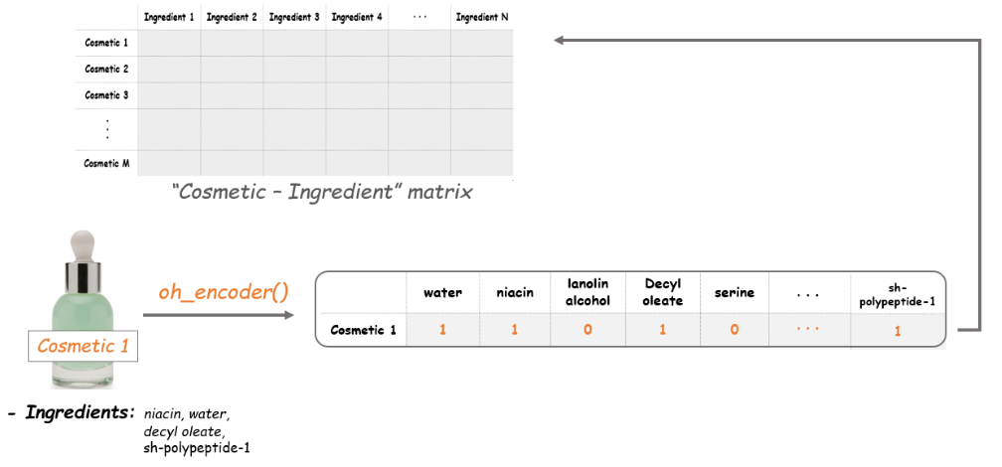
3. Modeling
Initializing a Cosmetic-Ingredient matrix
Get all value ingredient
Create a matrix that includes all components
Enter 0 or 1 for ingredient columns
Dimension reduction with t-SNE => generate [X], [Y]

Slide 11
3. Modeling
Output
index | Label | brand | price | price | rank | ingredients | Combination | Dry | Normal | Oily | Sensitive | X | Y
0 | Moisturizer_Combination | LA MER | Crème de la Mer | 175 | 4.1 | Algae (Seaweed) Extract, Mineral Oil, Petrolatum, Glycerin, Isohexadecane, Microcrystalline Wax, Lanolin Alcohol, Citrus Aurantifolia (Lime) Extract, Sesamum Indicum (Sesame) Seed Oil, Eucalyptus Globulus (Eucalyptus) Leaf Oil, Sesamum Indicum (Sesame) Seed Powder, Medicago Sativa (Alfalfa) Seed Powder, Helianthus Annuus (Sunflower) Seedcake, Prunus Amygdalus Dulcis (Sweet Almond) Seed Meal, Sodium Gluconate, Copper Gluconate, Calcium Gluconate, Magnesium Gluconate, Zinc Gluconate, Magnesium Sulfate, Paraffin, Tocopheryl Succinate, Niacin, Water, Beta-Carotene, Decyl Oleate, Aluminum Distearate, Octyldodecanol, Citric Acid, Cyanocobalamin, Magnesium Stearate, Panthenol, Limonene, Geraniol, Linalool, Hydroxycitronellal, Citronellol, Benzyl Salicylate, Citral, Sodium Benzoate, Alcohol Denat., Fragrance. | 1 | 1 | 1 | 1 | 1 | 2.3031232 | 17.373549
1 | Moisturizer_Combination | SK-II | Facial Treatment Essence | 179 | 4.1 | Galactomyces Ferment Filtrate (Pitera), Butylene Glycol, Pentylene Glycol, Water, Sodium Benzoate, Methylparaben, Sorbic Acid. | 1 | 1 | 1 | 1 | 1 | 7.593926 | -10.227859
2 | Moisturizer_Combination | DRUNK ELEPHANT | Protini™ Polypeptide Cream | 68 | 4.4 | Water, Dicaprylyl Carbonate, Glycerin, Cetearyl Alcohol, Cetearyl Olivate, Sorbitan Olivate, Sclerocarya Birrea Seed Oil, Bacillus/Soybean/ Folic Acid Ferment Extract, Nymphaea Alba Root Extract, sh-Oligopeptide-1, sh-Oligopeptide-2, sh-Polypeptide-1, sh-Polypeptide-9, sh-Polypeptide-11, Copper Palmitoyl Heptapeptide-14, Heptapeptide-15 Palmitate, Palmitoyl Tetrapeptide-7, Palmitoyl Tripeptide-1, Alanine, Arginine, Glycine, Histidine, Isoleucine, Phenylalanine, Proline, Serine, Threonine, Valine, Acetyl Glutamine, Coconut Alkanes , Coco-Caprylate/Caprate, Sodium Hyaluronate, Aspartic Acid, Linoleic Acid, Linolenic Acid, Lecithin, Butylene Glycol, Polyvinyl Alcohol, Sodium Lactate, Sodium PCA, PCA, Sorbitan Isostearate, Carbomer, Polysorbate 20, Polysorbate 60, Lactic Acid/Glycolic Acid Copolymer, Hydroxyethyl Acrylate/Sodium Acryloyldimethyl Taurate Copolymer, Xanthan Gum, Isomalt, 1,2-Hexanediol, Caprylyl Glycol, Chlorphenesin, Phenoxyethanol, Tocopherol, Sodium Benzoate, Phenylpropanol, Glyceryl Caprylate, Symphytum Officinale Callus Culture Extract. | 1 | 1 | 1 | 1 | 0 | -18.200281 | 4.0223184

Slide 12
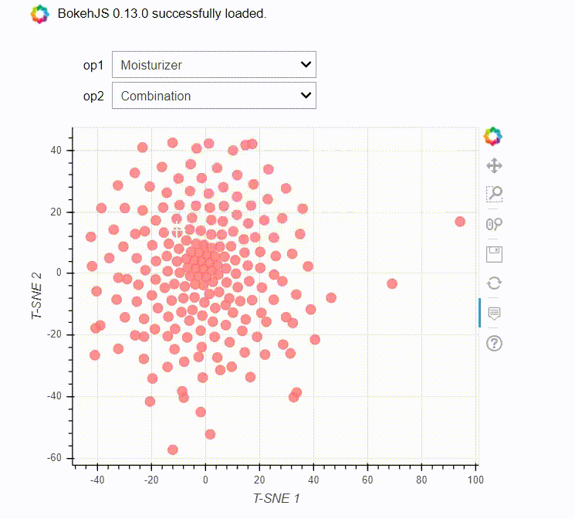
4. visualization
Make recommendations based on skin type and cosmetic type
Mapping with Bokeh

Slide 13
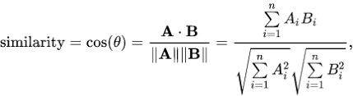
4. visualization
Make recommendations on cosmetic items based on their ingredient similarities
Cosine similarity is a metric used to measure how similar the documents are irrespective of their size.

Slide 14
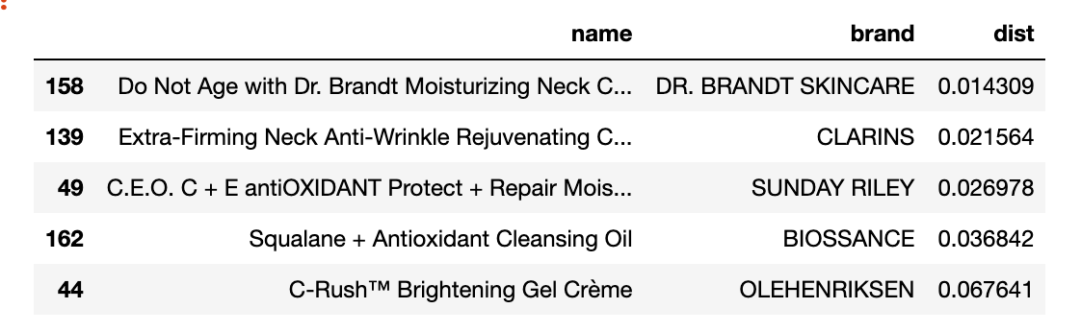
4. visualization
My item
These are the top 5 cosmetics that have similar properties with My Item

Slide 15

DEMO

Slide 16
References
The article explaining four different recommendation algorithms , link
Interactive Data Visualization with Bokeh Course, Link
Cosine Similarity – Understanding the math and how it works (with python codes), Link

Slide 17
Thank For Your Listening

