Slide 1


Lammy wong
For recall purposes:
Best person you met on the ral WX!

Slide 2

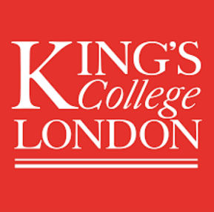


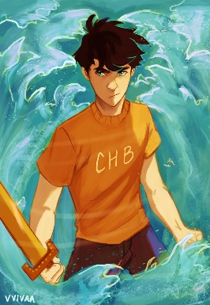
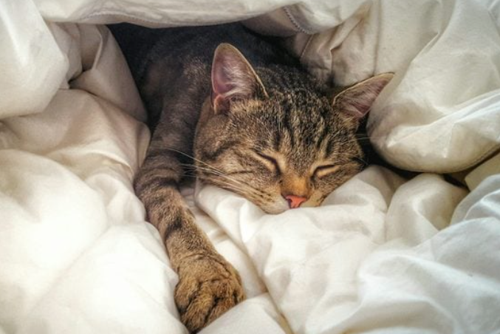

Who’s Lammy again?!
A-level: Maths, Further Maths, Physics; AS-level: CS (shock!)
King’s college London maths school
Uni or Apprenticeship; CS / CS & Maths
Hobbies: reading, sleeping, playing piano/ flute, and… well programming
The Hunger Games
Percy Jackson

Slide 3
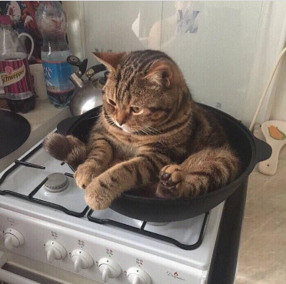
Work experience (ehem)
#cooked
Team: tune gui → envelope gui
Fighting with my soul to get vs code working
CalculatIONS…
FIGURING OUT WHAT’S GOING ON (!!)
DRAWING PROGRESS BAR & TICKING OFF TODO <3
Plotting
CalculatiONS…
BEGGING STREAMLIT TO LET THE USER INPUT A NUMBER WITH >2 DECIMAL POINTS
TICKING BOXES :3
I did stuff guys! TRUST!!

Slide 4
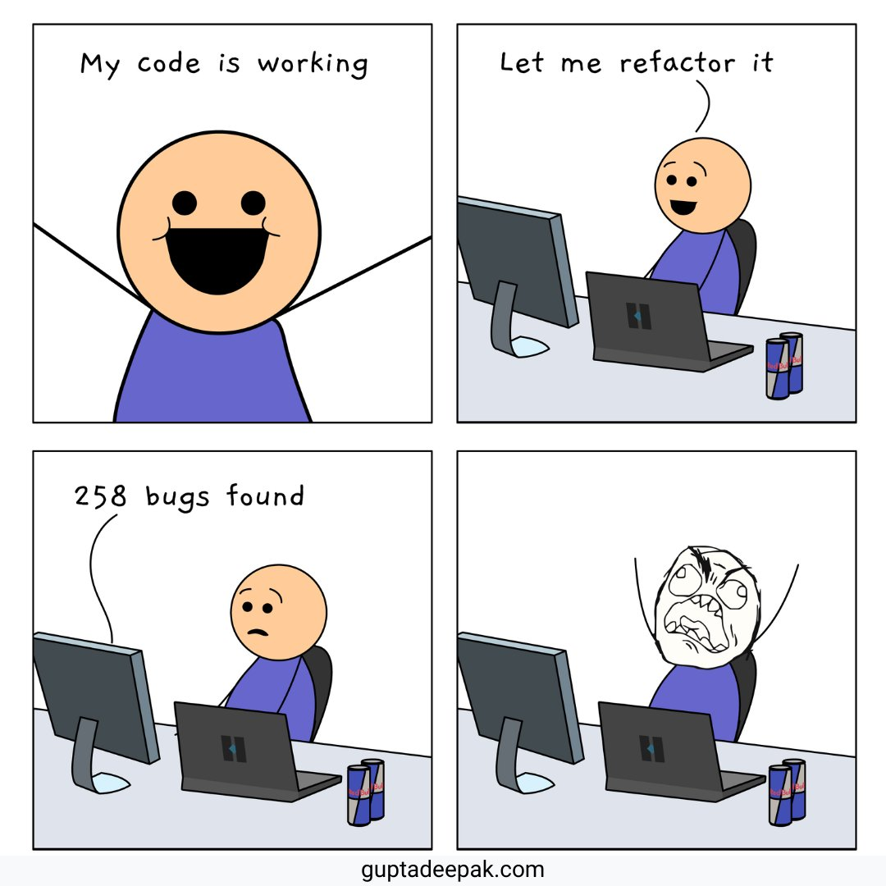
Work experience #2 (SO MUCH happened!)
Fun:
when things work out/ makes sense
Teamwork!
SWEETS!!!
Annoying: getting the laptops to work…
Difficult but interesting: understanding the physics :3
Highlight (best part!)
debugging for the 10 billionth time ☺
“Life is a Tragedy when Seen in Closeup, But a Comedy in Longshot” - Charlie Chaplin

Slide 5
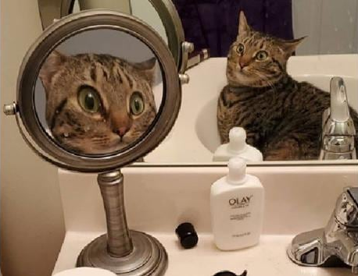
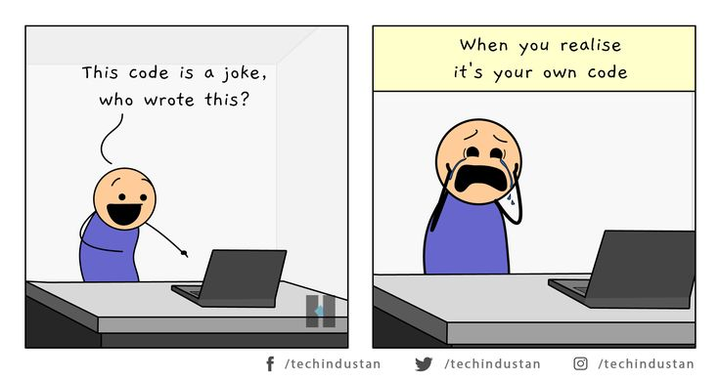
Reflections
Write good comments and name variables clearly
Use functions ( they are beautiful <3 )
Ensure communication in and across groups
Ask questions!
Take breaks
Sharing pain is great ☺

Slide 6

Quick big, big THANK YOU to…
Supervisors who answered my 10000+ questions
And Everyone who worked on this project!!
☺ You’re awesome! ☺
Thanks for listening! Any Questions?

