Slide 1
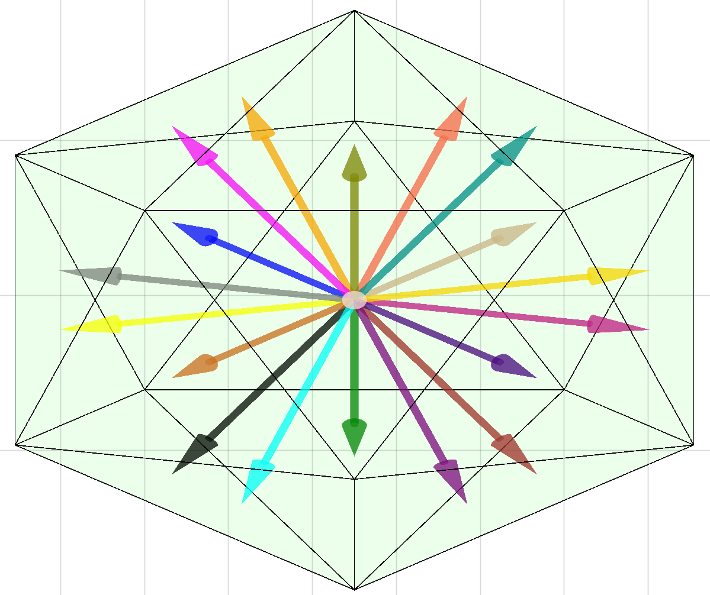
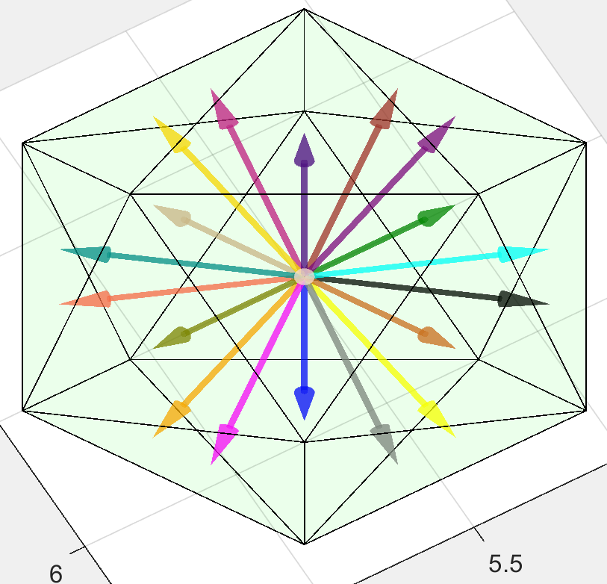
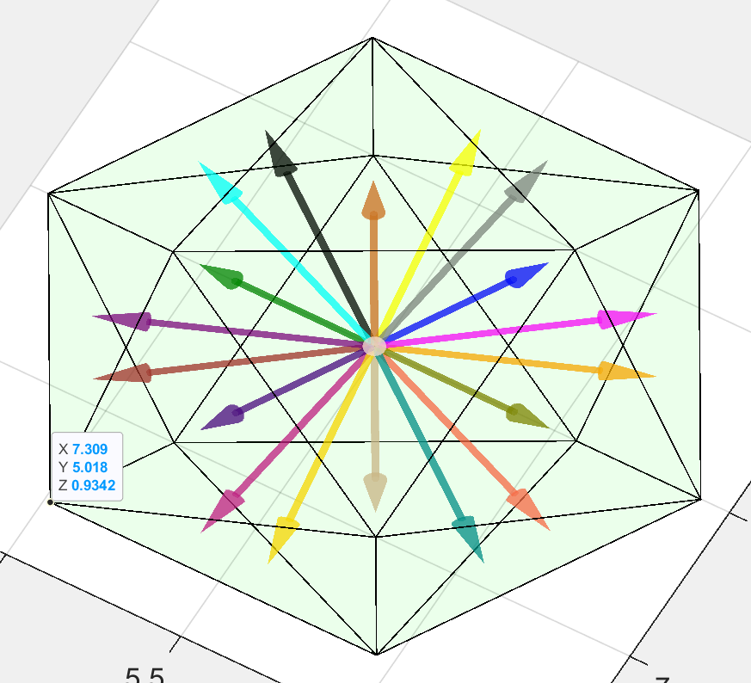
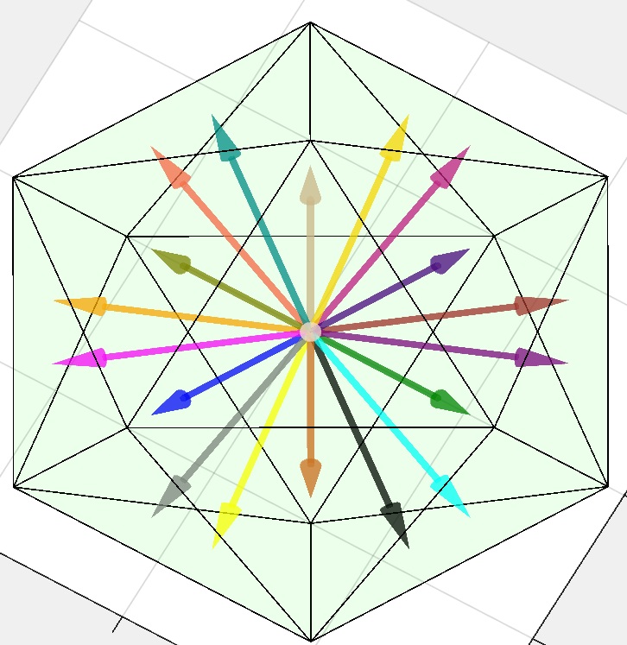
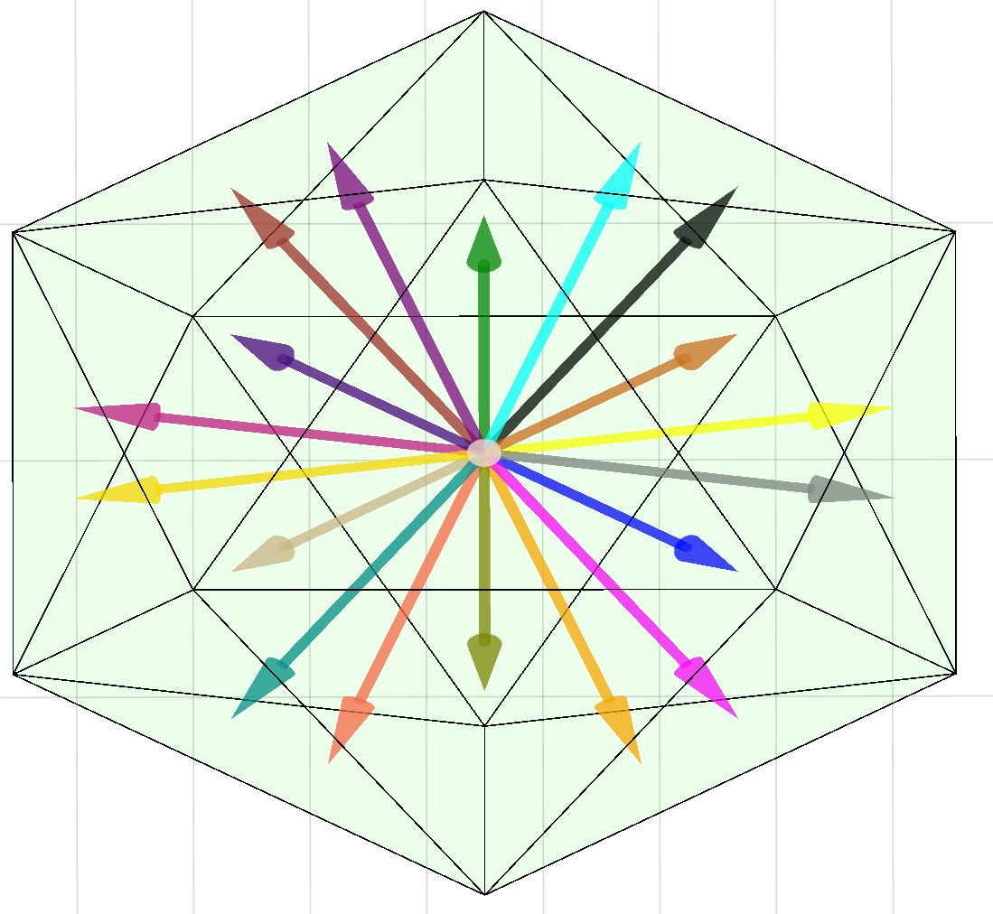
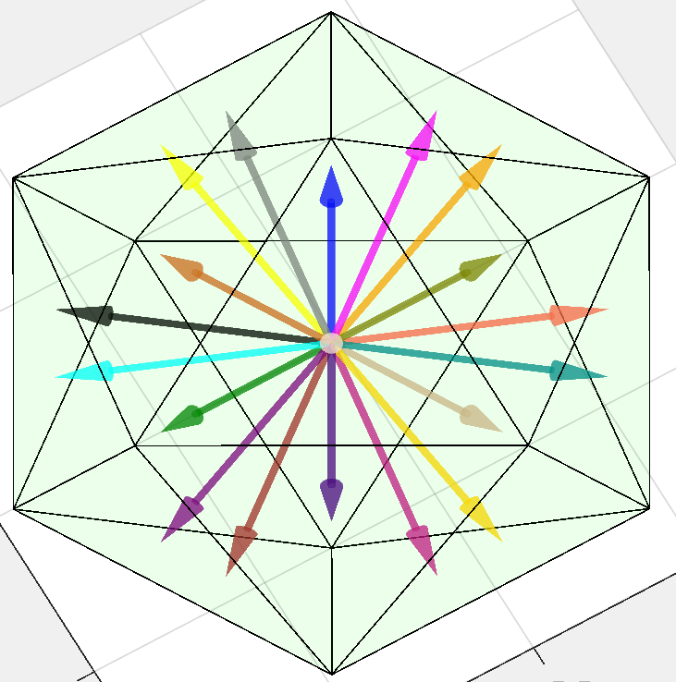
Red11
Red21
Red31
Red12
Red22
Red32

Slide 2
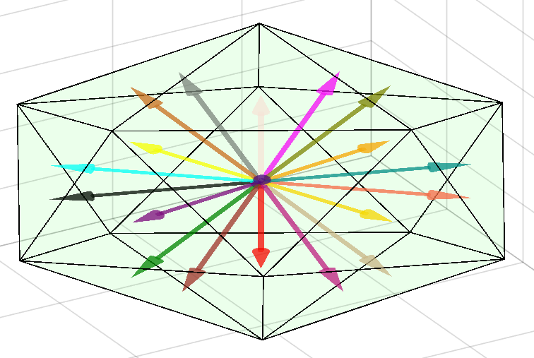
Blue11
Blue21
Blue31
Blue12
Blue22
Blue32

Slide 3
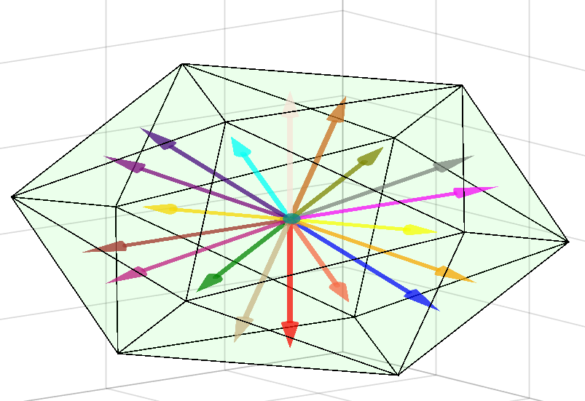
Black11
Black21
Black31
Black12
Black22
Black32

Slide 4
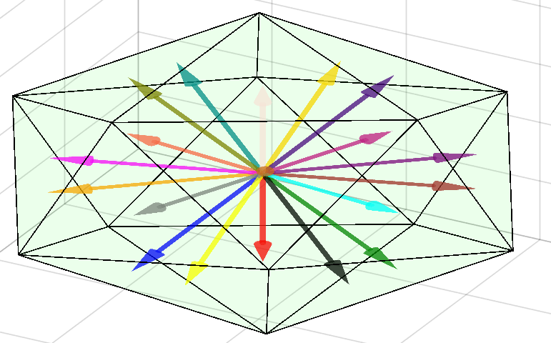
Tan11
Tan21
Tan31
Tan12
Tan22
Tan32

Slide 5
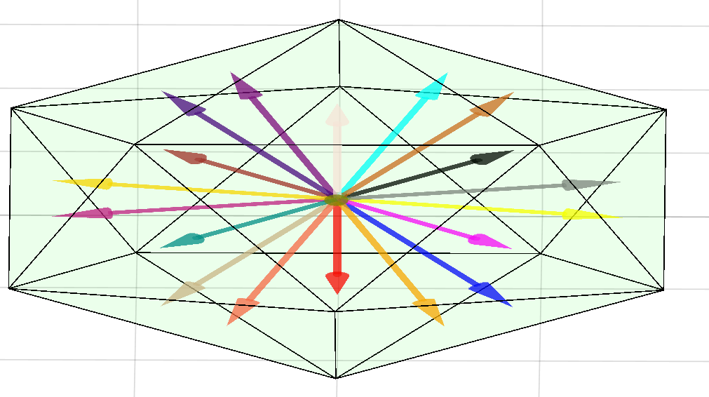
Green11
Green21
Green31
Green12
Green22
Green32

Slide 6
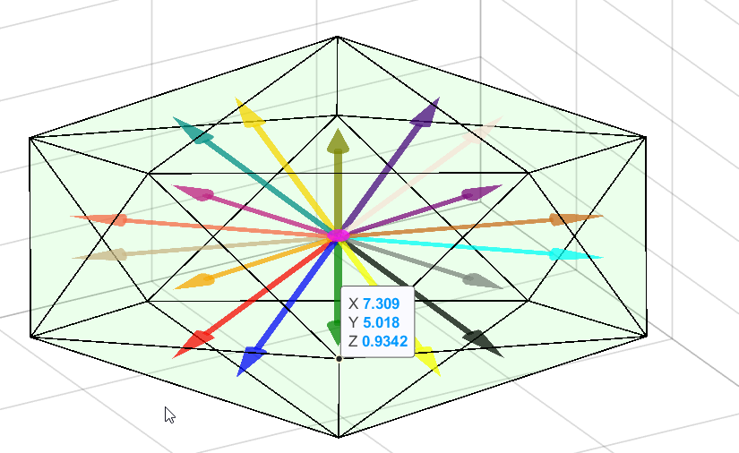
Brown11
Blue21
Blue31
Blue12
Blue22
Blue32

Slide 7
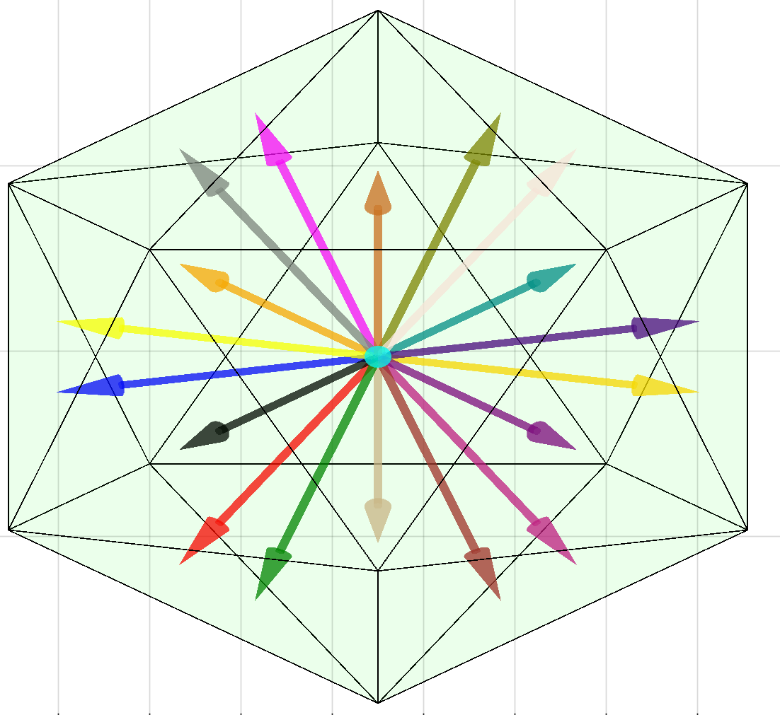
Tomato11
Blue21
Blue31
Blue12
Blue22
Blue32

Slide 8
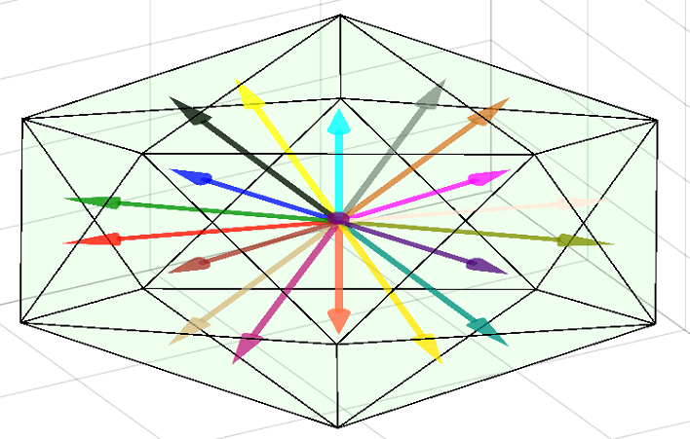
Orange11
Blue21
Blue31
Blue12
Blue22
Blue32

Slide 9
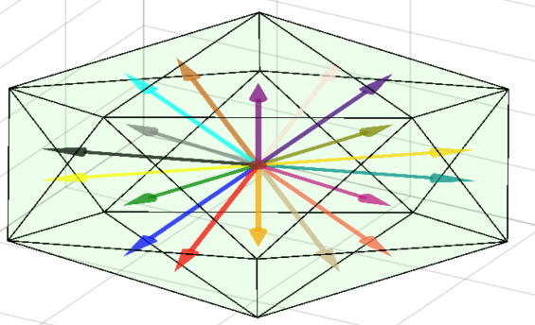
Magenta11
Blue21
Blue31
Blue12
Blue22
Blue32

Slide 10
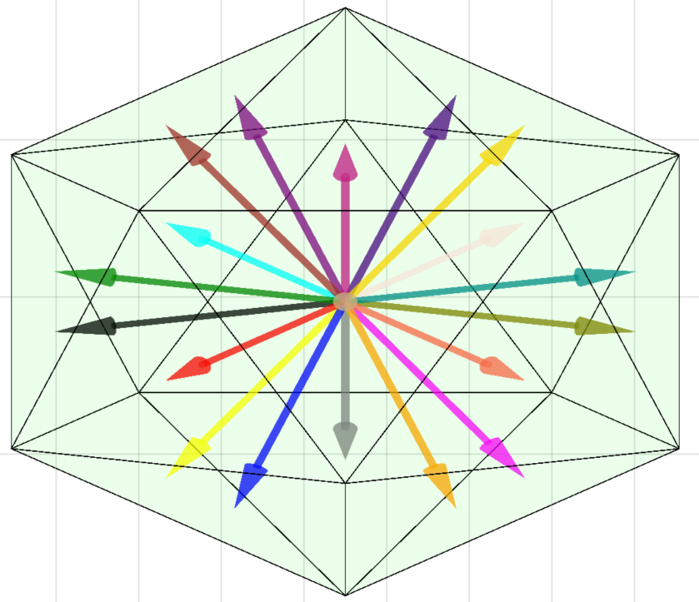
Choco11
Blue21
Blue31
Blue12
Blue22
Blue32

Slide 11
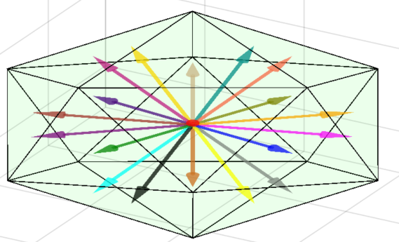
White11
Blue21
Blue31
Blue12
Blue22
Blue32

Slide 12
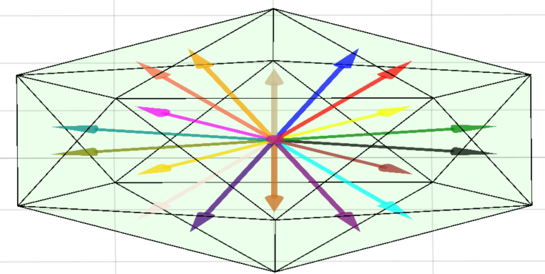
Grey11
Blue21
Blue31
Blue12
Blue22
Blue32

Slide 13
Blue11
Blue21
Blue31
Blue12
Blue22
Blue32

Slide 14
Blue11
Blue21
Blue31
Blue12
Blue22
Blue32

Slide 15
Blue11
Blue21
Blue31
Blue12
Blue22
Blue32

Slide 16
Blue11
Blue21
Blue31
Blue12
Blue22
Blue32

Slide 17
Blue11
Blue21
Blue31
Blue12
Blue22
Blue32

Slide 18
Blue11
Blue21
Blue31
Blue12
Blue22
Blue32

Slide 19
Blue11
Blue21
Blue31
Blue12
Blue22
Blue32

Slide 20
Blue11
Blue21
Blue31
Blue12
Blue22
Blue32

