Slide 1

Strike Mouse
UNIVERSITY OF ENGINEERING AND TECHNOLOGY
Team 4: Nguyễn Tùng Lâm (Leader)
Ngô Thị Thúy Lan
Lê Hải Linh
Lê Đình Linh
Trần Ngọc Linh

Slide 2
Contents
Overview of a Strike Mouse game
What did we do?
UML Diagram,Testing and Lint
Question and Answer

Slide 3
Overview
It’s a simple game to play in free time
Beating a mouse when it appears to achive high score

Slide 4
Overview
Language: Java
Platform: Android
Framework: LibGDX

Slide 5
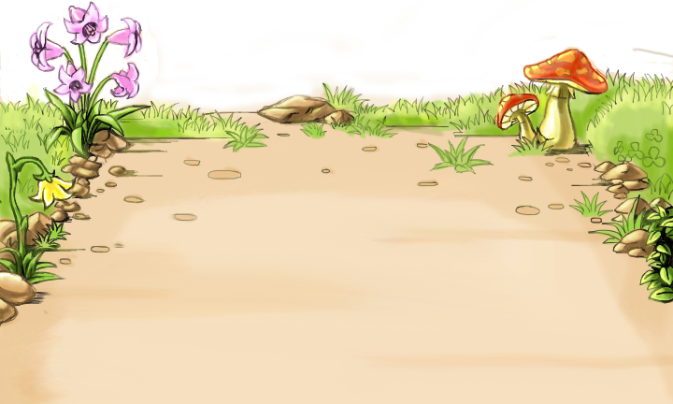
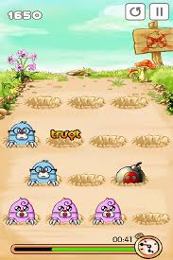
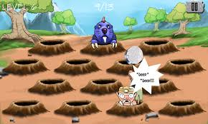


Overview

Slide 6
Plan for project
Making a plan:
Start :14/3/2014
End :16/5/2014
Weekly Scrum:
Using: Skype,facebook
Meeting: on Thursday afternoon
Working:
Using: GitHub, Pivotaltracker
Pair work

Slide 7
What did we do?
Finding materials and reading it(Week 1,2)
Making a background of game(Week 3)
Making holes (Week 4)
Finding smell code and refactor(Week 5)
Making mouse (Week 6)
Making hammer (Week 7)
Making mouse die (Week 8)
Display Score (Week 9)
Finding Bug,editting and finish project (Week 10)

Slide 8
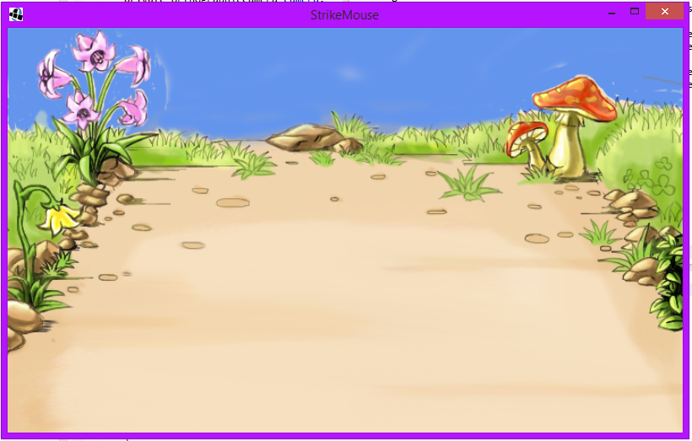
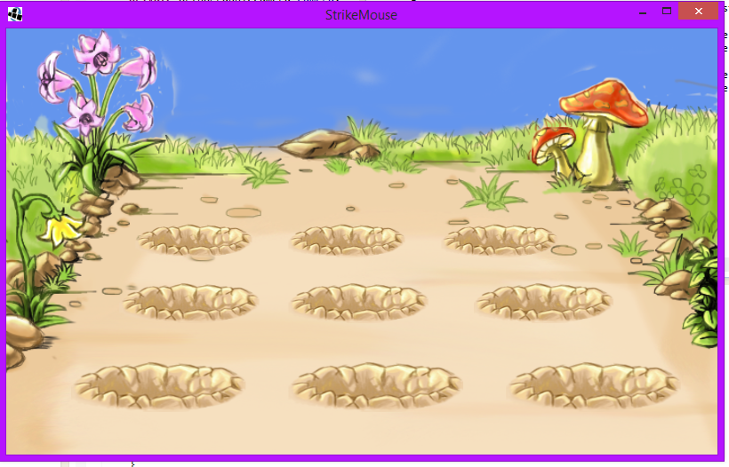
Complete
week 1
Week 2

Slide 9
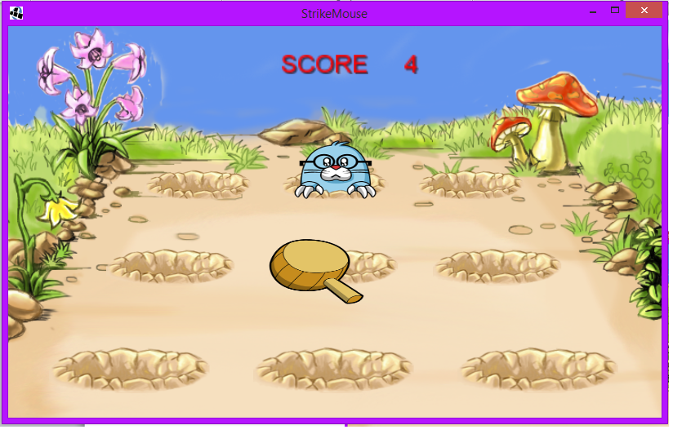
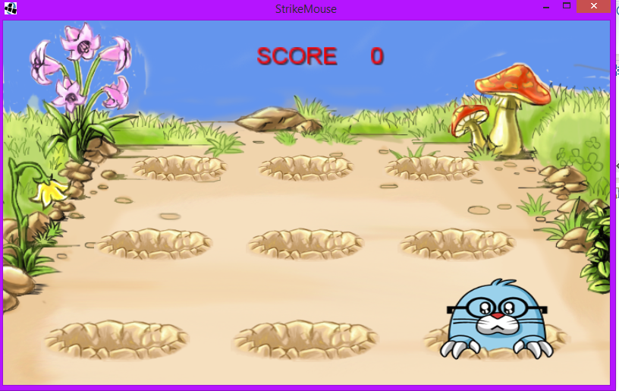
Complete

Slide 10
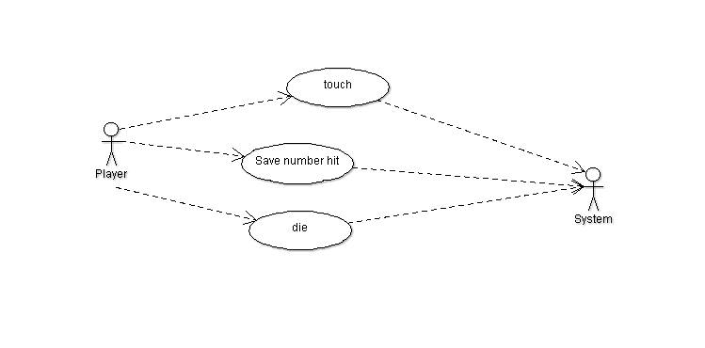
UML Diagram
User Case Diagram

Slide 11
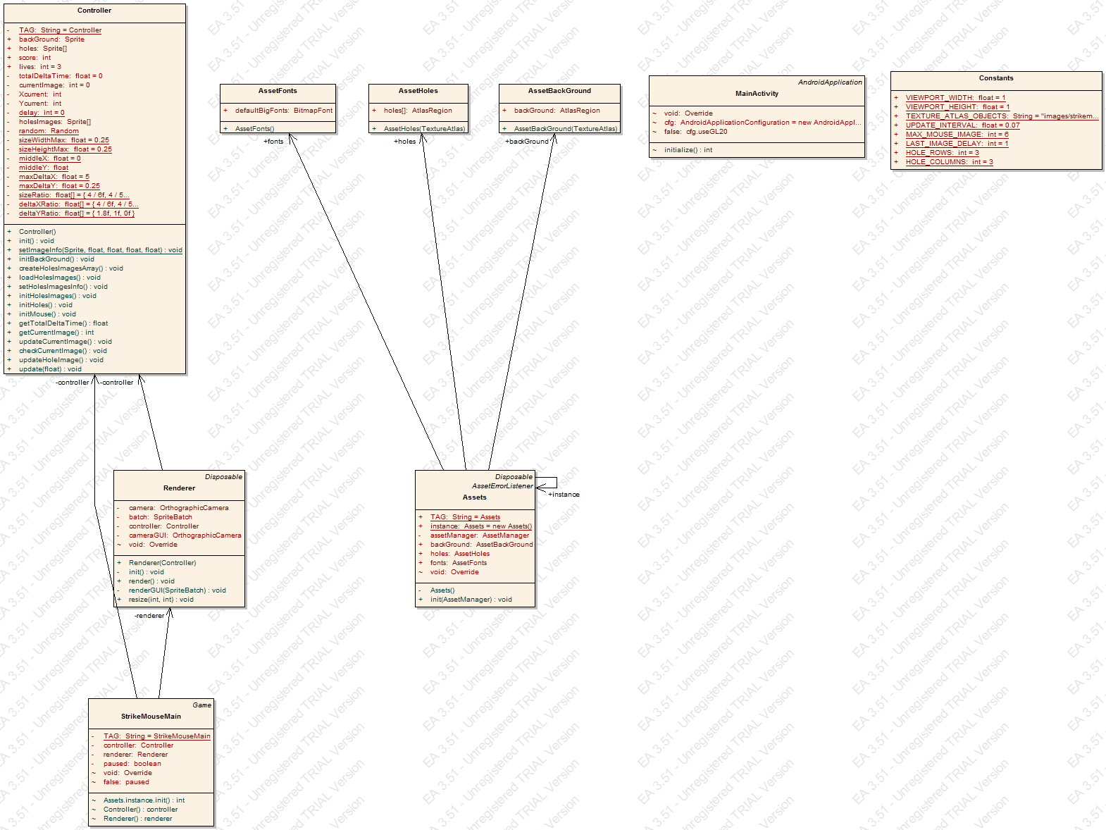
UML Diagram
Class Diagram

Slide 12
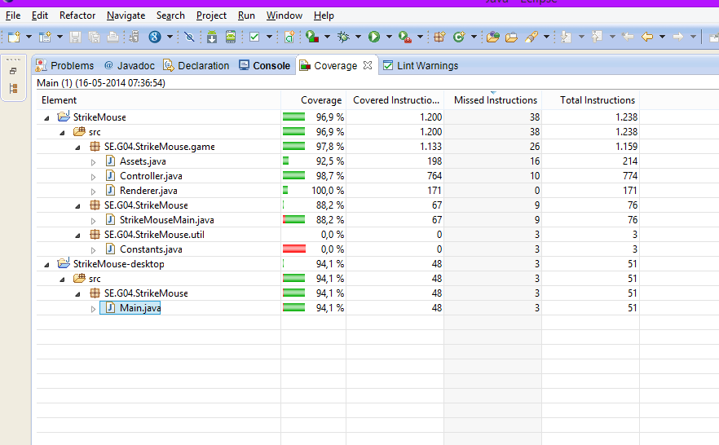
Test Coverage

Slide 13
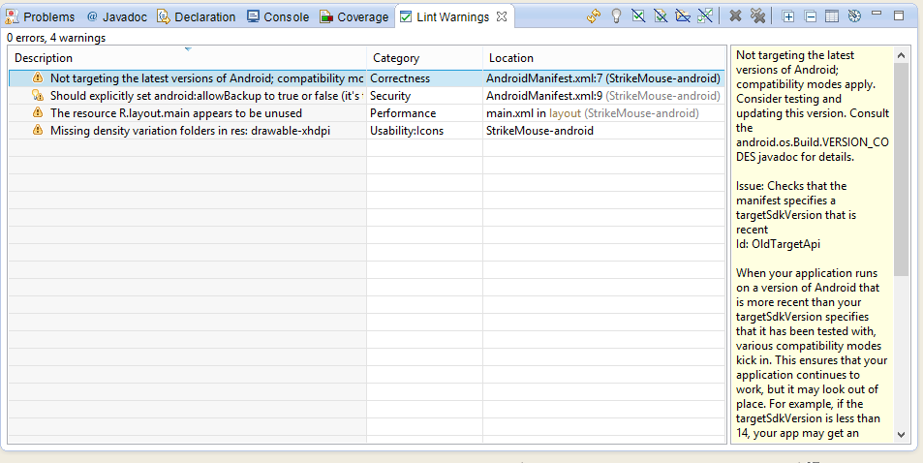
LintWarning
Before

Slide 14
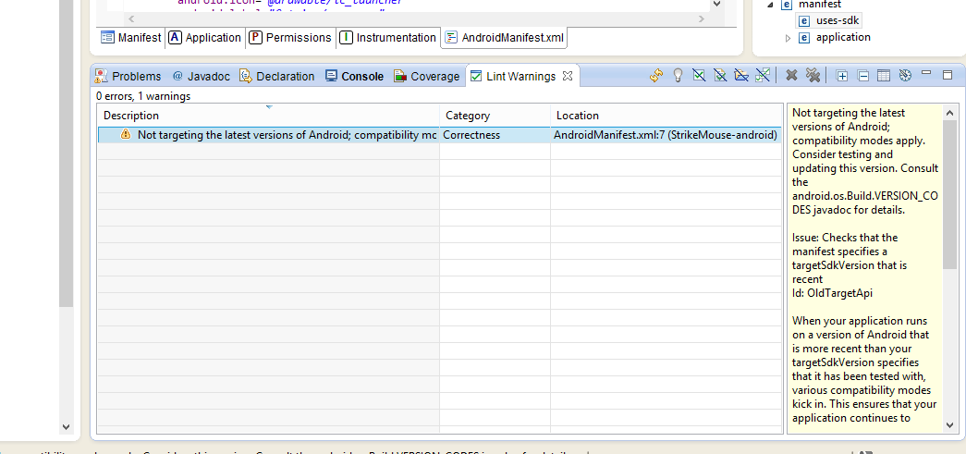
LintWarning
After edit

Slide 15
Q & A

Slide 16
Thanks for watching!

