Slide 1


FSA files
Proposed cloud system
Current approach
Proposed cloud system
Web application
GeneMapper Software
Provide an integration system from peak detection to report generation.
Prevent human bias
Improve efficiency
Improve management
Transparent
DNA sizing
Upload
DNA sizing
Plot intensity data
Review intensity data
Adjust bin range and height of intensity for peak detection
Adjust bin range and height of intensity for peak detection
Current approach
Manually genotype calling by PGx experts
Separate systems, software, requires some manual steps
High risk of human bias
Low efficiency because of system separation.
Hard to check history
Difficult to manage
Quality controls
Confirmation
Confirmation
Exporting result
Manually
upload
Genotype calling
Genotype calling (KIT)
Genotype calling result
Manually input
Feature process (generate report)
Feature process (generate report)
PGx: Pharmacogenomics
FSA: Fragment Sequence Analysis

Slide 2
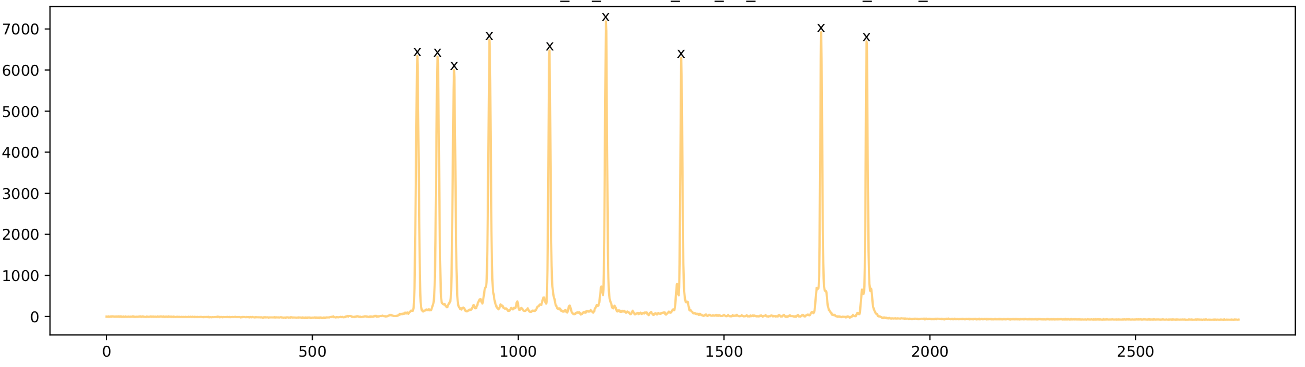
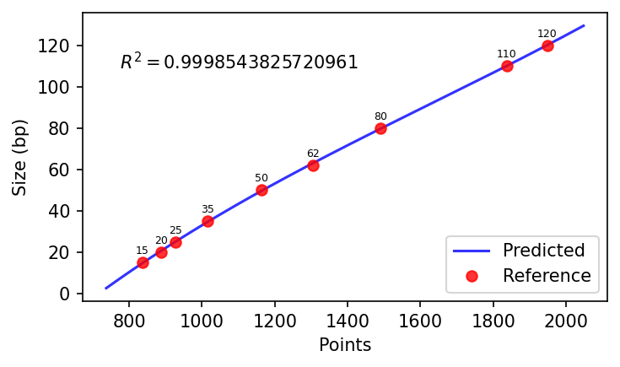
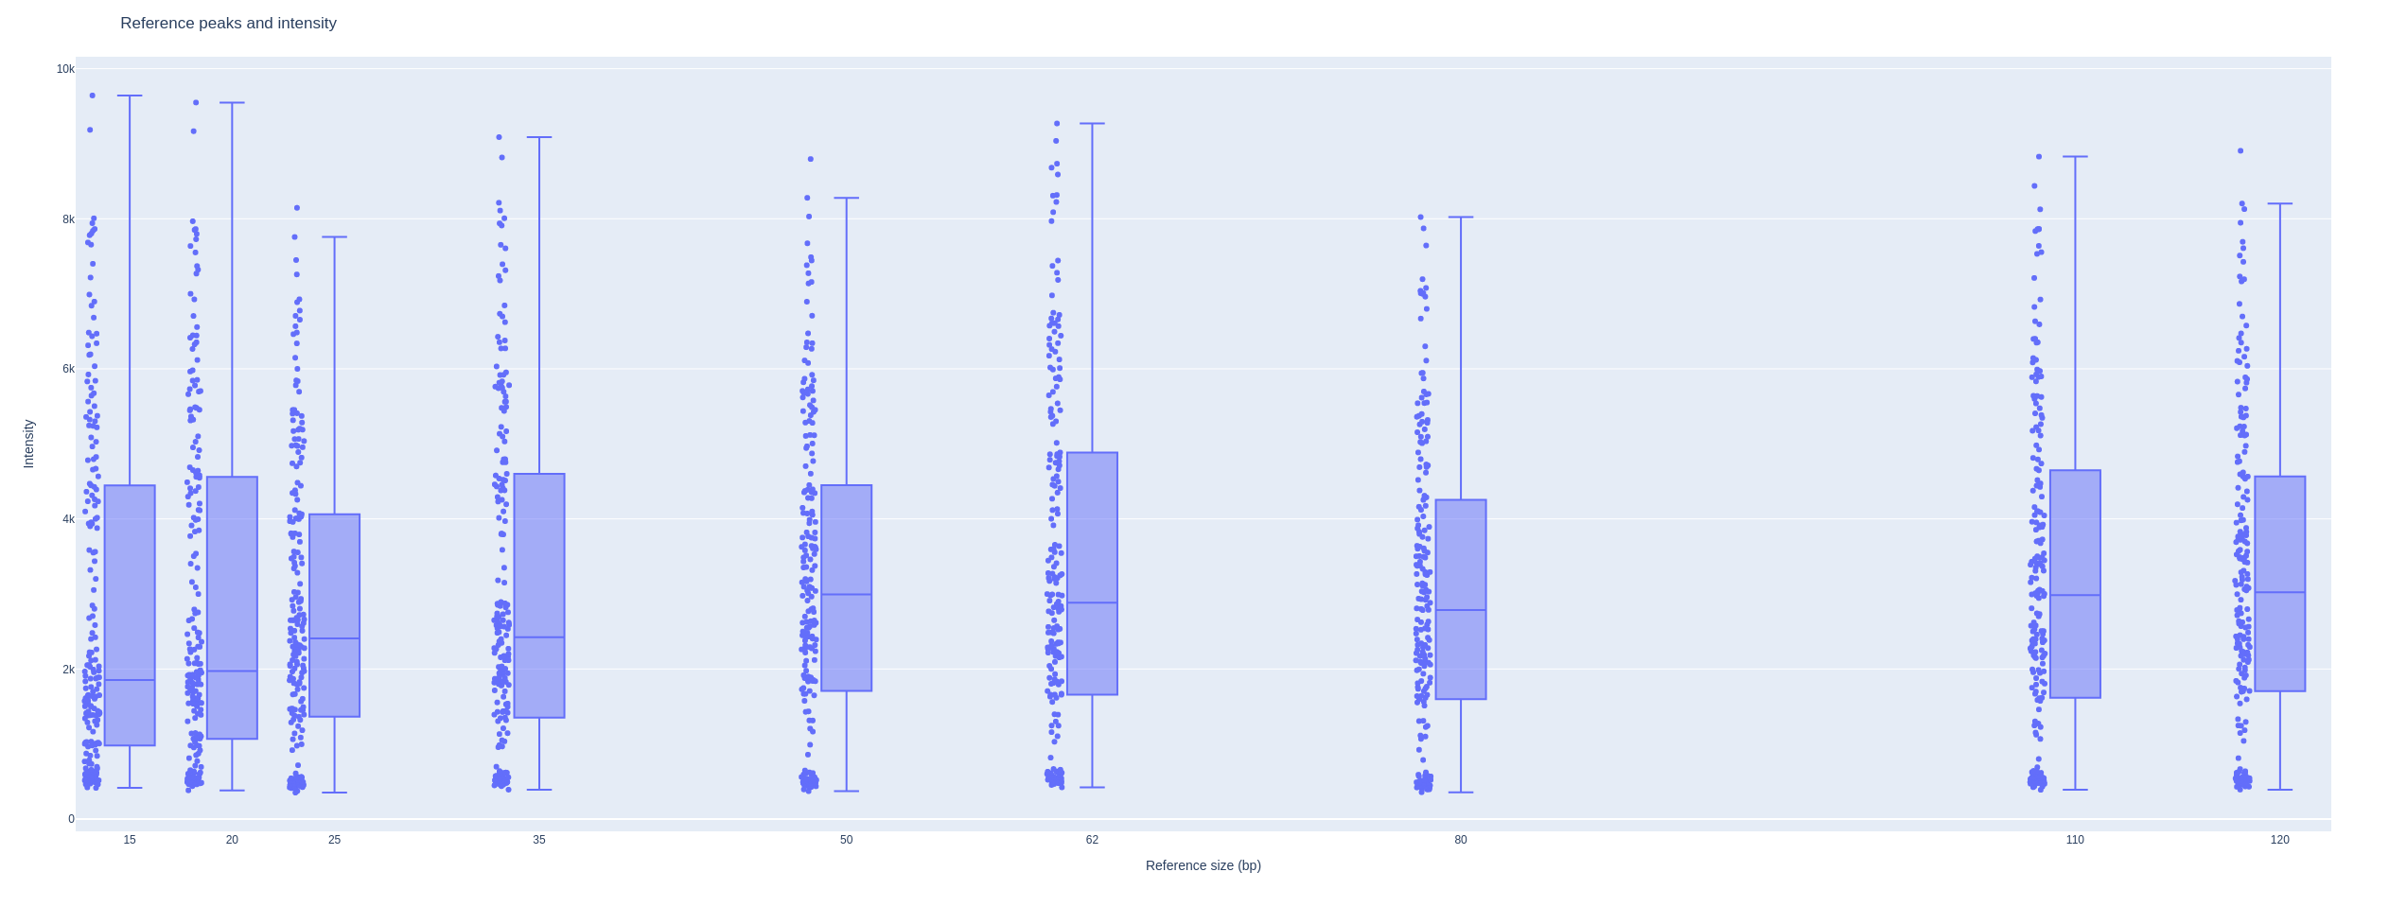
Reference peak detection
Data:
101 samples (202 FSA files)
Reference: GeneScan 120LIZ
Parameters: Minimum intensity: 300
Result:
We could detect all reference peaks of all 202 FSA files.
DNA sizing model of each FSA file was built based on corresponding detected reference peaks
R square: 0.999863 ± 0.000011
Reference sizes (bp) | Data points (cycles) |  |  | Intensity
 | Median | Min | Max | Median | Min | Max
15 | 756 | 619 | 973 | 1854 | 416 | 9643
20 | 806 | 667 | 1025 | 1973 | 383 | 9549
25 | 846 | 703 | 1067 | 2409 | 353 | 8146
35 | 934 | 788 | 1157 | 2424 | 392 | 9088
50 | 1077 | 925 | 1307 | 2992 | 372 | 8796
62 | 1215 | 1056 | 1451 | 2882 | 423 | 9270
80 | 1395 | 1228 | 1636 | 2786 | 358 | 8023
110 | 1732 | 1549 | 1983 | 2984 | 390 | 8828
120 | 1841 | 1654 | 2094 | 3022 | 393 | 8906

Slide 3
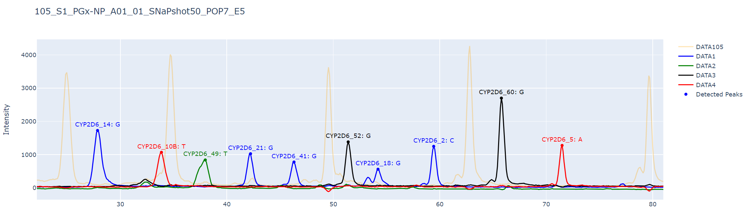
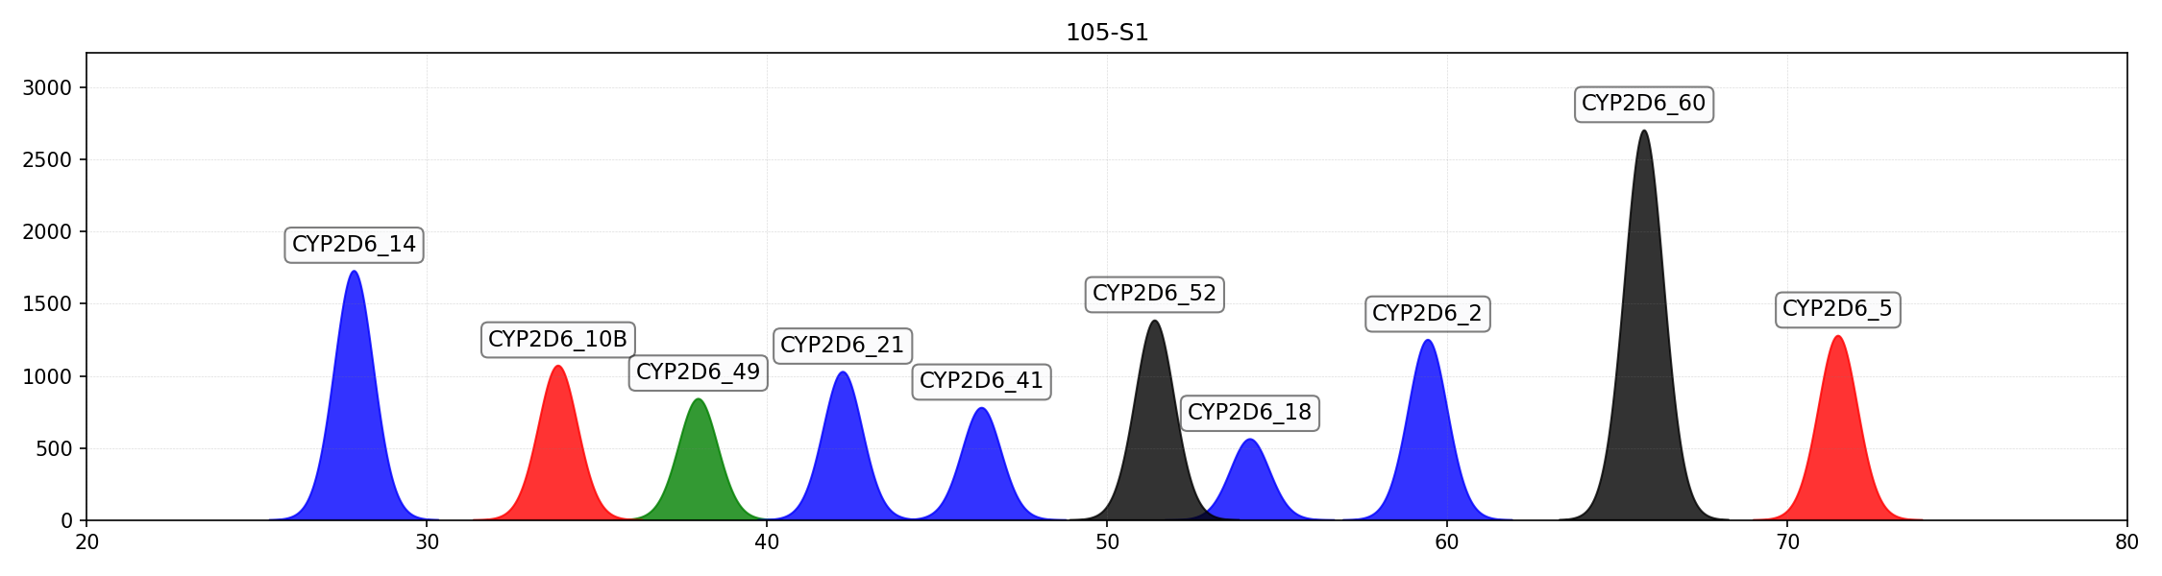
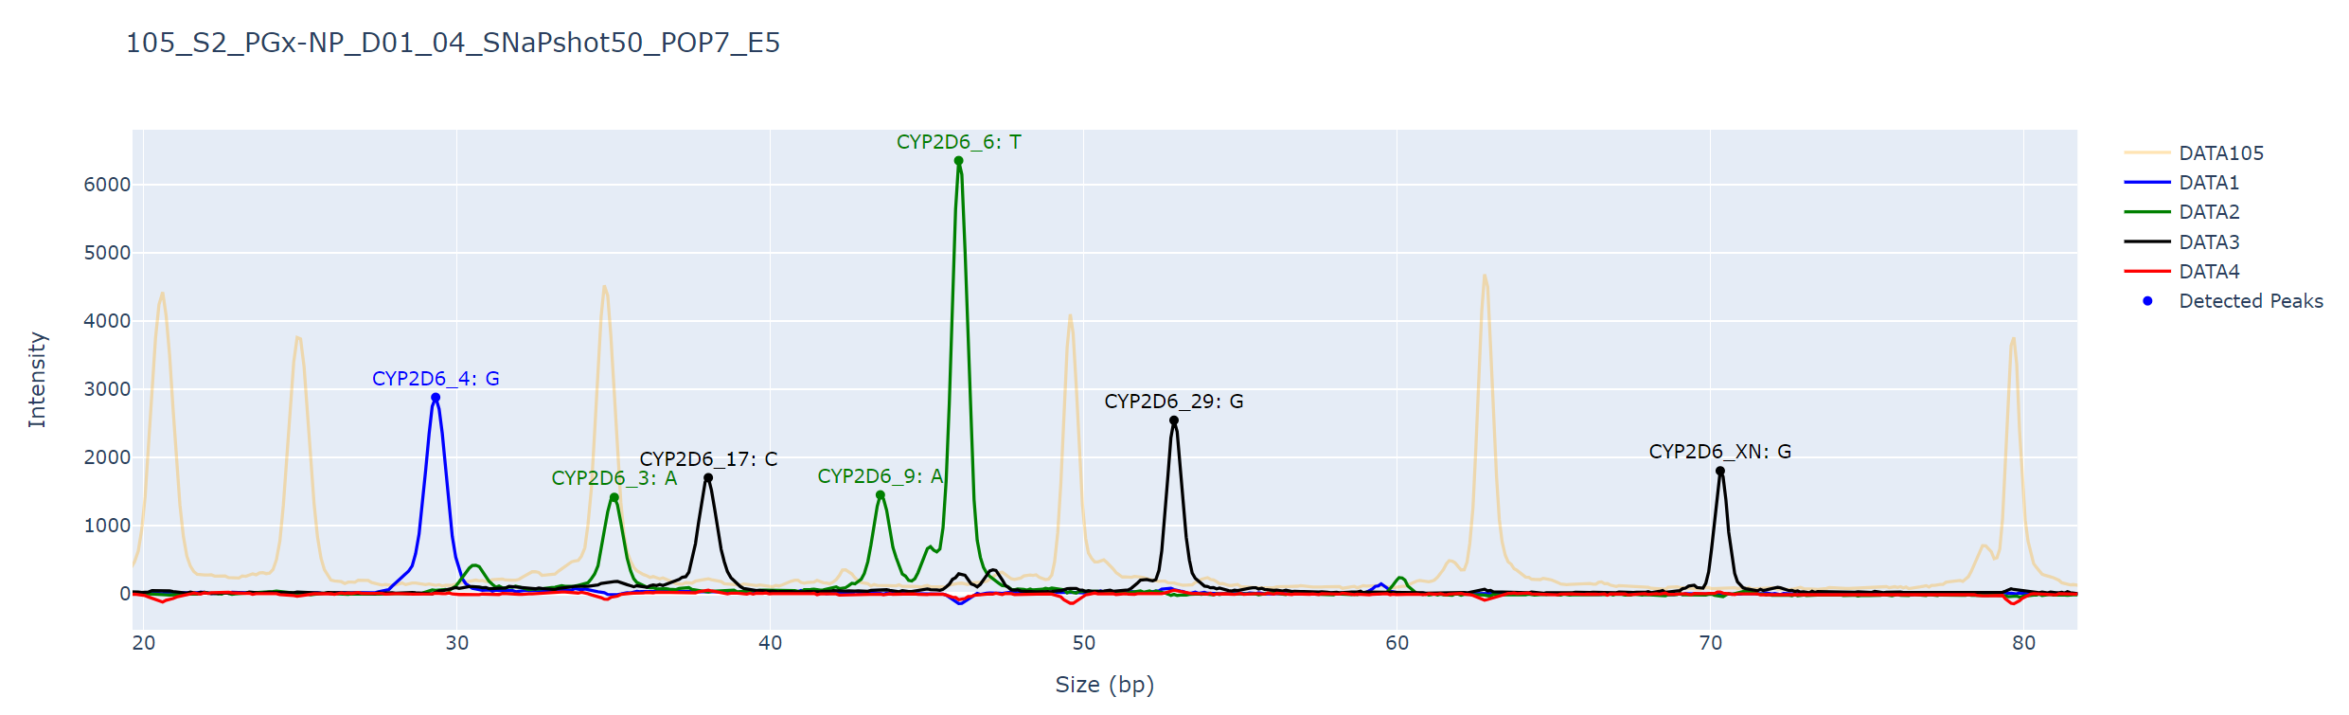
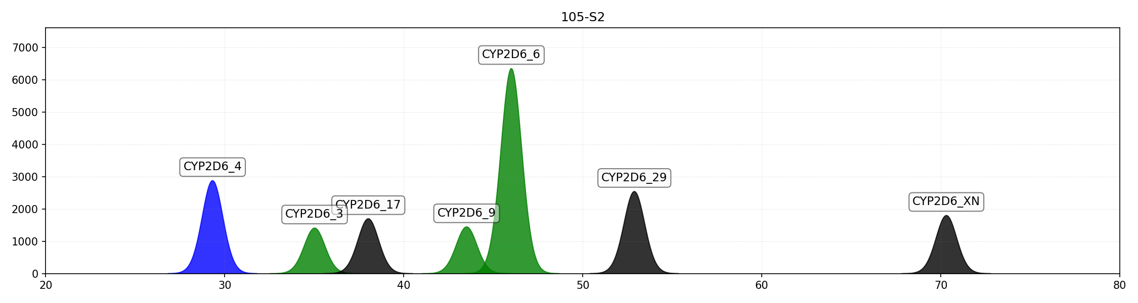
Example of calling process
Default minimum intensity was as 1000; some of marker could not be detected
After adjust intensity, these markers was identified:
*10B/*10B

Slide 4
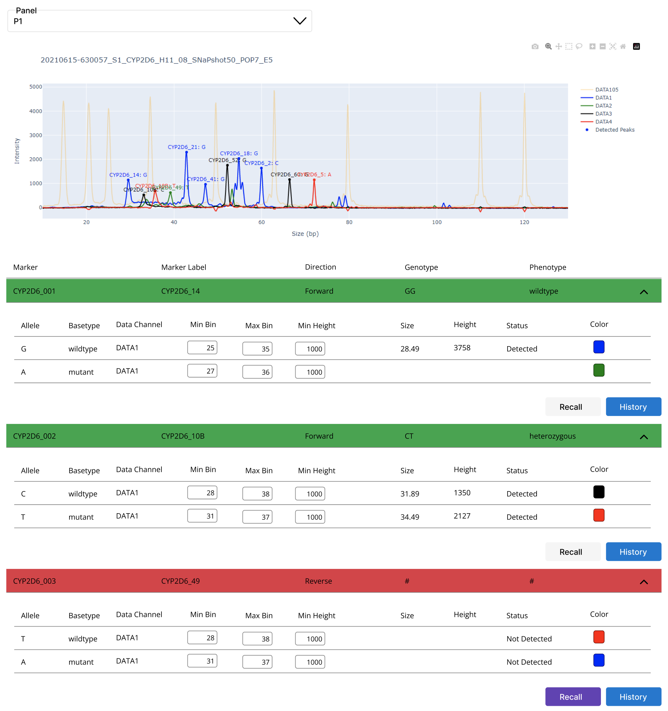
A
B
C
D

Slide 5
FSA files
Current approach
Proposed cloud system
Proposed cloud system
A
B
Web application
Provide an integration system from peak detection to report generation.
Prevent human bias
Improve efficiency
Improve management
Transparent
GeneMapper Software
Estimate DNA size
Upload
Estimate DNA size
Plot intensity data
Plot intensity data
Current approach
Review and adjust DNA size and intensity to detect target peaks
Review and adjust DNA size and intensity to detect target peaks
Separate systems, software, requires some manual steps
High risk of human bias
Low efficiency because of system separation.
Hard to check history
Difficult to manage
Manually genotype calling by PGx experts
Confirmation
Quality control and confirm
Exporting result
Manually
upload
Star-allele calling
Third party star-allele calling tools
Confirm called results
Manually input
Generate reports
Generate reports
PGx: Pharmacogenomics
FSA: Fragment Sequence Analysis

Slide 6
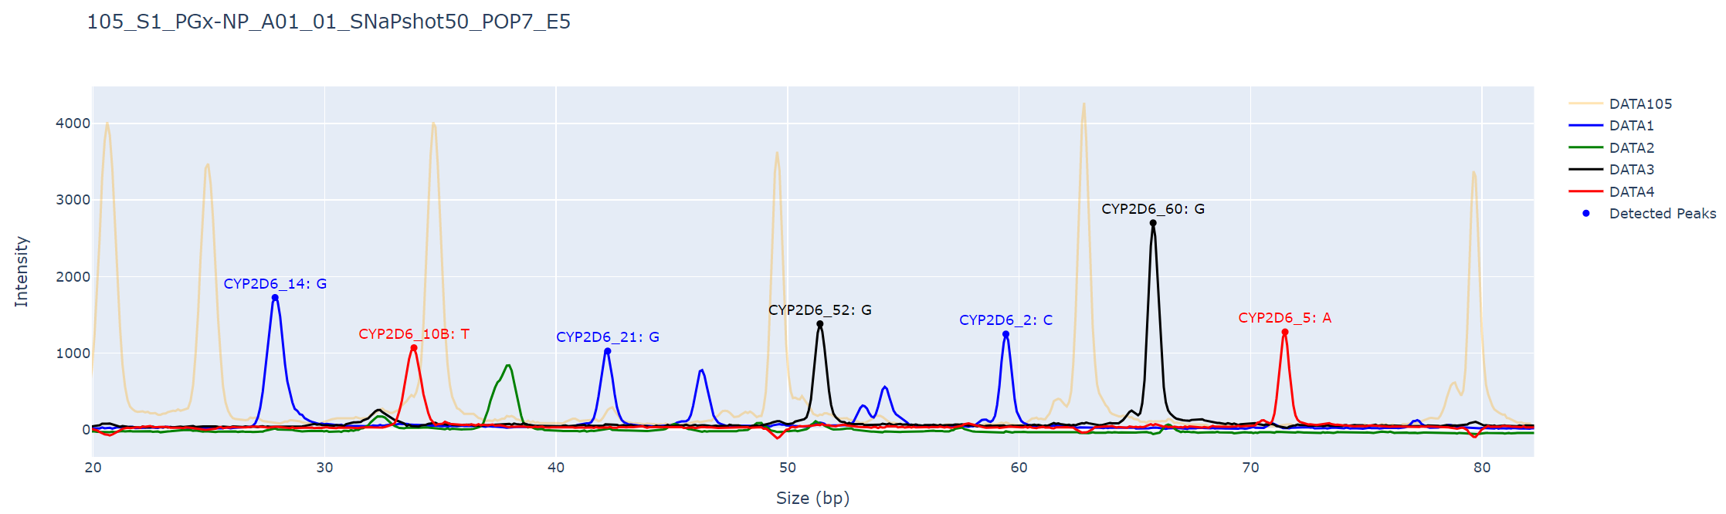
Example of calling process
Default minimum intensity was as 1000; some of marker could not be detected
After adjust intensity, these markers was identified:
*10B/*10B

