Slide 1
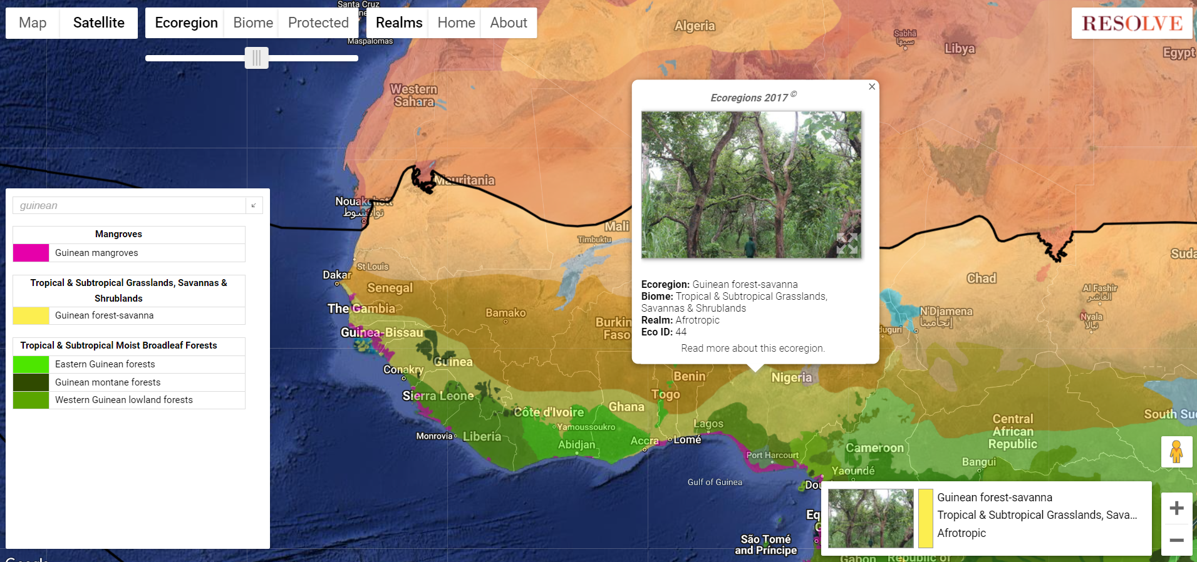
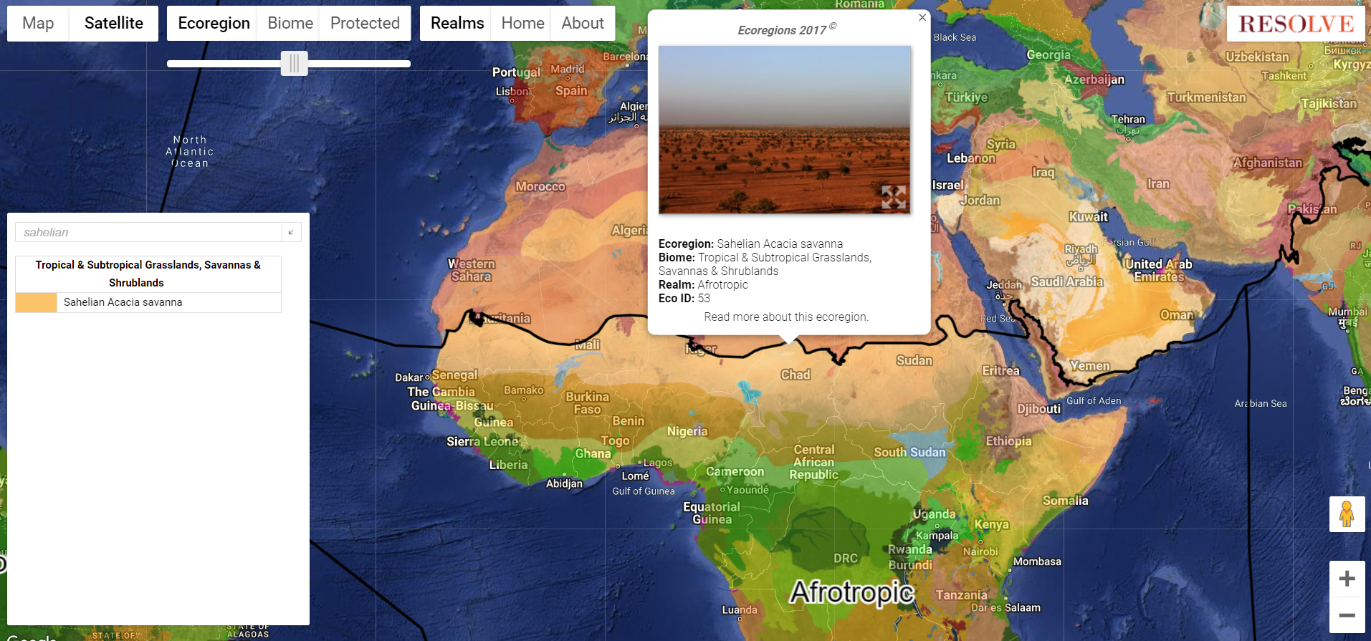
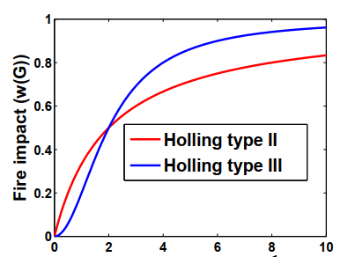
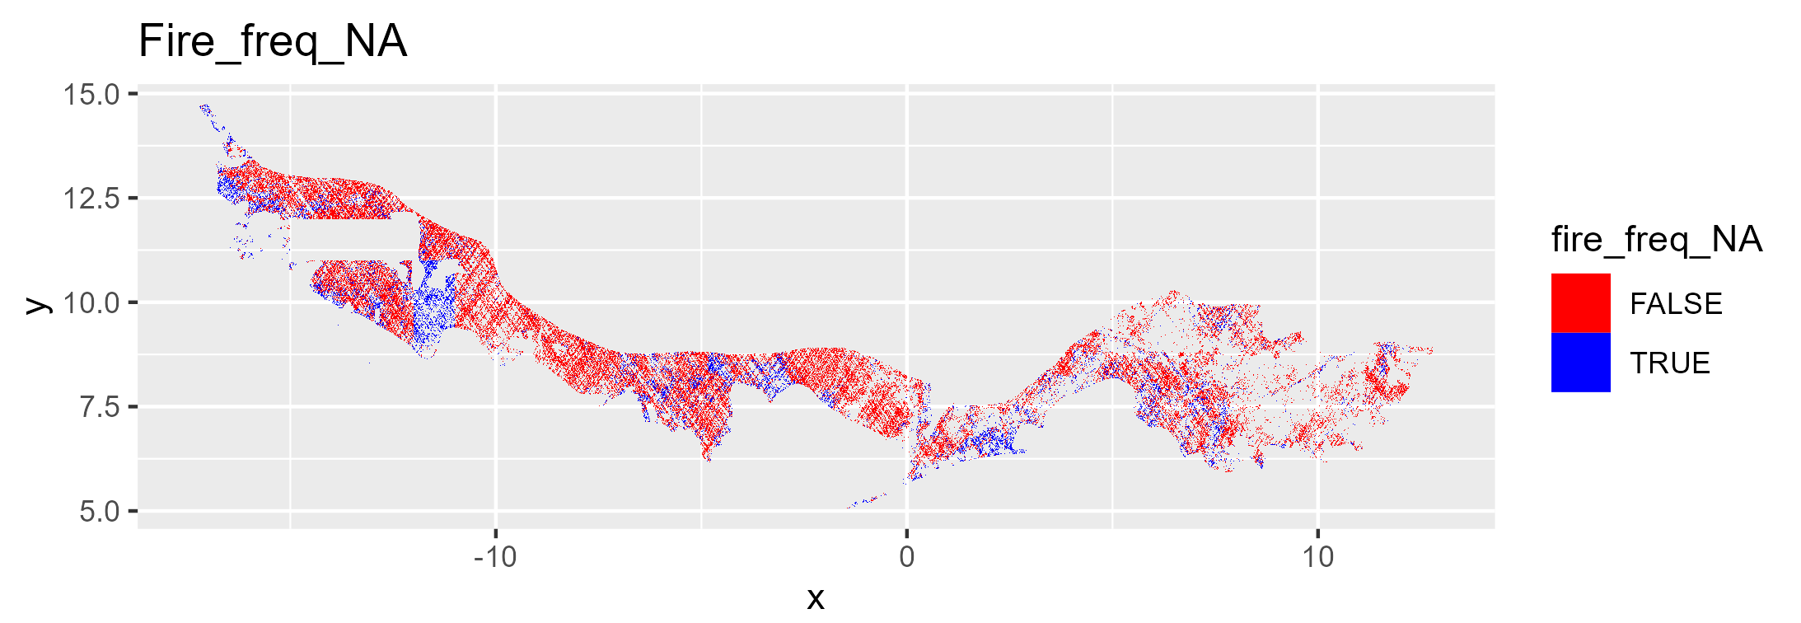
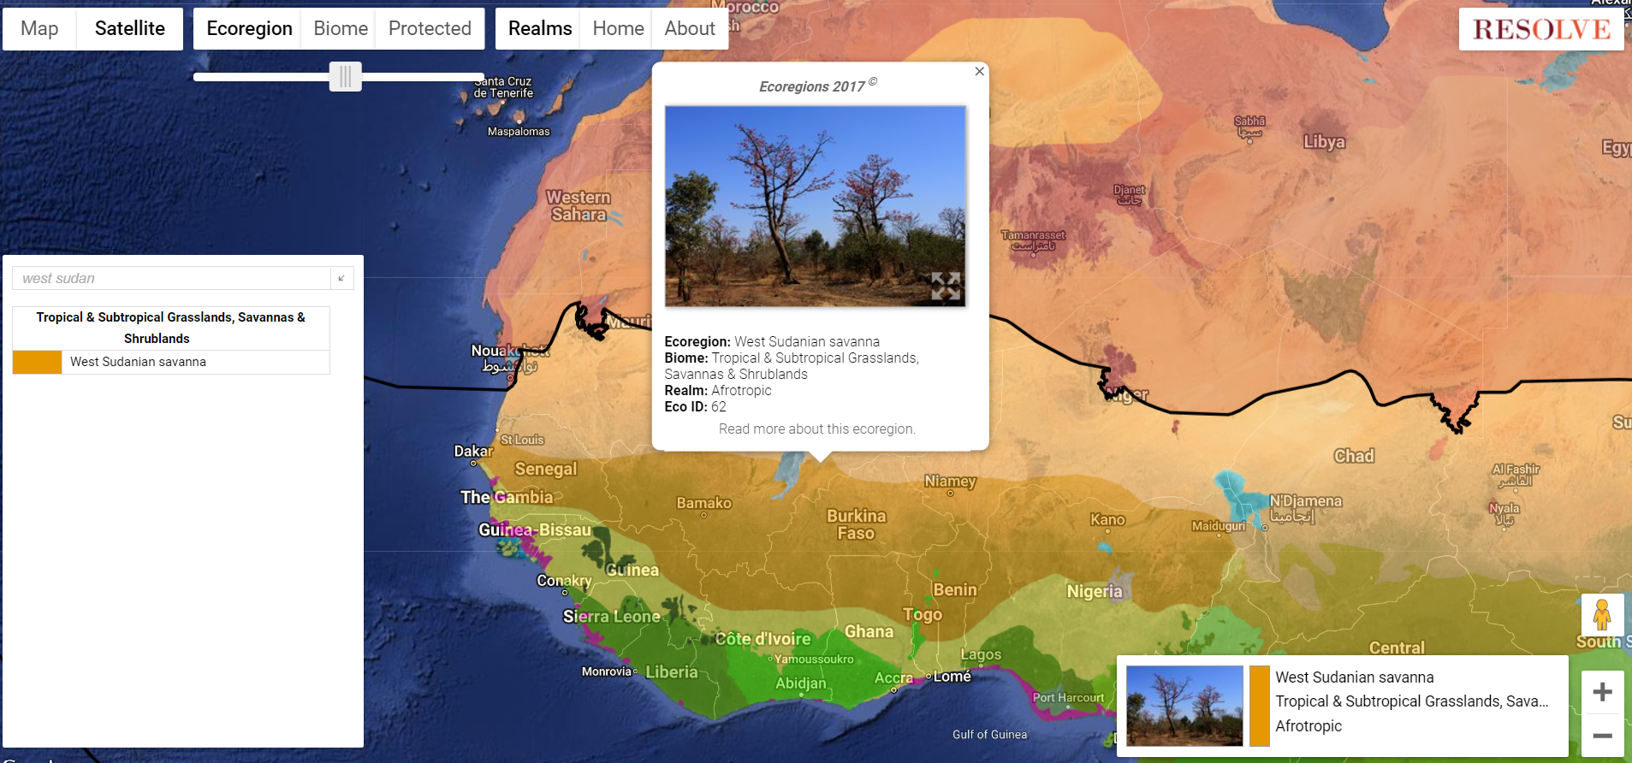
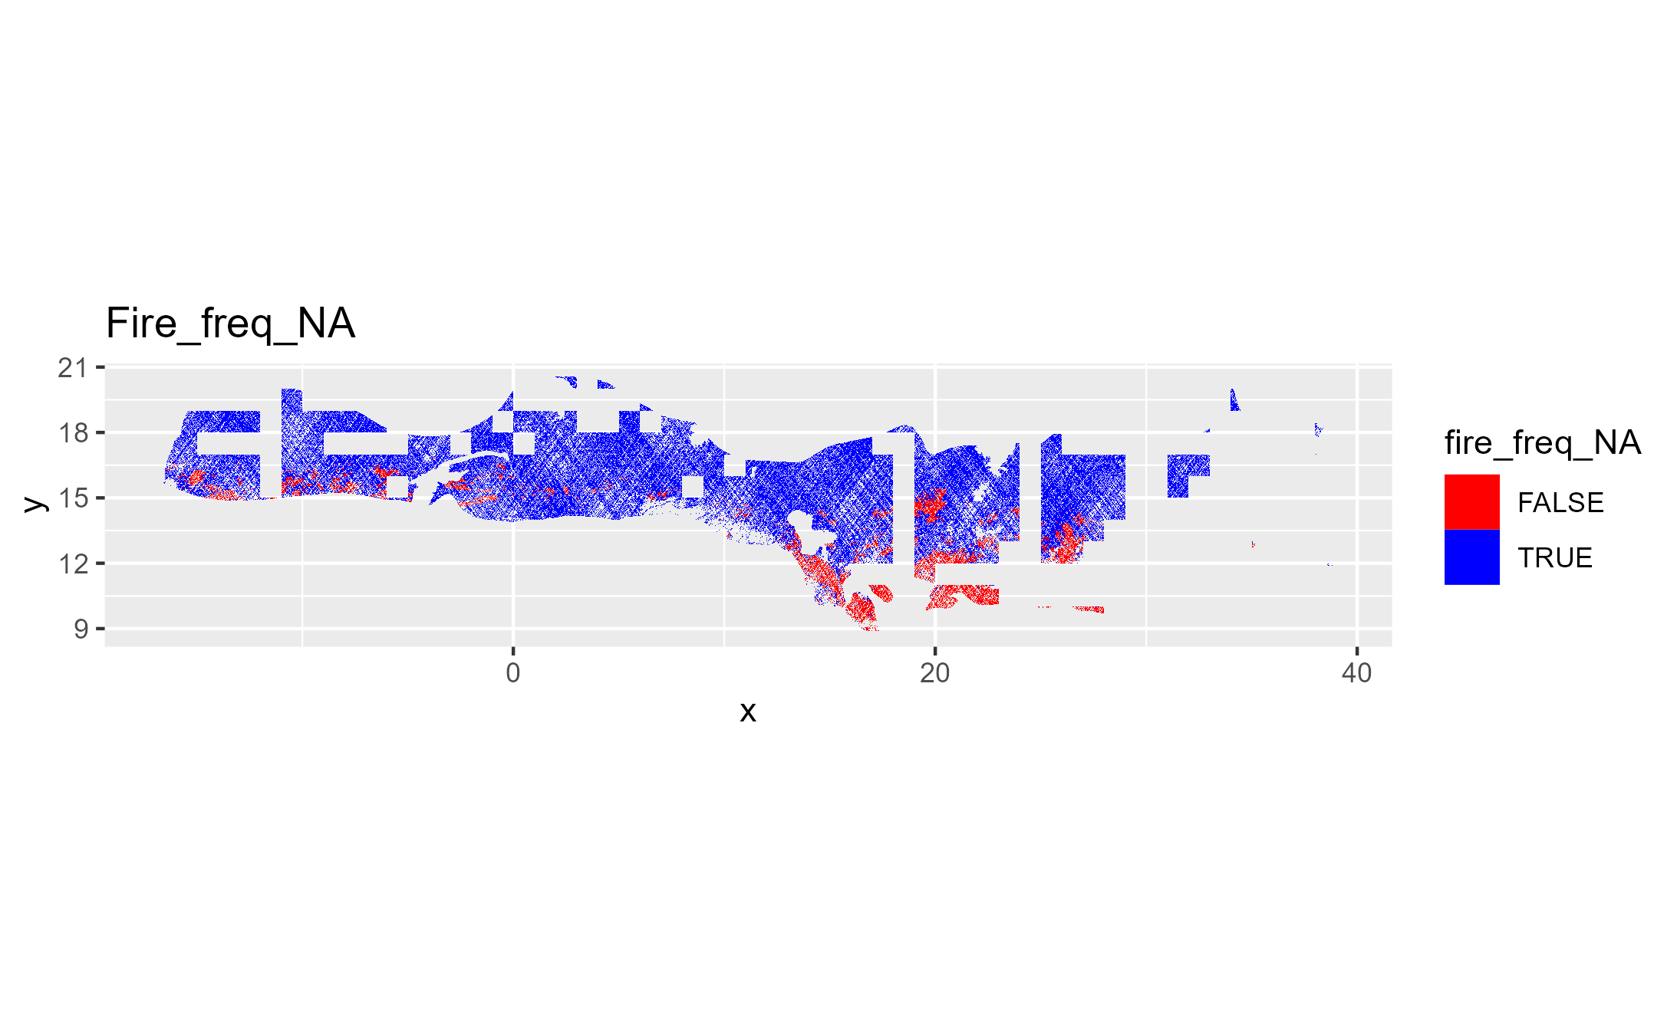
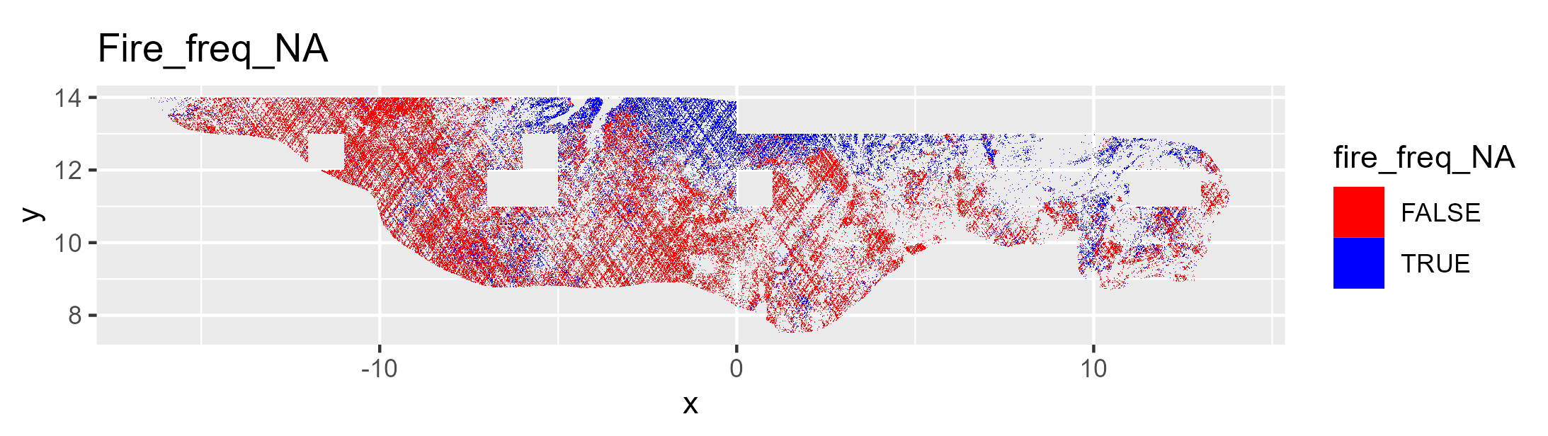
Guinean_forest-savanna
Essai d’interprétation
Sahelian_Acacia
Guinean
Guinean_forest-savanna
Sudanian
Sahelian
Observed fire frequency
Sahelian_Acacia
Mean annual rainfall or grass biomass (linear relationship)
West_Sudanian
West_Sudanian

Slide 2
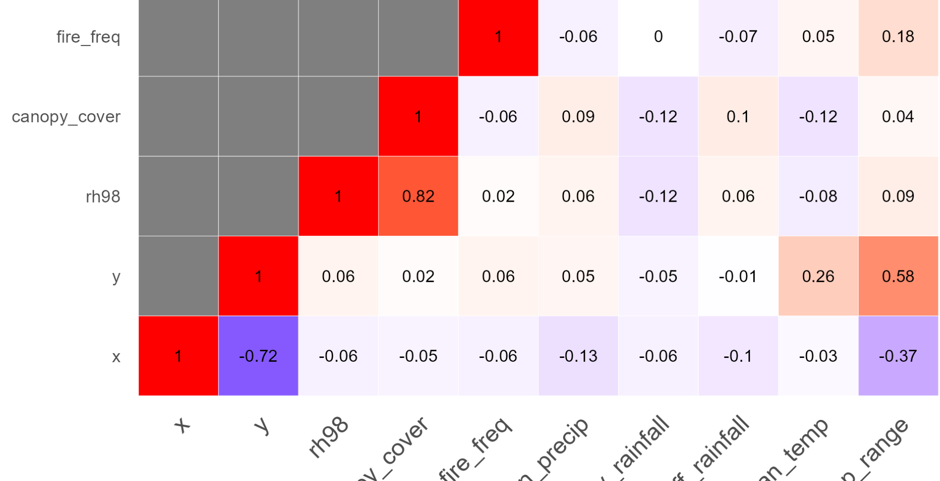
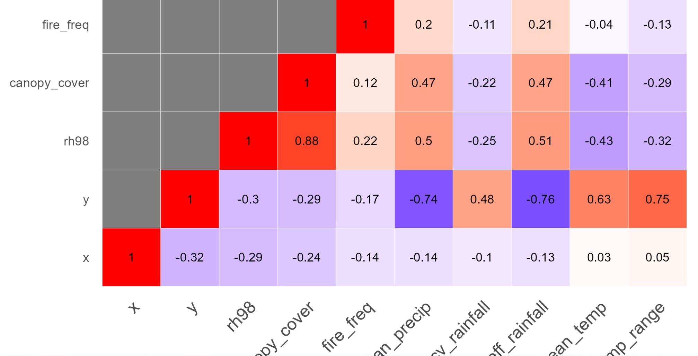
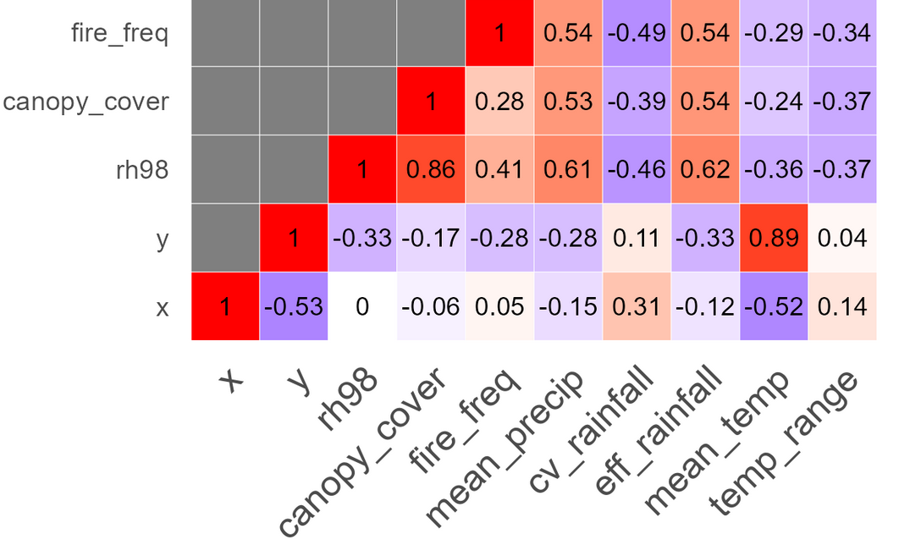
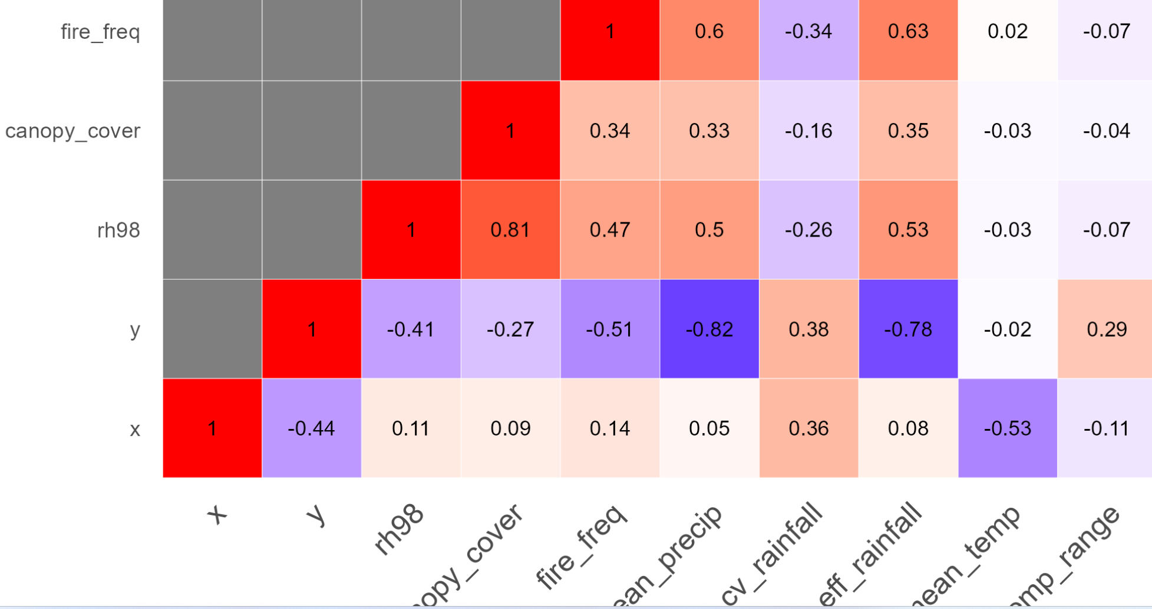
Guinean_forest-savanna
Essai d’interprétation
Sahelian_Acacia
Guinean_forest-savanna
Guinean
Sudanian
Sahelian
Observed fire frequency
Mean annual rainfall or grass biomass (linear relationship)
West_Sudanian
West_Sudanian
Sahelian_Acacia
All data

Slide 3
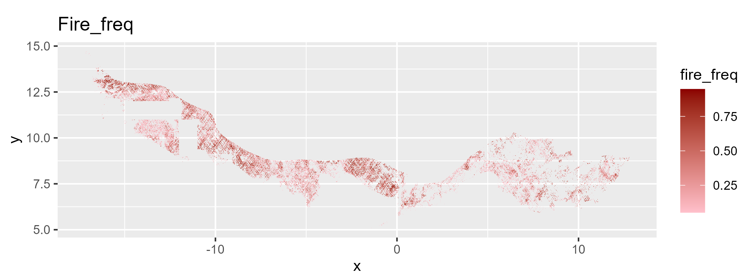
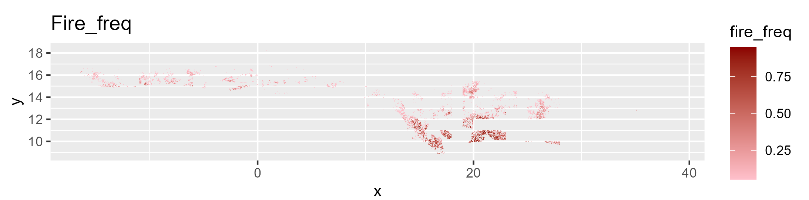
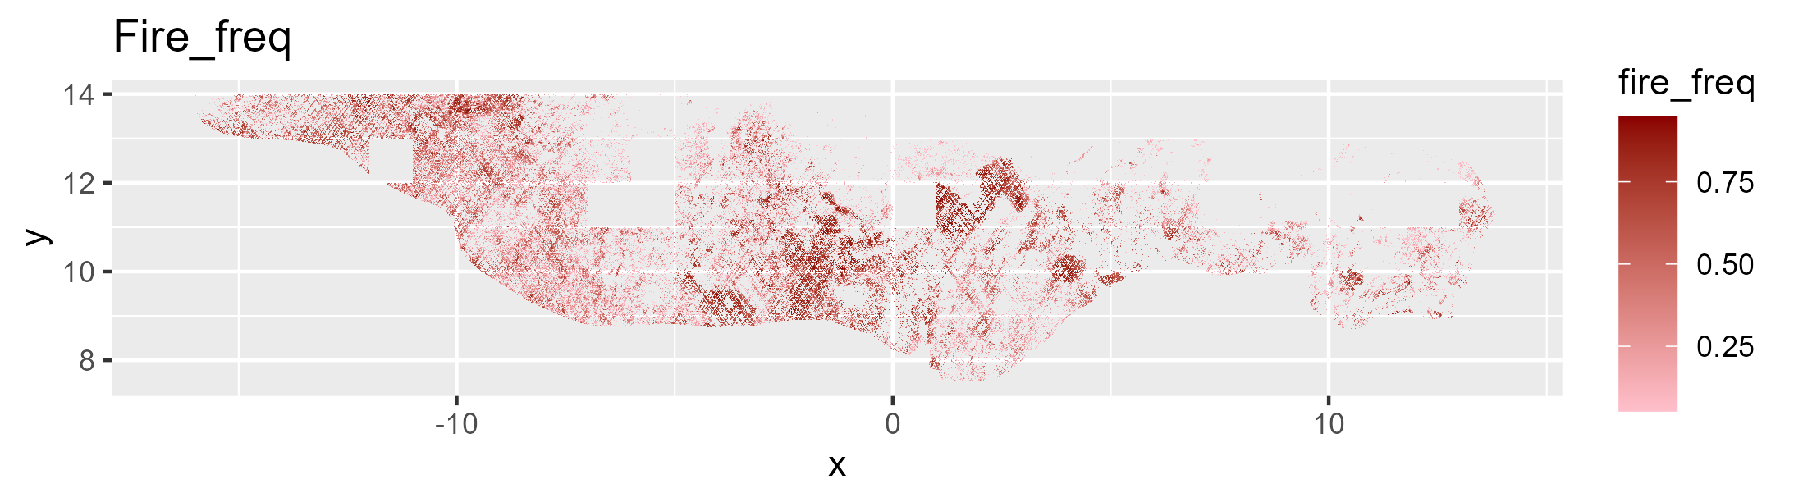
Guinean_forest-savanna
Sahelian_Acacia
West_Sudanian

Slide 4
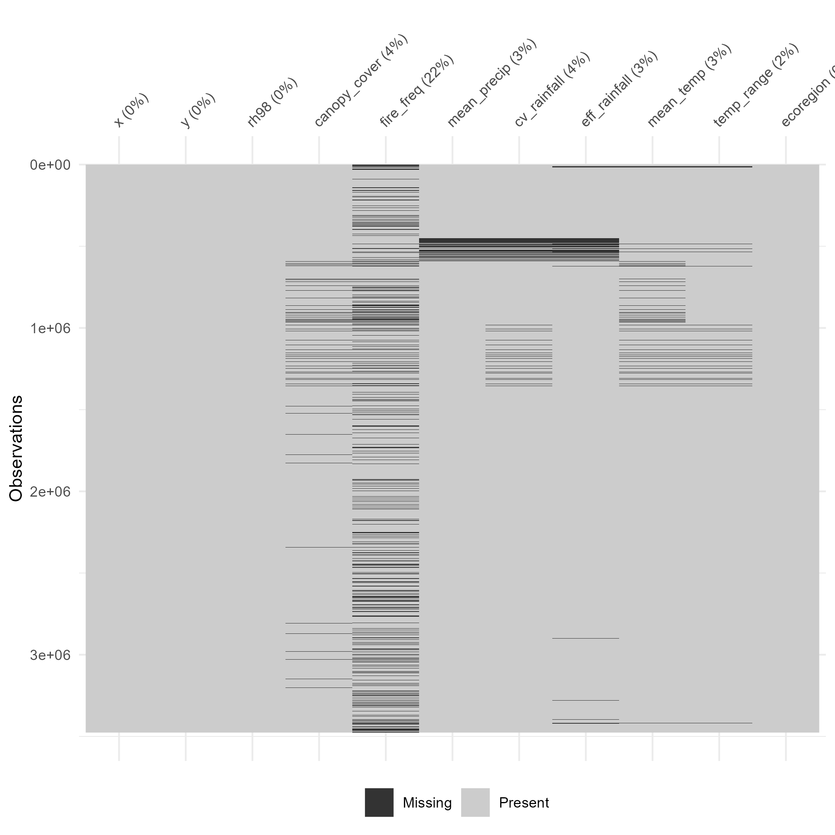
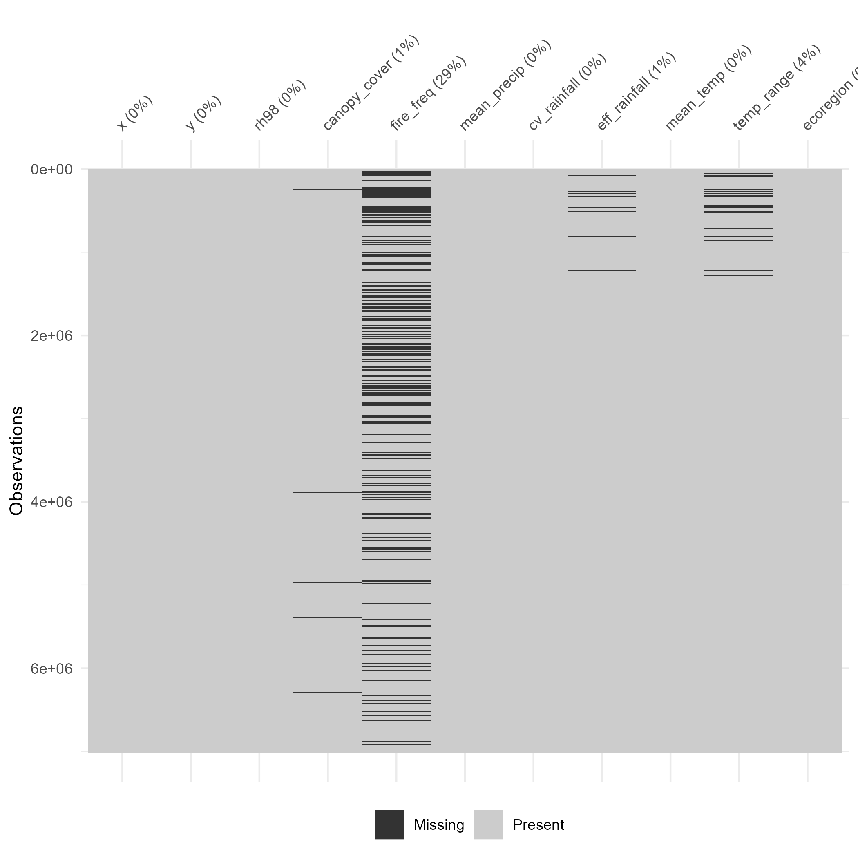
Guinean_forest-savanna
Sahelian_Acacia
Sahelian_Acacia
Je crois que c'était trop lourd pour le package visdat qui fait ces plots, à voir si ça marcherait sur un ordi plus puissant
West_Sudanian
West_Sudanian

Slide 5
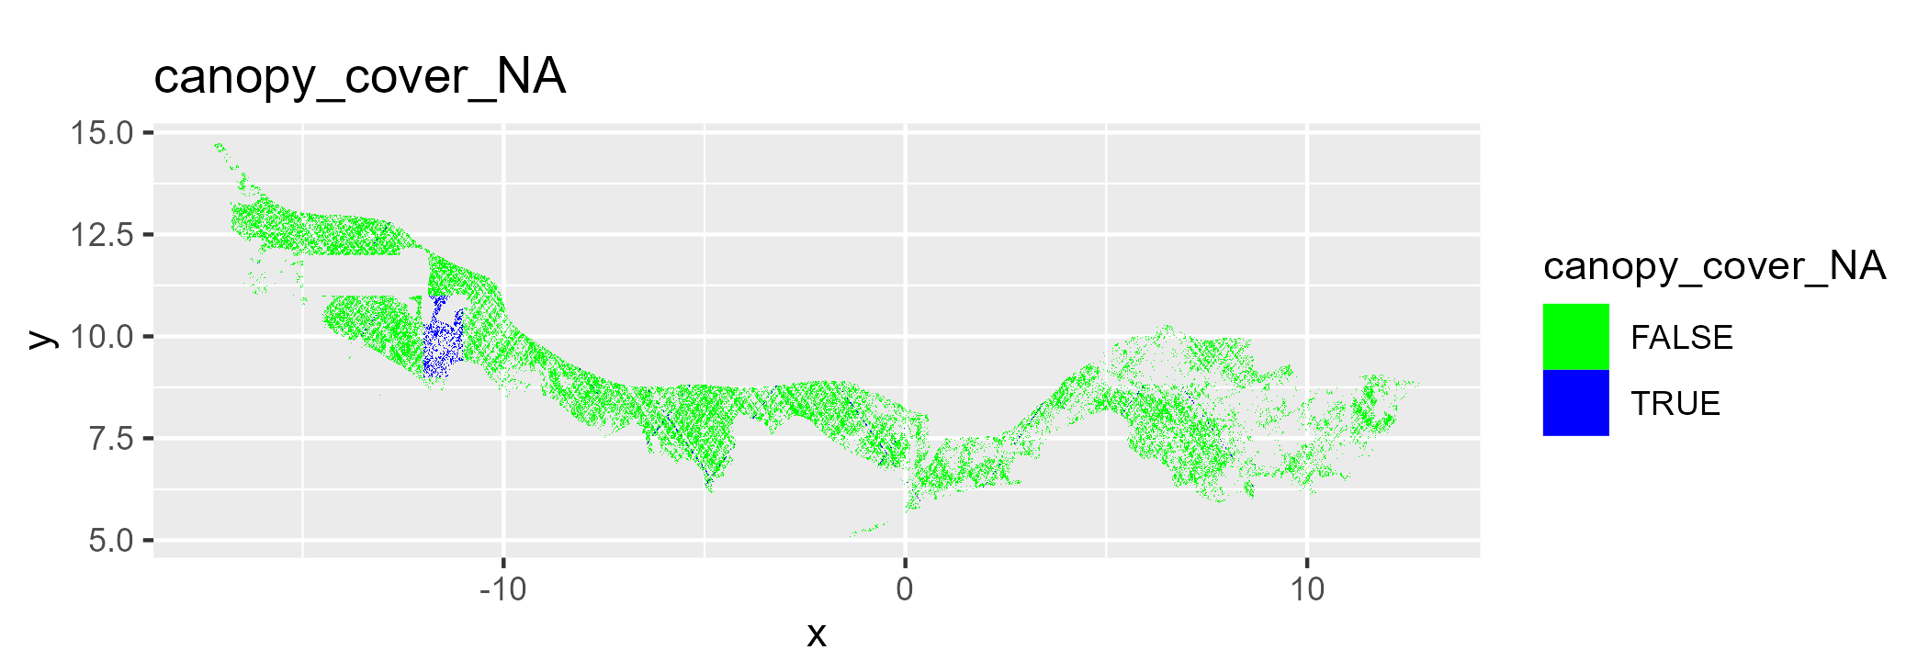
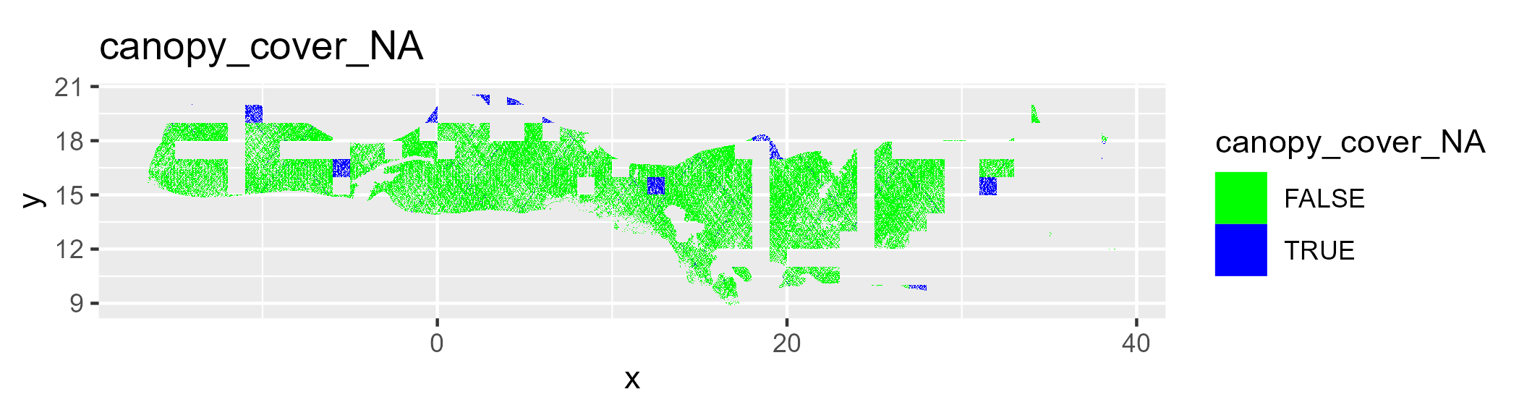
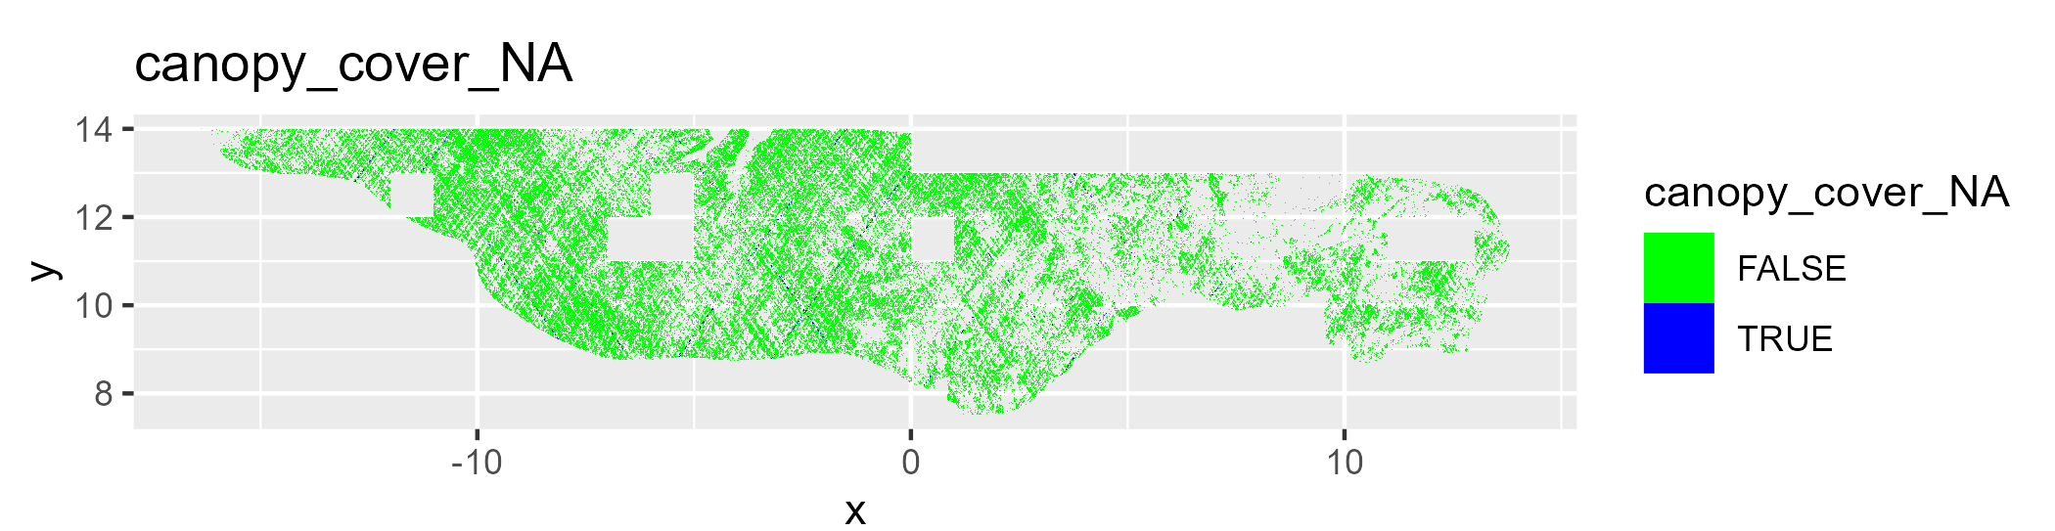
Guinean_forest-savanna
Sahelian_Acacia
Sahelian_Acacia
Sahelian_Acacia
West_Sudanian
West_Sudanian

Slide 6
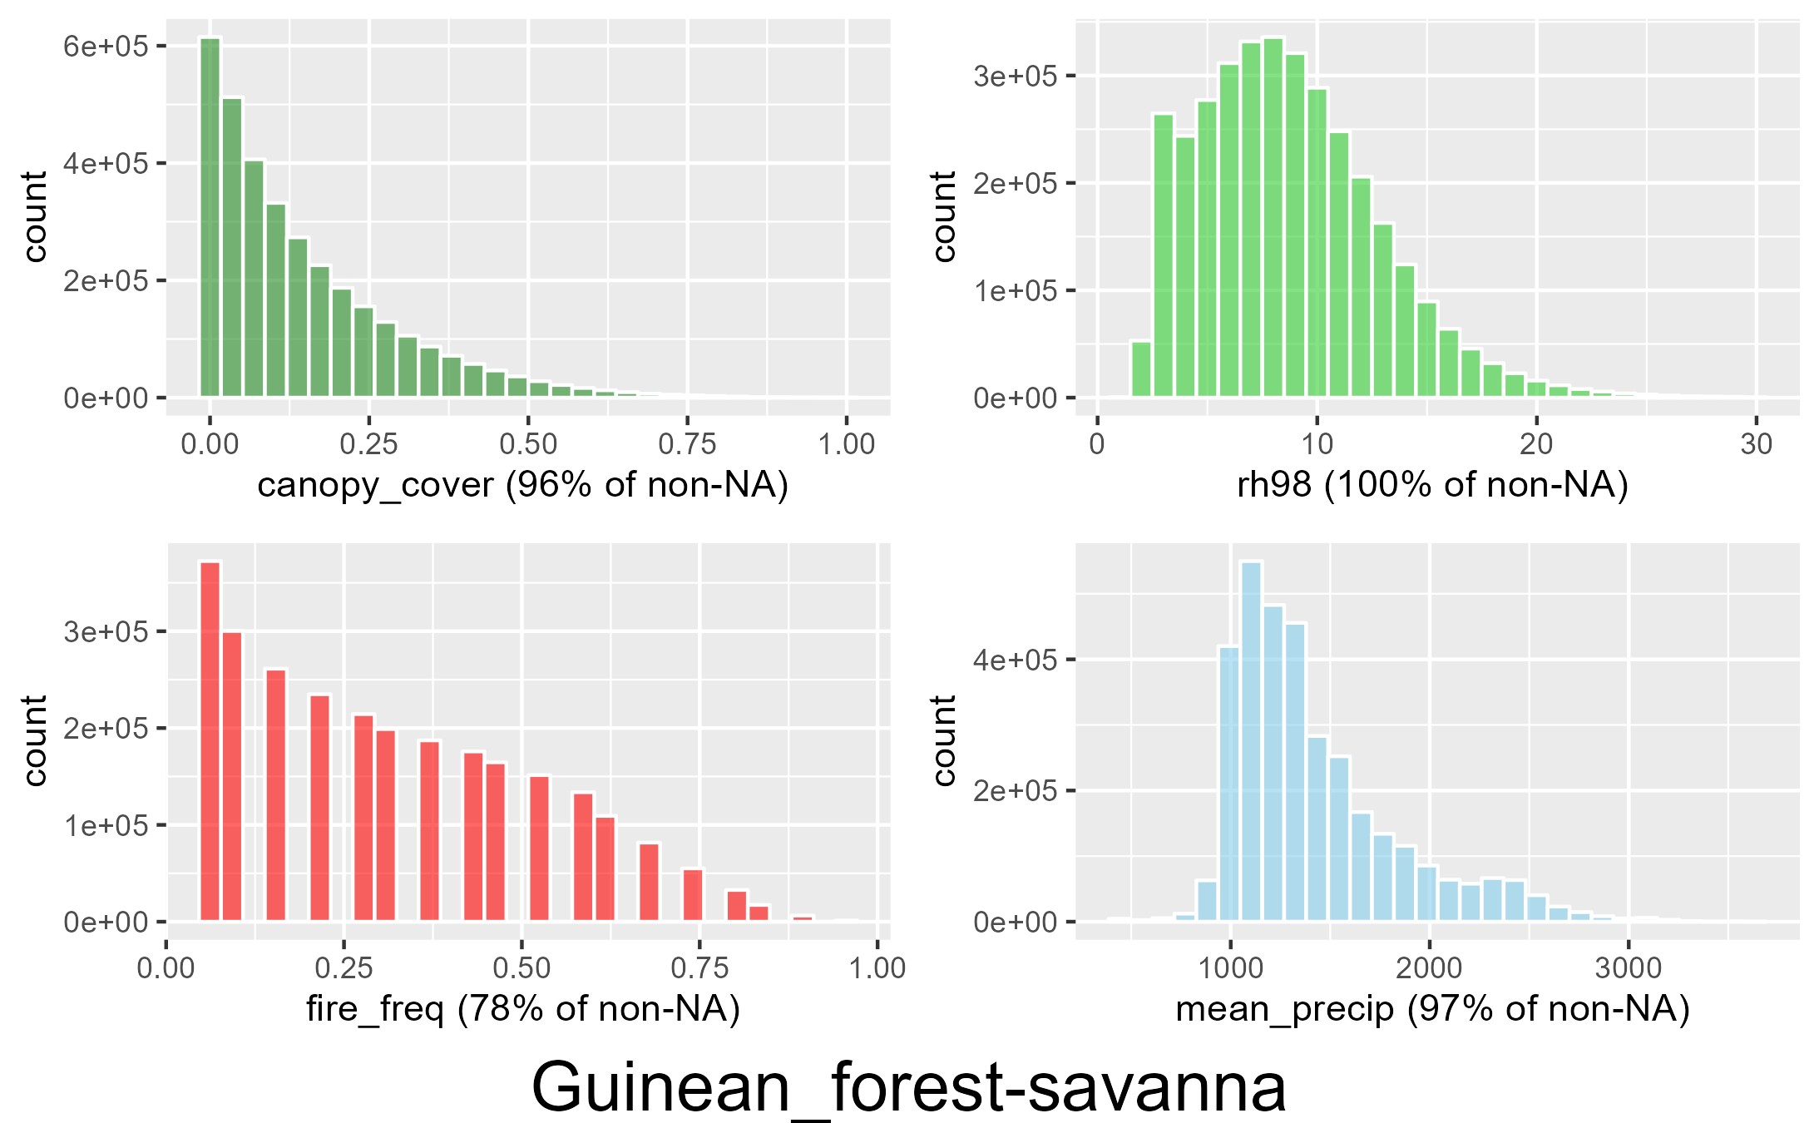
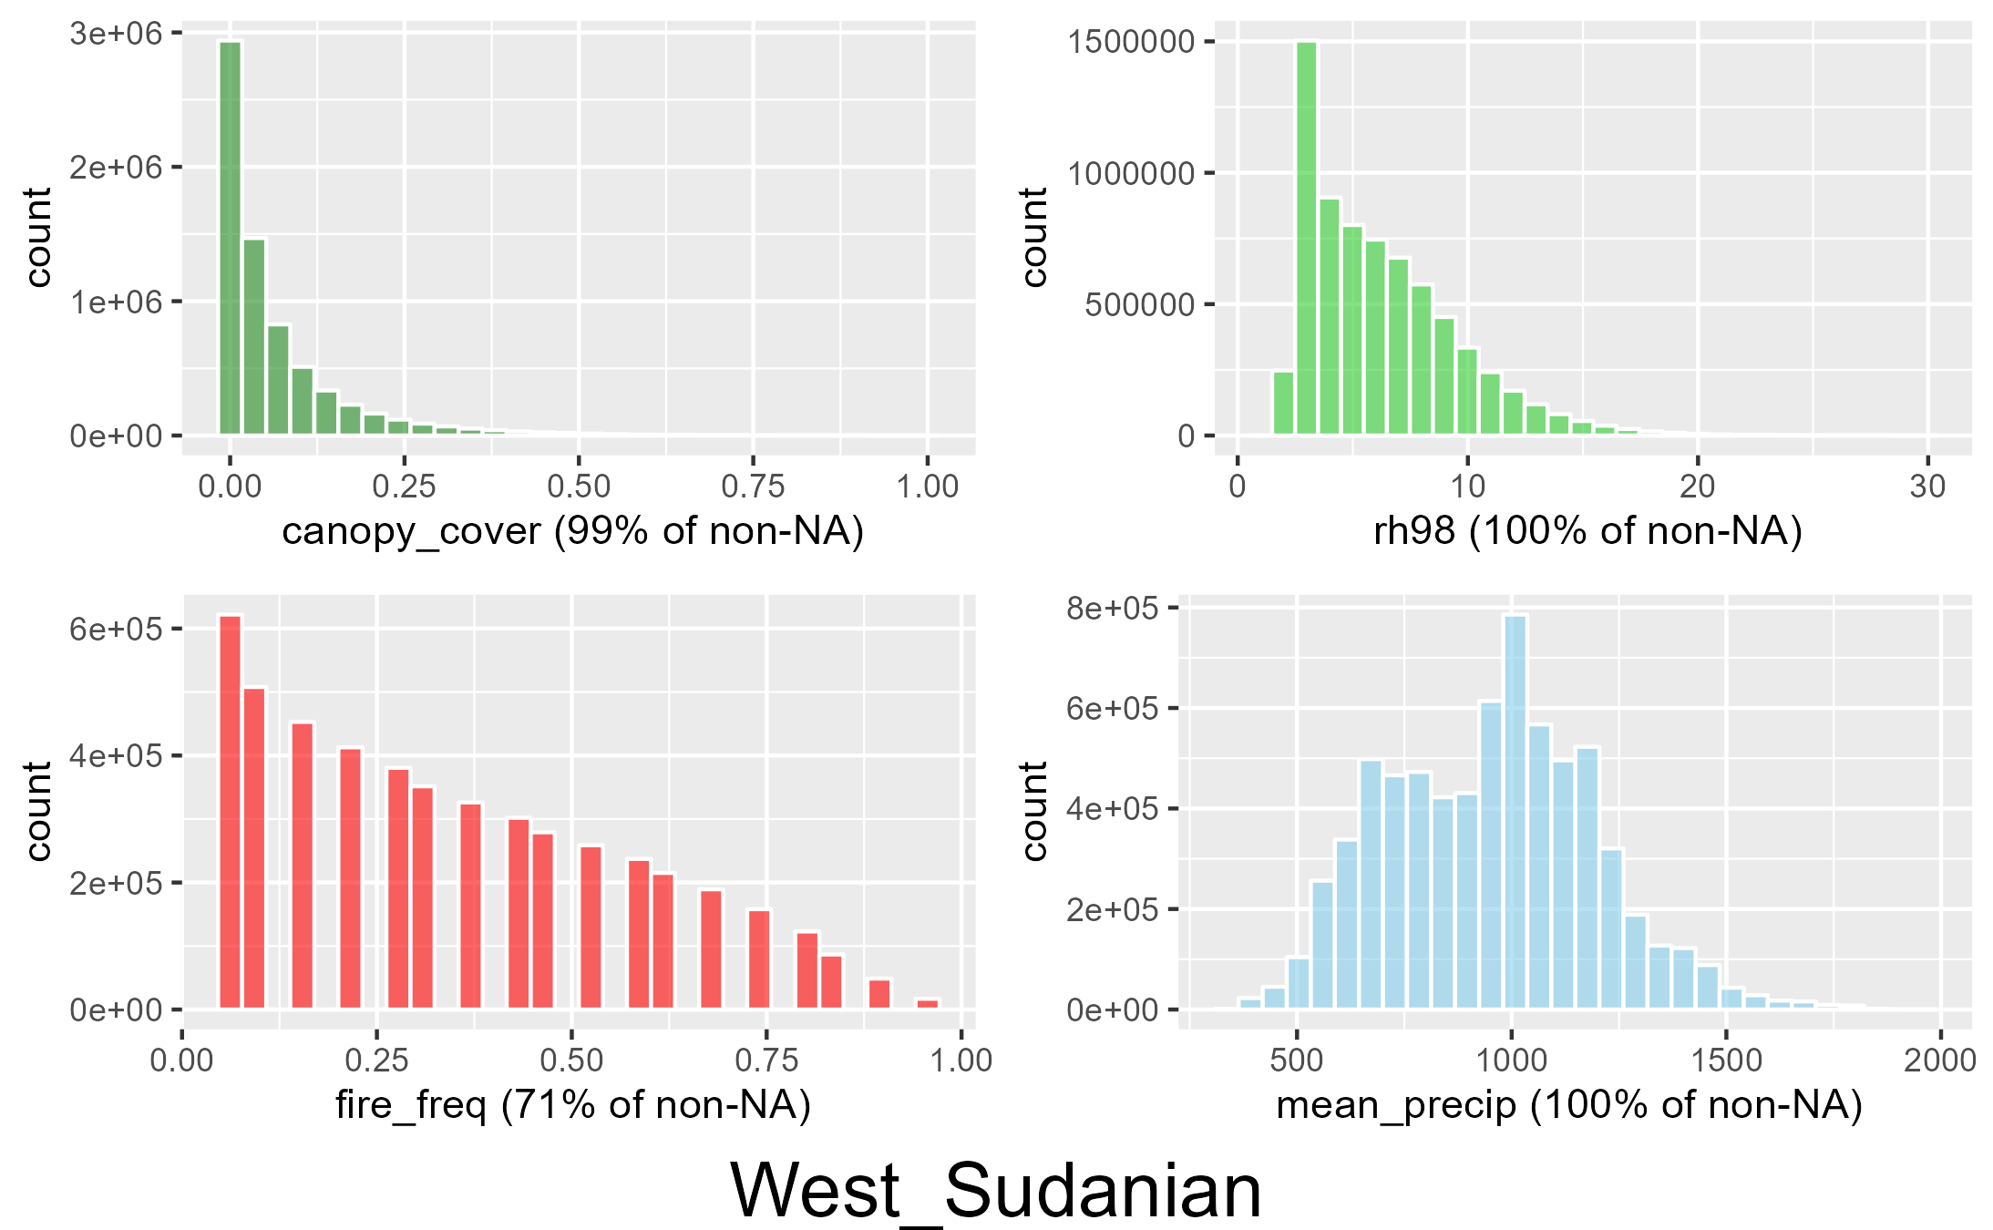
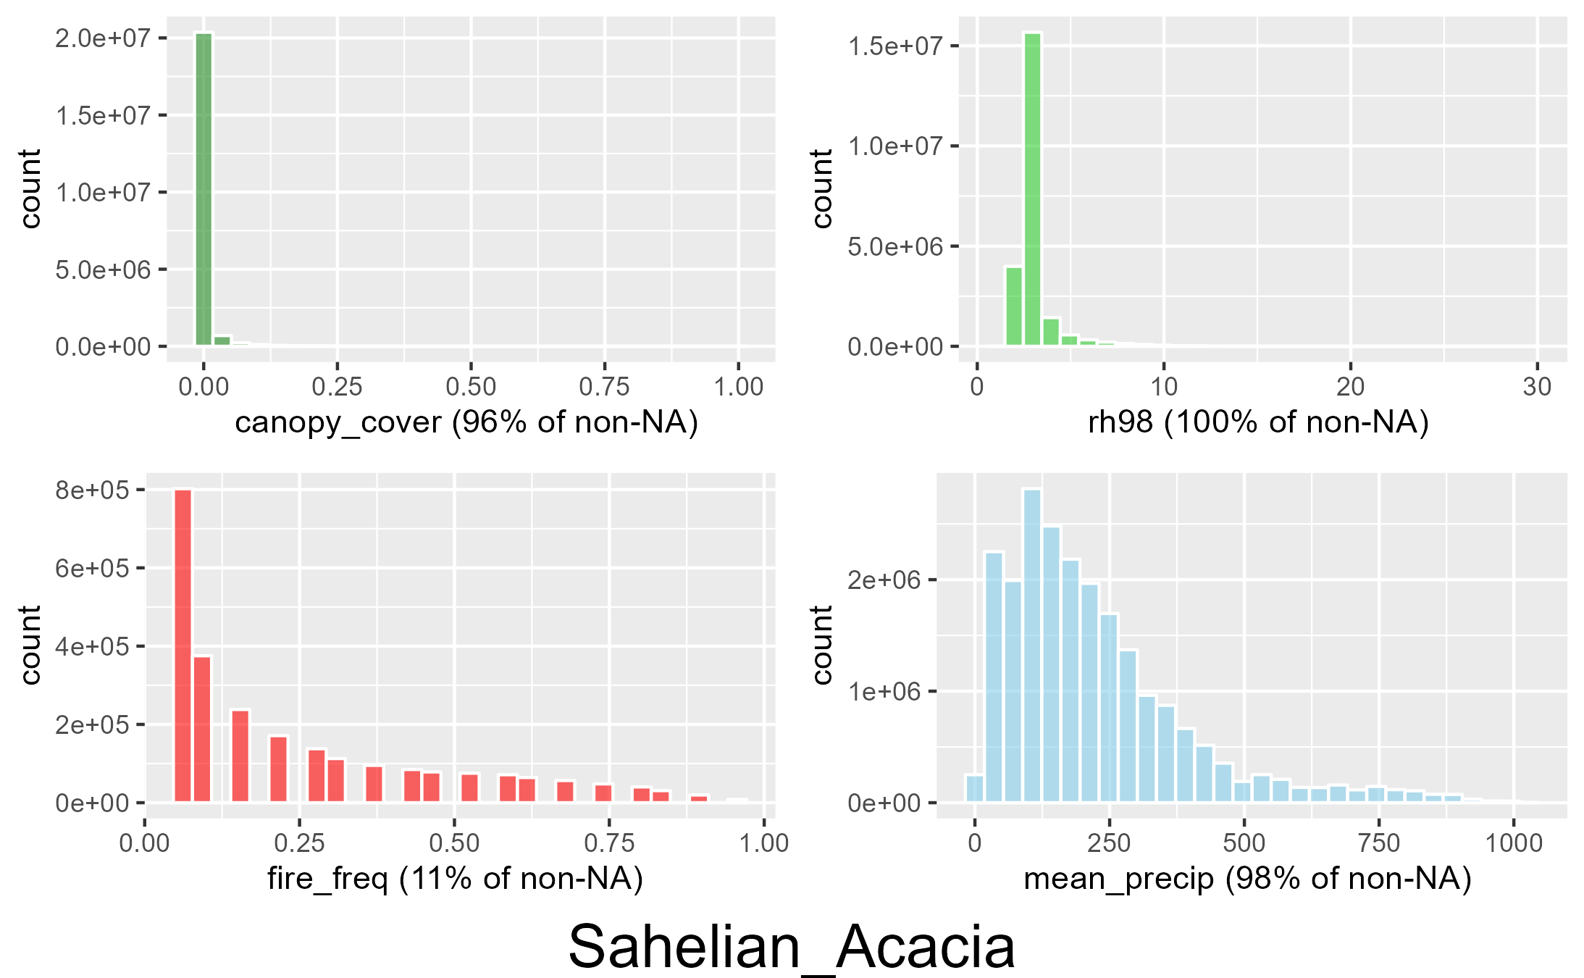
Guinean_forest-savanna
West_Sudanian
Sahelian_Acacia
All data

Slide 7
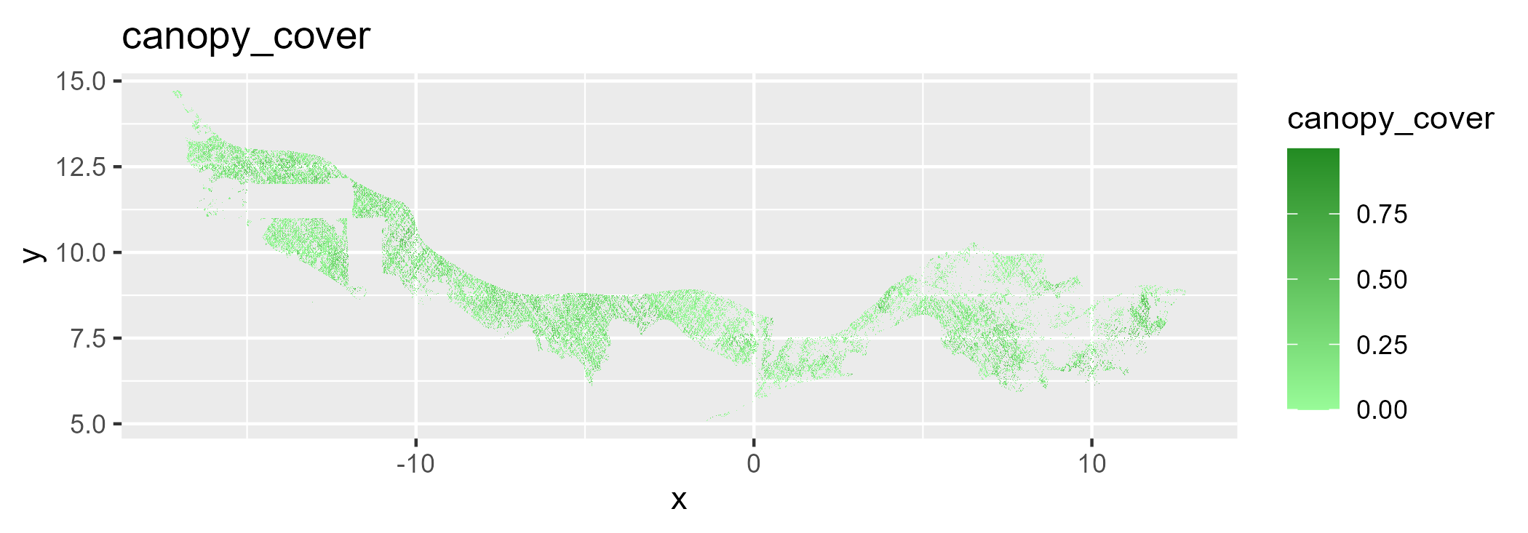
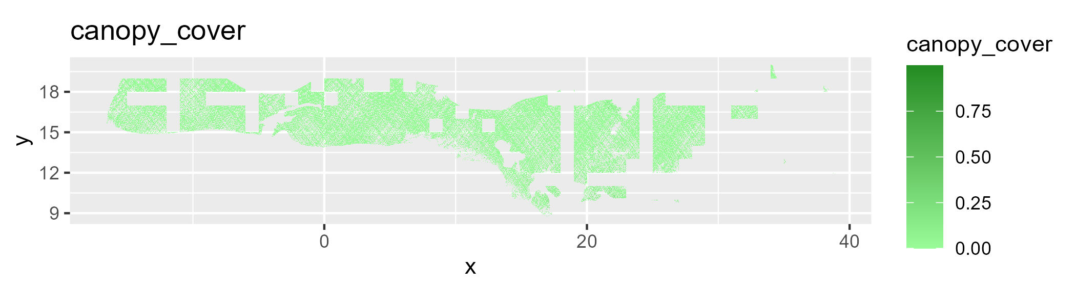
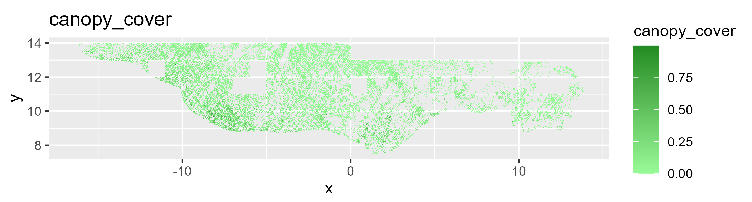
Guinean_forest-savanna
Sahelian_Acacia
Sahelian_Acacia
West_Sudanian

Slide 8
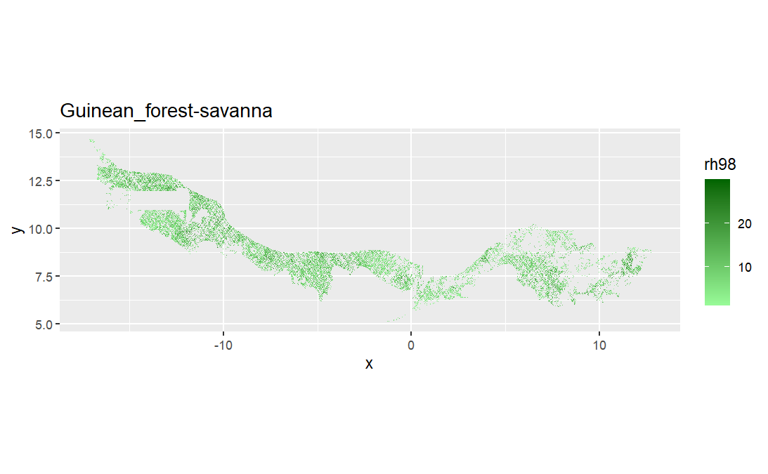
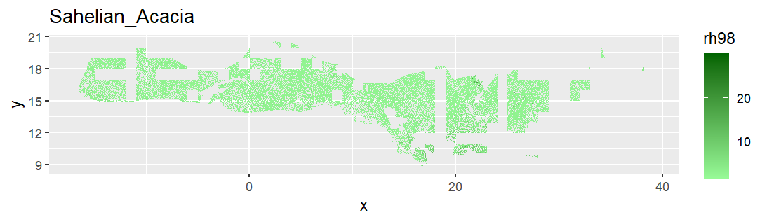
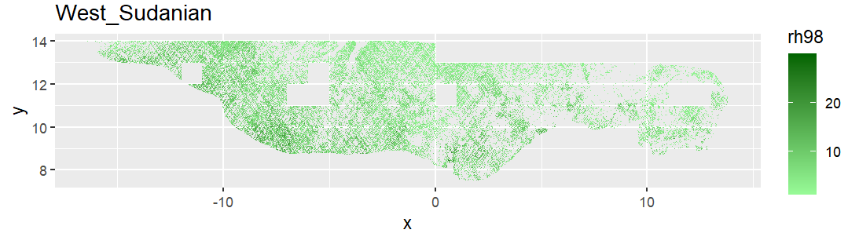
Guinean_forest-savanna
Sahelian_Acacia
West_Sudanian

Slide 9
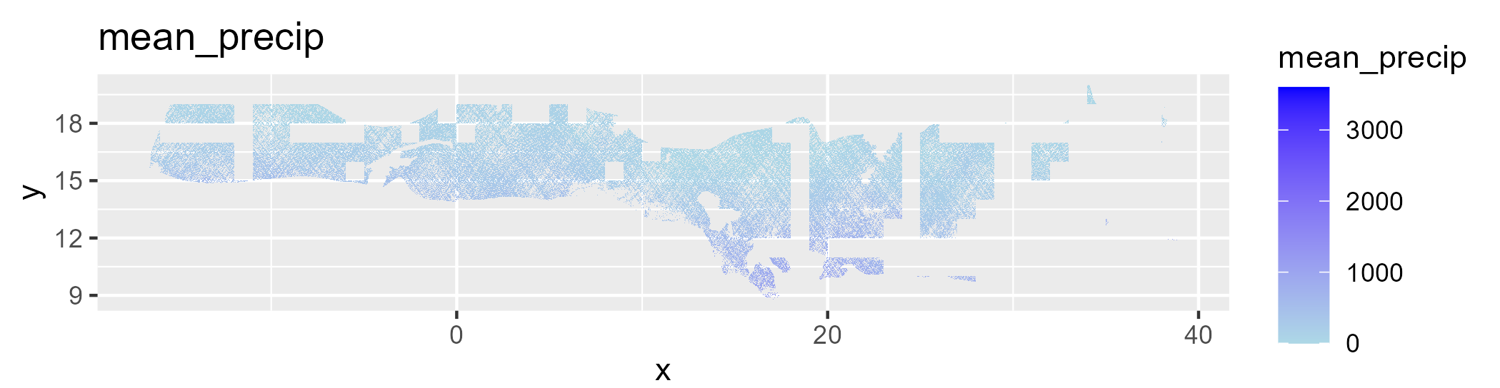
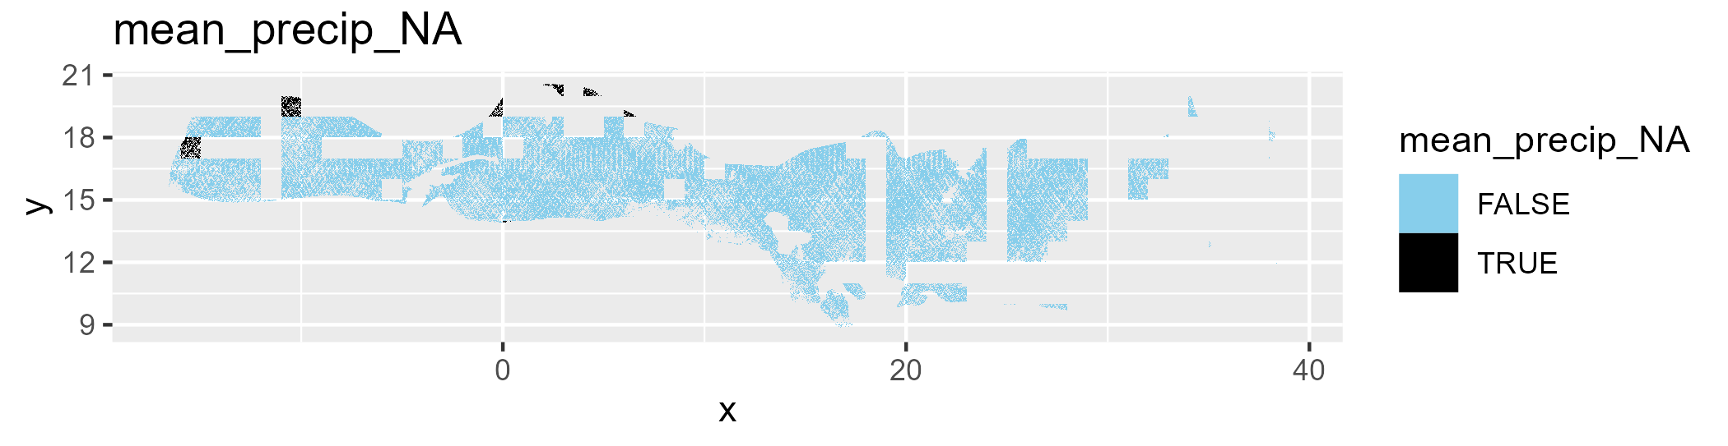
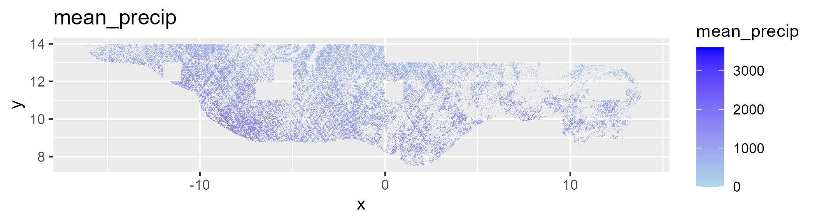
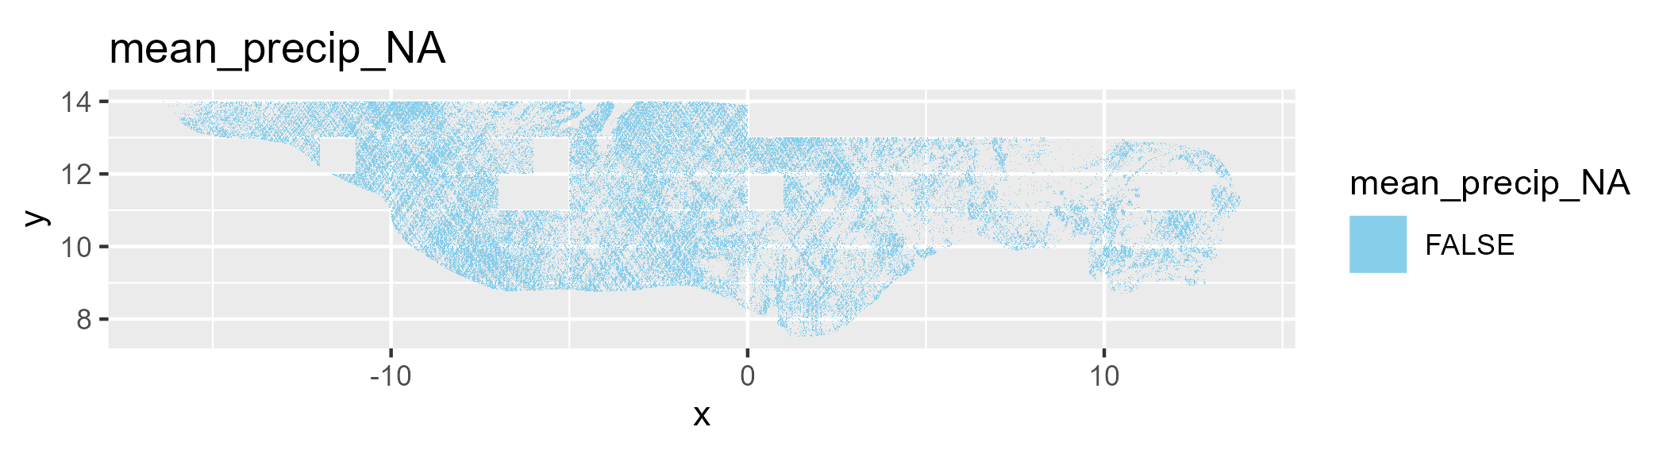
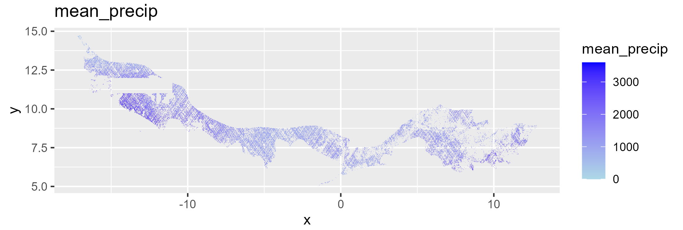
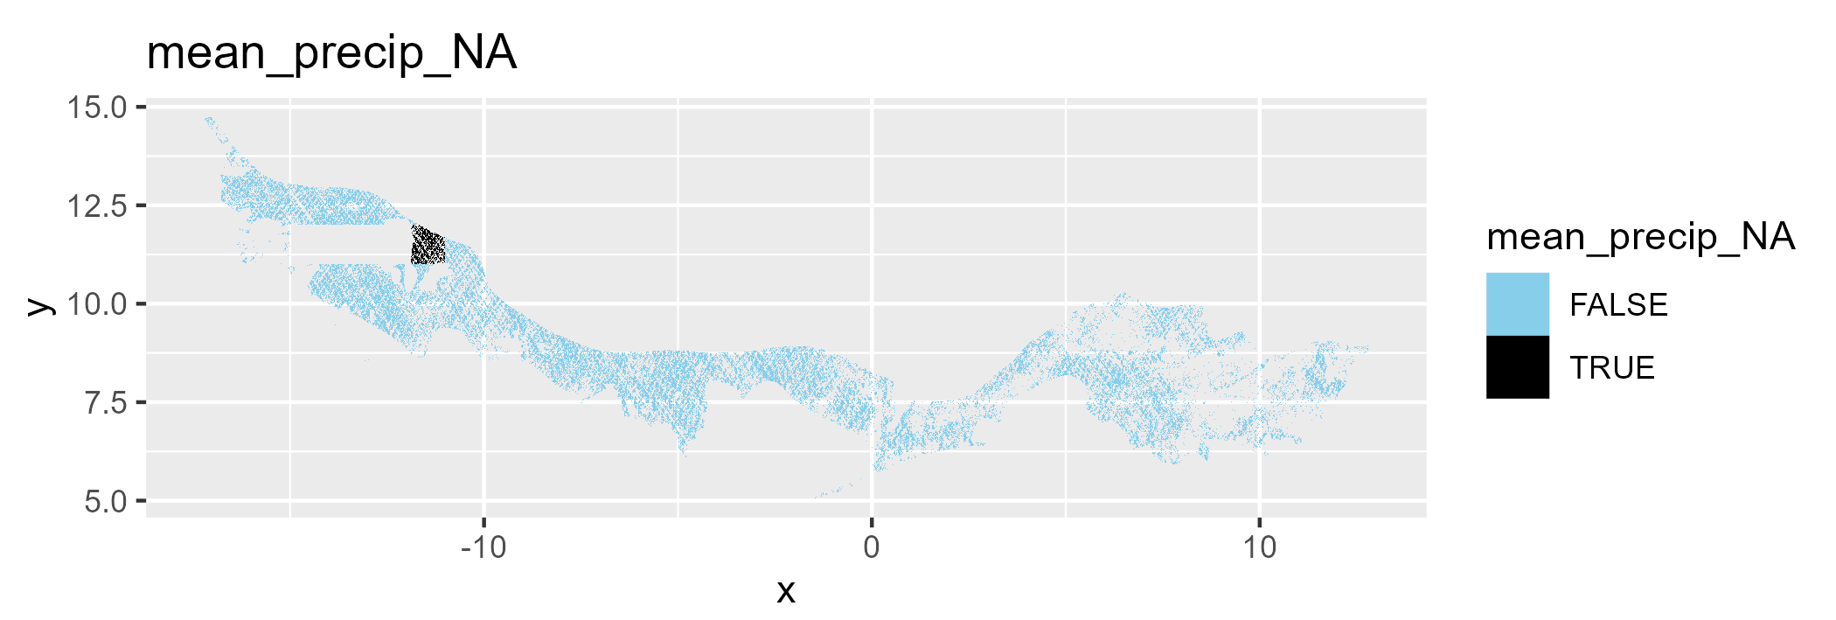
Sahelian_Acacia
Sahelian_Acacia
West_Sudanian
Guinean_forest-savanna

