Slide 1
The Effect of Covid-19 on Amazon Stock
Matusola Bein, Connor Chapman, Sam Holland and James Lamotte

Slide 2
Why we chose our data:

Slide 3
Questions
Describing the affect of new covid cases and deaths on AMZN volume and weighted average price, which time offset(s) have the strongest correlation (r-value)?

Slide 4
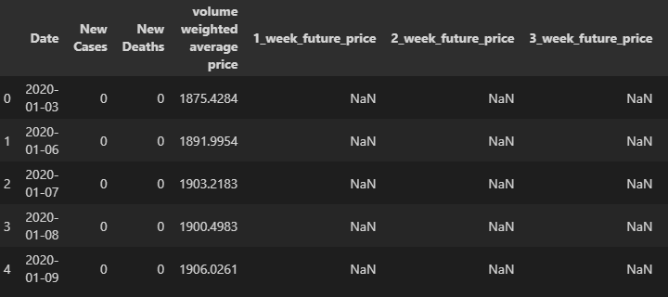
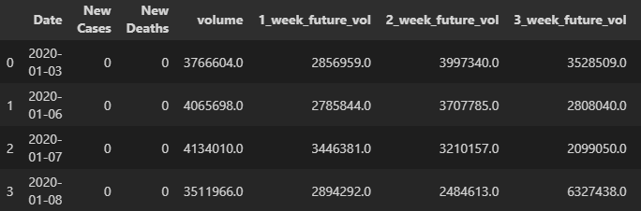
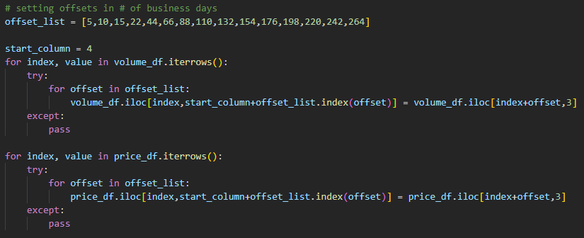
Data Cleaning: Creating time offsets

Slide 5
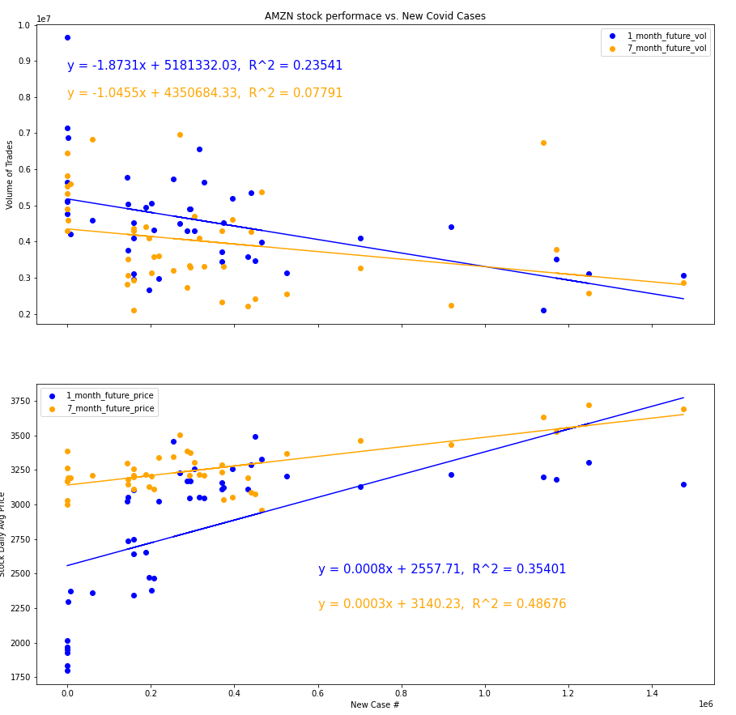
Figures

Slide 6
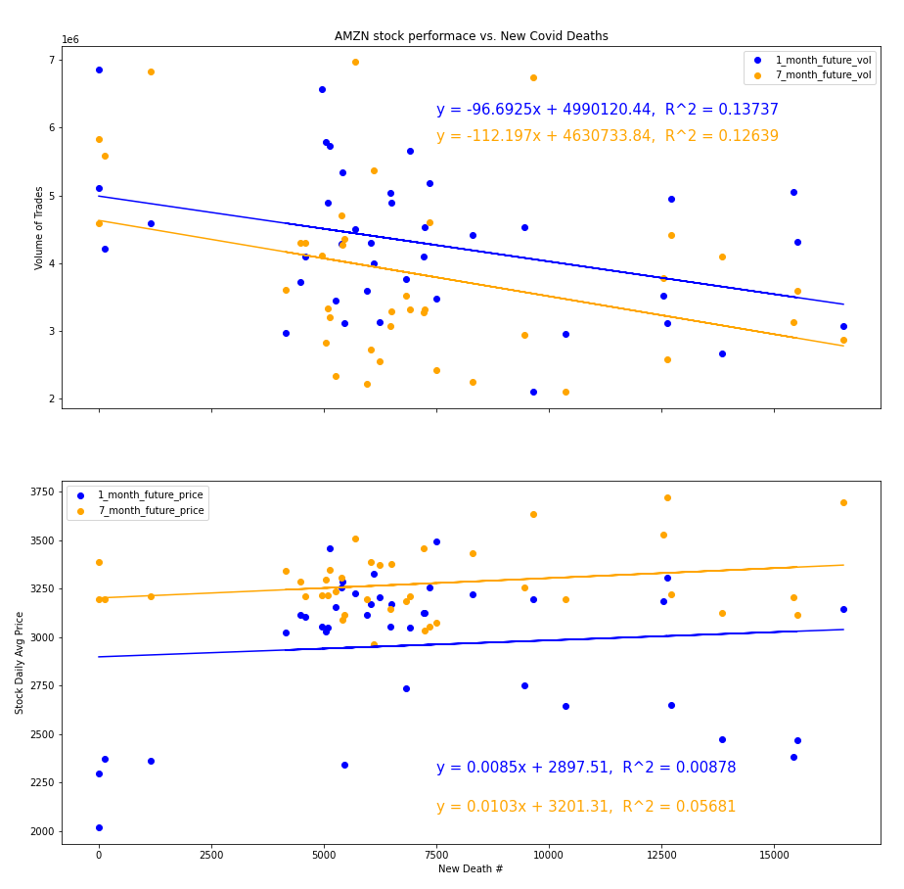

Slide 7
Next Steps for Further Analysis
Analyze more stock tickers, or index funds too
Data from other countries
Meta analysis of small vs. large business metrics during covid time period
Number of businesses (total, started, closed)
Statistics for people reported as “self-employed”
Algorithm to find highest slopes and r-squared values

Slide 8
Data Limitations
Amazon stock price (NASDAQ: AMZN) doesn’t have a direct relationship with growth of the fulfillment division of the business
AWS is a huge part of Amazon, largely affecting its stock price
Stock Price is more a function of investor perception than actual profits/revenue

