Slide 1
Project 1 Team 6 The Effect of Covid-19 on Amazon and Walmart Stock 11/14/2022
Participants involved:
Sam Holland
Matusola Bein
Connor Chapman
James LaMotte

Slide 2
Motivations and Summation
We found an article stating that Amazon profits increased 220% throughout the pandemic. We want to analyze weekly Covid cases versus Amazon stock data to see if there’s a correlation between increases in cases and rises in Amazon stock.
The questions we wanted answered were:
1. Did the release of the vaccine have a strong impact on the correlation on new covid cases and new covid deaths?
2. Did the stock values for Amazon fluctuate around the time of the first release of the Covid-19 vaccine?
3. Describing the effect of new covid cases and deaths on Amazon stock volume and weighted average price, which time offset(s) have the strongest correlation (r-value)?
4. How do the trends in Covid statistics and Walmart stock values compare?
Notes:
We asked this question when we discovered an article posted by The New York Times describing Amazon’s profits* and wanted to confirm such a change were possible through data analysis.
*See bibliography at end of presentation.

Slide 3
Covid counts before and after vaccine
Did the release of the vaccine have a strong impact on the correlation between new covid cases and new covid deaths?
We asked this question because we were interested in covid’s impact on Amazon’s stock over the course of the pandemic. This question specifically helped us get a baseline of covid data and how it changed before and after the vaccine.
To answer the question, we asked about whether covid cases and deaths were correlated, we needed to gather data about covid cases and deaths over time.
Notes:
We were able to answer this question satisfactorily and found that there was a stronger correlation between new cases and new deaths before the vaccine was released, with an r squared value of 0.62, as opposed to 0.26 after the vaccine was widely released.
This data was gathered from a CSV provided by WHO

Slide 4
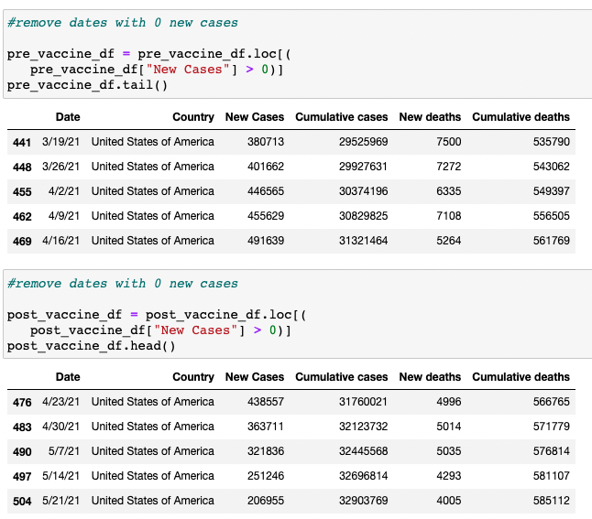
Data Cleanup & exploration
The data came as a CSV from who containing data about new covid cases, cumulative covid cases, new covid deaths, and cumulative covid deaths over the period of 2 years for all countries that reported it.
Notes:
The cleanup came by removing all countries except the USA
Also removing all rows that did not report new cases
New cases were only reported once a week in the US
Data was split by Date on 4/19/2021 as the established date as the wide release for the vaccine

Slide 5
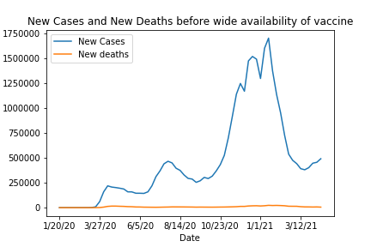
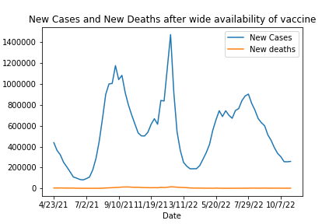
Data Analysis
The first steps to analyze the data was to make line plots comparing new covid cases and new covid deaths before and after the vaccine
Notes:
The number of cases skewed the y-axis so that new covid deaths was a straight line at the bottom and nothing of significance could be determined.

Slide 6
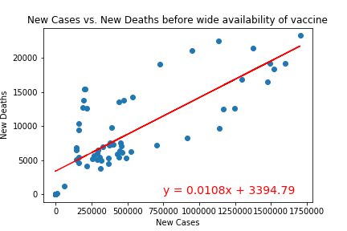
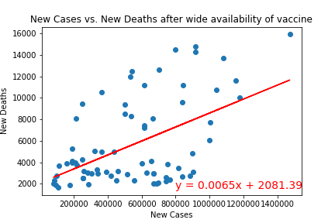
Data analysis cont.
After the line plots, scatter plots were created to determine if there was any correlation between covid cases and deaths before and after the vaccine.
Notes:
The r squared value was 0.62 before the vaccine and 0.26 after the wide release of the vaccine.

Slide 7
Covid Vaccine on Amazon stock
Did the stock values for Amazon fluctuate around the time of the first release of the Covid-19 vaccine?
For 2 years the coronavirus had persisted until the first vaccine was released on April 19, 2021. We wanted to see if there was a correlation between the release of the vaccine and the stock values for Amazon.
We monitored the stock values from the beginning of 2020, until the date of the vaccine release which became our time frame for the pre-vaccine period. Then we monitored the time frame from April 19th to the end of 2021 and had that as our post-vaccine period.

Slide 8
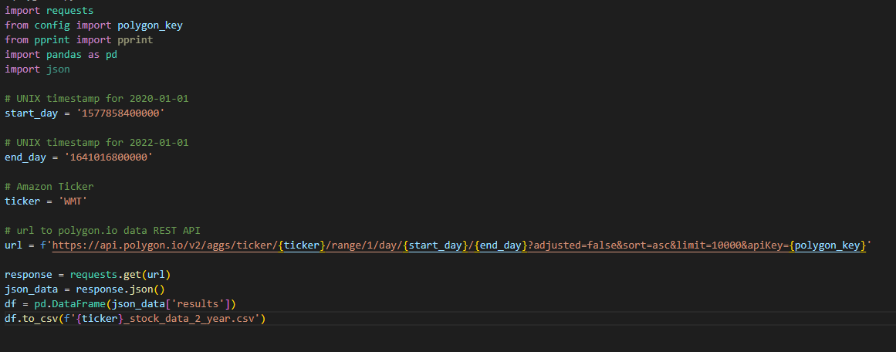
Amazon Data Source*
Notes:
*See bibliography

Slide 9
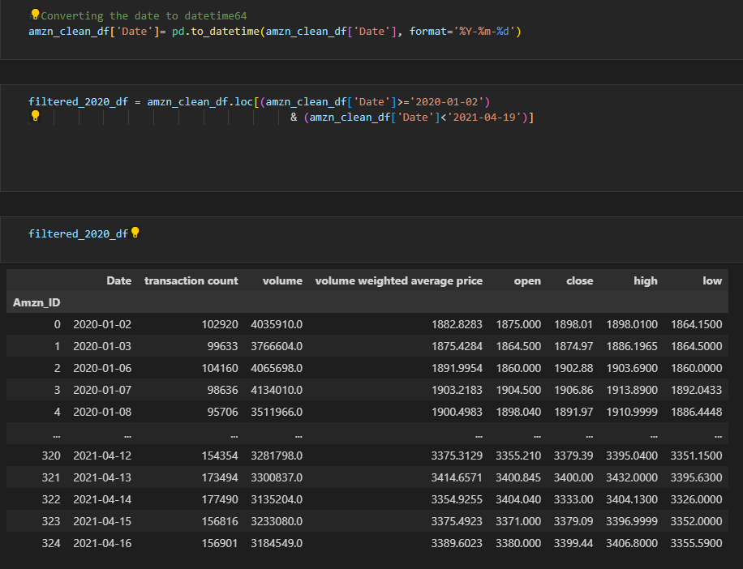
Cleaning the Data
The first portion of this was taking a cleaned csv file of the Amazon stock data which was pulled as an API, and we filtered this list for both the pre-vaccine and post-vaccine time frames separately.

Slide 10
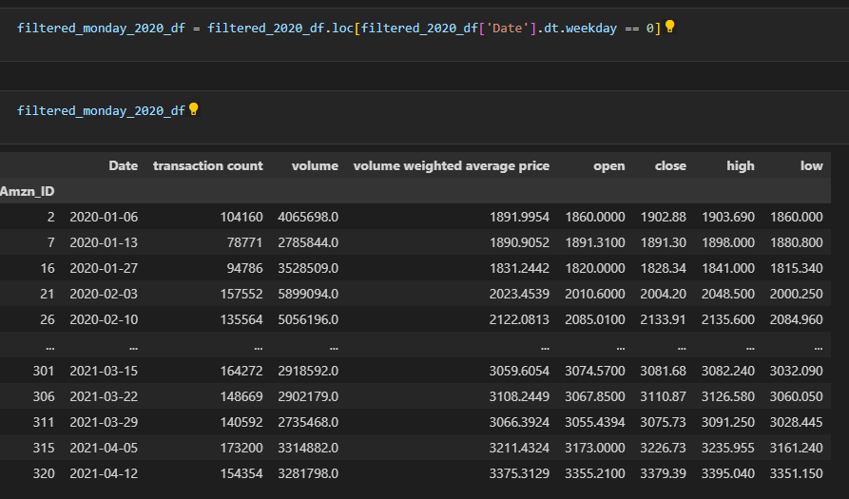
After partitioning the data by time frame, we filtered the list further to search for all Mondays through each time period. The WHO updated their infection/death list for the United States weekly on Monday.

Slide 11
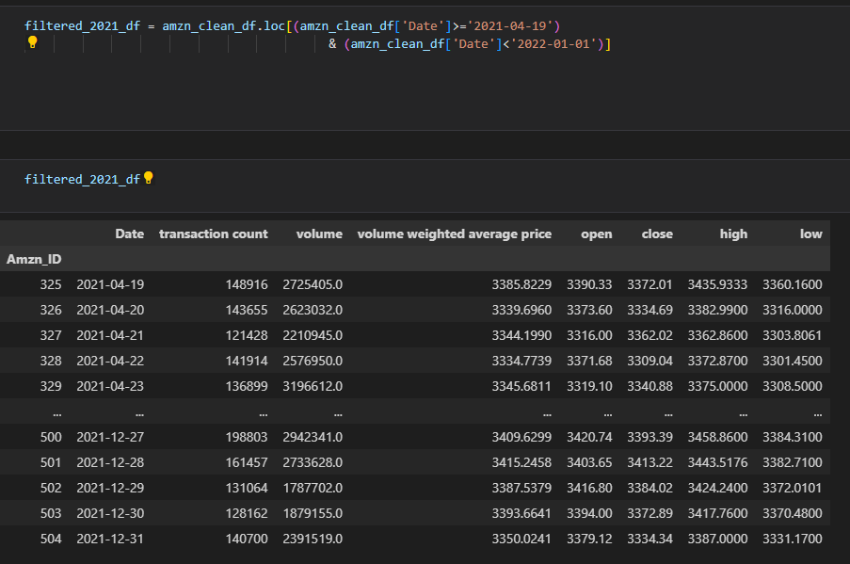

Slide 12
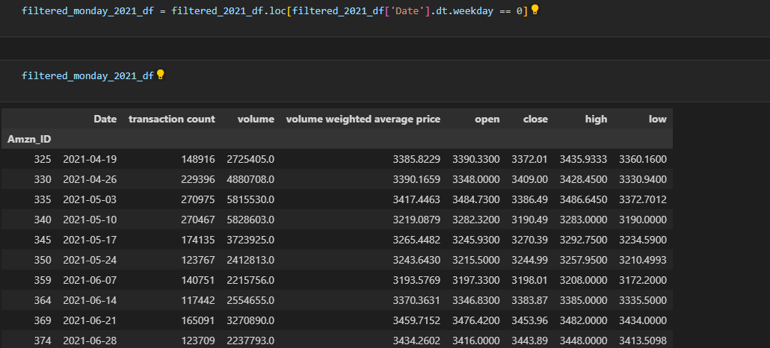

Slide 13
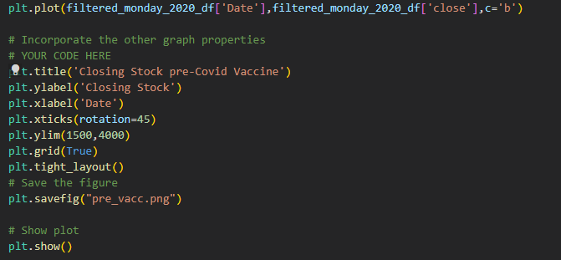
Data analysis
We intended to graph this data correlated over time on a line graph. This graph covered the Date and Closing Stock of Amazon.

Slide 14
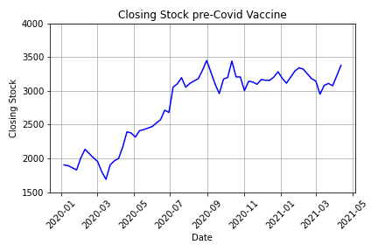
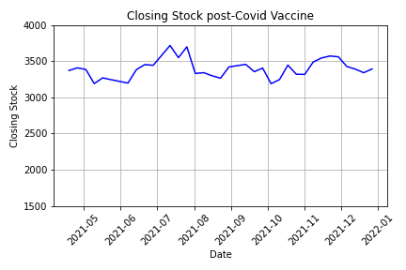
For the pre-vaccine portion of our time frame, we see a consistent climb in Amazon’s closing stock. Their stock nearly doubles by the time of the first vaccine release.
In the post-vaccine period, we see that their closing stock fluctuates over the period of the next 7 months before 2021’s closing.
By the end, their closing stock has remained unchanged from April’s.

Slide 15
question
Describing the effect of new covid cases and deaths on Amazon stock volume and weighted average price, which time offset(s) have the strongest correlation (r-value)?

Slide 16
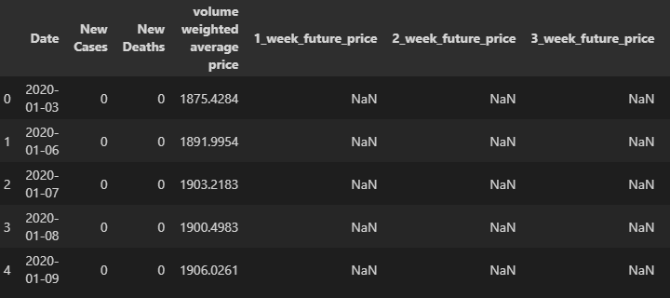
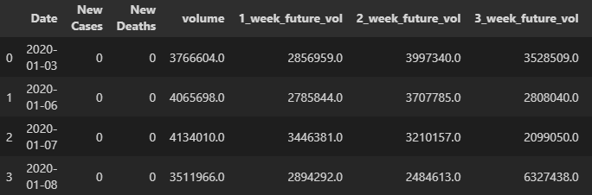
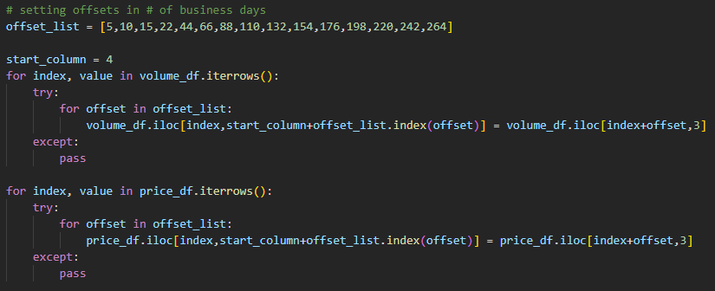
Data Cleaning: Creating time offsets

Slide 17
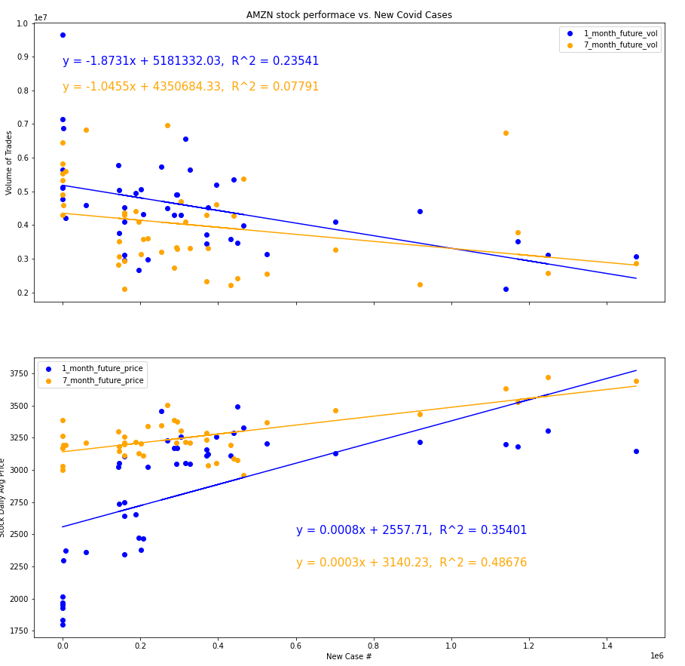
Figures

Slide 18
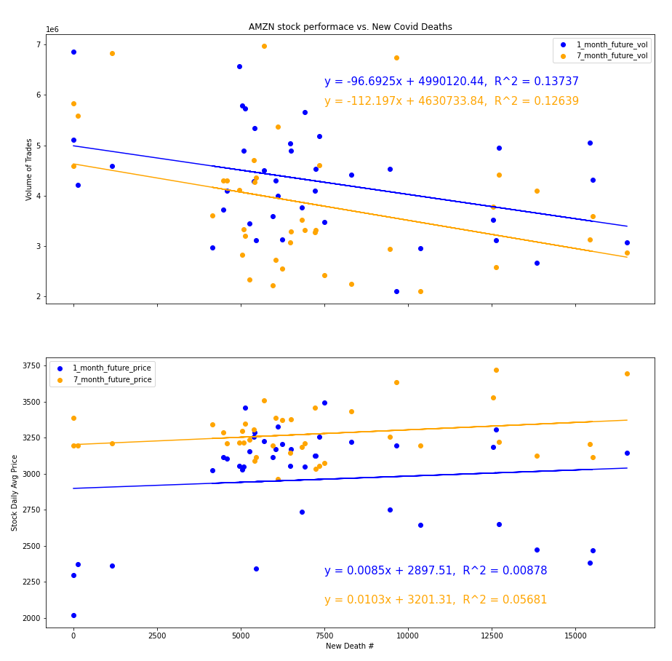

Slide 19
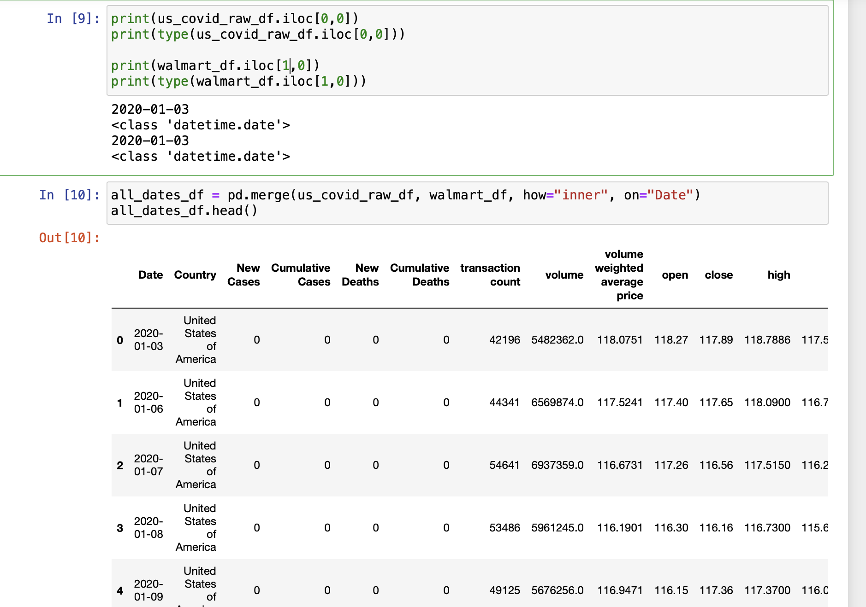
Walmart Comparison

Slide 20
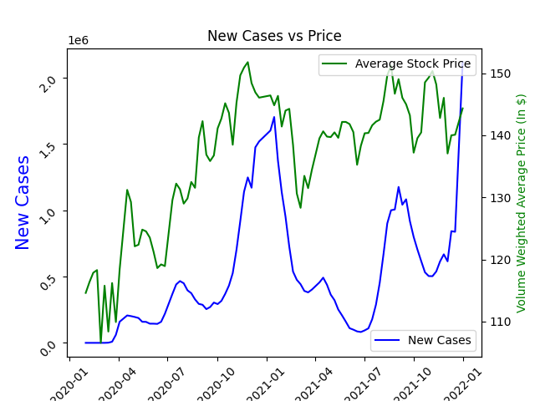
Figures

Slide 21
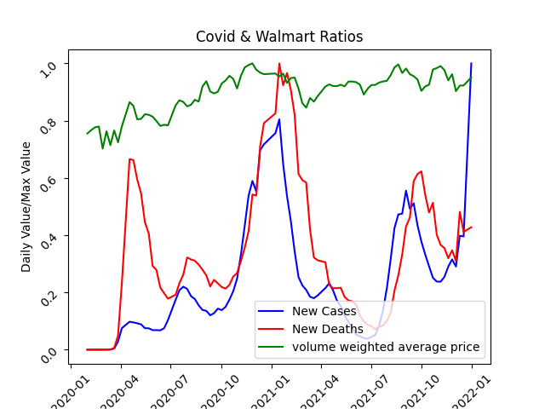

Slide 22
Next Steps for Further Analysis
Analyze more stock tickers, or index funds too
Data from other countries
Meta analysis of small vs. large business metrics during covid time period
Number of businesses (total, started, closed)
Statistics for people reported as “self-employed”
Algorithm to find highest slopes and r-squared values

Slide 23
Data Limitations
Amazon stock price (NASDAQ: AMZN) doesn’t have a direct relationship with growth of the fulfillment division of the business
AWS is a huge part of Amazon, largely affecting its stock price
Stock Price is more a function of investor perception than actual profits/revenue
The Amazon stock price list has gaps of missing entries in occasional periods of time. This may affect representation.
In the World Health Organization’s database, information was aggregated on a weekly basis. We could not find a database that had this information tallied daily.

Slide 24
Questions?

Slide 25
bibliography
“Amazon’s profit soars 220 percent as pandemic drives shopping online.” Karen Weise, The New York Times, https://www.nytimes.com/2021/04/29/technology/amazons-profits-triple.html. 04/29/2021
"Amazon Stock Data" Polygon.io, Polygon.io,
https://polygon.io/stocks. Accessed 11/2/2022
“Daily Cases and Deaths by Date Reported to WHO.” WHO Coronavirus (COVID-19) Dashboard|WHO Coronavirus(COVID-19) Dashboard With Vaccination Data, World Health Organization, https://covid19.who.int/data. Accessed 11/2/2022

