Slide 1
QDocs
Design and Implementation of Mobile Application
Academic Year: 2018/2019
Authors: Lamparelli Andrea 894005 (andrea.lamparelli@mail.polimi.it)
Chittò Pietro 899045 (pietro.chitto@mail.polimi.it)

Slide 2
Outline
QDocs description
Overall Architecture
Mobile Application Architecture
User Interface Design
Testing

Slide 3
QDocs Description

Slide 4



What the app was designed for?
Provide a cloud-storage file system
Introduce a new file access mechanism adopting a now widespread code scanning mechanism
Keep paper documents (or physical devices) and online documents connected

Slide 5
Usage Example
Suppose a student who wants to extend his notes with some digital articles or some digital book pages
He can upload the digital file (e.g. pdf) on the system, print the generated QR code on his paper notes
Now he can, when studying, directly open the digital article, without spending time to find it, but simply scanning the QR code

Slide 6
Overall Architecture

Slide 7
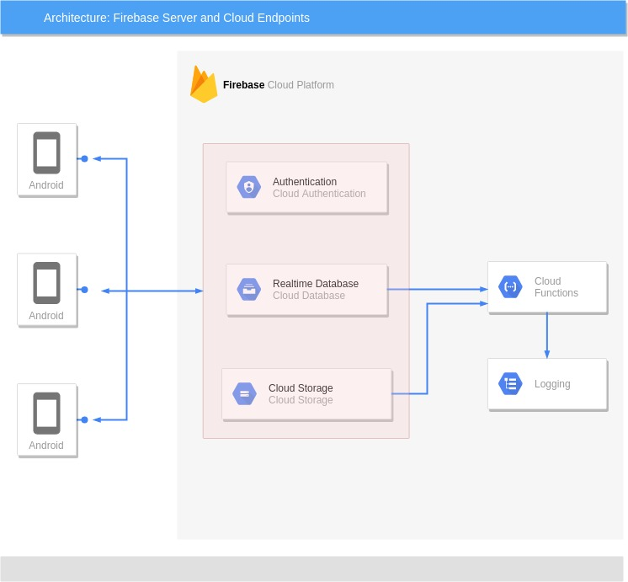
What is the system architecture?
Client - Server architecture

Slide 8






External Services
Authentication: Google, Facebook and Firebase Auth
Storage: Cloud Storage for Firebase
Database: Firebase Realtime Database
Backend Logic: Cloud Functions for Firebase

Slide 9
Mobile Application Architecture
QDocs

Slide 10
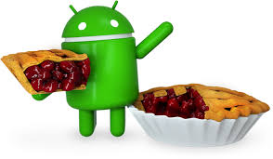

Settings
targetSdkVersion = 28
minSdkVersion = 23
Approximate devices coverage of 62.6%

Slide 11
Permissions
TYPE REASON
Camera
Write external storage
Read external storage
Internet
Qr-code scan
Save files offline
Retrieve offline files
Is connectoin available?

Slide 12
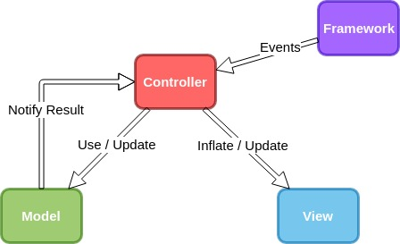
Design : FMVC
Framework, Android OS
Model, Business logic
View, Static user interfaces
Controller, Handle events and update UI

Slide 13
Example: right-side task auction
P1
W
P2
Offer 9!

Slide 14
Example: tasks execution
3 sec.
P1
W
P2

Slide 15
Example: renewal
P1
Renewal!
W
P2

Slide 16
Example: acknowledgement
Ack!
P1
W
P2
Ack!

Slide 17
Example: robot-failure
P1
W
P2

Slide 18
Example: single-task execution
P1
W
Under maintenance!
P2

Slide 19
Example: single-task execution
P1
W
Under maintenance!
P2

Slide 20
Example: right-side task auction first
Offer 5!
P1
Under maintenance!
W
P2
New tasks!

Slide 21
Example: right-side task execution
P1
Under maintenance!
W
P2

Slide 22
Example: new task allocation
New tasks!
Come back!
W
P2
P1

Slide 23
Example: new task allocation
Offer 8!
W
P2
P1
Offer 4!

Slide 24
Example: some steps later..
W
P2
GOAL REACHED!
P1

Slide 25
Conclusion
PROS & CONS

Slide 26


Conclusion
PROS
CONS
Overcome some communication problem
Overcome robot-failure problem
Reactivity to dynamic changes in the environment
Acts as an instantaneous greedy task scheduler
Strictly dependence on robot’s sensor data (computing fitness)
Unable to achieve some tasks

