Slide 1
QDocs
Design and Implementation of Mobile Application
Academic Year: 2018/2019
Authors: Lamparelli Andrea 894005 (andrea.lamparelli@mail.polimi.it)
Chittò Pietro 899045 (pietro.chitto@mail.polimi.it)

Slide 2
Outline
QDocs description
Overall Architecture
Mobile Application Architecture
User Interface Design
Testing
Lamparelli Andrea, Chittò Pietro

Slide 3
QDocs Description

Slide 4



What the app was designed for?
Provide a cloud-storage file system
Introduce a new file access mechanism adopting a now widespread code scanning mechanism
Keep paper documents (or physical devices) and online documents connected
Lamparelli Andrea, Chittò Pietro

Slide 5
Usage Example
Suppose a student who wants to extend his notes with some digital articles or some digital book pages
He can upload the digital file (e.g. pdf) on the system, print the generated QR code on his paper notes
Now he can, when studying, directly open the digital article, without spending time to find it, but simply scanning the QR code
Lamparelli Andrea, Chittò Pietro

Slide 6
Overall Architecture

Slide 7
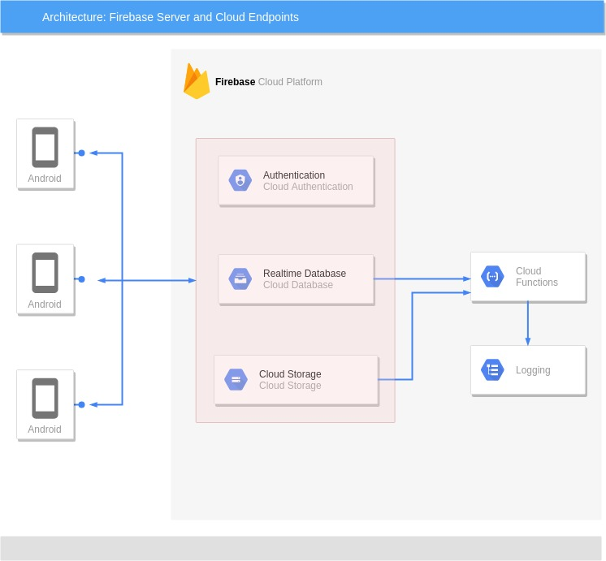
What is the system architecture?
Client - Server architecture
Lamparelli Andrea, Chittò Pietro

Slide 8






External Services
Authentication: Google, Facebook and Firebase Auth
Storage: Cloud Storage for Firebase
Database: Firebase Realtime Database
Backend Logic: Cloud Functions for Firebase
Lamparelli Andrea, Chittò Pietro

Slide 9
Mobile Application Architecture

Slide 10
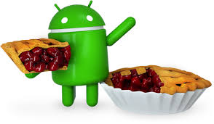

Settings
Target Sdk Version = 28
Minimum Sdk Version = 23
Supported languages: English, Italian
Approximate devices coverage of 62.6%
Lamparelli Andrea, Chittò Pietro

Slide 11
Permissions
PERMISSION REASON
Camera
Write external storage
Read external storage
Internet
QR-code scan
Save files offline
Retrieve offline files
Is connection available?
Lamparelli Andrea, Chittò Pietro

Slide 12
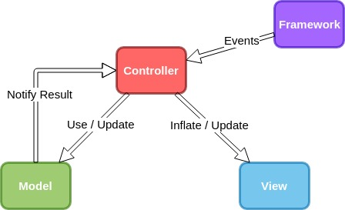
Design : FMVC
Framework, Android OS
Model, Business logic
View, Static user interfaces
Controller, Handle events and update UI
Lamparelli Andrea, Chittò Pietro

Slide 13
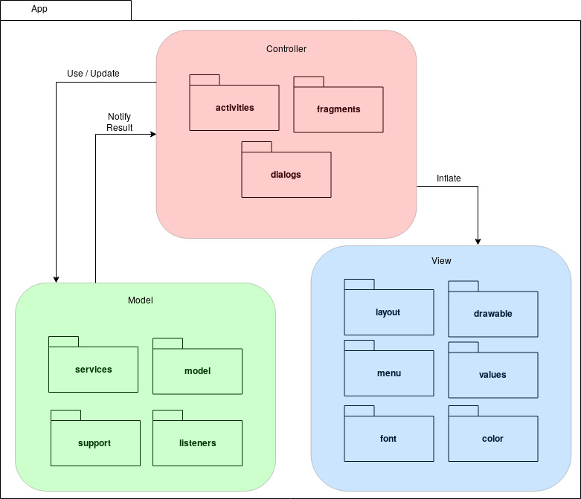
Packages organization
Lamparelli Andrea, Chittò Pietro

Slide 14
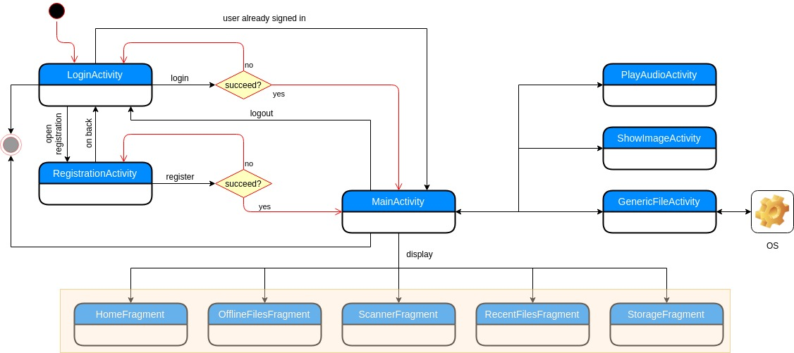
Activities Flowchart
Lamparelli Andrea, Chittò Pietro

Slide 15
Activities Flowchart
Authentication
Lamparelli Andrea, Chittò Pietro

Slide 16
Activities Flowchart
Storage Scanning
Lamparelli Andrea, Chittò Pietro

Slide 17
Activities Flowchart
File Opening
Lamparelli Andrea, Chittò Pietro

Slide 18
User Interface Design

Slide 19
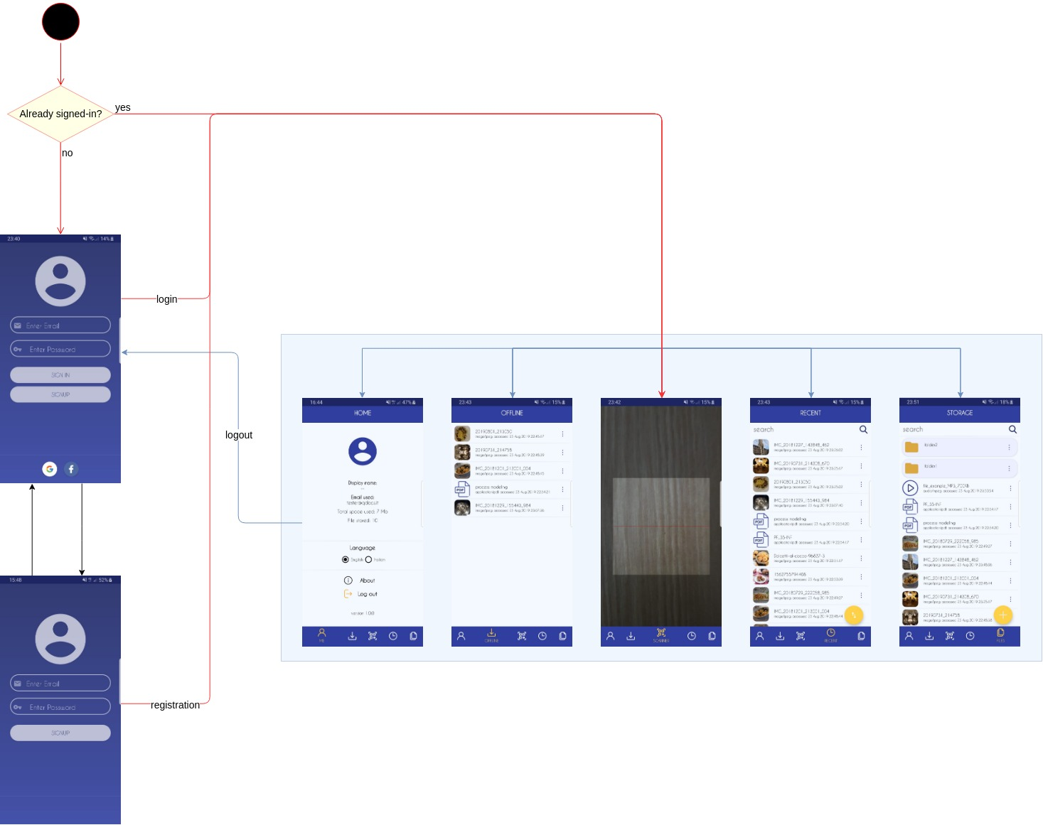
Application Start UI Design
Checks whether a user is already signed-in or not
Lamparelli Andrea, Chittò Pietro

Slide 20
Application Start UI Design
If yes, open scanner
If no, open login
Lamparelli Andrea, Chittò Pietro

Slide 21
Application Start UI Design
Users can switch among these screens as they want
User can switch between registration and login
From home page, user can logout from the system
Lamparelli Andrea, Chittò Pietro

Slide 22
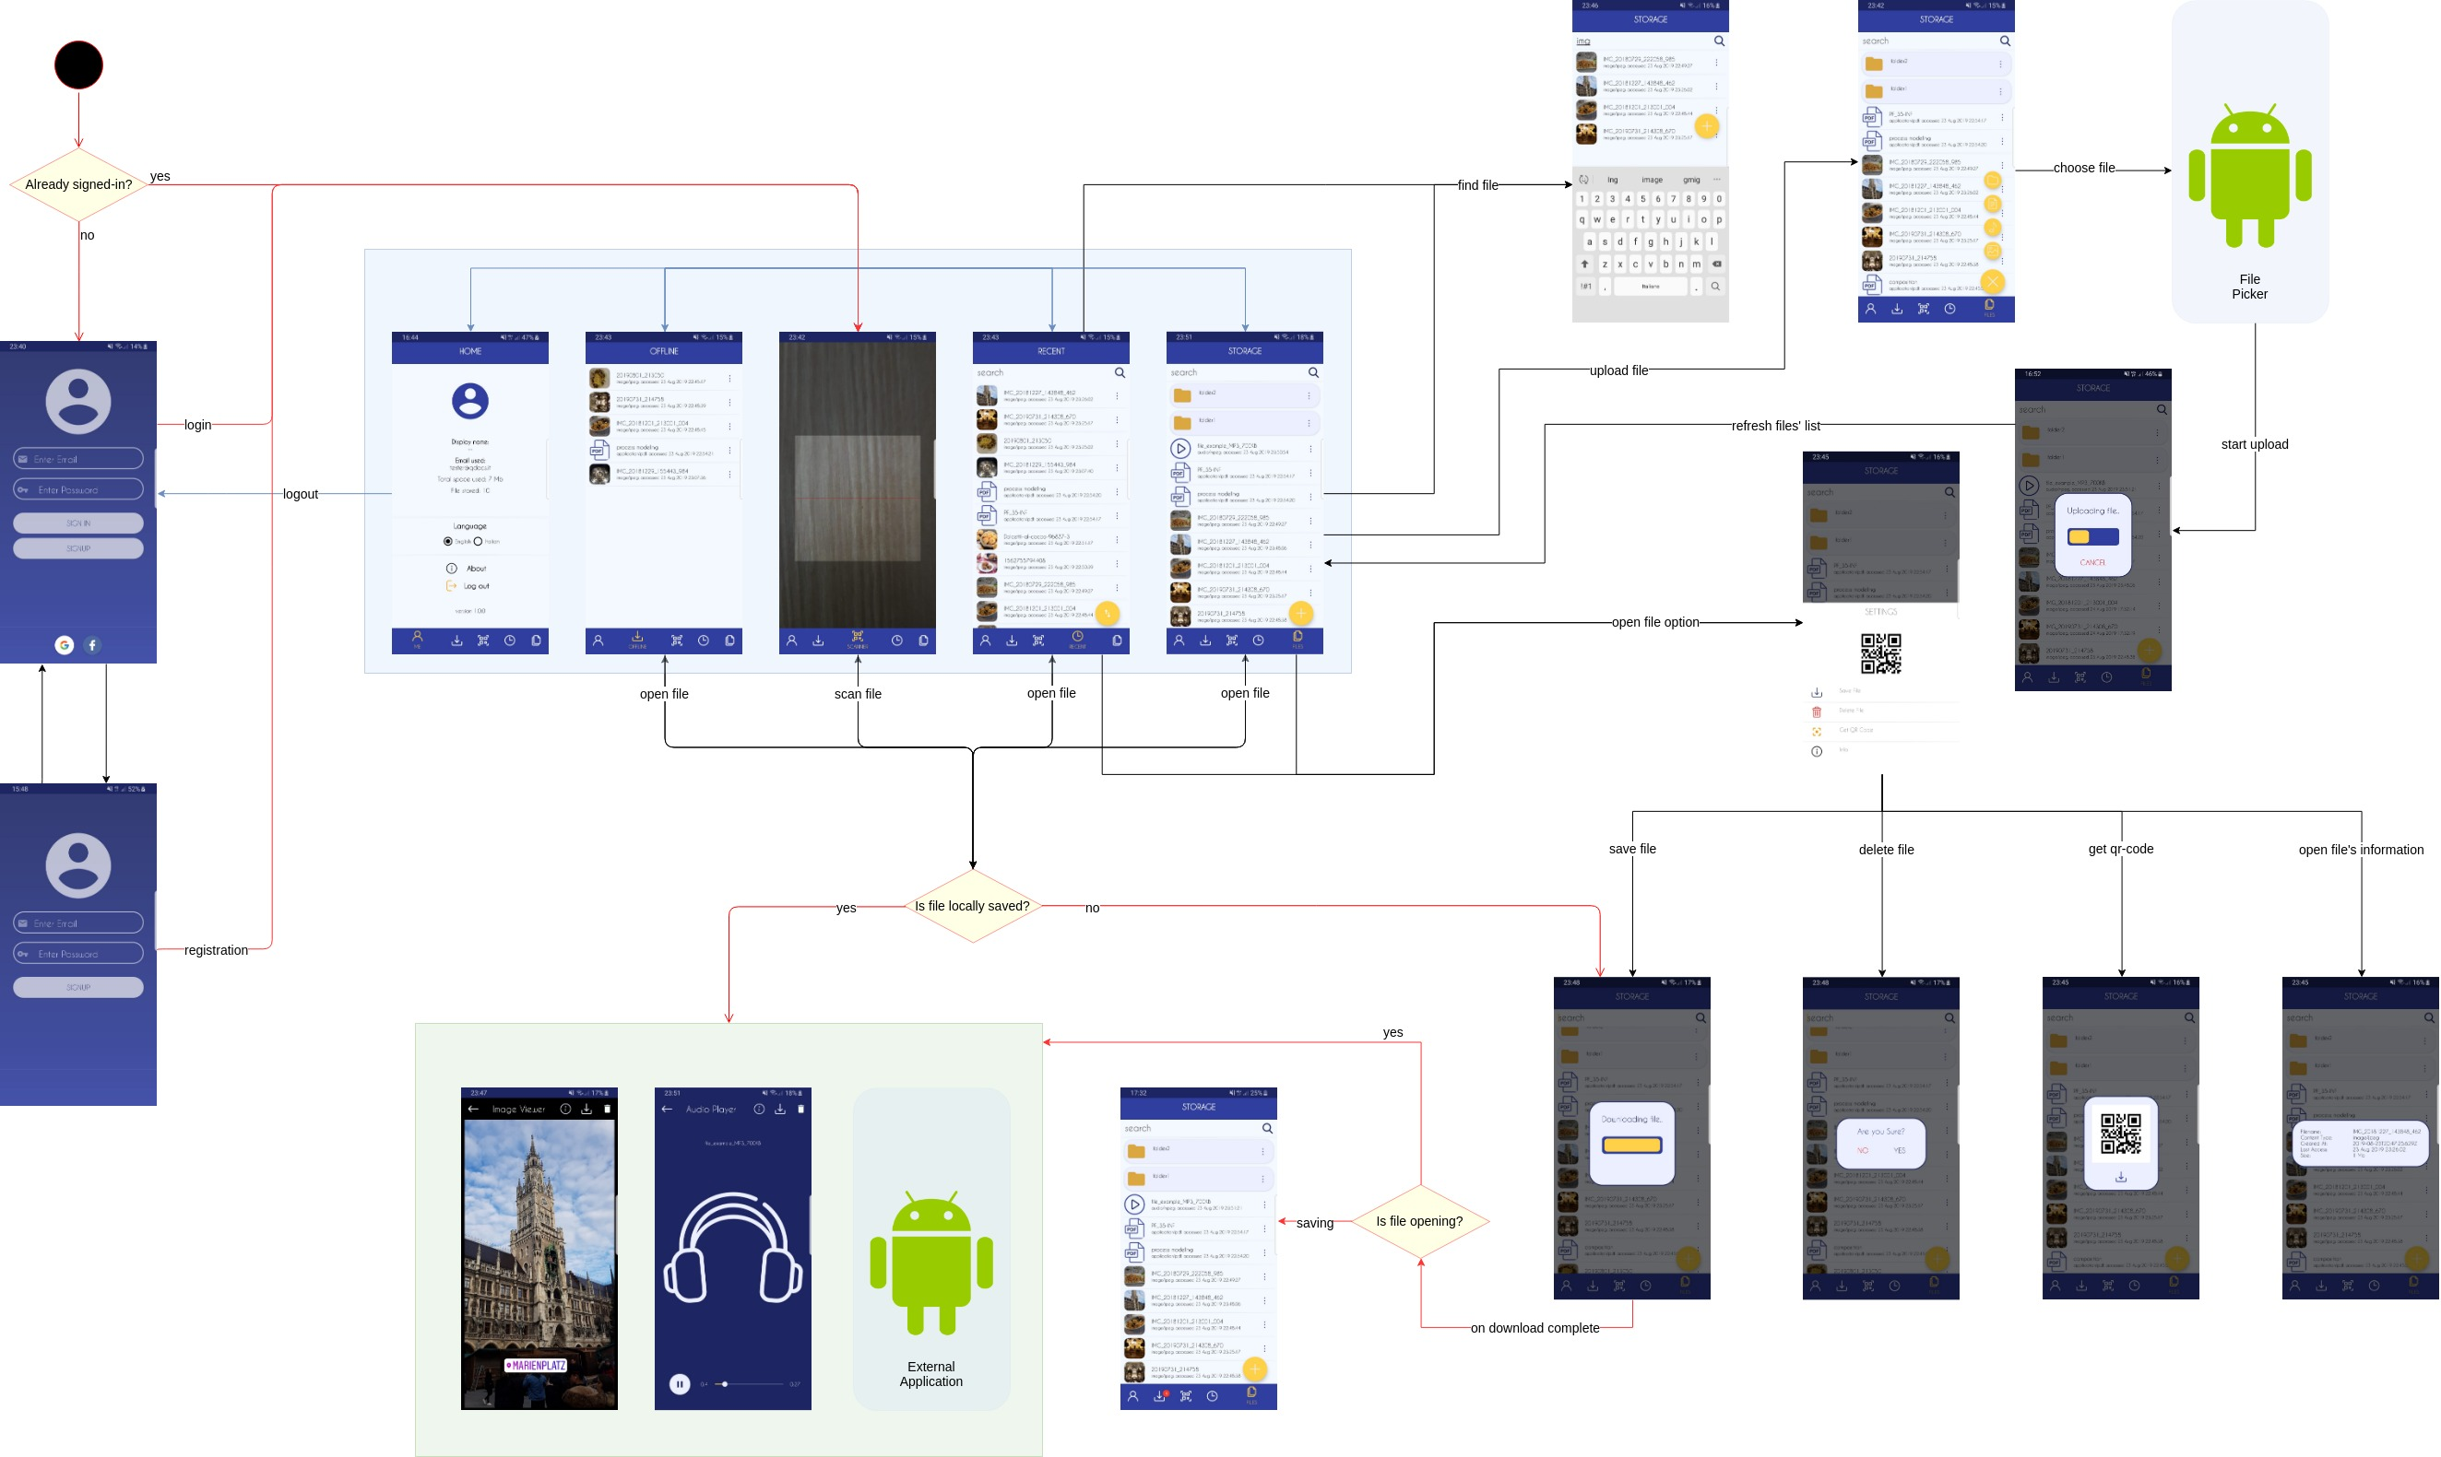
Complete UI Design
Lamparelli Andrea, Chittò Pietro

Slide 23
Testing

Slide 24
Unit Test
Local tests: used to test local classes functionalities
Tools: JUnit4 and PoweredMockito
Classes: MyFile, MyDirectory, StorageElement, Utility
Lamparelli Andrea, Chittò Pietro

Slide 25
Instrumentation Test
UI tests: used to test graphical aspects of the user interfaces
Tools: Espresso, Espresso Recorder and Firebase Test Lab
Classes: RegistrationActivity, LoginActivity, MainActivity and StorageFragment
Lamparelli Andrea, Chittò Pietro

