Slide 1
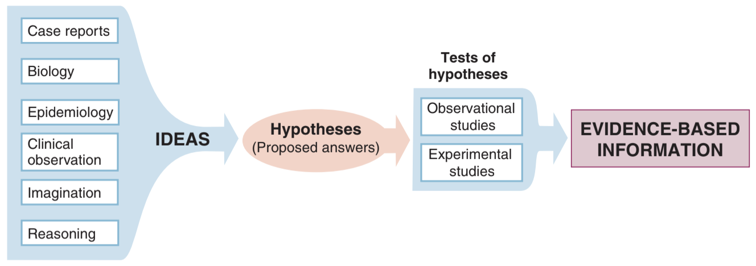
@fletcher_clinical_2014

