Slide 1
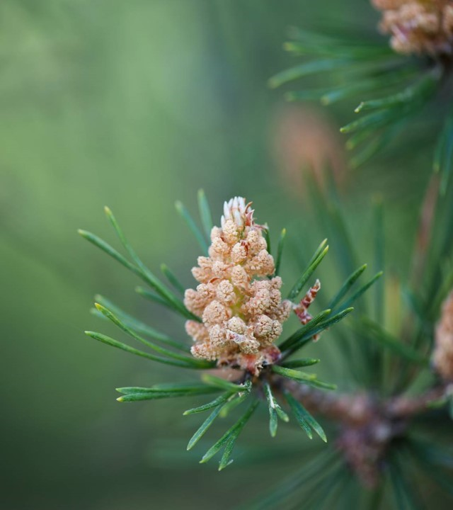
Biodiversity in The national parks of USA

Slide 2
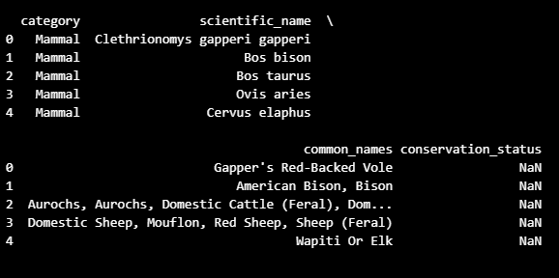
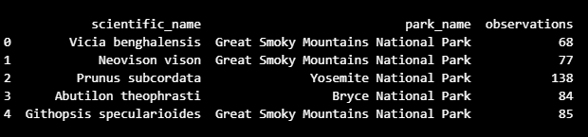
DATA
We looked at the two main datasets:
1) species.csv
category
scientific name
common names
conservation status
2) observations.csv
scientific name
park name (4 parks)
observations

Slide 3
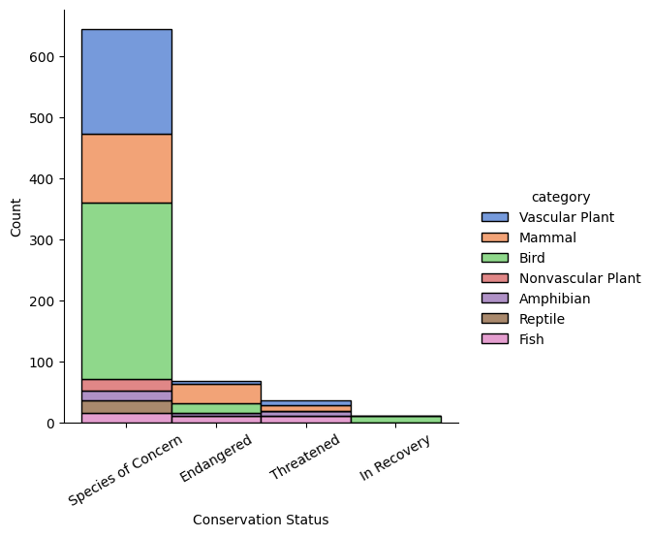
The findings
Top categories of concern: birds and mammals.
Top most observed category: Vascular plants

Slide 4
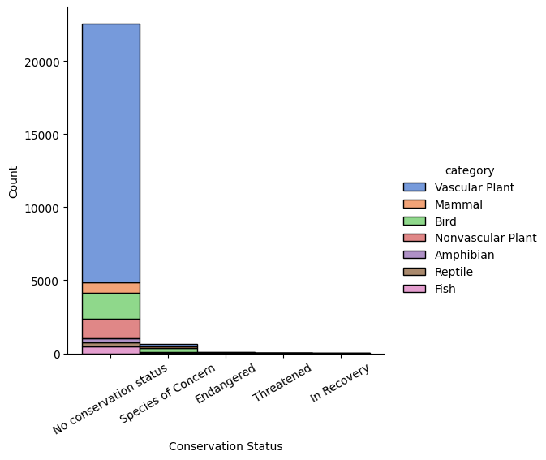
Problem
Most of observed animals have no conservation status in the data.
Does it mean, that they are not endangered or that it is not known how endangered are they?

Slide 5
Thank you

