Slide 1

Extending Search Engines with Synonyms
Lampros Lountzis

Slide 2
Table of Contents
INTRODUCTION
The problem
Challenges deep-dive
SEARCH ENGINE
Data and IR system
IR system architecture
Query extension methods
RESULTS
Results
Discussion
DEMO

Slide 3
INTRODUCTION

Slide 4

The problem
Problem statement
Context
To answer users’ questions as precisely as possible, we should examine their queries from many perspectives!
When we search for something on the web, we usually give keywords or a description of what we want to find.
But that’s not always the case! There are times when we’re careless of the words we choose to use in our searches, ambiguous, or even indifferent of the vocabulary we use.
Query expansion is a method which consists of adding terms to the user’s query.
Thesaurus is a collection of synonyms and sometimes antonyms of words.
Embeddings are vectors that encode the meaning of words such that words that are close in the vector space have similar meaning.
Synonymity is the semantic relation that holds between two words that can express the same meaning.

Slide 5
Challenges deep-dive
Challenge 1
Challenge 2
Challenge 3
User language & data
What kind of language should we be able to handle (formal or everyday vocabulary) ?
How can we handle terms that have a different meaning based on context ?
Is the search engine topic specific or is it a general-purpose IR system ?
Query extension method
The method is heavily dependent on the users’ queries and the data.
What kind of information should be included in a thesaurus or the embeddings (e.g., formal terms, abbreviations) ?
How big the thesaurus or the embeddings should be ?
Performance
The IR system’s performance is dependent on the method used to extend the queries.
Can the volume of the thesaurus or the embeddings impact the system’s performance ?
How quickly can we deliver results ?
The method used should not cause system degradation!

Slide 6
SEARCH ENGINE

Slide 7
Data and IR system
The Information Retrieval system (search engine) was created using the Apache Lucene library, in Java.
We’re using the CISI corpus (by the Information Retrieval Group of University of Glasgow) which consists of text data about 1,460 documents and 112 associated queries.
From the documents and queries we only keep the ID, the title and the abstract fields.
The documents have two searchable fields: the title and the abstract. Thus, we perform multifield document retrieval based on the fields mentioned above.
The data initially are cleaned by:
removing symbols and
lowercasing the text (optional).
Further analysis on data is carried by the EnglishAnalayzer, which:
tokenizes the text based on grammar (implements Word Break rules from Unicode Text Segmentation algorithm),
removes possessives from words and stopwords,

Slide 8
Data and IR system
lowercases the text,
stems the text using the Porter stemming algorithm.
Especially at query time, the EnglishAnalayzer is extended to handle query expansion with synonyms, either by using a thesaurus or word embeddings.
For query-document similarity and scoring we are using Okapi BM25 Similarity, which is state-of-the-art in probabilistic information retrieval.
To evaluate our IR system, we have used the trec_eval tool and its metrics.
Specifically, the search engine is evaluated on the top k retrieved documents, and we consider the following metrics:
precision,
recall,
mean average precision (MAP).

Slide 9
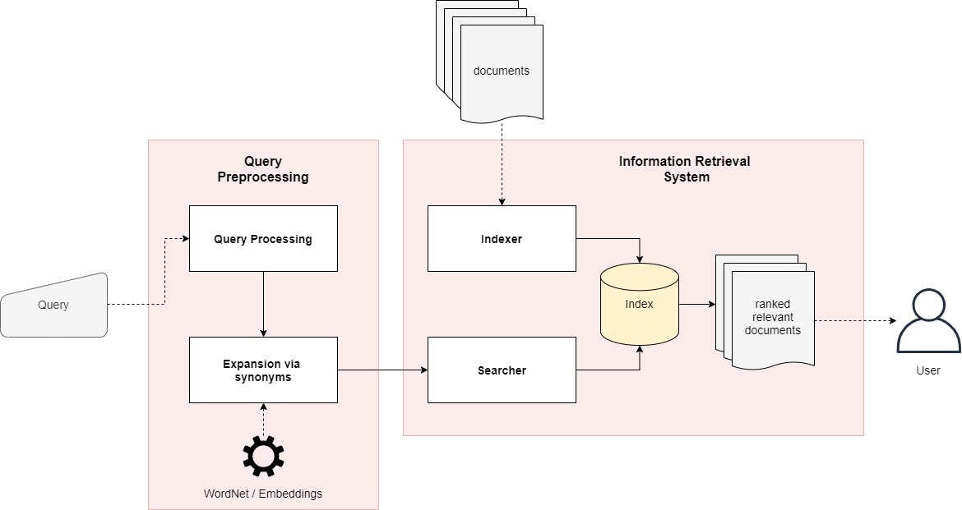
IR system architecture

Slide 10
Query extension methods
To capture the meaning of the user’s query, we’ll expand it using the synonyms of the terms included. The new query will be a conjunction of the initial terms and their synonyms.
Two methods are going to be used:
expansion through a thesaurus,
expansion through embeddings.
Thesaurus:
We’ll use WordNet which is a lexical database in which nouns, verbs, adjectives and adverbs are grouped into sets of cognitive synonyms (synsets), each expressing a distinct concept.
Synsets are interlinked by means of conceptual-semantic and lexical relations.
Embeddings:
We’ll use fastText which is an open-source library that allows to learn text representations and text classifiers.
The pre-trained word vectors used are wiki-news-300d-1M.vec.
Synonym terms are close in the vector space, so we’ll choose terms that minimize the cosine distance.
Thus, a similarity threshold of 0.98 has been chosen.

Slide 11
RESULTS

Slide 12
Results
 | Baseline |  |  | WordNet |  |  | Embeddings
 | k = 20 | k = 30 | k = 50 | k = 20 | k = 30 | k = 50 | k = 20 | k = 30 | k = 50
MAP | 0.1018 | 0.1157 | 0.1343 | 0.0617 | 0.0696 | 0.0809 | 0.1004 | 0.1143 | 0.1331
Precision @ k | 0.2638 | 0.2320 | 0.1924 | 0.1796 | 0.1632 | 0.1426 | 0.2579 | 0.2276 | 0.1913
Recall @ k | 0.1816 | 0.2392 | 0.3090 | 0.1332 | 0.1669 | 0.2283 | 0.1663 | 0.2336 | 0.3081

Slide 13
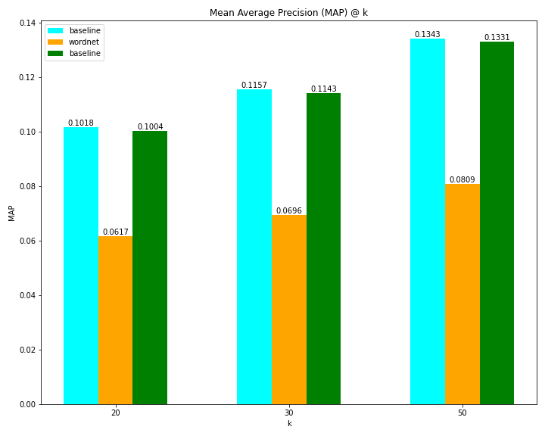
Results

Slide 14
Discussion
To begin with, as the number of top retrieved documents increases, precision decreases. This is because more irrelevant documents (lesser relevancy value with respect to the query) are retrieved.
Since precision decreases, recall increases, because these two measures are inversely proportional.
Also, the mean average precision increases while k (number of top retrieved documents) increases. That is because there are more true positives (relevant documents with respect to the query) leading the set of retrieved documents. One could say that the sorting by the similarity function is better.
We expected that our IR-system extended with synonyms would have a greater performance. However, it performs poorly 😥 Why?
Query expansion is often effective in decreasing precision. More documents are retrieved due to synonym terms, However not all of them have a high relevancy value.
To add, mean average precision is decreased since the true positives are lesser.
One thing we can clearly observe is that the use of WordNet has made our search engine perform worse than our baseline model. What we can speculate is that the use of every synonym for each term acts as noise during retrieval. Also, thesauri and dictionaries give far too little coverage of the rich domain-particular vocabularies of most scientific fields We could do, is make use of a domain specific thesaurus.

Slide 15
Discussion
Contrary to WordNet, the IR-system that leverages word embeddings seems to be perform as great as the baseline model. One reason, is that we have set a threshold to the selection of the synonyms (0.98 similarity and above) and thus we get rid of terms that have lost the initial meaning (noise). Another reason, is that fastText word embeddings contain more terms (1M terms) than a thesaurus. They contain everyday vocabulary, more scientific terms, etc. so it guaranteed that most query terms will have close synonyms. In general, building word embeddings (e.g. with Word2Vec) is easier than building a thesaurus or dictionary since it requires constant update and manual creation of relationships (synonymity, antonymy).
Overall, query expansion through synonyms was less successful.
Ideas and further discussion:
One way we could understand the users’ queries better could be if through users’ feedback.
Relevance feedback, is a feature of some IR-systems and the idea behind it is to take the results that are initially returned from a given query, to gather the user feedback, and to use information about whether those results are relevant to perform a new query.
There are three types of feedback: explicit feedback, implicit feedback and pseudo-feedback.

Slide 16
DEMO

Slide 17
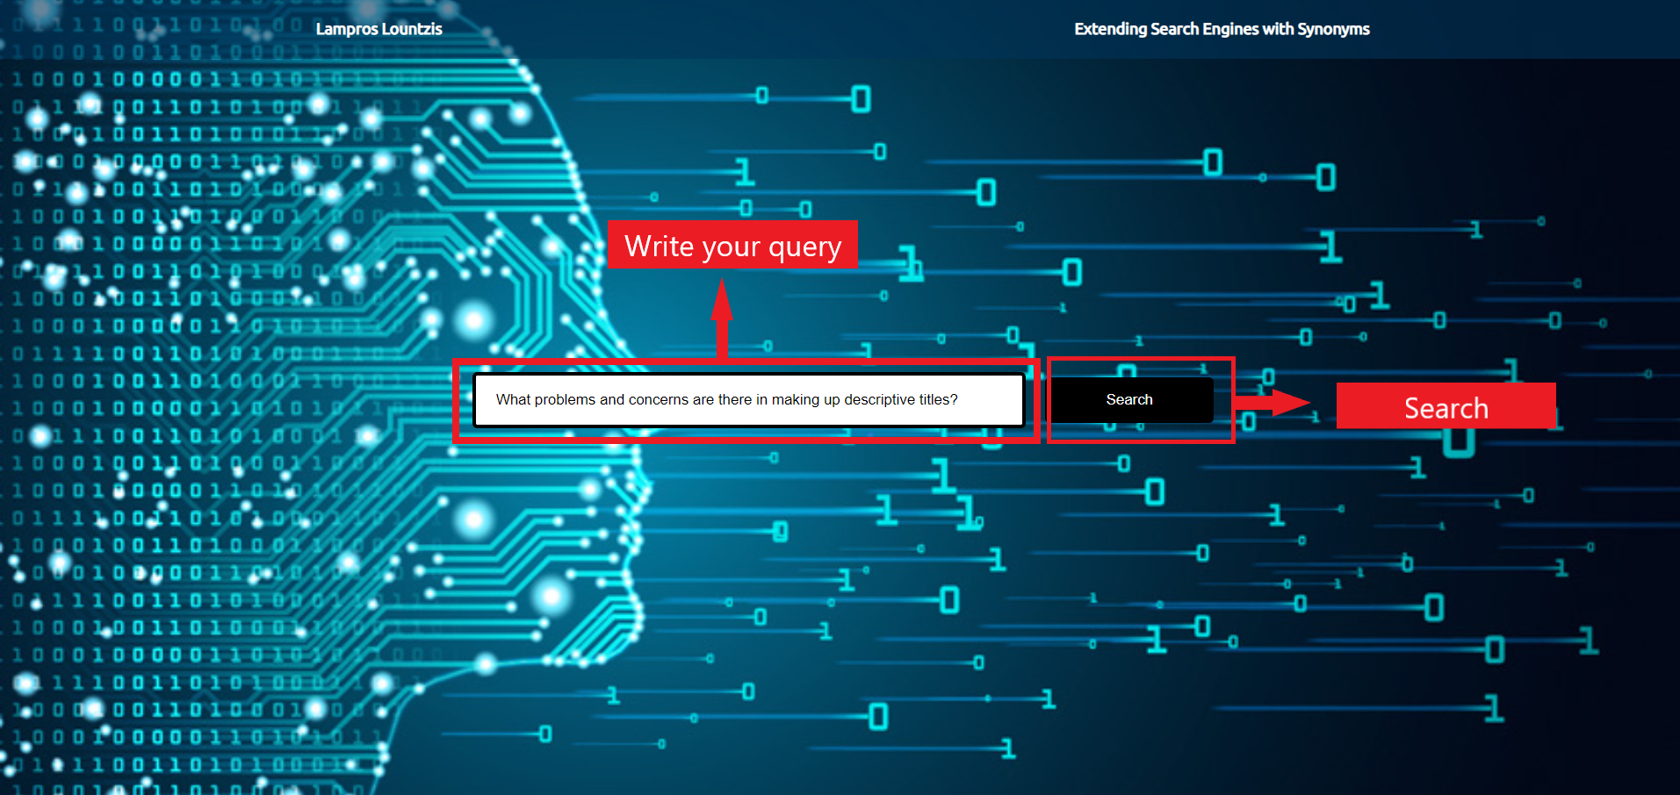

Slide 18
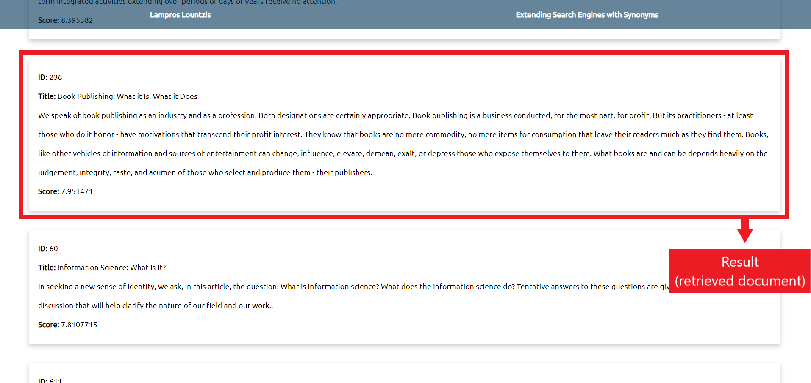

Slide 19
Thank you 😃

