Slide 1
Clarification of RFC7030 CSR Attributes definition draft-richardson-lamps-rfc7030-csrattrs
Please suggest
a better name!
Michael Richardson <mcr+ietf@sandelman.ca>
Dan Harkins (Industrial Lounge)
D. von Orhimb (Siemens)
Owen Friel (Cisco)

Slide 2
The Story so far
RFC7030 was unclear about CSR attributes
RFC8994 (ACP) and RFC8995 (BRSKI) made an assumption that values could be provided
  (RFC7030 and RFC8995 have one author in common)
We had a virtual interim meeting at the end of August
  https://datatracker.ietf.org/meeting/interim-2021-lamps-02/session/lamps
  https://www.youtube.com/watch?v=yAg9hKE844g
We seemed to come to conclude that we need to issue an Updates RFC7030 to fix the CSR Attributes
  That the document was correct, and the ACP usage was wrong.
Formed design team, had a few private threads, but no meetings, and little progress on draft and questions.

Slide 3
VIEWER WARNING: ASN.1 examples were created by ASN.1 amateur.
Some examples may be harmful to your cognitive functioning.
Divergent views on how to proceed follow.

Slide 4
Choice Alpha --- Make ACP usage work
CsrAttrs ::= SEQUENCE SIZE (0..MAX) OF AttrOrOID
AttrOrOID ::= CHOICE (oid OBJECT IDENTIFIER,
attribute Attribute,
value Value }
Attribute { ATTRIBUTE:IOSet } ::= SEQUENCE {
extType ATTRIBUTE.&id({IOSet}),
extAttr SET SIZE(1..MAX) OF ATTRIBUTE.&Type({IOSet}{@type})
}
Value { ATTRIBUTE:IOSet } ::= SEQUENCE {
extType ATTRIBUTE.&id({IOSet}),
type ATTRIBUTE.&Type({IOSet}{@type}),
value OCTET STRING
}
Create a new CHOICE
Put the stuff we need in it.
Most certainly wrong.

Slide 5
Choice Beta --- create new encoding to address name/keyspec needs only
1:1 array
What we had before
CsrAttrs ::= SEQUENCE {
oids SEQUENCE OF OBJECT IDENTIFIER,
attrs SEQUENCE OF Attribute,
subject [0] GenericName OPTIONAL,
keySpec [1] KeySpec OPTIONAL,
hashAlg [2] AlgorithmIdentifier OPTIONAL
}
Specific entries
To deal with todays
Current needs.
Extensible by new revision to ASN.1

Slide 6
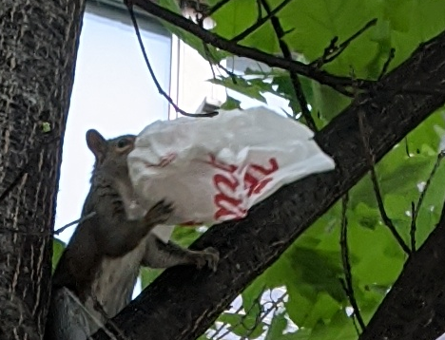
Discussion/Questions
Building at Carleton University, where CERN’s ATLAS detector was built.
Every Canadian
Squirrel
has a constitutional right
to Tim Hortons

