Slide 1
Clarification of RFC7030 CSR Attributes definition draft-richardson-lamps-rfc7030-csrattrs
Please suggest
a better name!
Michael Richardson <mcr+ietf@sandelman.ca>
Dan Harkins (Industrial Lounge)
D. von Orheimb (Siemens)
Owen Friel (Cisco)

Slide 2
The Story so far
RFC7030 was unclear about CSR attributes
RFC8994 (ACP) and RFC8995 (BRSKI) made an assumption that values could be provided
  (RFC7030 and RFC8995 have one author in common)
We had a virtual interim meeting at the end of August
  https://datatracker.ietf.org/meeting/interim-2021-lamps-02/session/lamps
  https://www.youtube.com/watch?v=yAg9hKE844g
We seemed to come to conclude that we need to issue an Updates RFC7030 to fix the CSR Attributes
  That the document was correct, and the ACP usage was wrong.
That the only real problem was that we needed an extra layer of ExtentionRequest to hold the subjectAltName components.

Slide 3
What WRONG looked like
0 72: SEQUENCE {
2 70: SEQUENCE {
4 3: OBJECT IDENTIFIER subjectAltName (2 5 29 17)
9 63: SET {
11 61: SEQUENCE {
13 59: [1] {
15 57: UTF8String
: 'rfc8994+fd739fc23c3440112233445500000000+@acp.ex'
: 'ample.com'
: }
: }
: }
: }
: }

Slide 4
What RIGHT now looks like
0 90: SEQUENCE {
2 88: SEQUENCE {
4 9: OBJECT IDENTIFIER extensionRequest (1 2 840 113549 1 9 14)
15 75: SET {
17 73: SEQUENCE {
19 3: OBJECT IDENTIFIER subjectAltName (2 5 29 17)
24 3: [0] {
26 1: BOOLEAN TRUE
: }
29 61: SEQUENCE {
31 59: [0] {
33 57: UTF8String
: 'rfc8994+fd739fc23c3440112233445500000000+@acp.ex'
: 'ample.com'
: }
: }
: }
: }
: }
: }
critical

Slide 5
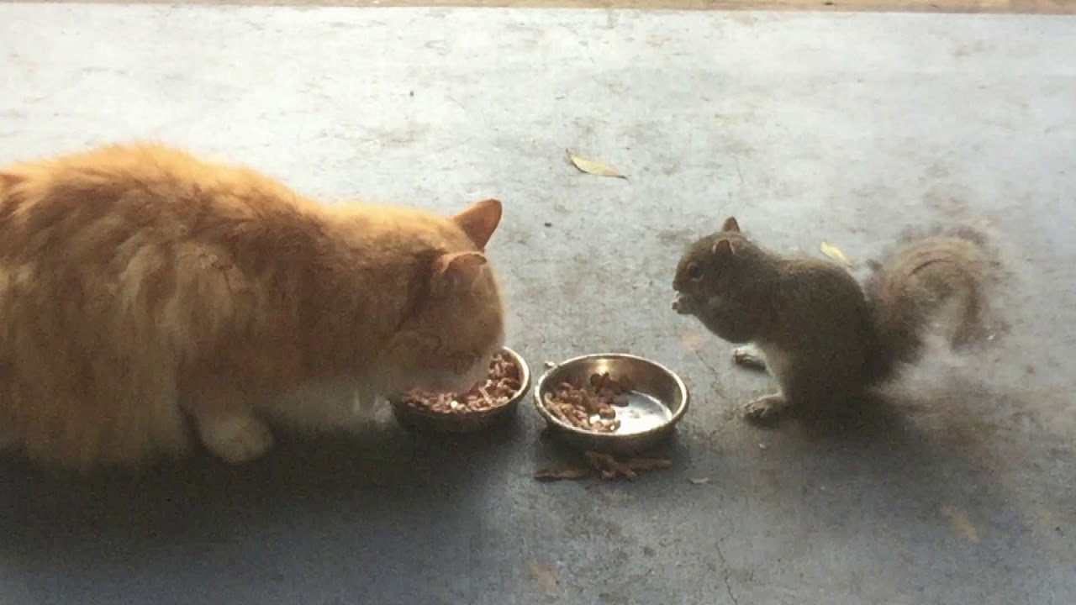
Discussion/Questions
Time to adopt document?

