Slide 1
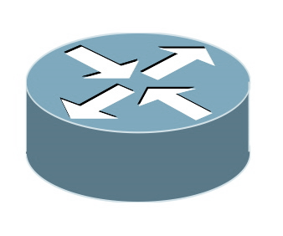
Host 1
Host 2
Container 1
Container 2
Container 3
veth0: 1.1.1.1
veth0: 2.2.2.2
veth0: 3.3.3.3
Overlay Router
NIC
NIC
Network

Slide 2
Host 1
Host 2
Container 1
Container 2
Container 3
veth0: 1.1.1.1
veth0: 2.2.2.2
veth0: 3.3.3.3
Overlay Router
NIC
NIC
Network

Slide 3
Host 1
Host 2
Container 3
Container 3
Pinned memory
Pinned memory
obj i
write
read
RDMA
RDMA
Network

Slide 4
Container 1
Pointer p
Container 2
write
read
Shared IPC Namespace
obj i
p

Slide 5
TCP/IP Apps
Container 1
RDMA Apps
Container 2
Container 3
IP to Verbs
Location Queries
Verbs API
Verbs API
Mesos
Container Locator
Fabric Controller
Container Locator
Shared Memory
Virtualized NIC
Virtualized NIC
DPDK
NIC
NIC
RDMA

Slide 6
Intra-VM
Shared Memory
Mesos
Intra-host
Fabric Controller
DPDK/Netmap
Inter-VM
RDMA
Inter-host

Slide 7
TCP/IP Apps
Container 1
RDMA Apps
Container 2
RDMA Apps
Container 3
Location/Resource Utilization
IP to Verbs
Mesos
Fabric Controller
Verbs API
Verbs API
queries
Virtualized NIC
Network Orchestrator
Virtualized NIC
Shared Memory
NIC
NIC
RDMA

