Slide 1
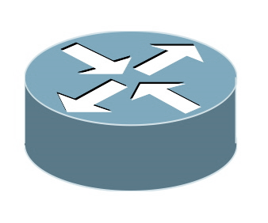
Host 1
Host 2
Container 1
Container 2
Container 3
veth0: 1.1.1.1
veth0: 2.2.2.2
veth0: 3.3.3.3
Overlay Router
NIC
NIC
Network

