Slide 1
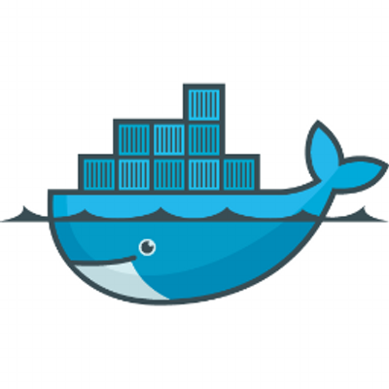
Docker 101
Harry Liu

Slide 2
it should be straightforward to run code

Slide 3
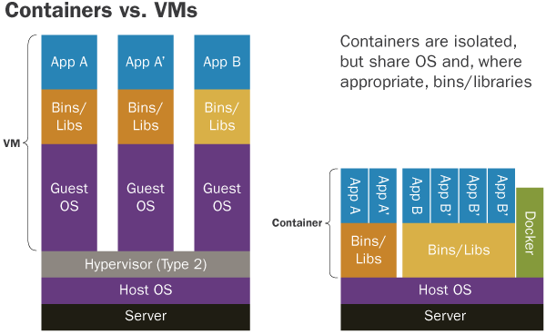
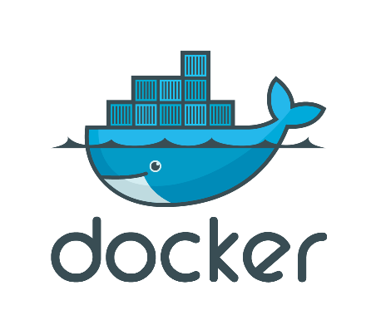
what are containers?
containers
wrap a process into a complete filesystem and namespace cell
can run directly on bare-metal.
Docker
packaging containers into images in a standard way
running and managing containers from images

Slide 4
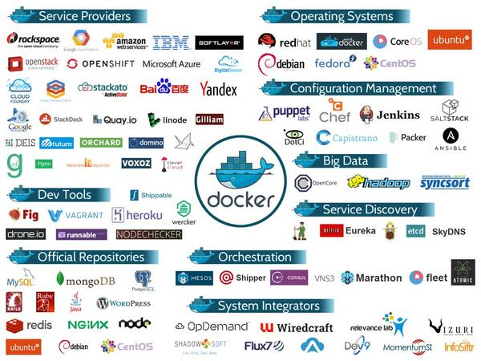
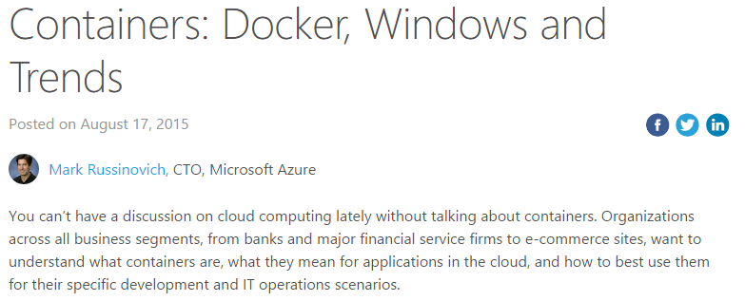
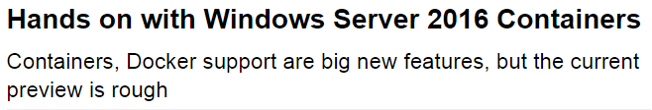
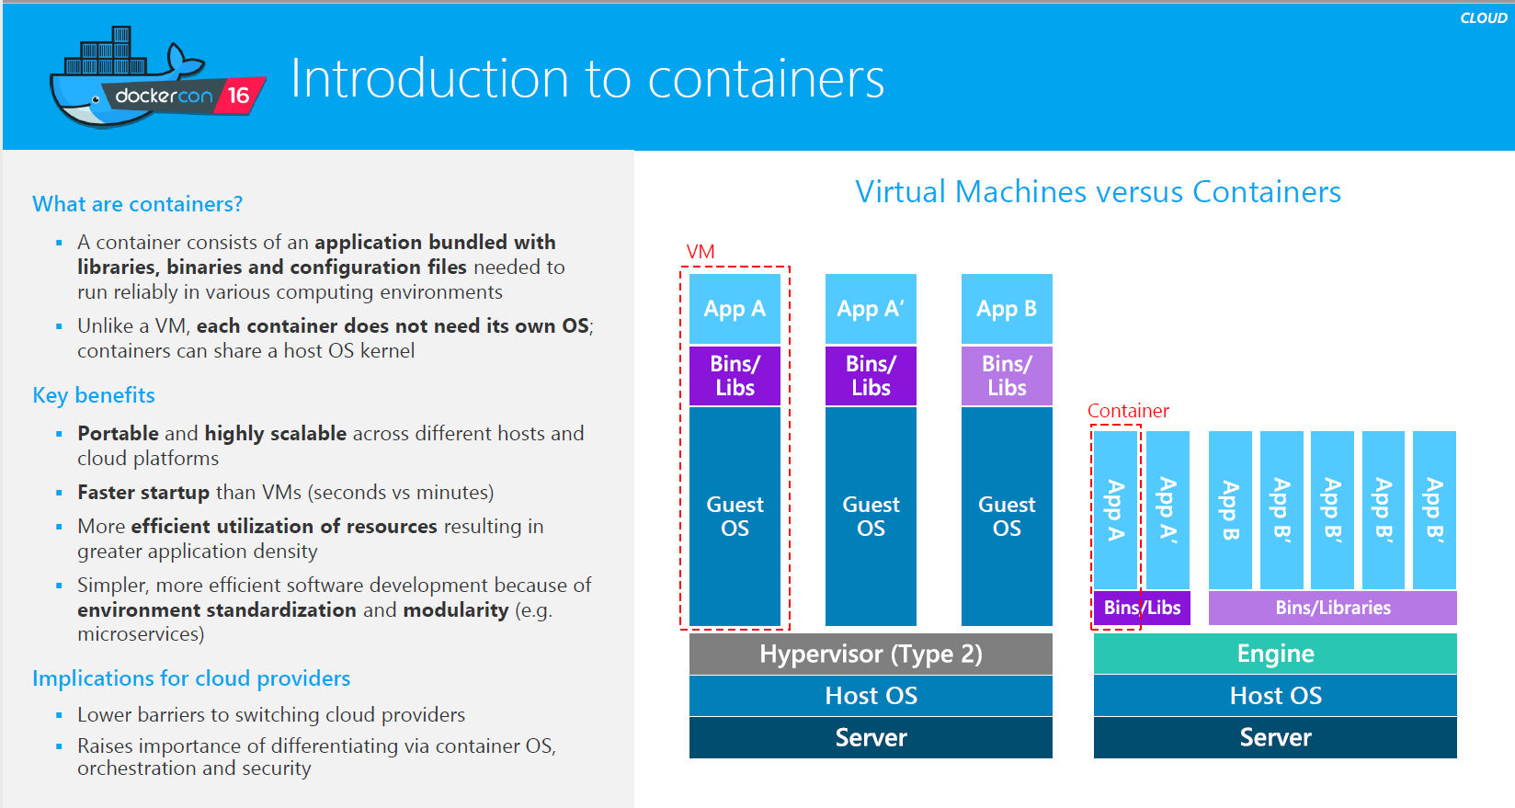
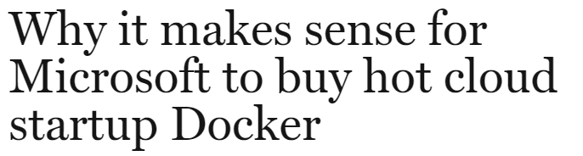

container is taking off
MSFT competitive report (June)

Slide 5




why containers are so attractive?
isolation
no naming or versioning conflicts with others
portability
directly running anywhere
lightweight (v.s. VMs)
faster start/stop
resource efficiency
less RAM
less disk
less CPU
Faster development and release
More reliable services to users
Less cost on hardware and IT operations
load balancer
frontend web
in-mem cache
backend db
Containerization makes it pragmatic to
all-stack testing
gray-box testing
smooth update
high availability

Slide 6
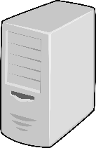
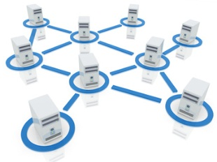
what do containers except from networks?
10.0.2.1
10.0.3.1
10.0.1.1
10.0.0.1
10.0.2.2
10.0.3.2
isolation/independence
containers can co-exist on a single host changes
portability
containers can run on any host without changes
performance
high bandwidth and low latency inter-containers
10.0.1.2
10.0.2.3
10.0.3.3

Slide 7
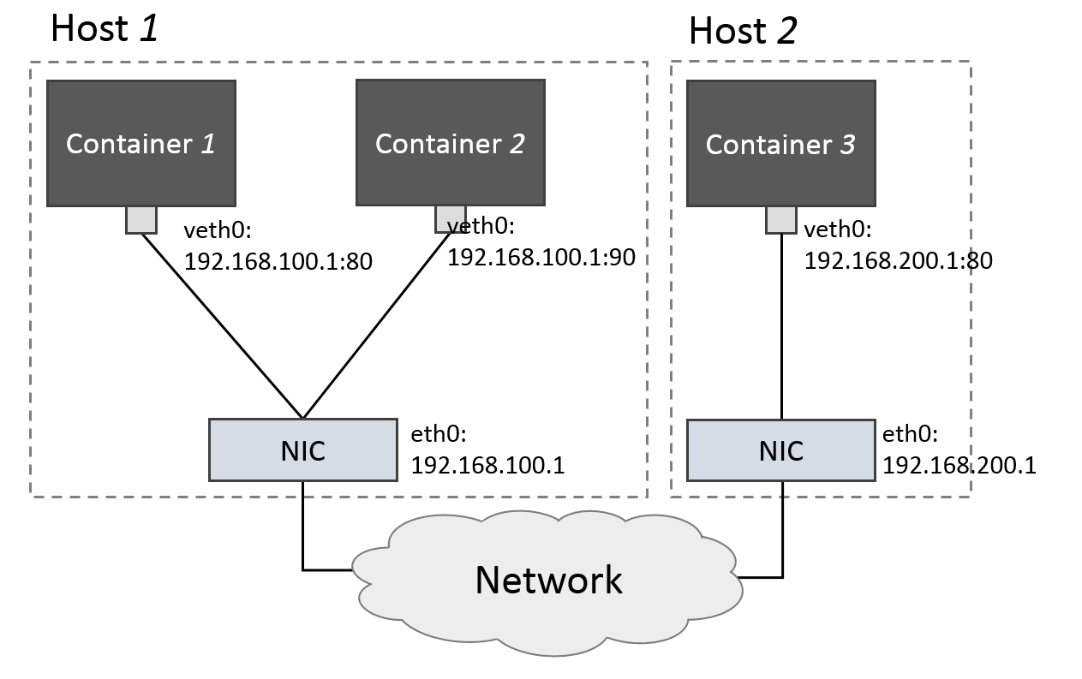
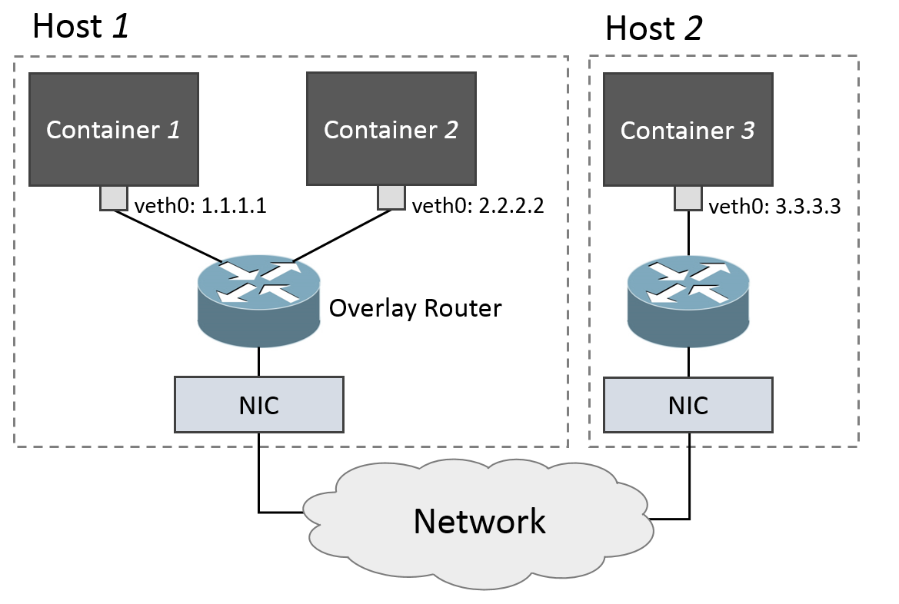
the current container networking solutions
host network mode:
poor isolation
poor portability
similar performance as raw processes
overlay network mode:
good isolation
good portability
poor performance

Slide 8
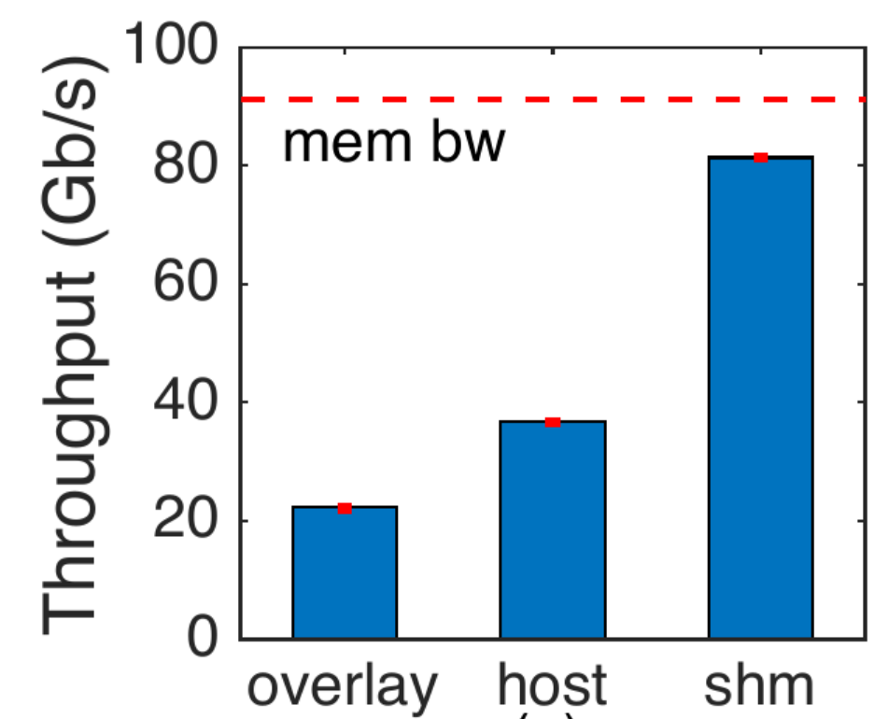
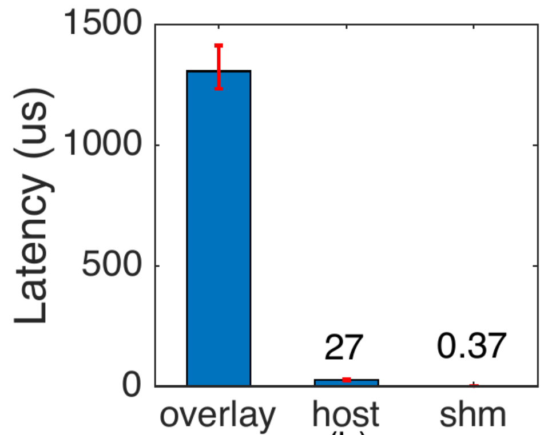
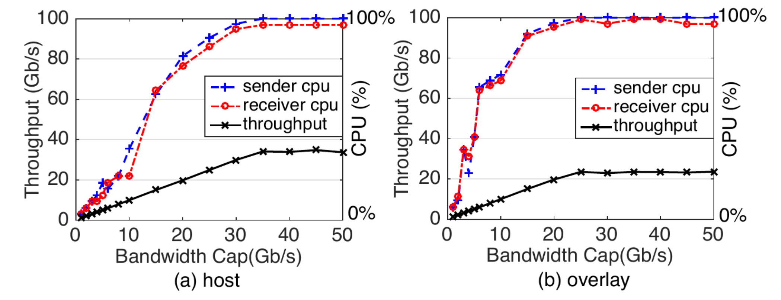
performance of current container networking

Slide 9
the implications of the poor performance
poor overall application performance
bigdata analytics
web services
key-value stores
machine learnings
…
high cost to run applications
reserving a lot of CPUs for merely traffic processing

Slide 10
can existing approaches solve containers’ problem?
single-root io virtualization (SR-IOV)
not scalable
it can at most support tens of virtual NICs
there can be hundreds of containers on a bare metal
hardware offload & kernel bypassing (e.g. RDMA, DPDK, etc.)
back to host mode: losing isolation and portability

Slide 11
what do we want to do?
to build an ultimate solution for container networking
good isolation
good portability
good performance
good backward compatibility
key observations to achieve out goals
no strict isolation is needed for containers from the same user
shared memory, RDMA is feasible
using shared memory intra-host, RDMA/DPDK inter-host for performance
building an overlay network for portability

Slide 12
what are the challenges
how to decide which communication paradigm to use
need container location formation
solution: get the information from cluster orchestrators.
how to make the decisions transparent to applications
supporting Socket API (TCP/IP), Verbs API (RDMA), MPI, etc.
solution: modifying network libraries
other open questions
security and middle-box
containers running on VMs
scalability
container live migrations

Slide 13
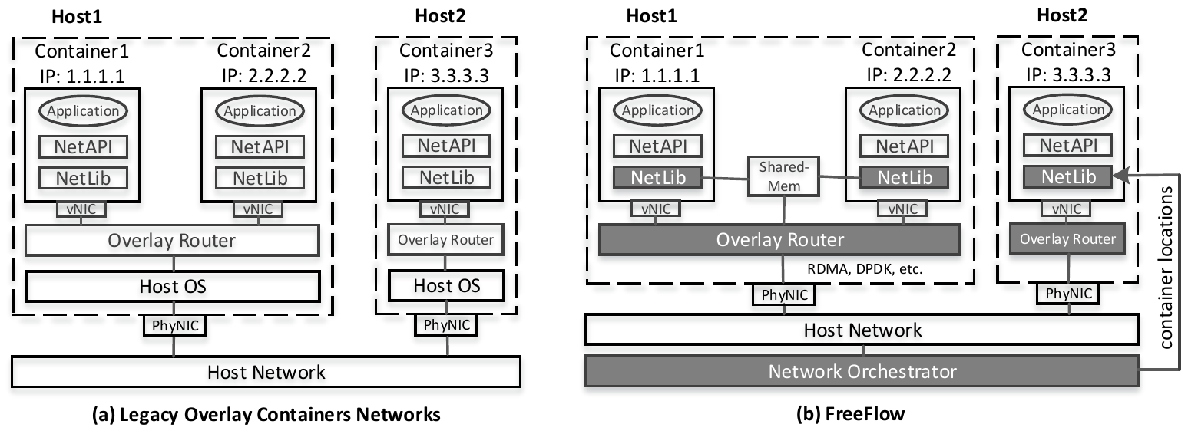
the design of FreeFlow

Slide 14
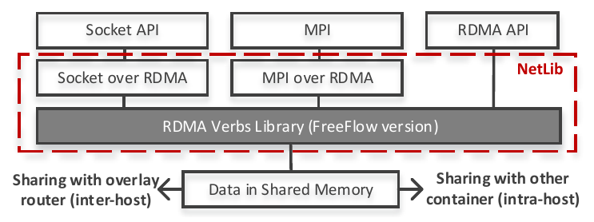
the design of FreeFlow (cont…)

Slide 15
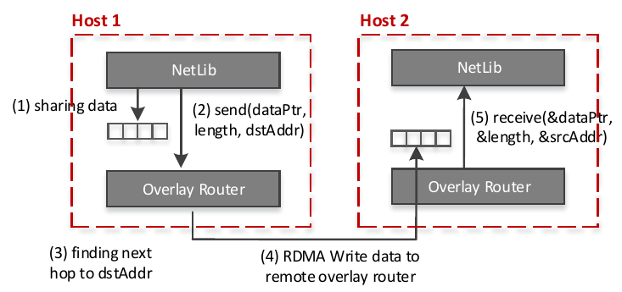
the design of FreeFlow (cont…)

Slide 16
agenda for next
implement FreeFlow
modifying RDMA library (libibverbs)
building a new overlay software router using RDMA
modifying Mesos for network orchestrator
running network performance sensitive applications on top of FreeFlow
Azure’s workload
open source workload
new research workload

Slide 17
meanings to Microsoft
Azure container services (ACS)
better network performance
lower price to the users
Azure services which are using containers
automation service
machine learning service
Azure’s internal dev-ops practice
example: the development of SONIC is pure containerized
using containers to test network updates
future: the whole autopilot moves to containers

