Slide 1
COMP 312/DATA 304
GROUP 7 PROJECT:
SIMULATING THE LAB CAFÉ SYSTEM
Olivia Baird, Rebecca Robson, Ray Wang, Riya Rana, Quang Thinh Lam
Notes:
We are group seven. For our COMP312/DATA304 project, we decided to simulate the queuing system for the Lab Cafe’s Kelburn Campus location.

Slide 2
GROUP 7
Rebecca Robson
Olivia Baird
Ray Wang
Riya Rana
Quang Thinh Lam
Yujie Huang
robsonrebe@myvuw.ac.nz
0009-0000-1949-1012
bairdoliv@myvuw.ac.nz
0000-0003-1275-8858
wangzhir@myvuw.ac.nz
0009-0005-3779-1947
ranariya@myvuw.ac.nz
0009-0004-2266-3734
lamthin@myvuw.ac.nz
0009-0008-0043-2950
huangjays@vuw.ac.nz
0009-0003-4378-6840
*This group member has not participated
Notes:
Here are the emails and unique ORCID ID’s of each of our group members.
Remember everyone must introduce themselves individually

Slide 3
01
System Identification & Tool Selection
02
Data Collection & Data Analysis
03
Modelling & Creating Simulation Models
04
Evaluating performance measures
05
Final Thoughts
Notes:
In this presentation, we will go over how we identified the system and the tools we decided to use in collecting and analysing our data. Afterwards, we will go into detail on how our data was collected and the results we obtained, as well as our initial data analysis. We will then go in to the models we thought fit our data the best, and how we created them. We will evaluate our performance measures before finally giving our final thoughts and conclusions.

Slide 4
01
System Identification & Tool Selection
Notes:
Our first topic of discussion will be the system we identified and the tools we decided to use.

Slide 5
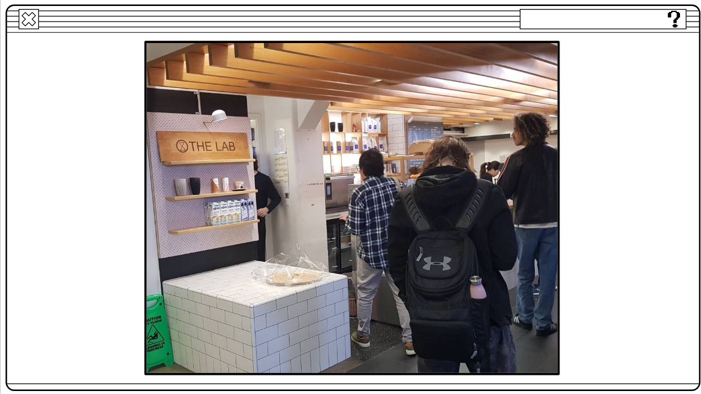
The Lab Café
Fig 1. Photo of the Lab Café
For our system, we chose to study The Lab Café, located in the Hub.
The Lab Café has one server and customer join the queue with a FIFS queueing discipline.
Notes:
As we said earlier, we decided to investigate and simulate the queue for the Lab cafe. We chose the Lab’s Victoria University of Wellington Kelburn campus location. We decided that a location at the university would be the best because it was a location that was easy for all members of the group to get to. We also thought that it would have a high volume fast-moving queue that would make it easy to collect a large amount of data in a small amount of time. Our data was collected just after the Lab moved to its new location, in the former site of Vic Books.
In the queue for the Lab, a customer joins at the back of the queue. That customer then will wait in the queue until they reach the front of the line in a first-in-first-served process. When a customer gets to the front of the queue, they will then order at the counter and will leave the queue.
Customers who left the queue may still end up waiting for their drinks to be made or their food to be heated, but we decided that the queue we were monitoring would end once the customer paid and left the line for the cash register. We decided we would record the data for each customer’s arrival and departure times for the queue for the counter. We wanted to make sure we matched up the correct arrival and departure times for each customer, so we decided we would track a customer’s progression in the line.

Slide 6
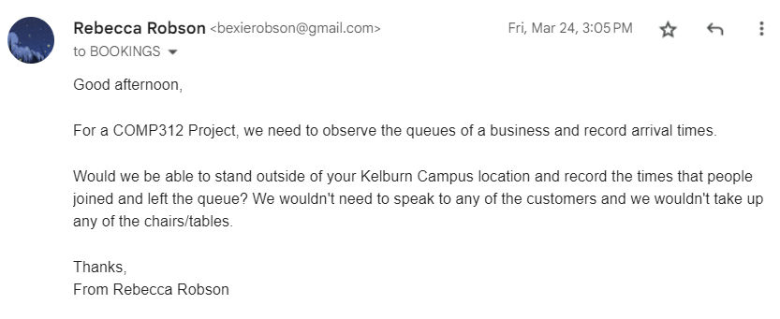
Permission
Fig 2. Photo of email sent to the Lab Café
Notes:
Before we began our data collection, we needed to secure permission from the Lab cafe. I sent them an email on Friday the 24th of May asking if we could observe the queue of their business and record their arrival times. I made sure to inform them that we would not be speaking to any of the customers and that we would not take up any of their tables.

Slide 7
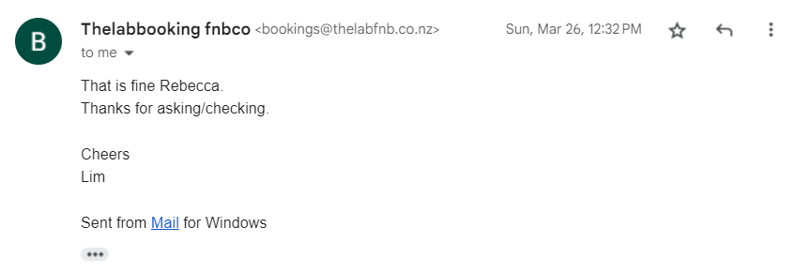
Fig 3. Photo of email permission from the Lab Café
Notes:
I received a response two days later saying that it was all fine, and we were ready to start our data collection.

Slide 8
Tools
Jupyter notebook
Discord
GitLab for creating a Git repository
RMarkdown to write the reports
Stopwatch
Google sheets document, later converted into a CSV file.
Notes:
Firstly, for the tools we used, we decided on a myriad of things. We decided that our code to be written in Jupyter Notebook, or similar software like Google Colab, in the python notebook format, as this was the way our programming assignments were made. This consistency across all our work made it useful to collaborate and send files back and forth. We also made a GitLab to host the project files on. Our data was inputted into Google Sheets initially, as it allowed us to record the values on our phones at the same time. It was easier than using a pen and pencil. The data could then be converted into a CSV file, for easy file reading.
To communicate with each other, we created our own Discord server. This allowed us to send work-in-progress screenshots and to communicate about what needed to be done.
When it came to writing our reports, we used RMarkdown. RMarkdown was useful as it allowed us to make reports that appeared professional.
The final tool we used was the clock app on our phone. We used this to keep track of the time and record the exact timestamps when people arrived or departed the queue.

Slide 9
02
Data Collection & Data Analysis
404 NOT FOUND
Notes:
Our second topic of discussion is how we collected our data and how we analysed it.

Slide 10
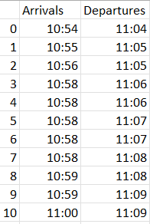
Data Collection
After consultation with and authorisation from 'The Lab', we collected a total of 284 rows of raw data.
We collected data on two different days at different times.
This means that our raw data includes several different time slots from 10am to 4pm.
Fig 4. Example rows and cols of the data collected
Notes:
Our data was collected by two teams. The first team consisted of Rebecca and Riya, and the other team of me and Ray. We collected the data across the morning through to the afternoon on two different days . We found that the Lab cafe was very busy and that it did not take long to collect our data.
Overall, we collected 284 pairs of arrival and departure times. On average, it appeared that multiple people arrived in a minute, ranging from zero to four people. The number of people served per minute was more consistent, with two people being served on average per minute. On average, a customer took 9 minutes to progress from arriving in the queue to leaving the queue.

Slide 11
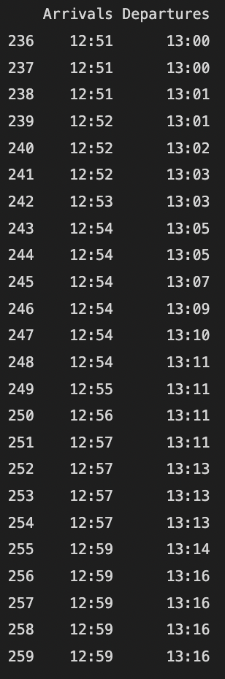
Data processing
Since each member of the group collected data in different ways, we used the 'DateTime' Library in Python to standardise the format of the raw data.
This will make it easier to do an analysis of the distributions of Inter-Arrival and Service times.
Fig 5. Example rows and cols of the standardised DateTime data
Notes:
Because the data was entered into the spreadsheet in different forms by different people, we used the DateTime library in python to standardise the format of the raw data. This meant that every data point could be given as a time component with hours, minutes, and seconds. This made it easier for us to analyse the data later on and easier to fit distributions to our inter-arrival and service times.

Slide 12
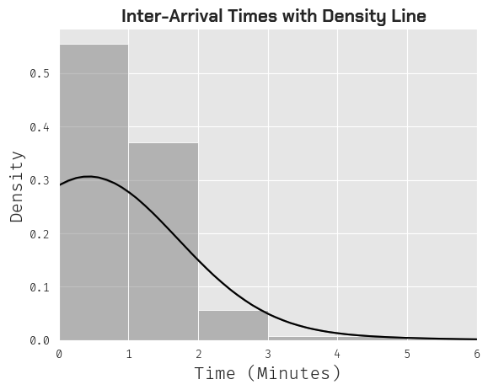
Inter-Arrival Times
Here is an initial plot of our inter-arrival times, with the density of the data overlaid.
Density
Inter-Arrival Times
Fig 6. Initial Histogram of Inter-Arrival Times Data with density line
Notes:
Olivia
For our data analysis we created histograms of the data with the density of the data overlaid to give us an initial look at the data before we started fitting any distributions to it. We can see that for inter-arrival times that typically, customers arrived every 1-2 minutes.

Slide 13
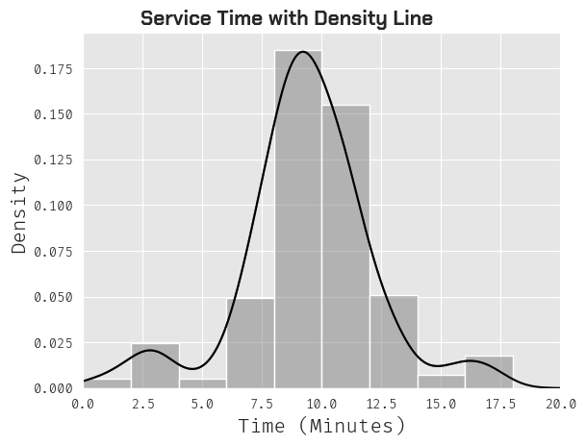
Service Times
Density
Service Times
Here is an initial plot of our service times, with the density of the data overlaid.
Fig 7. Initial Histogram of Service Times Data with density line
Notes:
Olivia
Here is a histogram of our service times, We can see that typically, customers were served between 7.5 and 12.5 minutes.

Slide 14
Finding Best Distribution - Goodness of fit
 | Gamma | Erlang | Exponential
Inter-Arrival Times | KS statistic: 0.5512 p-value: 2.5796 e-81 | KS statistic: 0.5512 p-value: 2.5796 e-81 | KS statistic: 0.5512 p-value: 2.5796 e-81
Service Times | KS statistic: 0.9119 p-value: 4.9864e-300 | KS statistic: 0.9120 p-value: 3.8531 e-300 | KS statistic: 0.9120 p-value: 3.8531 e-300
Notes:
Olivia
Next we used the Kolmogorov-Smirnov test as a goodness of fit measure to compare the Gamma, Erlang and Exponential distributions.
Using this test we found that for all the distributions, we obtained extremely small p values.

Slide 15
Goodness of fit cont.
Kolmogorov-Smirnov Test
Compares underlying distribution of a sample against a given distribution
If p < 0.05 = sufficient evidence
As p < 0.05, we can reject the null hypothesis
We will use an alternative method to find the best fitting distributions for our data.
Notes:
Olivia
The Kolmogorov-Smirnov test for goodness of fit compares the underlying distribution of a sample against a given distribution.
Since the p-values were lower than the significance threshold (0.05) this indicates that there is sufficient evidence to reject the null hypothesis.
We can reject the null hypothesis that the two samples being compared are drawn from the same distribution and conclude that there is a statistically significant difference between the two samples in terms of their distribution.
We will use an alternative method to find the best fitting distributions for our data.

Slide 16
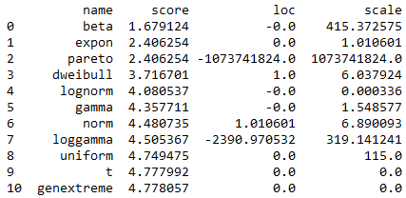
Finding the Best Distribution for
Inter-Arrival Times
> from distfit import distfit
We used the distfit package to find the top three distributions for our inter-arrival times data.
Beta
Exponential
Pareto
Notes:
Olivia
We decided to use the distfit function to find the best distributions for our data. The DistFit package used RSS as a goodness of fit measure. RSS is the deviation prediction from the actual empirical values of data. It measures the discrepancy between the data and the distributions. A smaller RSS value indicates a tighter fit of the distribution to the data. Therefore, the lowest RSS value is the best distribution. The package also does most of the work by ordering the distributions from best to worst.
WE found that the top three distributions we obtained for inter-arrival times were the Beta, exponential and pareto distributions.

Slide 17
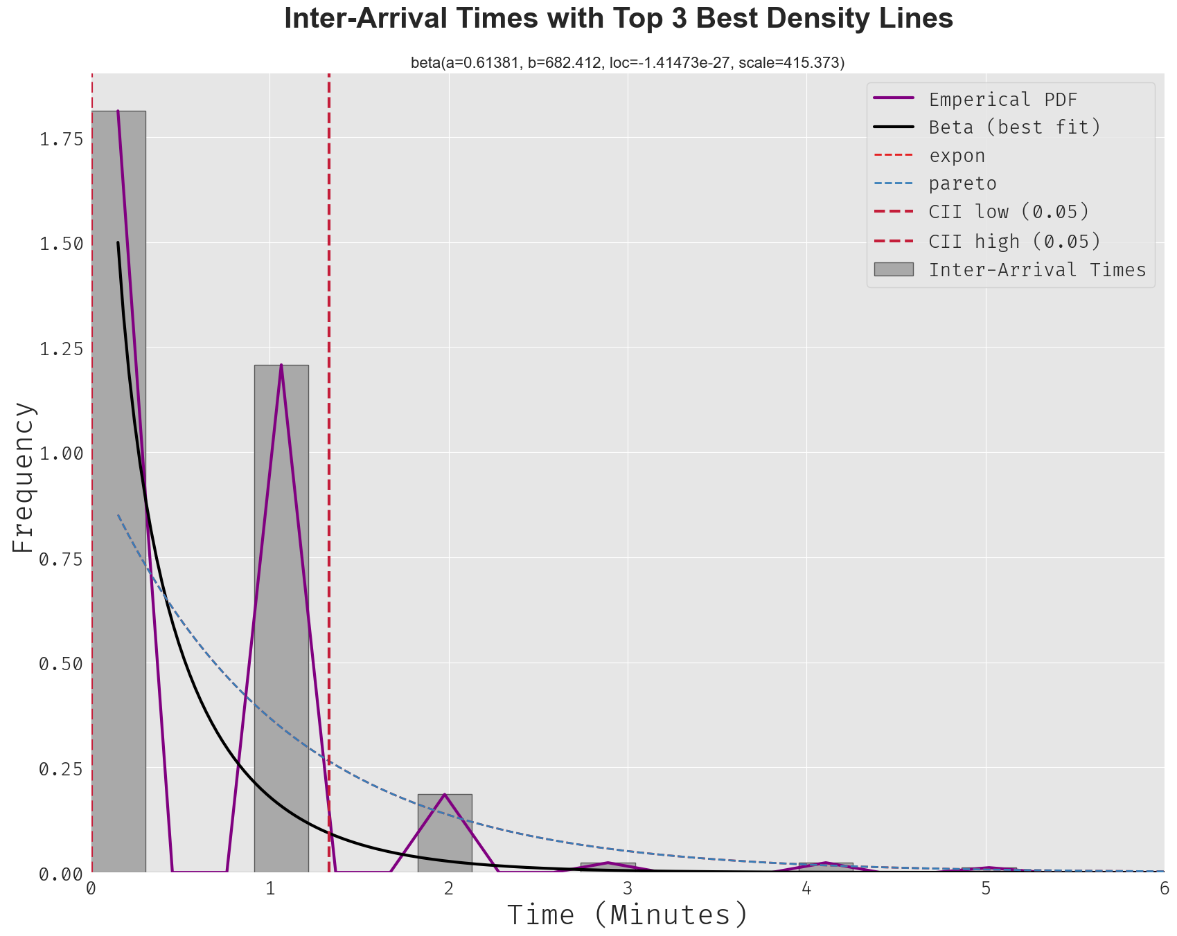
Best Distributions: Inter-Arrival
Exponential line is not visible - assume there is overlap with either beta or pareto density
Of all the distributions the Beta distribution fits the data best
Fig 6. Histogram of Inter-Arrival Times Data with Top 3 Best Distribution Density lines
Notes:
Olivia
We plotted the distributions as density lines against the inter - arrival times histogram to see how well each of the distributions fit the data.
The Exponential density is not visible - we assume it likely overlaps with either the beta or pareto distribution density.
Of all the distributions the Beta distribution fits the data best

Slide 18
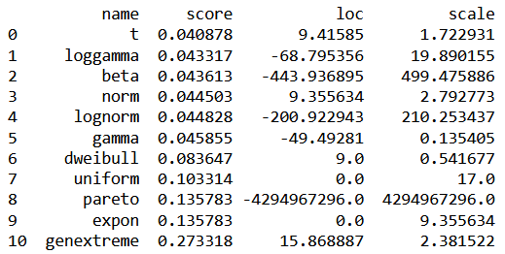
Finding the Best Distribution for
Service Times
> from distfit import distfit
We used the distfit package to find the top three distributions for our service times data.
t
loggamma
beta
Notes:
Olivia
Again for service times we used distfit to find the best distributions, which for service times were the t, loggamma and beta distributions.

Slide 19
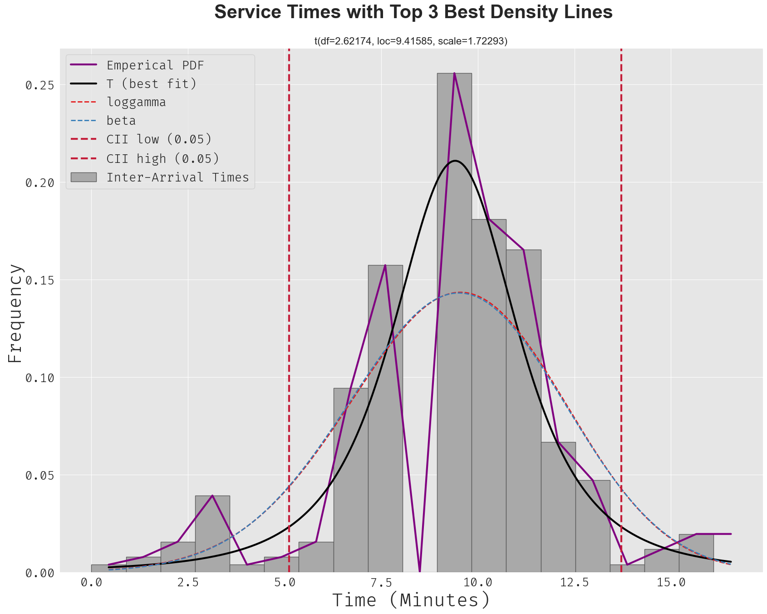
Best Distributions: Service
loggama and beta distributions have very similar density lines.
t by far has the best density line (matches the data the best).
Fig 7. Histogram of Service Times Data with Top 3 Best Distribution Density lines
Notes:
Olivia
We then plotted the distributions as density lines against the service time histogram.
From this graph we can see that the Log Gamma and beta distribution have very similar density lines and that the t distribution by far has the best fit.

Slide 20
03
Modelling & Creating Simulation Models
Notes:
I will then explain the simulation model we have created.

Slide 21
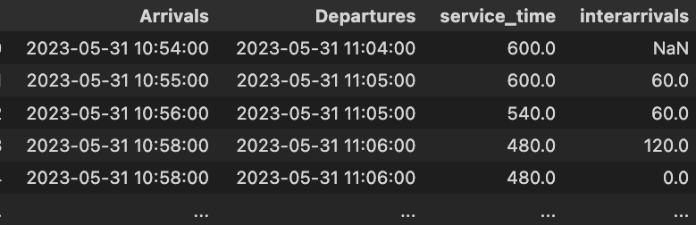
Data Analysis - Performance Measures
 | Estimate
Average Time spent in the system (μ) | 9.35 m
Average Inter-Arrival Rate of customers to the system (λ) | 1.01 m
These were calculated from the raw data & we will use this as a basis for comparison when creating the simulation models.
The closer the simulation models get in value to our observed data, the better.
Fig 8. overview of the processed data
Notes:
First we need to know Mu and Lambda, and from the raw data we separate the collected times of arrival and end of service of the customers to calculate the actual service times and interarrival times.
The the better simulation model will return us the most closser results with The Mu and Lambda
‘The Lab’, have average service time Mu of 9.35 minutes. And their customer arrival rate Lambda is one customer in every 1.01 minutes.

Slide 22
Model 1 - M/M/1
 | Estimate | Confidence Interval
W: Average Time spent in the system | 78.29 | 74.72 | 81.87
L: Average number of customers in the system | 62.33 | 60.92 | 63.75
B: How Busy is the system? | 99.87% | 99.77% | 99.67%
𝝁 = 9.35 𝞴 = 1.01
Notes:
The first model we created was an M/M/1 model. We use the M/M/1 model because The Lab has only one counter to serve customers. We bring in the Mu and Lambda I mentioned last page as our first model parameters.
Model1 results in an average time for customers in the system of 78.29 minutes, which is high because the system is not in a steady state because customers arrive faster than they can be served. The average number of customers in the system is also high for the same reason, at 62.33 customers. The system is busy in 99.87% of the time, which is also reasonable.

Slide 23
Model 2 - Best Fit
 | Estimate | Confidence Interval
W: Average Time spent in the system | 9.52 | 8.83 | 10.204
L: Average number of customers in the system | 0.047 | 0.044 | 0.051
B: How Busy is the system? | 4.75% | 4.44% | 5.1%
Inter-Arrival Times: beta dist
Service Times: t dist
𝝁 = 9.35 𝞴 = 1.01
Notes:
For the second model: the best-fit model. As mentioned earlier: we used the distfit package to find the best distributions for data. The best distribution for arrival time is the beta distribution and for service time is the T distribution. Using the algorithm provided by scipy.stats, we find the values of B_a B_b B_loc and B_scale from the B-beta distribution as parameters, and the values of t_c, t_loc and t_scale from the T distribution as simulation parameters to simulate guest arrivals and get serviced.
Results for Model2: The average time spent in the system was 9.52 minutes, which is very similar to the average service time in our data. The average number of customers in the system is much lower compared to model 1, with only 0.047 customers in the queue. This is much lower than what we observed. The volume of business in the system was also lower than we observed, In fact the system was always busy when we were doing data collection.

Slide 24
Model 3 - Empirical Distribution
 | Estimate | Confidence Interval
W: Average Time spent in the system | 8.40 | 7.43 | 9.38
L: Average number of customers in the system | 0.00031 | 0.00028 | 0.00035
B: How Busy is the system? | 0.0311% | 0.0275% | 0.0347%
Empirical distributions of the inter-arrival times and service distributions
𝝁 = 9.35 𝞴 = 1.01
Notes:
For our last model we used the empirical distribution of arrival and the service.
The result is: the average time spent in the system is 8.4 minutes, which is slightly less than the average service time in our data. The average number of customers in the system is also much lower compared to Model 1, with only 0.00031 customers in queue. The volume of business in the system is also much lower than we observed.

Slide 25
04
Evaluating performance measures
Notes:
Finally we evaluated the performance measures.

Slide 26
Model Selection
Model 1
Model 2
Model 3
Not in a steady state due to it being peak time during data collection
The W value of model 2 was the most similar to what we expected
The empirical fit showed some similar performance estimates to model 2
M/M/1 Model
Best Fit Model
Empirical Distribution Model
The M/M/1 Model was the best simulation model, as we observed that at peak times the system did not have a steady state and that waiting times increased exponentially.
Notes:
From our results we found that the Best Fit model and the Empirical Distribution model produced similar results for the performance metrics.
The average service time values for both these models obtained was indeed what we observed in our queue. However, they both had incredibly low values for the length of the queue and for the proportion of time the server was busy.
Because of this, the model that best represented our data was the M/M/1 model.
This is because the recorded data from the Lab’s queue was taken during peak time and therefore, was not in steady state.
Meaning that the times and length of queue in theory would increase exponentially if the arrival and service rate remained the same across the whole day.

Slide 27
05
Final Thoughts
Notes:
Here are our final thoughts and conclusions

Slide 28
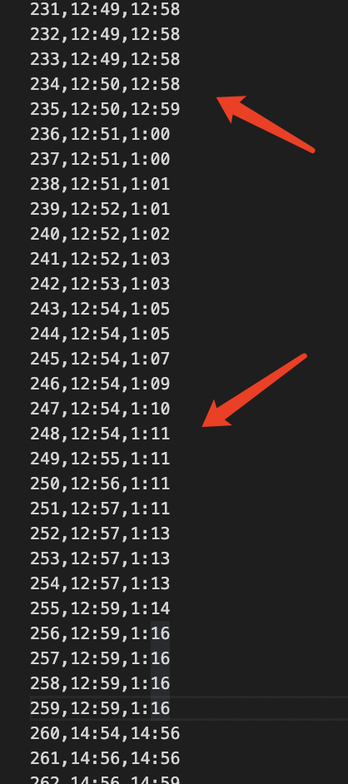
What problems did we face? What would we do next time? Errors and Improvements
Issues we Faced:
The raw data was in two different formats
Balking & Customers leaving the queue
Future improvements that could be made:
More data could be collected
More time periods (across the opening hours)
Fig 9. Example of data in different formats
Notes:
We had faced a few issues throughout the collection of the data.
Due to the recent closure of Vic Books, The Lab was essentially twice as busy as normal, it was also their first week back since moving.
The long queue, whilst good for data collection, caused a lot of balking to occur. Customers would see the long line and would turn away. Some customers even left part-way through. Because of this, we had to “clean” the data by removing the data points with missing departure times.
We also had an issue with customers joining friends midway, it was hard to distinguish whether they had joined the queue or not.
We also had another issue with our collected data.
Our two data collecting groups had inputted the data differently. This meant we had to fix the data in order to have it all in the same format and ideal for testing. We resolved this issue by converting all the data to dateTime
For the future, we would definitely want to increase the amount of data we collected and also collect data across a whole day. Because we had only collected peak operating time data, this meant our model was not in steady state.
Instead across a whole day, the interarrival times and service times would show a different distribution and it would be interesting to analyse that.

Slide 29
Who did what?
Report Number: | Practical Work: | Report Write-up:
1 | Permission Seeking: Rebecca Robson Group Decisions: Rebecca Robson, Riya Rana, Ray Wang, Quang Thinh Lam | Rebecca Robson
2 | Data Collection: Rebecca Robson & Riya Rana, Ray Wang & Quang Thinh Lam Data Processing: Ray Wang | Rebecca Robson, Olivia Baird
3 | Plotting Histograms: Quang Thinh Lam, Olivia Baird Goodness of Fit Tests: Rebecca Robson, Olivia Baird | Rebecca Robson, Olivia Baird
4 | M/M/1: Rebecca Robson, Riya Rana Best Fit Model: Rebecca Robson, Ray Wang Empirical Fit Model: Olivia Baird, Rebecca Robson | Rebecca Robson, Olivia Baird
Notes:
Here is a break down of what group members specifically worked on.

Slide 30
Thanks!
Do you have any questions?

