Slide 1
CMSC204
Kartchner
V(StateGraph) = {Oregon, Alaska, Texas, Hawaii, Vermont, NewYork, California}
E(StateGraph) = {(Alaska, Oregon), (Hawaii, Alaska), (Hawaii, Texas), (Texas, Hawaii), (Hawaii, California), (Hawaii, New York), (Texas, Vermont), (Vermont, California), (Vermont, Alaska)}
1. Draw the StateGraph
Oregon
Alaska
Vermont
California
Hawaii
Texas
New York

Slide 2
a. Show the adjacency matrix that would describe the edges in the graph. Store the vertices in alphabetical order
AL CA HW NY OR TX VT
States
Alaska
California
Hawaii
New York
Oregon
Texas
Vermont
0 0 0 0 1 0 0
0 0 0 0 0 0 0
1 1 0 1 0 1 0
0 0 0 0 0 0 0
0 0 0 0 0 0 0
0 0 1 0 0 0 1
1 1 0 0 0 0 0
3. b. Show the adjacency lists
that would describe the edges in the graph
Alaska
California
Hawaii
New York
Oregon
Texas
Vermont
OR
AL
CA
TX
NY
HW
VT
AL
CA

Slide 3
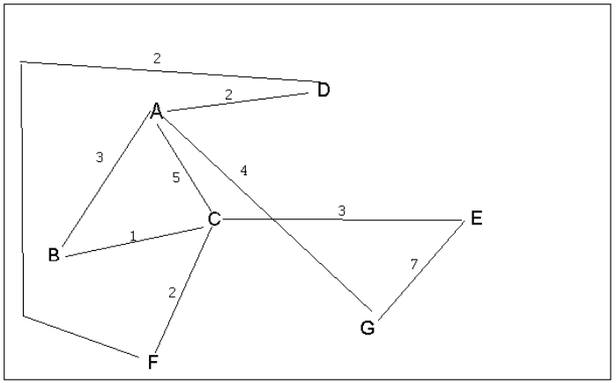
4 a. Which of the following lists the graph nodes in depth first order beginning with E?
A) E, G, F, C, D, B, A
B) G, A, E, C, B, F, D
C) E, G, A, D, F, C, B
D) E, C, F, B, A, D, G
4 b. Which of the following lists the graph nodes in breadth first order beginning at F?
A) F, C, D, A, B, E, G
B) F, D, C, A, B, C, G
C) F, C, D, B, G, A, E
D) a, b, and c are all breadth first traversals

Slide 4
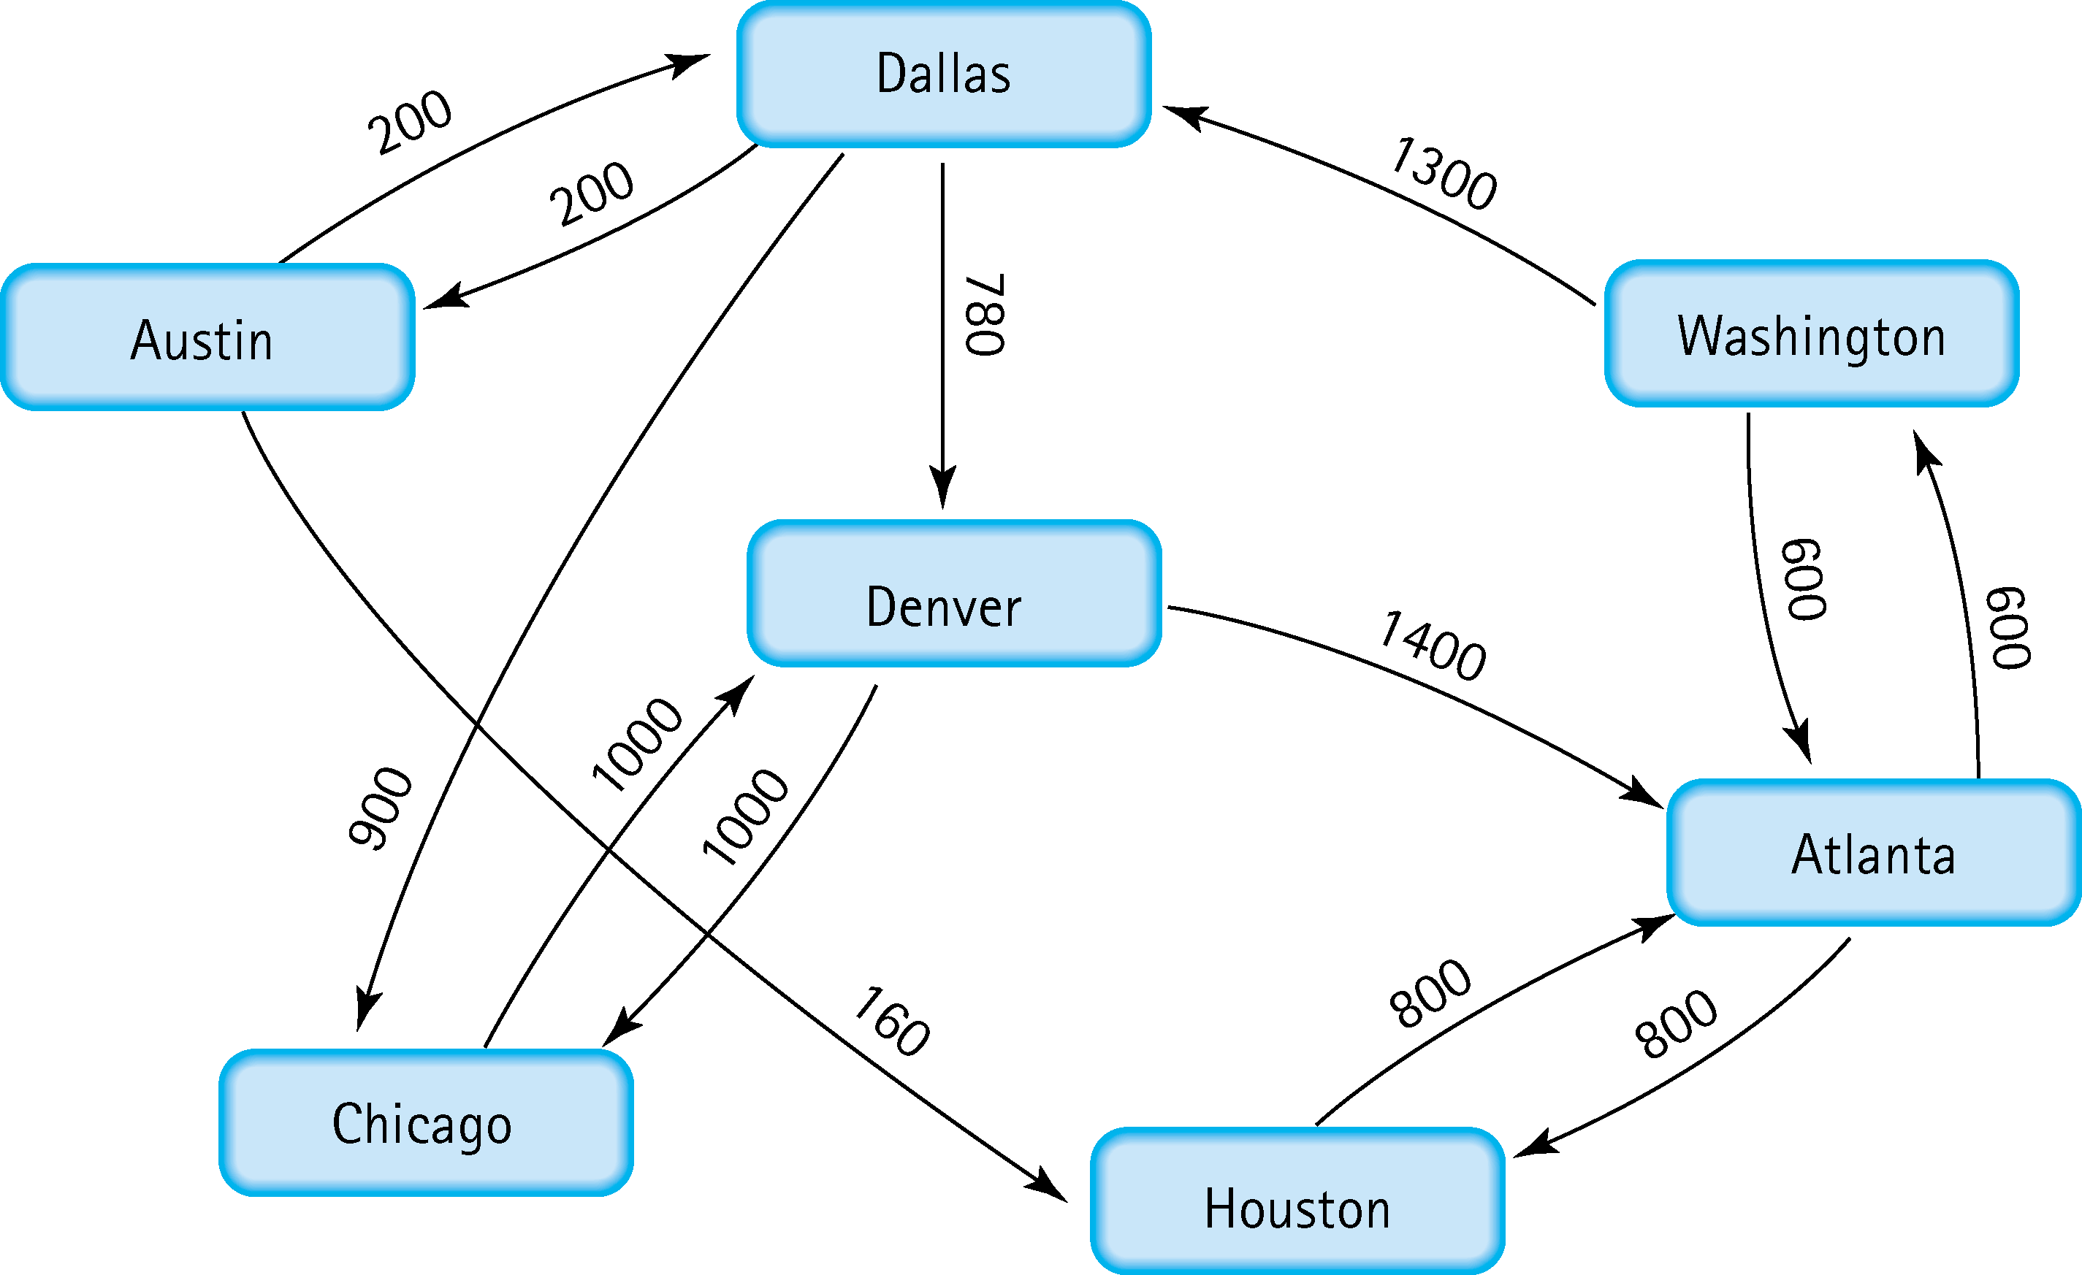
5. Find the shortest distance from Atlanta to every other city
From Atlanta to Houston: 800
From Atlanta to Washington: 600
From Atlanta to Chicago: 2800
From Atlanta to Denver: 2680
From Atlanta to Dallas: 1900
From Atlanta to Austin: 2100

Slide 5
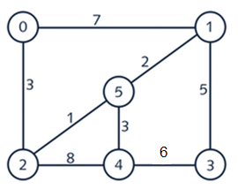
6. Find the minimal spanning tree using Prim’s algorithm. Use
0 as the source vertex . Show the steps.
Step 1: From the graph, select the minimum edge, or from one edge that connects the minimum edge.
Step 2: Pick the next smallest edge’s weight from the previous vertexes connected and add it to the MST.
Step 3: Repeat Step 2 until.
Step 4: If the next smallest edge form a cycle, discard that edge and pick the next smallest, otherwise continue repeating Step 2
Vertex (0) is picked
Edges [7] and [3] are considered, edge [3] added, and vertex {0,2} are connected
Edges [7], [1], and [8] are considered, edge [1] added, and vertex {2,5} are connected
Edges [8], [3], [2], and [7] are considered, edge [2] added, and vertex {5,1}are connected
Edges [8], [3], and [5] are considered, edge [3] added, and vertex {5,4} are connected
Edges [6] and [5] are considered, edge [5] added, and vortex {1,3} are connected

Slide 6
7. Find the minimal spanning tree using Kruskal’s algorithm.
Show the weights in order and the steps.
Step 1: List all edges and sort them in increasing order by their weights.
Step 2: Pick the smallest edge’s weight and draw the edge.
Step 3: Check if the new edge creates a cycle or loop in a spanning tree.
Step 4: If it doesn't form a cycle, then include that edge in MST, otherwise discard that edge
Step 1:
Step 2:
Step 3 & 4:
Edge
Weight
Edge
Weight
0 - 1
0 - 2
1 - 3
1 - 5
2 - 4
2 - 5
3 - 4
4 - 5
7
3
5
2
8
1
6
3
2 - 5
1 - 5
0 - 2
4 - 5
1 - 3
3 - 4
0 - 1
2 - 4
1
2
3
3
5
6
7
8
0
1
5
2
4
3
0
1
0
1
0
1
0
1
5
5
5
5
2
4
3
2
4
3
2
4
3
2
4
3

Slide 7
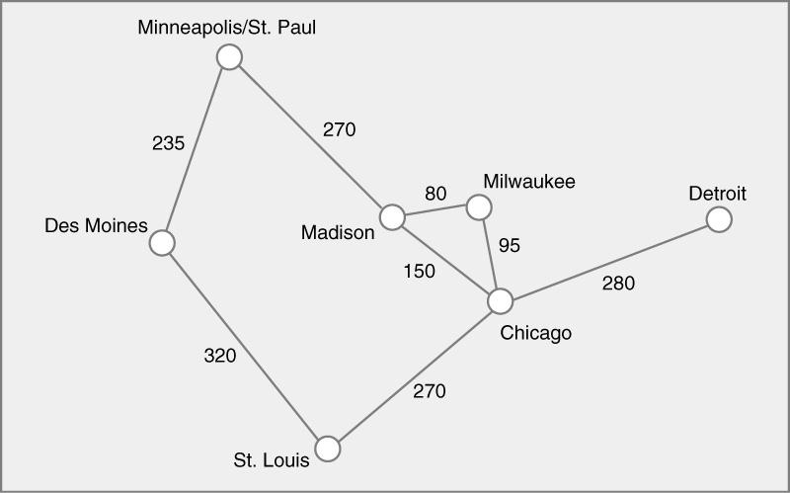
8. Find the minimal spanning tree using the algorithm you prefer. Use
Minneapolis/St. Paul as the source vertex
Kruskal’s Algorithm
Edge
Weight
Edge
Weight
0 - 1
0 - 3
1 - 2
2 - 5
3 - 4
3 - 5
4 - 5
5 - 6
235
270
320
270
80
150
95
280
3 - 4
4 - 5
3 - 5
0 - 1
0 - 3
2 - 5
5 - 6
1 - 2
80
95
150
235
270
270
280
320

Slide 8
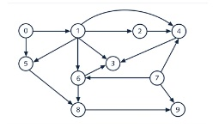
9. List the nodes of the graph in a breadth first topological ordering. Show the
steps using arrays predCount, topologicalOrder and a queue
Queue
9
3
8
4
6
5
2
1
7
0
Step 4. Add new node with degree 0 to the queue
Step 1. Add all nodes with degree 0
Nodes
[0] [1] [2] [3] [4] [5] [6] [7] [8] [9]
predCount₀
predCount₁
predCount₂
predCount₃
predCount₄
predCount₅
predCount₆
predCount₇
predCount₈
0[ [1[ [1[ [3[ [3[ [2[ [2[ [0[ [2[ [2
Step 3. Decrease -1 degree all affected nodes (Node 1 and 5 affected)
0 0 1 3 3 1 2 0 2 2
0 0 1 3 2 1 1 0 2 1
0 0 0 2 1 0 0 0 2 1
0 0 0 2 0 0 0 0 2 1
0 0 0 2 0 0 0 0 1 1
0 0 0 1 0 0 0 0 0 1
0 0 0 0 0 0 0 0 0 1
0 0 0 0 0 0 0 0 0 0
Step 2. Eliminate and add from queue to the Topological Ordering
Step 5. Eliminate the next node from queue and add it to the Topological Ordering
Topological Ordering:
0 , 7 , 1 , 2, 5, 6, 4, 8, 3, 9
Step 6. Repeat from step 3

Slide 9
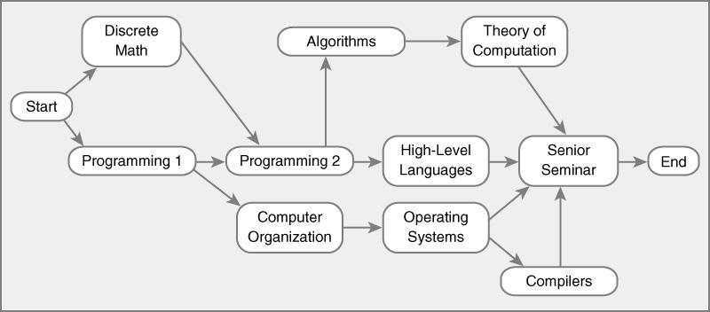
10. List the nodes of the graph in a breadth first topological ordering.
S DM P1 P2 CO AL HLL OS TC SS C E
predCount₀
predCount₁
predCount₂
predCount₃
predCount₄
predCount₅
predCount₆
predCount₇
predCount₈
0 1 1 2 1 1 1 1 1 4 1 1
Queue
0 0 0 2 1 1 1 1 1 4 1 1
0 0 0 1 1 1 1 1 1 4 1 1
0 0 0 0 0 1 1 1 1 4 1 1
0 0 0 0 0 0 0 1 1 4 1 1
0 0 0 0 0 0 0 0 1 4 1 1
0 0 0 0 0 0 0 0 0 4 1 1
0 0 0 0 0 0 0 0 0 3 1 1
0 0 0 0 0 0 0 0 0 2 0 1
0 0 0 0 0 0 0 0 0 1 0 1
0 0 0 0 0 0 0 0 0 0 0 1
0 0 0 0 0 0 0 0 0 0 0 0
E
SS
C
TC
OS
HLL
AL
CO
P2
P1
DM
S
Topological Ordering:
S, DM, P1, P2, CO, AL, HLL, OSS, TC, C, SS, E

