Slide 2

Psychological Distress among Greater Jakarta Area Residents
COVID-19 PandeMic and community quarantine
Presented by: Aly Lamuri
Center: Indonesia Medical Education and Research Institute
Email: aly.lamuri@ui.ac.id
Notes:
Good evening, I hope you can hear my voice just fine. My name is Aly Lamuri and today I’m excited about disclosing our findings on <<read title>>. We conducted this study in collaboration with the Department of Psychiatry and Department of Internal Medicine from University of Indonesia.
I’m currently working in a research institute, and if you have further enquiry please don’t hesitate to contact my email. We plan to share our data through Mendeley and will welcome any collaboration in such regards.

Slide 3
Introduction
What do we know about COVID-19?
How do we solve current issue?
Potentially arising problem?
Notes:
To address some lingering questions, I’d love to reminisce a moment regarding:
What we know about COVID-19
How do we solve the issue? And,
What is the potentially arising problem?

Slide 4
COVID-19?
Current Pandemic
Widely affecting global population
Highly transmissible
Notes:
I believe previous presentations have highlighted key points regarding COVID-19. As we understand, COVID-19 is the current pandemic, widely affecting population, and highly transmissible.
Etiologically, SARS-CoV-2 caused the pandemic. Said virus underwent several homologous recombination, expressing furin-recognition site in S1/S2 spike proteins. The presence furin-recognition side presumably let the virus to readily infect human hosts. Only in three months, COVID-19 has globally spread with R-null of 1.4-2.5.
Infected subjects display mild respiratory symptoms, while some also manifested as severe pneumonia and sepsis.
Not to mention its implication on the gastrointestinal, neurological and immune system. COVID-19 is a devastating adversity, probably the greatest difficulty we have faced besides the influenza pandemic

Slide 5
Solution?
Initial public health measure: individual vs community-level
Drug and vaccine development
Convalescent plasma
Notes:
With currently limited understanding of COVID-19 pathogenicity, abating pandemic progression requires a prompt public health mitigation.
On an individual level, the population will comply by isolating or performing self-quarantine. While on the community level, the government needs to impose lockdown or community-containment policy. By separating healthy from infected subject and minimizing physical contact, we are sought to prevent the disease transmission.
On the other hand, drug and vaccine development deserves more spotlight on currently ongoing research.
If we were to be overly optimistic, we may expect the vaccine as available by the mid-quarter of 2021, which is still a long run to go.
There are also other proposed treatments, such as convalescent plasma or using stem cell to improve the patient condition. But we don’t have enough clinical trial to confirm such novel treatments.
Thus, it is still of essence to adequately contain pandemic progression by following stipulated quarantine policy.

Slide 6
Further Problems?
Immediate psychological impact: wariness and negative percept
Community quarantine: induces distress
Socioeconomic instability during quarantine
Aim
Quantify psychological distress among residents
Objectives
Measure DASS-21 as an initial assessment of psychological distress
Collect socio-demographic data
Notes:
Although, we have experienced numerous habitual changes during this strange time.
Some reported an increase in wariness and negative percept during quarantine. And others perceived physical distancing as a social distancing, which induce distress to a certain subpopulation. Furthermore, enacted lockdown policy also caused socioeconomic instability and market plummeting.
Therefore, our study aimed to quantify distress among urban residents in the Greater Jakarta Area. To do so, we measured DASS-21 as an initial assessment of psychological distress also collected socio-demographic data, including sex, age, education, and income level.

Slide 7
Methods
Study design
Addressing variables
Data analysis
Notes:
I wish to further delineate our research methods in order to support reproducibility in different contextual settings.

Slide 8
Study Designs
Cross-sectional, analytic-observational
Targeted respondents: Jakarta, Bogor, Depok, Tangerang, Bekasi
18 years of age
Snowball sampling, stop at 2,000 entries
Socio-demographic data
Gender
Age
Educational Background
Notes:
We designed our investigation as a cross-section observational-analytic study. With targeted respondents from five adjacent cities, including Jakarta, Bogor, Depok, Tangerang, and Bekasi, our team collected data from residents of at least 18 years old.
To collect responses, we utilized a snowball sampling method and stopped data collection after reaching 2,000 entries. We first initiate an online questionnaire dissemination through social media group and personal chat, then we encourage the participants to further share our link to potential respondents, including family or colleagues.
We presented three demographic data in this report, including gender, age and educational background.

Slide 9
Addressing Variables
Gender
Assumes binary gender classification
Age
Group: Early, prime, mature, elderly
Based on workforce participation age classification by the UN
Educational Background
Low: Elementary, Junior, High School and Vocational degree
Moderate: Bachelor’s, Master’s, Professional degree
High: Doctoral and Post-Doctoral
Grouping based on proportional convenient segregation
Notes:
We used the word gender interchangeable with biological sex. In our study, we only consider binary representation of biological sex; female and male. With all due respect, we just aimed to minimize bias when analyzing sex dimorphism.
Collected age data segregated into several groups based on the United Nation stipulation on workforce age participation. So we have a group of early-age workers (between 18-24 years old), prime-age workers (between 25-54 years old), mature-age workers (between 55-64 years old), and elderly (above 65 years old).
Lastly, we divided educational background into low, moderate, and high based on proportion.

Slide 10
Data Analysis
Bivariate: Welch’s T-Test and ANOVA
Generalized Linear Model:
Gaussian family, identity link function
Response variable underwent square-root transformation
VIF: Assess multicollinearity
Harrison-McCabe: Determine homogeneity
Notes:
To perform bivariate test and investigate the mean difference, we use T-Test and ANOVA as we see fit. In conducting T-Test, Welch’s method is preferable to Student’s, since it does not assume standard deviation and sample size similarity between two groups. Instead, Welch’s method calculates a pooled variance based on both imputed groups, hence providing a more robust estimation of statistical significance.
With p-value < 0.25, imputed variables will then estimate DASS-21 score using a GLM, Generalized Linear Model. In designing GLM, we used Gaussian family with identity link function. We set the square-root transformed DASS-21 score as a response variable.
To assess multicollinearity, we employed Variable Inflation Factor calculation, where we considered value below 5 as having no colinear relationships.
Lastly, we used Harrison-McCabe test to determine homogeneity for its robustness in preventing False Detection Rate, especially in a large sample size.

Slide 11
Results
Demographic
DASS-21 overview
DASS-21 and associated variables
Multiple regression
Notes:
We shall begin examining our results by evaluating the demographic data, followed an overview of DASS-21 score, and how it associates with independent variables. Finally, we will see how the multiple regression demonstrate its usefulness in estimating DASS-21 score.

Slide 12
Demographic
Total 2029 participants, 824 men and 1205 women
Participants spent 3 hours outside
Age median 32 (18–81 years old)
Education
Low: 447 (22.03%)
Moderate: 1130 (55.69%)
High: 452 (22.28%)
Notes:
In total, we acquired slightly over 2,000 participants, with 824 males and 1205 females. In average, participants reported to spend at most three hours outside. The age median was 32, ranged from 18 to 81 years old.
About 22% of the participants has low educational background, 55% with moderate, and 22% with high.

Slide 13
DASS-21 Overview
Mild distress to none at all; Low DASS-21 score
 | Depression | Anxiety | Stress
Mild | 18.88 | 23.8 | 10.69
Moderate | 9.12 | 9.4 | 3.60
Severe | 0.94 | 1.9 | 0.59
Note: Value as percentage
Notes:
Urban residents in the Greater Jakarta Area perceived mild distress to none at all, indicated by low DASS-21 score. Among all participants, about 24% reported at least mild anxiety, and only a minority had worse than moderate level of depression, anxiety, and distress.

Slide 14
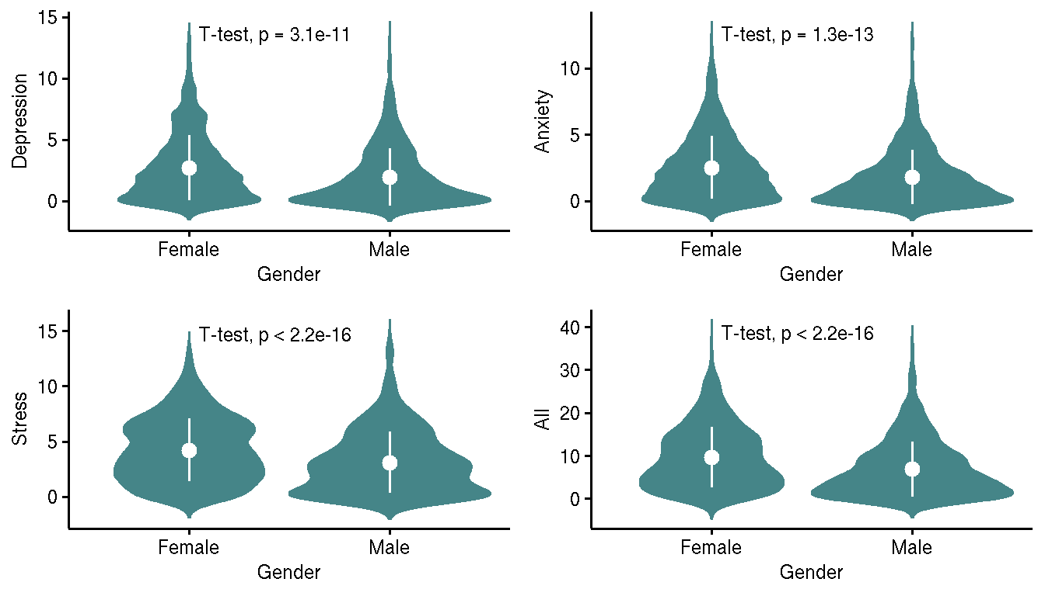
DASS-21 and Gender
Notes:
For the next three slides, we will focus on an overview of DASS-21 score mean differences. We will later discuss the rationale behind such differences.
We demonstrated different DASS-21 score among participants, where females perceived a greater degree of distress during pandemic compared to males. The mean difference is consistent among all DASS-21 components, thus consequently its total score.

Slide 15
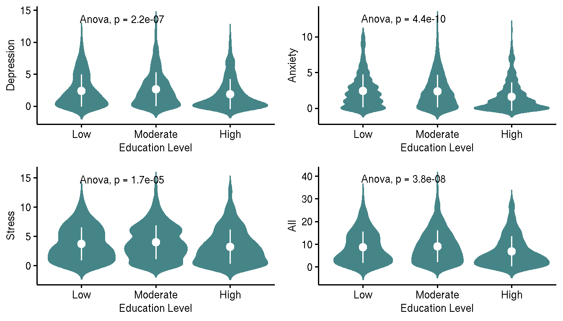
DASS-21 and Education
Notes:
By grouping the respondents based on their education strata, it appears people of higher education level displayed a lower tendency of having psychological distress. Performing a posthoc test using Tukey’s Honest Significance Difference revealed significant differences between high to low, and high to moderate pairwise comparison.
Obtained mean in subject with high education level was 6.86, 9.1 in moderate, and 8.64 in low.

Slide 16
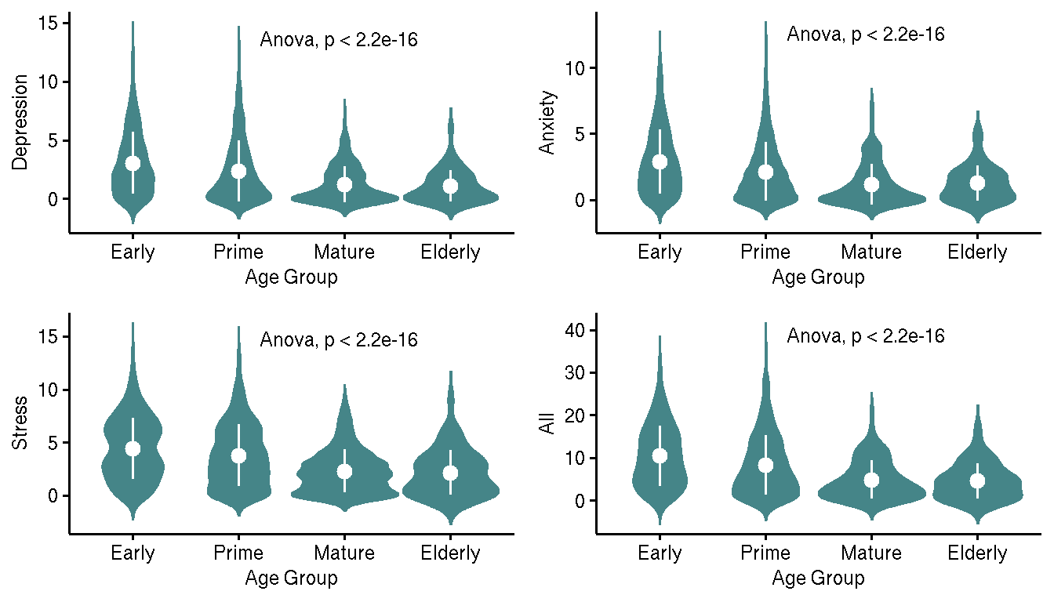
DASS-21 and Age Group
Notes:
When we classify participants based on their respective productive age, we observed lower psychological distress in mature and elderly groups. Tukey’s HSD yielded pairwise differences for prime to early, mature to early, elderly to early, mature to prime, and elderly to prime. However, no significant pairwise difference between elderly and mature group.

Slide 17
Multiple Regression
 | Estimate | Std. Error | t value | Pr(>|t|)
(Intercept) | 3.06 | 0.07 | 41.97 | 0.00
Male | -0.48 | 0.06 | -8.16 | 0.00
Age Group
Prime | -0.37 | 0.07 | -5.23 | 0.00
Mature | -0.93 | 0.12 | -7.91 | 0.00
Elderly | -1.02 | 0.20 | -5.11 | 0.00
Education
Moderate | 0.15 | 0.07 | 2.02 | 0.04
High | -0.09 | 0.09 | -0.96 | 0.34
VIF: {1.03, 1.23, 1.22}
HMC: 0.51 p=0.78
Notes:
We consider our GLM model as having a good fit, denoted by low VIF and non-significant HMC score. Statistically non-significant Harrison McCabe implies homogeneity of residual variances. Significant findings are consistent in male, prime, mature, elderly age group, and moderate education level.
Interpreting the intercepts, males tend to have lower psychological distress, while age groups older than early working age displayed lower psychological distress, and people of moderate education level has higher stress level.
Imputing the model into ANOVA revealed significant differences in sex, age, and education level.

Slide 18
Discussion
Sex dimorphism on distress perception
Socio-demographic status and psychological well-being
Age and quality of life
Notes:
After reviewing the results, there are compelling evidence on how subject background influence psychological distress. However, how do they come so? We shall discuss the importance of sex dimorphism, socio-demographic status, and age in estimating DASS-21 score.

Slide 19
Gender and Distress
We denoted higher psychological distress in women
Adversities re-experiencing and hyper-arousal
Negative alterations: cognition and emotion
Gender-based violence
Tendency of having longer working period (Hidrobo et al., 2020
Hidrobo M, Kumar N, Palermo T, Peterman A, Roy S. Gender-sensitive social protection: A critical component of the COVID-19 response in low- and middle-income countries. Intl Food Policy Res Inst; 2020
Notes:
We denoted higher psychological distress in females. Previous studies highlighted sex dimorphism in perceiving distress. Females are more likely to re-experience adversity and having a hyper-arousal.
Biologically speaking, if we’d consider the hypothalamus – pituitary – adrenal axis in regulating stress, a previous investigation reported higher cortisol productions in female following acute stress. It is accountable to differences in gonadal endocrine activity in regulating adrenocorticoid release.
Psychologically, higher distress in females is also inherently related to how females, compared to males, cope with a perceived distress. Females incline to depend on social and spiritual belief support, while males to a distractive coping mechanism.
Furthermore, Males also have a tendency of displaying externalizing disorder as compared to females, either as a distractive habit (such as smoking or drinking) or physical and psychological abuse. Coherently, females and children are more likely to receive gender-based violence.
Both in developed and developing countries, females also work longer compared to males, approximately 30 and 50 minutes more for developed and developing countries, respectively.

Slide 20
Educational Level
Depressive disorder is less prevalent in well-educated subjects (Lee and Park, 2015)
Subjects with lower education levels tends to have worse disease comprehension (Chen et al., 2019)
Education determines depression or anxiety risk (Luo et al., 2019)
Lower educational status corresponds to elevated depressive symptoms (Schlax et al., 2019)
Intervening Variables
Situational comprehension
Planning
Perception
Information discernment
Lee EW, Park JH. Individual and Socioeconomic Contextual Effects on Depressive Symptom in Korea: Multilevel Analysis of Cross-sectional Nationwide Survey. Journal of Korean Medical Science. 2015;30(2):186. Available from: https://doi.org/10.3346/jkms.2015.30.2.186.
Chen YY, Xu P, Wang Y, Song TJ, Luo N, Zhao LJ. Prevalence of and risk factors for anxiety after coronary heart disease. Medicine. 2019 Sep;98(38):e16973. Available from: https://doi.org/10.1097/md.0000000000016973.
Luo Z, Li Y, Hou Y, Liu X, Jiang J, Wang Y, et al. Gender-specific prevalence and associated factors of major depressive disorder and generalized anxiety disorder in a Chinese rural population: the Henan rural cohort study. BMC Public Health. 2019 Dec;19(1). Available from: https://doi.org/10.1186/s12889-019-8086-1.
Schlax J, Jünger C, Beutel ME, Münzel T, Pfeiffer N, Wild P, et al. Income and education predict elevated depressive symptoms in the general population: results from the Gutenberg health study. BMC Public Health. 2019 Apr;19(1). Available from: https://doi.org/10.1186/s12889-019-6730-4.
Notes:
Previous studies suggested lower psychological distress in well-educated subjects. It is in relation with an impaired disease comprehension among subjects of lower education level. Moreover, education also determines depression and anxiety risk. Thus, it becomes a part of our duty as a community to reach and educate subjects of lower socioeconomic segment.
There are intervening variables in considering education impacts on psychological wellbeing, including: <<read the list>>

Slide 21
Age
Current finding does not follow previous studies
Suicide rate among elderly rises after SARS pandemic in Hongkong (Cheung, Chau and Yip, 2008)
COVID-19-infected older adults complaint increased distress (Lima et al., 2020)
Rationale
Different cultural and demographic situation
An investigation by Lima et al. (2020) only considered infected subjects, while we are evaluating healthy subjects
Referring to Maslow’s hierarchy of needs, younger and productive subjects perceive more distress (Ryan et al., 2020)
Erik Erikson: quarantine as burdensome distress (Johal, 2009)
Cheung YT, Chau PH, Yip PSF. A revisit on older adults suicides and Severe Acute Respiratory Syndrome (SARS) epidemic in Hong Kong. International Journal of Geriatric Psychiatry. 2008 Dec;23(12):1231–1238. Available from: https://doi.org/10.1002/gps.2056.
Lima CKT, de Medeiros Carvalho PM, de Araújo Araruna Silva Lima I, de Oliveira Nunes JVA, Saraiva JS, de Souza RI, et al. The emotional impact of Coronavirus 2019-nCoV (new Coronavirus disease). Psychiatry Research. 2020 May;287:112915. Available from: https://doi.org/10.1016/j.psychres.2020.112915.
Ryan BJ, Coppola D, Canyon DV, Brickhouse M, Swienton R. COVID-19 Community Stabilization and Sustainability Framework: An Integration of the Maslow Hierarchy of Needs and Social Determinants of Health. Disaster Medicine and Public Health Preparedness. 2020 Apr;p. 1–7. Available from: https://doi.org/10.1017/dmp.2020.109.
Johal SS. Psychosocial impacts of quarantine during disease outbreaks and interventions that may help to relieve strain. Journal of the New Zealand Medical Association. 2009
Notes:
Our findings showed lower distress among older participants. It is not in agreement with previous studies, which demonstrated higher suicide rate among elderly after SARS pandemic in Hong Kong. In current pandemic, increased distress also reported in infected older adults.
Why does our findings differ? We do have several rationales on this regard.
Differences in our findings may happen due to cultural and demographic differences. A study by Cheung et al. only considered suicide count as an indicator of increased distress, which may not allow direct generalization for psychological wellbeing.
Meanwhile, an investigation by Lima et al. only looked for infected subjects and compared how age determine the distress level. Therefore, even though there are higher reported cases of distress among infected older subjects, it does not completely reflect how the general population will behave.
If we would consider Maslow’s hierarchy of needs, younger and productive subjects perceive more distress due to constrained and unstable socioeconomic condition.
Furthermore, we could argue based on Erik Erikson psychosocial development phase, where younger adults regard social interactions as love and intimacy. Therefore, imposed self-quarantine is potentially perceived as burdensome distress.

Slide 22
Limitations
Non-probability sampling
Does not fully represent subjects of lower socioeconomic status
Potential intervening variables
Notes:
Although we obtained 2,000 participants in this study, our design still suffer from a non-probability sampling. It may not fully represent subjects of lower socioeconomic status. We also addressed potential intervening variables in causing psychological distress.

Slide 23
Conclusions
Sub-groups at risk of having psychological distress:
Women
Early to prime age group
Low to moderate education level
Generalizable? Yes, if we only consider VIF and HMC, but…
Policymaker should consider Maslow’s hierarchy of needs in imposing quarantine
Notes:
There are several sub-groups at risk of having psychological distress, including: <<read the list>>
It is generalizable for population of similar sociodemographic status. Our model presented without multicollinearity nor heteroscedasticity. However, we still require probability sampling method and need to reach populations of lower socioeconomic segments.
We would suggest policymakers to consider Maslow’s hierarchy of needs in imposing or easing quarantine.
Finally, we also emphasize the importance of sociodemographic profiling as a health information investment.

