Slide 1
Case Study: Bella
Presented by: Lam Vi Nam
Last Updated: 29-04-2025

Slide 2
Table of Contents
1. Summary of the business task
2. Data source used
3. Documentation of data cleaning and data manipulation
4. Visualizations and key findings
5. Recommendations based on analysis

Slide 3
1. Summary of the business task
Provide insights into consumer usage patterns that will then help guide Bellabeat's marketing strategy.
- Analyze smart device usage data of non-Bellabeat smart devices to answer these questions:
1. What are some trends in smart device usage?
2. How could these trends apply to Bellabeat customers?
3. How could these trends help influence Bellabeat marketing strategy?

Slide 4
2. Data source used
FitBit Fitness Tracker Data (CCO: Public Domain, dataset made available through Mobius): This Kaggle data set contains personal fitness tracker from thirty fitbit users.
- Thirty eligible Fitbit users consented to the submission of personal tracker data, including minute-level output for physical activity, heart rate, and sleep monitoring.
- It includes information about daily activity, steps, and heart rate that can be used to explore users' habits.

Slide 5
3. Documentation of data cleaning and data transformation
Merging
bella/documentation/merging/merging_log.xlsx
bella/code/data_merging.Rmd
Cleaning
bella/documentation/cleaning/cleaning_log.xlsx
bella/code/data_cleaning.Rmd
Transformation
bella/documentation/transformation/analyzing.nb.html
bella/code/analyzing.Rmd

Slide 6
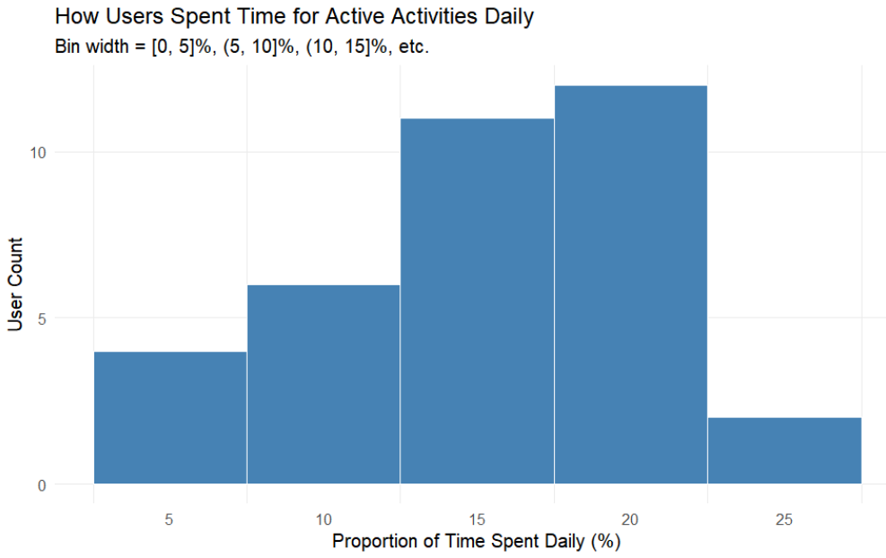
4. Visualizations and key findings
The amount of daily time spent daily for physical activies is 15% on average (3 hours a day). Most of users ranges from from 10% to 20% (2 - 4 hours a day).
This is much higher than the average of people in the US (about 0.5 hour a day), which shows a high level of physical activity of FitBit users.

Slide 7
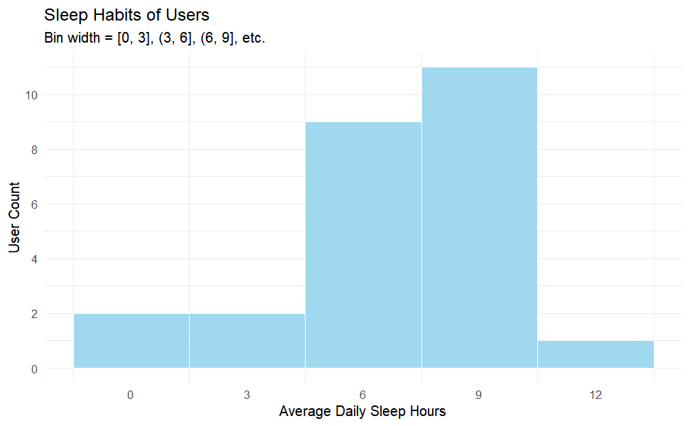
4. Visualizations and key findings
Most of the users already had a healthy amount of sleep hours (more than 6 hours per day). And users who even had 9-to-12-hour sleep is the peak.

Slide 8
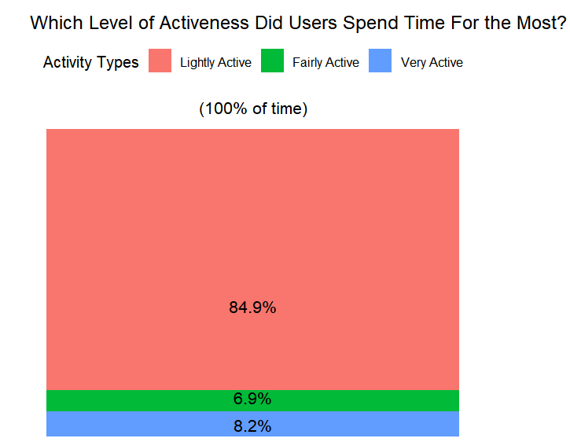
4. Visualizations and key findings
Light physical activities occupies a major time proportion (84.9%), dominating the two other types of active activites.

Slide 9
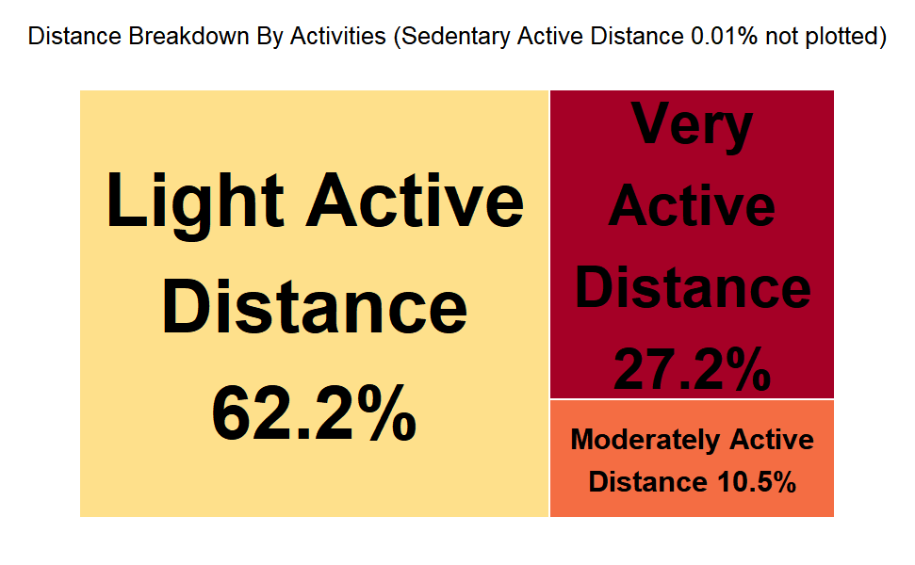
4. Visualizations and key findings
Light physical activities occupies a major distance proportion (62.2%), even though less so comparing to the previous dimension.
So it’s worth noticing moderate and very active physical activities but to a lesser extent.

Slide 10
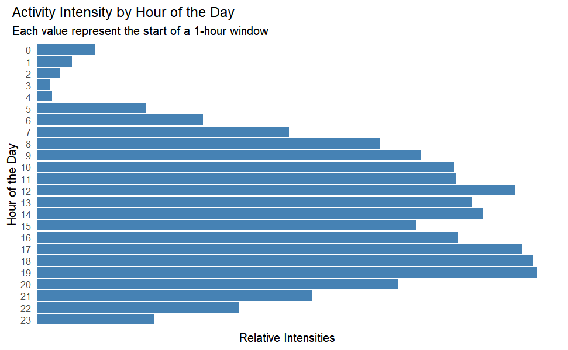
4. Visualizations and key findings
The most easily regconizable peak intensity period is from 17:00 to 20:00. The second one is from 12:00 to 15:00.
Amping up periods are time windows that precede the peaks and see a relative increase in intensity levels. Those are: “8:00 to 12:00”, “15:00 to 17:00”.
Winding down periods: the rest.
Worth noticing window: “15:00 to 17:00” (both amping up and winding down).

Slide 11

Fitbit users demonstrate a higher level of physical activity compared to the average person. Additionally, an examination of their sleep habits indicates that Fitbit users are health-conscious .
The activity profile shifts toward light activities. Moderate and very active physical activities are noticeable but to a lesser extent.

Slide 12
5. Recommendations based on analysis
Assumption:
The sample size is sufficient to represent the population.
FitBit and Bella customer bases are similar.
Light activities: includes leisurely walking or other low-effort movements.
Moderate activities: includes activities like brisk walking, moderate cycling, or other activities that elevate your heart rate and breathing somewhat but where you can still hold a conversation.
Very active activities: includes activities like running, high-intensity interval training (HIIT), or other efforts where you are breathing heavily and finding it difficult to speak in full sentences.
Recommendations
The time window for ads is from 15:00 to 17:00, in which people would have finished their work-out or prepared for one. (high level of motivation, high level of contentment, problem-product association, etc.)
The ads content should show a healthy and active lifestyle in which light physical activities (a large ads portion) and moderate/heavy physical activities (a smaller ads portion) are the focus.

Slide 13


