Slide 1
CampusHub
University Student, Faculty & Course Management System
MySQL 8.0 (Relational ACID Engine) + MongoDB (NoSQL Document Store) + Python Flask
Name: Lamya Kadiwala
Registration No: 2502051918
Section: M4
RDBMS Fast Learners Assignment

Slide 2
MOTIVATION & ARCHITECTURE
Problem Statement & Why Hybrid RDBMS + NoSQL?
Why modern university ERP platforms require Polyglot Persistence
02 / 12
The Challenge with Single-Database Systems
Traditional RDBMS-only systems excel at structured relational records but struggle with schema-flexible feeds, multi-tag course broadcasts, and high-volume session logs.
Concurrent Course Registration requires strict ACID row-level locking (SELECT ... FOR UPDATE) so seat capacity is never exceeded.
Grade Modifications require database-level AFTER UPDATE triggers to guarantee an immutable compliance audit trail.
Course Announcements & Student Reviews contain variable tag arrays and require live star-rating aggregation pipelines.
Daily Class Attendance across 12 courses creates thousands of rows; storing each session as 1 embedded NoSQL document speeds up retrieval.
MySQL 8.0 (Relational Engine — System of Record)
Enforces 3NF normalization & Foreign Key constraints
Prevents seat overbooking via ACID transactions
Computes Weighted GPA (4.0 scale) & SQL Analytical Views
Fires automated AFTER UPDATE / DELETE Audit Triggers
MongoDB (CampusHub_NoSQL — Document Store)
Stores course_announcements with nested tag arrays
Aggregates student course_feedback via $group & $avg
Archives full class attendance_sessions in single BSON docs
Saves denormalized student_transcripts & audit_logs

Slide 3
SYSTEM DESIGN
Architecture & Tech Stack
End-to-End Request Flow Across Role-Based Portals, Flask REST API, MySQL 8.0, and MongoDB
03 / 12
1. Presentation Layer (3 Role-Based Web Portals)
Admin Portal (/) • Faculty Portal (/faculty-portal) • Student Portal (/student-portal)
Built with HTML5, Modern Enterprise CSS (Inter + Outfit + JetBrains Mono), and Vanilla ES6 Fetch API.
2. Application & Security Layer (Python Flask REST Backend)
Role-Based Access Control (@app.before_request) • Werkzeug PBKDF2 Password Hashing • 35+ REST API Endpoints
Dual-Database Orchestration: Synchronizes transactional writes to MySQL and document snapshots to MongoDB.
3A. Relational Engine: MySQL 8.0 (CampusHub)
9 Tables (3NF) • Foreign Keys • ACID Row Locking (FOR UPDATE) • 2 Analytical Views • 4 Audit Triggers.
Driver: PyMySQL | Port: 3306 | Engine: InnoDB
3B. NoSQL Engine: MongoDB (CampusHub_NoSQL)
5 Collections (course_announcements, course_feedback, attendance_sessions, audit_logs, student_transcripts).
Driver: PyMongo + Portable JSON Document Engine

Slide 4
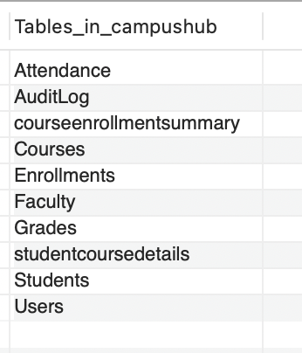
RELATIONAL DATABASE (MYSQL 8.0)
MySQL 8.0 Schema Design (9 Normalized 3NF Tables)
Strict Foreign Key Referential Integrity & Composite Uniqueness Constraints
04 / 12
9 Core Relational Tables in CampusHub
1. Departments (department_id PK, department_name UNIQUE, hod_name)
2. Faculty (faculty_id PK, email UNIQUE, designation, department_id FK)
3. Students (student_id PK, email UNIQUE, status, department_id FK)
4. Courses (course_id PK, credits, max_capacity, department_id & faculty_id FK)
5. Enrollments (enrollment_id PK, student_id FK, course_id FK, status)
6. Grades (grade_id PK, enrollment_id FK UNIQUE, marks, grade)
7. Attendance (attendance_id PK, enrollment_id FK, session_date, status)
8. AuditLog (log_id PK, table_name, action_type, old_value, new_value)
9. Users (user_id PK, username UNIQUE, password_hash, role, linked_id)

Slide 5
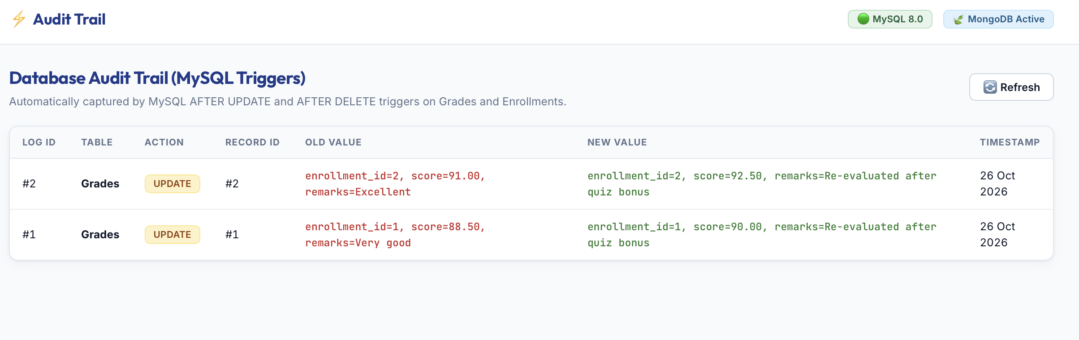
ADVANCED RDBMS ENGINEERING
Triggers, Views & ACID Concurrency Control
Database-Level Automation & Transaction Safety in MySQL 8.0
05 / 12
1. Automated Audit Triggers (4 MySQL Triggers)
trg_grades_after_update, trg_grades_after_delete, trg_enrollments_after_update, trg_enrollments_after_delete automatically capture OLD and NEW values into AuditLog.
2. Pre-Compiled Analytical SQL Views (2 Views)
View_Student_Performance (5-table JOIN) and View_Course_Utilization (calculates seat fill % and remaining seats).
3. Pessimistic Row-Level Locking (SELECT ... FOR UPDATE)
Locks the Courses row during student self-enrollment so concurrent requests cannot exceed max_capacity.
4. Credit-Weighted GPA Engine (4.0 Scale)
GPA = SUM(grade_points * credits) / SUM(credits), mapping A+/A=4.0, A-=3.7, B+=3.3, B=3.0, C+=2.3, C=2.0, D=1.0, F=0.0.

Slide 6
NOSQL PLATFORM (MONGODB)
MongoDB Document Store Architecture (CampusHub_NoSQL)
5 Schema-Free BSON/JSON Collections Powering Real-Time Features Across All Portals
06 / 12
1. course_announcements
Faculty course broadcasts with priority levels (Urgent/Important/Normal) and embedded tags: ['exam', 'syllabus'] arrays.
2. course_feedback
Student 1–5 star ratings, difficulty levels, and reviews. Aggregated via MongoDB $group & $avg pipelines.
3. attendance_sessions
Stores an entire class session's attendance roster in 1 nested document with summary counts & records: [...] array.
4. student_transcripts
Self-contained, denormalized academic transcript snapshots generated when students view/print their transcript.
5. audit_logs (NoSQL Stream)
Schema-free event stream recording polymorphic metadata payloads across self-enrollment, grading, and broadcasts.

Slide 7
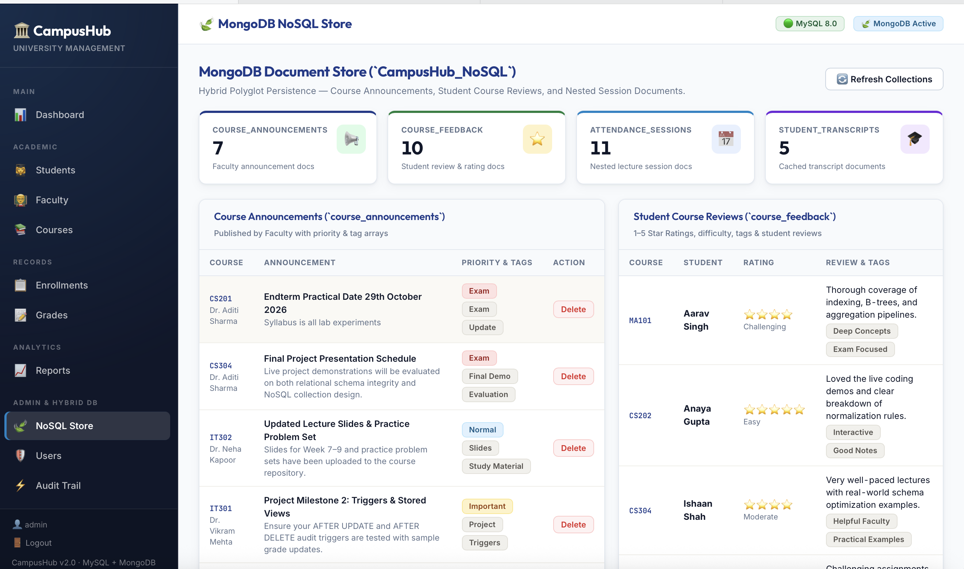
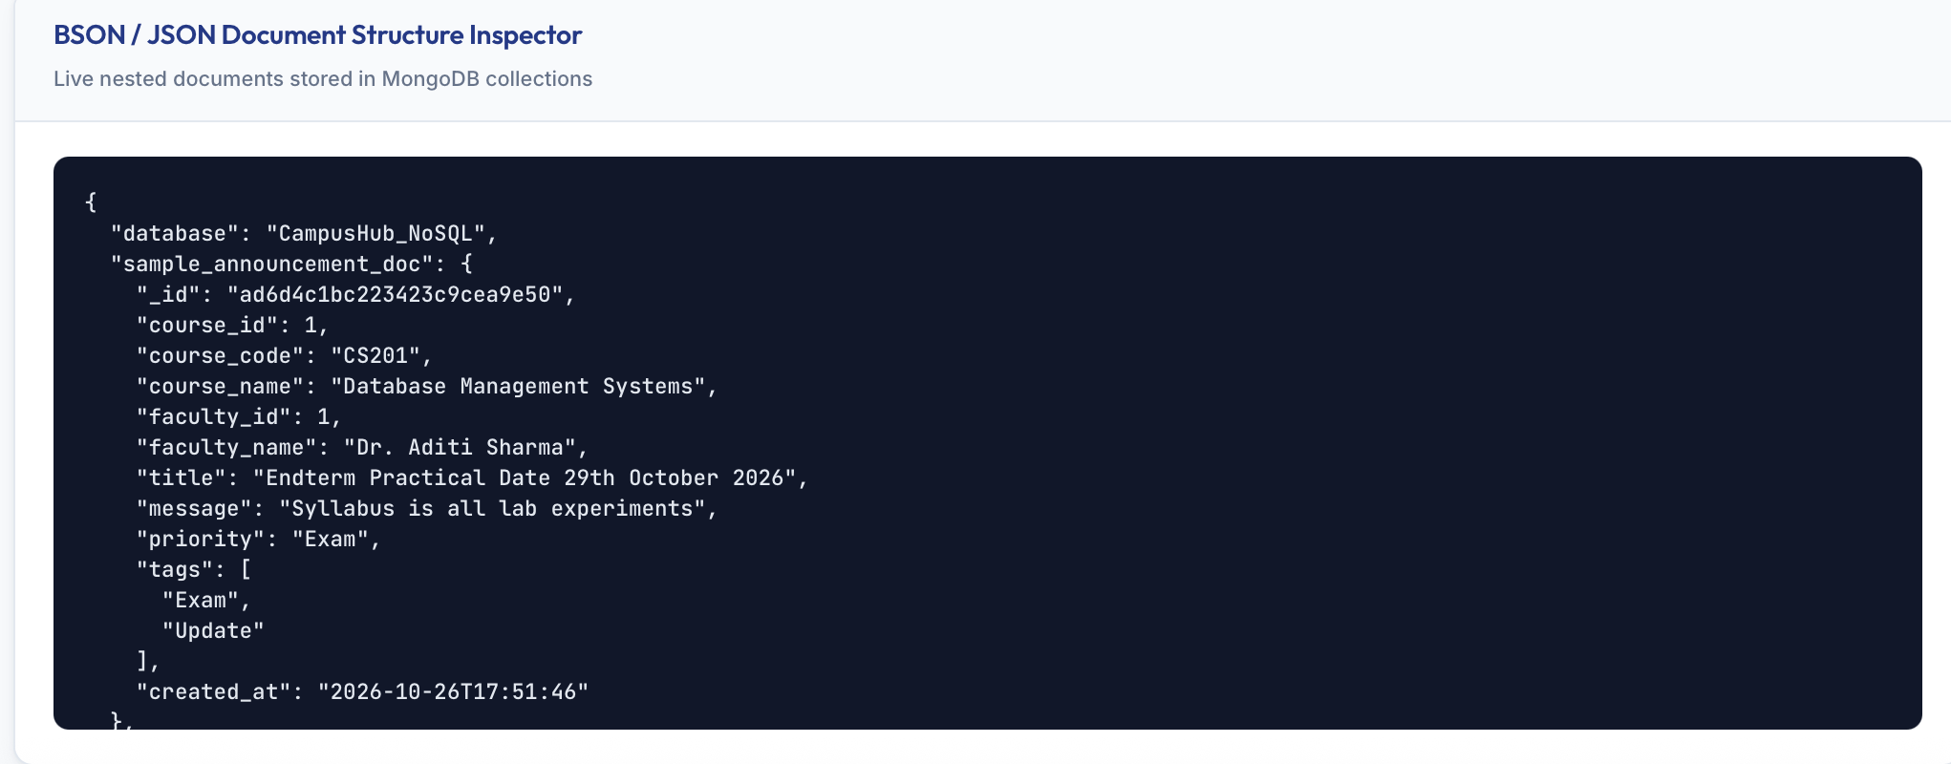
NOSQL ANALYTICS & JSON INSPECTOR
MongoDB Aggregation Pipeline & Document Explorer
Real-Time Course Rating Analytics ($match -> $group -> $avg -> $sort)
07 / 12
Live MongoDB Aggregation Pipeline
When Faculty or Students open the Reviews tab, CampusHub executes a multi-stage MongoDB aggregation pipeline on course_feedback:
Stage 1 ($match): Filters feedback documents by the instructor's assigned course_id list.
Stage 2 ($group): Groups by _id: '$course_id' and computes avg_rating: { '$avg': '$rating' } and total_reviews: { '$sum': 1 }.
Stage 3 ($sort): Orders courses by highest average rating.
Dual-Mode Resilience (mongo_db.py)
Connects automatically to live MongoDB (localhost:27017) via PyMongo, with automatic fallback to portable JSON document persistence (mongodb_data/*.json).

Slide 8
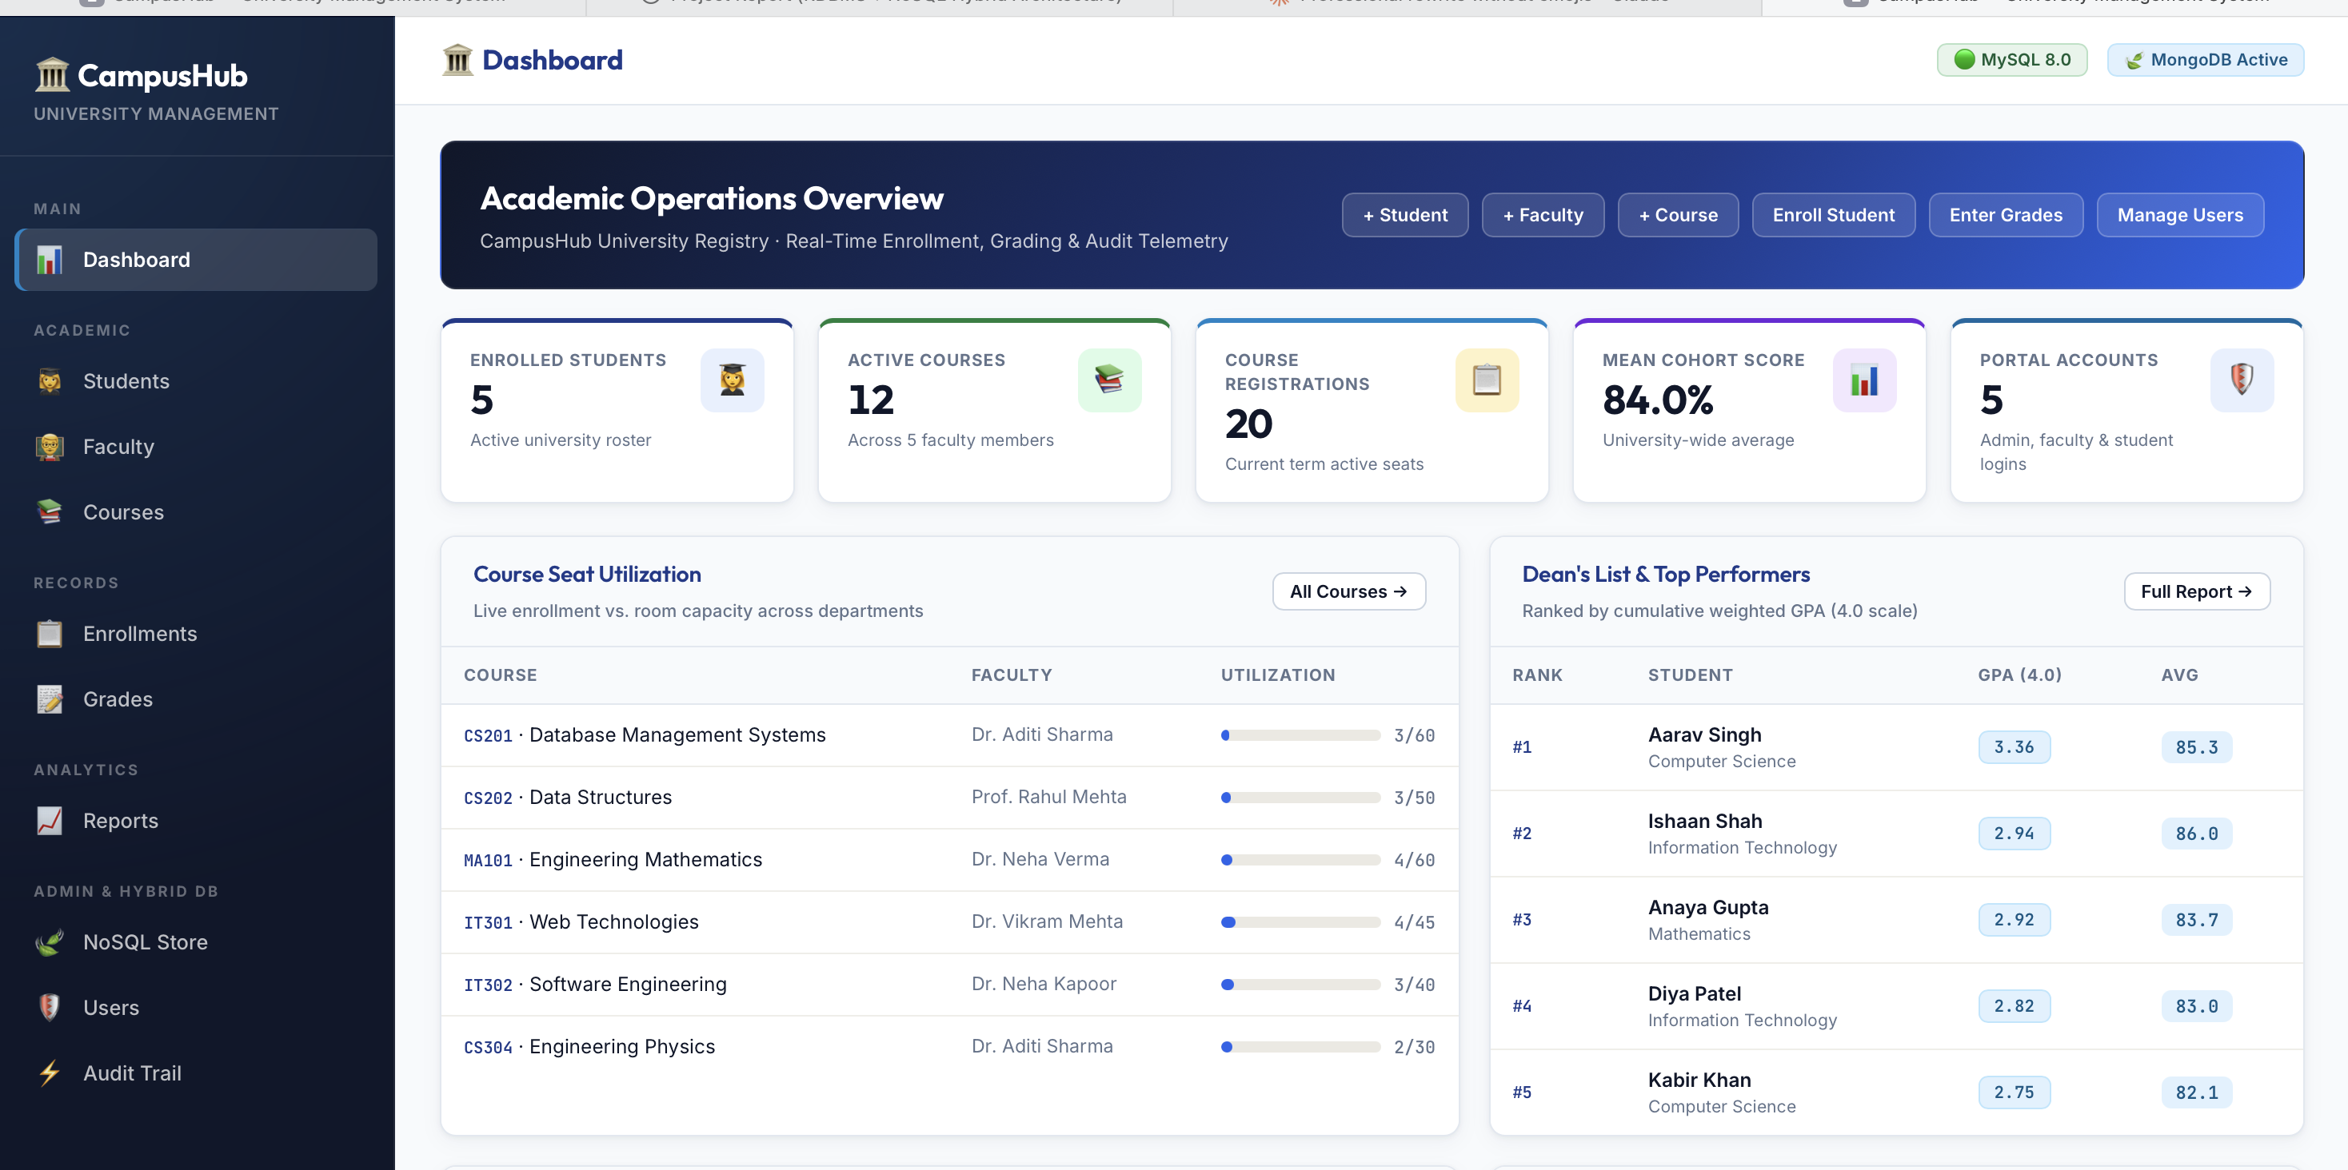
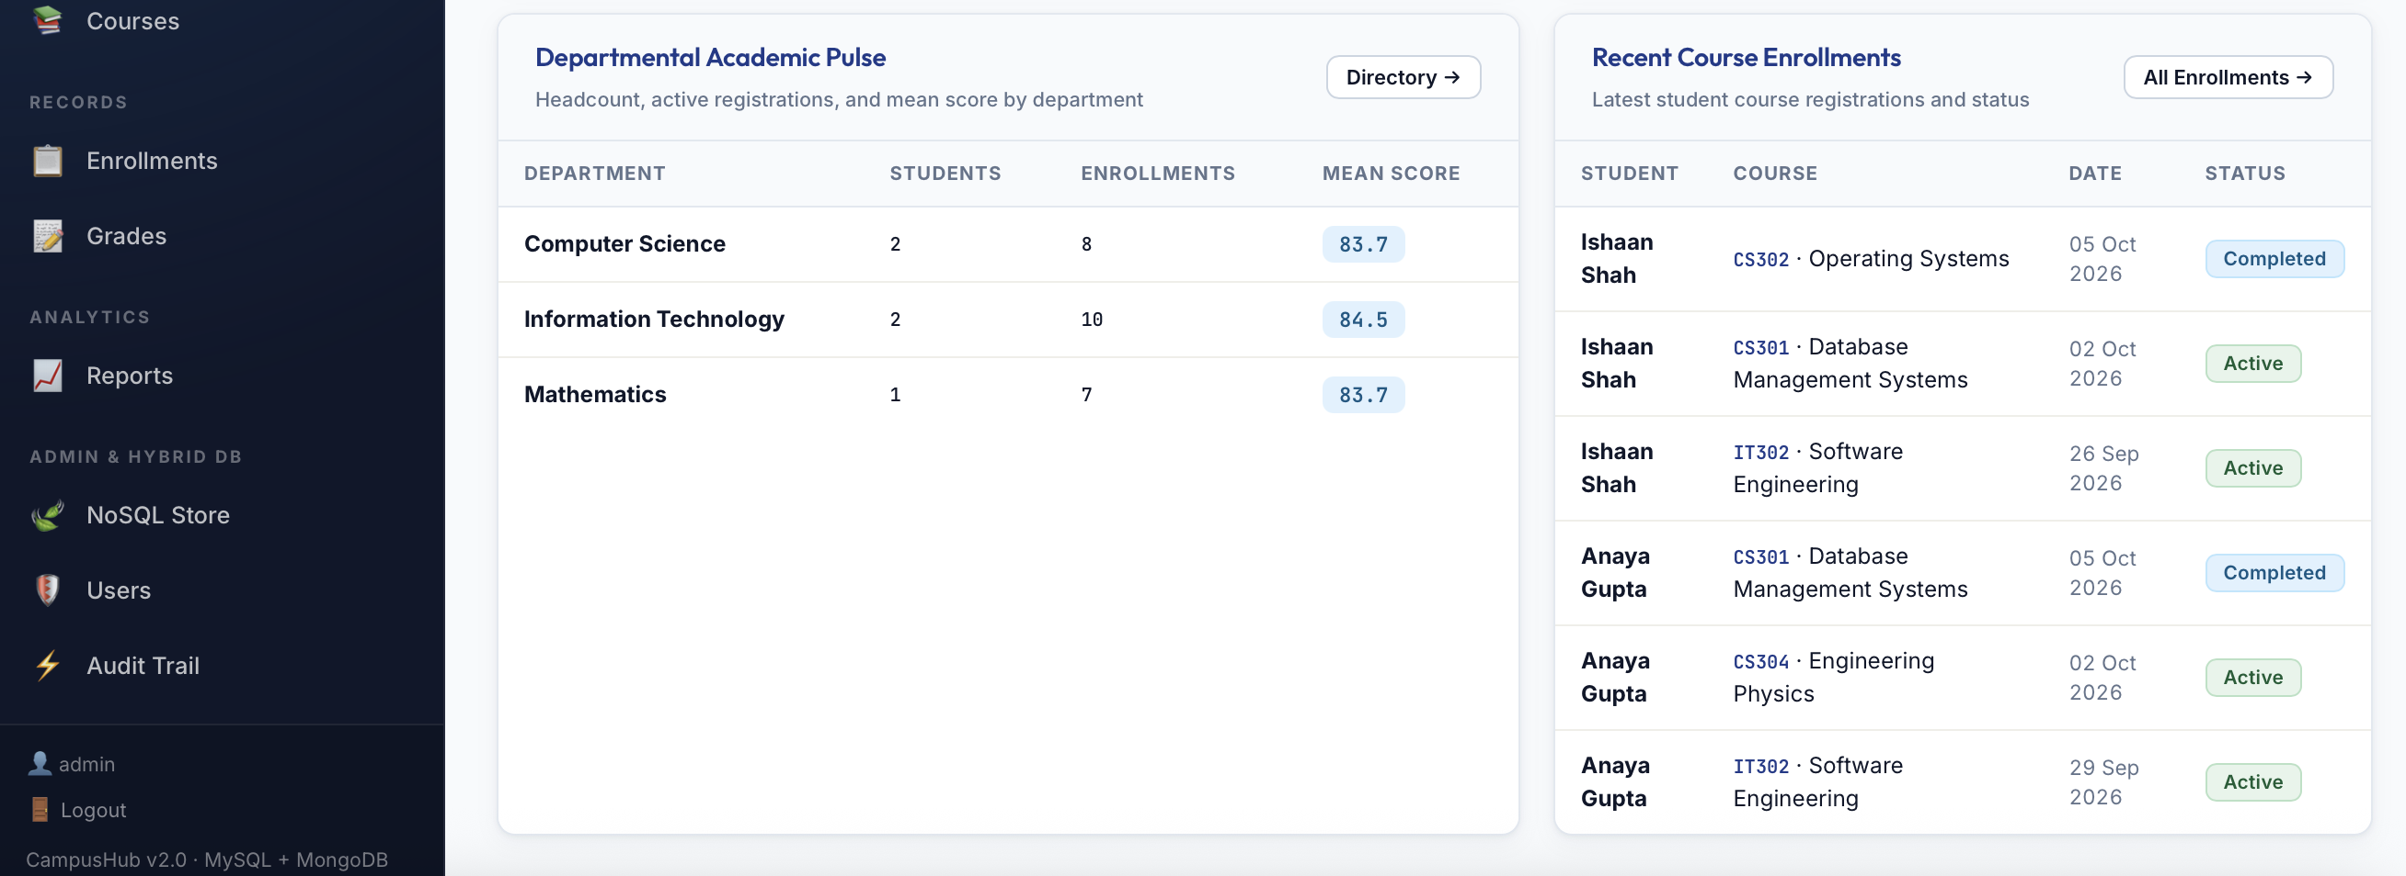
ROLE PORTAL 1 — ADMINISTRATOR
Admin Executive Portal & 2×2 Bento Analytics Grid
Comprehensive University Oversight, Seat Utilization, and Full Entity CRUD
08 / 12
Key Capabilities of the Admin Portal (/)
6 Live KPI Summary Cards: Total Students, Active Students, Total Courses, Total Faculty, Enrollments, and Average Marks.
Card 1 — Course Seat Utilization: Live capacity progress bars warning when courses approach 90%+ capacity.
Card 2 — Dean's List & Top Performers: Ranks top students by average score and GPA badge.
Card 3 — Departmental Academic Pulse: Compares student counts, courses offered, and avg marks across all 5 departments.
Card 4 — Recent Course Enrollments: Real-time feed of student registrations and status badges.
Full CRUD Management: Students, Faculty, Courses, Enrollments, Grades, Users, Audit Trail, and MongoDB Explorer.

Slide 9
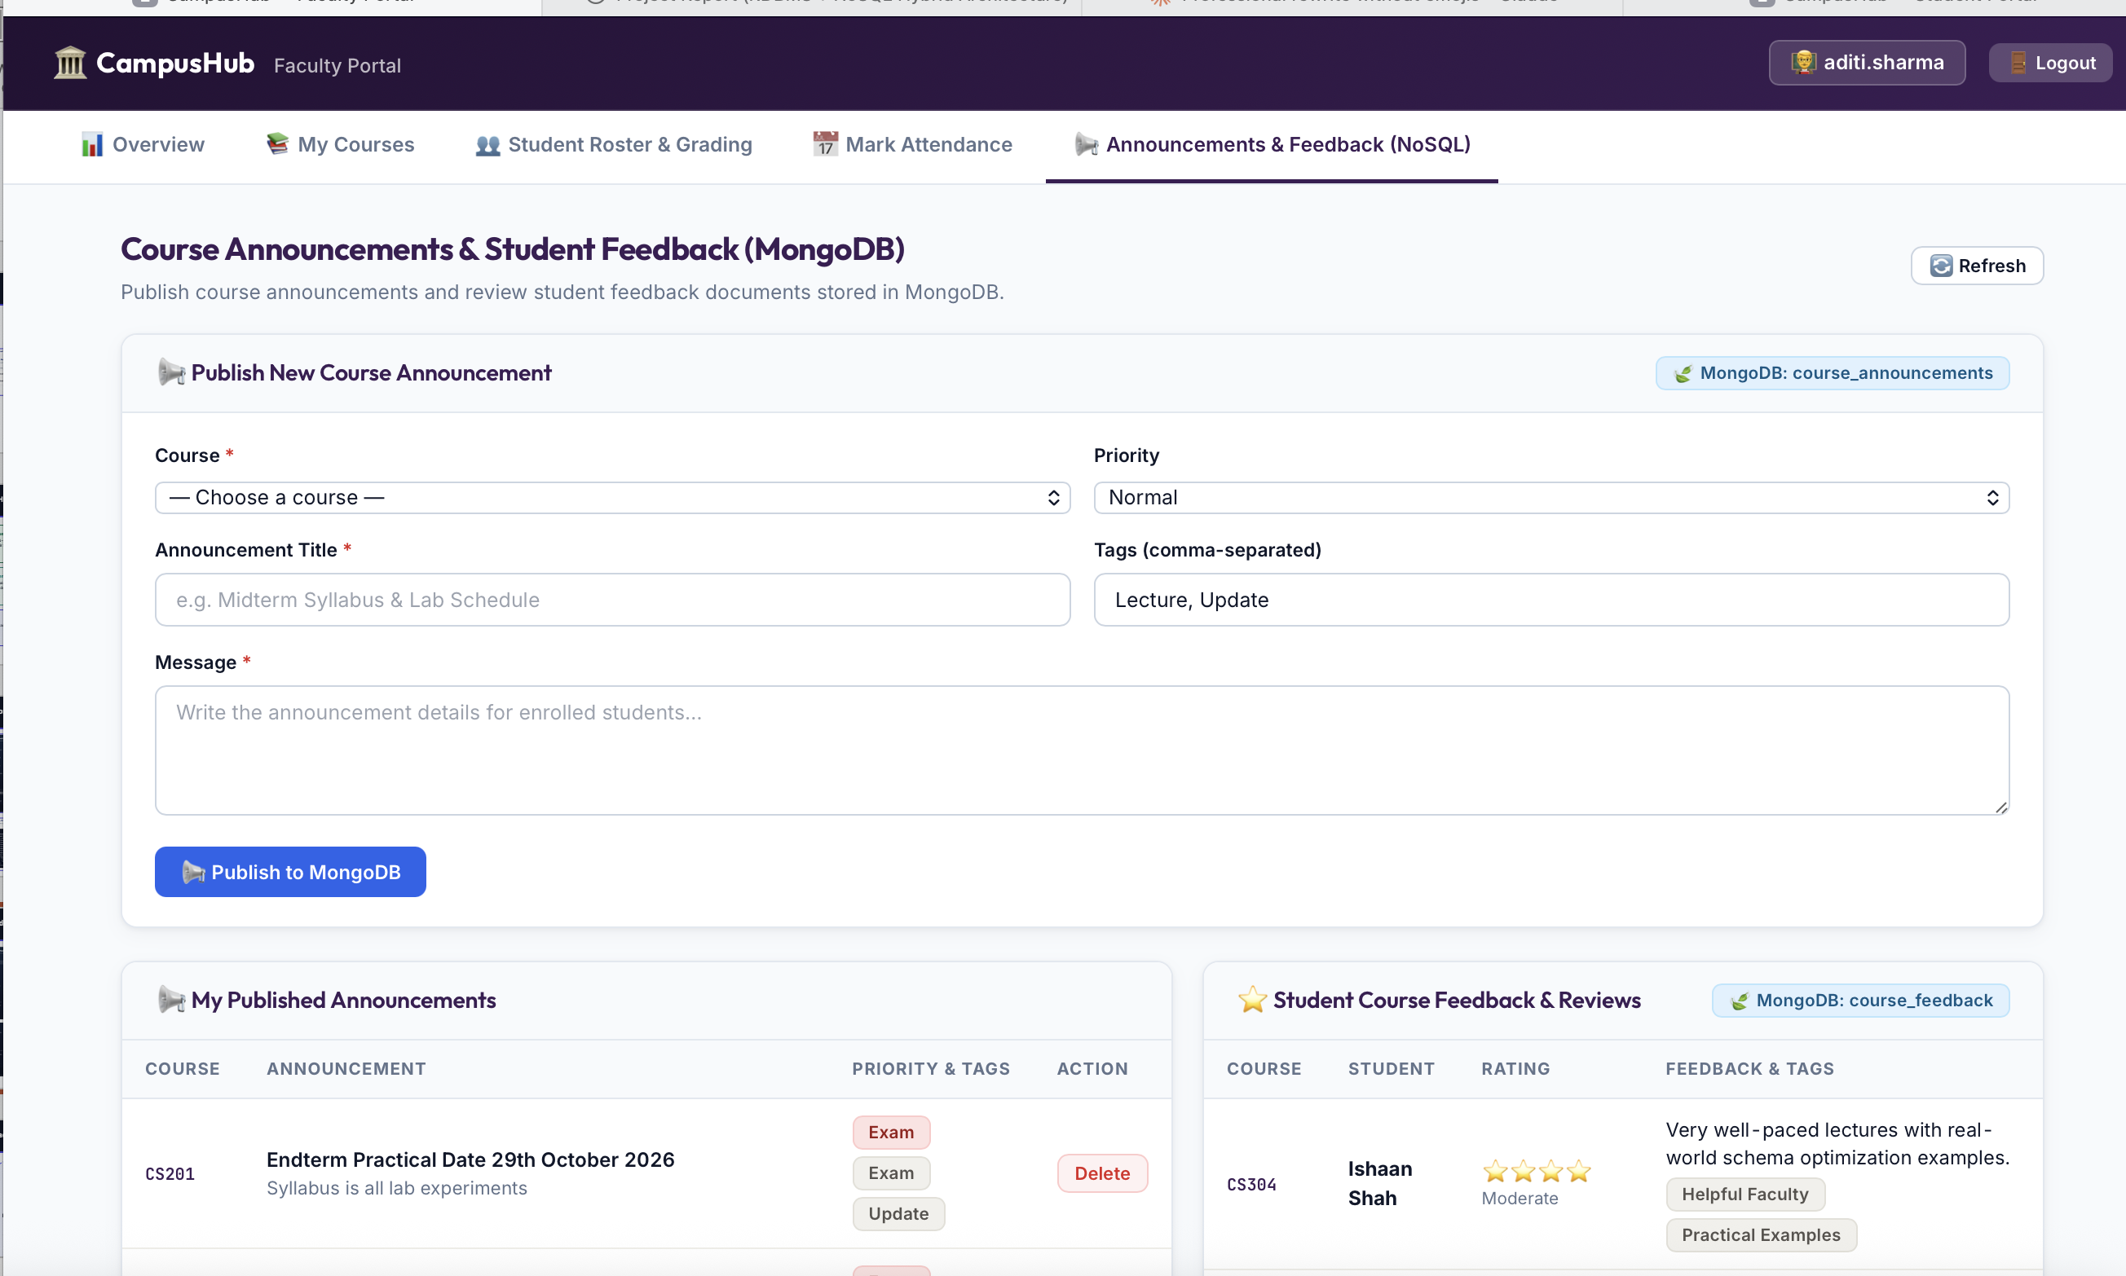
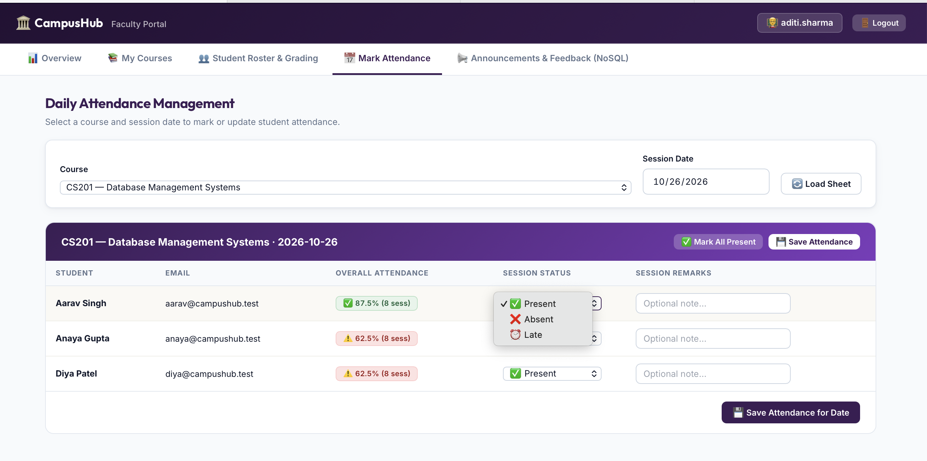
ROLE PORTAL 2 — FACULTY MEMBER
Faculty Portal: Grading, Attendance & NoSQL Broadcasts
Dedicated Instructor Workspace Synchronized with Both MySQL & MongoDB
09 / 12
Key Capabilities of the Faculty Portal (/faculty-portal)
My Courses & Student Roster: View enrolled students per assigned course and enter numeric marks (0–100).
Auto-Calculated Letter Grades: Automatically assigns A+, A, A-, B+, B, C+, C, D, or F and triggers MySQL AuditLog.
Batch Session Attendance: Mark Present, Absent, Late, or Excused for an entire class date; saves to MySQL Attendance AND syncs a nested session document to MongoDB.
Course Announcements (MongoDB): Broadcast rich announcements with priority levels and custom tag arrays.
Student Feedback Analytics (MongoDB): View aggregated course star ratings and anonymous student reviews.

Slide 10
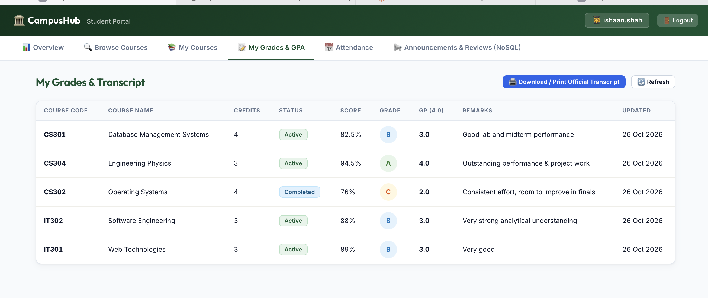
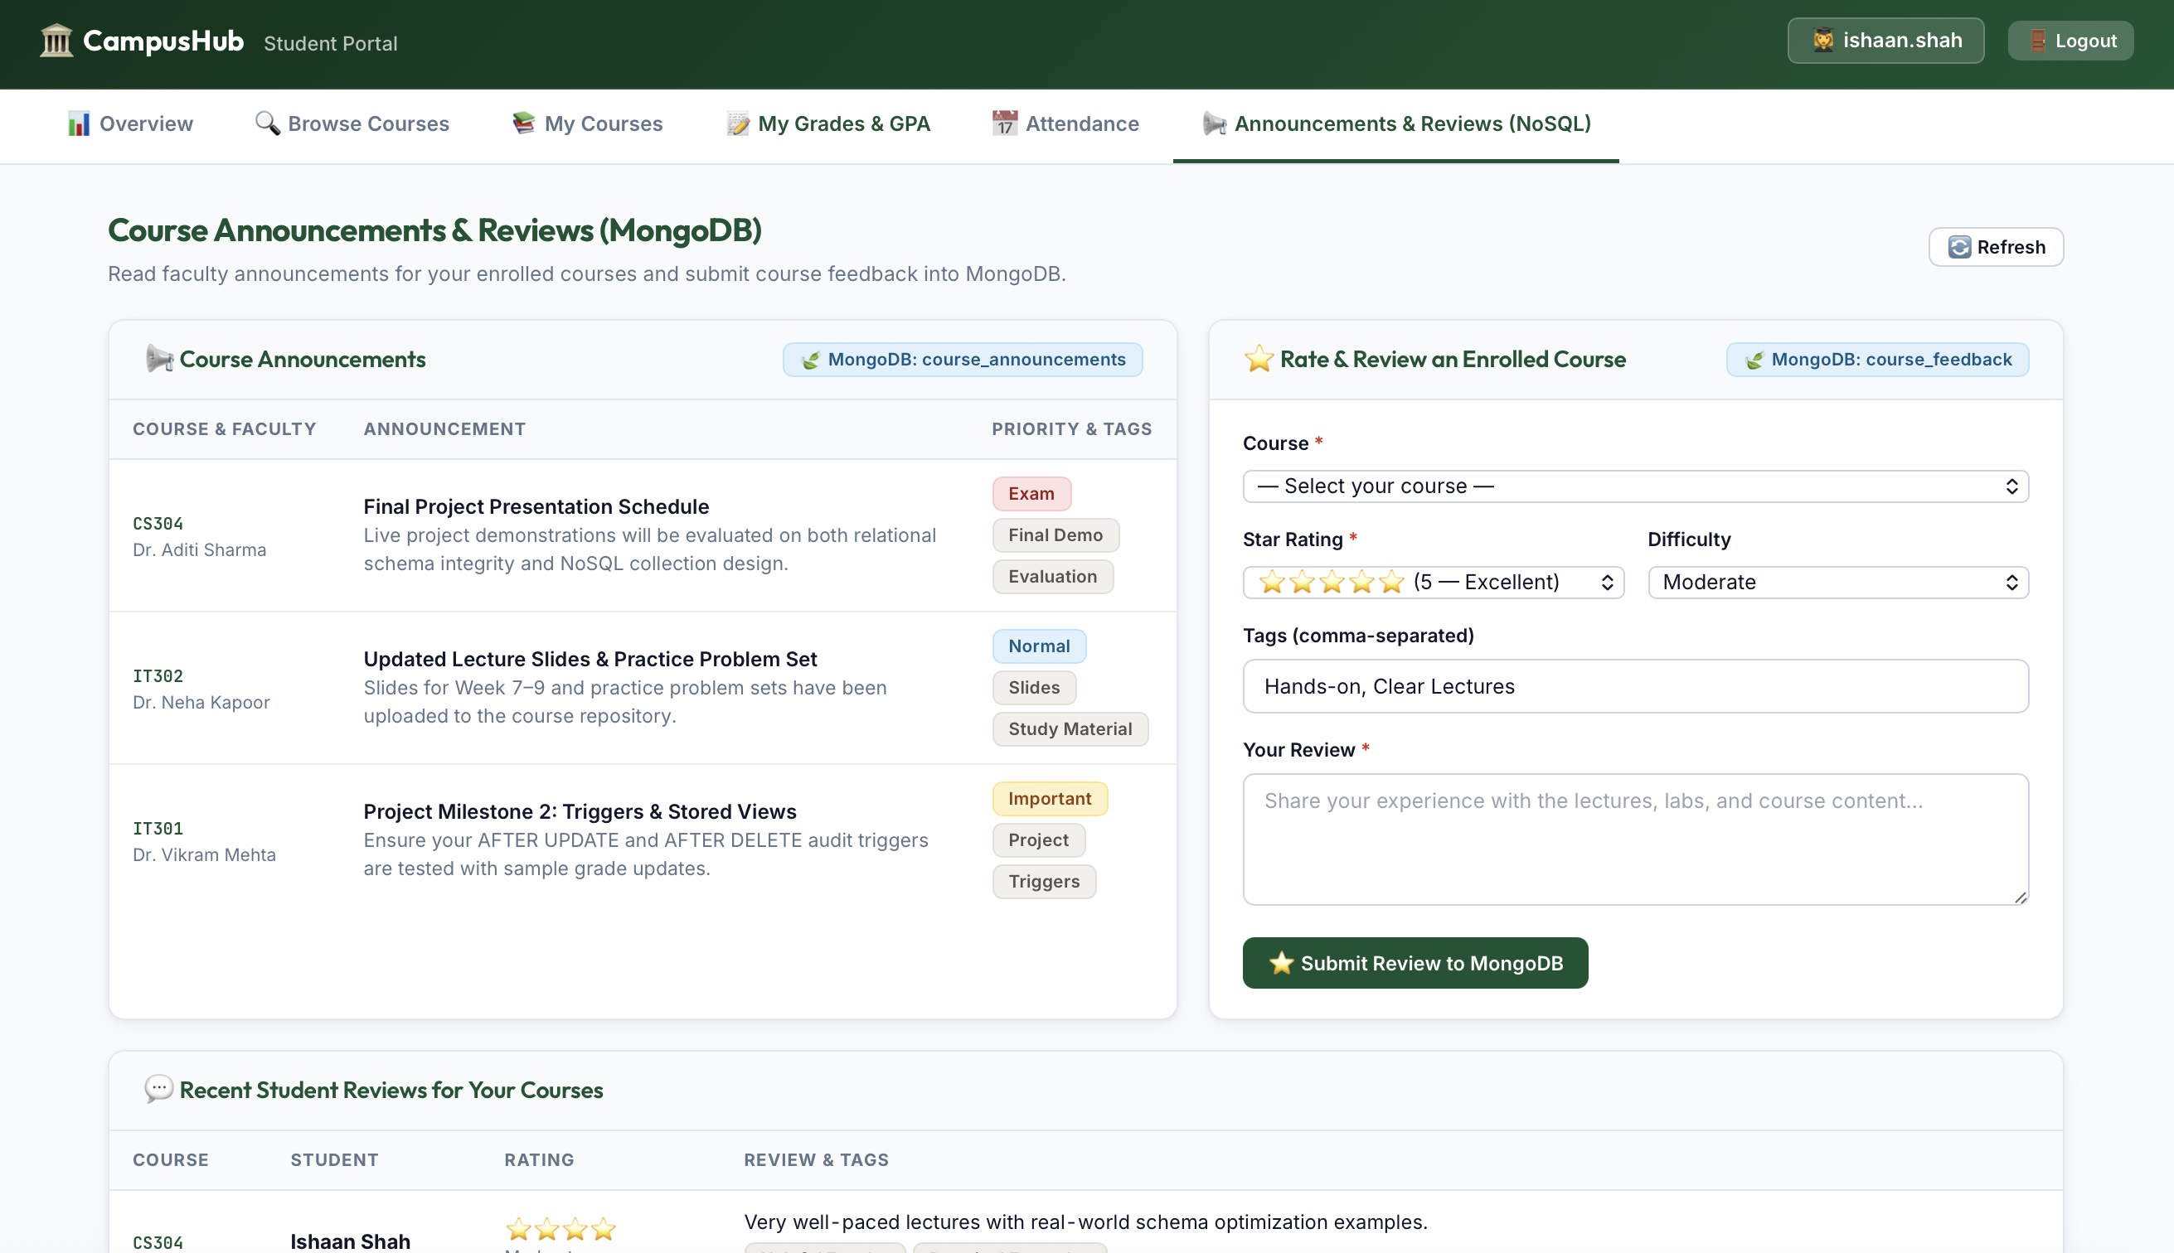
ROLE PORTAL 3 — STUDENT
Student Portal: Self-Enrollment, GPA Transcript & Reviews
Real-Time Course Registration, Attendance Alerts, and Official Printable Transcript
10 / 12
Key Capabilities of the Student Portal (/student-portal)
Browse Course Catalog & Self-Enroll: View real-time seat availability bars and enroll/drop courses with ACID transaction safety.
Weighted GPA (4.0 Scale) & Printable Transcript: Generates an official academic transcript (window.print()) and archives a JSON snapshot in MongoDB student_transcripts.
Attendance Tracker & <75% Warning Badge: Displays per-course attendance % and flags courses below the 75% threshold.
Course Announcements & Reviews (MongoDB): Read instructor broadcasts and submit 1–5 star ratings with feedback tags.

Slide 11
SECURITY & DATA INTEGRITY
Role-Based Access Control & Dual-DB Synchronization
How CampusHub Guarantees Security and Consistency Across MySQL & MongoDB
11 / 12
Security & Access Control
Password Hashing: All user passwords in the Users table are hashed using Werkzeug PBKDF2 cryptographic hashing.
Strict Route Guard (@app.before_request): Intercepts every HTTP request to verify session role ('admin', 'faculty', 'student') and prevents cross-portal privilege escalation.
Parameterized SQL Queries: 100% of PyMySQL queries use %s bound parameters to eliminate SQL Injection vulnerabilities.
Auto-Profile Linking: Automatically binds student/faculty user accounts to their relational entity IDs.
Dual-Database Event Synchronization
Attendance Sync: Faculty marking attendance executes an upsert into MySQL Attendance AND writes a full session document to MongoDB attendance_sessions.
Grade Update Sync: Updating a student's marks fires the MySQL AFTER UPDATE trigger into AuditLog AND appends a JSON event to MongoDB audit_logs.
Transcript Archival: Generating a student transcript computes live GPA from MySQL and upserts an immutable snapshot into MongoDB student_transcripts.

Slide 12
CONCLUSION & PROJECT IMPACT
CampusHub: Best of Both Database Worlds
9 MySQL 3NF Tables
Strict Foreign Keys, 2 Analytical Views, 4 Automated Audit Triggers, and ACID Row Locking.
5 MongoDB Collections
Announcements, Course Feedback, Session Attendance, Audit Logs, and Student Transcripts.
3 Role-Based Portals
Dedicated Admin, Faculty, and Student workspaces with live analytics and printable transcripts.
Thank You!

