Slide 1


Slide 2

Blockchain = Database

Slide 3
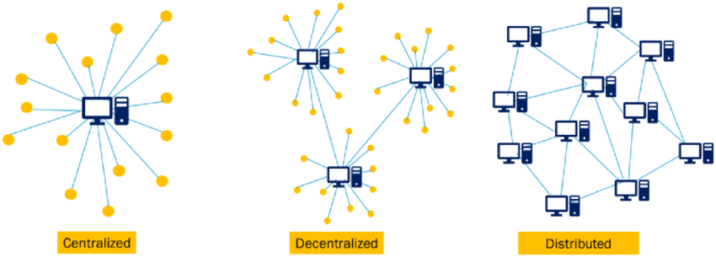
Blockchain = Réseau

Slide 4
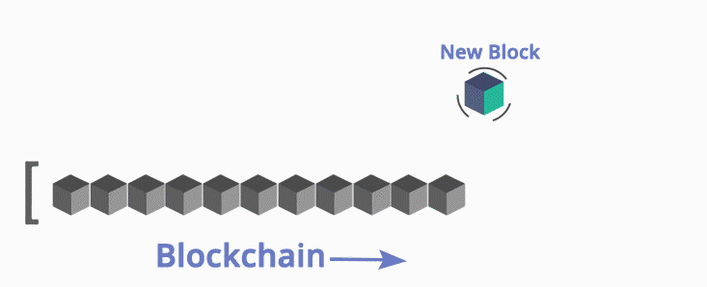
Blockchain = blocs

Slide 5
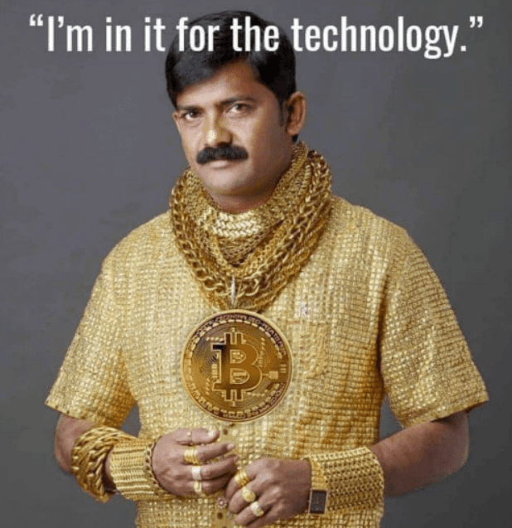

Slide 6
Cryptographie
kruptos (κρυπτός) : caché
graphein (γράφειν) : écrire

Slide 7
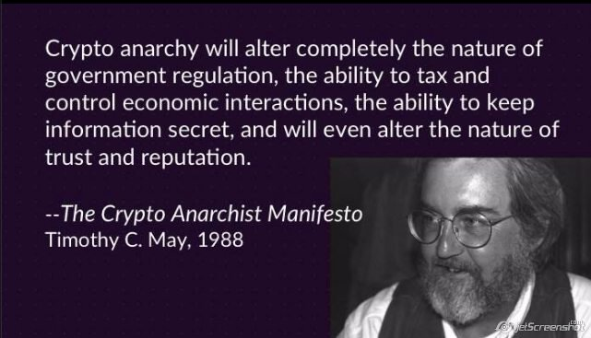

Slide 8
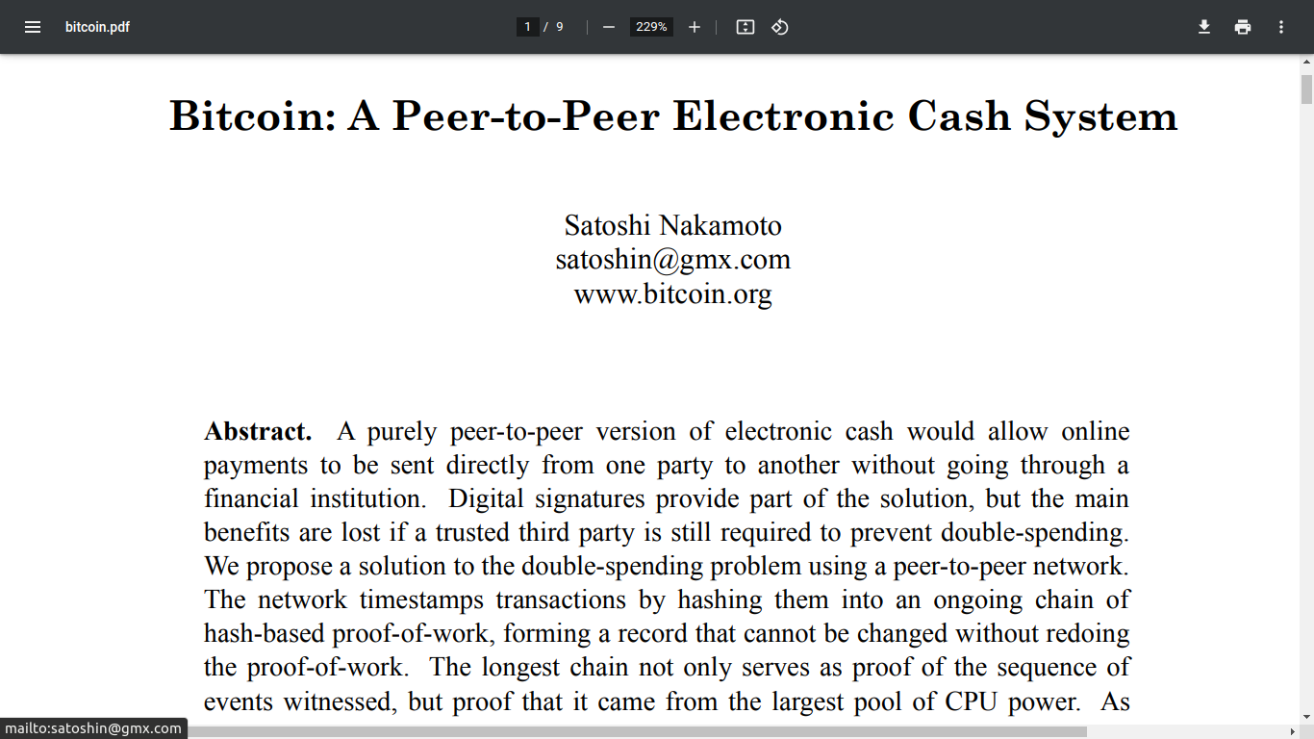
31 Octobre 2008 : Bitcoin

Slide 9
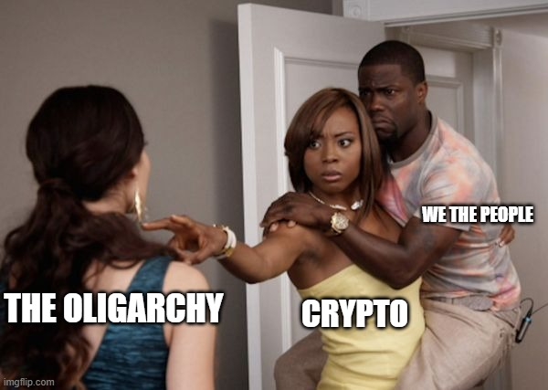

Slide 10

2014 : Monero

Slide 11

2015 : ETHEREUM

Slide 12
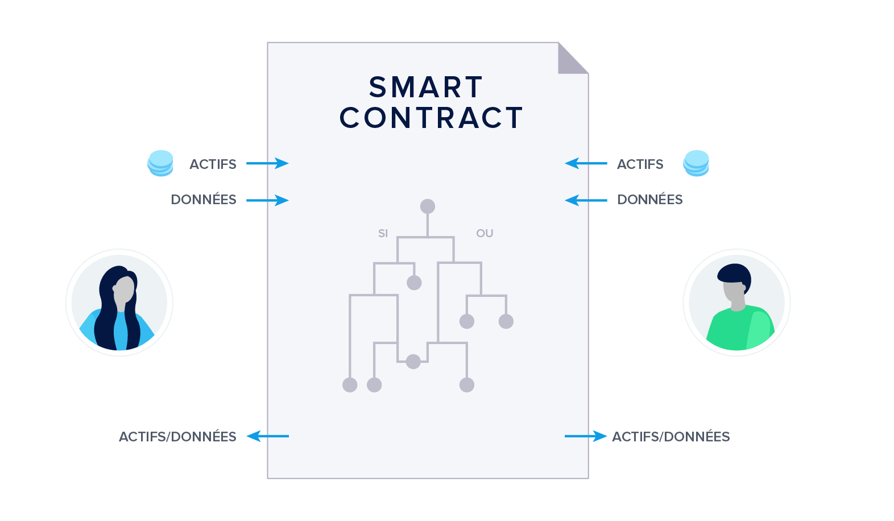
Smart Contract

Slide 13
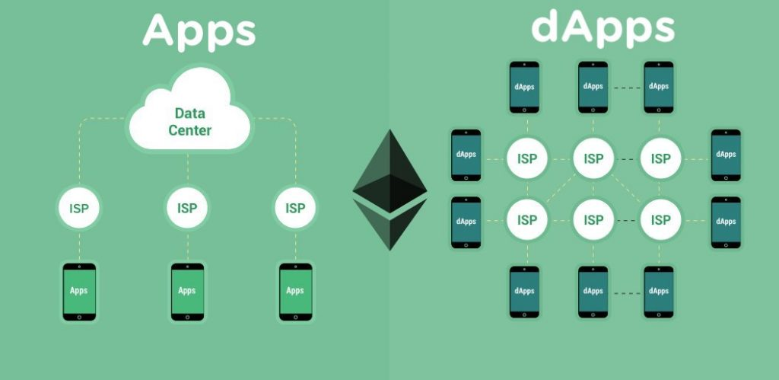
dApp

Slide 14


Slide 15
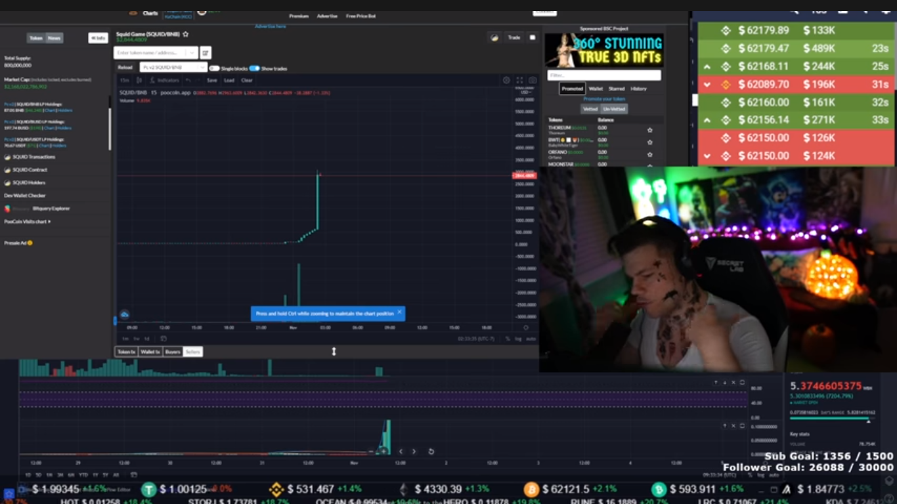

Slide 16
$SQUID = rug pull !

Slide 17
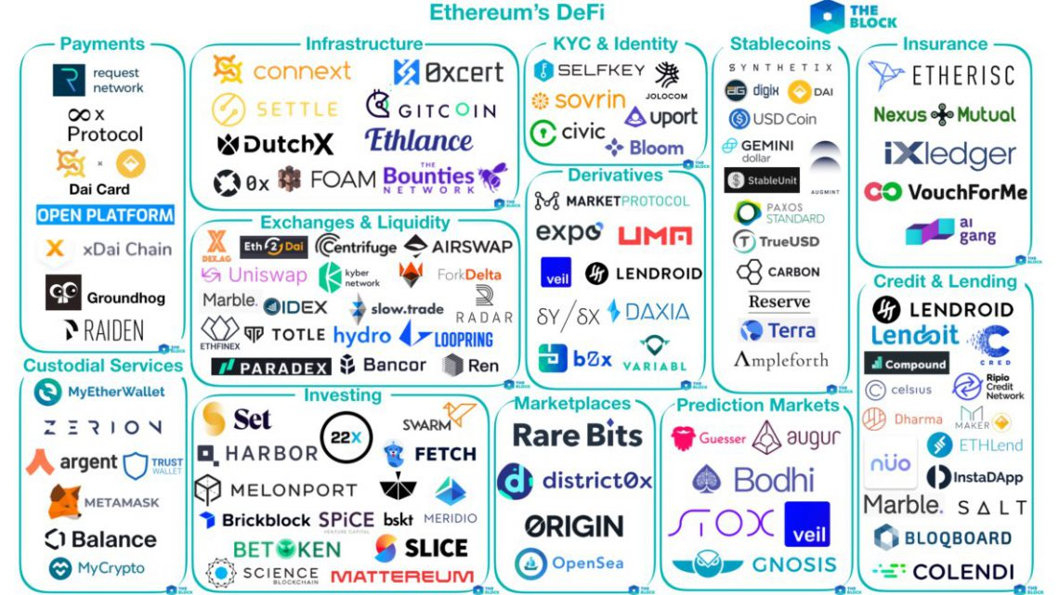
DeFi

Slide 18
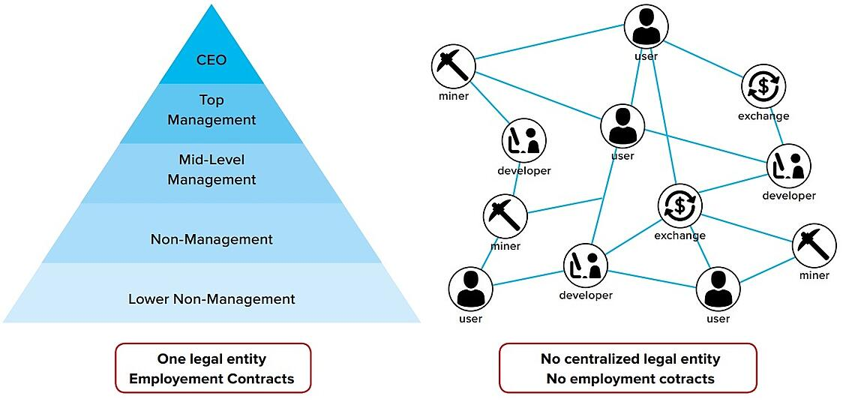
DAO

Slide 19
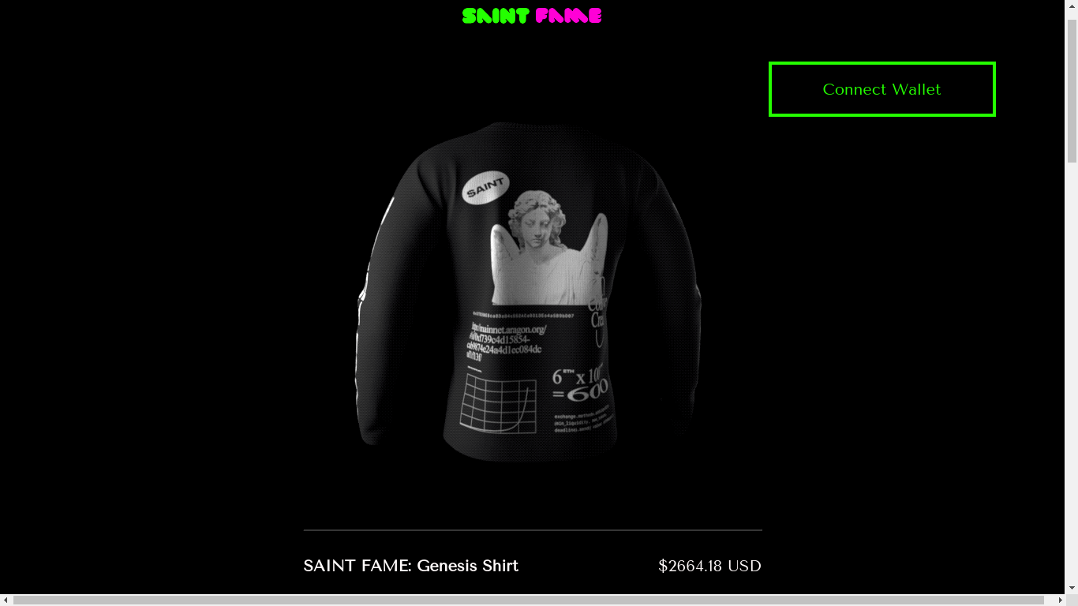

Slide 20
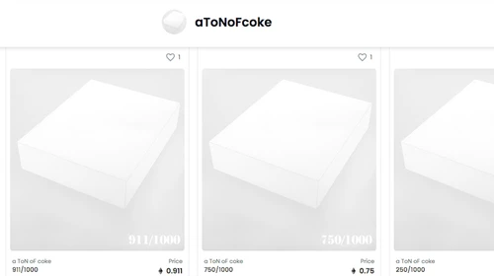
NFTs

Slide 21
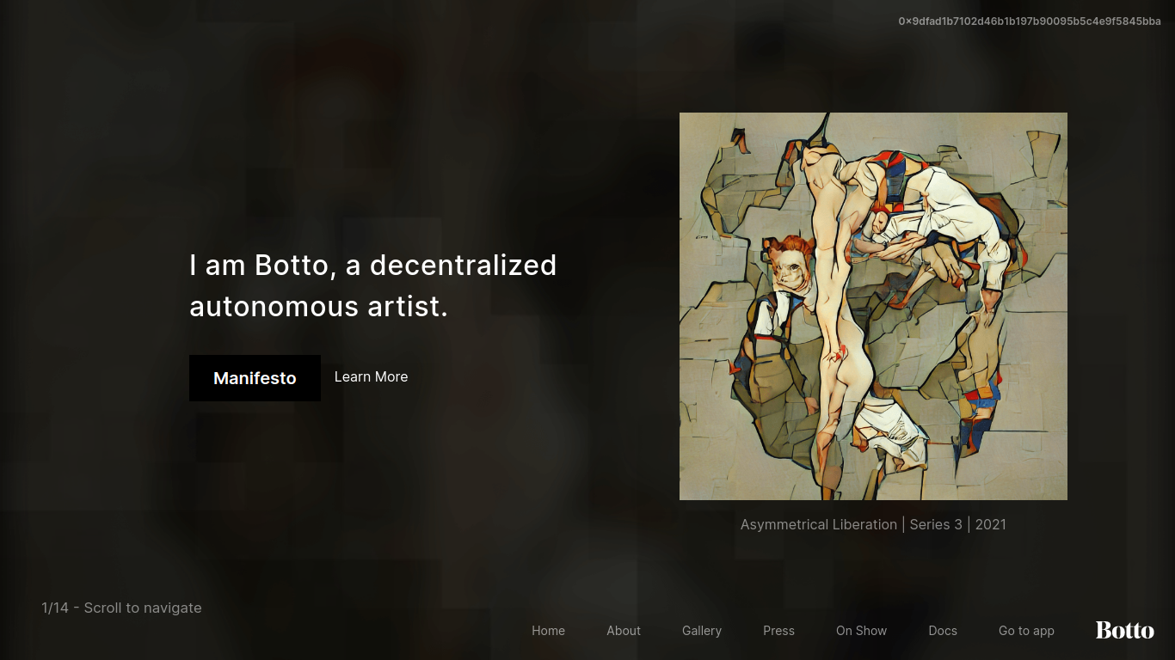

Slide 22
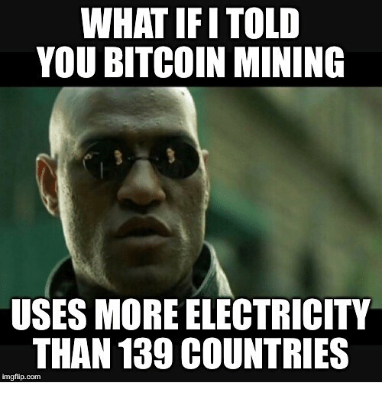

Slide 23
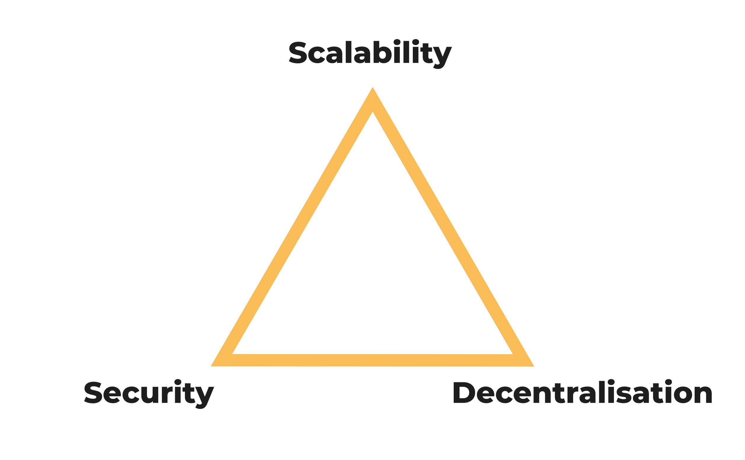

Slide 24
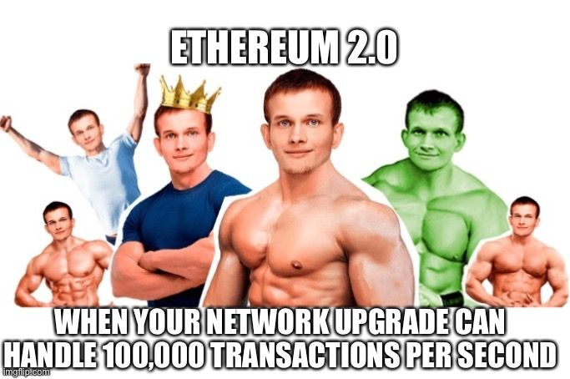

Slide 25
POW / POS / DPOS / POA / DAG
POW = Proof of Work (btc/eth/xmr)
POS = Proof of stake (bnb/matic/ada)
DPOS = Delegated Proof of stake (tron/cosmos)
DAG = Directed Acyclic Graph (miota)

Slide 26
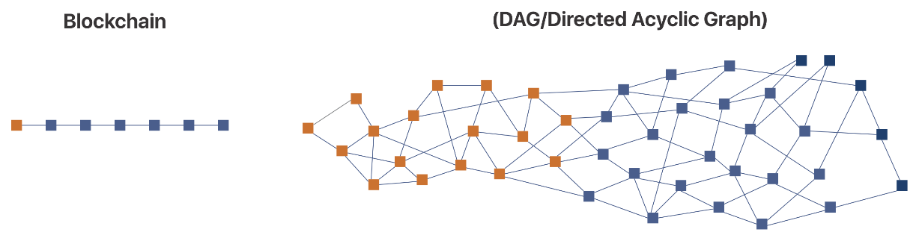

Slide 27
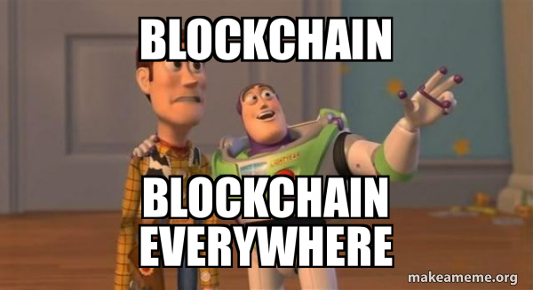

Slide 28


