Slide 1
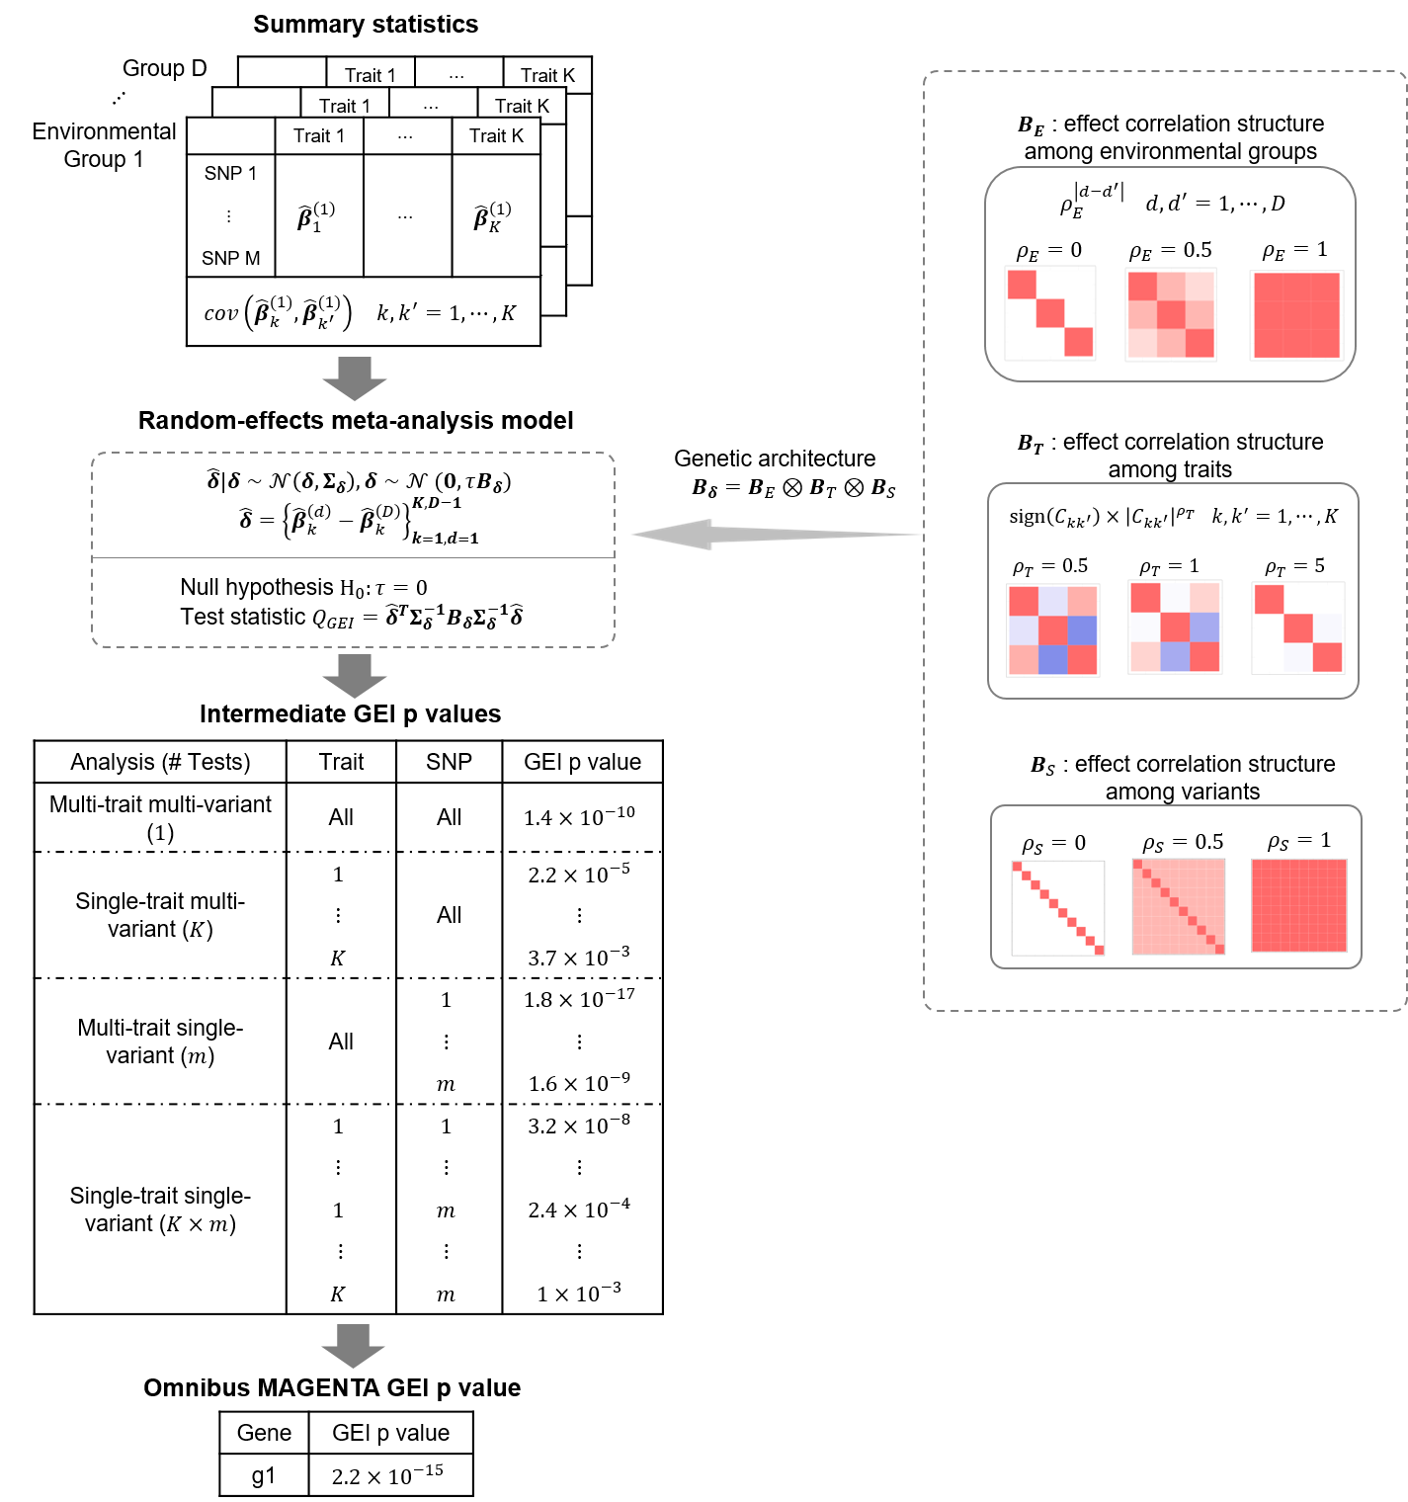

Slide 2
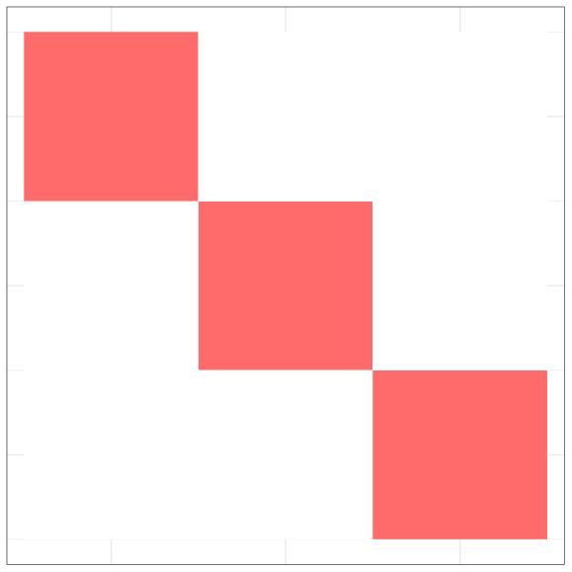
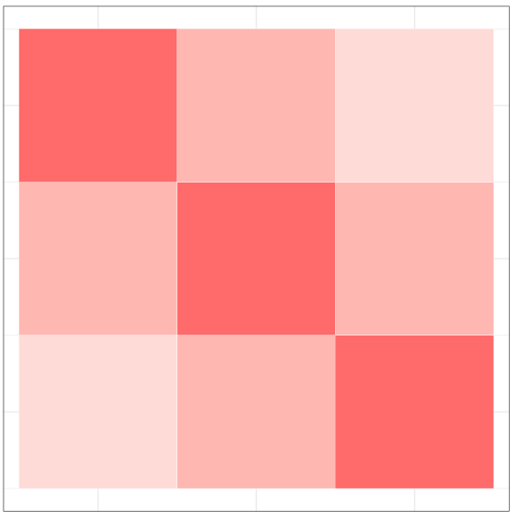
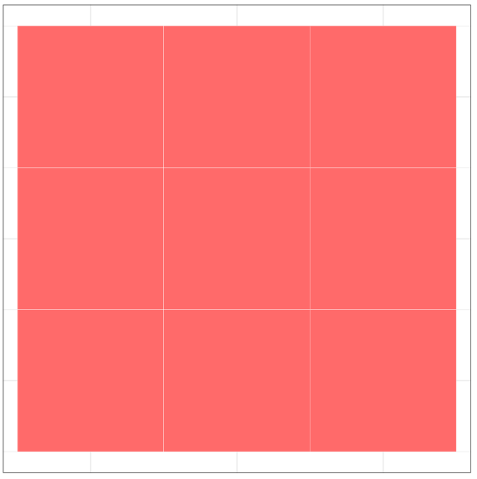
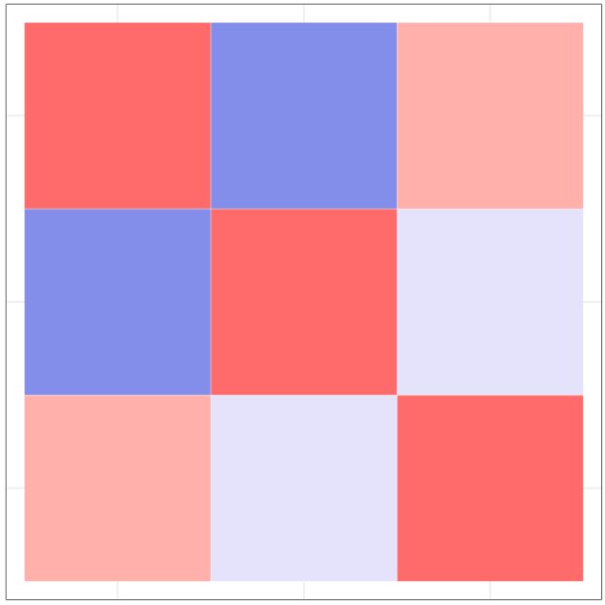
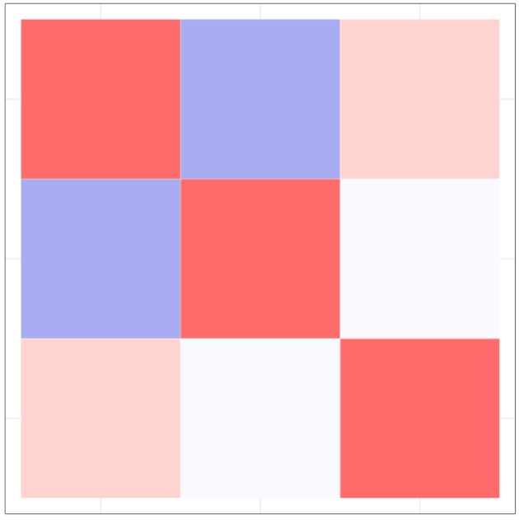

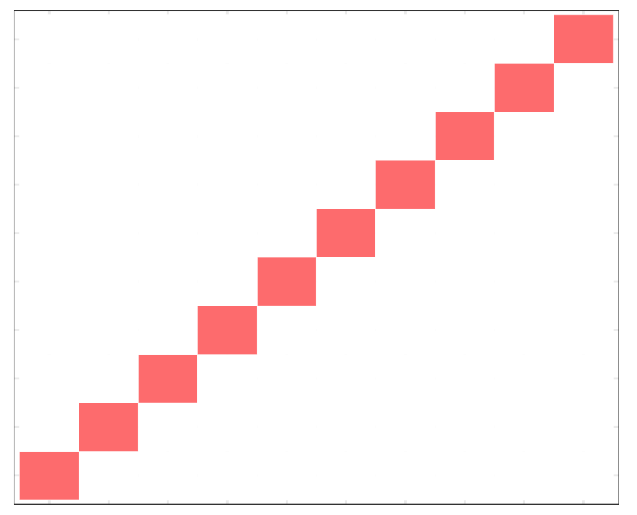
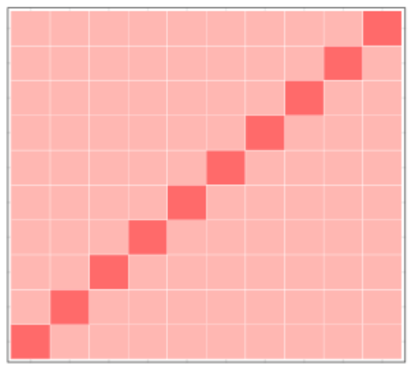




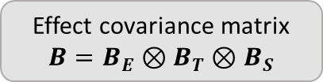



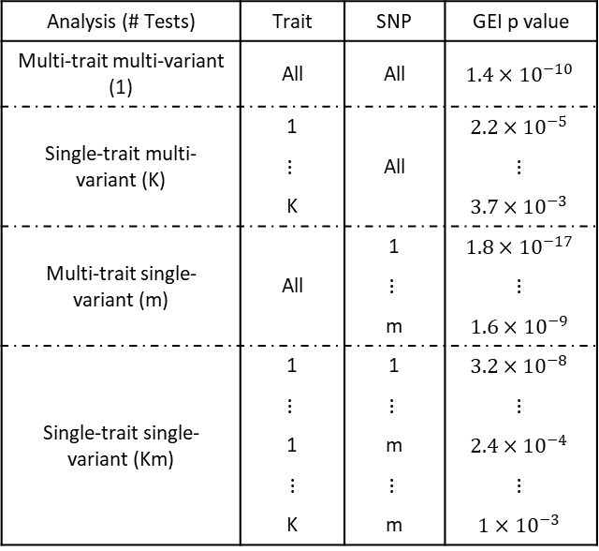










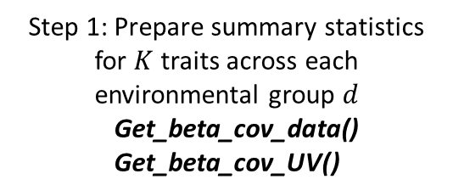





Use common independent variants to estimate between-trait Z-score covariance in each environmental group
Get_zeta()
Step 1: Prepare summary statistics for $K$ traits across each environmental group $d$
Get_beta_cov_data()
Get_beta_cov_UV()
$$ρ_{T}$$
Genetic correlation $C_{kk^{′}}$
$$ρ_{T}$$
MAF
$$ρ_{S}$$
$$ζ$$
$(U, V)$ or $(Y, G, X)$
$B_{E}$: Effect correlation structure among environmental groups
$B_{T}$: Effect Correlation structure among traits
$B_{S}$: Effect Correlation structure among variants
$ρ_{E}^{\left|d−d^{′}\right|}, d,d^{′}=1, …, D$
$sign\left(C_{kk^{′}}\right){×\left|C_{kk^{′}}\right|}^{ρ_{T}},k, k^{′}=1, …, K$
$$ρ_{E}=0$$
$$ρ_{E}=0.5$$
$$ρ_{E}=1$$
$$ρ_{T}=0.5$$
$ρ_{T}=1$
$$ρ_{T}=5$$
$ρ_{S}=0$
$$ρ_{S}=0.5$$
$$ρ_{S}=1$$
Marginal effect estimates and its covariance
Effect covariance matrix $B=B_{E}⊗B_{T}⊗B_{S}$
Step 2: Conduct GEI and joint test to capture various signal patterns
MAGENTA()
Construct test statistics for joint/GEI effects
Construct intermediate p values for multi-/single-trait $×$ multi-/single-variants analysis
Analysis (# Tests) | Trait | SNP | GEI p value
Multi-trait multi-variant (1) | All | All | $$1.4×{10}^{−10}$$
Single-trait multi-variant (K) | 1 | All | $$2.2×{10}^{−5}$$
 | $$⋮$$ | $$⋮$$ | $$⋮$$
 | K | All | $$3.7×{10}^{−3}$$
Multi-trait single-variant (m) | All | 1 | $$1.8×{10}^{−17}$$
 |  | $$⋮$$ | $$⋮$$
 |  | m | $$1.6×{10}^{−9}$$
Single-trait single-variant (Km) | 1 | 1 | $$3.2×{10}^{−8}$$
 | $$⋮$$ | $$⋮$$ | $$⋮$$
 | 1 | m | $$2.4×{10}^{−4}$$
 | $$⋮$$ | $$⋮$$ | $$⋮$$
 | K | m | $$1×{10}^{−3}$$
Final p values

Slide 3

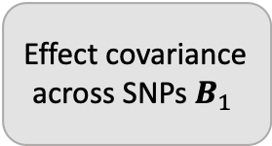
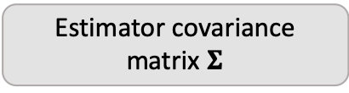
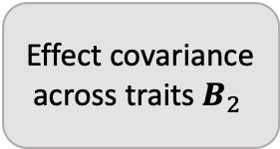

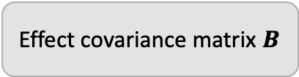
Step 1: Prepare summary statistics for multiple traits
Get_UV_from_data(), Get_UV_from_varU(),
Get_UV_from_beta()
Step 2: Calculate covariances of Z-scores between traits from overlapping samples
Get_zeta()
MAF
rho.SNP
Genetic correlation
rho.trait
Effect covariance across SNPs $B_{1 }$
Effect covariance across traits $B_{2 }$
$U$and $V$
zeta
Effect estimates
$$\hat{β}=({\hat{β}}_{1}, …,{\hat{β}}_{K})$$
Estimator covariance matrix $Σ$
Effect covariance matrix $B$
Test statistics
Step 3: Conduct MTAR
MTAR()
Final p-values

