Slide 1
CHALLENGE 3
REMOTE ACCESS
TO A WIRELESS SENSOR NETWORK
GROUP 3
AOSHUANG WANG, LAN YAO, YIXUAN HUANG, LAN LUO

Slide 2

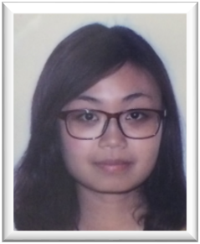


 | Lan Yao | Aoshuang Wang | Yixuan Huang | Lan Luo
Challenge 1 | Presenter |  | Presenter
Challenge 2 |  | Presenter
Challenge 3
Challenge 4
Challenge 5
Challenge 6
Challenge 7
Challenge 8

Slide 3
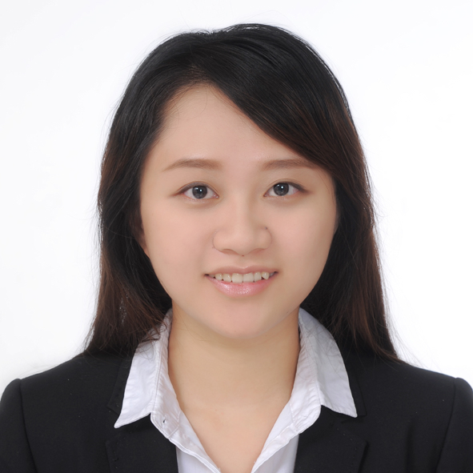
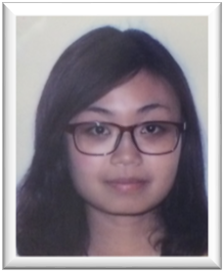
 | Lan Yao | Aoshuang Wang | Yixuan Huang | Lan Luo
 | Program Writing (unidirectional/ bidirectional) Webpage Control | Program Writing (unidirectional/ bidirectional) Webpage Control | Webpage Design Program Writing (bidirectional) Remote Access | Remote Access IOS App Design & Control

Slide 4
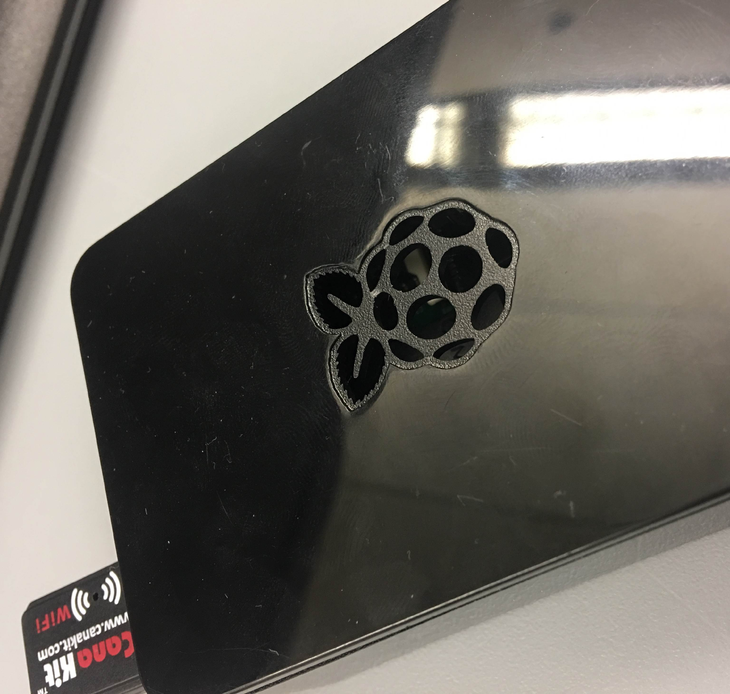
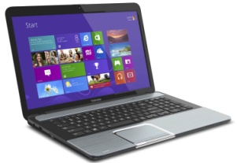
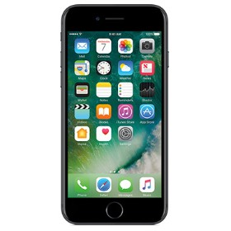
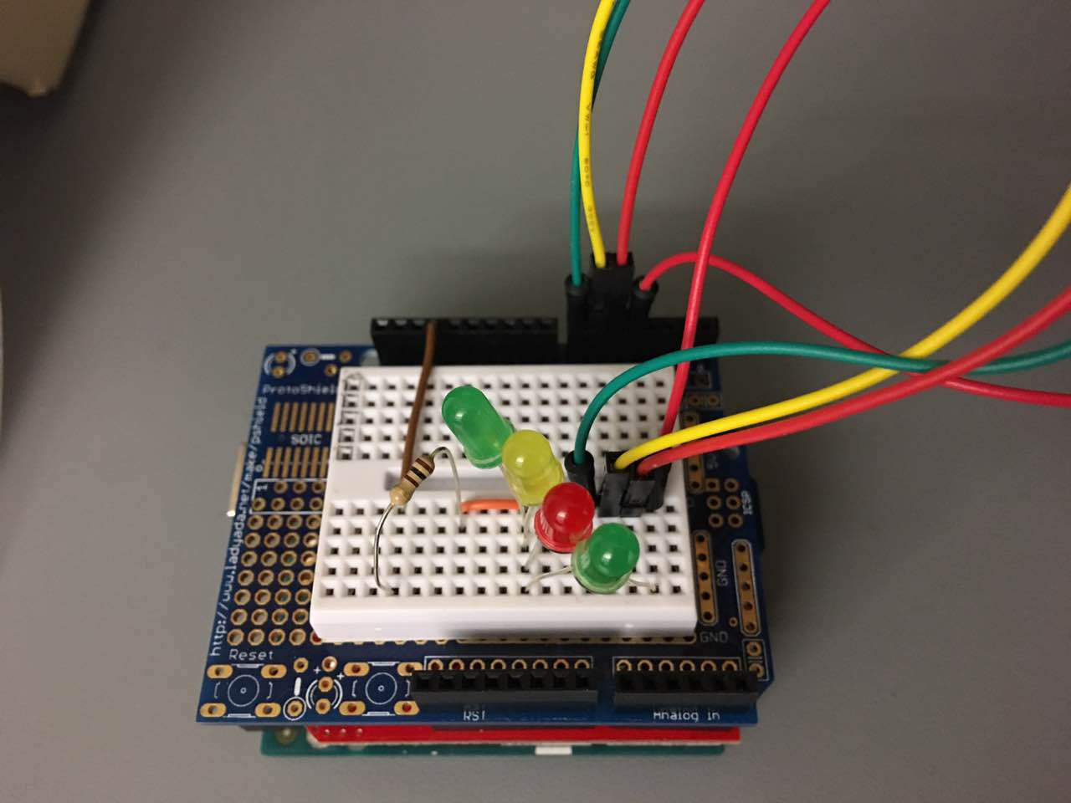
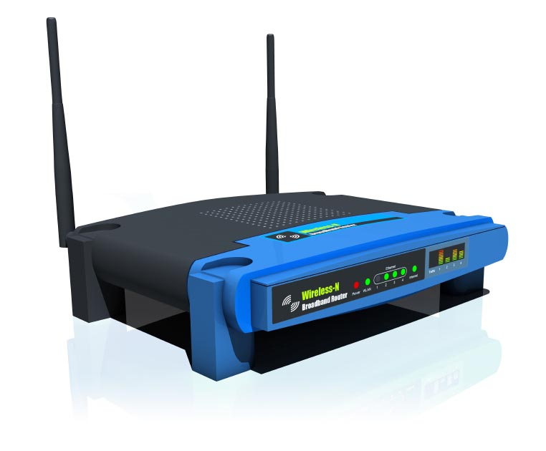
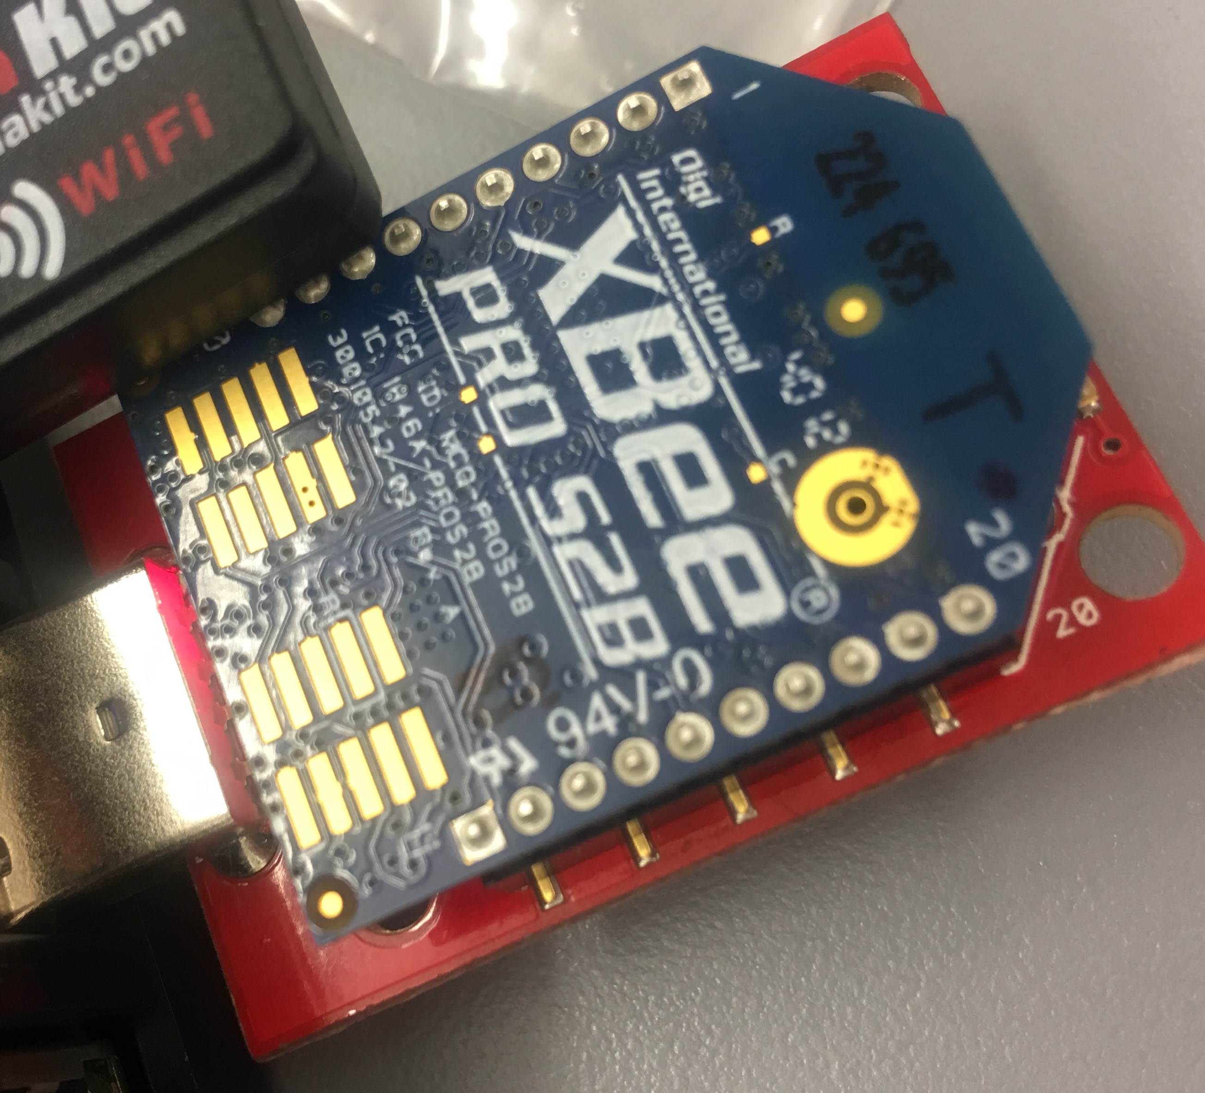
Devices
Laptop
Phone
Raspberry Pi
LED & Router XBee
Router
Coordinator XBee

Slide 5

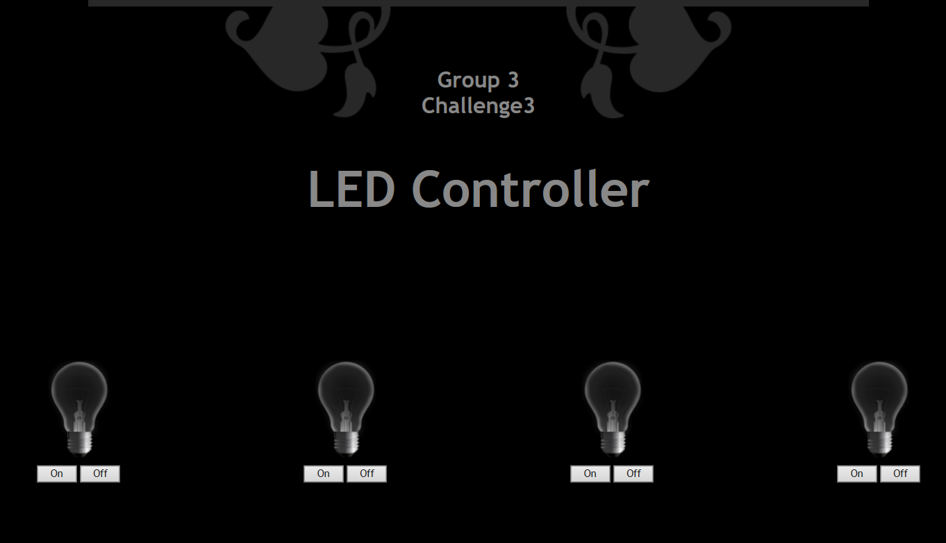

MAIN ARCHITECTURE
group3story.hopto.org
Port: 3000
Client: Laptop & Phone
Under Group3 WiFi
Port Forwarding
to Server’s Static
Address: 3000
Bidirectional
Data Exchange
Server: Pi & Laptop

Slide 6
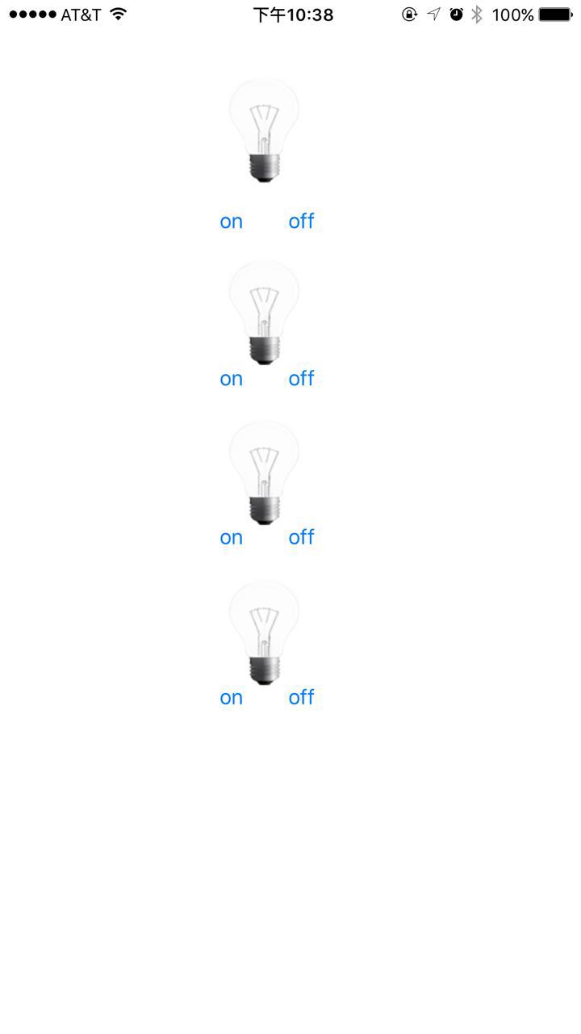
EXTRA FUNCTIONS
IOS APPLICATION DESIGN & CONTROL
socket.io-client-swift: https://github.com/socketio/socket.io-client-swift
Xcode: https://developer.apple.com/xcode/
swift: https://developer.apple.com/swift/

Slide 7
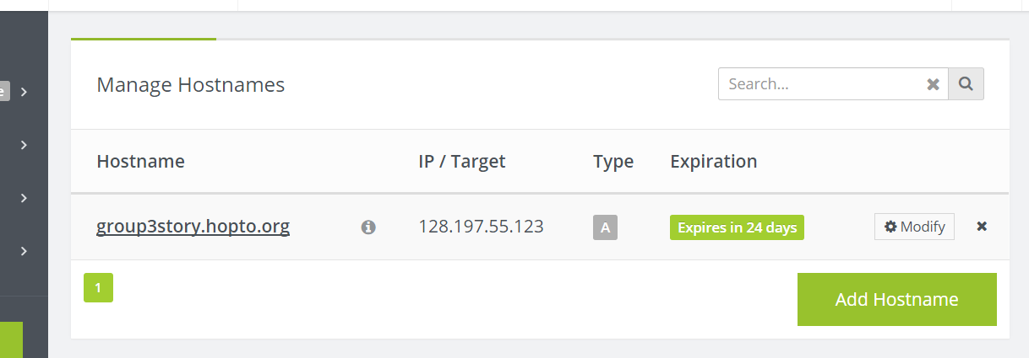
DESIGN DETAILS
Remote access control Method:
DDNS : No-ip

Slide 8
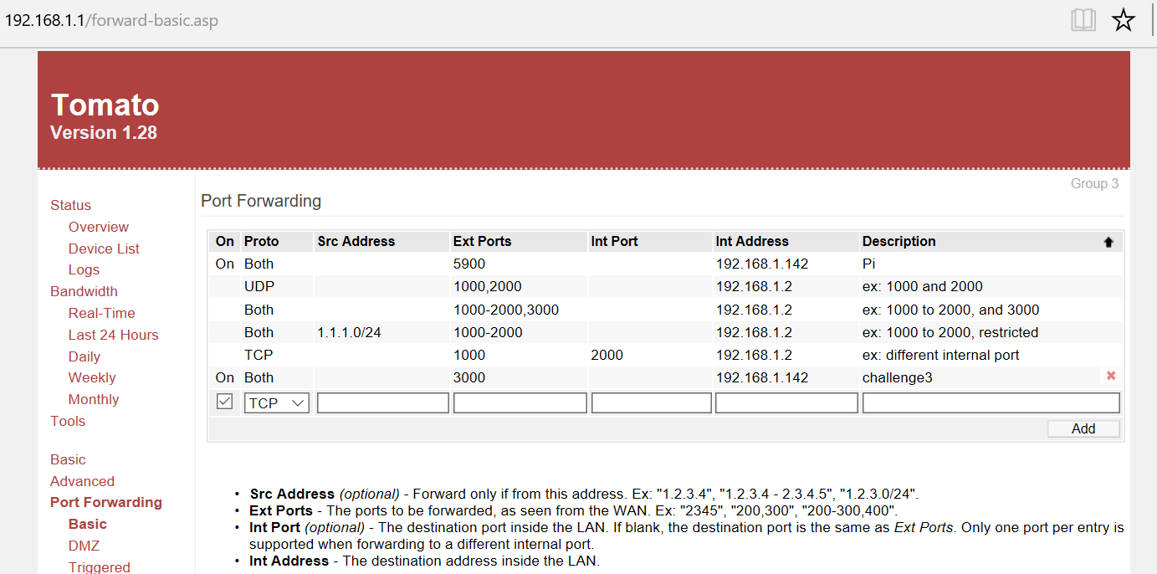
DESIGN DETAILS
Remote access control Method:
Port Forwarding:

Slide 9
CHALLENGES ENCOUNTERED AND RESOLVED
Communication between webpage and Arduino
Latency issue
Realization in raspberry Pi
IOS application

